Slide 1

An Najah National University
Faculty of Engineering
Building Engineering Department
Graduation Project -2
Environmental Friendly Residential Villa
Prepared by:
Ahmad Jarrar
Mohammad Qassem Suliman
Nehad Rabayaa
Project Supervisor:
Dr. Amir Al-Sharif

Slide 2
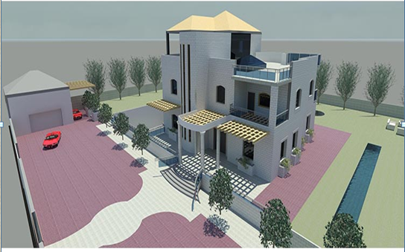

Slide 3
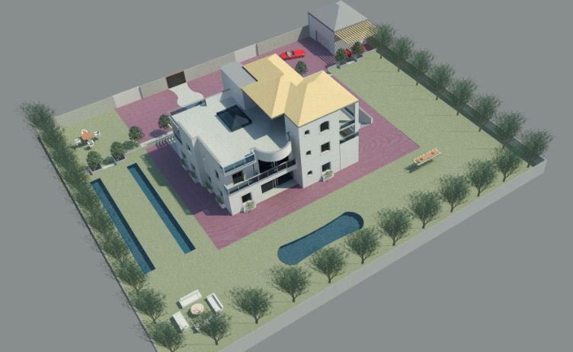

Slide 4
Outline:-
1-Site analysis .
2- Architectural design .
3-Structural design .
4-Environemental design .
5-Mechanical design .
6-Electrical design .
7- Cost estimation .

Slide 5
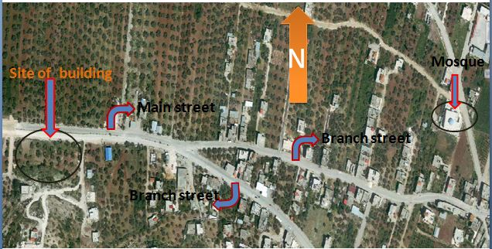
Site analysis

Slide 6
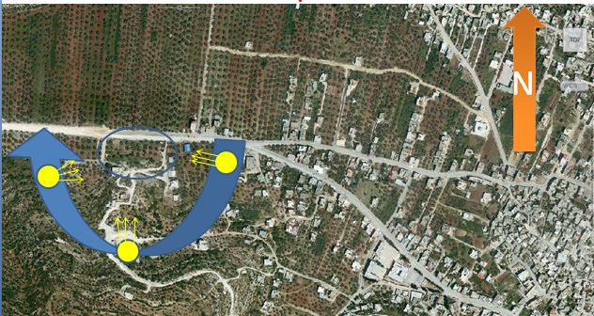
Site analysis
Sun path :-

Slide 7
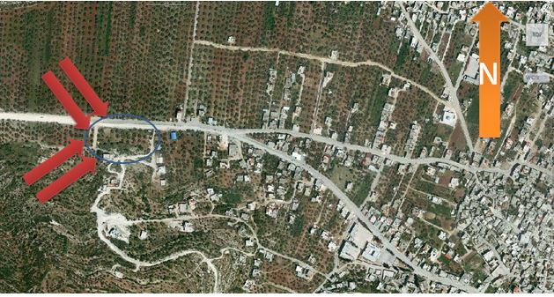
Site analysis
Wind direction :-

Slide 8
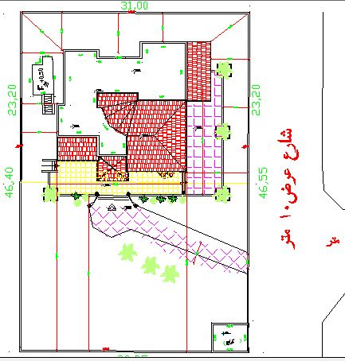
Architectural design
Plans before and after modification :

Slide 9
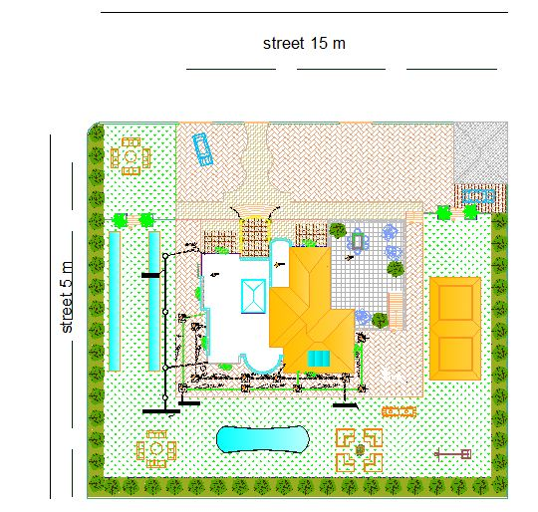
Architectural design
Plans before and after modification :

Slide 10
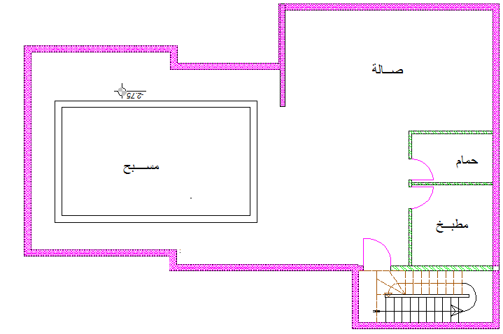
Architectural design
Plans before and after modification :

Slide 11
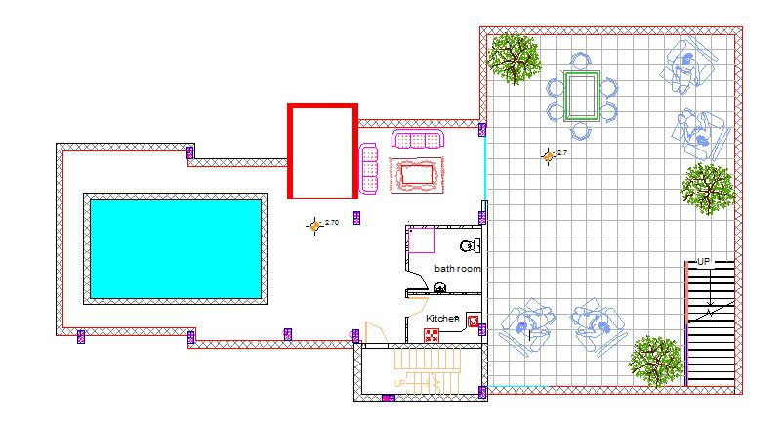
Architectural design
Plans before and after modification :

Slide 12
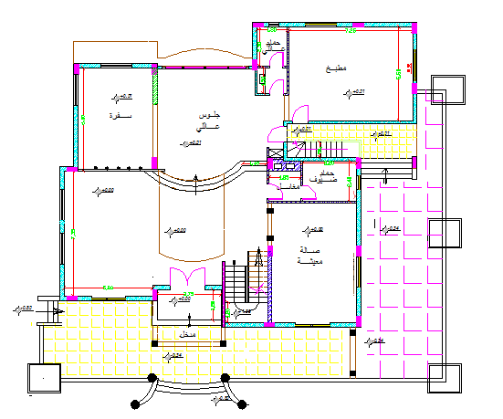
Architectural design
Plans before and after modification :

Slide 13
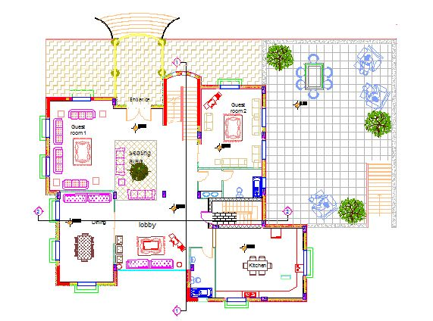
Architectural design
Plans before and after modification :

Slide 14
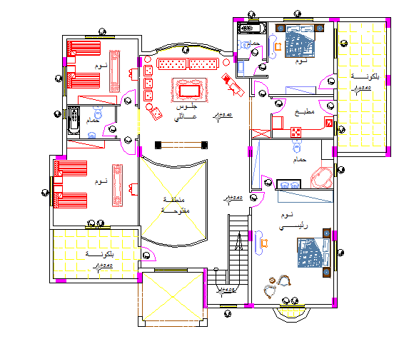
Architectural design
Plans before and after modification :

Slide 15
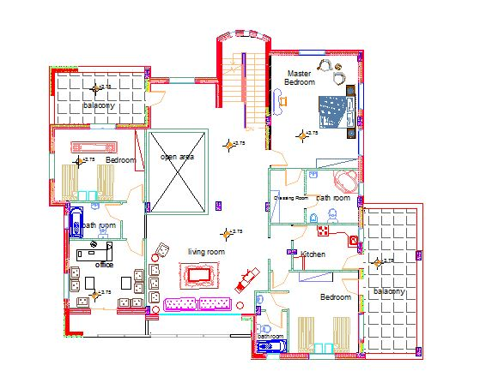
Architectural design
Plans before and after modification :

Slide 16
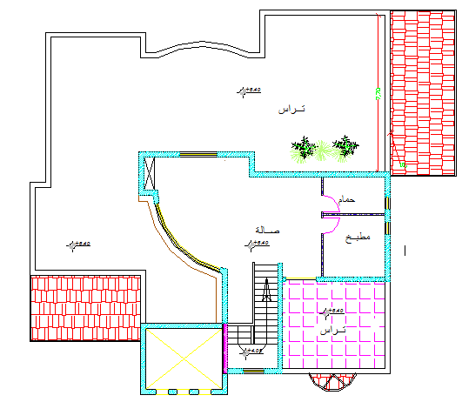
Architectural design
Plans before and after modification :

Slide 17
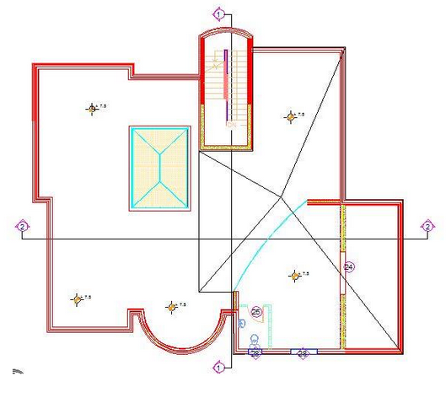
Architectural design
Plans before and after modification :

Slide 18
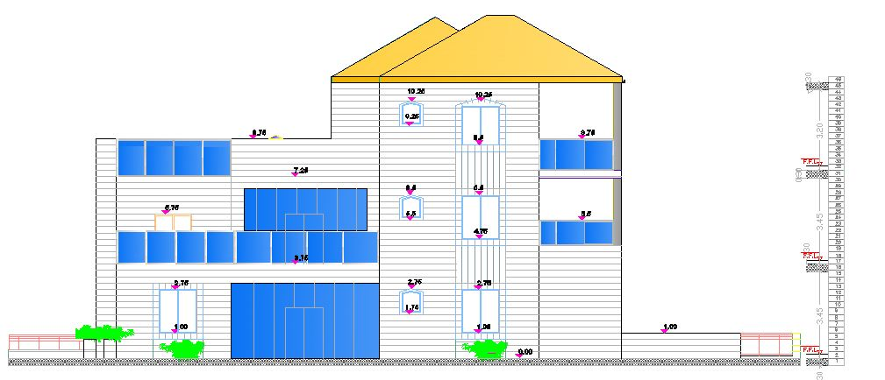
Architectural design
Plans before and after modification :
South Elevation

Slide 19
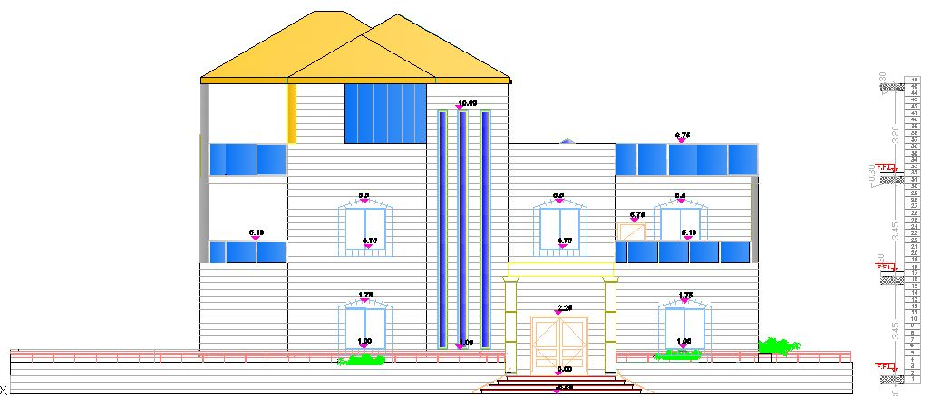
Architectural design
Plans before and after modification :
north Elevation

Slide 20
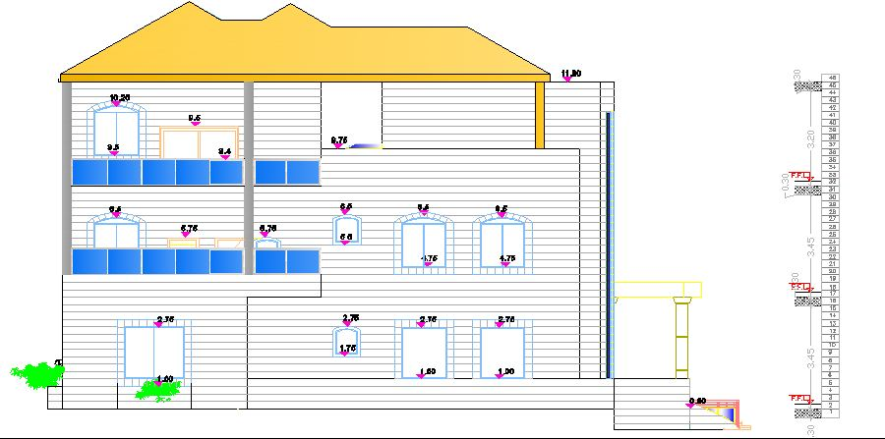
Architectural design
Plans before and after modification :
East Elevation

Slide 21
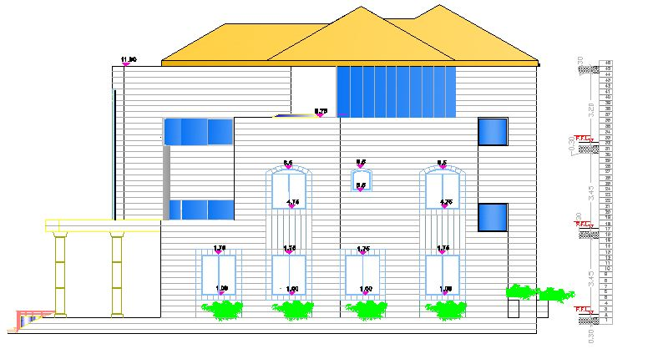
Architectural design
Plans before and after modification :
West Elevation

Slide 22
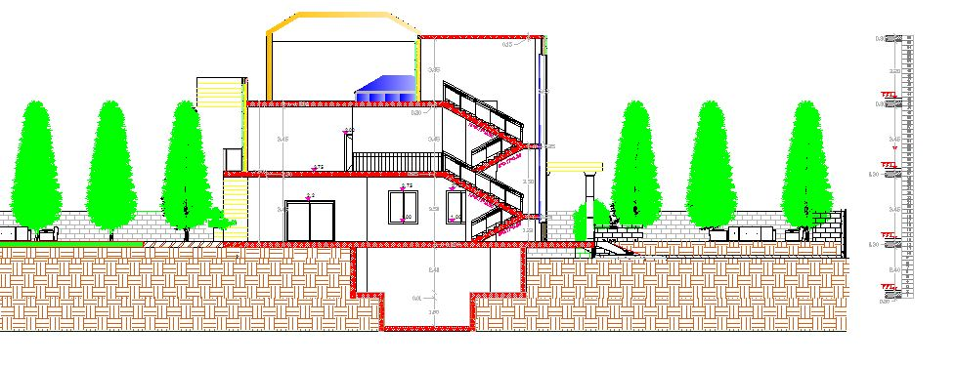
Architectural design
Plans before and after modification :
Section

Slide 23
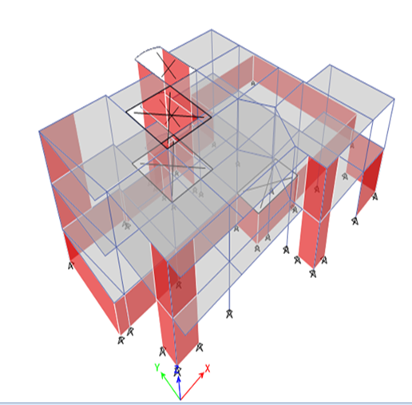
Structural design

Slide 24
Structural design
Materials
* Structural materials
Concrete:
Concrete strength for all concrete parts is B300
Modulus of elasticity equals (2.5*10⁵ Kg\cm²) Unit
weight is (2500 kg\m³)
Steel:
Modulus of elasticity equals( 2*10⁶ Kg\cm²)
For steel reinforcement, is( 4200 Kg\cm²)
* Non-structural materials
They are mainly, blocks, plasters, tiles, filling, mortar and masonry.

Slide 25
Structural design
Codes and Standards
The following codes and standards are used in this project :
ACI 318-11 : American Concrete Institute provisions for reinforced concrete structural design.
UBC-97 : Uniform Building Code provisions for seismic load parameters determination .

Slide 26
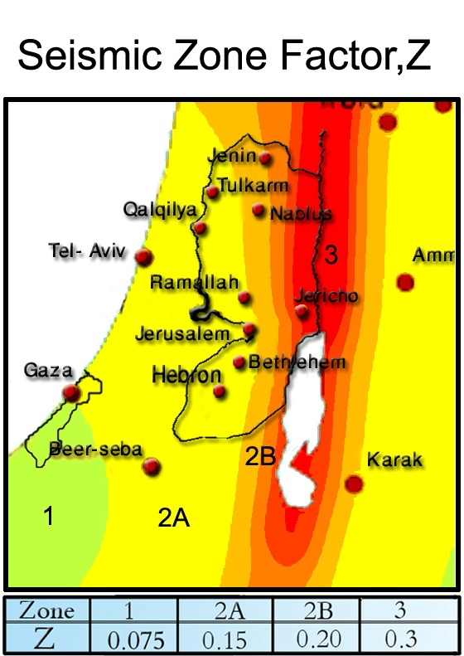
2) Lateral loads:
Seismic loads:
The UBC97 code seismic parameters
are as follows:
  The seismic zone factor, Z= 0.2 .
  The importance factor, I = 1.0 .
  The ductility factor, R = 3.5.
  The seismic coefficient, C_{a} = 0.24 .
  The seismic coefficient, C_{v} = 0.32.
Type of soil is Sc

Slide 27
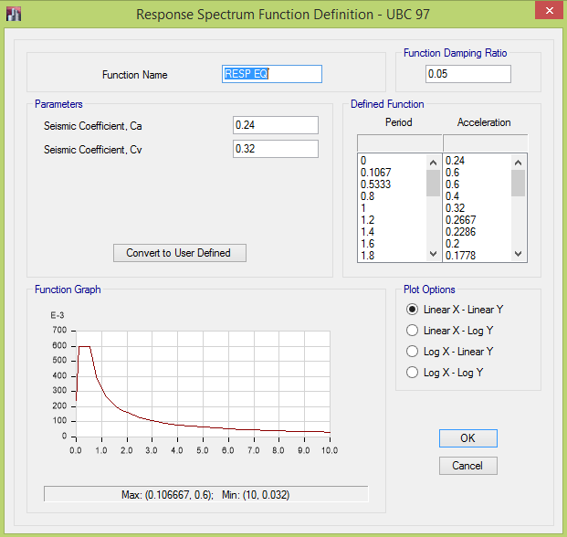

Slide 28
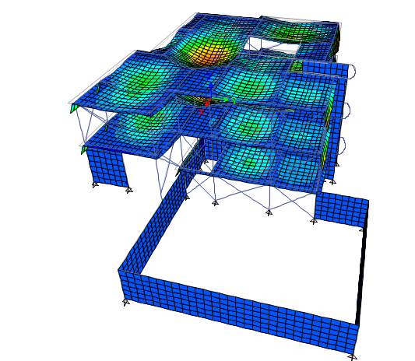
Structural design
-: Check Compatibility

Slide 29
Structural design
Structural Model Verification :
Check Equilibrium
Error % | Manual | ETABS | Load
4% | 1813.5 KN. | 1889.9 KN | L . L
4.1 % | 12875.25 KN | 13435.9 KN | D . L
Error % < 5% ok

Slide 30
Check the moments on the beams :
Structural design
Error % | Manual | ETABS | Beams
4.17 | 141 KN.m | 146.6 KN.m | B12
6.5 | 143.4 KN.m | 153.4 KN.m | B22
6.7 | 121 KN.m | 129.7 KN.m | B38

Slide 31
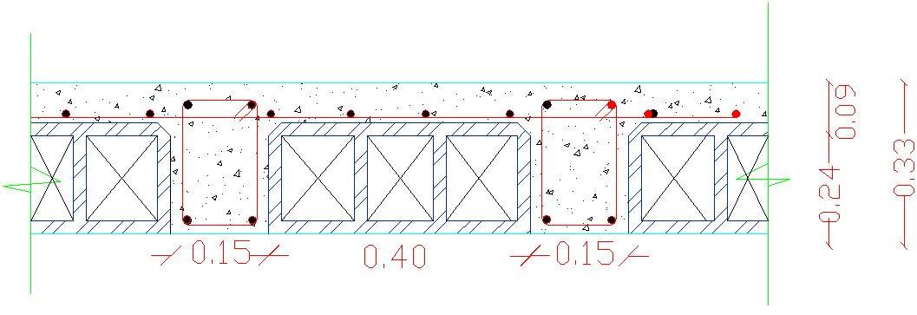
Structural design
  Ribbed slab analysis and design :
The thickness of the slab:
H= L/18.5 = 5.94/18.5 = 32cm use h= 33 cm

Slide 32
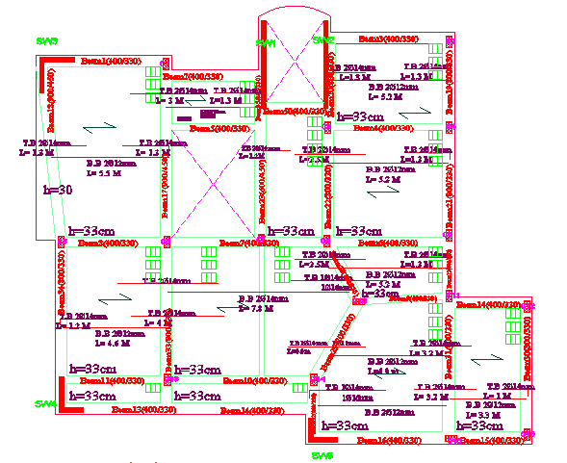
Structural design
  design of Slab :-

Slide 33
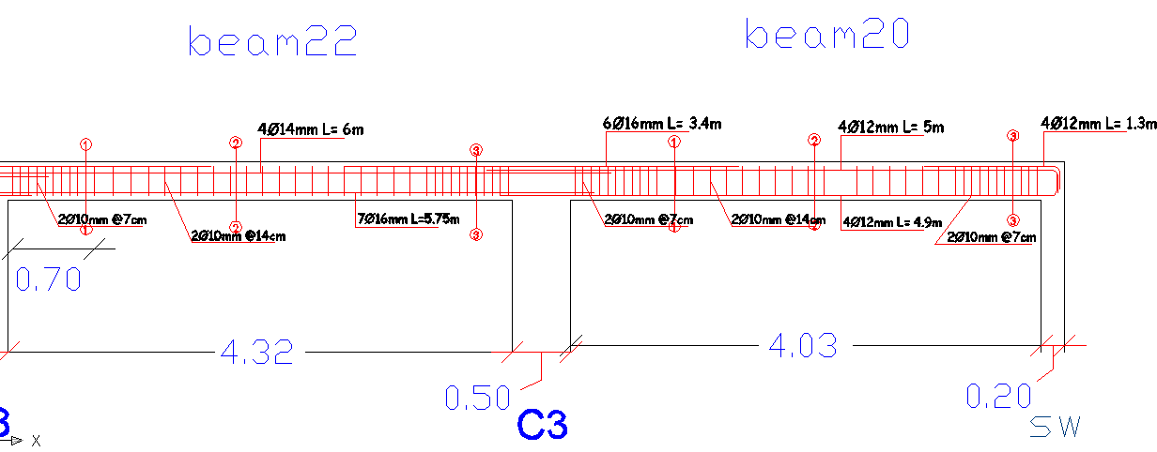
Structure design
Beam details:-

Slide 34
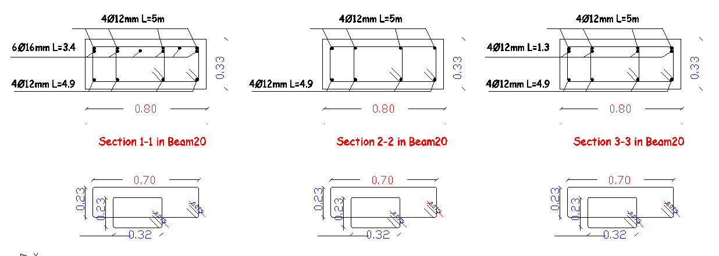
Structure design
Beam details:-

Slide 35
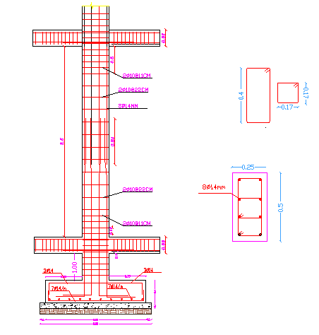
Structure design
column details:-

Slide 36
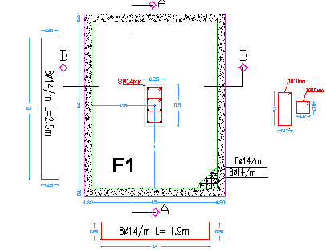
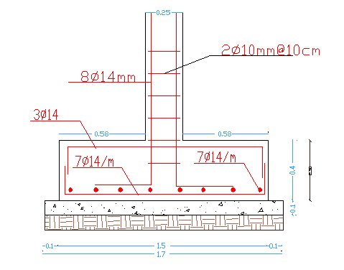
Structure design
Footing details details:-

Slide 37
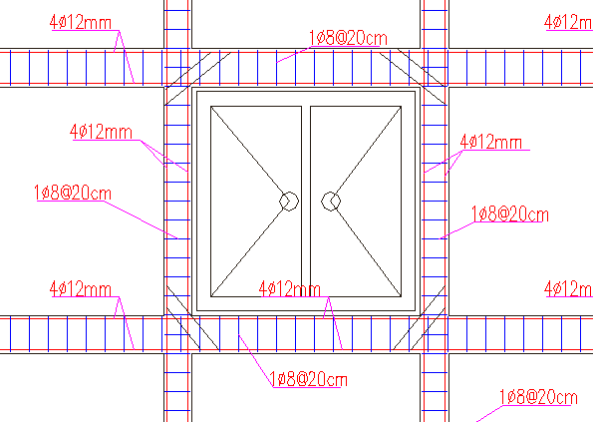
Structure design
Opening details:-

Slide 38
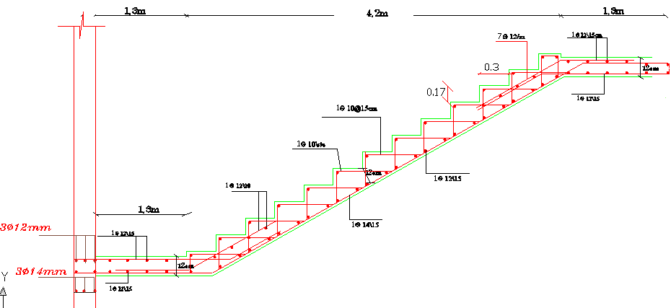
Structure design
stair details:-

Slide 39
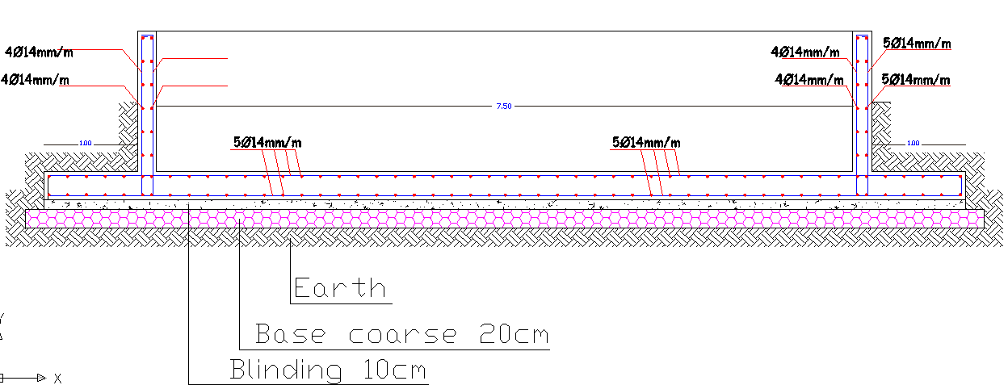
Structure design
Swimming pool

Slide 40
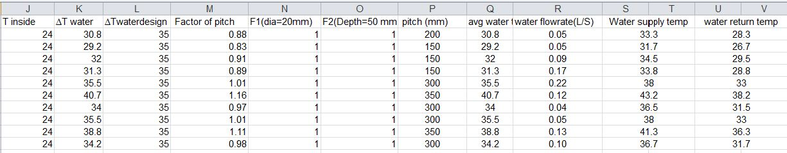
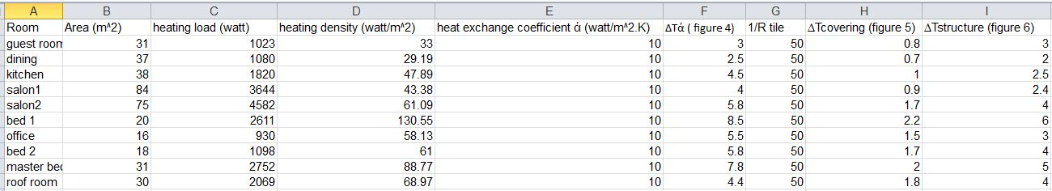
Environemental design
Under floor Heating

Slide 41
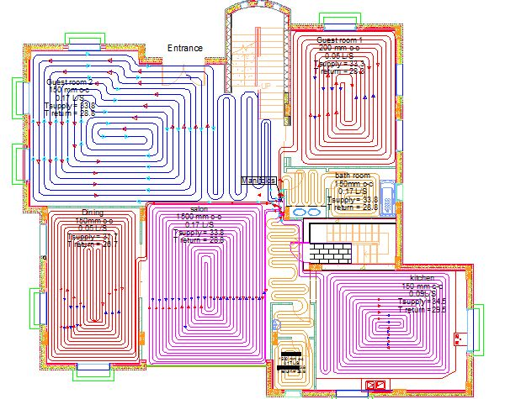
Environemental design
Under floor Heating

Slide 42
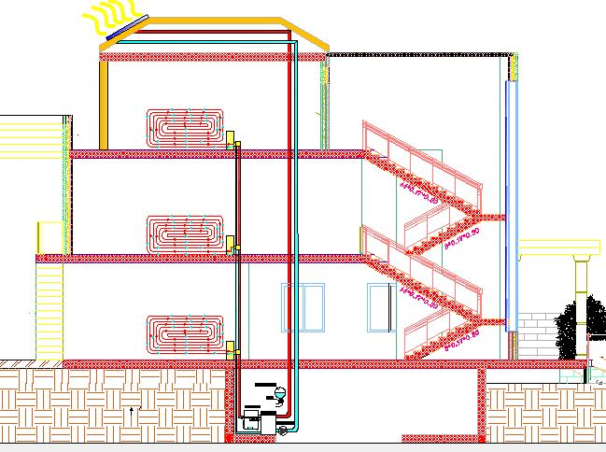
Environemental design
Section in Under floor Heating

Slide 43
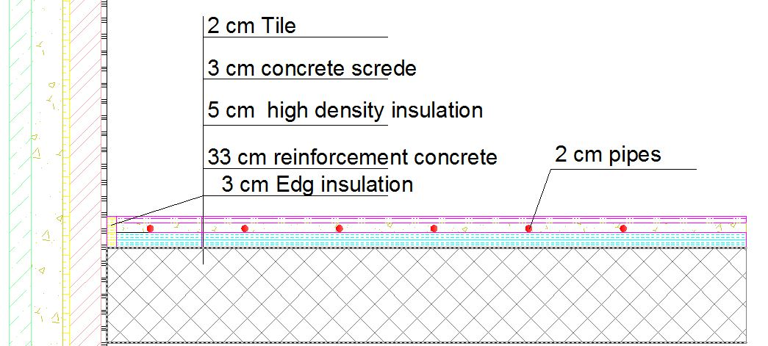
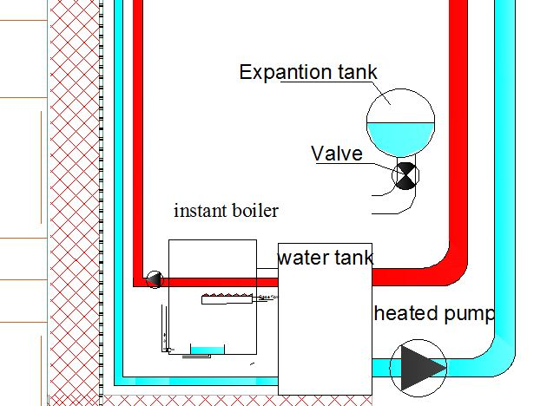
Environemental design
Details for Under floor Heating .

Slide 44
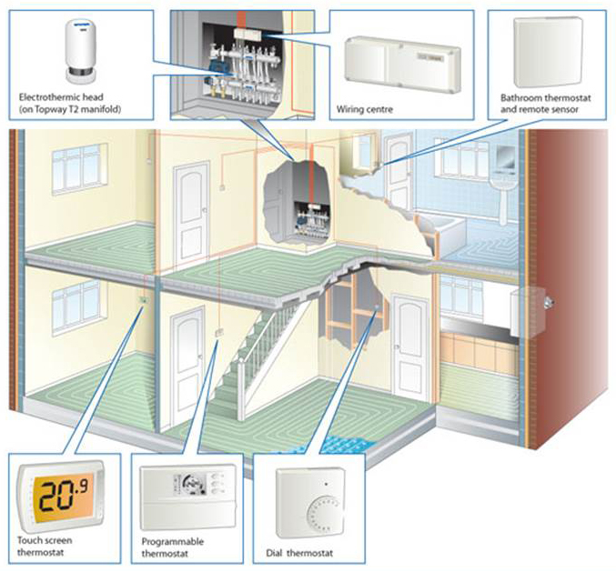
Environemental design
Details for Under floor Heating .

Slide 45
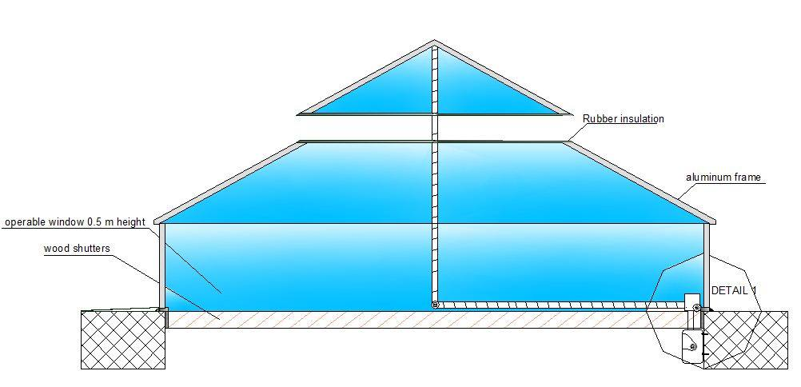
Environemental design
Natural ventilation

Slide 46
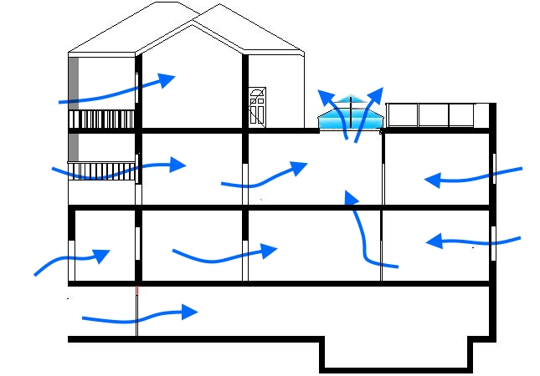
Environemental design
Natural ventilation

Slide 47
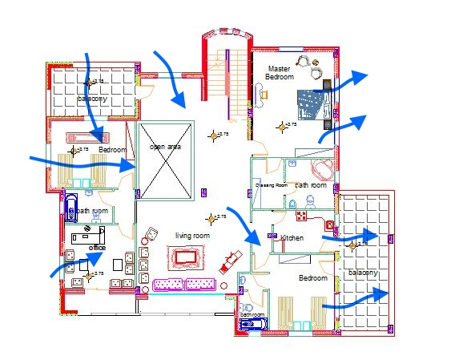
Environemental design
Natural ventilation

Slide 48
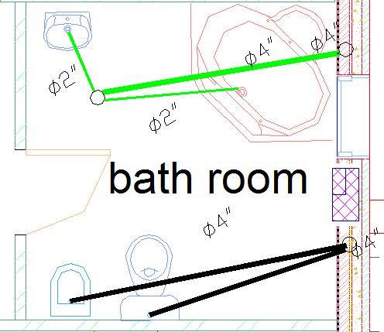
Environemental design
Gray water treatment

Slide 49
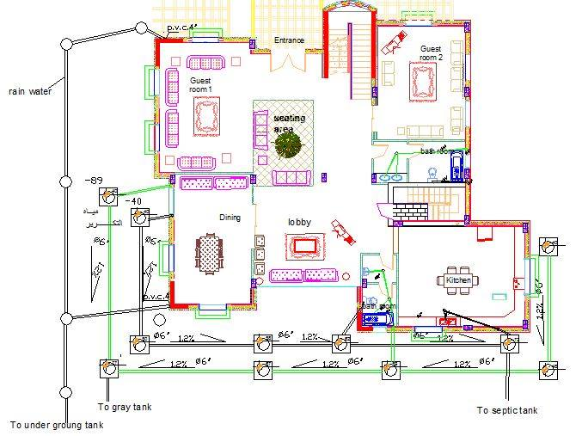
Environemental design
Gray water treatment

Slide 50
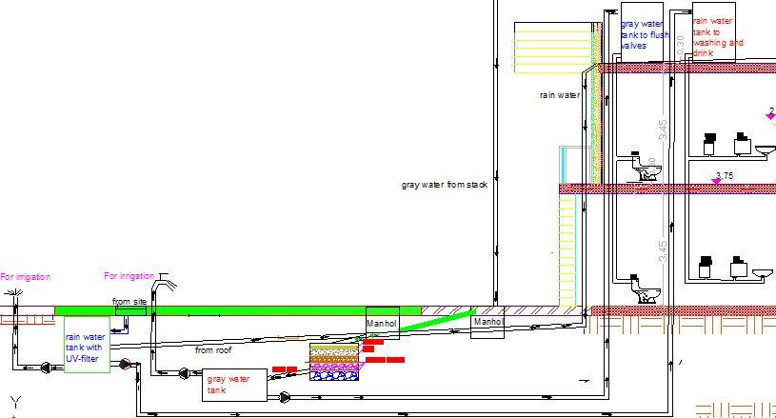
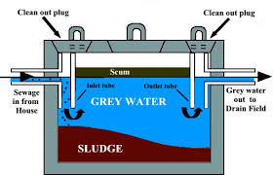
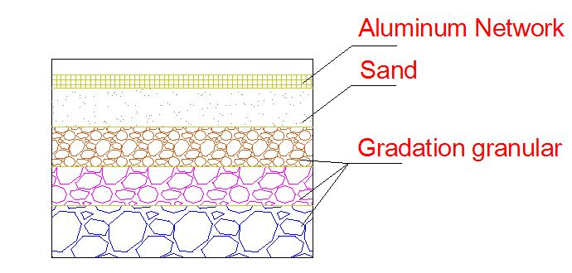
Environemental design
Section in gray water treatment

Slide 51
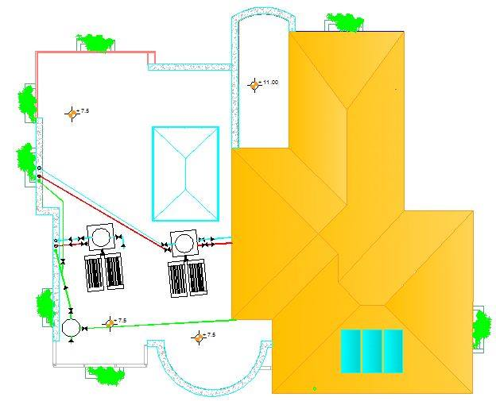
Environemental design
Water supply tank

Slide 52

Environmental design
Using gray water and water supply

Slide 53

Environemental design
Line gray water diagramed

Slide 54

Environmental design
Ecotect analysis – 3D model

Slide 55

Environmental design
Ecotect analysis – Annual sun path

Slide 56

Environmental design
Ecotect analysis – Guest room
Average Daylight factor = 5 %..

Slide 57

Environmental design
Ecotect analysis – Guest room
Average Day lighting level = 499 lux.

Slide 58



Environmental design
Ecotect analysis – layer of outside wall
Wall after insulation Wall before insulation

Slide 59


Environmental design
Ecotect analysis – heating and cooling
Monthly heating/cooling load.

Slide 60

Environmental design
Ecotect analysis – heating and cooling

Slide 61

Environmental design
Shading

Slide 62

Environmental design
Shading

Slide 63

Electrical design
Dialux analysis- Living Room 3D Model for living Room

Slide 64

Electrical design
Dialux analysis- Living Room

Slide 65

Electrical design
Dialux analysis- Living Room

Slide 66

Electrical design
Living Room Calculation Surface

Slide 67

Electrical design
Living Room- Isoline

Slide 68

Electrical design
Lighting Distribution :

Slide 69

Electrical design
Socket Distribution :

Slide 70
Cost Estimation
Total cost = 1053895 Nis
Total area = 700 m2
Cost /m2 = 1506 Nis

Slide 71


