Slide 1

An-Najah National University
Faculty of Engineering and Information Technology
Industrial Engineering Department
Graduation Project 2
Supervisor Name:
Dr.Ramiz Assaf
Eng.Raya Al-Shinnar
Group members:
Malak Saadeh
Ghusoon Salah

Slide 2

Enabling Sustainable Futures and Economic Empowerment through PET Recycling in Nablus
RECYCLING

Slide 3
Outline:
Background
Feasibility Study
Problem statement
Results and Discussions
Project Objectives
Conclusion and Recommendation
Introduction of PET
Previous work

Slide 4

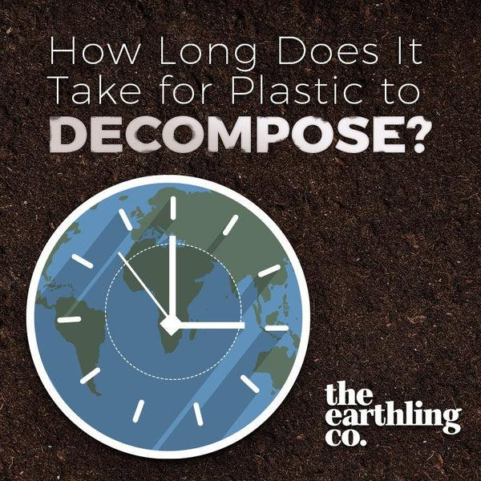
General Background
There are numerous environmental problems negatively affecting the environment.
Our project will focus on plastic waste, as studies have shown that plastic takes 1000 years to decompose.

Slide 5
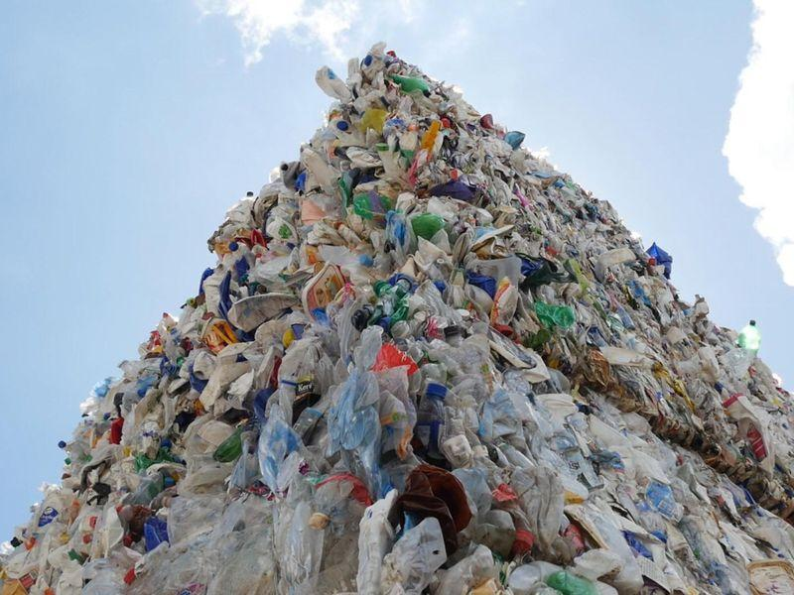
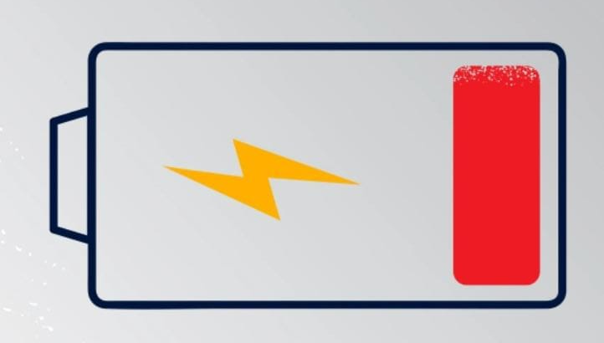
Problem Statement:
01
Accumulation of plastic waste in landfills.
02
Lack of recycling and absence of an integrated recycling facility.
There is no recycling of PET plastics in the West Bank.
03
PLASTIC PET

Slide 6
Objectives:
Feasibility study for establishing a recycling plant
Encourage the cooperation of all stakeholders
Production of recycled PET plastic and high quality

Slide 7
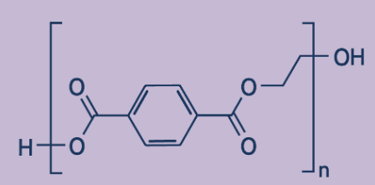
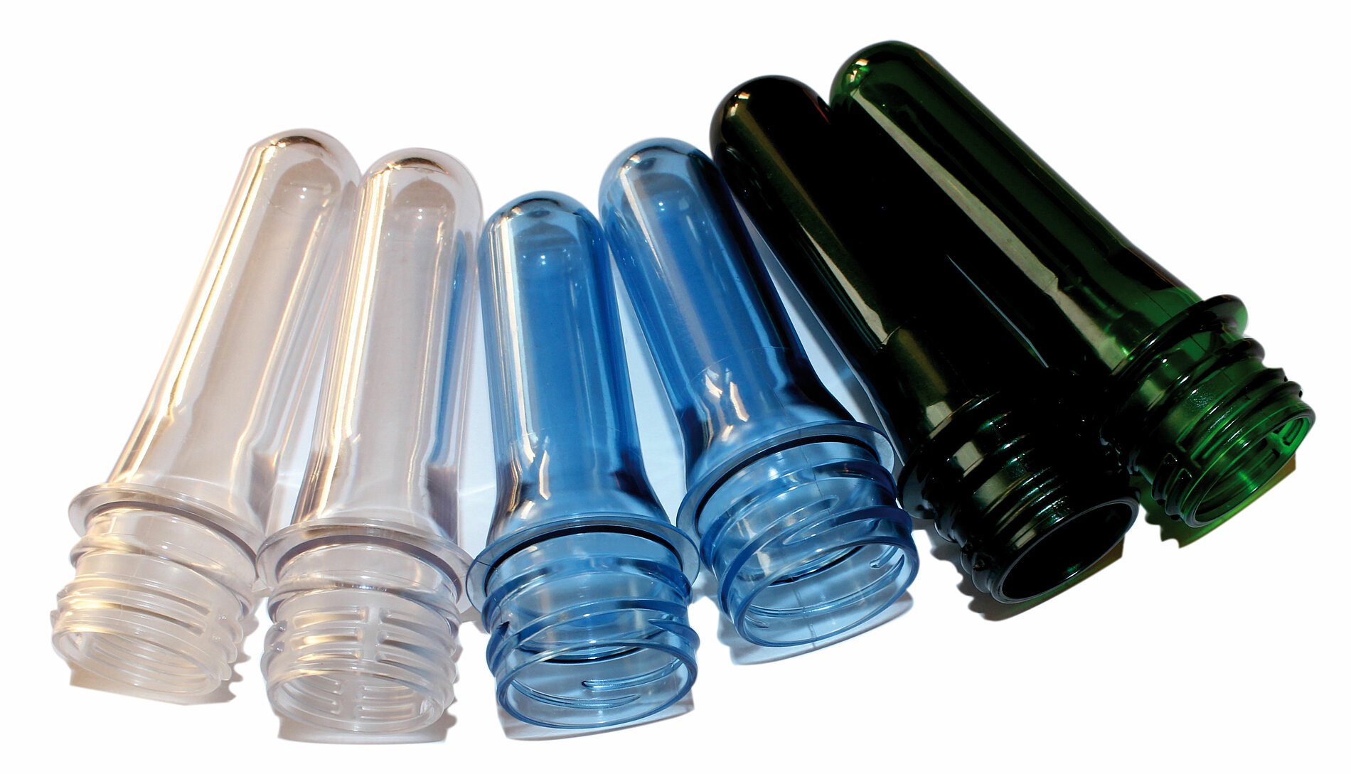
Introduction of PET
Polymer
Polyethylene terephthalate
properties
Chemical Resistance
Strength to Weight Ratio
Transmissivity
Shatterproof
Potential for Recycling

Slide 8
Previous Work:
Through our research and data collection, we have learned that there are plastic recycling practices in the West Bank, but they are not specialized in PET plastic, such as Moatasem Khamis’ workshop.

Slide 9
Our Work:
Feasibility study
PET plastic waste
Processes
Recycled PET
PET quantities.
Suppliers.
Collecting and sorting.
Mechanical recycling plant
Machines
Equipment
Labor
Capacity
Plant layout
Location.
Area.
transportation
Valuable final product
Customers.
Price.

Slide 10
Assumptions :
A plastic sorting station in the city of Nablus, on Al-Sayrafi land
PET plastic is devoid of non-plastic impurities and unwanted plastic contaminants.
Impurities constituted 15% to 20% of PET plastic.
150 tons of recycled PET flakes requires approximately 180 tons of PET plastic waste.

Slide 11
Feasibility Study:
A comprehensive analysis and evaluation of a proposed project.
Assess the potential risks and benefits.
Provide decision-makers with the necessary information to proceed with the project or not.
Feasibility study components:
Feasibility study
Market study
Technical study
Financial
study

Slide 12



Market Study:
The goal is to use the Delphi method to determine whether the project is worth pursuing.
Academic advisors
Specialists from the Nablus Municipality
Plastic factory owners

Slide 13
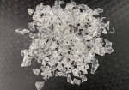
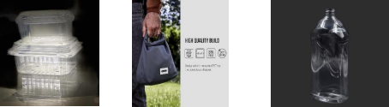
Market Study
Description of the product:
Examples of industries that rely on recycled PET plastic:
The finished product of our factory RPET flakes

Slide 14
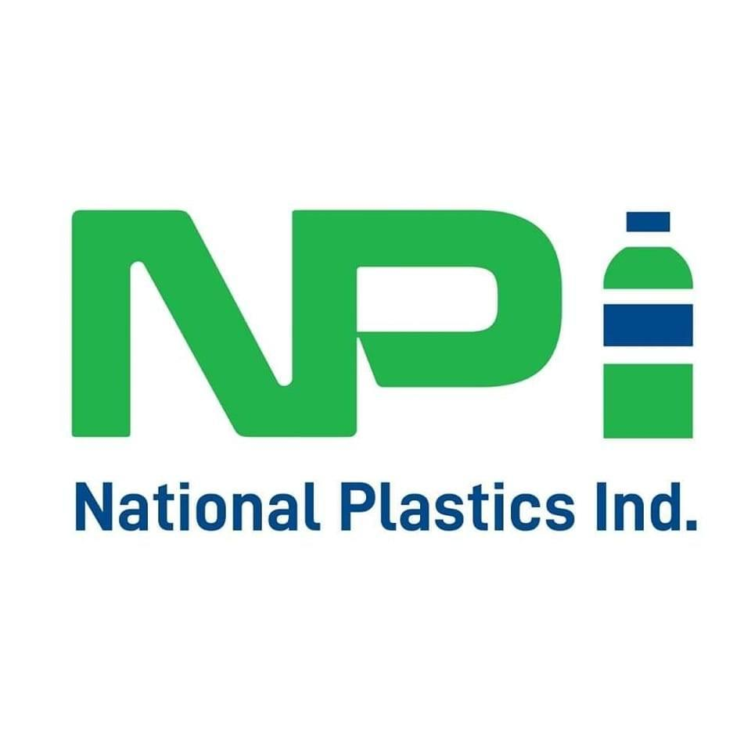

Market Study
The target customers:
Customer interest confirmed: plastic factories like Ithmar and National are keen to receive our output. One contacted owner expressed capacity for 150 tons recycled PET.

Slide 15
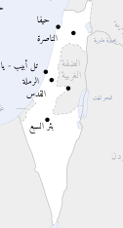
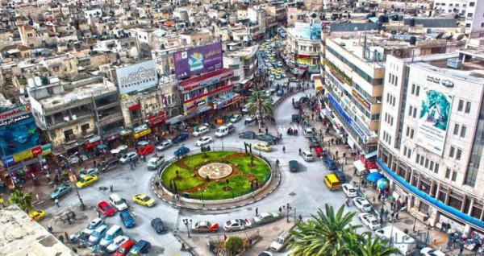
Market Study
The target city:
Expansion plan outside the city limits of Nablus
Nablus City
Market Study
The competing market:
-Timely customer service/fulfillment
-Minimize delays and ensure top quality with local production & direct inspection
-Reducing shipping and transportation costs for the customer by providing local manufacturing.

Slide 16
Market Study
Availability of raw material :
Based on statistics from the Municipality of Nablus, 220 tons of PET plastic are available per month, and according to the advice of experts and to ensure the arrival of full quantities, we will adopt an amount of 180 tons per month.
Market Study
Estimating current demand size:
After studying the market, it was found that the quantity of 150 tons would meet the needs of local factories.
If we provide PET plastic raw materials of appropriate quality, we will encourage the local market to manufacture products instead of importing them.

Slide 17
Technical Study:
This stage ensures that the project can be developed and executed successfully from a technical perspective.
Equipment and machinery
Plant Location and Layout
Technical study
Production Process

Slide 18
Production Process
Flow process chart:
Non labeled PET
NO
Raw material inspection
Label Removing
Manual sorting
Remove Labeled PET
YES
Cleaning
by rubbing washing machine
Washing and separating
Hot washing and cleaning
Crushing PET
Separating
Dewatering PET flakes
Packing PET into Bags
Final product RPET flakes

Slide 19
Equipment and machinery
Production line Criteria:
specifications | amount
annual demand | 1800 ton/yr
working hours per year | 8hr* 5 days* 50 weeks
production rate | 900 kg/hr
line capacity | 1000 kg/hr
final product form | PET flakes
final product applications | non-food production
Shuliy Machinery Company furnished us with essential information, tailoring their recommendations to the specific polymer types, operating capacities, and desired final product shapes and qualities of our factory.

Slide 20
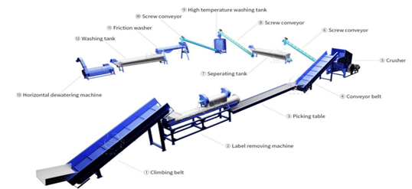
Equipment and machinery
Production line layout:

Slide 21
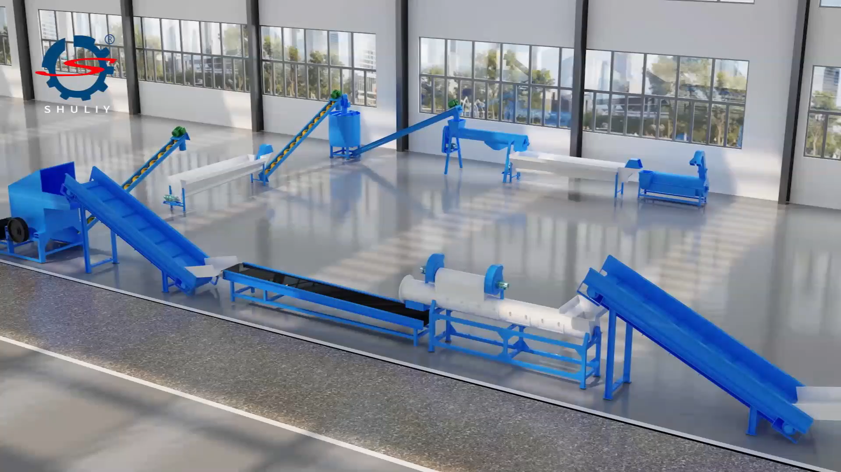
Equipment and machinery
Production line video:

Slide 22
Plant Location and Layout
Site selection and construction:
the establishment of the factory on Al-Sayrafi land, situated in the city of Nablus.
The required area is about 1 dunum, with a monthly rental cost amounting to 8,000 shekels.
Department | Construction | Required Area | Cost NIS/ | Total Cost
Production | prefabricated building | 720 | 500 NIS | 360,000 NIS
Store | prefabricated building | 63 | 500 NIS | 31,500 NIS
Reception | Brickwork | 100 | 1,000 NIS | 100,000 NIS
Offices | Brickwork | 100 | 1,000 NIS | 100,000 NIS
Total construction cost |  |  |  | 591,500 NIS
The total required area for the construction equals 883 𝒎𝟐 .

Slide 23
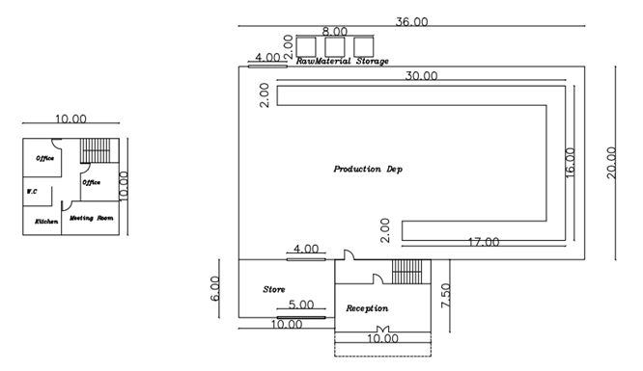
Plant Location and Layout
plant layout:

Slide 24
Financial Study:
The financial study focuses on the project's financial feasibility. It involves estimating costs, revenue projections, and potential financial risks.
Financial study
Costs classification
Financial
analysis
Revenues

Slide 25
Costs
classification
Capital investment:
Fixed assets:
2. Working Capital:
# | Item name | Total cost (NIS)
1 | Building | 605,800
2 | Machines and equipment | 295,969
3 | Furniture | 17,500
4 | IT equipment | 7,700
5 | Vehicles | 22,000
Grand total |  | 948,969
# | Item name/ description | cost/year | Cost/month | Cost for 4 months
1 | Total production cost | 2,472,305 | 206,025 | 824,102
2 | General and Admin. Expenses | 204,300 | 17025 | 68100
The working capital for 4 months |  |  |  | 892,202
The capital invested in our project amounts to 1,841,171 NIS.

Slide 26
Costs Classification
# | Item name | Cost/year (NIS)
1 | HR Budget | 358,800
2 | Supplies | 1,635,360
3 | Utilities | 450,360
4 | Land rent | 96,000
5 | Licenses | 2,000
6 | Insurance | 15,000
7 | Maintenance | 63,946
8 | Hospitality | 1,500
9 | Stationery Expense & Ink | 3200
Grand total |  | 2,604,066
Operational Costs:

Slide 27
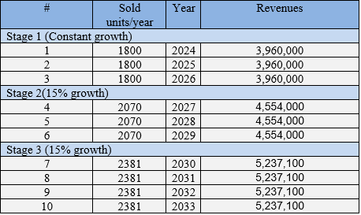
Revenues
Selling Price:
Expansion Plan:
# | Item name | Unit | Price NIS/ unit
1 | Recycled PET flakes | Ton | 2200 NIS/Ton

Slide 28
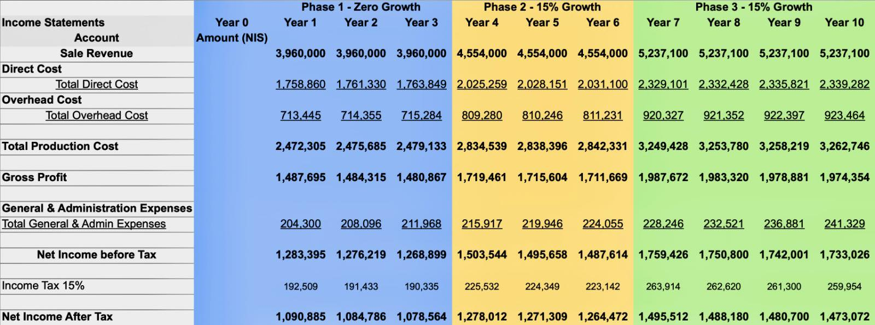
Financial Analysis
Income Statement :

Slide 29
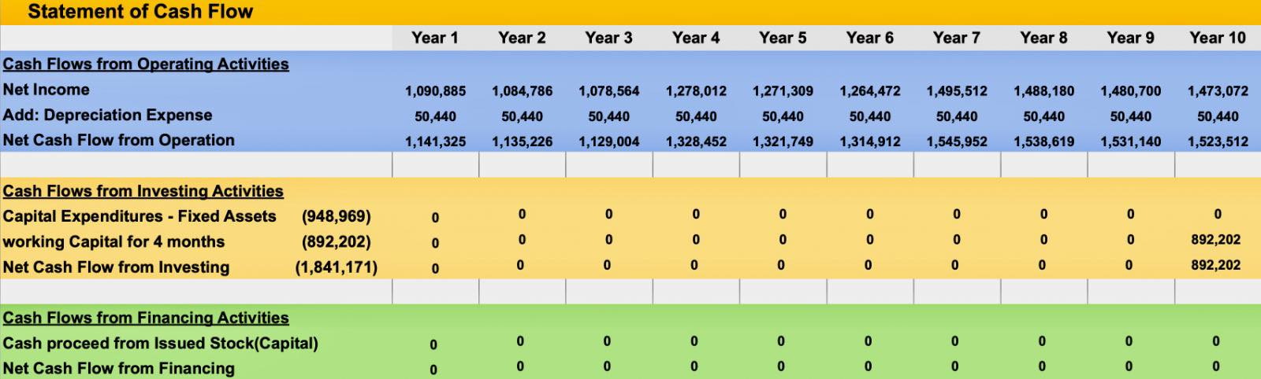
Financial Analysis
Cash Flow Statement :

Slide 30
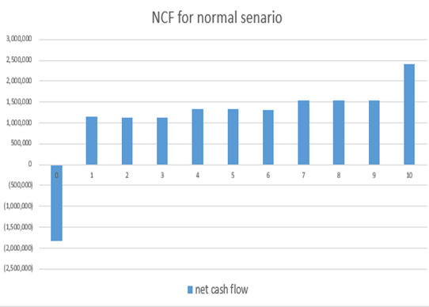
Financial Analysis
Net Cash Flow Diagram :

Slide 31

Financial Analysis
Worse Scenario Analysis :

Slide 32
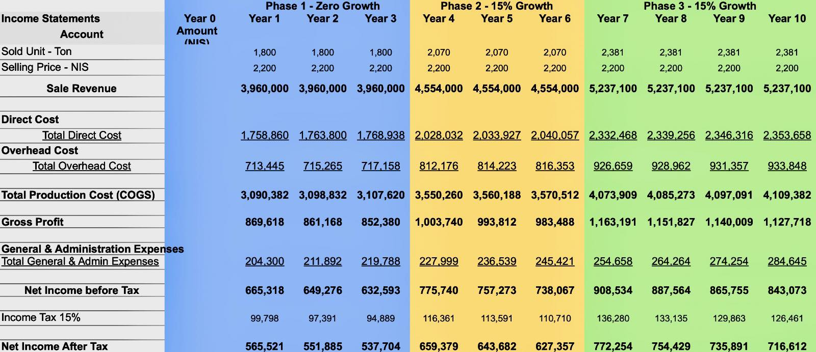
Financial Analysis
Worse Scenario Analysis :
Income Statement:

Slide 33
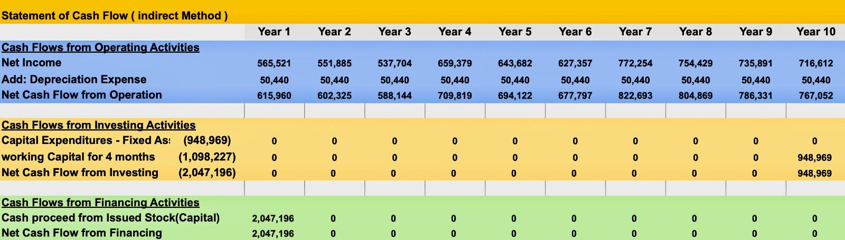
Financial Analysis
Worse Scenario Analysis :
Cash Flow Statement:

Slide 34
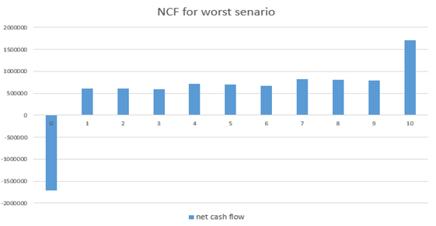
Financial Analysis
Worse Scenario Analysis :
Net Cash Flow Diagram:

Slide 35
Financial Analysis
# | Comparison | Scenario 1 | Scenario 2
1 | Rate of Return (ROR) | 64% | 37%
2 | MARR | 25% | 25%
3 | NPV without inflation | 2,745,664 NIS | 765,410 NIS
4 | Inflation | 2% | 5%
5 | NPV with inflation | 2,385,392 NIS | 317,025 NIS
6 | Payback Period (PbP) | 2 years & 4 months | 3 years & 6 months
7 | Break Even Point (BEP)
Stage 1 |  | 257 ton/year | 267 ton/year
Stage 2 |  | 270 ton /year | 297 ton /year
Stage 3 |  | 290 ton/year | 344 ton /year
Comparison between the two scenarios

Slide 36

Results and Discussion:
Market Results:
-Our study, including an interview with Dr. Issam and gathering additional details, revealed that plastic waste makes up 10.1% of solid waste in Nablus. Despite the existence of recycling workshops in the West Bank, they do not focus on recycling PET plastic.
-After setting the factory's goal, we identified and considered all essential requirements, including location, land, machinery, and other fundamental aspects.
Technical Results

Slide 37
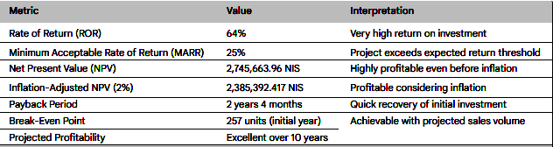
Results and Discussion:
Financial Results:

Slide 38
Conclusion :
Nablus wastes valuable PET plastic (recyclable!) by landfilling it. A dedicated PET recycling facility can fix this, creating jobs, industries, and eco-friendly products. Challenges exist, but potential is huge.

Slide 39
Recommendations:
The success of the project hinges significantly on the active participation and collaboration of all relevant stakeholders, including the municipality, the establishment of a sorting station, and the engagement of community members.

Slide 40
Thank you

