Slide 1

An-Najah National University
Faculty Of Engineering
Building Engineering Department
Graduation project II
Integrated design Of Fuel Station

Slide 2
Supervised by:
Dr. Ahmad Saleh
Prepared by:
Ali Ghannam
Morad Azoqa
Majd Alhaj

Slide 3
Outline
Site analysis .
Architectural Design
Structural Design.
Environmental Design.
Electrical Design.
Mechanical Design.
Safety Design.
Total Cost.
Conclusion.

Slide 4
Introduction
The project presents an integrated design for a fuel station, it locates in the southern west part of Nablus (Qalqilya – Nablus Street). The significance of project come from that there is no fuel station like our project in this part of city

Slide 5
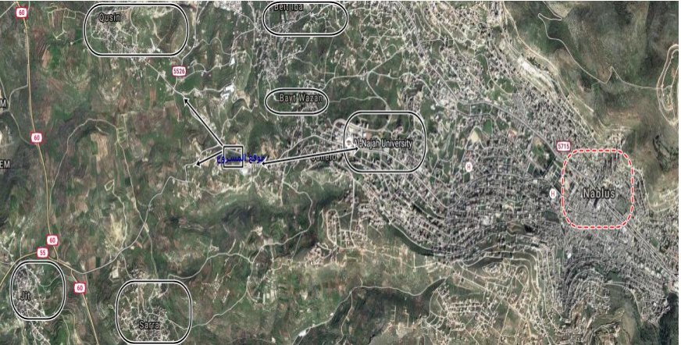
Site of the project

Slide 6
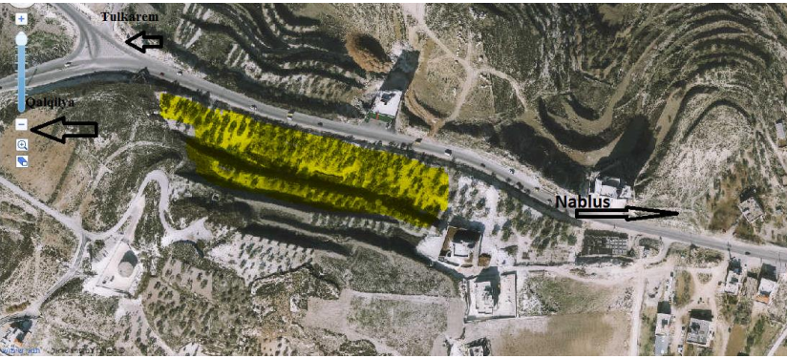
Site of the project
Area = 5000 Square Meter.

Slide 7

Architectural Design

Slide 8
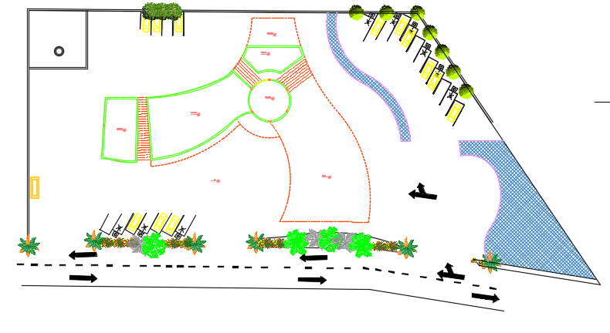
Site plan for the project

Slide 9
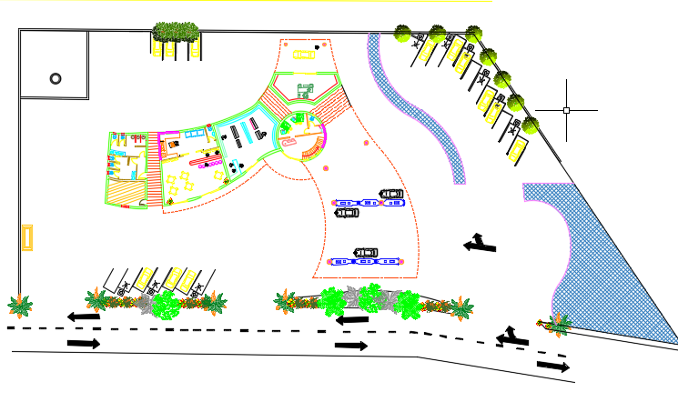
The Master plan for the project

Slide 10
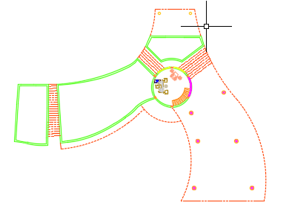
First Floor paln (Area = 54)

Slide 11
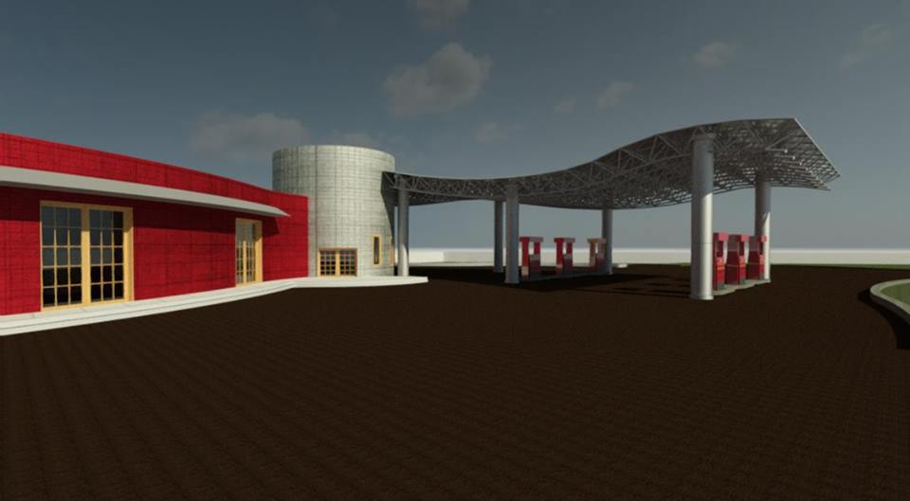
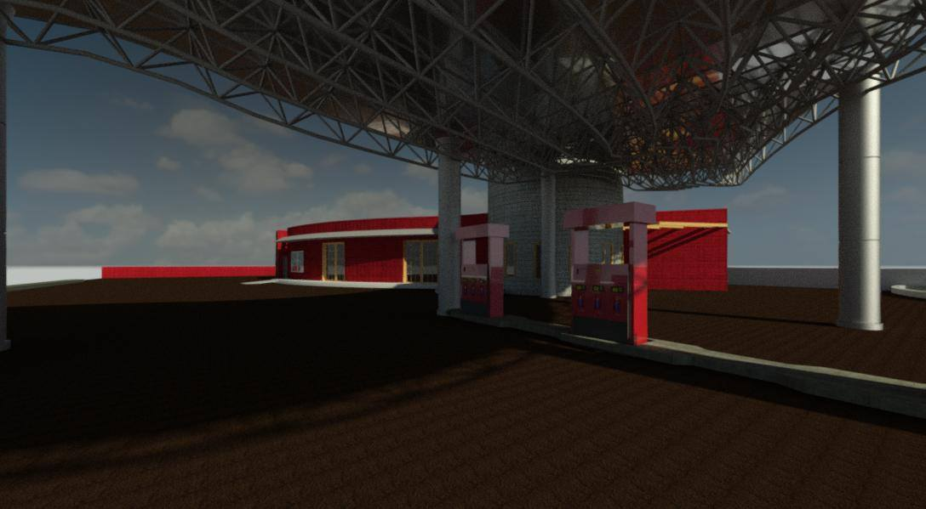
Rivet

Slide 12
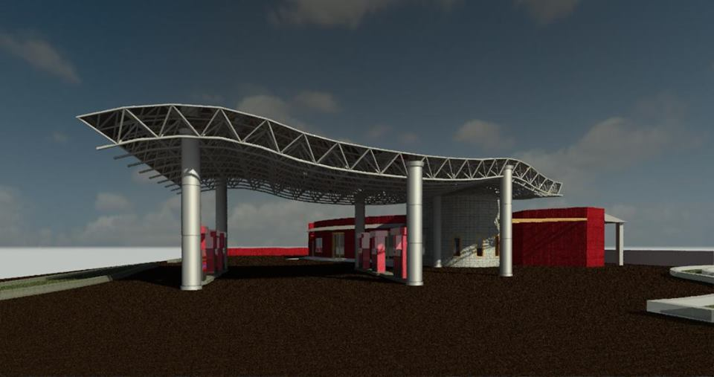
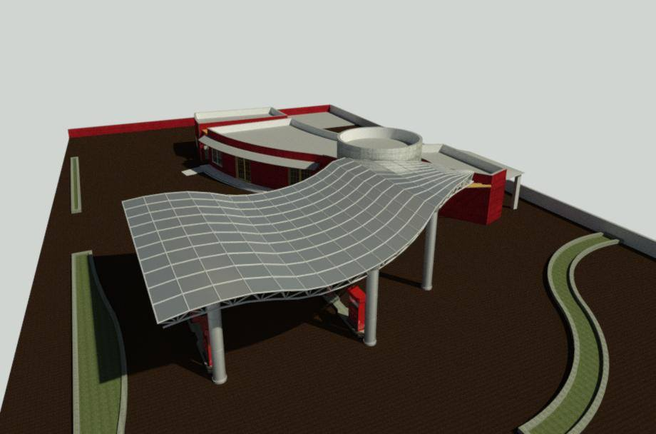
Rivet

Slide 13
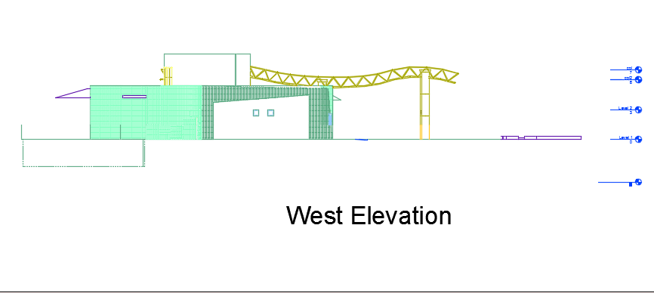
Elevation

Slide 14
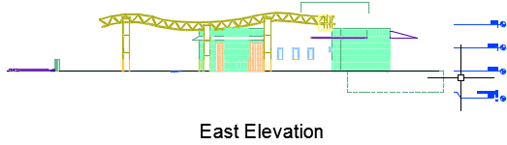
Elevation

Slide 15
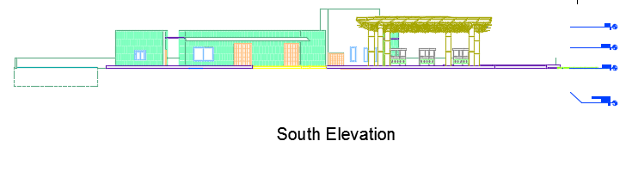
Elevation

Slide 16
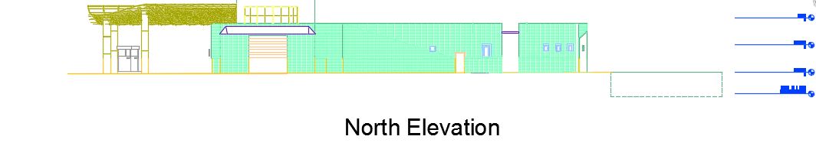
Elevation

Slide 17
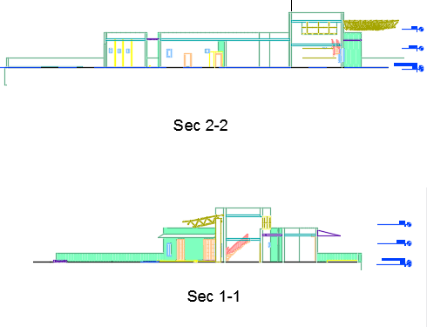
Sections

Slide 18

Environmental Design

Slide 19
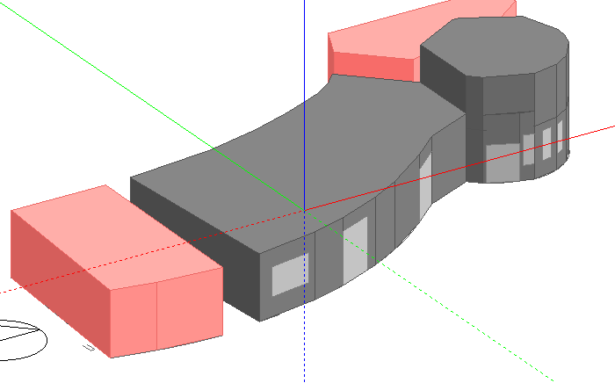
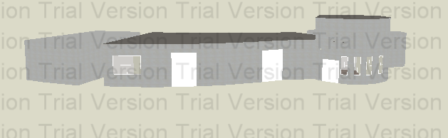
Design Builder Was used for Thermal performance analysis and Simulation

Slide 20
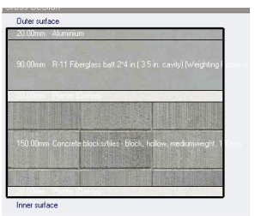
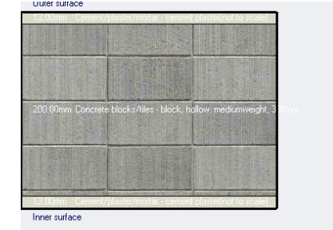
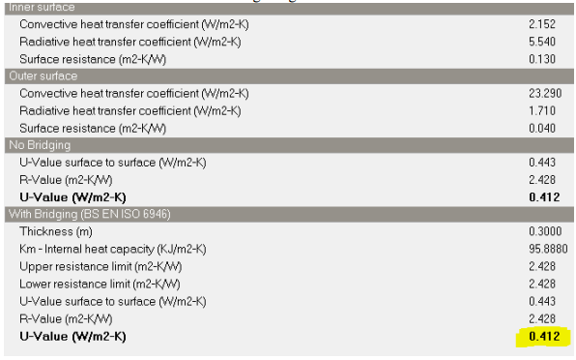
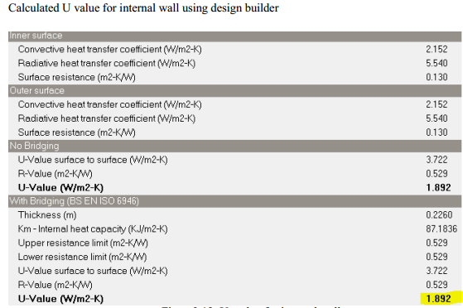
Layers of external walls in building
Layers of internal

Slide 21
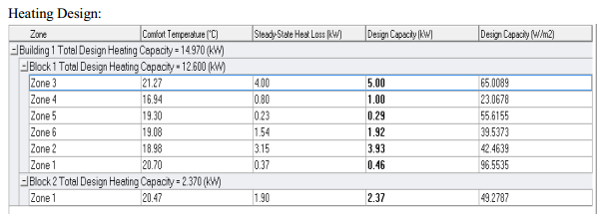
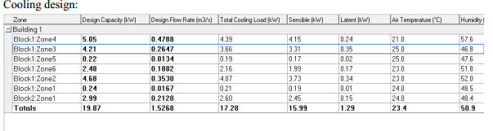
Heating And Cooling Result From Design Builder

Slide 22
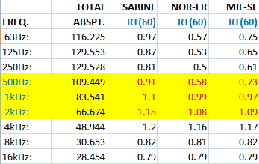
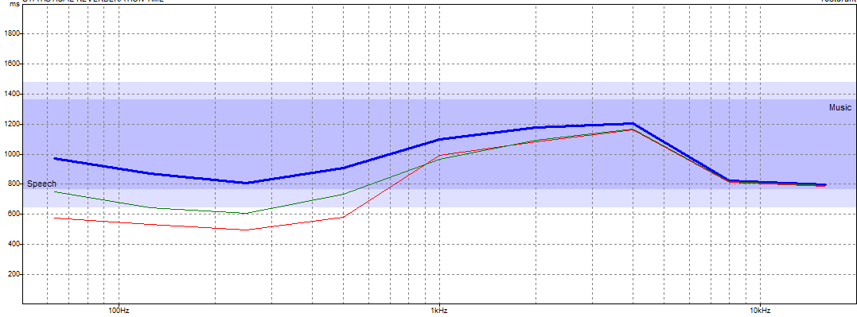
Acoustical design :
Reverberation time (RT60) for the restaurant when the occupancy =100%

Slide 23
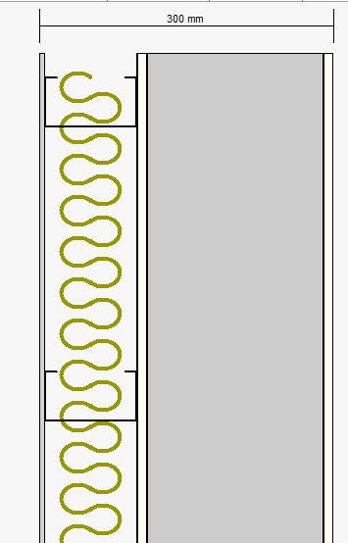
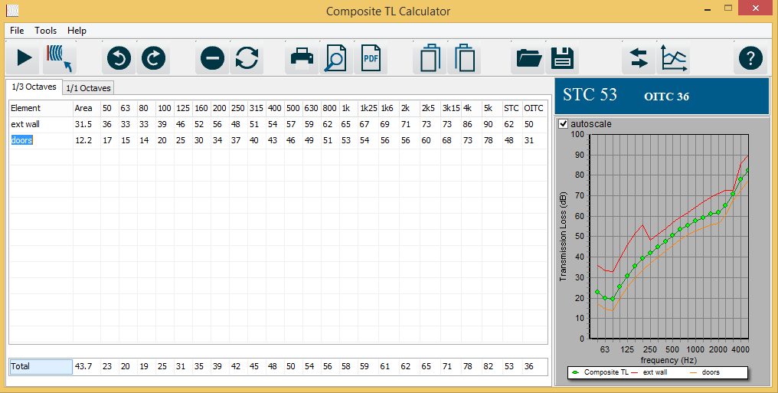
STC value :
Between restaurant and out side
STC = 53

Slide 24
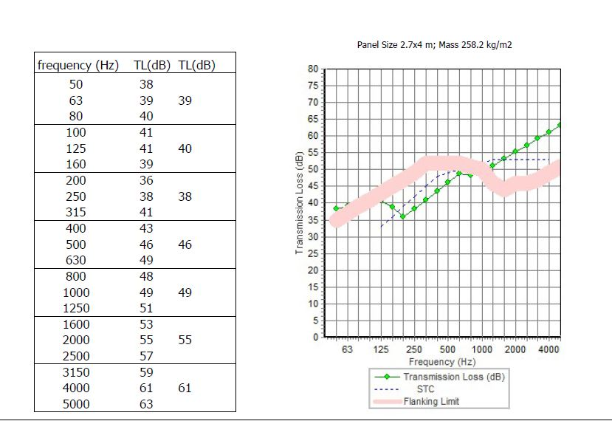
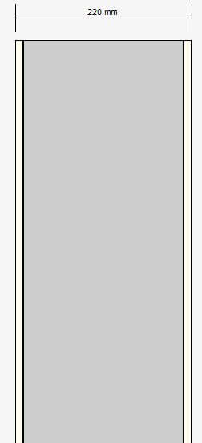
STC value :
Between restaurant and Super market (int wall)
STC = 49

Slide 25
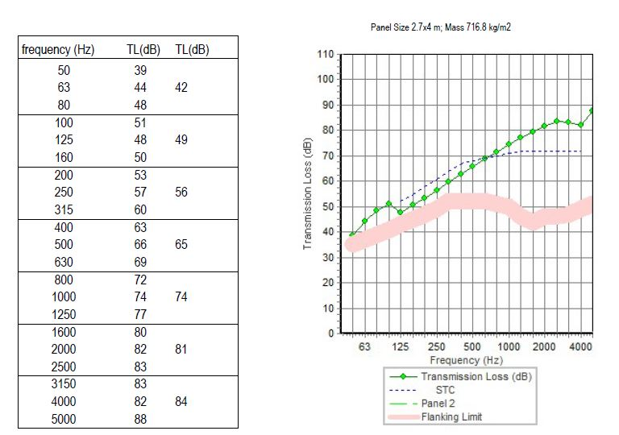
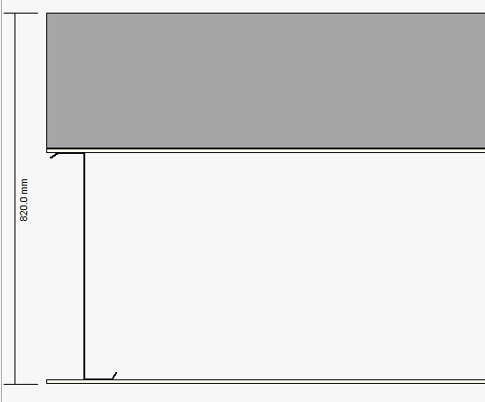
IIC value :
For roof
IIC = 63

Slide 26
Structural Design

Slide 27
Structural Design
Two structural systems were used in the project:
concrete structure.
steel structure in covering.

Slide 28
Structural Design
concrete structure.
Data Sheets
Concrete Compressive Strength :
F’c =24 Mpa For Slabs, Shear Wall & Beam.
F’c =28 Mpa For Columns & Footing.
Bearing Capacity For Soil 250 Mpa.
Yielding Strength Of Steel : Fy= 420 Mpa

Slide 29
Structural Design
concrete structure.
Structural system
Ribbed slab with drop beams
The Thickness Of Slab (H) = 30cm
Beams:
Main beams 40*60 cm^2.
Girder beams 40*60 cm^2.
Secondary beams 20*30 cm^2.
Columns:
25*50cm diameter .
Columns for main canopy
0.8cm diameter .
Columns for secondary canopy
0.5cm diameter .

Slide 30
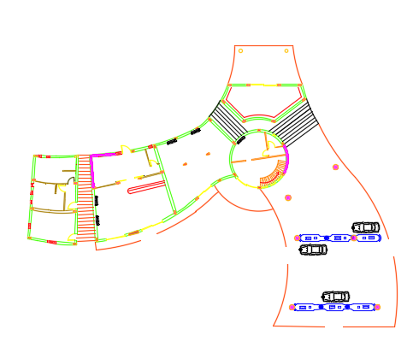
Structural Design
Columns Distribution:

Slide 31
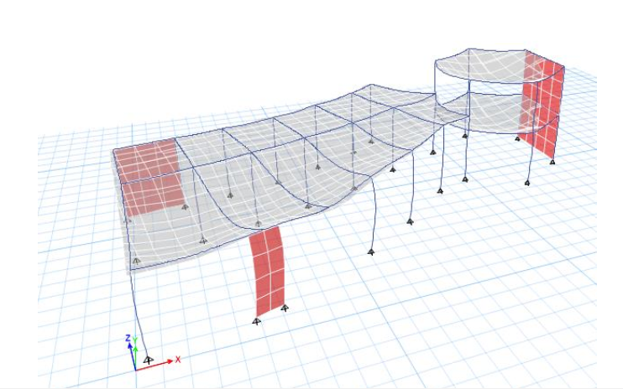
concrete structure.
3D modeling from Etaps Program
Compatibility Check:

Slide 32
Equilibrium Checks
load | manual | From etabs | % of error
Live load | 3428.99 | 3330.37 | 2.9%
Dead load | 1050 | 1000 | 4.7%
SID load | 700 | 667.37 | 4.6%
All percent of error < 5% >> OK

Slide 33
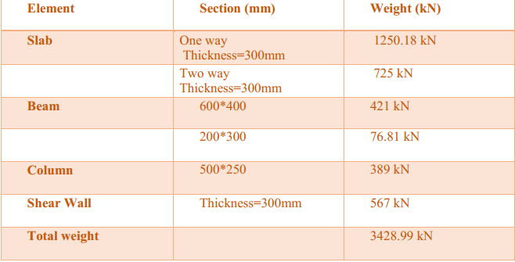
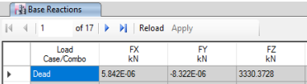
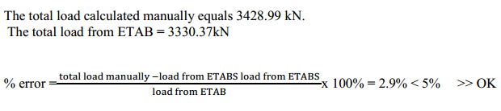
concrete structure.
Equilibrium Checks

Slide 34
Stress Strain relationship:
 | manual | From etabs | % of error
beams | 230 | 217 | 5.19%
Slab | 11.5 | 11.36 | 1.23%
column | 117 | 107.15 | 8.5%
All percent of error < 10% >> OK

Slide 35
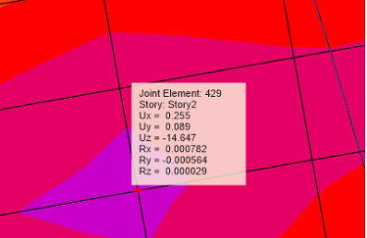
Deflection
Max deflection in the model = 14.647 mm
Max allowable deflection in slab = 7.68/ 240 = 32 mm
14.67 < 32 so it is ok

Slide 36
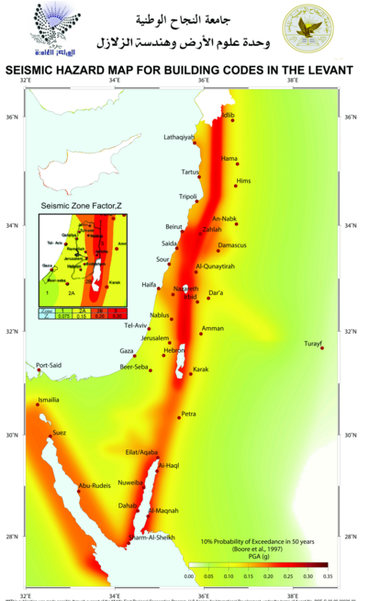
concrete structure.
Seismic Design
Importance factor (I) = 1.25
velocity-dependent seismic coefficient (Cv): = 0.40
acceleration-dependent seismic coefficient (Ca): = 0.28
The Structural System in Nablus.
Peak Ground Acceleration = 0.2g
Structural system Coefficient (R) = 5.5

Slide 37
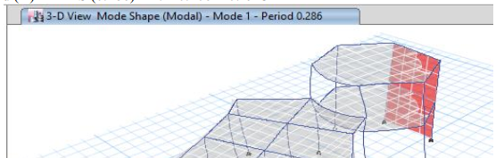

concrete structure.
Natural Period (T) for the building:
Period from ETABS (0.286) < 1.4*0.207 = 0.29 OK

Slide 38
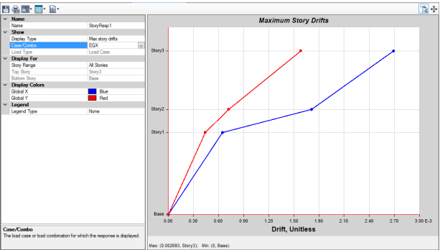
Drift:
T<0.7 sec
Δm =0.7*5.5*0.724= 2.7
Drift from Etabs =2.7
(4000/400) = 10mm
2.7<10 its ok

Slide 39
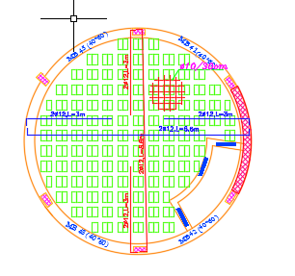
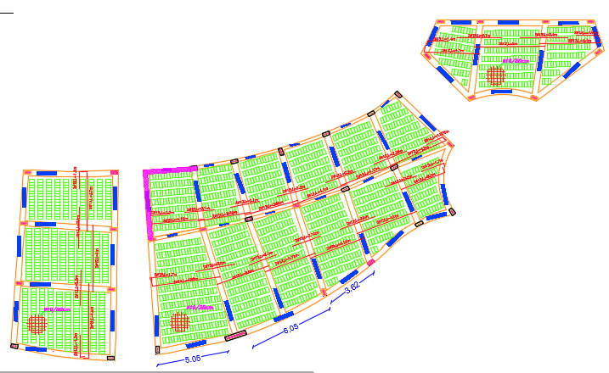
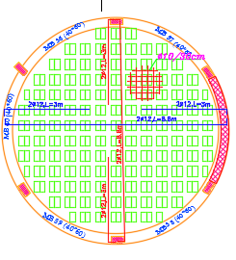
concrete structure.
Slab Design
1st Slab
2ed Slab
3rd Slab

Slide 40
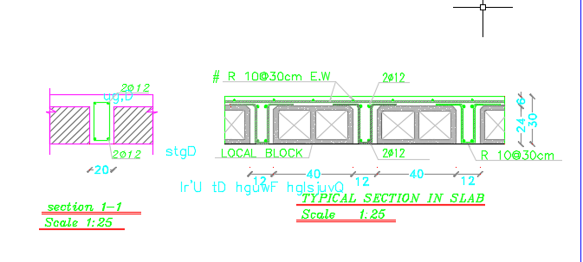
concrete structure.
Slab Section

Slide 41
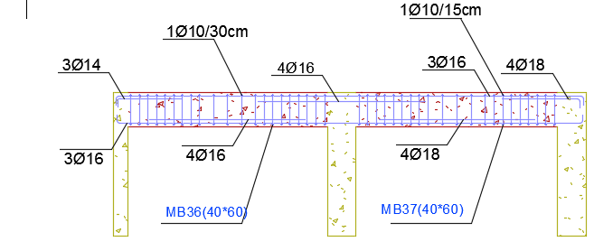
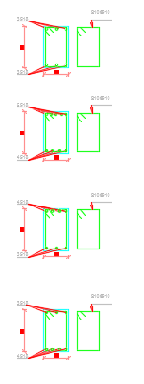
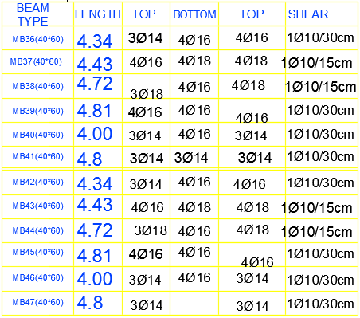
concrete structure.
Main Beam Design

Slide 42
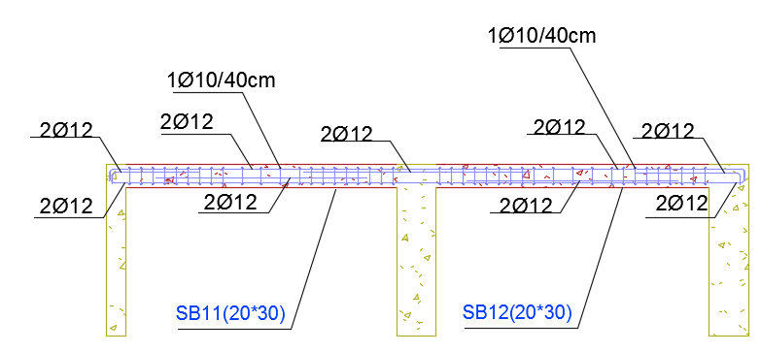
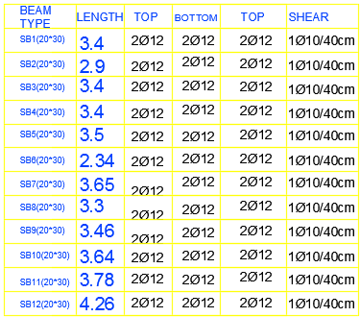
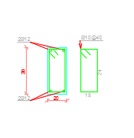
concrete structure.
Secondary Beam Design

Slide 43
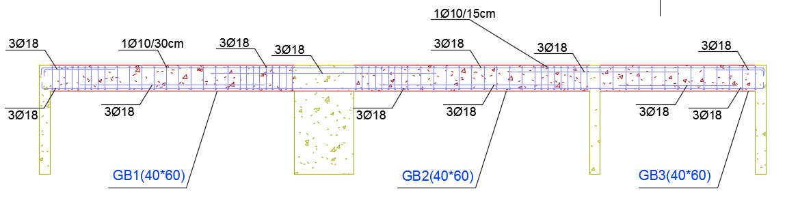

concrete structure.
Girder Beam Design

Slide 44

concrete structure.
Footing Design

Slide 45


concrete structure.
Column + Footing Design

Slide 46

concrete structure.
Shear wall Desgin

Slide 47
Structural Design
Steel structure.
Data Sheets
Steel truss system used to cover circular building by using Polycarbonate sheet as covering material.
Covering Material properties:
2cm thickness
Density= 22.46 Kg/m²

Slide 48

Structural Design
Steel structure.
SID = 0.023KN/m²
Live Load= 1.6 KN/m²
Snow load= 2.40 KN/m²
Wind load = 0.491 KN/m²

Slide 49


Structural Design
Steel structure.
SAP Checks:
Compatibility:
Start animation OK
period (Modal) T=0.05 < 1 ok
Equilibrium:
Max Deflection = 0.021mm ➔ deflection check is ok

Slide 50

Structural Design
Truss Design

Slide 51


Structural Design
Connection Design.

Slide 52
Mechanical Design

Slide 53

Mechanical Design
Water Supply # of tanks

Slide 54


Mechanical Design
Water Supply Design

Slide 55

Mechanical Design
Water Supply For Ground Floor

Slide 56

Mechanical Design
Water Drainage

Slide 57

Mechanical Design
Water Drainage For Ground Floor

Slide 58

Mechanical Design
Water Drainage For 1st Floor

Slide 59

Mechanical Design
HVAC System Design
Split unit has been used in this project.

Slide 60


Mechanical Design
HVAC System Design

Slide 61
Electrical Design
The simulation analysis and design by “DIALux Evo”

Slide 62



Electrical Design
Restaurant.

Slide 63



Electrical Design
canopy.

Slide 64



Electrical Design
Supermarket.

Slide 65


Electrical Design
Lighting arrangement
1st Floor
Ground Floor

Slide 66


Electrical Design
Soket
1st Floor
Ground Floor

Slide 67
Safety Design

Slide 68






Safety Design

Slide 69

Safety Design
Fire Sprinkler system :

Slide 70
Quantity Surveying

Slide 71



Slide 72


