Slide 1
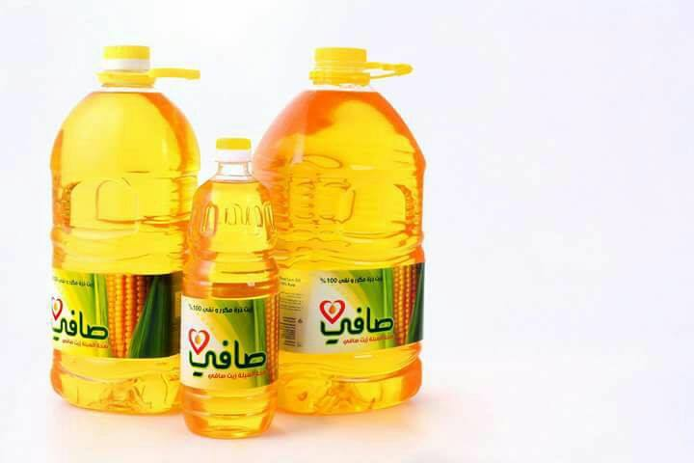
Graduation Project II
Applying Quality Function Deployment concepts in Anabtawi factory ( Al- Safi company )

Slide 2
Prepared by:
Rami Mousa
Murad Ibrahim
Omar Masri
Mohammad Ali
Under Supervision: Dr. Mohammad Othman

Slide 3
outline:
1- company overview
2- Introduction
3- problem statement
4- Objectives
5- literatures
6- Methodology
7- Results and Analysis
8- Conclusion
9- Recommendations

Slide 4
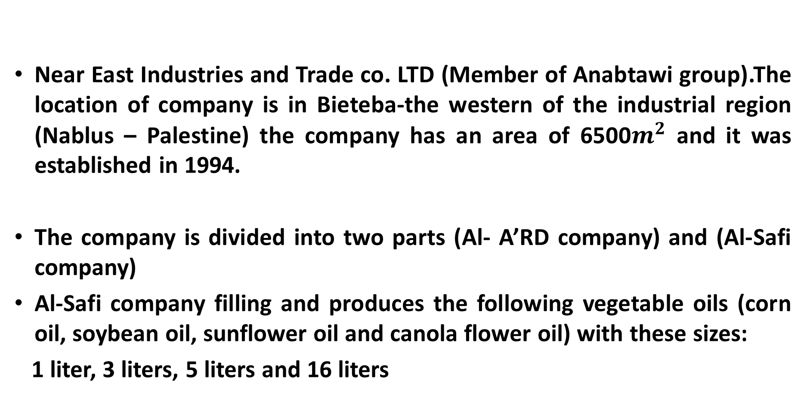
Company overview
Company overview :
Near East Industries and Trade co. LTD (Member of Anabtawi group).The location of company is in Bieteba-the western of the industrial region (Nablus – Palestine) the company has an area of 6500$m^{2}$ and it was established in 1994.
The company is divided into two parts (Al- A’RD company) and (Al-Safi company)
Al-Safi company filling and produces the following vegetable oils (corn oil, soybean oil, sunflower oil and canola flower oil) with these sizes:
1 liter, 3 liters, 5 liters and 16 liters

Slide 5
introduction
In our project we will concern on the vegetable oils sector by working with Al-Safi Company that the most of production from it to Palestinian market
We will identify the customer requirements and customer satisfaction and customer importance
We will study the properties of vegetable oils that company producing and the factors that effects on the quality of products from the opinions of producer and consumers
We will using the QFD concept to analysis the relationship between the properties of product and the factors that lead to reduce from the quality of the product, comparing with competition products.

Slide 6
Problem statement
The root of the problem is that it is difficult to understand and define the basic customer requirements and expectations as a result of the weakness of the company's direction to focus on the customer, and hence lack of interest in the tools of understanding measuring and analyzing the customer's voice that has been extolled to deliver superior value that earns customer satisfaction and contributes to achieving a sustainable competitive advantage. Due to lack of interest in understanding and applying TQM tools primarily the tool for quality function deployment.

Slide 7
Objectives
Understand and accurately define the basic customer requirements, and then determine the level of their importance, to ensure focus on the requirements that are most important from his point of view.
Attempting to improve the quality of the product by converting the basic customer requirements to manufacturing and technical characteristics of the product and determine their technical priorities including ensuring that they are focused on meeting the desired customer requirements and / or exceeding their expectations.

Slide 8
Objectives cont.’
Identify the competitive gaps through market and technical competitive analysis, which helps to diagnose strengths and weaknesses of the quality of the product compared to the nearest competitors in order to improve the quality of the product provided.
Attempting to measure the perceived quality of the market and the percentage of the value of the customer to the dimensions of quality and price characteristics, in order to direct the company's attention towards achieving superior value to the target customer

Slide 9
Literature review
Customer requirements : Particular characteristics and specifications of a good or service as determined by a customer.
Voice Of the Customer (VOC) : The “voice of the customer” is a process used to capture the requirements/feedback from the customer (internal or external) to provide the customers with the best in class service/product quality.
Quality Function Deployment : In a few words: The voice of the customer translated into the voice of the engineer.
House of Quality: The first phase in the implementation of the Quality Function Deployment process
otalquality management tools:

Slide 10
Literature review
ARTICLE Name | Publishing year | Authors | Subject | Conclusion
(Translating consumer’s olive-oil quality-attribute requirements into optimal olive growing practices: A quality function deployment (QFD) approach) | 2017 | Sayadi, Erraach & para lopez | The purpose of this paper is to translate consumer requirements regarding olive-oil quality attributes into specific olive-growing practices that most contribute to satisfy these attributes. | The demand for quality attributes of olive oil includes not only chemical and sensory attributes (flavor, acidity, and color) but also others related to marketing (price, place of purchase, and bottle), quality certification and guarantee (PDO, Organic Farming (OF)), social aspects (maintaining the local population, creating employment, etc.), and even environmental issues (environmentally friendly, etc.).

Slide 11
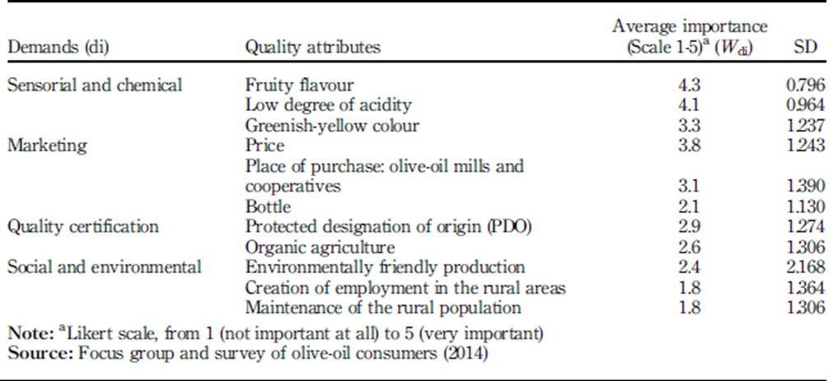
Literature review
The QFD implementation for olive oil article
(WHATs) Consumer requirements towards olive-oil quality attributes

Slide 12
Literature review
ARTICLE Name | Publishing year | Authors | Subject | Conclusion
Effects of Storage Conditions and PET Packaging on Quality of Edible Oils in Iran. | 2012 | Khaneghah,Shoeibi and Ameri | The Effects of polyethylene terephthalate (PET) pieces and different storage conditions on fatty acids profile and some quality factors in three types of commercial oils, namely sunflower oil, canola oil, and blended oil | Results show the quality of oil has been decreased after the storage at high temperature (45°C) and longtime of storage. So for preventing of deterioration, the oils which were packed in PET bottles should be stored at a temperature lower than 25°C. If the temperature is raised (T<45°C) the shelf life of product should be limited stability of vegetable oils is dependent on the type of oil and its initial physical and chemical properties, time and temperature of storage and the type of packaging (PET and Glass)

Slide 13
Literature review
ARTICLE Name | Publishing year | Authors | Subject | Conclusion
Effect of Light and Air on the Quality and Stability of Selected Vegetable Oils: | 2016 | Leonia Ndesiamoo Henry | The quality and stability of industrially processed palm, sunflower and cotton oils as affected by light and air were investigated. | The oxidative stability of oils is affected by the storage conditions including exposure to light and air. The study showed the values of PV, AV and FFA varying proportionally with the exposure to light and air. There was also a significant difference between the oils stability to spoilage where palm oil showed the highest stability (p<0.05)

Slide 14
Methodology
make interviews:
Plant interview:
The factory was visited and several departments supervisors were interviewed inside the in the plant: production department, sales department, quality department in addition marketing department
To get data about types of cooking oils and data about properties and characteristics of oils.
Several questions were asked on several departments of the plant concerning the factors that could be affect the quality of the oil and the quality of the product in general.

Slide 15
Methodology
Customers’ interview:
Several interviews were conducted with customers through their relatives and inquired about the type of oil that used it, what characteristics they preferred in the oil, whether they used a certain type of oil, and why they bought another type of oil to help us construct the questionnaire accurately are clearly defined when the questionnaires will be distributed.

Slide 16
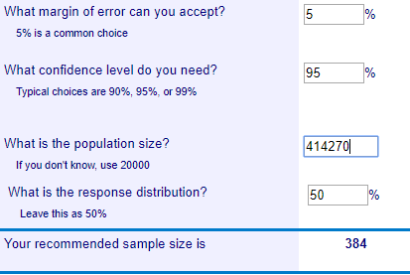
Sample size:
  The population of West bank is 414,270 houses, we taken Confidence level 95 % and margin of error 5%, the sample size result is 384 surveys approximately.

Slide 17
Quality function deployment concept methodology.
Customer Requirements
Product Planning Specifications
Part/Subsystem Planning Specifications
process planning specifications
quality control specifications

Slide 18
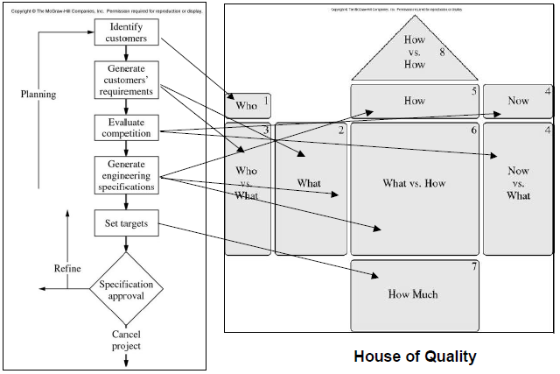
Building (House of Quality).

Slide 19
Results and Analysis
Customer requirements:
Low price of oil: The results showed that customers are complaints from the price in comparison with other competitors.
Good taste of oil : customers wants delicious taste of oil
Good smell of oil : the customer said that the smell of oil is very important when using it in frying and cooking

Slide 20
Customer requirements cont’
Convenient bottle use: In high volume bottles 5 liters the customers said that it’s not comfortable in use.
stability in the taste of oil: many customers’ needs oil with stable color of oil
Availability of oil in all stores: Many customers complained from that them buying other cooking oil products because they don’t found there product in the stores.

Slide 21
Customer requirements cont’
Increase offers: there are many customers saying that extra quantities should be offered on the bottle.
Pure oil : Most customers want pure oil
Good food content of oil : Many customers’ needs are to increase dietary ingredients,

Slide 22
Customer requirements cont’
High health benefits: Some customers said that be heavy on the stomach that may be from effects of reduction of health benefits that may affect on heart patient.
Good oil color: some customers said that the color is very important when using the oil in salad or make sweets.

Slide 23
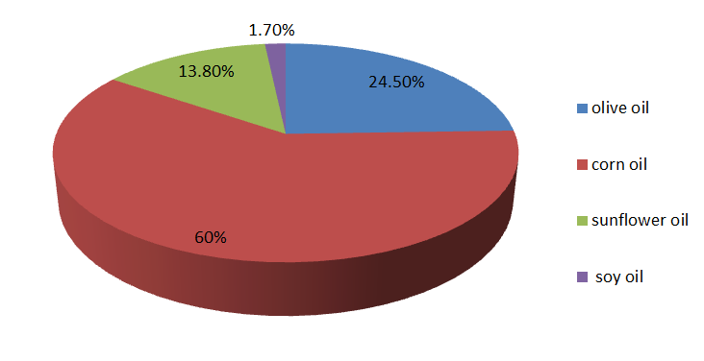
Types of consumption vegetable oil
Results of the surveys:

Slide 24
The percentage of corn oil customers according the company

Slide 25
The percentage of sun flower oil customers according the company

Slide 26
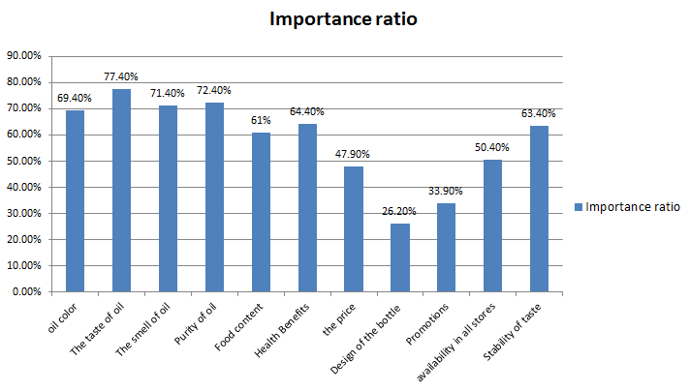
Importance characteristics for the customer.

Slide 27
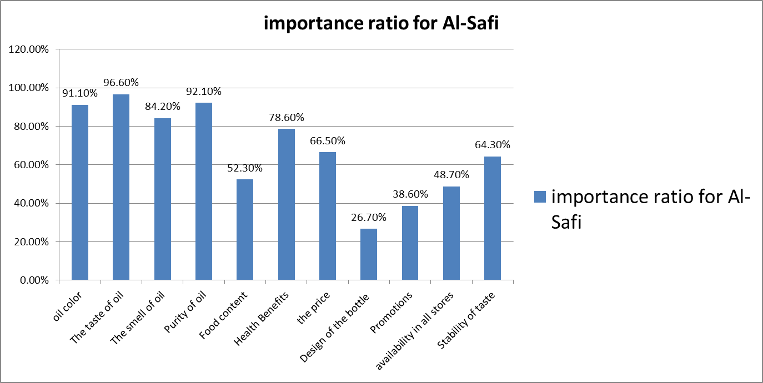

Slide 28
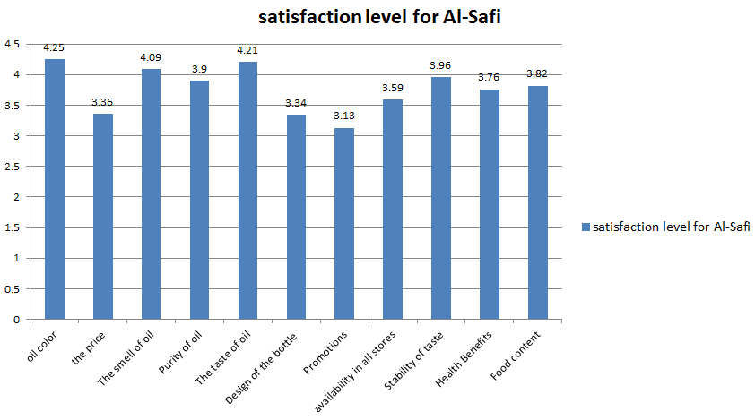
Customers satisfaction for Al-Safi

Slide 29
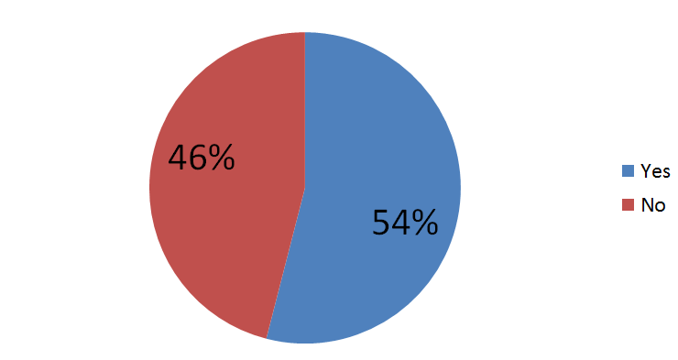
Customer's loyalty to the product
This chart clarifies that 54% from customers will buy another competitor’s product if not find Al-Safi product and 46% will not buy if not find Al-Safi product

Slide 30
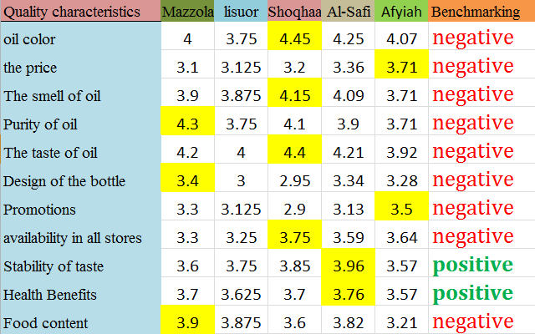
Competitive Benchmarking:

Slide 31
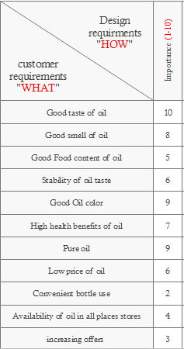
customer priority level

Slide 32
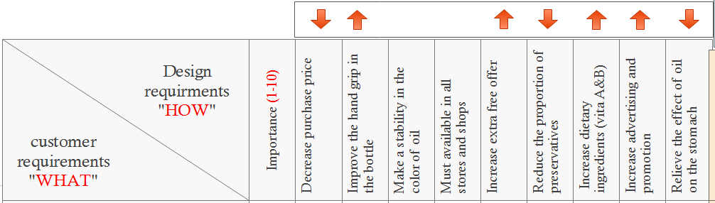
Design requirements Characteristics

Slide 33
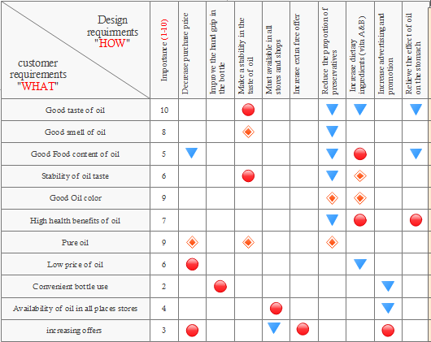
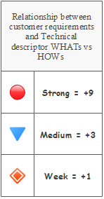
Relationship Matrix

Slide 34
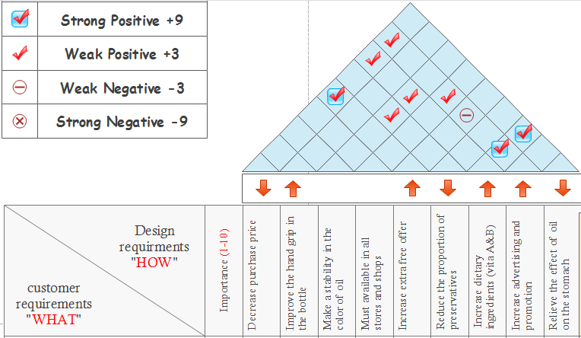
Correlation Matrix

Slide 35
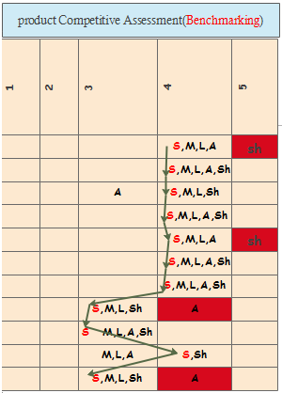
taste
product competitive Assessment) benchmarking)
color
price
offers

Slide 36
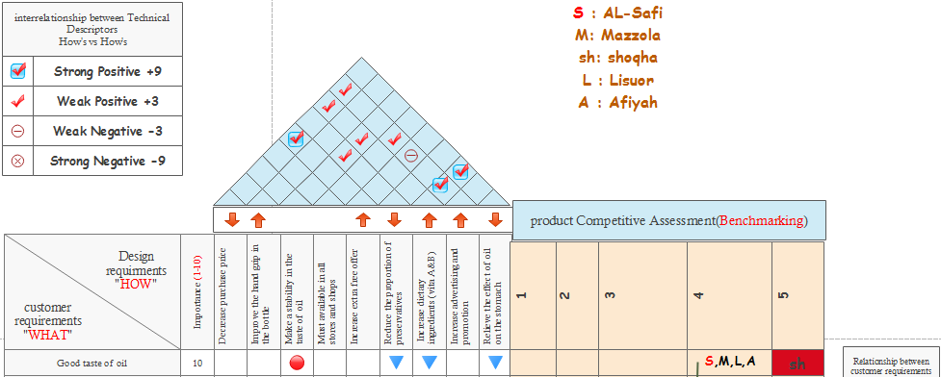
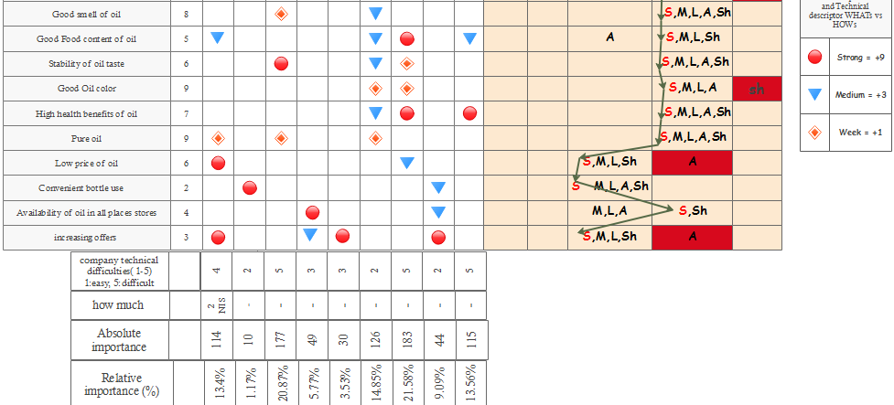
House of Quality

Slide 37
Conclusion
Identify what Al-Safi customers requirements and determining the customers’ importance level
Measuring the level of satisfaction for Al-Safi oil

Slide 38
With QFD analysis we have achieved the next goals:
As we see in the results of house quality from relative importance the higher relative importance = 21.58% is Increase dietary ingredients (vitamin A& D) the company must start improvement in food content of oil requirement.
Identify the areas of weaknesses in Al-Safi product as we see in benchmarking these areas are : the taste , the color , the price , the offers
Identify Al-Safi market share = 30% corn oil , 18% sun flower oil
The company situation in the local market is good and satisfied for most of customers

Slide 39
Recommendations
1- The company should study the market well and know its market share, listen to the views of customers as a feedback.
2- The company should apply QFD directly to reach its objectives and make the necessary improvements to satisfy customers.
3- Considering that meeting customer requirements can increase company profits and market share and beat competitors.

Slide 40
4- In view of the competitive power of the vegetable oil industry, the company must offer distinct promotional offers from other competitors to get more customers, and more customers mean more profit.
5- The company collect customer voice data by interviewing customers or through focus groups, In order to accurately identify the customer's real requirements, and then deployed during the process of product design and development using the quality function deployment tool

Slide 41


