Slide 1
Colored-balls Collecting Robot
By : Asmaa Shehadeh and Nareman Alawneh
Project supervisor: Eng. Asmaa Afeefi

Slide 2
Outline
What is Colored-balls Collecting Robot
Components
Methodology
Constraints
Future work
Demo

Slide 3
What is Colored-balls Collecting Robot
It is a robot that collects balls from the kids playing area using its arm and sorts them into the designated baskets according to their colors.

Slide 4
Components

Slide 5
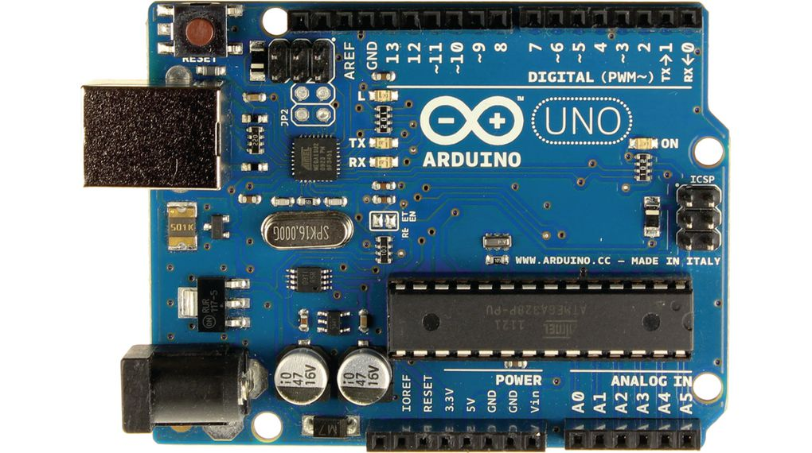
Arduino UNO

Slide 6
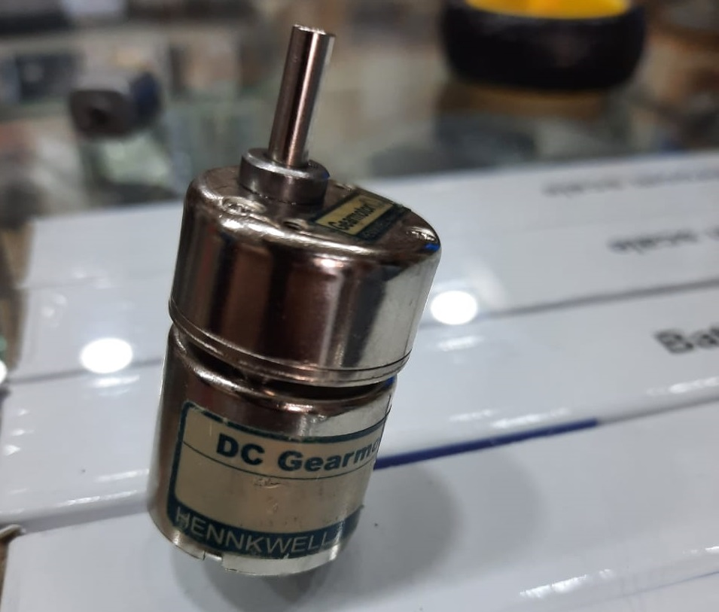
Gear DC Motors

Slide 7
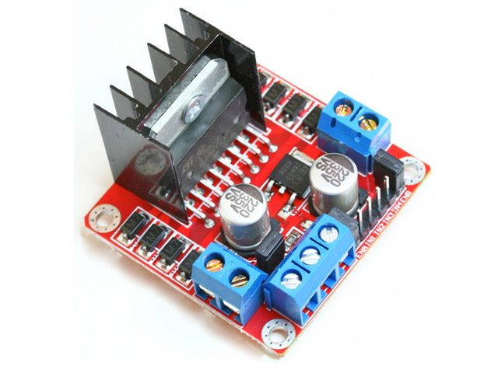
L98N Motor Driver

Slide 8
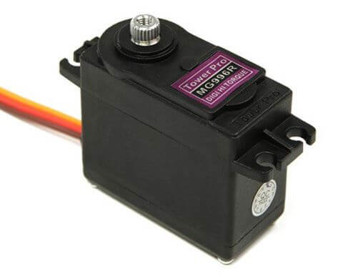
Servo motors

Slide 9
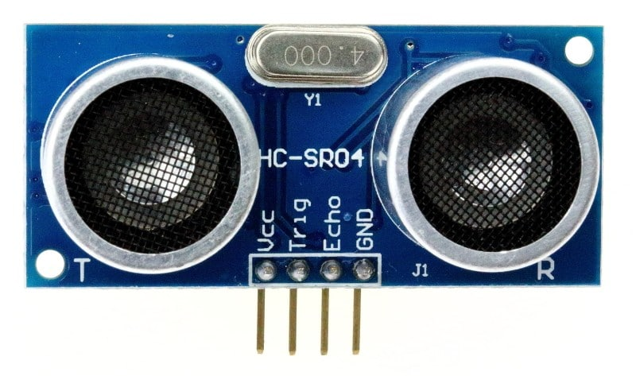
Ultrasonic sensors

Slide 10
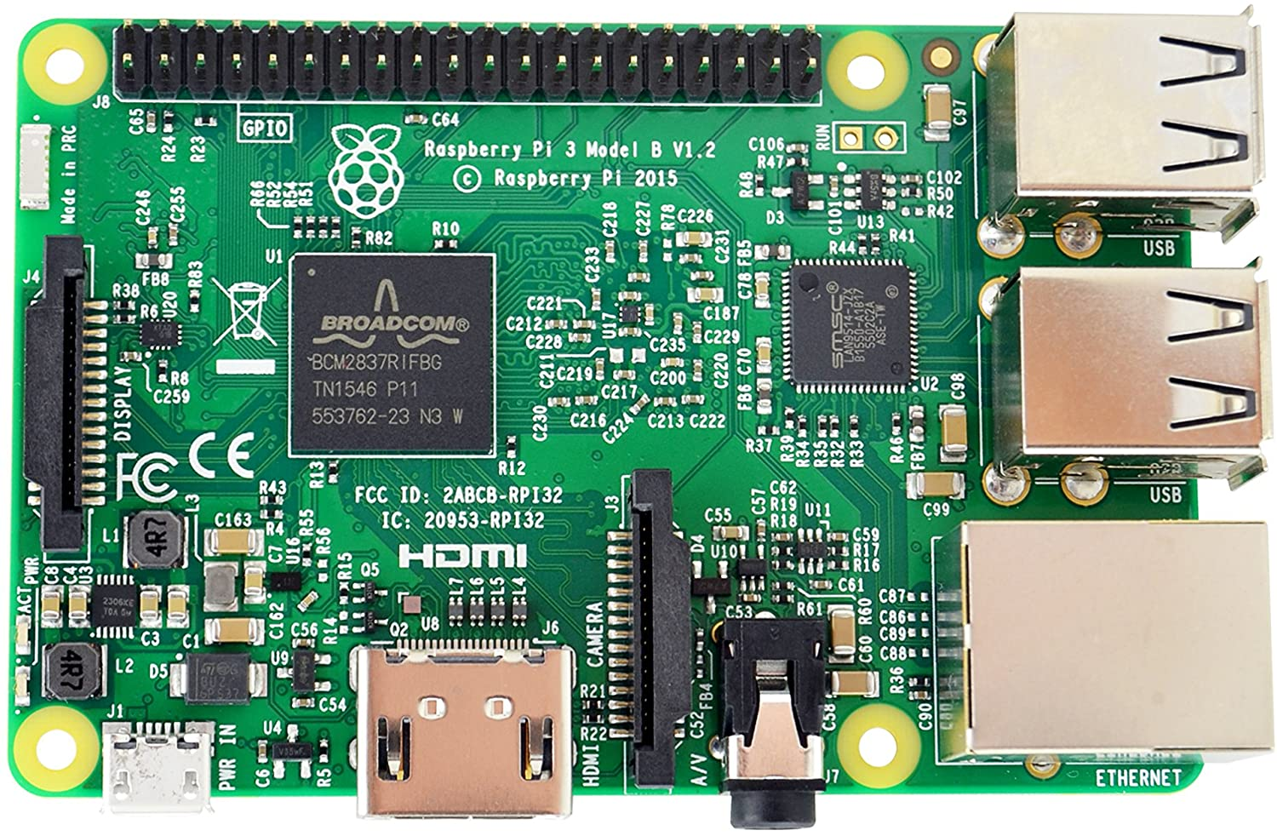
Raspberry pi 3B

Slide 11
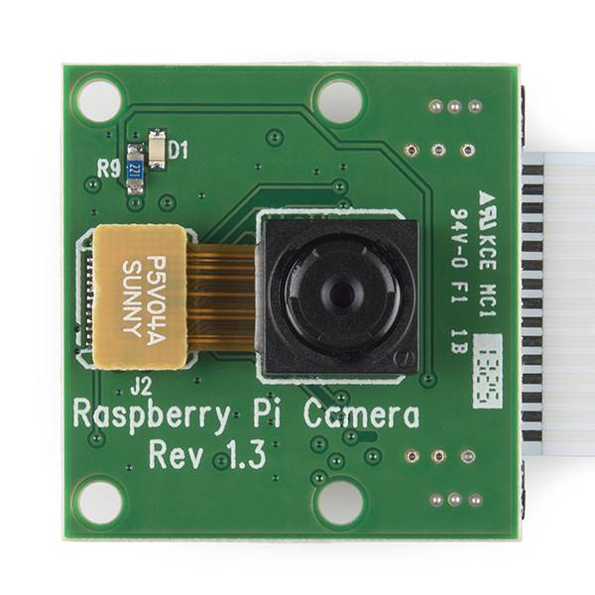
Raspberry pi Camera module

Slide 12
Methodology
Project main parts are :
Balls and baskets detection using Raspberry pi and Image Processing .
Car and Gripper movement using Arduino.

Slide 13
Raspberry pi Algorithm

Slide 14
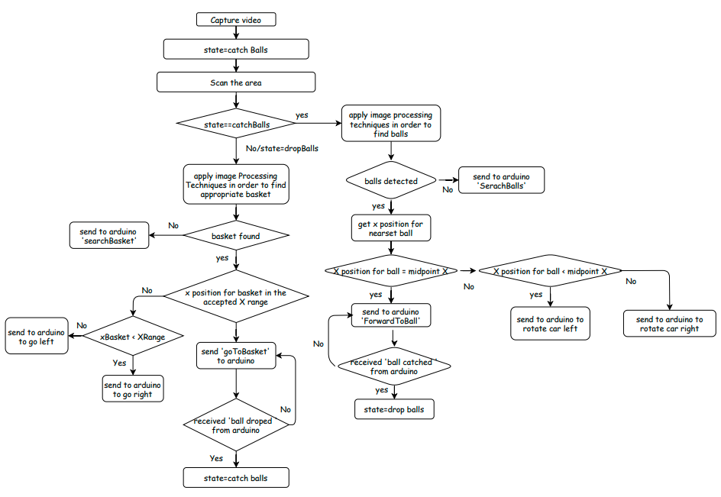

Slide 15
Arduino Algorithm

Slide 16
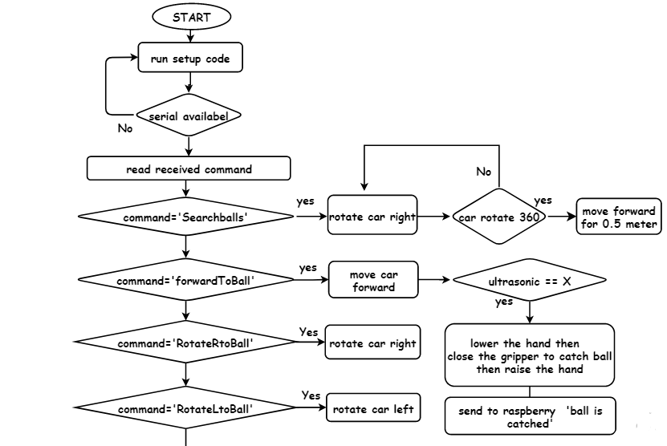

Slide 17
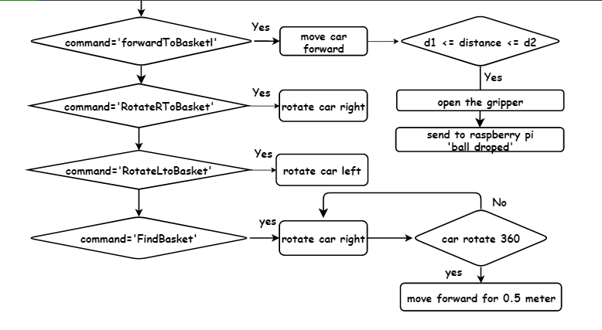

Slide 18
Constraints
The limited weight that the robot can carry
Camra delay.
Accuracy reduced with low light settings.

Slide 19
Future Work
Adding a tube above the robot to hold the balls after picking them up.
Detecting more objects and toys like teddy bears.
Attaching the camera with a servo motor.
Making the gripper base move freely (360 degrees).
Save the robot's path after dropping a ball.

Slide 20
DEMO

Slide 21
Thanks!
Do you have any Questions?

