Slide 1
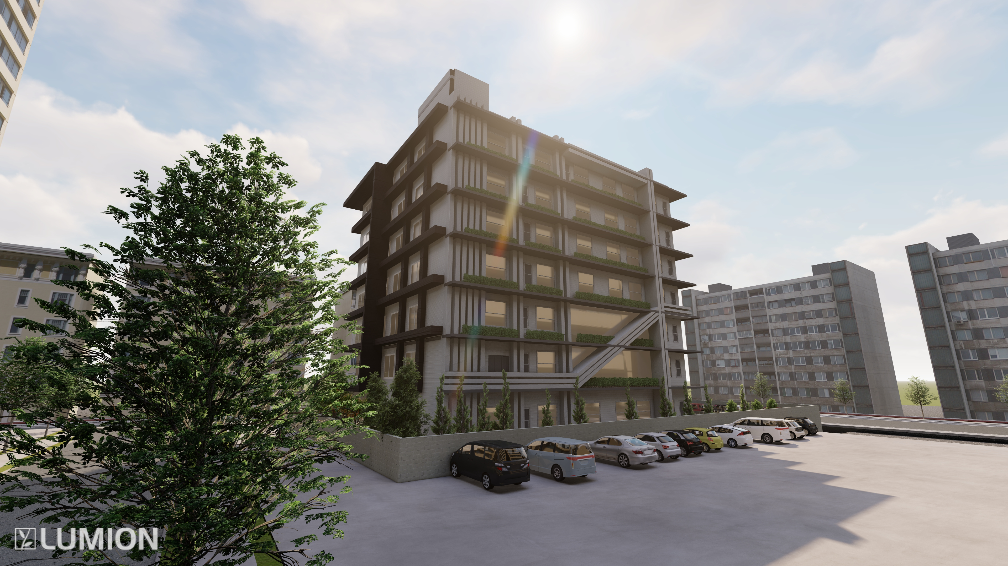
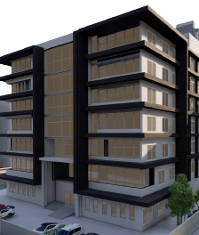
“An Integrated Redesign of Anti-Corruption Commission in Ramallah City”
Submitted by:
Lama daghlas
Fatima daraghma
Deema shakhsher
Supervisor name: Dr. Luay Dwaikat

Slide 2
Table of content
01 : introduction
03 : Architectural aspect
02 : site analysis

Slide 3
Table of content
04 : Environmental aspects
05 : Structural Aspects
06 : electro –mechanical aspects
04 : quantity serving and cost estimation

Slide 4
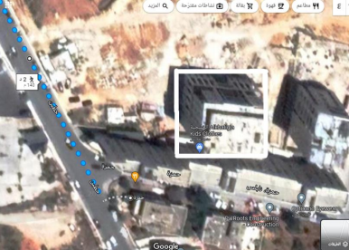
Introduction
Located in in
Al-Bireh - Ramallah
on latitudes 31.5419° and 35.1254.
Land area = 1800 S.M
Building area =9700 S.M,
Distributed on 10 floors

Slide 5
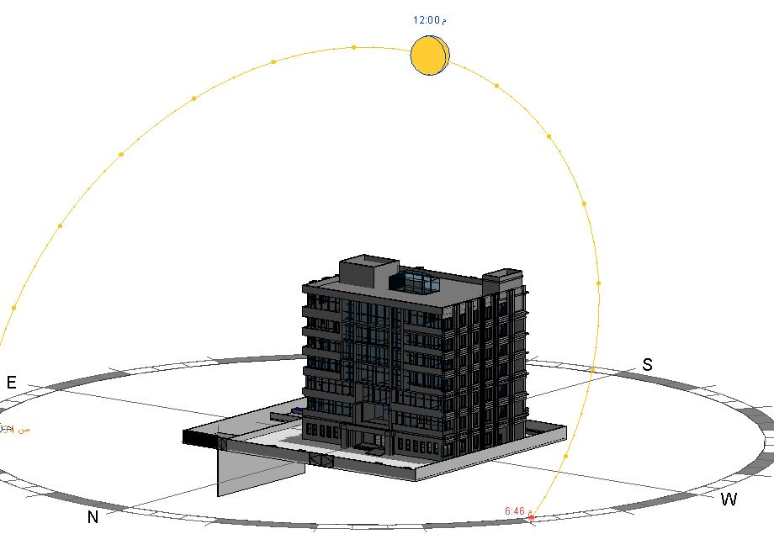
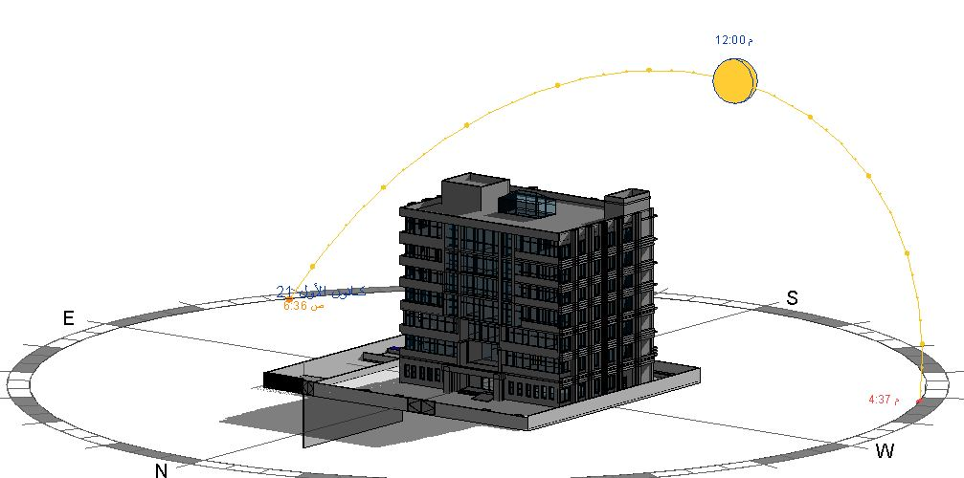
SITE ANALYSIS
Sun path diagram in summer
Sun path diagram in winter

Slide 6
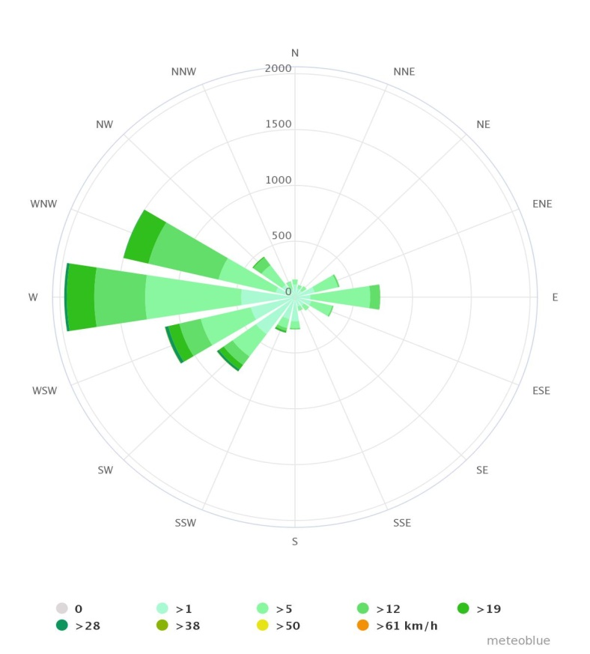
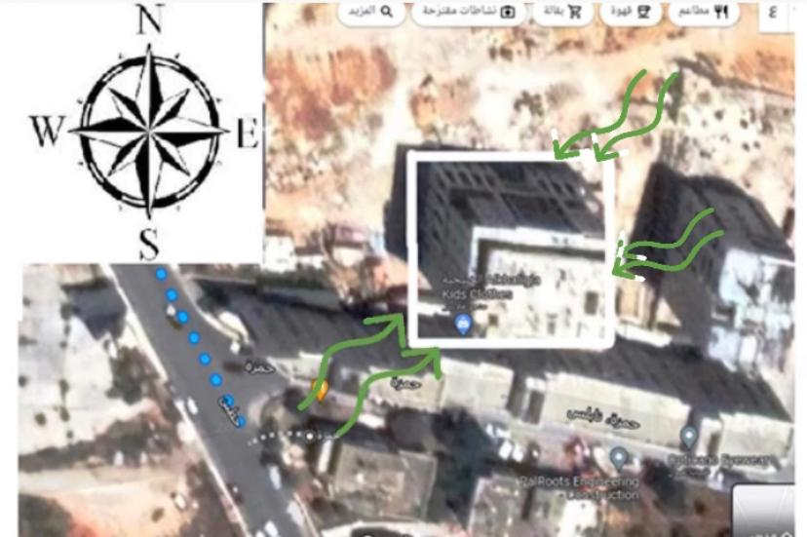
Wind analysis in Ramallah
Wind Rose
The main wind direction in Ramallah is southwest

Slide 7
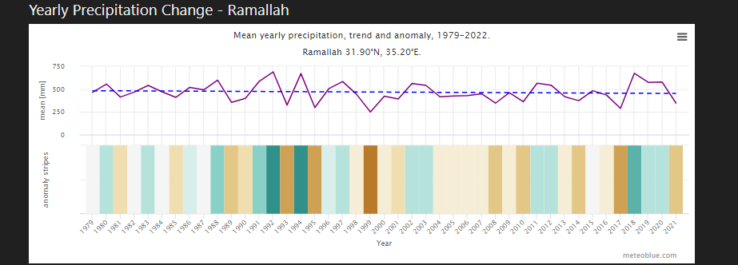
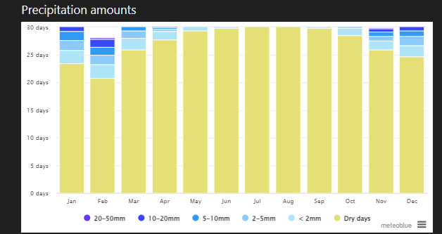
Precipitation amounts, amount of the rain
Amount of rain from 1980-2022
Amount of rain throughout the year

Slide 8
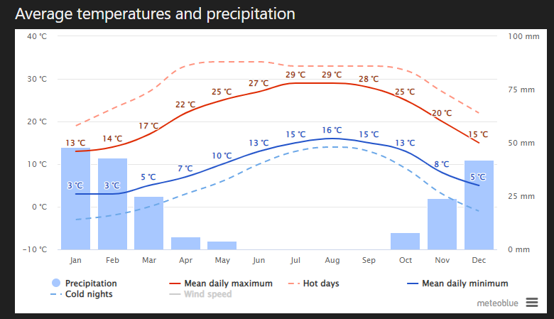
Temperature analysis
The average temperature along a year

Slide 9
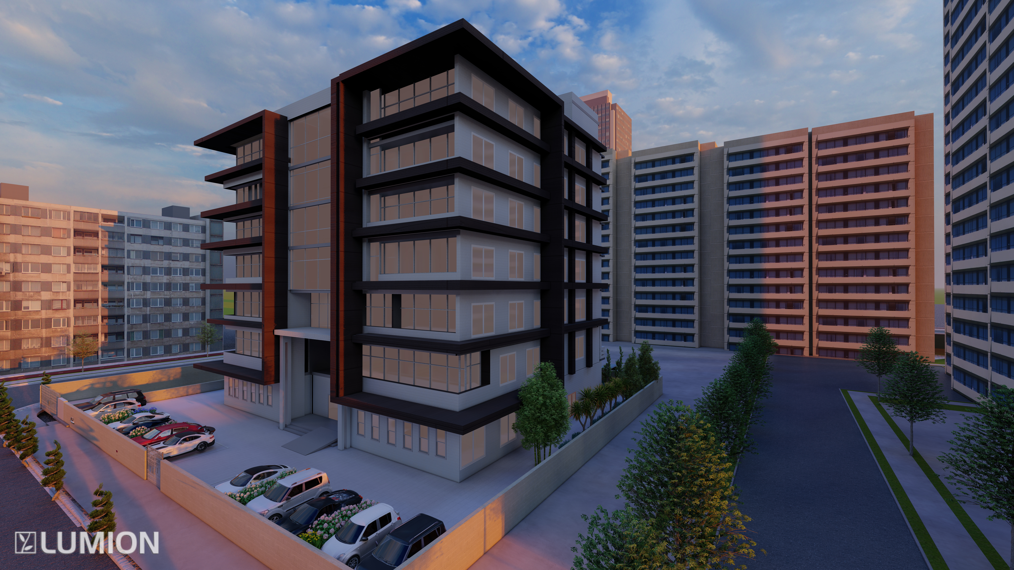
ARCHITECTURAL ASPECTS

Slide 10
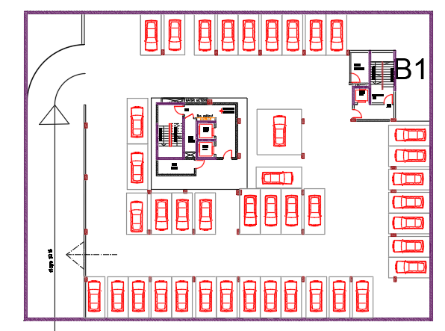
3rd Basement Floor
After

Slide 11
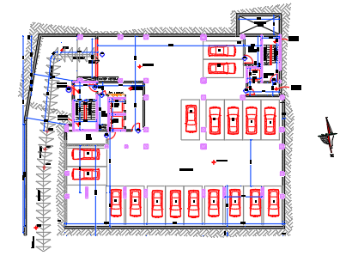
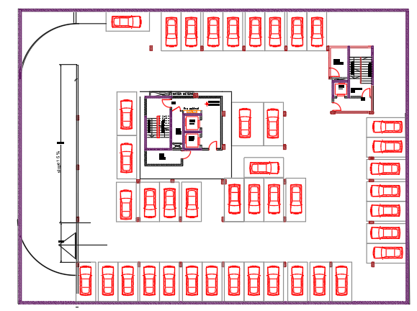
2nd Basement Floor
Before
After

Slide 12
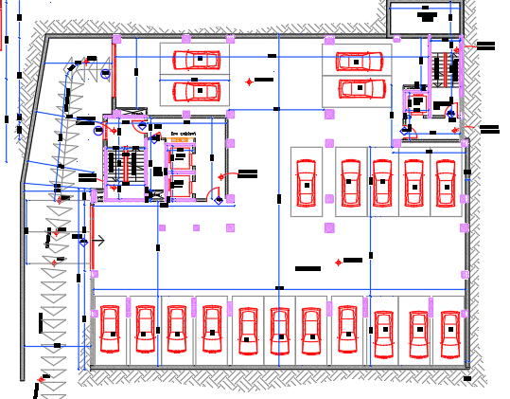
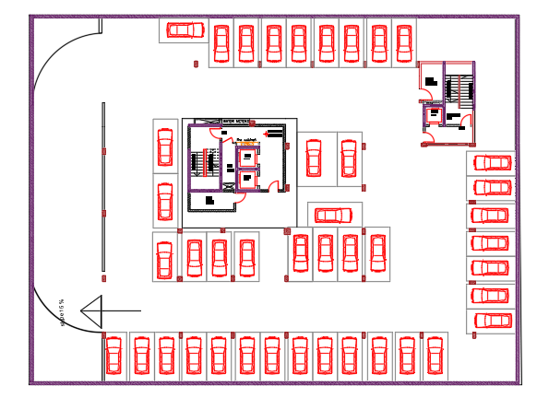
1st Basement Floor
Before
After

Slide 13
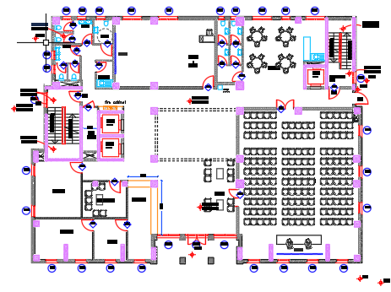
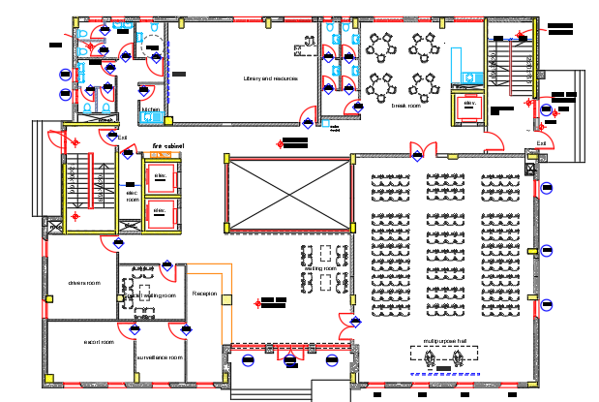
Ground Floor
Before
After

Slide 14
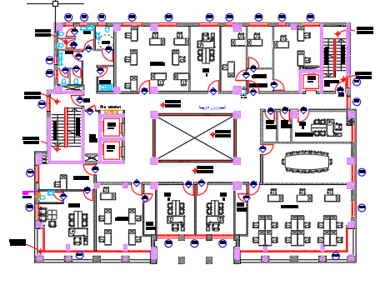
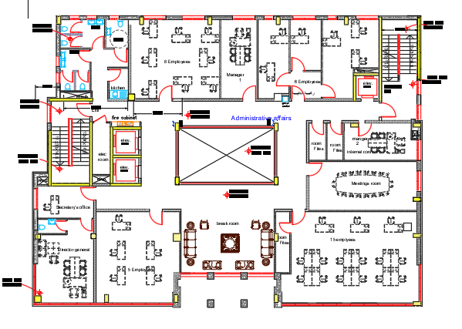
First Floor
Before
After

Slide 15
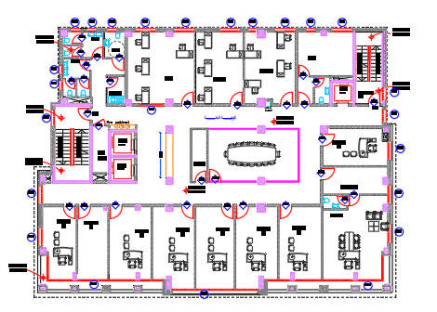
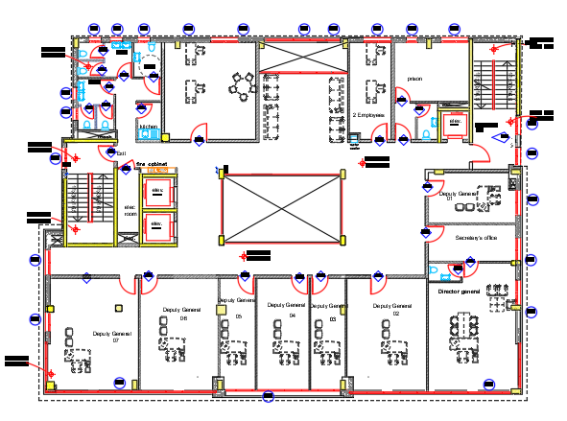
Second Floor
Before
After

Slide 16
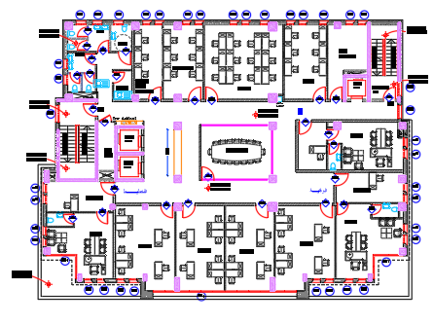
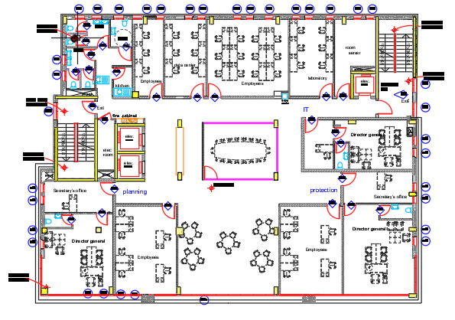
Third Floor
Before
After

Slide 17
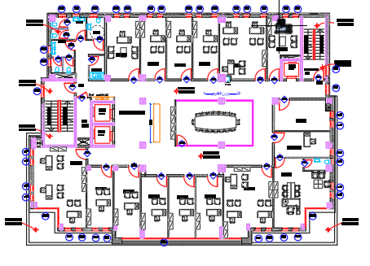
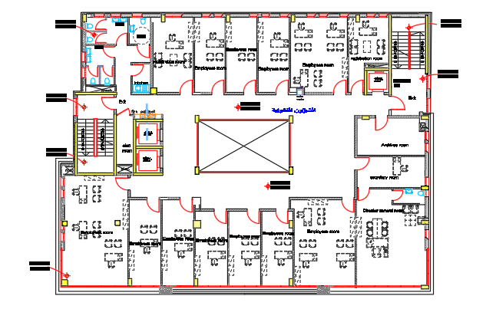
Fourth Floor
Before
After

Slide 18
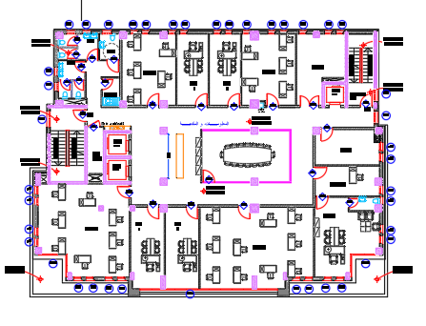
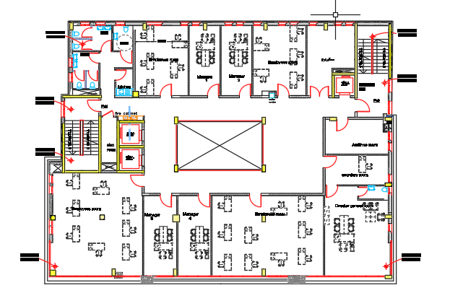
Fifth Floor
Before
After

Slide 19
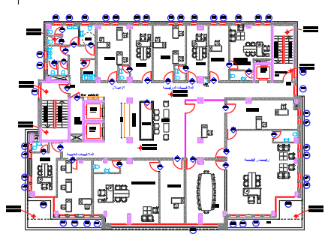
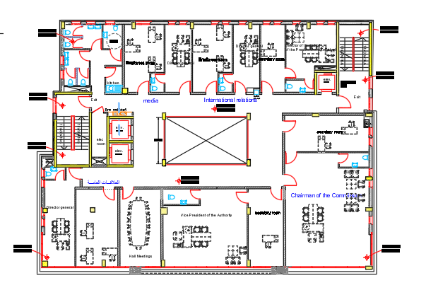
Sixth Floor
Before
After

Slide 20

ENVIRONMENTAL ASPECTS

Slide 21
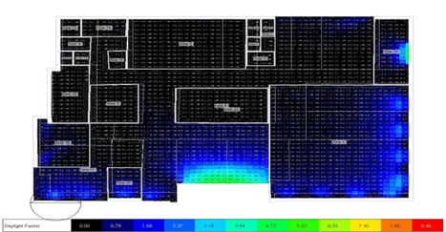
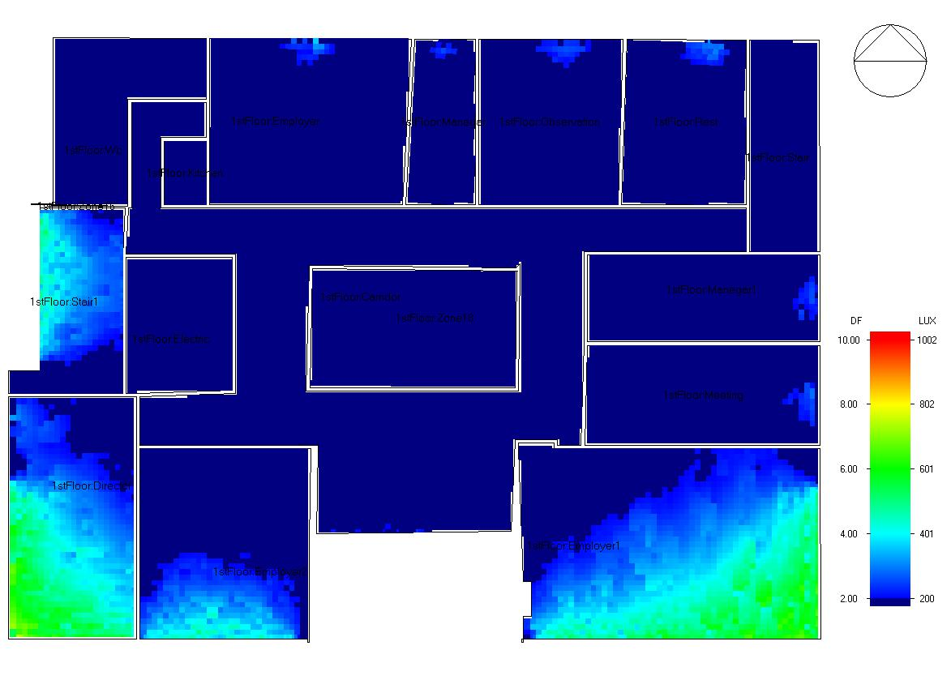
Daylight Factor Analysis
GROUND FLOOR
before
after

Slide 22
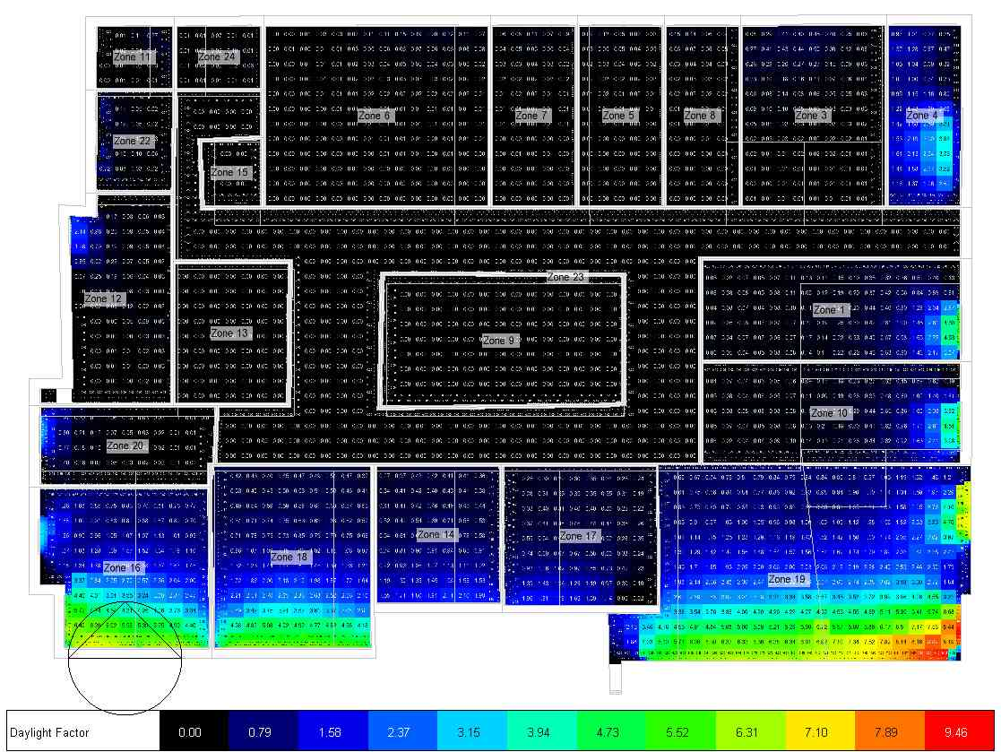
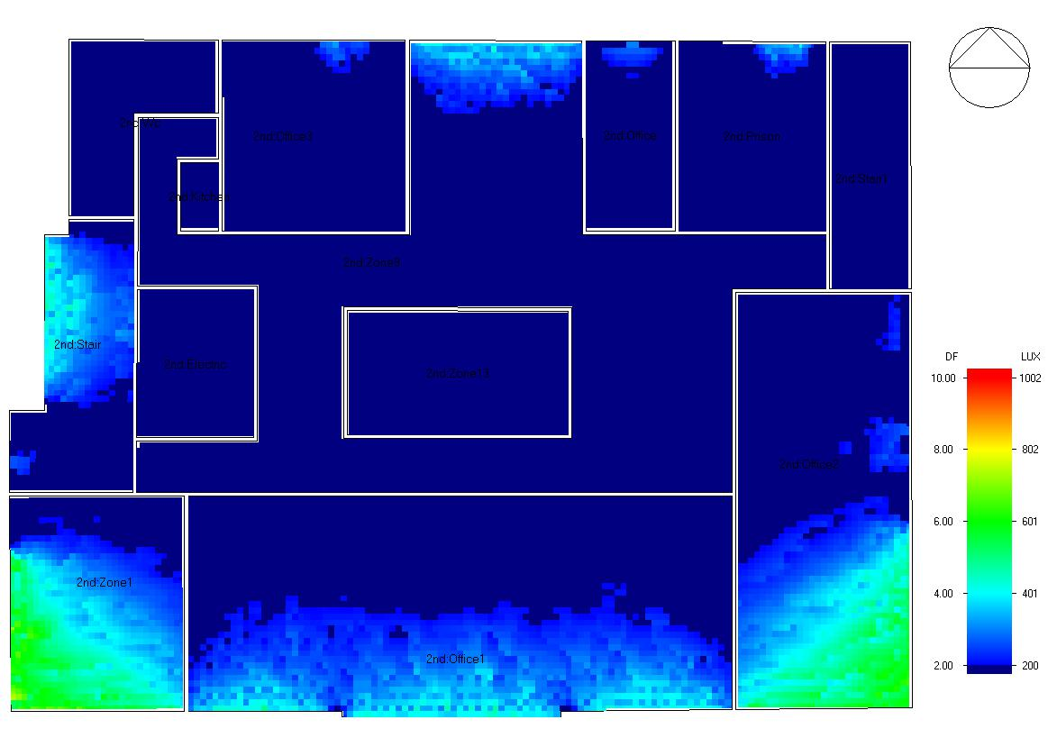
Daylight Factor Analysis
first FLOOR
before
after

Slide 23
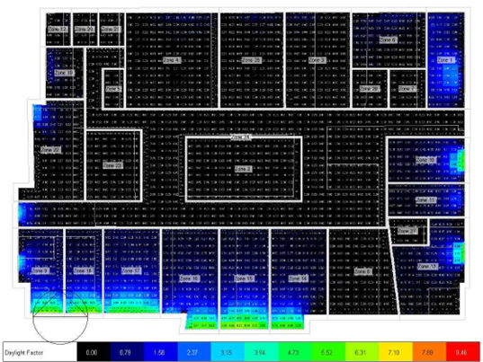

Daylight Factor Analysis
second FLOOR
before
after

Slide 24
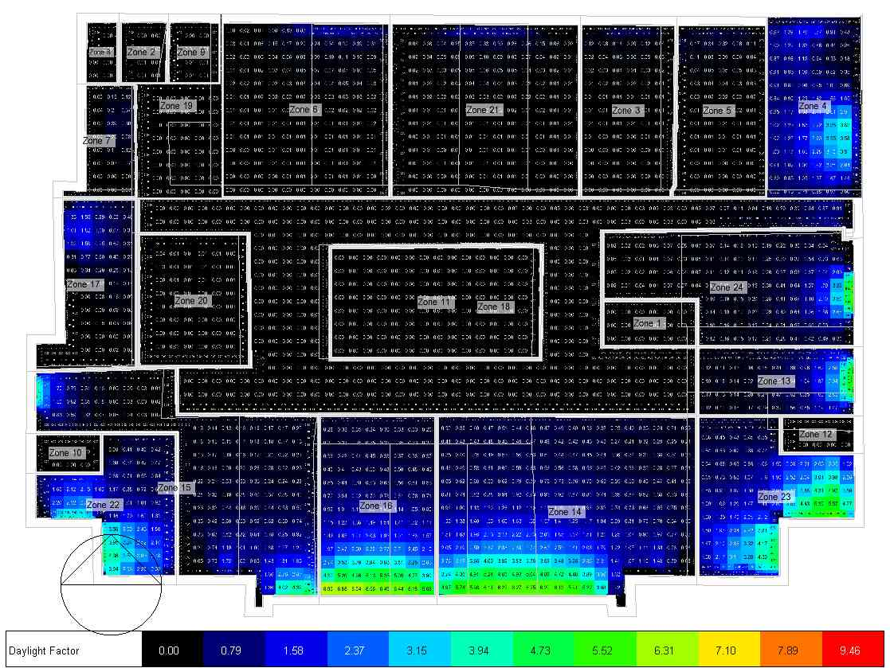
Daylight Factor Analysis
third FLOOR
before
after

Slide 25
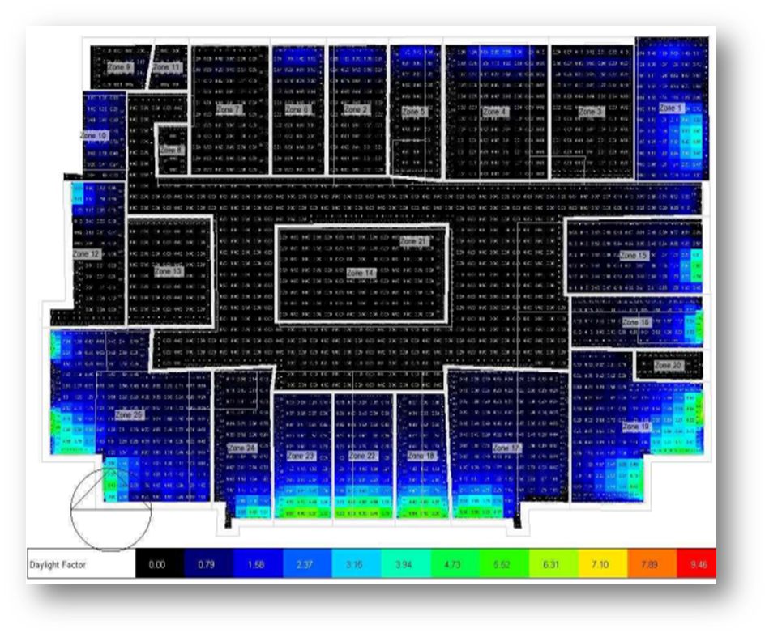
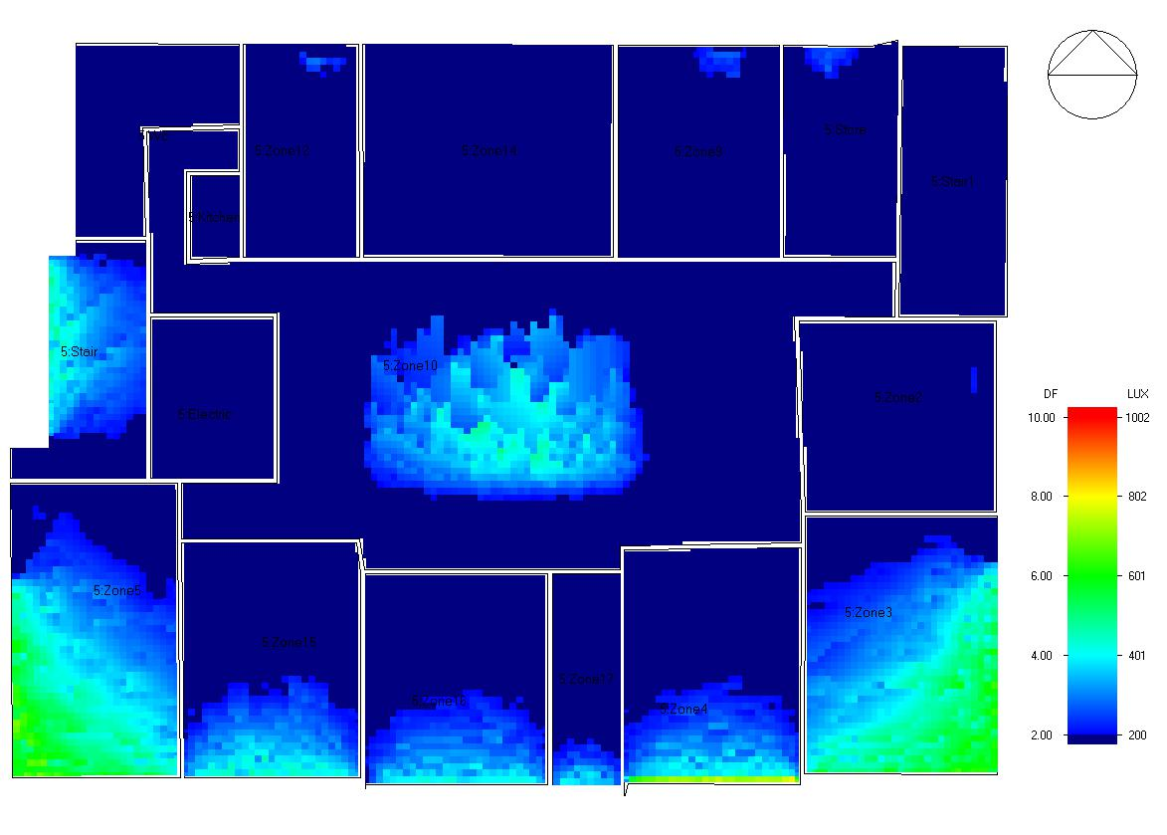
Daylight Factor Analysis
fourth FLOOR
before
after

Slide 26
Daylight Factor Analysis
fifth FLOOR
before
after

Slide 27
Daylight Factor Analysis
sixth FLOOR
before
after

Slide 28
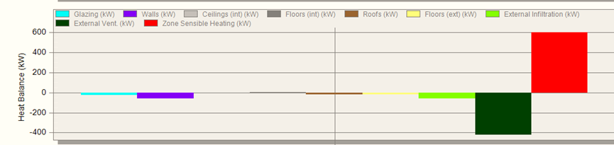
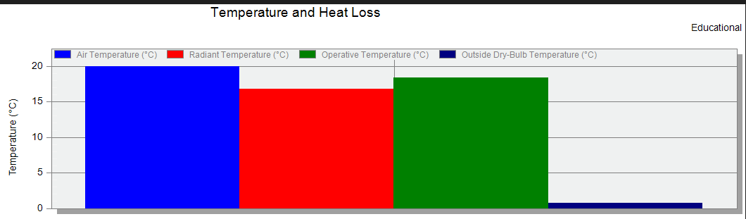
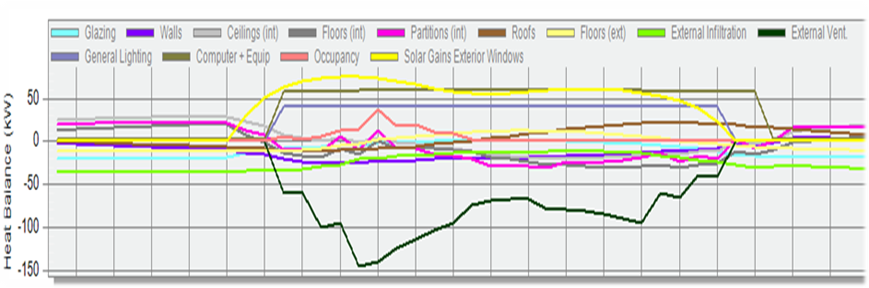
Heating and Cooling Loads
Before modifications
Temperature and heat loss
Heat gain case 1.

Slide 29
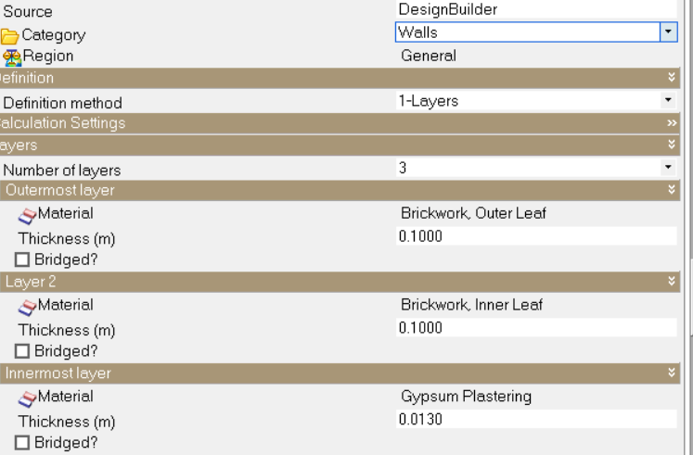

Heating and Cooling Loads
Before modifications
The wall without insulation layers:
.

Slide 30

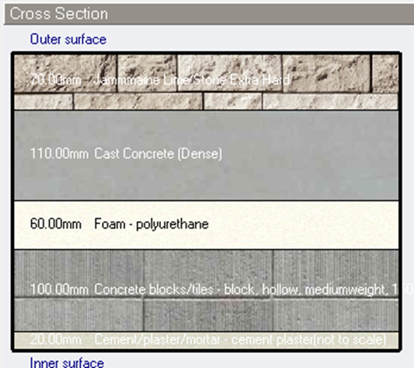
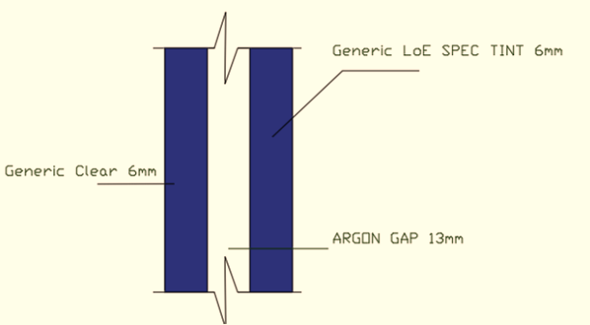


Heating and Cooling Loads
Thermal Modifications on Glazing area Thermal Modifications on exterior wall

Slide 31
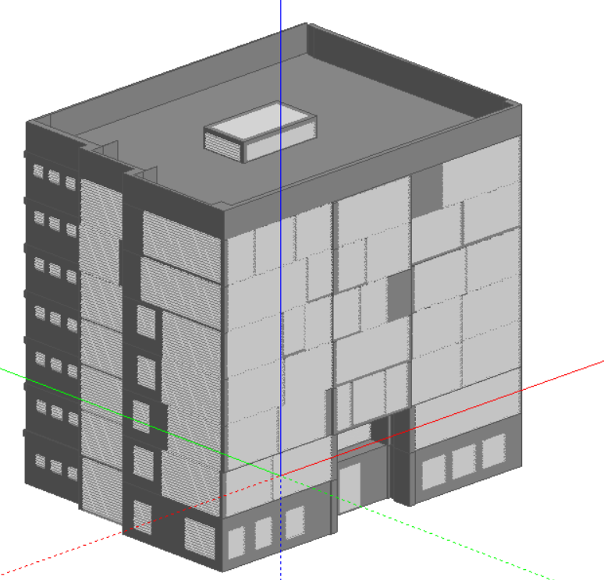

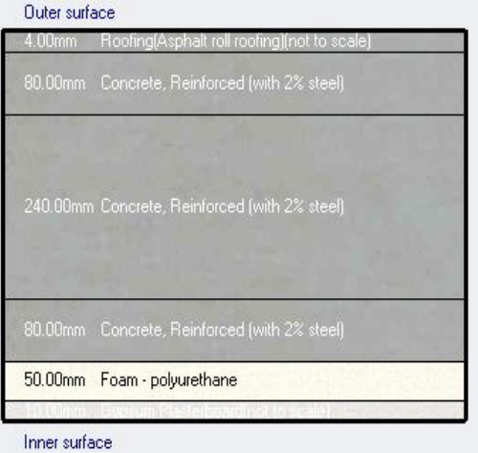

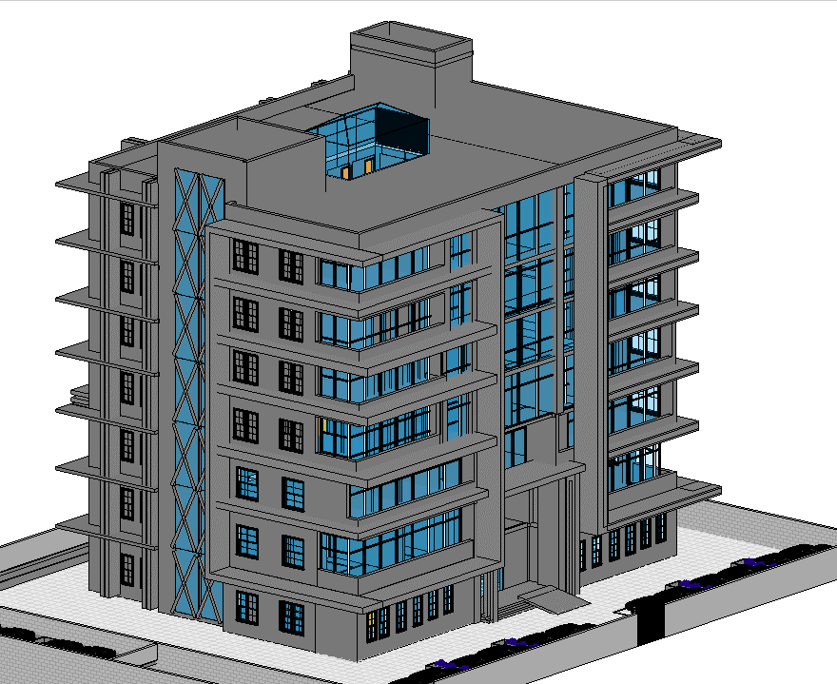
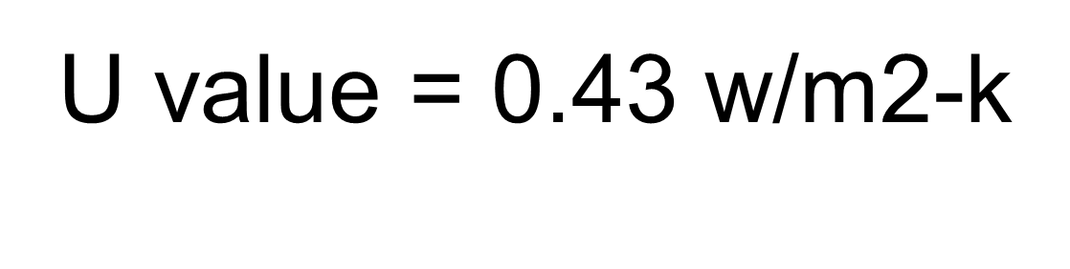
Heating and Cooling Loads

Slide 32
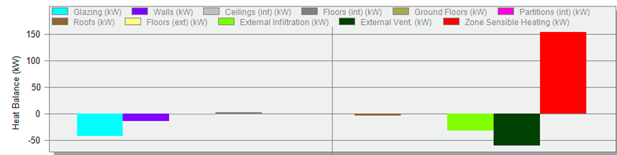
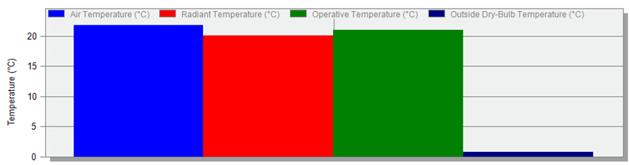

Heating and Cooling Loads
after modifications
Temperature and heat loss
Heat gain case 1.

Slide 33


Thermal Comfort
PMV Index graph:
PMV index value is between the allowable range
(-1 , 1 ) which indicates that the building is thermal comfort .

Slide 34



Site and Source energy
Total energy saving of 63.06%

Slide 35



Shadowing and Overshadowing Analysis
In Summer solstice (21/6):
At 8:00 AM
At 12:00 PM
At 2:00 PM

Slide 36



Shadowing and Overshadowing Analysis
In winter solstice (21/12):
At 8:00 AM
At 12:00 PM
At 2:00 PM

Slide 37

Structural
aspect

Slide 38
Designing data
material used:
Concert B350 for slabs ,beams and columns (fc`=28 MPA, ɣ=25 kN/m³)
Steel rebar E = 200 GPA , FC =420 MPA , unit weight (ɣ=78kN/m³]
project designing load:
- Live load is 2.4KN/m2, we use2.5 KN/m².
- Live load for car garages = 4 KN/m²,
- SID is assumed = 4 KN/m².
- Wall load = 20 KN/m-
- used cod :
- ACI 318-14
- seismic design UBC97
-ASCE for load design

Slide 39

Sesmic design
The building is located in Ramallah city witch mean the seismic zone is 2A and from the ,map above the seismic zone factor = .15

Slide 40
Sesmic design
-Soil profile type :
The soil under the building is very dense soil with bearing capacity =350 KN/m2 its mean that the soil
profile is SC .
Acceleration-Dependent Seismic Coefficient ( Ca) :
(at soil profile sc and z = .15 CA = .18
Velocity-Dependent Seismic Coefficient ( Cv) :
The seismic coefficient from table = .25 from table at z = .15 , and soil profile =Sc
Force Reduction Factor (R) :
The used structural system in the building is #2-3-a which is Building frame system with concrete shear walls. Seismic reduction factor R = 5.5 & Ω =2.8.
Important factor :
It usually serves to describe or demonstrate how significant a building is(i=1)

Slide 41

Structural detailing
Block dimensions | slab thickness | Structural system used
24*40 *20* | 30 cm | Two way ribbed slab
Section in slab
Typical story

Slide 42

Structural detailing
Slab plan for typical story :

Slide 43

Gravity checks
Compatibility
Check:

Slide 44
Equilibrium check
 | Error% | Etabs | Manual | LOOD
<5% OKK | 1.3 % | 75007 KN | 76360 KN | Dead
 | .3% | 24393KN | 24312KN | Live load
 | .2% | 30575 KN | 30572 KN. | Sid load

Slide 45
Stress – strain check
Column check
< 15 % OKK | Difference % | Etabs | Manual | Column
 | 8.8 % | 1358 KN | 1238KN | column1
 | 3.6 % | 4405 KN | 4564KN | column2
 | 3.6% | 5264 KN | 5073kn | column3
Slab check
< 15 % OKK | Difference % | Etabs | Manual
 | 11.3% | 345 KN . m | 384.23 KN .m | Middle strip
 | 9 % | 88 KN .m | 96 KN .m | Column strip
Beams check
< 15 % OKK | Difference% | Etabs | Manual
 | 14.4% | 692 KN.m | 592 KN.M | Beam1
 | 11.1% | 630KN.m | 560KN.m | Beam2

Slide 46
Deflection check
 | ETABS DEFLECTION | MAX DEFLEATION
OK | .03 | .03 | SERVICE LOAD
OK | .007 | .02 | LIVE LOOD

Slide 47
Sesmic checks
1 – period check :
Check result | Limitation | ETABS results
ok | .92 | 1.2 sec | TX
ok | .92 | 1.02 | Ty
2- model participation mass ratio :
Number of mode | limitation | Etabs result | Check name
45 mode | 90% > | 92 %
3- base shear check :
Check | Deference | Manual base shear | Base shear from etabs
okkk | .08 % | 5523.3 kn | 5523kn.

Slide 48
Sesmic checks
4- drift check
Check | Delta limit | Limit y | Limit x | story
Ok | 60 | 2.3485 | 2.6565 | Story 2
Ok | 76.7 | 7.7 | 11.165 | Story3
Ok | 72 | 9.625 | 16.555 | Story 4
Ok | 72 | 11.165 | 17.325 | Story 5
Ok | 72 | 10.395 | 16.94 | Story 6
Ok | 72 | 15.4 | 23.1 | Story 7
Ok | 72 | 15.4 | 19.25 | Story 8
Ok | 72 | 15.4 | 11.55 | Story 9

Slide 49
Sesmic checks
5- p-delta check
Check | Өy | Өx | Stiffness y kn/m | Stiffness x kn/m | story
ok | 0.002464 | 0.002171 | 26811881 | 30440546.7 | base2
ok | 0.008923 | 0.010634 | 6458279 | 5418980.14 | Base1
ok | 0.029205 | 0.019761 | 1378019 | 2036630.2 | ground
ok | 0.035673 | 0.04511 | 818679.4 | 645618.85 | 1
ok | 0.035286 | 0.044072 | 674721.7 | 538719.555 | 2
ok | 0.038827 | 0.044507 | 554847.6 | 482694.939 | 3
ok | 0.030105 | 0.029859 | 432317.1 | 434676.474 | 4
ok | 0.025817 | 0.021676 | 302444.5 | 359215.195 | 5
ok | 0.02104 | 0.016229 | 176296 | 227917.356 | 6

Slide 50

Structural detailing
Sheet pile

Slide 51

Structural detailing
Sheet piles detail :
Cross section in sheet pile

Slide 52


Structural detailing
Single footing detail :
Section in F1-C1

Slide 53


Structural detailing
Single footing detail :
Section in F2-C1

Slide 54

Structural detailing
Raft foundation detail :

Slide 55

Structural detailing
Wall footing detail

Slide 56

Structural detailing
Wall footing detail

Slide 57

Structural detailing
Section in slab
Typical story

Slide 58

Structural detailing
Slab plan reinforcement in x direction :

Slide 59

Structural detailing
Slab plan reinforcement in y direction :

Slide 60

Structural detailing
Column layout

Slide 61




Structural detailing
Column detail :

Slide 62




Structural detailing
Column detail
Cross section in column 1
Cross section in column 2

Slide 63


Structural detailing
Column detail
Cross section in column 4

Slide 64

Structural detailing
Shear wall lay out :

Slide 65



Structural detailing
Shear wall detail :
Cross section in shear wall 11
Cross section in shear wall 12
Cross section in elevator shear wall

Slide 66

Structural detailing
Basement wall detail :

Slide 67

Structural detailing
Beams lay out

Slide 68


Structural detailing
Beams detail :
Depth | Width | Beam
300 mm | 900 mm | Main beam
300m | 1000mm | Main beam 2
500 mm | 700 mm | Drop beam
Cross section in beam 3
Cross section in beam 2

Slide 69


Structural detailing
Beams detail :
Cross section in beam 4

Slide 70


Structural detailing
Beams detail :
Section in beam 1

Slide 71

Structural detailing
Beams detail

Slide 72

Structural detailing
Beams detail

Slide 73

Structural detailing
Water tank detail

Slide 74

Structural detailing
Water tank detail

Slide 75

Structural detailing

Slide 76


Structural detailing
Cross section in ground beam

Slide 77



Structural detailing
Stairs detail :

Slide 78


Structural detailing
Ramp detail :

Slide 79
Electro-Mechanical ASPECTS

Slide 80
Artificial lighting design
Fire Fighting System
HVAC Design
Electro-Mechanical ASPECTS
Water supply system
Acoustical
Design
Photovoltaic design

Slide 81

Artificial lighting design
Types of Artificial lighting:
General
Accent
Task
Decorative

Slide 82

The reflection factors used
Ceiling: 75
Floor: 60
Wall: 30

Slide 83
3D lighting Modeling for the the offices.
The Glare check
lux level on Employees Office
3D lighting Modeling

Slide 84


3D lighting Modeling for the Reception + waiting room
.

Slide 85

3D lighting Modeling for Multipurpose room

Slide 86






lux value in multipurpose room

Slide 87
Glare Rating (UGR)

Slide 88
Glare Rating (UGR)

Slide 89
Glare Rating (UGR)

Slide 90
Glare Rating (UGR)

Slide 91
3D lighting Modeling for Meeting room
Glare check
3D lighting Modeling for Meeting room
lux level on Meeting Room

Slide 92




Glare check:

Slide 93
Glare check:

Slide 94
Glare check:

Slide 95
Glare check:

Slide 96

3D lighting Modeling for Kitchen & Cafeteria

Slide 97

3D lighting Modeling for Garage

Slide 98


HVAC Design

Slide 99
HVAC Design
Heating and Cooling Loads:

Slide 100

HVAC Design:
Outdoor Unit:
The used HVAC system is VRF
indoor Unit:
Split Unit for the Offices, and caste unit for commercial spaces.

Slide 101


HVAC Design:
HVAC Design:
indoor Units Used:
[FXSQ40], a 4.5-kW unit
(FXAQ50P, FXAQ32P), a 5.6-kW, 3.6-kW

Slide 102

Sample of the distribution of fan coils and diffusers in the Ceiling
HVAC Design:

Slide 103

3D HVAC system by Revit program

Slide 104


Acoustical
Design

Slide 105
Acoustical consideration
Private Offices
Conference room
RT₆₀ | SPL (dB) | NR (dB) | Noise level (dBA)
0.6- 1.0 | 40-45 | 35 | 30-40
RT₆₀ | SPL (dB) | NR (dB) | Noise level (dBA)
0.8 - 1.2 | 25-30 | 30 | 30- 40
Open Offices
Courts
RT₆₀ | SPL (dB) | NR (dB) | Noise level (dBA)
0.8 - 1.3 | 45 | 40 | 40
RT₆₀ | SPL (dB) | NR (dB) | Noise level (dBA)
0.6 - 1.3 | 40 | 40 | 40

Slide 106



Multipurpose room - lobby
Acoustical Design
Meeting room - Private office

Slide 107



Acoustical Design
Office – toilet:
Office – loopy
office & outside:

Slide 108

Fire Fighting System

Slide 109

Fire Fighting System

Slide 110

Fire Fighting System

Slide 111
Fire Prevention
Fire Prevention
Smoke detector
Call point
Exit sign
Alarm bell
Heat detector

Slide 112


Fire Fighting System

Slide 113

In our building we use

Slide 114

Photovoltaic design

Slide 115


Photovoltaic design:
Module selection:
The mechanical specification data of the used photovoltaics module

Slide 116


Photovoltaic design:
inverter selection:

Slide 117

Drainage system

Slide 118




Using pipes

Slide 119


Sample design

Slide 120

Drainage in building

Slide 121

Water supply system

Slide 122


Used pipes in water supply system

Slide 123


Sample design

Slide 124

Drainage of rain water on the roof

Slide 125
QUANTITY SURVEYING and COST ESTIMATE

Slide 126
QUANTITY SURVEYING and COST ESTIMATE
The Bottom-up estimating method was adopted for the cost estimate of the project.
The unit cost of the project | The total cost of the project
1300 NIS / m2 | 11,127,123 NIS

Slide 127
THANKS!

