Slide 1

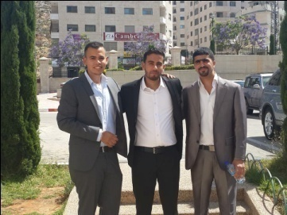
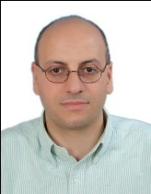
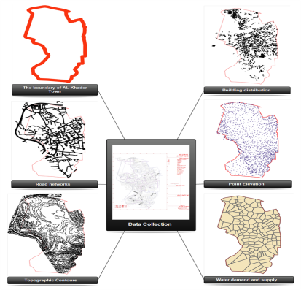
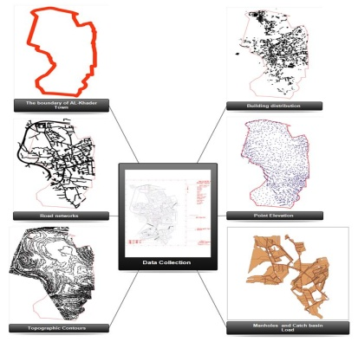
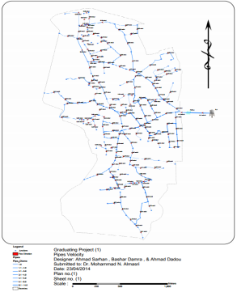
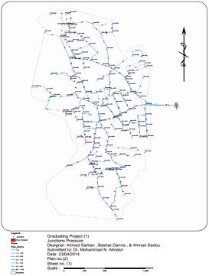
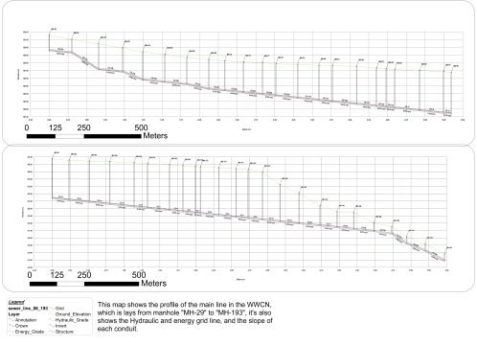
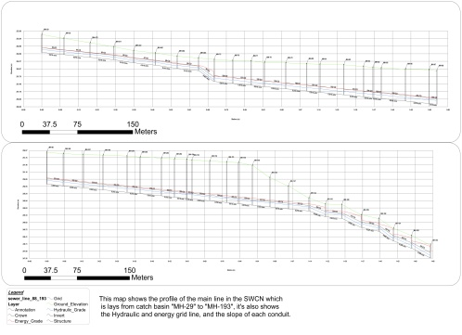
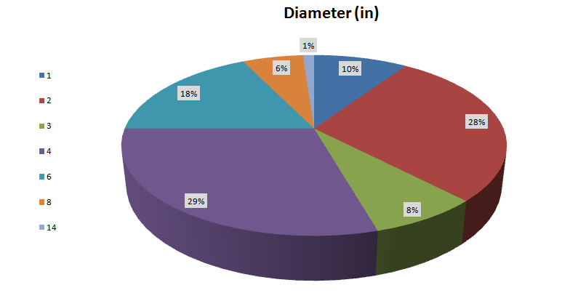
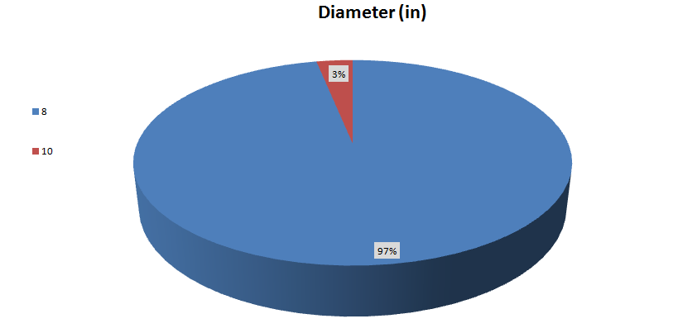
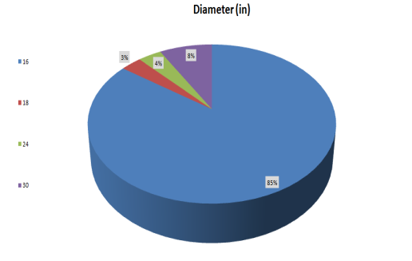
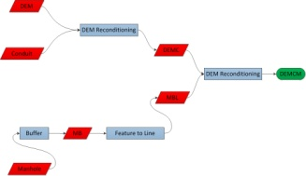
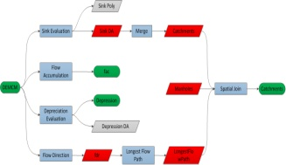
Design of Water distribution, Waste, And Storm Water
Collection Networks for Al Khader Town.
Done By:
1-Eng. Bashar Y. Damra (e-mail: bashardamra@gmail.com. Mobile: 0599589920).
2-Eng. Ahmad A. Sarhan (e-mail: ahmad.m.sarhan@gmail.com. Mobile 0595108850).
3-Eng. Ahmand I. Dadou (e-mail: a7mad-3abd@hotmail.com. Mobile: 0597320080).
Supervisor :
Dr. Mohammad N. Almasri.
Stormwater Collection Network | Wastewater Collection Network | Water Distribution Network
We only use the master plain of Al-Khader to export the whole needed data. | We only use the master plain of Al-Khader to export the whole needed data. | We only use the master plain of Al-Khader to export the whole needed data. | Input
Profile shows cover depth in (m) and slope in (m/m) from MH-29 to MH-193. | Profile shows cover depth in (m) and slope in (m/m) from MH-29 to MH-193. | Profile shows velocity (m/s) presser in (m H2O) for the whole network. | Output
Most of stormwater collection network conduits diameters are 16 inch. | Most wastewater collection network conduits diameters are 8 inch. | The majority percentages of water pipes are 2 and 4 inch, and the rest percentages of pipes diameters as shown. | Conclusion
ArcHydro:-
Arc Hydro is a geospatial and temporal data model for water resources designed to operate within ArcGIS (Maidment,2003). A data model is distinct from a simulation model in that a data model provides a standardized framework for storing information, but contains no routines to simulate hydrologic processes.
It's consisting of three main assumptions which are:
1-Roads as an open channel segments.
2-Manholes as sink points.
3-The needed catchments are the sink drainage area.
The use of ArcHydro give us a lot of advantages such as saving time and raising accuracy. The figures at the right side shows the
workflow to find the loads, for more comprehensive details go to "How to find the Sewer & Storm Loads" tutorial.
Recommendation :-
1-Site investigation must be done in order to the nature of the study area.
2-We recommend to civil engineering department to but the Arc Hydro tools in GIS course plan, because it saves a lot of time, give more accurate results, and the design process will be easier.
3-If possible treatment plant is considered as a feasible project.
4-Suitable space between water pipes and wastewater pipes must be achieved (water pipes must be above wastewater pipes).
5-A periodic maintenance should be done and the damaged parts should be replaced.

