Slide 1
Graduation Project Master Planning for Qalqilya City
By
Aseel Husien - 11611111
Karmel Hamayel - 11610577
Monya Nofal - 11642670
Under supervision of: Dr. Anan Jayyousi

Slide 2
Outline of the project
Introduction
Methodology of the project
Data Collection
Conclusion

Slide 3
Objectives
The Main Objective of the project is to develop a master plan for the water supply network for Qalqilya Municipality (QM). And there are sub-objectives such as:
1. Study the existing water supply network, and find the present problems.
2. Write down any suggested plans and develop the best options as solutions.
3. Check the validity of the existing water resources for the coming 20 years.
4. If there is a gap between demand and supply in the future; find alternatives.
5. Achieve financial sustainability concepts and promote private sector participation in the management and distribution of water.
6. Achieve a balance between quantity and quality of available water and the needs of Qalqilya city in the present and the future.

Slide 4
Study Area
Qalqilya city is located in the northwestern part of the West Bank. It has an average elevation of 57 meters above the mean sea level. The average annual rainfall is about 625 millimeters and the average annual temperature is 19 degrees Celsius. The city is located within the western aquifer basin. In the official 2017 census the city had a population of 51,235 and the estimated population for the year 2020 is 54,737. The measured area of the city is 25.6 km².

Slide 5
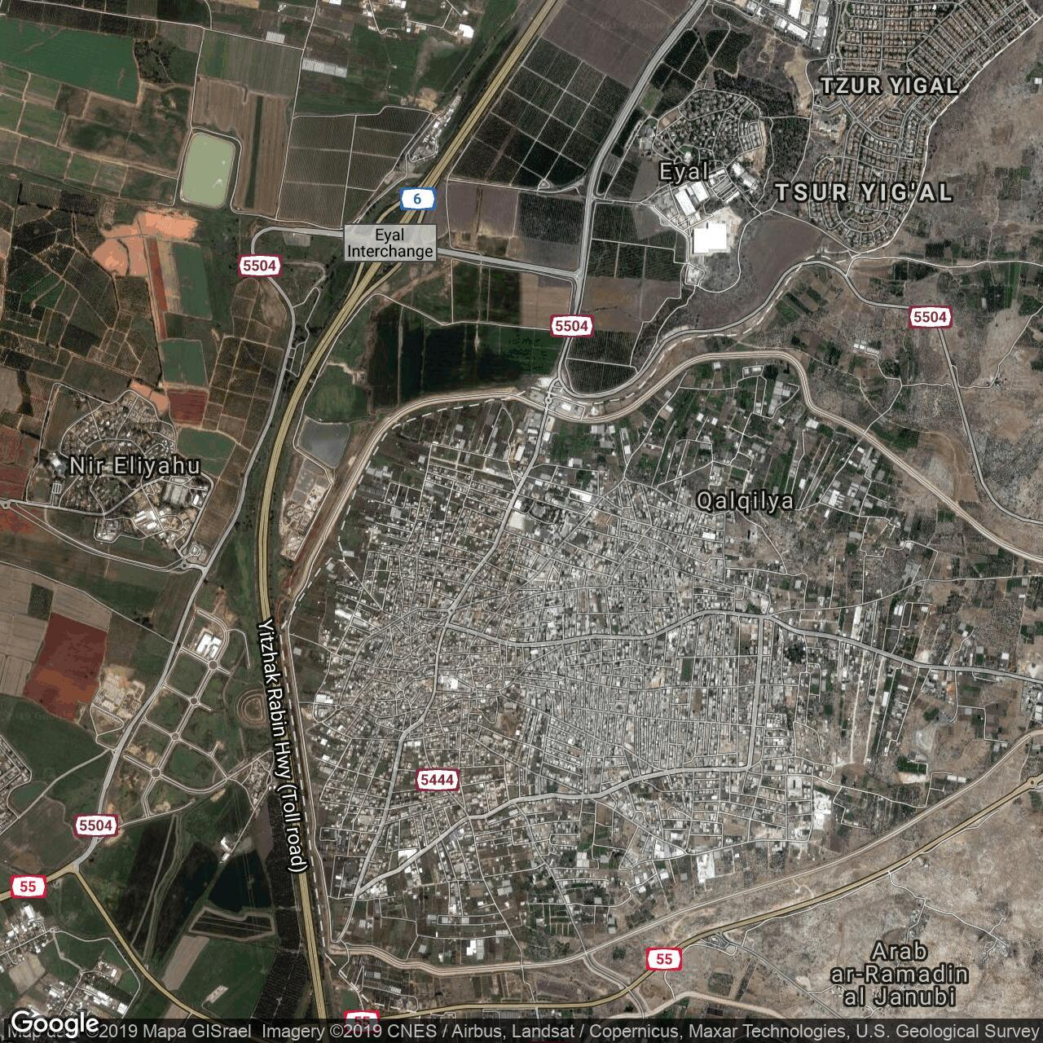
Aerial Photograph for Qalqilya City

Slide 6
Introduction
What is Master Plan?
In general the master plan is a dynamic long-term planning document that provides a conceptual layout to guide future growth and development.
Water Master Plan is a framework needed in order to coordinate water activities and to safeguard that the resources are also available for future generations like drinking water, pastoral needs, industries, agriculture or others.

Slide 7
How does the Master Plan work?
Assess the present availability, withdrawals, uses of the water resources and losses.
Formulate alternative development scenarios for water resources and demand/use at various planning horizons.
Perform the balancing of resources versus demands for the recent past as well as for the alternative development options.
Identify technical and operational options in order to bridge the gap between resources and demands.

Slide 8
Methodology
To develop a master plan for the water supply network for Qalqilya municipality, the following are the main steps:
Review the existing water network.
Estimate future water demand.
Propose needed interventions.
Develop a master plan for the city.
Cost estimation.

Slide 9
Qalqilya Zones
Qalqilya water distribution system is divided into four water distribution and service zones (Al Muntazah, Al Shuhada, Al Wakalah, and Khallat Nofal) that are supplied by gravity. One service zone (part of Khallat Nofal) is supplied by pumping. Each of the service zones is supplied by water via its individual distribution network and by gravity from the designated service and storage reservoir.

Slide 10
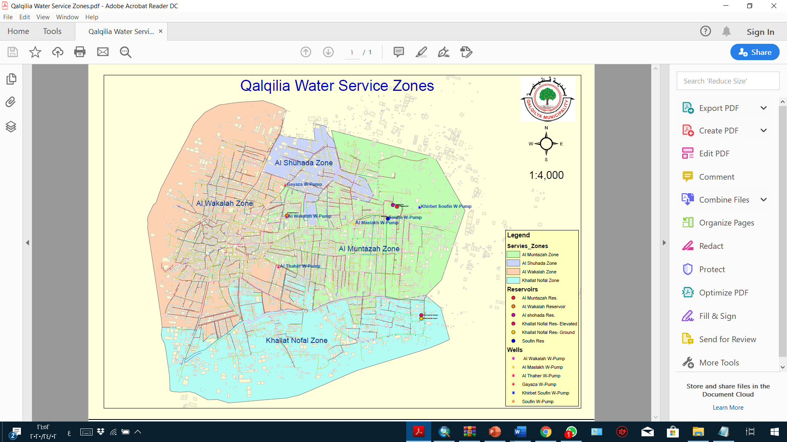

Slide 11
Data Collection: Water Services
Qalqilya City, with about 11,000 house connections depends on 4 groundwater wells managed by the Municipality.
The maximum capacity of these wells equals 900 m³/hr, extracted from the Surface aquifer on the Western Basin.
The present demand of clean water exceeds 4.39 Mm³/yr = 501 m³ /hr, i.e 170 lcd through a storage capacity of 5500 m³ .
The working wells are:
1. Gayyaza.
2. Wakala.
3. Maslakh.
4. Soufin.

Slide 12
Qalqilya Four Wells
Name | Gayyaza | Wakala | Maslakh | Soufin
Age | 1964 | 1964 | 2002 | 1979
Level (m asl) | + 70 | + 88 | +102 | + 123
Depth (m) | 124 | 120 | 126 | 172
Water Static Depth (m) | 59 | 77 | 91 | 112
Dynamic Depth (m) | 78 | 78 | 91 | 115
Well Diameter (") | 20 | 20 | 12 | 14
Discharge Capacity (m³/hr) | 78 | 317 | 217 | 288
Chlorination (mg/lit) | 0.5 | 0.5 | 0.5 | 0.5
Total Supply m³/hr |  | 900
Total Storage m³ |  | 5500

Slide 13
Reservoirs of Qalqilya City:
Reservoir | Capacity (m³) | Elevation (m asl) | Shape | Type | Condition
Al Shuhada | 2000 | +125 | Circular | Ground | very good
Al Muntazah | 500 | +125 | Cubic | Elevated | very good
Al Wakalah | 500 | +88 | Cubic | Elevated | very good
Khallat Nofal | 2000 | +113 | Circular | Ground | very good
Soufin | 300 | +124 | Cubic | Elevated | Poor (out of order)
Khallat Nofal (Elevated) | 2000 | +113 | Cubic | Elevated | Excellent

Slide 14
Pumping Stations:
There are six pumping stations in the Qalqilya city, operating at a rate of 12 hrs/day/year (16 hours in the summer and 8 hours in the winter). These pumps are used to pump water from the well to the reservoir. These pumps work when the water level in the reservoir drops to a certain point using sensors. In addition to pump station used to raise the water energy and deliver it to areas with a higher height than the reservoirs in Khallat Nofal zone. Maintenance is done on pumps every 20,000 working hours.

Slide 15
خزان المتنزه
(500m³, 125masl)
خزان الخلة الجديد
(500m³, 125masl)
خزان صوفين القديم
(300m³, 125masl)
خزان الشهداء
(2000m³, 125masl)
خزان الخلة
(2000m³, 113masl)
بئر صوفين (288م³/س)
خزان الوكالة
(500m³, 88masl)
بئر المسلخ (217م³/س)
(
Forced
بئر غياظة (78م³/س)
بئر الوكالة (318م³/س)
المستهلكين
المستهلكين
المستهلكين
المستهلكين
Transmission mains of Qalqilya city water
المستهلكين

Slide 16
Water Network
The first parts of the water network in Qalqilya were constructed almost 60 years ago. Regular expansion of the network occurred parallel to the population increase. The present total length of Qalqilya water network is about 137.6 km including the transmission pipes (in average 2.76 m/capita). The pipes material is steel and galvanized steel with diameters ranging between 12.5 to 300 mm. The smaller diameters and service lines that connect the households to the network are not listed. The water network mapping for the four service zones is presented in the base map.

Slide 17
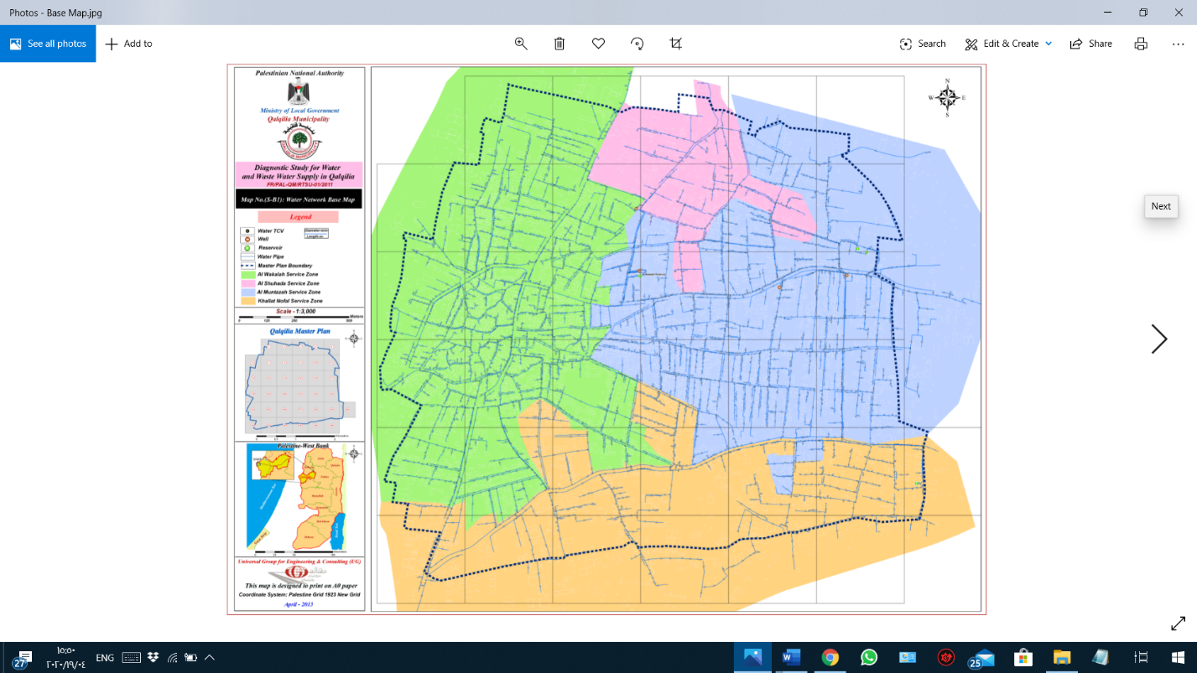
Qalqilya City Base Map

Slide 18
*Water Consumption:
According to the statistics for Qalqilya city , the municipality needs to afford at least 170 l/c/d taking in consideration losses and increasing of population each year.
Un – Accounted For Water (UFW):
In the year 2017,
the pumped water was 4.45 Mm³
the sold water was 3.29 Mm³
the un–accounted-for water was 26.17%
There have been very few cases of illegal connections, while most of the unaccounted for water goes through leakage due to the old aged pipes.

Slide 19
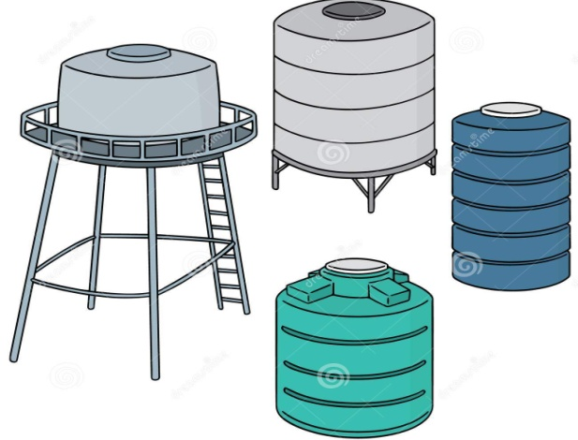
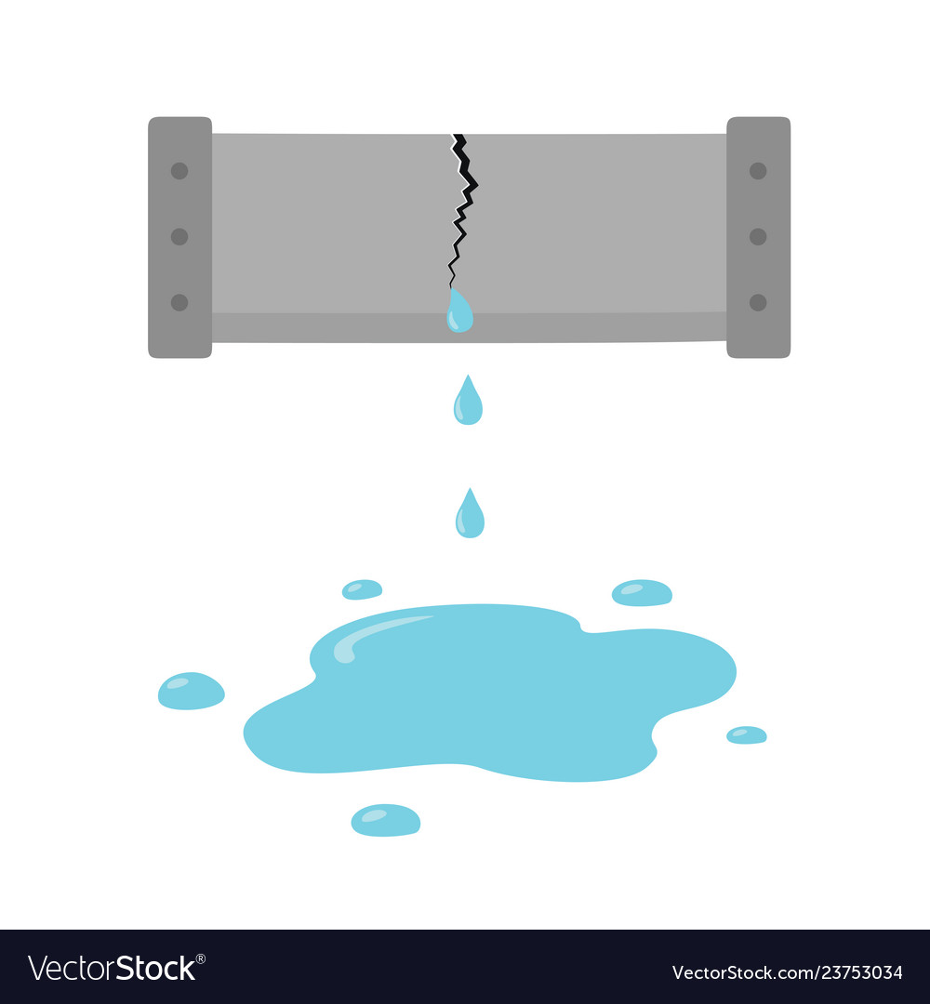
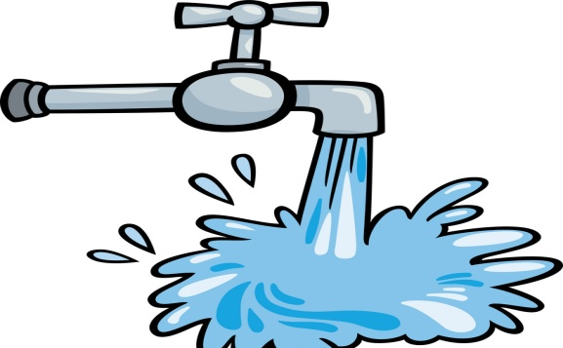
Supply (100%)
= 900 m³/hr
-LEAKAGE (PHYSICAL)
-METER LOSSES
-BLACK LOSSES
UFW = 26.17%
235.53 m³/hr
CONSUMPTION = 73.83%
664.47 m³/hr

Slide 20
Future Population:
Population increase is the fundamental parameter affecting future water needs. This parameter determines not only domestic demand, but also agricultural, commercial and industrial demands to support the economic development of the population. The assessment is carried out using the PCBS 2017 results that accounts for a 2.3% population growth rate for Qalqilya City. This population growth rate is taken for the whole planning horizon, the projected population for Qalqilya City for the next twenty years is shown as in the table.
Year | Population (Growth Rate = 2.3%)
2017 | 51239
2022 | 57412
2027 | 64323
2032 | 72068
2037 | 80746

Slide 21
Population in Qalqilya Zones (2017):
Al Shuhada | Al Muntazah | Khallat Nofal | Al Wakalah | Name
376 | 1361 | 933 | 1534 | Area
3573 | 17789 | 933 | 21702 | Total population (2017)

Slide 22
The Future Population in The Four Zones
Using the PCBS 2017 results that accounts for a 2.3% population growth rate for Qalqilya City. The following table shows the future population in the four zones:
Name | Area (du) | Total population (2017) | Total population (2022) | Total population (2027) | Total population (2032) | Total population (2037)
Al Wakalah | 1534 | 21702 | 24316 | 27243 | 30524 | 34199
Khallat Nofal | 933 | 8175 | 9160 | 10263 | 11498 | 12883
Al Muntazah | 1361 | 17789 | 19932 | 22331 | 25020 | 28033
Al Shuhada | 376 | 3573 | 4004 | 4486 | 5026 | 5631
Total | 4204 | 51239 | 57412 | 64323 | 72068 | 80746

Slide 23
Water Use
Municipal water demand comprises the demand for all domestic uses, general municipal use, public buildings, institutions such as schools, hospitals, business and commercial properties, within the urban area. In the case of Qalqilya, agricultural activities took place within the urban area at present. The plan assumes this situation in the future but with no further additional supply to these activities. This means that, their present supply level will continue, which is already included in the per capita present water consumption.
Consumption Category | Domestic | Commercial | Industrial | Agricultural | Associations | Institutions | Total
No. of subscription | 6458 | 531 | 35 | 509 | 51 | 96 | 7680
% of subscription | 84.1 | 6.9 | 0.5 | 6.6 | 0.7 | 1.3 | 100
Average monthly consumption (m³) | 210858 | 11097 | 3142 | 8359 | 1660 | 11873 | 246991
% of consumption | 85.4 | 4.5 | 1.3 | 3.4 | 0.7 | 4.8 | 100

Slide 24
Water Consumption Rates
The total annual extracted water from the four wells has increased from about 4 MCM in the year 2011 to 4.45 MCM in the year 2017 as shown in the figure. This represents an increase of about 0.45 MCM in 6 years which can be partially explained by the population growth and the increase in per capita water consumption. Dividing the 4.45 MCM by the population in 2017, gives a daily per capita water supply at about 230 liters.

Slide 25
Future Consumption Rates
The present Municipal per capita water consumption in Qalqilya is about 175 l/c/day while the demand rate, consumption including Un-accounted-For-Water, is about 220 l/c/day. These values are higher than the proposed consumption rates by PWA of 120 l/c/day but matches the average WHO standards of 150 l/c/day for domestic uses if it is considered that some 15% of the 175 l/c/day goes to the other components of the Municipal supply such as general municipal use, public buildings, institutions business and commercial properties, within the urban area. This high consumption rate compared with other areas in the West Bank is explained by two factors; the fact that water prices in Qalqilya is low and the fact that water is available to meet such demands unlike other areas in the West Bank where demand is suppressed due to restricted supply.
Based on this, it is assumed that consumption rates will stay the same for the whole planning period although there is a chance to reduce them if a proper tariff system is applied. The following table shows the total future consumption in each zone.

Slide 26

Future Consumption = Future Population $×$ Consumption (l/c/d)
Name | Area (du) | Total consumption (2017) )m³/h) | Total consumption (2022) )m³/h) | Total consumption (2027) )m³/h) | Total consumption (2032) )m³/h) | Total consumption (2037) )m³/h)
Al Wakalah | 1534 | 154.68 | 177.30 | 198.65 | 222.57 | 249.37
Khallat Nofal | 933 | 59.61 | 66.79 | 74.83 | 83.84 | 93.94
Al Muntazah | 1361 | 129.71 | 145.34 | 162.83 | 182.44 | 204.41
Al Shuhada | 376 | 26.05 | 29.20 | 32.71 | 36.65 | 41.06

Slide 27

Gap Estimate
Supply needed for the future = $\frac{consumption }{1−Physical Losses }$ ; physical losses =15%
Name | Area (du) | Total supply (2017) m³/h | Total supply (2022) m³/h | Total supply (2027) m³/h | Total supply (2032) m³/h | Total supply (2037) m³/h
Al Wakalah | 1534 | 181.980313 | 203.8998 | 228.4439 | 255.9565 | 286.7729
Khallat Nofal | 933 | 68.5507813 | 76.81042 | 86.05953 | 96.41552 | 108.0293
Al Muntazah | 1361 | 149.168177 | 167.1381 | 187.2547 | 209.8031 | 235.0684
Al Shuhada | 376 | 29.9610938 | 33.57521 | 37.61698 | 42.1451 | 47.21828

Slide 28
The Master plan for the year 2037 will be based on the fact that seven groundwater wells are available for water supply for Qalqilya Municipality. These wells are the 4 wells used for domestic water supply at present, the two wells owned by Qalqilya and partially used for agricultural purposes at present in addition to another well that Qalqilya Municipality is planning to buy and takeover and is currently negotiating this with the well owner. The estimated potential supply of each well is based on the fact that the well will pump 20 hours per day and for 350 days per year. This means 7000 hours per year. Based on this assumption and the pumping rate of each well. The table below shows the annual production of these wells.

Slide 29
Source |  | Capacity (m³/year)
Existing Wells | Soufin well | 2,030,000
 | Al Maslakh well | 1,519,000
 | Al Wakalah well | 2,296,000
 | Gayyaza well | 560,000
Subtotal |  | 6,405,000
New Wells | Abdel Rahman well | 700,000
 | Khirbet soufin well | 700,000
 | Al Thahr well | 1400,000
Subtotal |  | 2,800,000
Total |  | 9,205,000
The combined annual production of the existing and the new wells (about 9.2 million m³/yr.) is safely above the projected annual water demands in 2037 (5.9 million m³/yr.)

Slide 30
State of condition and assessment of well production
Based on Wells and Transmission Mains map the supply of four zones is estimated. This is achieved through considering the wells that feed the same zone as a single unit. This leads to:
Wakala and Gayyaza.
Maslakh and Soufin.
Wells | Supply
Wakala+ Gayyaza | 318+78 =396 m³/h
Maslakh+ Soufin | 217+288 =505 m³/h

Slide 31
Since Wakala+ Gayyaza mainly feeds Al Wakalah and Al Shuhada zones
And Maslakh+ Soufin mainly feeds Khallat Nofal and Al Muntazah zones this leads to:
Supply Needed for The Future:
Name | Area (du) | Total supply (2017) m³/h | Total supply (2022) m³/h | Total supply (2027) m³/h | Total supply (2032) m³/h | Total supply (2037) m³/h
Al Wakalah Al Shuhada | 1534 | 181.980313 29.9610938 | 203.8998 33.57521 | 228.4439 37.61698 | 255.9565 42.1451 | 286.7729 47.21828
 | 376
Al Muntazah Khallat Nofal | 1361 | 149.168177 68.5507813 | 167.1381 76.81042 | 187.2547 86.05953 | 209.8031 96.41552 | 235.0684 108.0293
 | 933

Slide 32
Difference between supply in 2037 and 2017:
Name | Area (du) | Total Supply (2017) (m³/h) | Total Supply (2037) (m³/h) | Difference between 2017 and 2037( m³/h)
Al Wakalah | 1534 | 181.9803 | 286.7729 | 104.79259
Khallat Nofal | 933 | 68.55078 | 108.0293 | 39.478519
Al Muntazah | 1361 | 149.1682 | 235.0684 | 85.900223
Al Shuhada | 376 | 29.96109 | 47.21828 | 17.257186
So, the conclusion is:
No additional resources are required.
Additional quantities from existing resources.

Slide 33
Assessment of Conveyance Lines
According to population estimations and population increasing , Water demand increases which leads to higher flow ;so will this network be valid for the upcoming 20 Years ?
Velocity values in the different pipes do not only indicate the appropriateness of the pipe diameter but also the capacity of the pipe to pass additional flows for any future expansion or population increase.
No. | From | To | Diameter (in)
1 | Gayyaza well | Al Wakalah reservoir | 6
2 | Al Wakalah reservoir | Al Shuhada reservoir | 8
3 | Al Shuhada reservoir | Al Muntazah reservoir | 8
4 | Al Wakalah well | Al Wakalah reservoir | 8
5 | Soufin well | Al Muntazah reservoir | 10
6 | Soufin well | Khallat Nofal reservoir | 10
7 | Al Maslakh well | Soufin well | 12+10

Slide 34
Most of the velocity values are below 1.0 m/s even at maximum or peak flow conditions which means that the pipes can sustain double or more of the existing flows where velocities would remain in the acceptable range.
Name | Area (du) | Q (m³/h) | Required Diameter (inch)
Al Wakalah | 1534 | 290 | 12.6
Khallat Nofal | 933 | 195 | 10.34
Al Muntazah | 1361 | 270 | 12.17
Al Shuhada | 376 | 37.5 | 4.54

Slide 35
Diameter calculations for Al Wakalah Zone:
Diameter calculations for Khallat Nofal Zone:
Al Wakalah Zone
Resource | Main Resource | From Al Wakalah well | From Gayyaza well
D (m) | 0.32026 | 0.28715 | 0.1418
D (inch) | 12.6 | 11.31 | 5.58
Replacement | ---- | Yes | No
Khallat Nofal Zone
Resource | Main Resource (Soufin well)
D (m) | 0.26262
D (inch) | 10.34
Replacement | Yes

Slide 36
Diameter calculations for Al Muntazah Zone:
Diameter calculations for Al Shuhada Zone:
Al Muntazah Zone
Resource | Main Resource | From Soufin well | From AlShuhada reservoir
D (m) | 0.309 | 0.2854 | 0.1185
D (inch) | 12.166 | 11.24 | 4.67
Replacement | - | Yes | No
Al Shuhada Zone
Resource | Main Resource (Al Wakalah reservoir)
D (m) | 0.11516
D (inch) | 4.54
Replacement | No

Slide 37
Sizing of Reservoirs:
The main objective is to estimate the total storage requirements in year 2037. The following table Shows existing reservoirs capacities:
The total storage requirements in year 2037 is analyzed based on plotting the hourly demand and the hourly supply for the entire city. Three assumptions are made here:
It is assumed that the actual daily consumption pattern is valid for the year 2037.
It is assumed that water supply will remain continuous as at present.
Hourly demand and the hourly supply for the entire city is used because the city reservoirs are interconnected.
Reservoirs | Capacity (m³)
Soufin reservoir* | 300
Al Wakalah reservoir | 500
Al Shuhada reservoir | 2000
Al Muntazah reservoir | 500
Khallat Nofal reservoir | 2000
* out of service

Slide 38
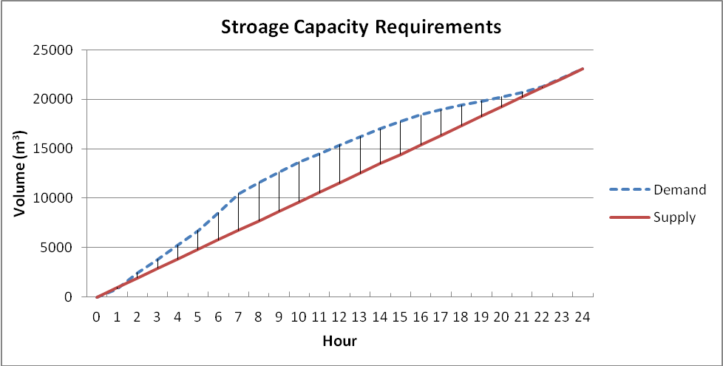

The result of this analysis is presented in the figure which shows that the deficit between supply and demand reaches about 4,000 m³. This amount is less than the capacity of the existing reservoirs (5,000 m³). Nonetheless, the existing reservoirs cannot deliver water to the expansion areas by gravity, which implies having new reservoirs to serve the expansion areas.
Hourly Supply – Demand Curves:

Slide 39
The Investment Plan
The investment plan will be divided into two stages, the short term stage and the long term stage. It will significantly depend on the circumstances that may develop between now and the year 2037 in terms of institutional and organizational arrangements in the country in general and in the study area in particular, the extent of implementation of the proposed projects for the earlier stage, the availability of funds and other unpredictable factors.

Slide 40
The short-term stage which will include:
Emergency repairs and maintenance projects.
Rehabilitation of existing water networks.
Development of institutional and organizational capacities.
Purchase of Necessary tools and equipment.
The long-term stage which will include:
Segmentation of the available water resources projects.
Construction of new facilities, such as main lines, pumping stations, reservoirs, etc.. projects.
Expansion of existing networks projects.
Development of other system components to increase and improve the level and extent of the water services projects.

Slide 41
Projects for the Short Term Period
Based on the outcome from the diagnostic phase and the planning criteria presented above, the following are the main projects proposed as part of the plan for the short term period. The table below summarizes the proposed projects for the short term period for the water network. The table shows that 2 projects are planned with a total cost of 2,691,653 Euros distributed over the period of 5 years.
Project Name and Number - Water | Total Budget (Euro)
Rehabilitation of Al Wakalah Water Supply Network | 656,153
Upgrading of Agricultural Wells | 2,035,500
Short Term Projects Costs | 2,691,653

Slide 42
Projects for the Long Term Period (up to 2037)
Based on the outcome from the diagnostic phase and the planning criteria presented above, the following are the main projects proposed as part of the plan for the long term period. The table below summarizes the proposed projects for the long term period for the water network. The table shows that 2 projects are planned distributed over the period of 20 years.
Project Name and Number - Water | Total Budget (Euro)
Extension of New Water Network for the Eastern Area | 569,403
SCADA System | -
Long Terms Projects Costs | -

Slide 43
Recommendations
Do maintenance for pipes and water meters to decrease water losses.
Having new reservoirs to serve the expansion areas.
Activate new resources in order to reduce load on the existing resources.
Replace the conveyance lines if needed.
Capacity development and introduction of advanced system i.e. SCADA.

Slide 44
Conclusion
Study water services in Qalqilya city.
Estimate the future demand and supply up to coming 20 years.
Suggest new water resources.
Suggest new reservoirs.
Create short term and long term investment plan.

Slide 45
خزان المتنزه
(500m³, 125masl)
خزان صوفين القديم
(300m³, 125masl)
خزان الخلة الجديد
(500m³,
125masl)
خزان الخلة
(2000m³, 113masl)
خزان عبد الرحمن
(m³ 500)
خزان الشهداء
(2000m³, 125masl)
بئر صوفين (288م³/س)
خزان خربة صوفين ((500m³
Transmission mains of Qalqilya city water
2037
خزان الوكالة
(500m³, 88masl)
بئر المسلخ (217م³/س)
Forced
خزان خربة صوفين
((1500m³
بئر غياظة (78م³/س)
بئر الوكالة (318م³/س)
Exiting wells & Reservoirs
بئر الظهر 240م³/س)
New wells & Reservoirs
Elevated Reservoirs
Out of order
بئر عبد الرحمن (100م³/س)
المستهلكين
المستهلكين
بئر خربة صوفين (100م³/س)
المستهلكين
المستهلكين
المستهلكين
المستهلكين
المستهلكين
المستهلكين

Slide 46
References
An-Najah National University – Civil Engineering Department.
Eng. Abd-Al Mo’men Afaneh, Qalqilya municipality director.
Eng. Ashraf Abu Dyah, Head of water department in Qalqilya municipality.
Eng. Reena Dawood, Director of the Engineering and Regulatory Department in Qalqilya municipality.
Palestinian Central Bureau of Statistics (PCBS), (2017).
Palestinian Meteorological Center.
Ministry of Local Government.

Slide 47

Any Questions?

Slide 48
Thanks

