Slide 1
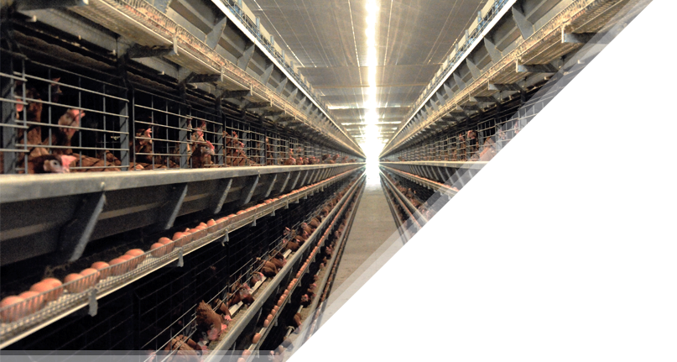
SMART POULTRY FARM
EGGS SORTING & PACKING MACHINE
Graduation project at An-Najah National University.

Slide 2
PRESENTATION
TIMELINE
1
Smart farm’s Subsystems
Abd Alrahman Hijji
3
Packing machine design
Bahjah Moqadi
5
Introduction
Abd Alrahman Hijji
Sorting machine design
Bahjah Moqadi
PLC Ladder
& Simulation
Lo’ay Jode
2
4
This report was prepared according to the guidelines of creating graduation project of graduation project course in An-Najah National University.
Preparation:
  Abd Alrahman A Hijji, 11525313.
  Lo’ay S Jode, 11523654.
  Bahjah A Moqadi, 11523813.
Supervision:
  Dr. Kamel Saleh.
Academic year 2019/2020.

Slide 3
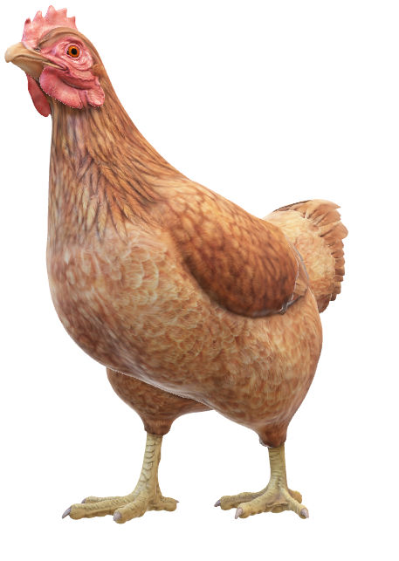
INTRODUCTION
Poultry sector is an important sector of the livestock in Palestine.
Separation of eggs is done manually in Palestine. That’s makes eggs production process slow and limited.
Poultry farm companies suffer from many problems that cause many losses mainly in poultry lives and money.
The aim is to search for alternative to replace the workers and to give an effective machine provides faster packing and sorting process comparing with workers.
The aim of designing an automatic egg sorting and packing machine is to help farmer packing eggs by size, reduce workers power and process time, increase eggs production to meet the high demand and with reasonable cost.
Production of automatic equipment's is a huge assist for farmers.

Slide 4
AIMS & OBJECTIVES
Also, it aims to design and develop an automatic eggs classification machine prototype design using software and hardware that can separate the eggs according to sizes S, M, L and XL. And, build a system that can reduce workers time work in eggs packing and sorting process that easy to operate.
These intelligent systems will facilitate farm management of the farm, save resources, control disease and control high temperatures.
This project aims to build an intelligent system that enables the Palestinian farmer to overcome these problems. The intelligent system monitors the farm through sensors and directs orders to control the farm management process through more than one intelligent system.

Slide 5
SMART SYSTEM
VS
TRADITIONAL SYSTEM
In comparison, of | Smart system | Traditional system
Capacity (chicken for m²) | Up to 50 | 10
Production percentage | Up to 98% | Up to 92%
Air condition system | Yes, Automatic | No
Virus protection | High | Low
Workers needed | Less | More
Manure removal system | Yes | No
Feed System | Automatic | Manual
Collect system | Automatic | Manual
Damaged product percentage | <1% | 1-2%
Product quality | High | Low
Production cost | Low | High

Slide 6
01.
Ventilations and cooling systems
SUB SYSTEMS
04.
Egg collection system
02.
Feeding system
05.
03.
Electronic control and monitoring systems
Manure removal system
06.
Packing and sorting machine

Slide 7
CONSTRAINTS
The difficulty of getting support to build the model on a real farm.
The difficulty of working, moving, collecting information and purchasing supplies for the work team due to government measures to combat the Covid-19 virus. These two problems were solved by agreeing to build a simulation model for only the packing and sorting machine using software that demonstrates the mechanism of action.
Maintaining the safety of workers on the farm, there will be a few workers on the farm to check it and the functioning of the systems. Workers may experience an unexpected accident because of the machines that used on the farm.
the difficulty to build a scalable and flexible system can used in various farms with various capacities and sizes.

Slide 8
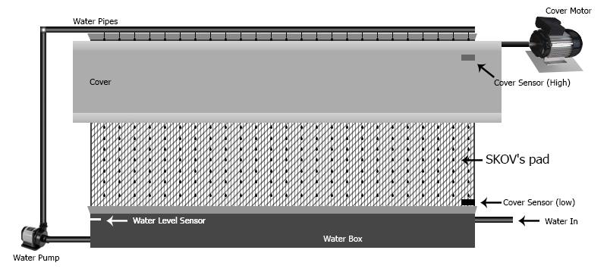
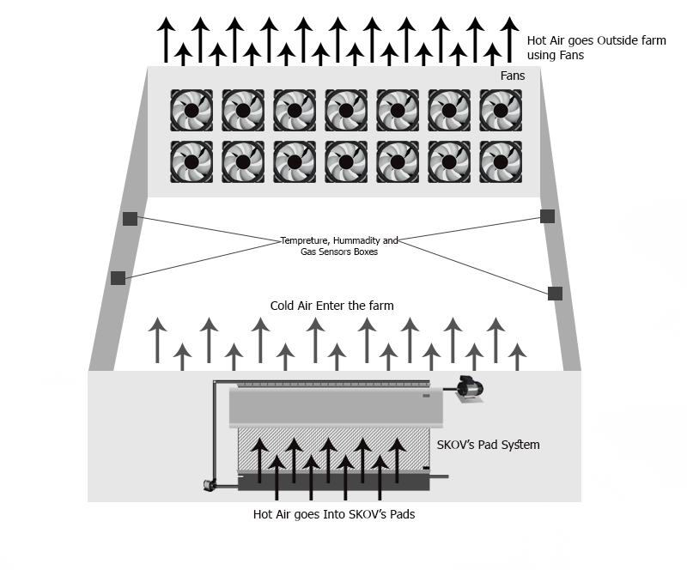
VENTILATIONS
AND
COOLING SYSTEM
The user selects the optimum temperature to keep it inside the farm.
Initial in-farm sensor readings and off-farm temperature are sent to the control system.
The cooling system cover is opining, turning on cooling plates water pump and turn on a minimum number of fans. Hot air from outside the farm enters the cooling system and is cooled by water and pumped into the farm until a temperature is fine.
Then the water and fans are turned off and the cover closed to make the temperature inside maintained. The system repeats the same process when the inside temperature rises.
The temperature outside the farm in winter is less than 20 degrees Celsius, the farm is closed to allow the temperature inside to rise, if the temperature rises to more than 23 degrees Celsius the system will open The cover without dropping water and operating fans to allow cold air from outside to enter to cool the atmosphere inside.
If the farm is closed for heating and the high percentage of toxic gases (CO and CO2), the cover will be opened to allow the farm to be ventilated and oxygen to enter.

Slide 9
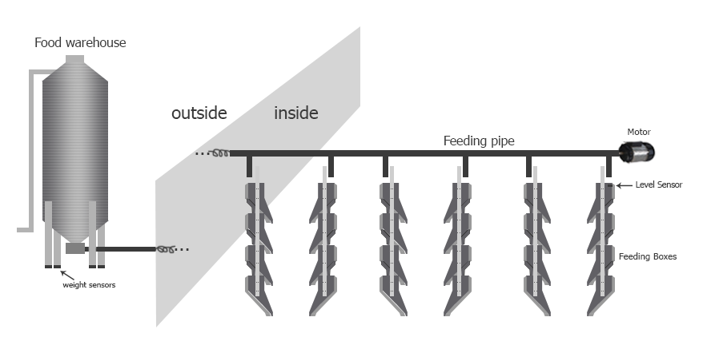
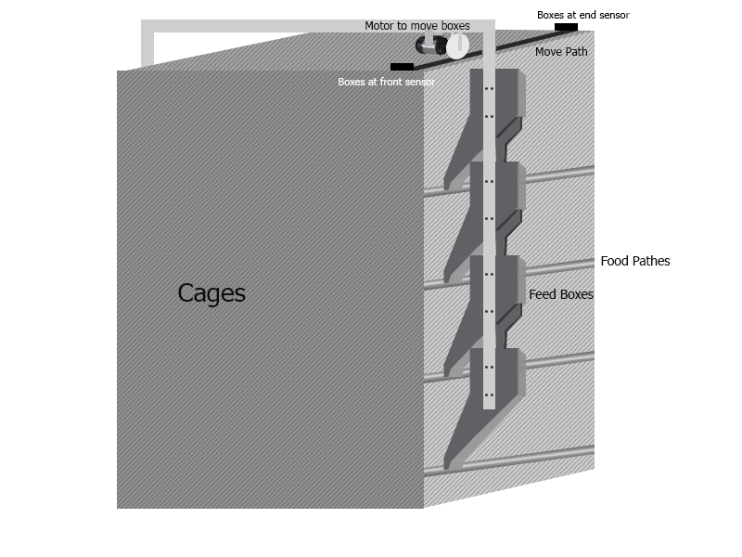
FEEDING
SYSTEM
There is a feed warehouse outside the farm, a weight sensor will be used in the warehouse.
The warehouse is connected to the farm by a pipe and contains an auger, and a motor, This motor is at the feed warehouse and works based on the condition of the sensor.
After the motor works, the feed is moved from the warehouse to the boxes inside the farm.
These boxes are supplied with feed through a long tube extending from the beginning of the farm to the end of it. The boxes are connected to this tube through holes under of it.
The process of filling the boxes is consecutive, until the last box is filled. There will be a sensor connected to the last box, every Box In every cages line moves by a motor.

Slide 10
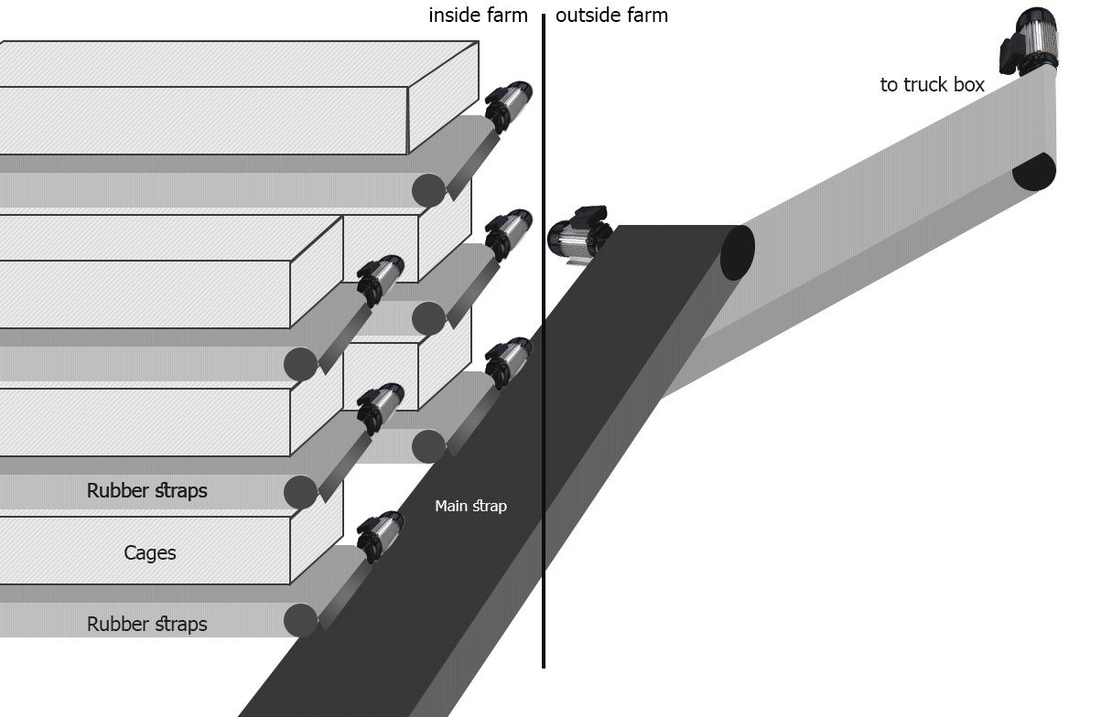
MANURE
REMOVAL
SYSTEM
Rubber straps are placed longitudinally under chicken cages. the wastes from chickens fall from cages to straps.
These straps are connected to a motor that moves them horizontally below the chicken cages to transfer the wastes to the end of farm.
At the end of farm manure falls from the straps below the cages to another strip that places to run transversely at the end of all cage’s straps.
The main strip is moved by another motor and transfer the waste outside the farm to another strip tilted up to transfer wastes to truck box.

Slide 11
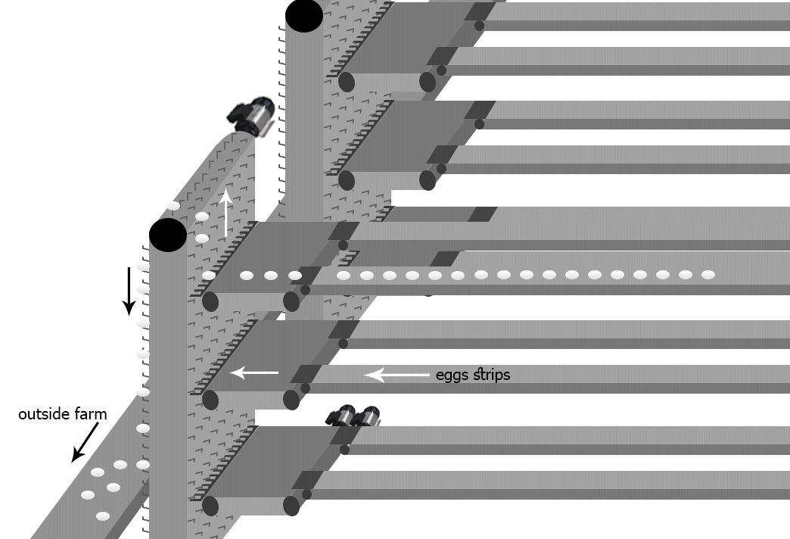
EGG
COLLECTION
SYSTEM
The eggs move from the cages to a strip ,The strip consists of two sections the first section is the one that carries the eggs from the cage to the other section. The other section is a strip made of coarse tissue that stabilizes the egg, All straps are connected to a motor.
When the motor is activated the straps will move until they reach (the Egg holder), It is a machine Consists of moving tape and the holders Its shape helps to carry eggs and prevents them from falling and there is an Image Processing.
The egg moves from the strip to the holder, the holder rises to the top and then throws the egg to the holder, then the eggs move from the machine to a container at the bottom.
Then the eggs move to a sloping strip that hold only one egg, the egg reaches another bar with several holes in it, so the egg passes over the first hole, if it is small, it passes through the hole to its warehouse and If it is large it will not pass through the small hole and complete its path until it reaches the appropriate hole and then reach the warehouse.

Slide 12
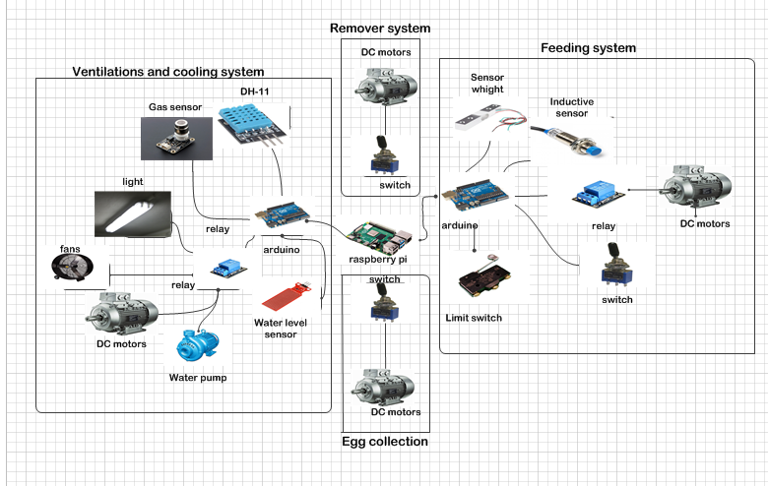
ELECTRONIC CONTROL
AND
MONITORING SYSTEM
The system reads and collecting and analyzing data from other systems and display it.
The system receives input from the farmer for feeding times and the temperature that the farmer wants the system to maintain, the lighting times and the birds age.
The system can automatically control lighting and temperature times and recommend to the farmer the appropriate temperature and humidity of the birds.
The system monitors the faults in the farm and in case of power failure in the cooling system or the inability of the cooling system to control the temperature of the farm due to any malfunction, the system will open windows through motors powered by a UPS to ensure the ventilation of the farm.

Slide 13
EGGS PACKING
AND
SORTING PROCESS
1
Getting rid of damage and dirty eggs
3
5
From farm
Packing
Washing
Sorting to
Stamping
2
XL L M S
4
Ready to sale
The eggs enter many procedures after exit the farm on the way to the sale.
At first, the egg enters washing machine to ensure all eggs is clean and sterile.
Second, it enters a system consists of special sensors and cameras to get rid of broken, damaged and dirty eggs.
Third, the eggs enter the sorting machine which sort eggs to four different sizes according to weight. Fourth, the eggs enter the packing machine which packing it into eggs cartons.
Finally, the eggs find it way to the market.

Slide 14
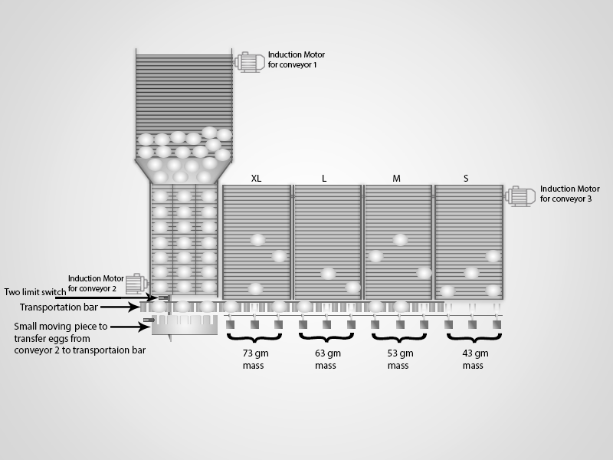
SORTING MACHINE
The eggs are transferred from collection system to the egg sorting machine.
there is sections and each one has scales and there is a hook for each scale The bar moves in a shape vertical oval movement To help transport, and carry eggs.

Slide 15
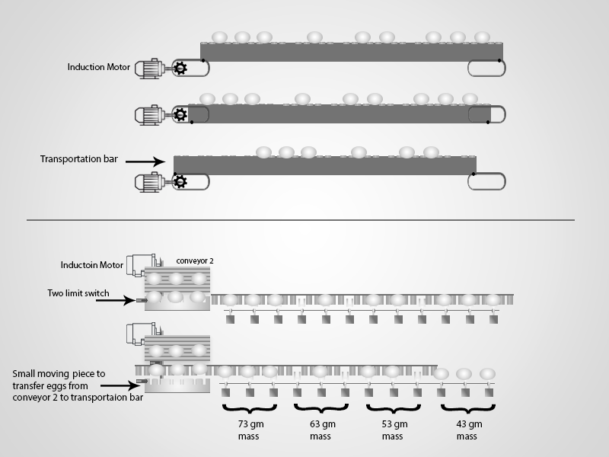
SORTING MACHINE
Three eggs are transferred from the conveyor to the bar, Then it will move left to the first part then to the second, the third, and so on.
The process continues until the eggs reach the last section, the bar becomes empty and continues with its oval movement, goes down and returns to its position at the conveyor to carry three other eggs.

Slide 16
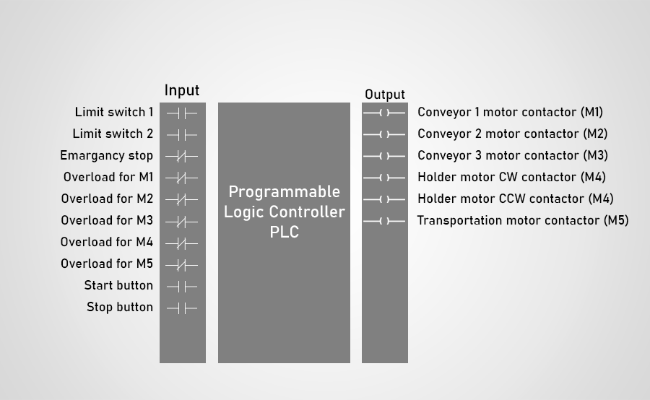
SCHEMATIC FOR SORTING MACHINE

Slide 17
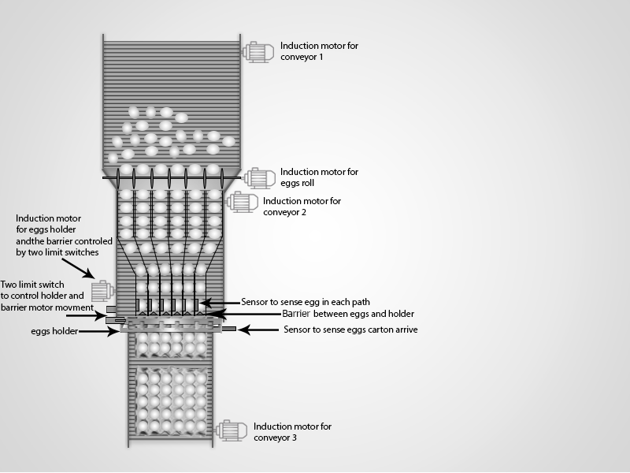
PACKING MACHINE
After the eggs are separated in the sorting machine.
The eggs are delivered to conveyor 1,to move and pull the eggs using a motor, At the end of this conveyor there are paths, each path accommodates one egg .
Turning to Conveyor 2. Eggs enter through rolls that driven by a motor. the eggs walk along these paths in succession. Gradually narrowing the pathways, until the paths reach their end in conveyor 2.
There is an egg sensor, carton sensor, barrier, holder and counter ,And There are 2 Limiting Switches.
When the eggs reach the end of the paths, and if there is 6 eggs and one carton; 6 eggs are sent onto the carton, to fill it with 30 eggs.

Slide 18
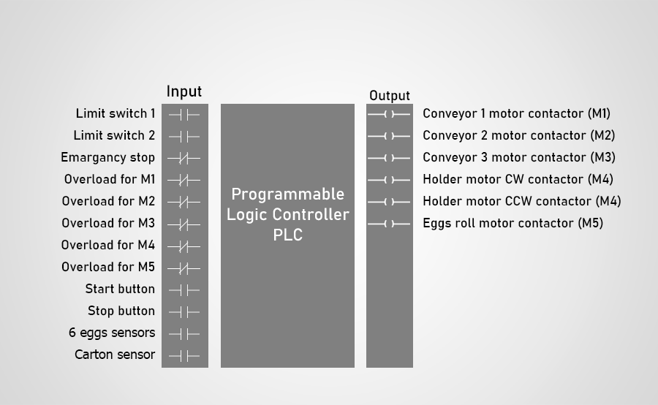
SCHEMATIC FOR PACKING MACHINE

Slide 19
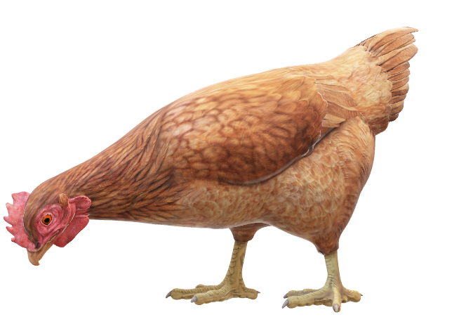
HARDWARE PARTS
Programmable Logic Controller (PLC)
Limit switches
Induction Motors
Capacitive sensors
Contactors
Electrical Circuit Overload

Slide 20
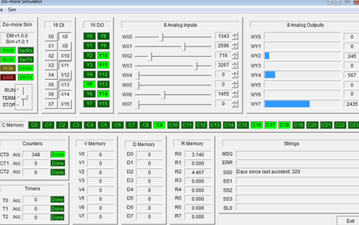
Do-more Designer PLC Programming Software
Do-more Designer™ is the full-featured PLC programming software for the Do-more™ series of programmable logic controllers (PLCs). Flexible program management supports a mix of stage and ladder logic for a best-of-both-worlds approach that simplifies programming and makes trouble-shooting easier.

Slide 21
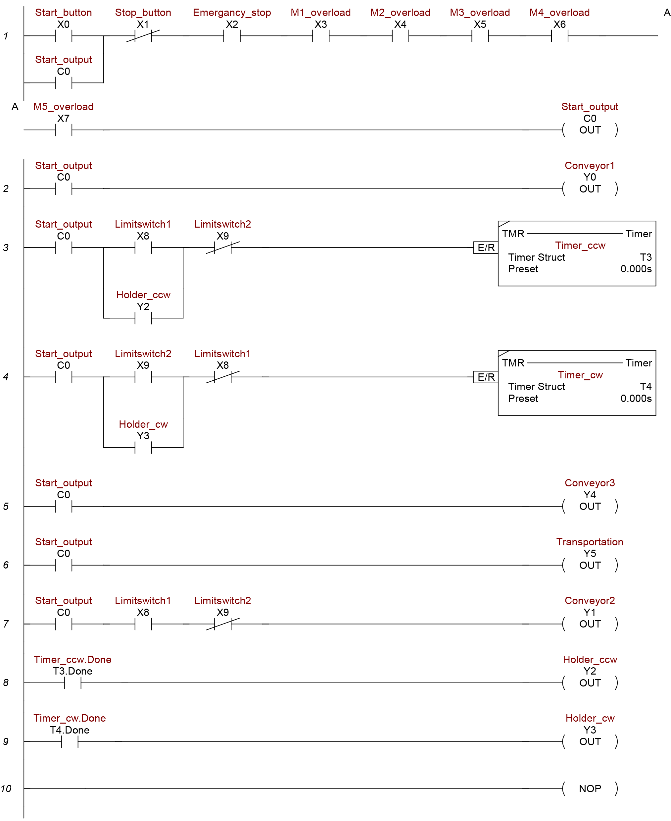
SORTING MACHINE LADDER
First line contains the main buttons for start and stop machine and separating it upon completion or if an emergency situation or overload happens. C0 represent internal memory output makes latch to operate the machine.
Y5 represent transportation bar motor, and works at time the machine run. The motor of transposition works where it is moving in a circular manner, which in turn
Y1 represent conveyor 2 motor, it works when the holder position is in the top close to the conveyor, that knows by first limit switch status which must be closed.
Y2 represent holder motor CCW contactor. When the holder is at the top and when it touches the First Limit Switch An effect is made for a short time that depends on experience during work to synchronize between motors, so the eggs will be placed on the holder and the holder will slowly and smoothly descend so that its speed is appropriate.

Slide 22
SORTING MACHINE LADDER
Y3 represent holder motor CW contactor. After the eggs are released, the holder will go down come into contact with the second limit switch. So, its work will be delayed for a period of time. Then it reflects the direction of rotation of the motor that responsible for the holder, to return to the top and transfer the eggs again.
Y0 represent conveyor 1 motor, and works at time the machine run.
Y4 represent conveyor 3 motor, and works at time the machine run.

Slide 23
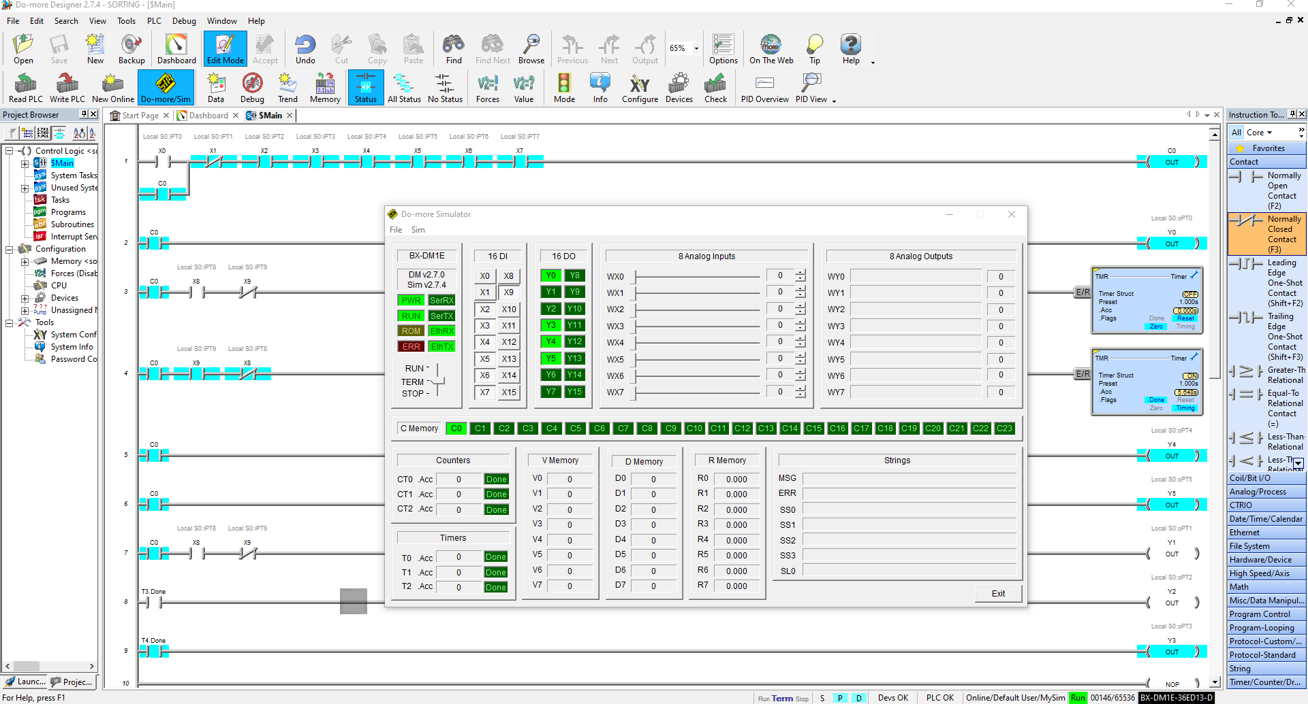
DO-MORE SIMULATION FOR SORTING LADDER

Slide 24
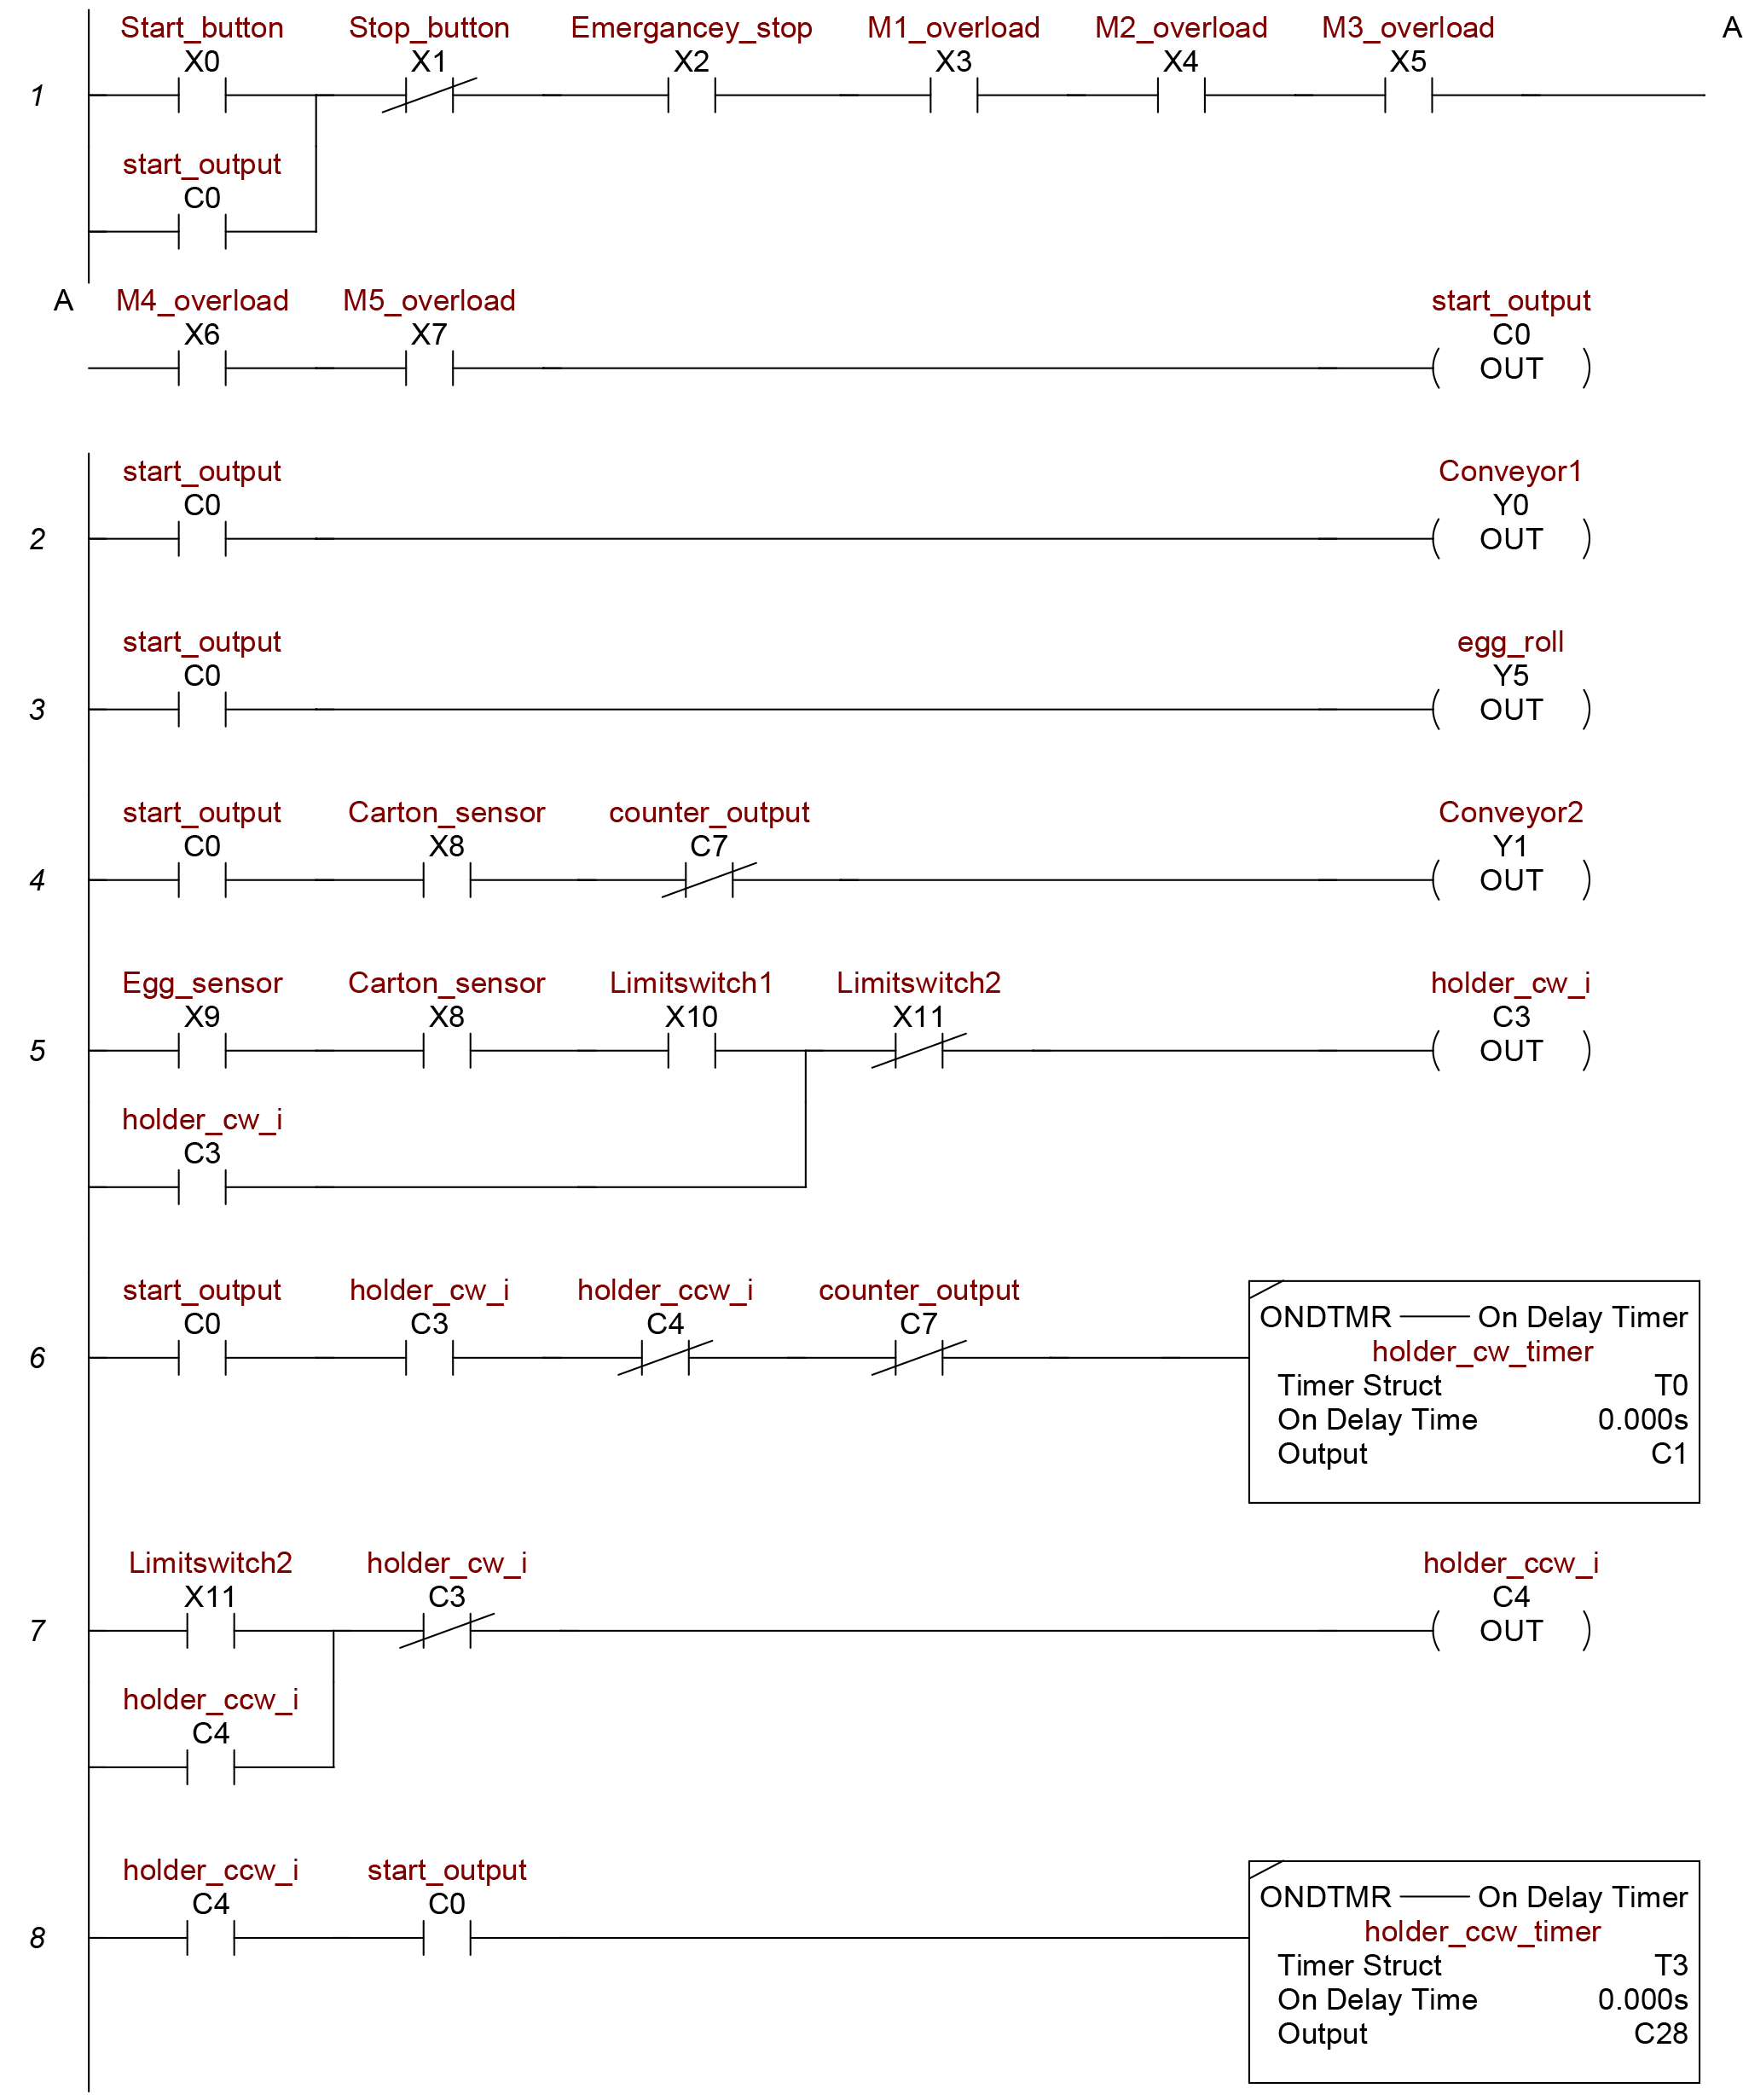
PACKING MACHINE LADDER
First line: This line contains the main buttons for forming the whole machine and separating it upon completion or if an emergency situation happens.
The second line: the first motor will work and It is the motor that will be responsible for the part that carries eggs " Conveyor 1"
The third line: the second motor will work And It is for the part that sorts eggs into paths that contain one egg in each path.
Fourth line: the motor for the third conveyor will work If there is a signal from the sensor, which senses the presence of a carton.
Fifth line:
      The Sensors that sense the presence of eggs, which number 6 and connected respectively; to reduce the number of inputs.
The Sensors that sense the presence of cartoon.
The holder comes into contact with the switch, with these conditions; the internal contactor is activated on the plc.
Sixth line: The motor for the holder will work;
In case the third contactor is working, and the main switch is on.
When the fourth and seventh contactors that they are related to the counter and the second limit switch are not working, and The second limit switch spins a little fast and goes down.
Seventh line: The Limit Switch works when the holder reaches it and touches it, which leads to the work of the internal contactor No. 4.

Slide 25
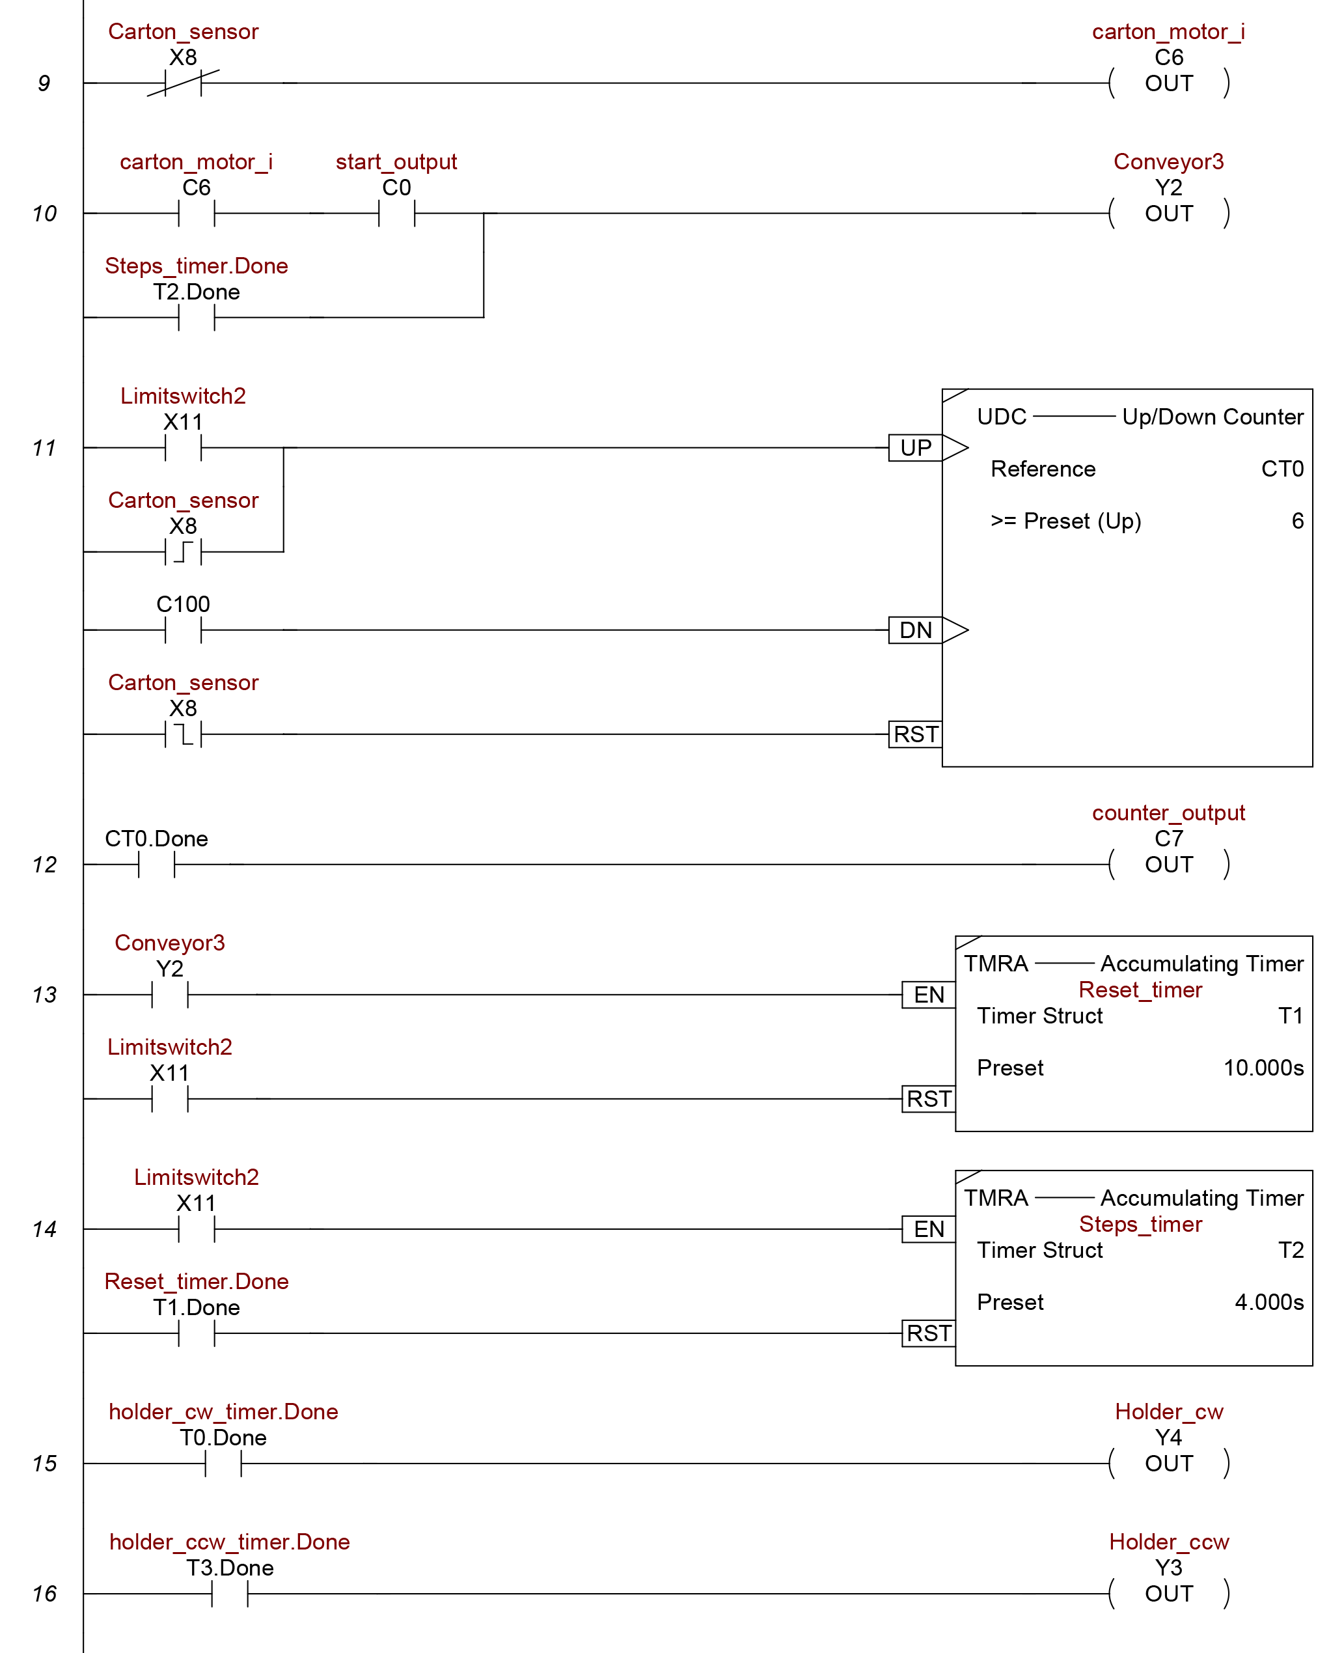
PACKING MACHINE LADDER
The eighth line: When Contactor 4 is turned on, the rotation will be reversed, and the direction of the holder and barrier is reversed to move upward.
Line nine: When there is no carton under the holder, there is the number six contour that works.
The tenth line: The contactor number six works when there is no carton, which in turn moves the conveyor and This conveyor holds the cartons until it reaches the carton sensor and stops.
The eleventh & twelves line: The count starts from the time the carton reaches the sensor, When the holder comes down each time to move the eggs, and when the counter reaches the number 5, that is, 5 rows, the counter No.7. works, which in turn stops the work of the second conveyor and the holder.
The thirteenth & fourteenth line: The motor that responsible for the part that moves the cartons will move at a specified time, which depends on the speed of the holder to come down and go back up.

Slide 26
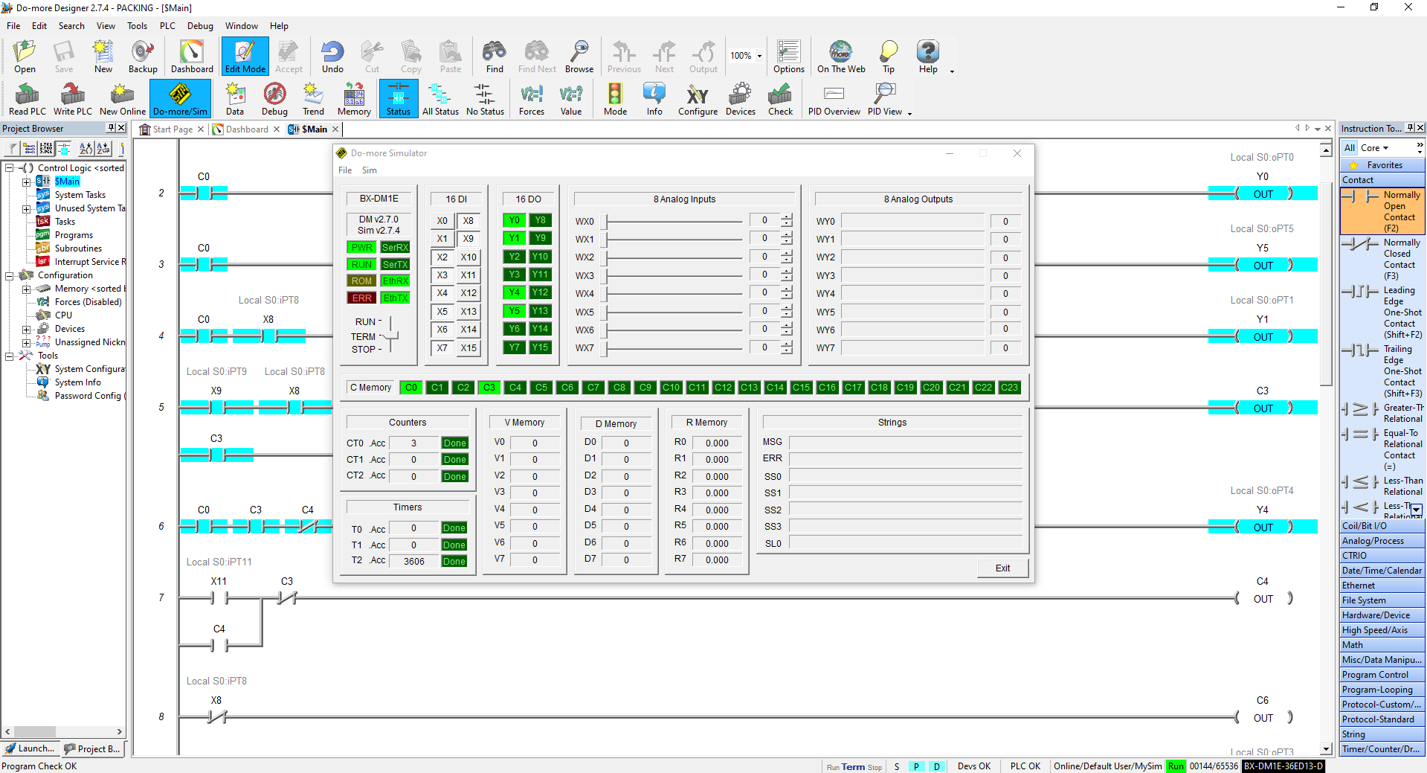
DO-MORE SIMULATION FOR PACKING LADDER

Slide 27
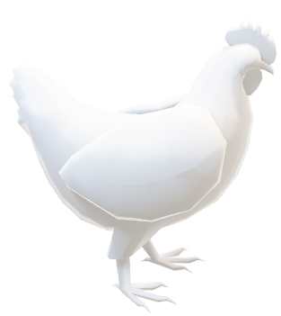

CONCLUSION
The operation of farms can be facilitated using modern farms and this operation can be speeding up. It is also possible to take advantage of the largest possible area on the farms. The dirt from farm's birds can be recycled and use as fertilizer in many areas. It is also possible to use modern systems to collect, disperse, and package eggs. This makes it easier for the farmer to do the work quickly and productively. And makes the modern farm economically viable and very helpful.
Thanks!
  ABD ALRAHMAN A HIJJI
  LO’AY S JODE
  BAHJAH A MOQADI

