Slide 1


Slide 2
CONTENTS
OBJECTIVES
STUDY AREA
QUESTIONNAIRE
WATER NETWORK ANALYSIS
ANALYSIS of EXISTING WATER NETWORK USING EPANET
EPANET USING DESIGN of FUTURE WATER NETWORK
COMARISON of The TWO NETWORK DESIGNS
CONCLUSIONS

Slide 3
OBJECTIVES
Collect basic information about Attil Town .
Analyze the outcome of the questionnaire to draw some conclusions regarding the water supply services in the area .
Analysis an existing network .
Re-design of water supply network for Attil
Town .
Reach to final design. Two options with cost estimates and compare between them .

Slide 4
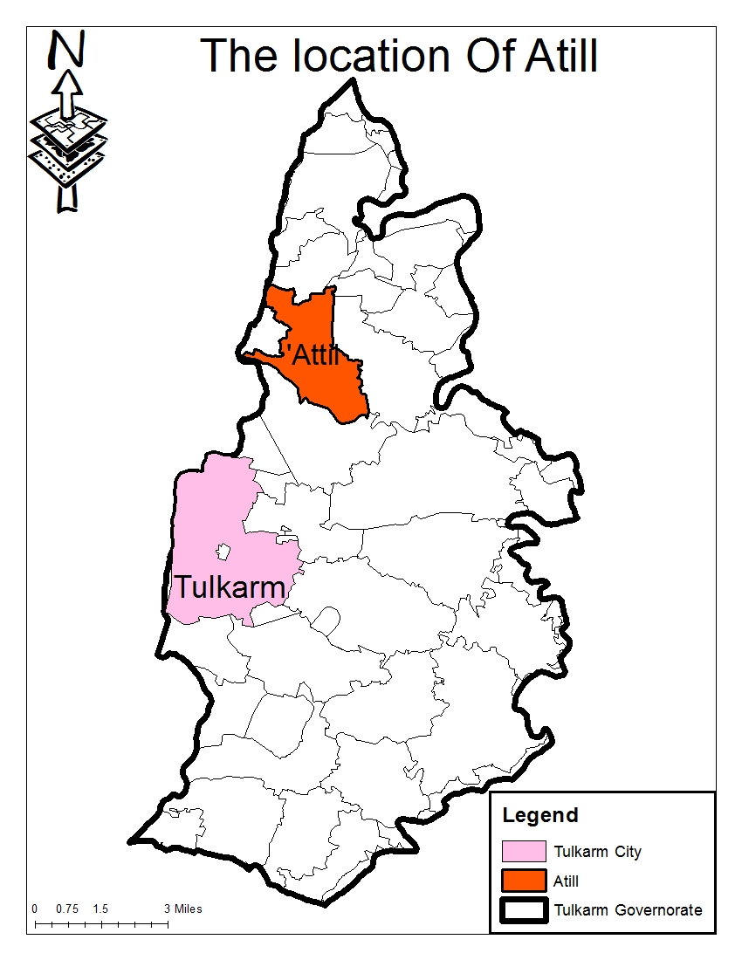
STUDY AREA

Slide 5
. Currently it is estimated at 11,000 capita : Population
Educational Situation : The education rate in the town is one of the highest compared to other towns . in Palestine
. Health Situation : Attil has a good healthy status
Agriculture is the main source of : Economic Situation
the economy of the town .
The climate of Attil is Meteorological Condition :
a Mediterranean type with moderate summers and
. warm winters

Slide 6
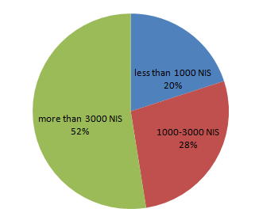
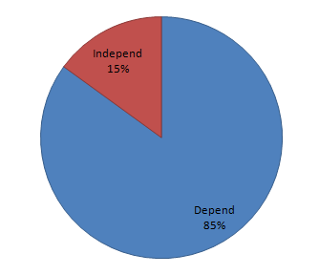
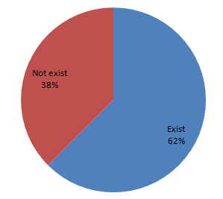
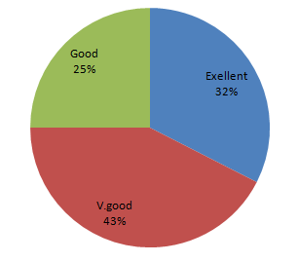
QUESTIONNAIRE
Monthly income
Dependence on municipality as a source of water.
Existence of a garden in the house
Evaluation of the network

Slide 7
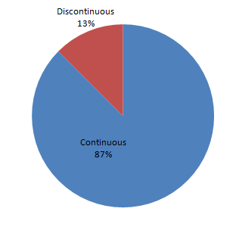
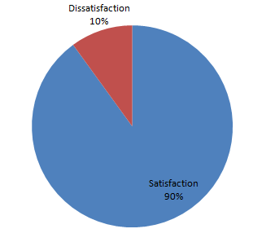
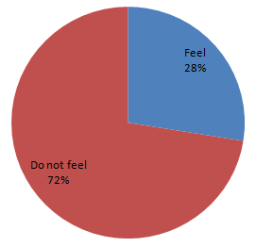
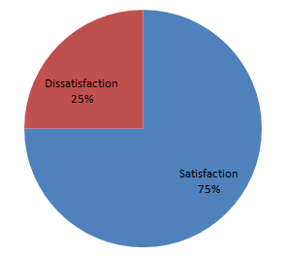
Infusion of water
Satisfaction with the arrival of the service
Feeling any taste color/odor in water
Satisfaction of pressure level in the network

Slide 8
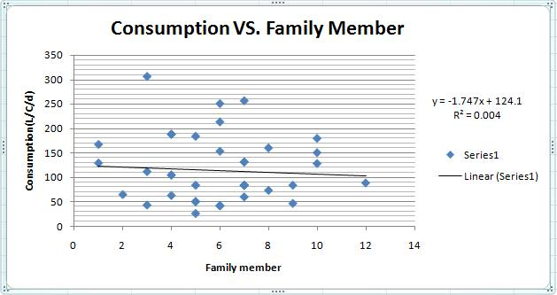

Slide 9
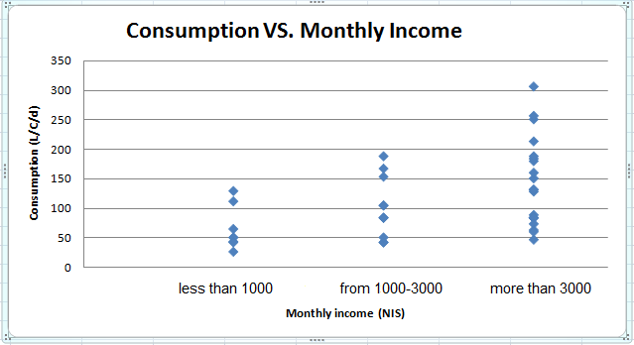

Slide 10
WATER NETWORK ANALYSIS
Source of water: Attil Town is fed from Abu Sabha irrigation project . Water is pumped from the well by a booster pump and stored in the tank. The well rises
. 62 m above sea level
Tank : Water tank had been set up for Attil Town in 1976. It has a capacity of 200 m³ and rises 116 m above . sea level
Water is distributed in Length of the network :
a network of total length equals approximately 58 km ,and diameters ranging from 2 inch to 6 inch .

Slide 11
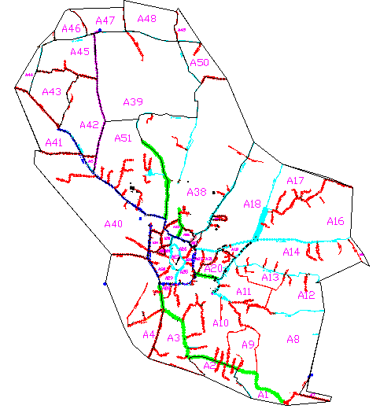
Attil Water Network

Slide 12
In Attil Network
Pipes : Pipes that transfer water has a different diameter 6, 4, 3 and 2 inches made from steel and steel pipes lined from inside with cement. The number of the pipes = 256 .
Nodes : Nodes are points join lines in the network with each other and where water enters or leaves the network. . The number of nodes = 232
. Area : Attil Town has a recent area equals 4572 dunums
Density : The average density almost equal to 4capita/dunum .

Slide 13
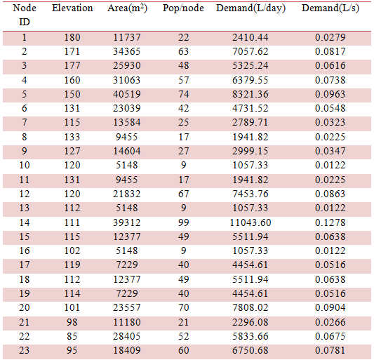
Sample of Nodal Demand

Slide 14
Summary of Nodal Demand Table
Total Pop / node = 10921 capita
Total Demand (L / day) = 1222938.73
14.1544= (Total Demand (L / S

Slide 15
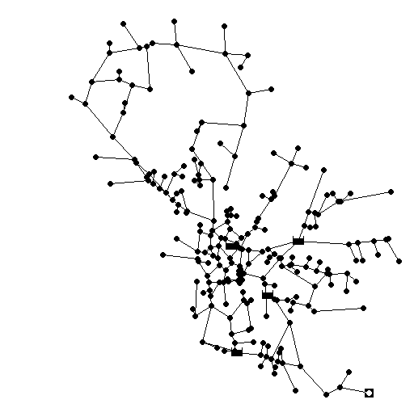
ANALYSIS of EXISTING WATER NETWORK USING EPANET
Network Model in EPANET
R
P
R : reservoir
P : pump
P
P

Slide 16
Two Runs for Existing Water Network
At a Steady State Condition
1
2
At an Unsteady State Condition
By entering data on patterns icon and that is sourced from distribution of water consumption .during day and night in the West Bank

Slide 17
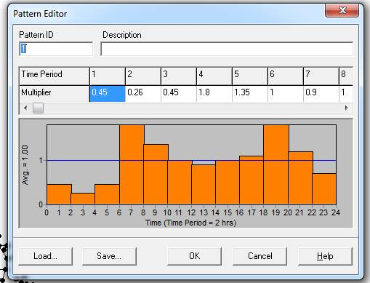
Distribution of Water Consumption

Slide 18
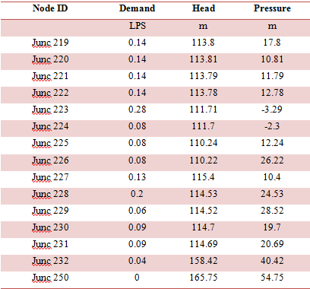
Network Table - Nodes at 6:00 Hrs for Existing
Network

Slide 19
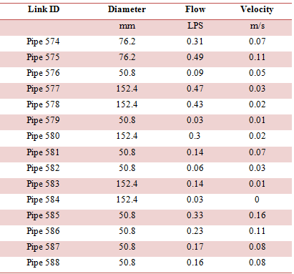
Network Table - Links at 6:00 Hrs for Existing
Network

Slide 20
DESIGN OF FUTURE WATER NETWORK
USING EPANET
Attil water network will be designed for the next 25 years based on the year 2014 .
Population growth rate=1.6% according to Palestinian .Central Bureau of Statistics
The population in 2039 is estimated to be 16360 capita .
Per capita water consumption = 120 L/C/d according to Palestinian Water Authority .
Physical losses=15% and 90% of the municipal water .consumption is domestic consumption

Slide 21
a per capita municipal water demand equals to 157 .L/C/d
The expansion in the urban areas in the future for a period of almost 25 years is within the area that is served from the existing water network . No horizontal expansion on the network .
The future water demand for each node in the network increases by a factor equals 2.42 .

Slide 22
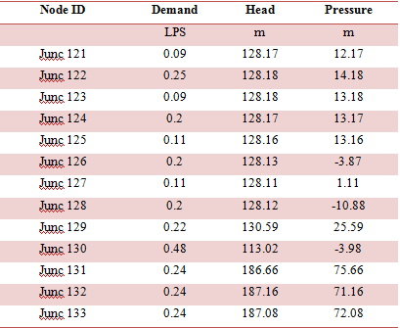
After Increasing Demand
Network Table - Nodes at 6:00 Hrs

Slide 23
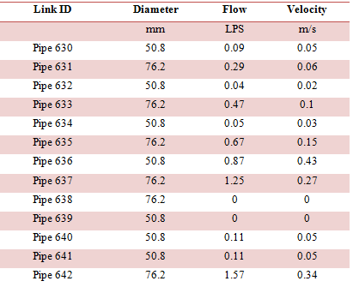
Network Table - Links at 6:00 Hrs

Slide 24
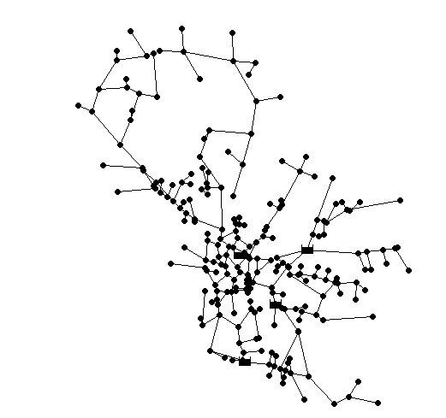
Two options for modifying the network
Expansion on Existing Network:Model 1
R
P
R : reservoir
P : pump
P
P

Slide 25
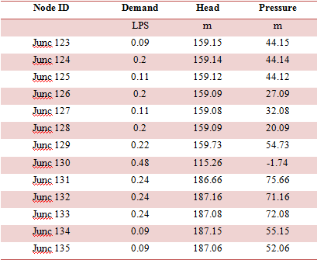
Network Table - Nodes at 6:00 Hrs for Model 1

Slide 26
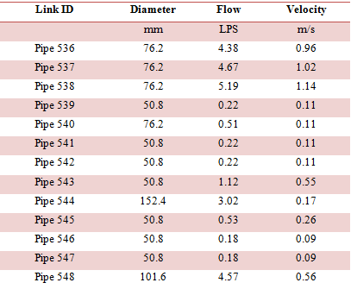
Network Table - Links at 6:00 Hrs for Model 1

Slide 27
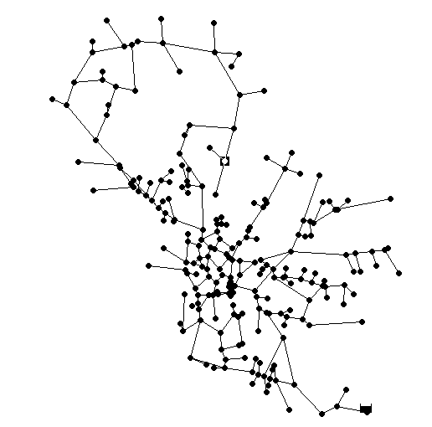
Model 2: Installation of a New Reservoir
R
R : reservoir

Slide 28
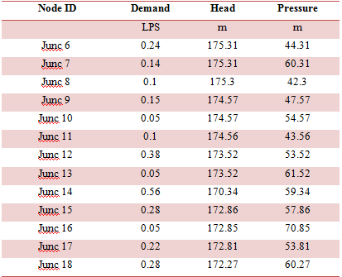
Network Table - Nodes at 6:00 Hrs for Model 2

Slide 29
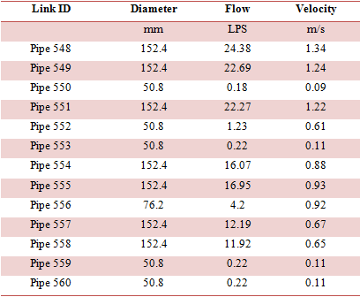
Network Table - Links at 6:00 Hrs for Model 2

Slide 30
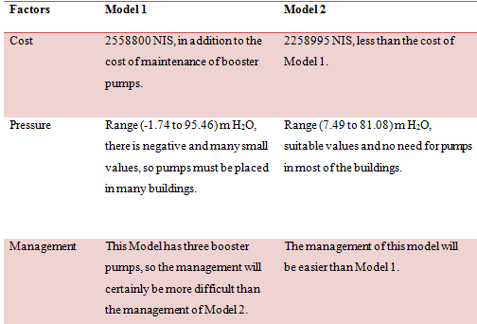
COMPARISON BETWEEN The TWO MODELS

Slide 31
CONCLUSIONS
Model 2 of design is better than model 1 to meet the requirements of future water demand for the next 25
years for many reasons:
Cost is cheaper than model 1 and equals around 2.26 Million NIS .
Has suitable pressure values and no need for pumps .in most of the buildings
The management of this model will be easier than .Model 1

Slide 32


