Slide 1



EMULATOR
BIKE
Bike Emulator
Done By: Masa Lubbadeh & Raya Hindi
Supervisor: Dr. Anas Toma

Slide 2
Table of contents
01
Structure and Hardware Components
Motivation
04
02
Main Idea
05
Mobile Application
03
Features
06
Challanges & Constraints
07
Future Work

Slide 3

Motivation
We found indoor cycling boring and outdoor biking risky, so we aim to make gym cycling more engaging and motivating.

Slide 4
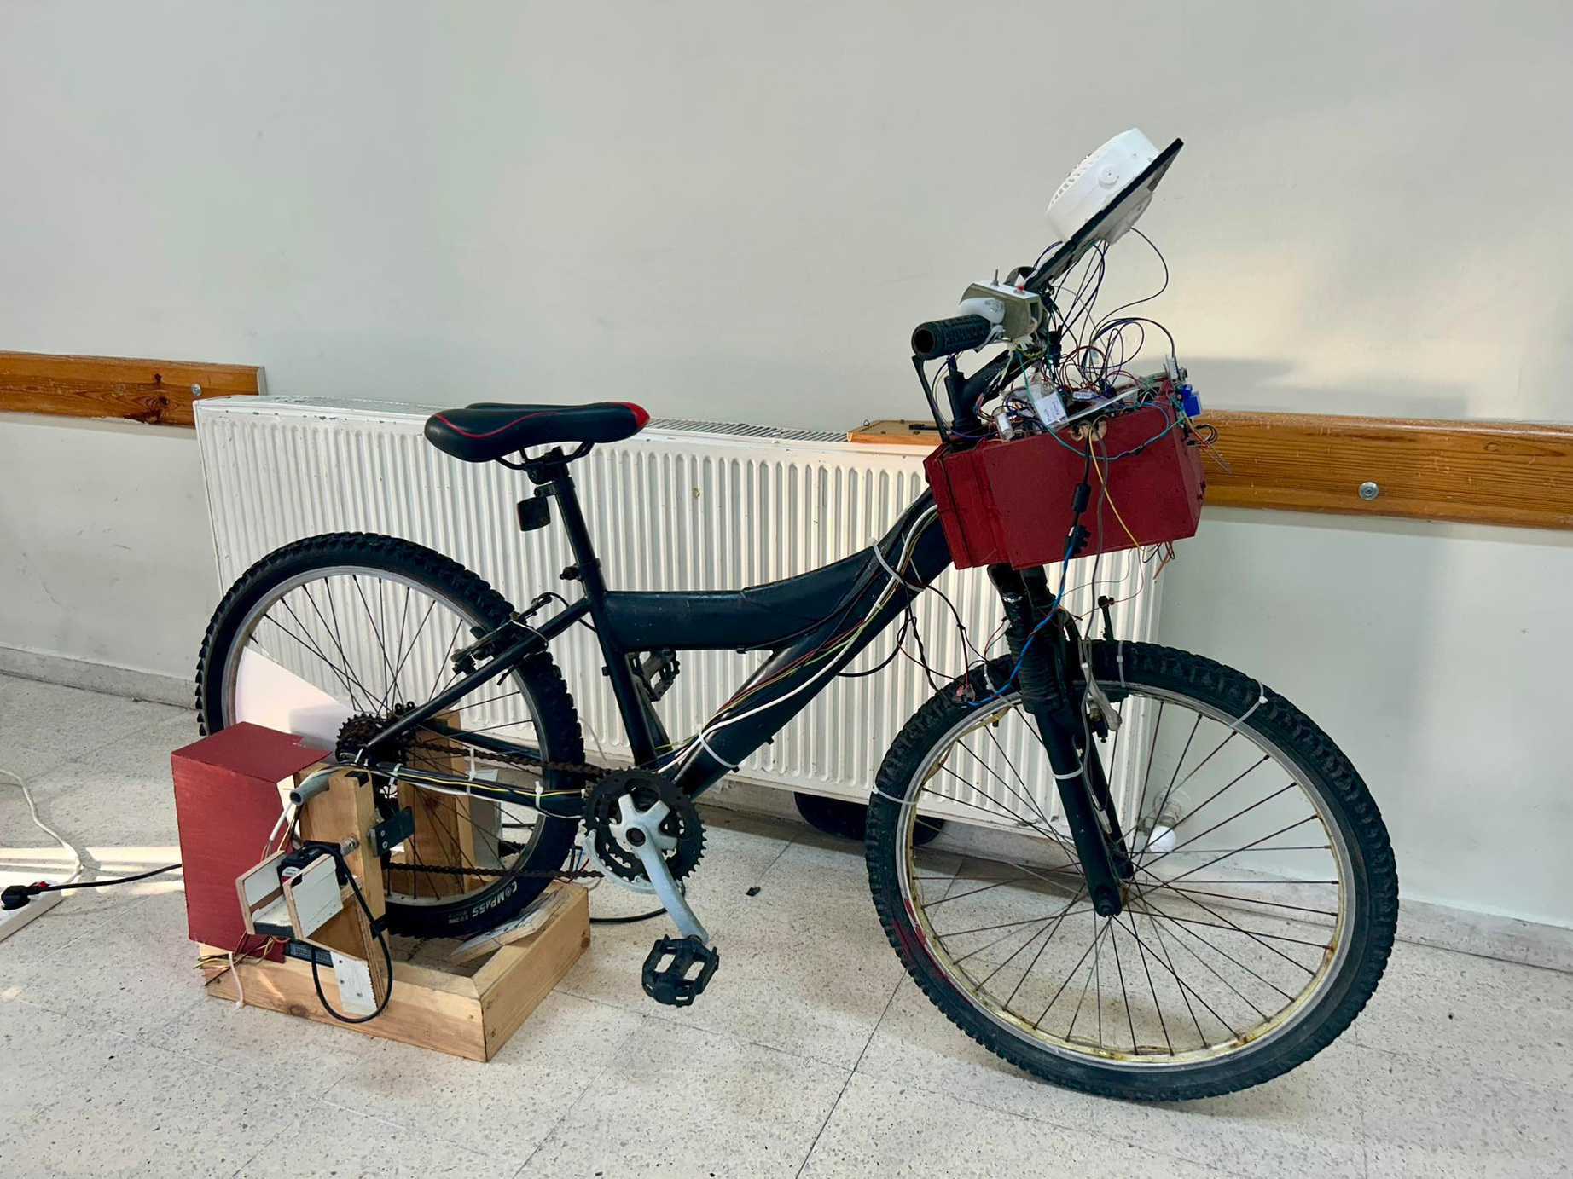
Main Idea
Transforming a regular bicycle into a stationary gym bike, with advanced tracking and feedback features.

Slide 5
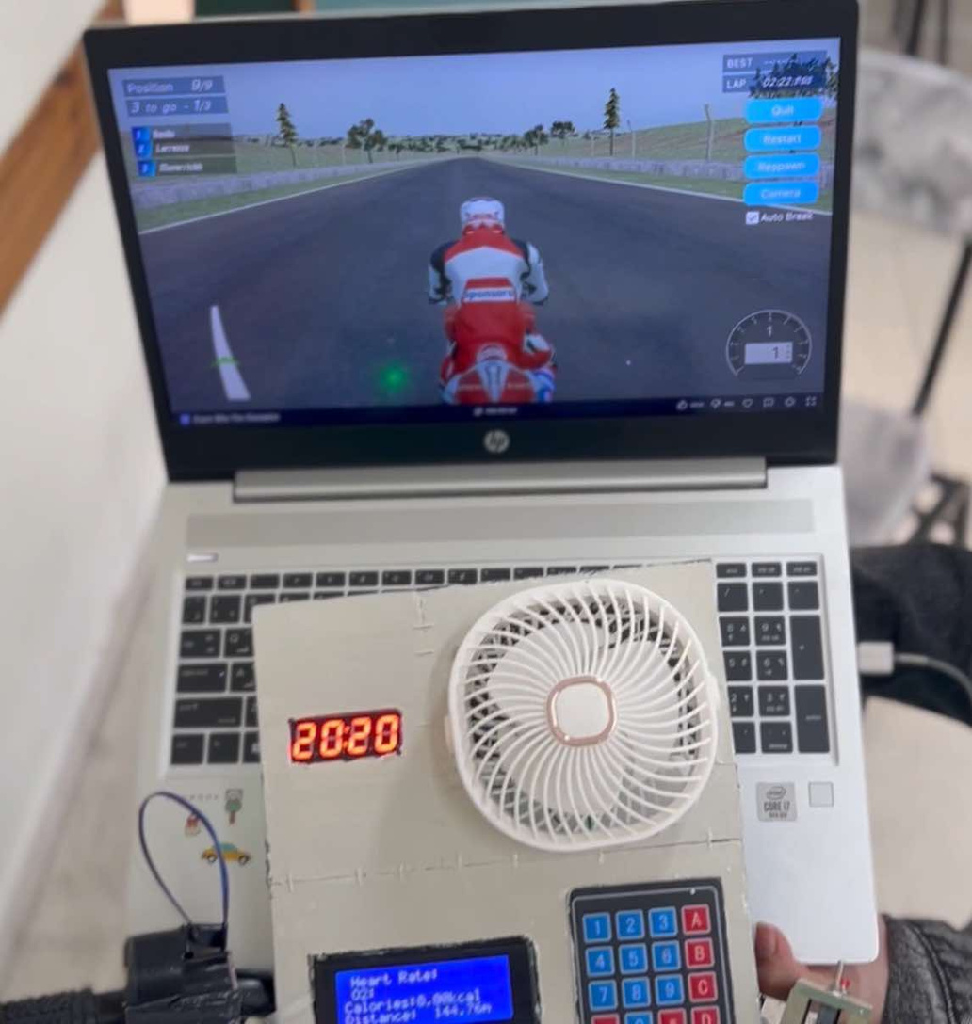
FEATURES
1.Drive
Simulation
Replicates the feeling of biking outdoors by adjusting resistance, providing users with a realistic riding experience.

Slide 6
FEATURES
1
2
2. Real-time Display of Metrics
HEART RATE
CALORIES
  Continuous calculation and display of heart rate using the MAX30105 sensor.
  Estimation of calories burned based on speed and distance.

Slide 7
FEATURES
3
4
2. Real-time Display of Metrics
DISTANCE TRACKING
REMAINING TIME
  Accurate tracking of total distance traveled.
  Display of workout time, using a TM1637 7-segment display

Slide 8
FEATURES
1
2
3
3. Interactive Control System
BICYCLE INTERFACE
MOTOR CONTROL
BUTTON CONTROL
  Intuitive interface for switching modes and controlling workout settings.
  Simulates real-world biking with adjustable resistance.
  Simple button interface for easy navigation and control.

Slide 9
Structure
Of The Project

Slide 10


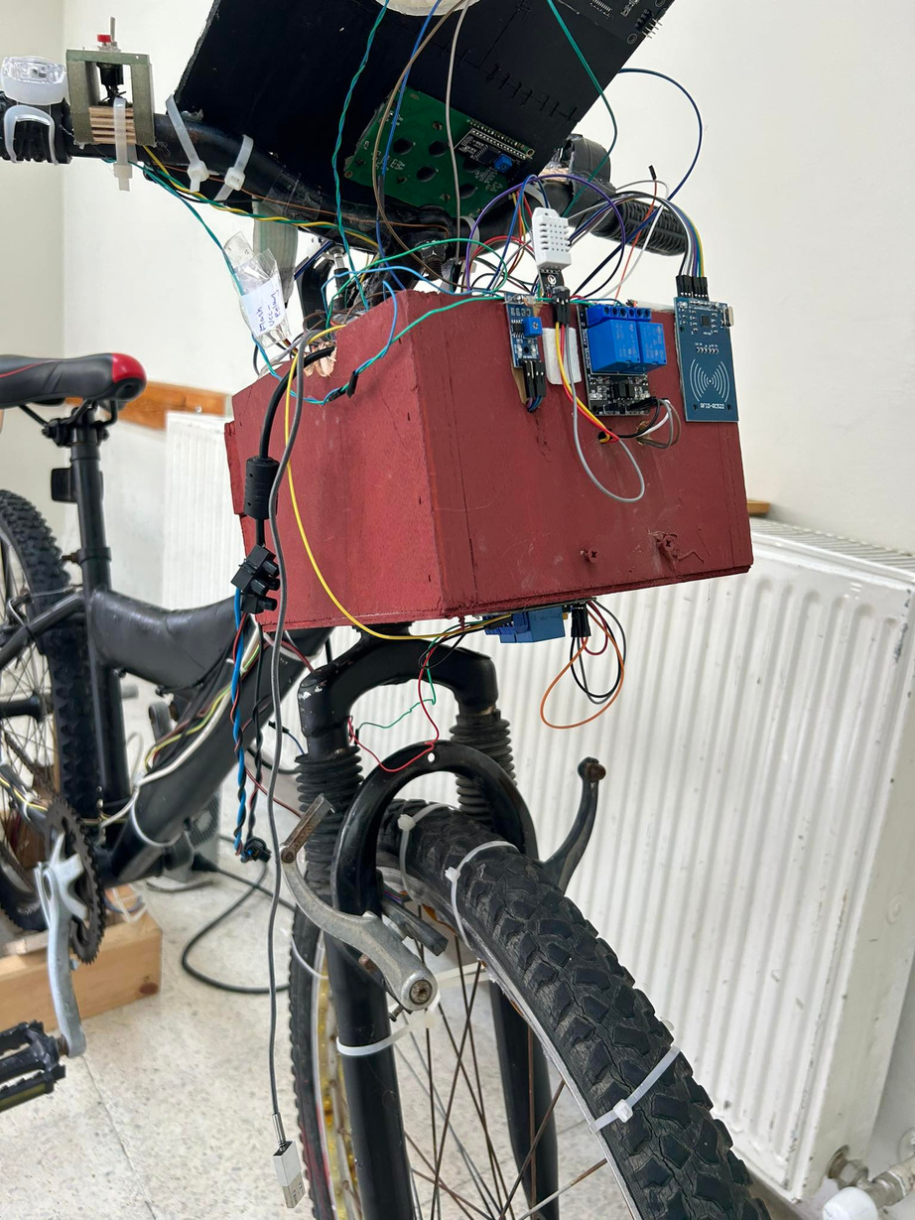
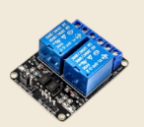
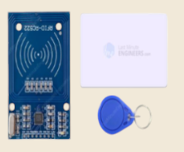

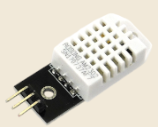
Hardware components Used:
Hardware Storage Box
Relays
RFID
Fan & light control
Authentication
DHT22 temperature sensor

Slide 11
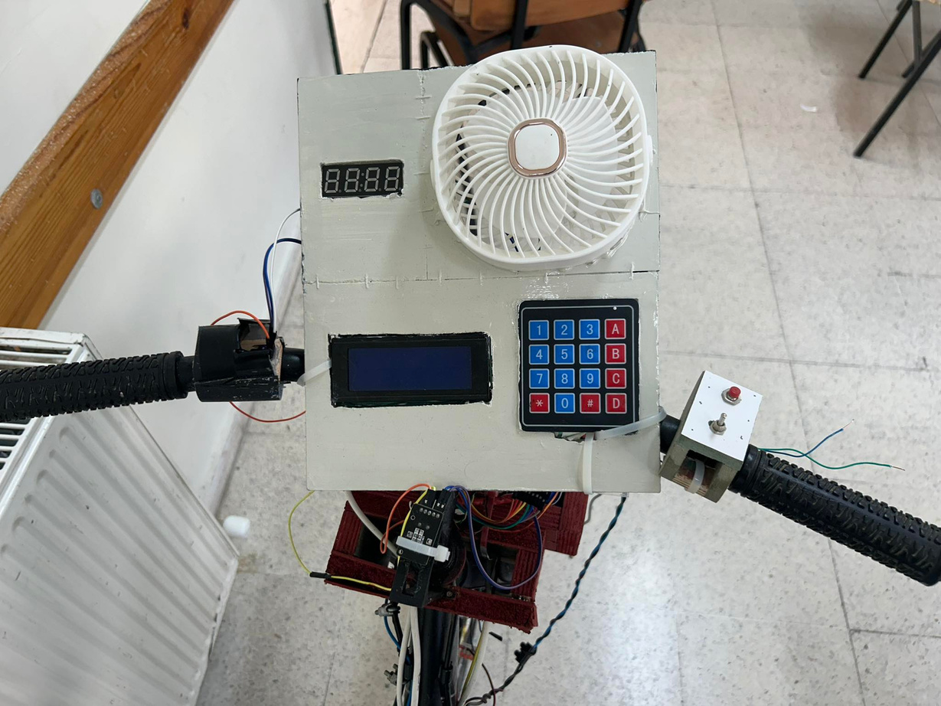
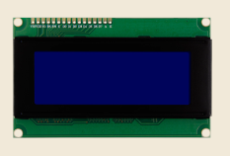
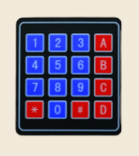
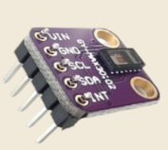
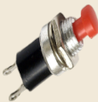
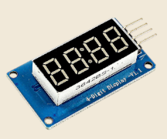
Hardware components Used:
Interactive Display Panel
LCD
Keypad 4x4
Push Button
max30102
4-Digit 7-segment Display

Slide 12
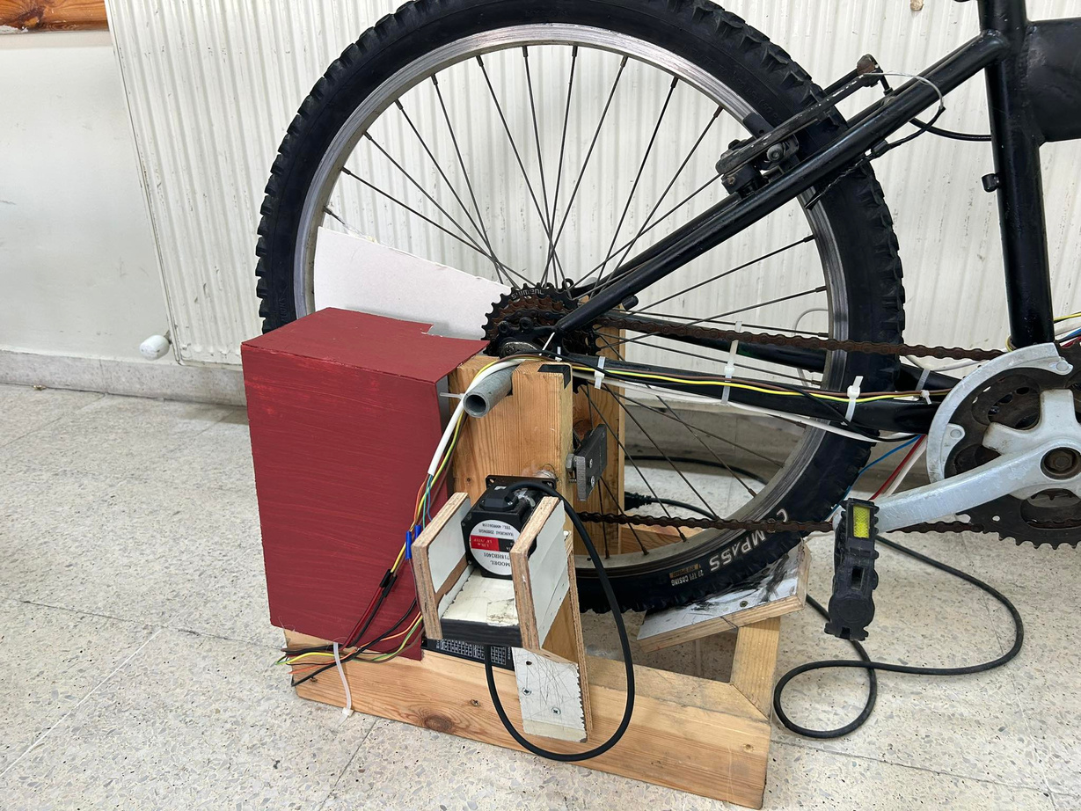
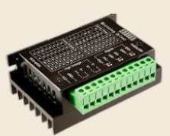
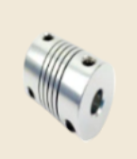
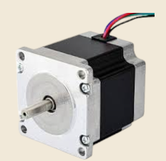
Hardware components Used:
TB6600 Driver
Coupler
J-5718HB2401 Stepper Motor

Slide 13
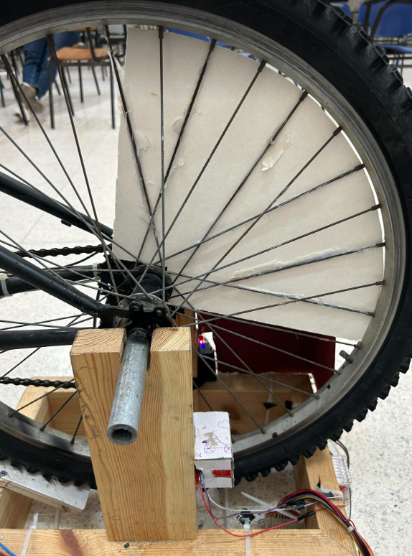
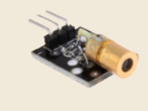
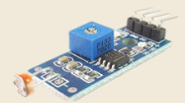
Hardware components Used:
Laser
LDR

Slide 14
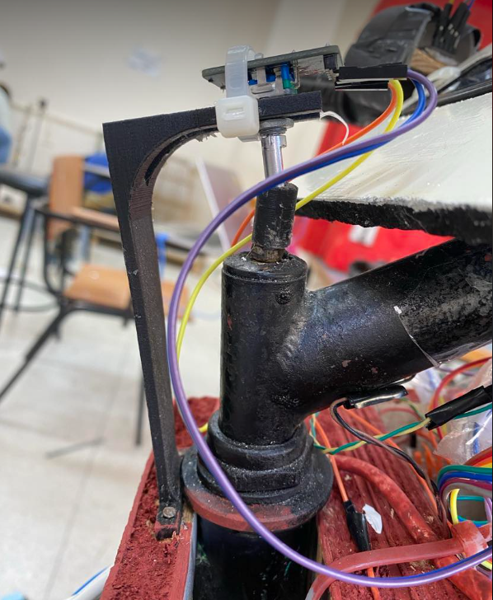
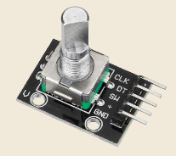
Hardware components Used:
Rotary Encoder

Slide 15
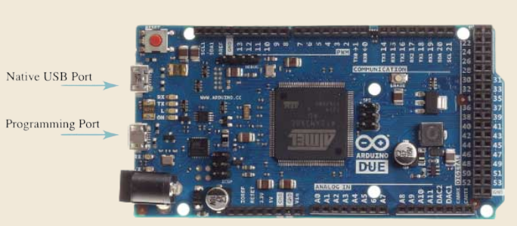

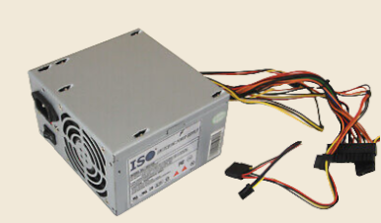
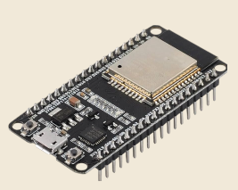
Hardware Components
Main Components:
Arduino DUE
Power Supply
ESP32

Slide 16
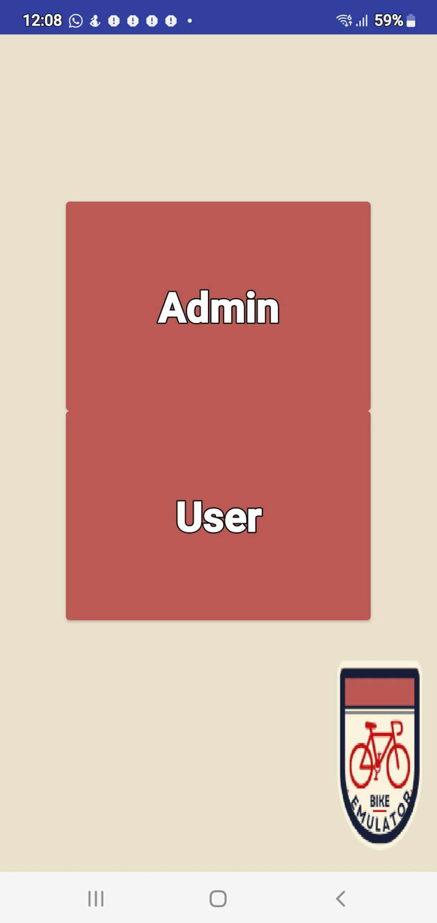

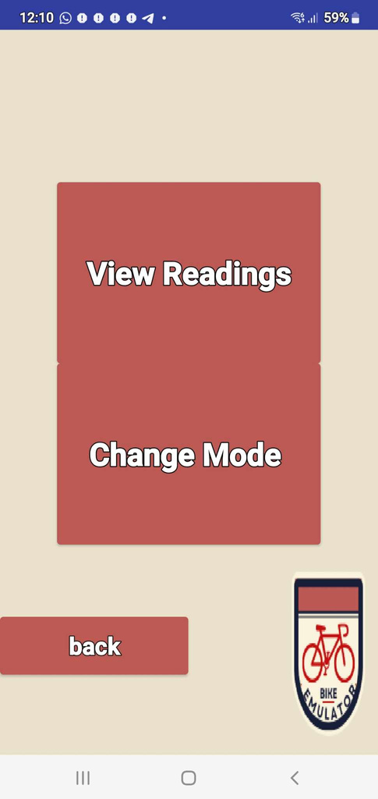
Mobile Application:

Slide 17
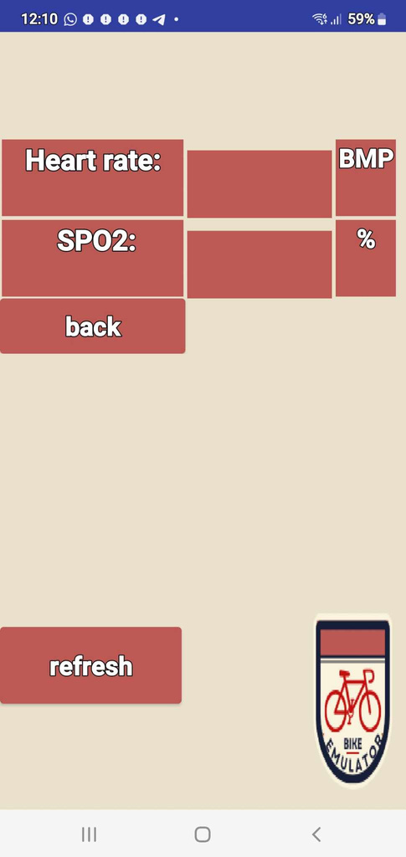
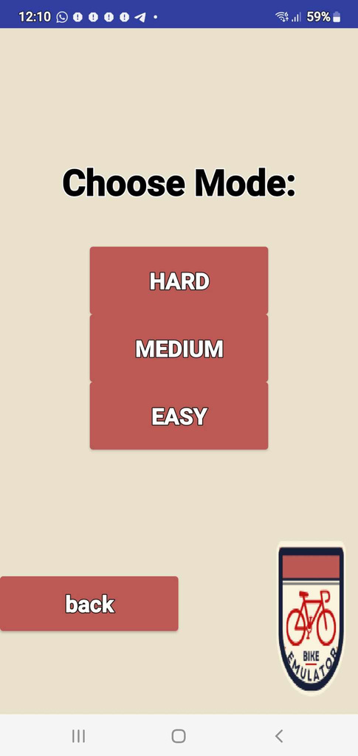

Mobile Application:

Slide 18


CHALLENGES &
CONSTRAINTS
Insufficient mechanical knowledge
Limited time
Measurement Challenges

Slide 19

FUTURE WORK
AI and machine learning integration.
Increase system’s security.
Increase safety measures

Slide 20


Thank You
EMULATOR
BIKE

