Slide 1
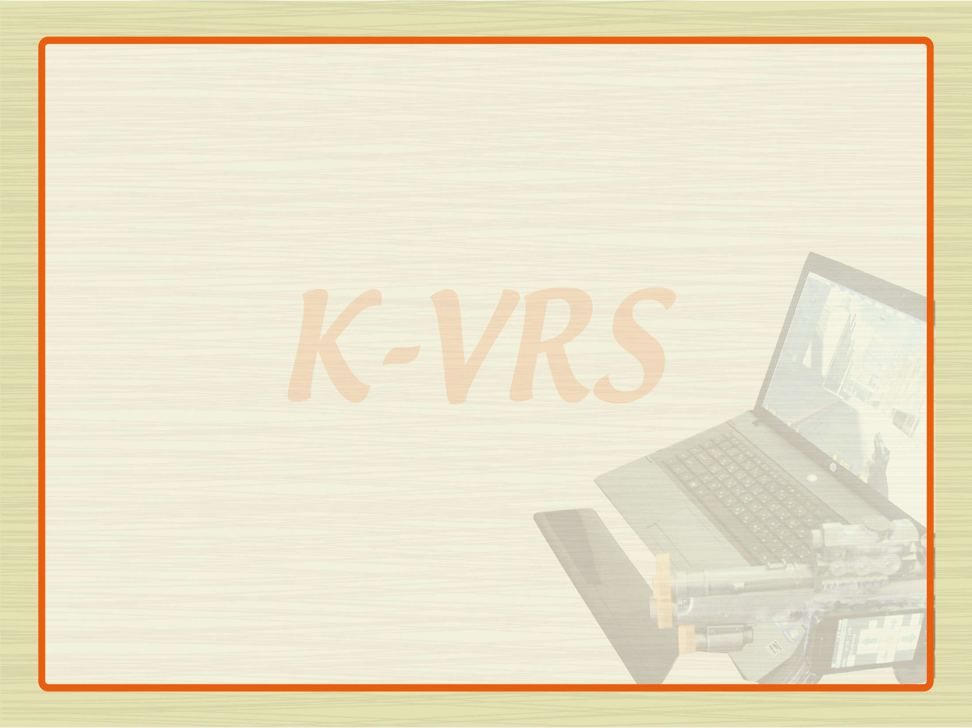

An-Najah National University
Faculty of Engineering
Department of Computer Engineering
Software Graduation Project “1”Seminar
Kinect Virtual Reality System (K-VRS )
Prepared by:
Belal Mazen Qaddara
Mohammed Wajeeh Abu-Aisha
Supervised by :
Dr. Samer Arandi

Slide 2
Outline:
Introduction
What is K-VRS?
Kinect in K-VRS
Android in K-VRS
3D Graphics in K-VRS
Demo Time

Slide 3
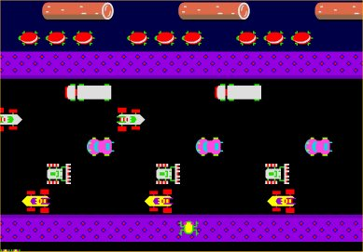
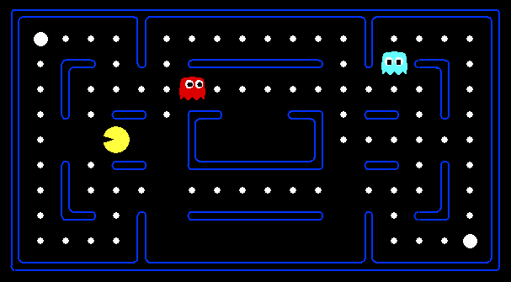
Introduction
Computer and Video Games have come a long way since the days of Pac- Man and Frogger
Atari Wired Remote control used to play games
Rapid Development in Technology gives more fun and entertainment in video games industry

Slide 4
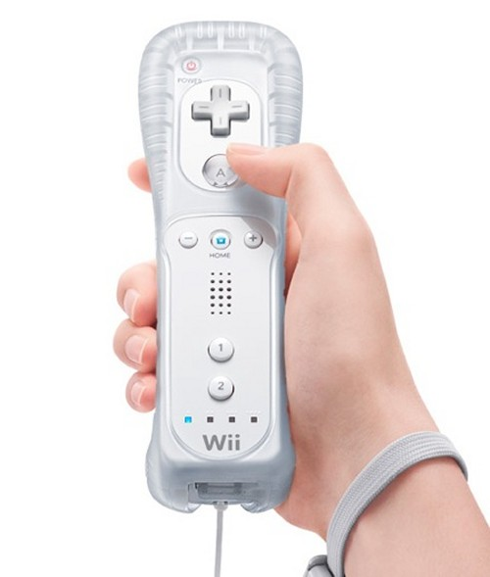
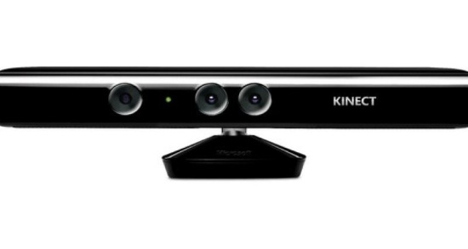
Many companies came to introduce its products in video games world for more fun .
Nintendo s’ controller (WiiRemote) one of untraditional controller in video games
With Kinect from Microsoft everything changed and user become the main controller for playing games without any additional controllers

Slide 5
Kinect and WiiRemote employ concept of virtual reality to give users sense of fun and entertainment by allowing users to be fully/partially control of the game
So what is Virtual Reality ?
Virtual Reality is a simulation in which computer graphics is used to create a realistic-looking world.
synthetic world is not static, but responds to the user’s input (gesture, verbal command, etc.)
real time interactivity: computer is able to detect a user’s input and modify the virtual world instantaneously

Slide 6
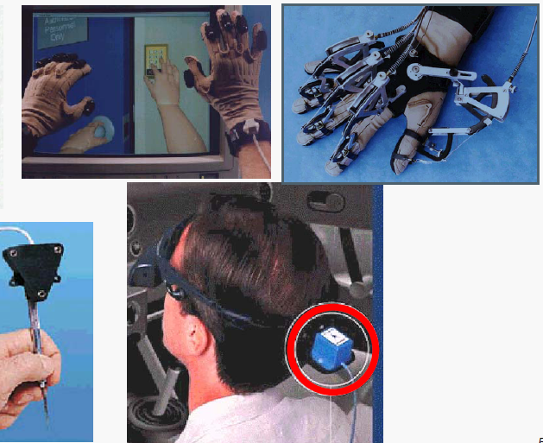
The Virtual World is Interactive

Slide 7
What is K-VRS?!
K-VRS: Kinect-Virtual Reality System
software application based on the Virtual Reality.
Uses Kinect to give player the sense of fun and entertainment and an immersive interactive experience
control FPS games
Contains simple 3D FPS game
Utilize Android device for Controlling

Slide 8
K-VRS uses the following technologies
Xna game library .
Kinect SDK API’s 1.0v .
Android Bluetooth API’s
C# and WPF.
32feet.net library.
Win 32API’s.

Slide 9
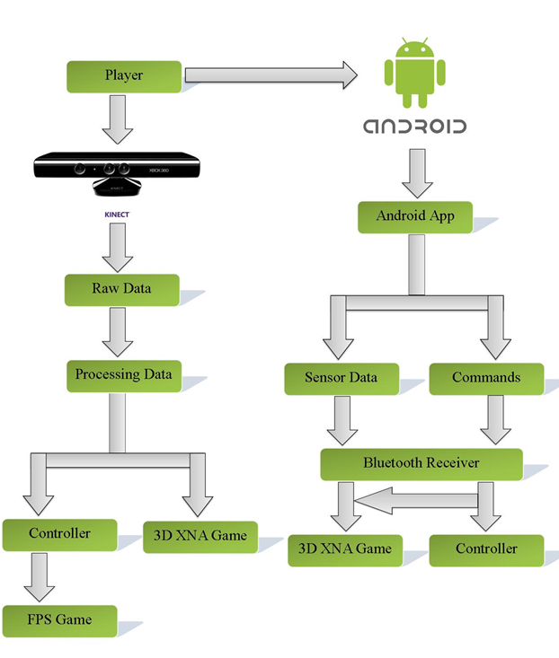
K-VRS can be described as Complete system in the following figure:

Slide 10
Kinect in K-VRS
The Microsoft Kinect sensor facilitate and provide new way of interacting and controlling with PC
Kinect for XBOX360
Kinect captures video images and detect sounds and measure depth
sensor cannot detect objects less than 80 cm and cannot measure the distance farther than 3.5m
Kinect sensor brought with Windows SDK

Slide 11
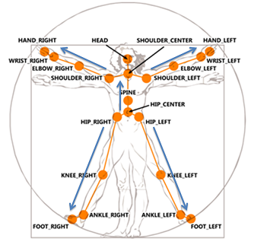
Kinect sensor can provide tracking of human bodies
Kinect can track 20 different joints for player
Each joint represents as 3D position (X,Y,Z)

Slide 12
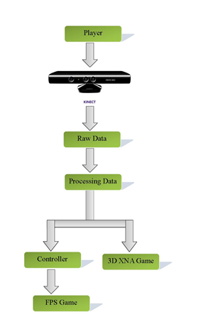
Sequence of steps from player to kinect to PC illustrated in the following figure

Slide 13
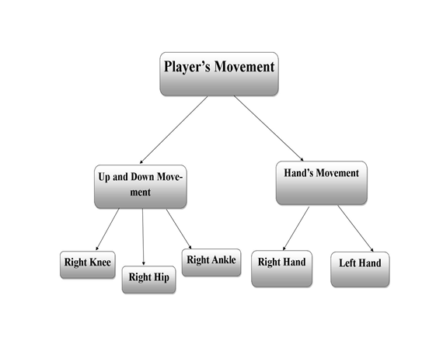
Kinect can track up to 20 joints and K-VRS uses different movements based on the following figure

Slide 14
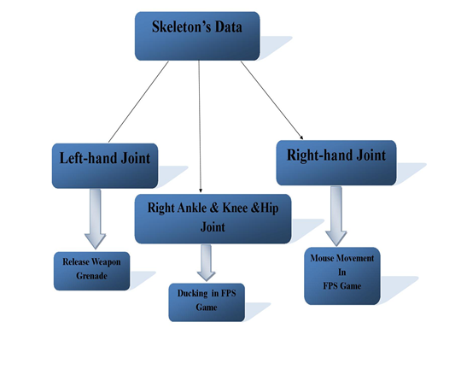
In general, data was retrieved from Skeleton’s Player is used as described in the figure below

Slide 15
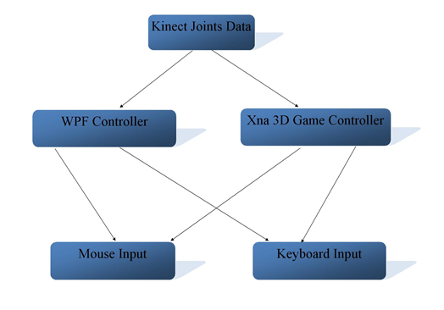
after retrieving data from kinect its time to use these data to control and play games (FPS game and our 3D Xna game) .After each one receive its data, both of them will simulate Mouse and Keyboard event

Slide 16
To send commands to Mouse and Keyboard we need special API to do this
To control mouse we need (X,Y) value from kinect(Right Hand Joint) and then scaled this value to the screen and then send normalized (X,Y) to the Mouse API 32
Scaled value (X,Y)need to normalized as absolute coordinates between 0 and 65,535
ScreenWidth(MaxX) mapped -> 65,535
X(scaled Value) mapped -> X_Normalized Value
X_Normalized Value=(X-ScaledValue)*65,535/ ScreenWidth(MaxX

Slide 17
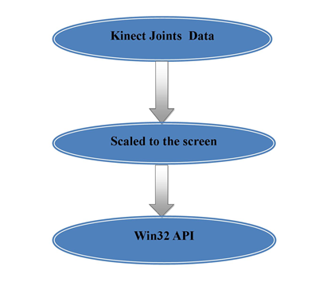
The following figure represent process of sending data to the win32 API

Slide 18
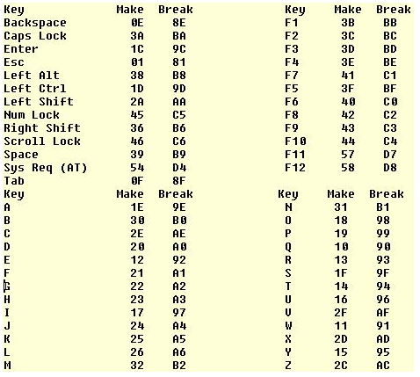
Sending command to keyboard also need Win32 API to simulate the press and release of the keys
Each key in keyboard has scan code

Slide 19
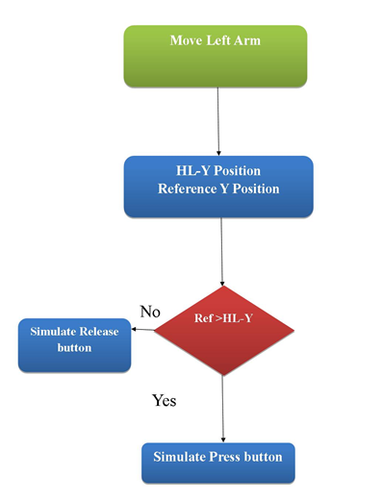
Release the grenade using Hand-Left Joint :this joint is used for in FPS games such as Counter Strike

Slide 20
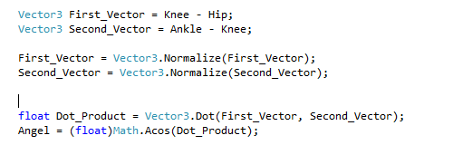
Ducking based on Right Ankle & Hip &Knee Joints:
these joints are used for up and down movement ,we need these joints data to decide whether the player is standing or ducking and we can accomplish this goal by taking 2 vectors and having dot product between these vectors and noticing how the Angle changes and according to that changes we decide the if player is up or down

Slide 21
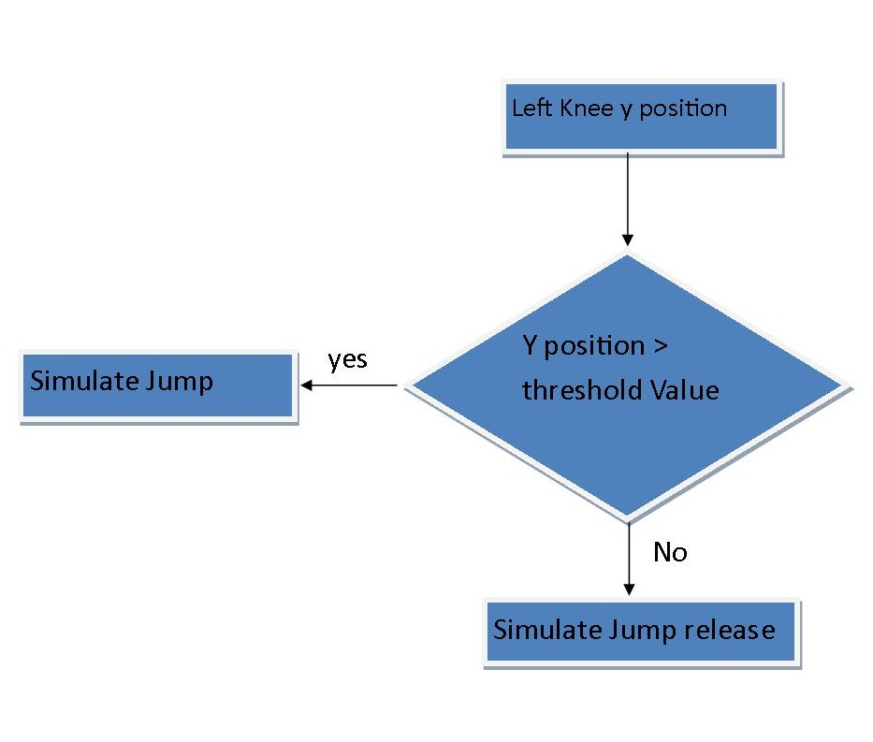
Jumping based on left Knee

Slide 22
Android in K-VRS
Android Technology utilized in K-VRS to control the virtual reality game .
The main parts of android platform used is
Android Bluetooth API
Android platform Sensor.

Slide 23
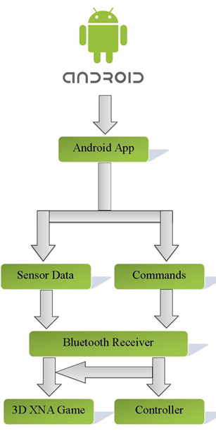

Slide 24
Android Sensor
Sensor can categorized based on hardware and on software.
Many Smartphone Android device Contains at least an accelerometer sensor .
So, in K VRS accelerometer Rotation type used in our case.

Slide 25
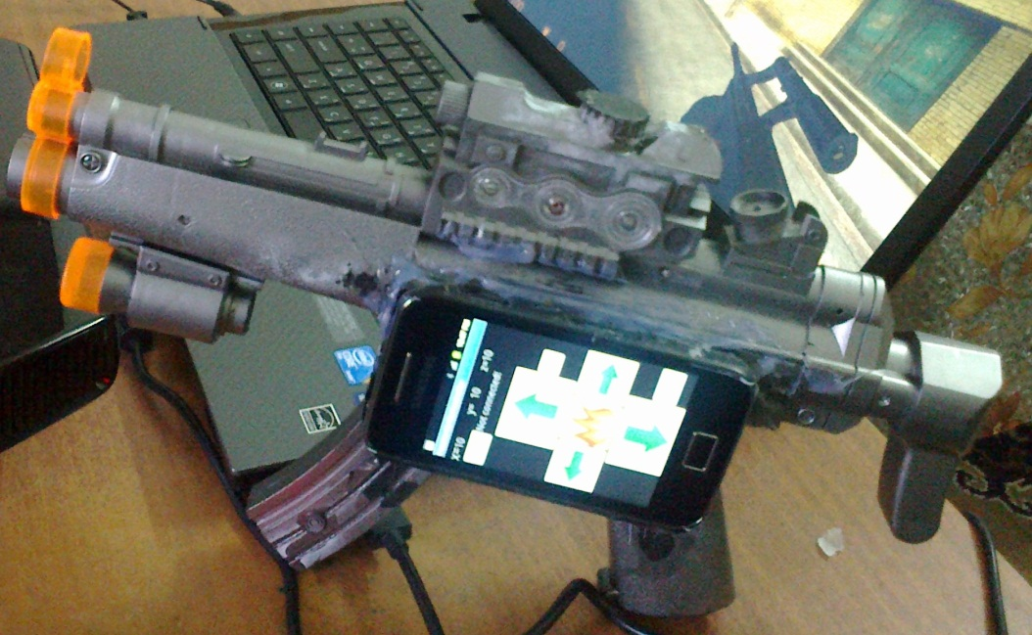
The sensor type orientation which software , used to detect the motion of weapon .
The motion of weapon left and right in real world , Detected by Orientation Sensor , Reflected to the weapon model in XNA Game .

Slide 26
Sensor Orientation type measures degrees of rotation that a device makes around all three physical axes (x, y, z).
We implement this concept in our android app
By capturing the value of three physical axes (x, y, z).
These Values sent via Bluetooth to the XNA Game and the Software Controller as array of bytes .

Slide 27
Android Bluetooth API
The Android phone will connect to a Bluetooth PC using an SPP connection.
This makes it possible to send bytes of characters from the phone to the Xna game which then reacts by turning on the weapon in the proper way .

Slide 28
Android Platform is full with rich APIs and Android Bluetooth package is one of that rich APIs.
Receiving sensor Raw of Data via Bluetooth setting ranges for these value to move the gun left or right by using trial and error.

Slide 29
Regarding to receiver part that will receive data and process them is simply a block of code inside WPF controller and Xna game.
However, the library that we used at receiver part for Bluetooth connection is 32Feet.Net.
32Feet.NET is a shared-source project to make personal area networking technologies such as Bluetooth, Infrared (IrDA) and more, easily accessible from .NET code.

Slide 30
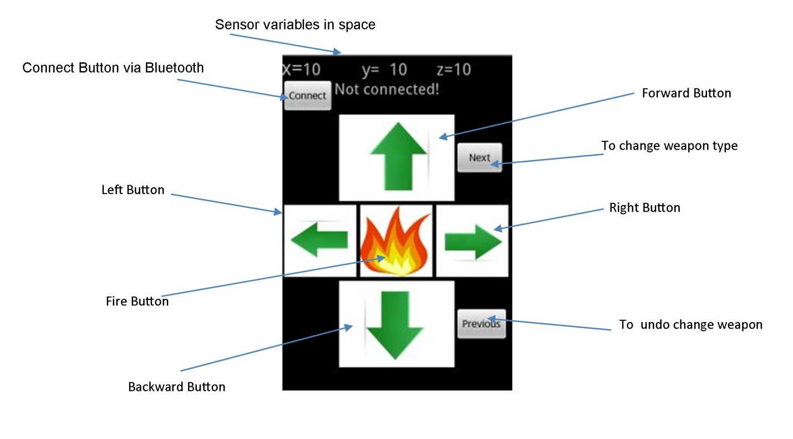

Slide 31
3D Graphics in KVRS
K-VRS system uses XNA game Framework library .
K-VRS Can run on any FPS Game, here Counter Strike.
XNA Game Studio 4.0 Refresh is a programming environment that allows you to use Visual Studio to create games for Windows Phone, Xbox 360, and Windows.

Slide 32
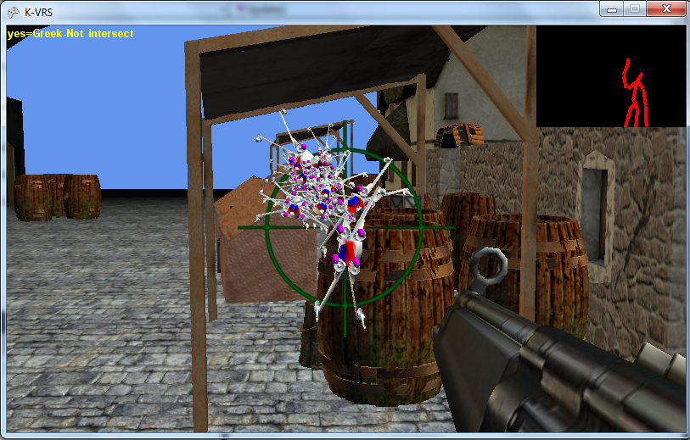

Slide 33
Loading, Drawing models in XNA environment .
A model is a file exported from a 3D modeling package such as 3D Studio Max.
The file basically contains a list of points called vertices, which form the edges of polygons that, joined together, give the appearance of a smooth surface.

Slide 34
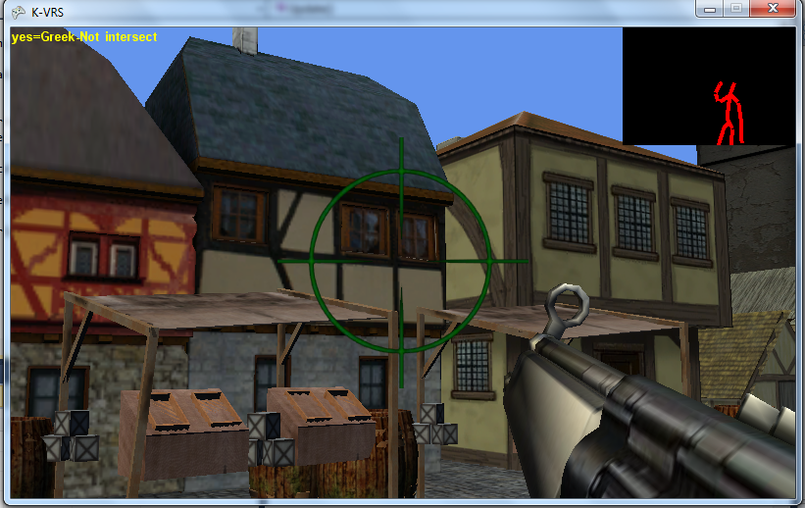

Slide 35
By adding the models to content project , XNA automatically build all the content .
After loading model now we can draw the model, using function draw the model .
We do this in the Draw() function of our game.

Slide 36
Moving in a First-Person Camera
The FirstPersonCamera Class that implements a blueprint for methods and variables that define the camera vectors, direction, projection, and camera target, matrices.
Rotation in First Person Camera

Slide 37
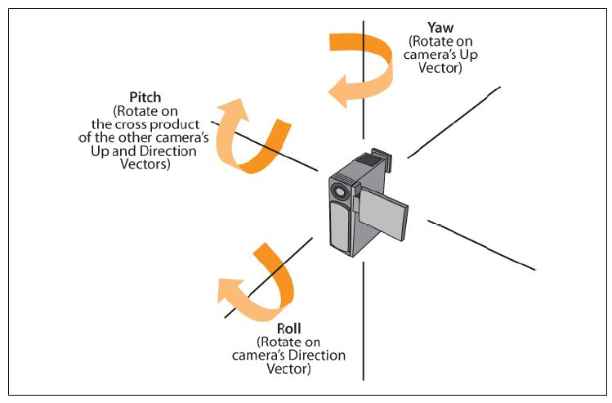

Slide 38
Firing Shot
we implement most basic level of shooting.
we realized that a projectile flying through the air or through space .
Essentially, shots (or bullets) each consist of a model, a position, and a direction, and potentially some form of rotation as well.

Slide 39
Creating moving enemies .
In XNA we generated a random number of enemies , spawned form specific position , that move in random directions .
Collision detection :
Camera Collision: the environment we draw has boundaries limit act as threshold value for the camera positions to prevent player from penetrate the limit

Slide 40
Model Collision: to know whether two 3D models interact with each other ,XNA provide several ways to detect collision for 3D models .
Enemy collision detection with bullets (Balls).
XNA depend on the radius intersection between 3D models to detect the Collision

Slide 41
Demo Time

