Slide 1

Healthy Lifestyle App
Supervised by : Dr. Samer AL-Arandi

Slide 2

Our team
Sahar Saleh
Hala Abduljalil

Slide 3








Outline
Introduction
Mobile Demo
Target group
Web Demo
Features
Technologies
Future work

Slide 4

Introduction
People's activity began to decline due to the lack of movement, and the large number of restaurants that serve unhealthy meals.
Our application is intended for the individuals who want to get a perfect body through healthy food and exercises, and it is difficult for them to know what their needs and what suitable for them hence the idea of our graduation project.

Slide 5
Target Group
People who wants to care of their health
Gym owners

Slide 6




Technologies
Flutter
Firebase
MongoDB
Node.js

Slide 7
Features

Slide 8
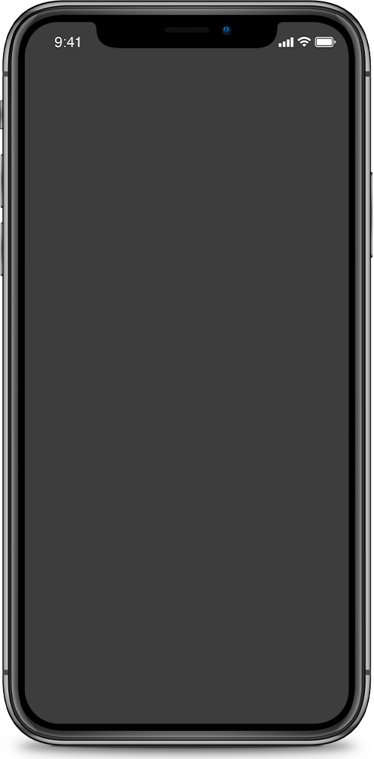
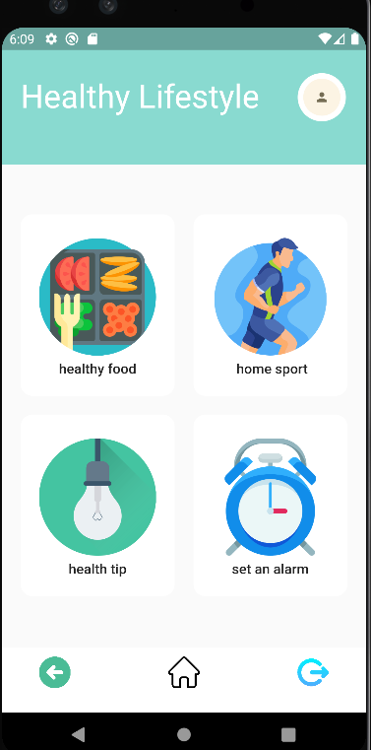
Home Page
This is the home page for our app. It allows the the user to select among its 4 main functionalities

Slide 9
Healthy Food

Slide 10
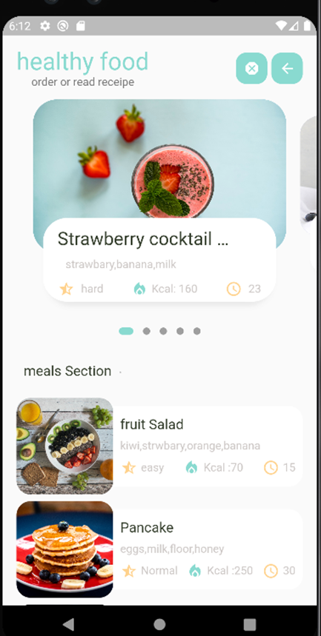
Healthy food
This page contains two sections :
  Drink section .
  Meals section .
User can order or read recipe for each section ,
The properties for each item in the food list:
ingredients, calories, difficulty level of the food,
making time of the food,
recipe .

Slide 11
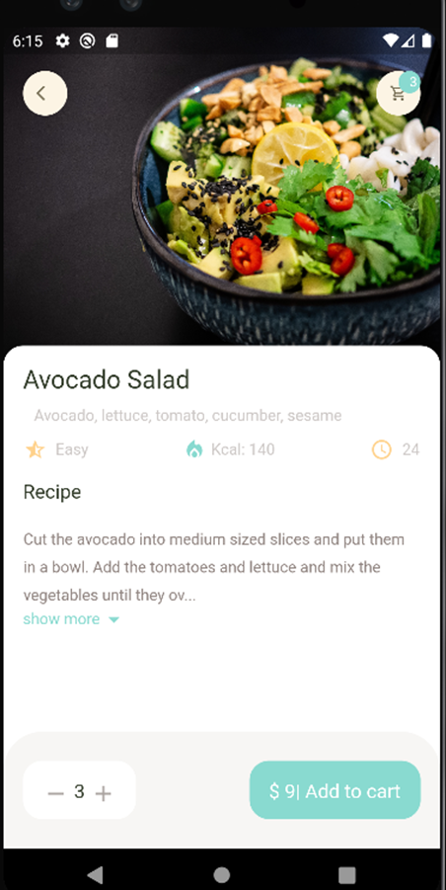
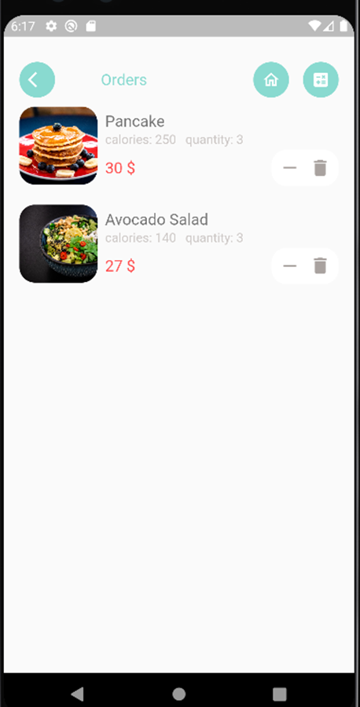
Orders
The first screen shows the
details of a food item as
recipe . Also the ability to
order the food .
The second screen shows
the orders for user with ability
to delete order or just
decrease quantity.

Slide 12
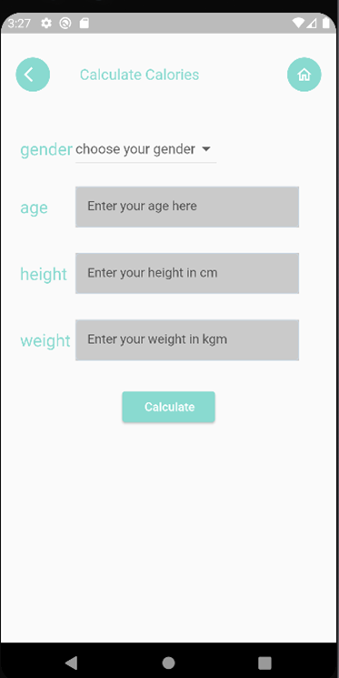
Check Calories
The user here can check if the calories he needs per day is more or less than what he ordered .
If what he needs is more than what he ordered :
then it will be okay .
Otherwise :
the app will advise him to remove some orders .

Slide 13
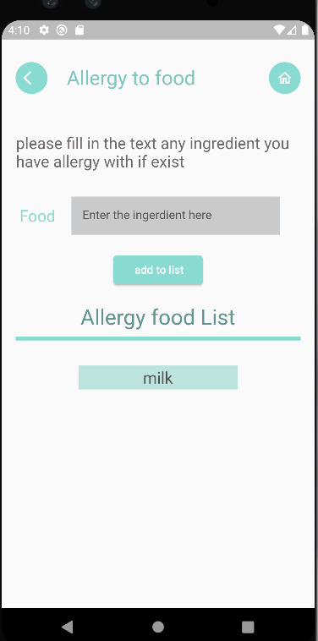
Allergy to food
The user here can specify if he has an allergy to certain ingredients.
Based on this, any recipe that includes this ingredient will be removed from viewable lists.

Slide 14
Exercises

Slide 15
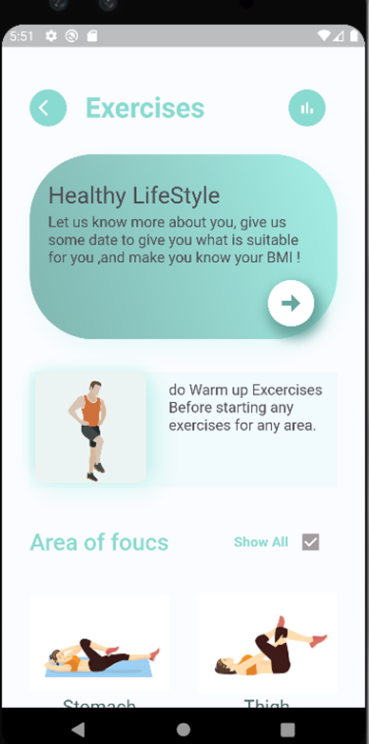
Exercises main page
Exercises main page contains three sections:
- Data required for BMI calculations.
- Warm up exercises.
- Area of focus.

Slide 16
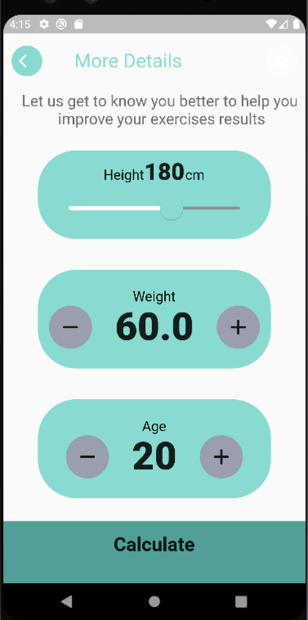
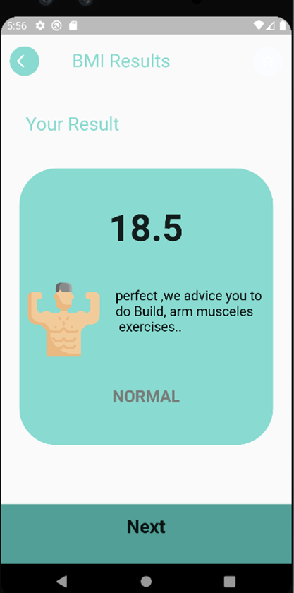
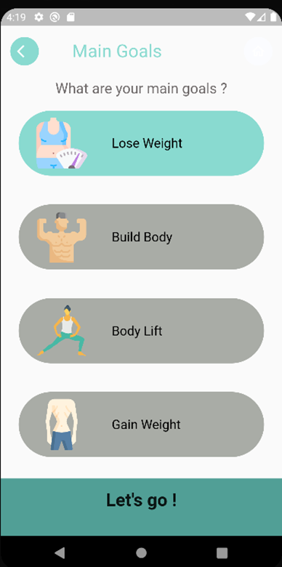
BMI

Slide 17
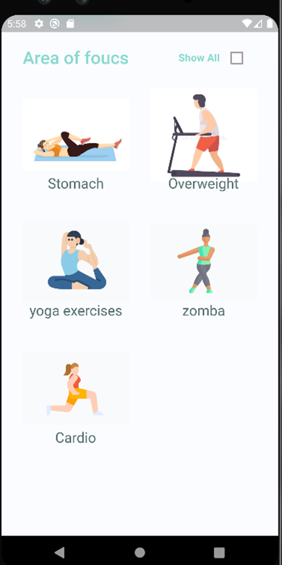
Area of focus
Exercises that they are suitable for
the user case depends on what he entered in
the BMI section .

Slide 18
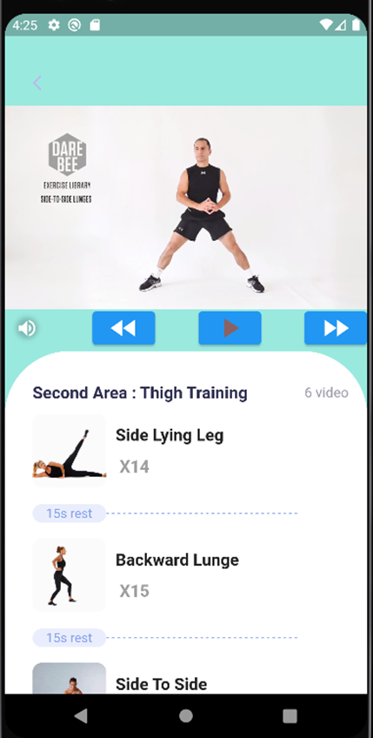
Exercises page
List of exercises to do in each group of
exercises , each exercise has repeat property
to let the user know how many times he should repeat this exercise .

Slide 19
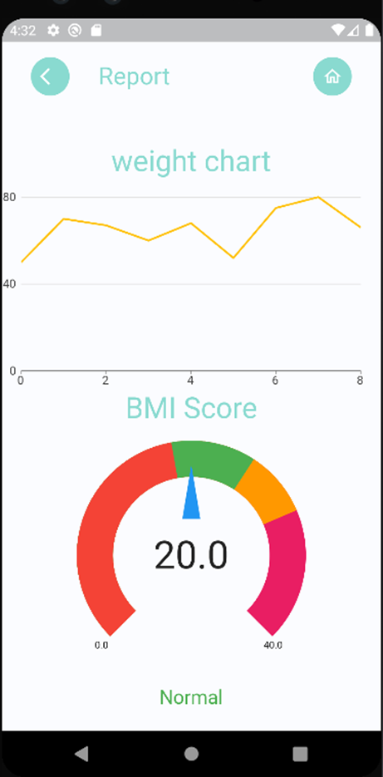
Report Page
In this page the user can see his weight
changes from the first entered weight until now .
Also he can see his current BMI.

Slide 20
Alarm Reminder

Slide 21
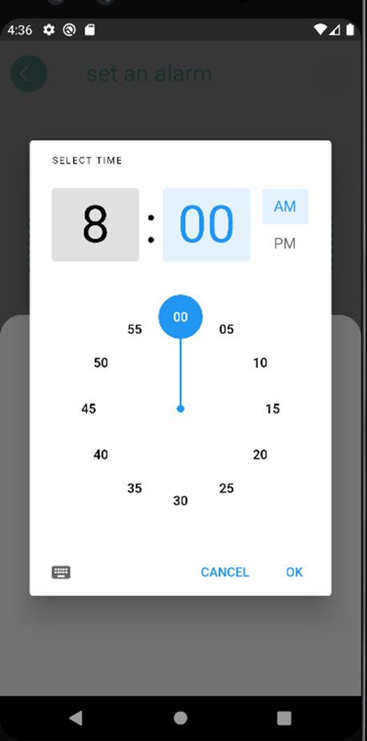
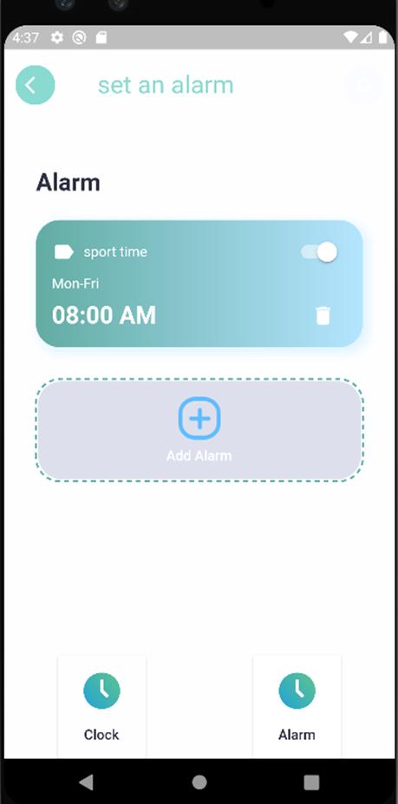
set Alarm page
This page allows the user to
set an alarm reminder for
doing his activities .

Slide 22
Health Tip

Slide 23
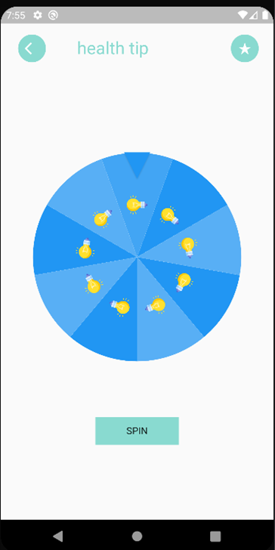
Health Tip
A funny spinner to give the user an advice
one per day .

Slide 24
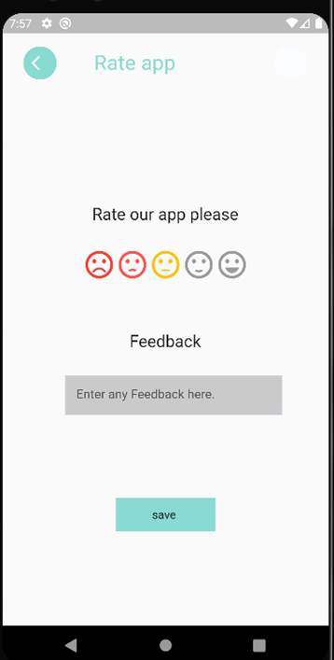
Feedback
The user can rate the app and give some
feedback here.

Slide 25
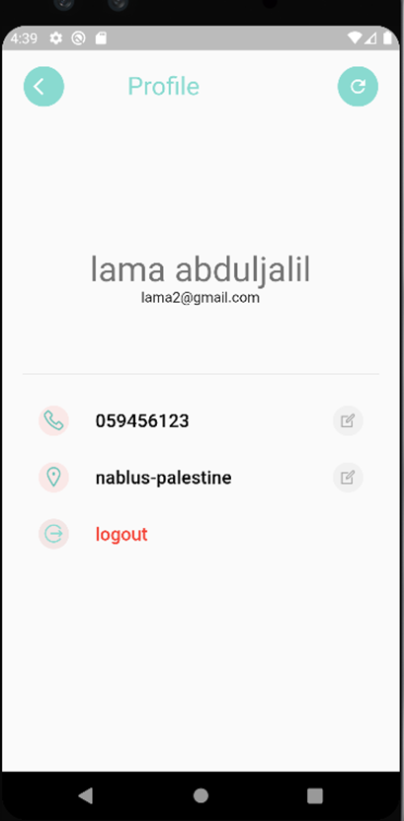
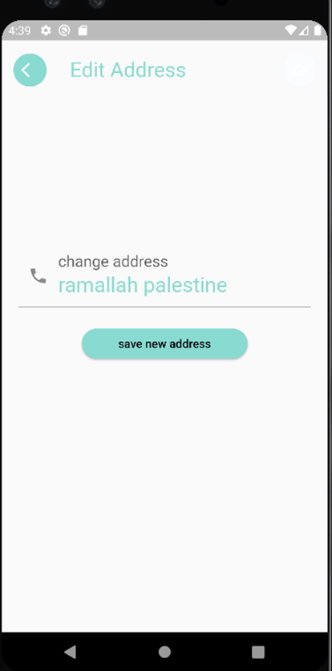
Profile Page
This is the user has a profile
page, he can edit his number
or his address .

Slide 26
Admin Website

Slide 27
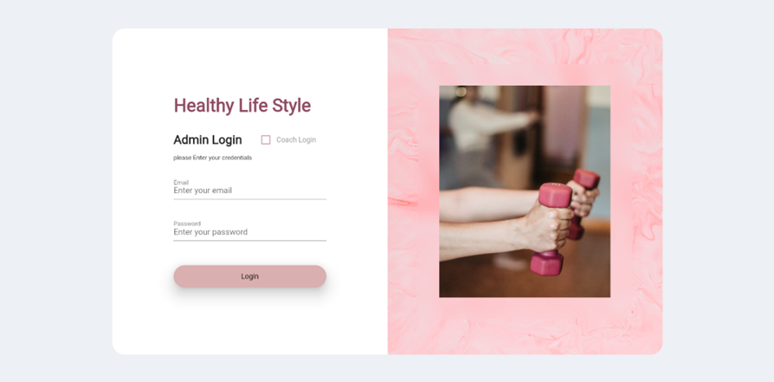
Website login
In this page the user will enter the admin home page if the coach login unchecked , otherwise he will enter the coach home page

Slide 28
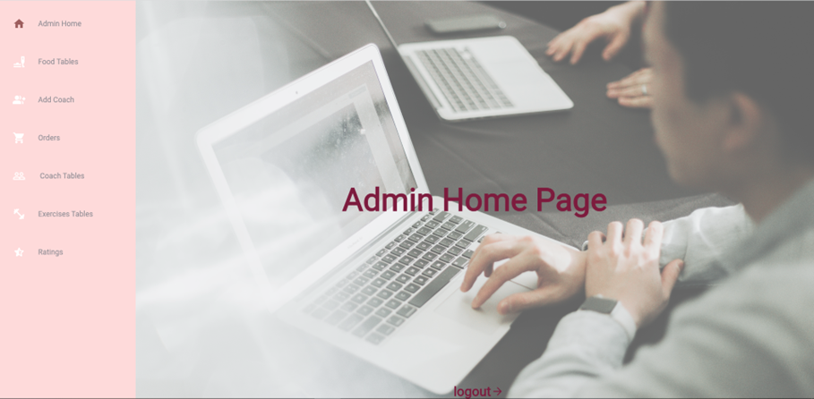
Admin Home Page
In this page the admin can see food list ,Exercises list , add coach , take orders , see ratings and feedback .

Slide 29
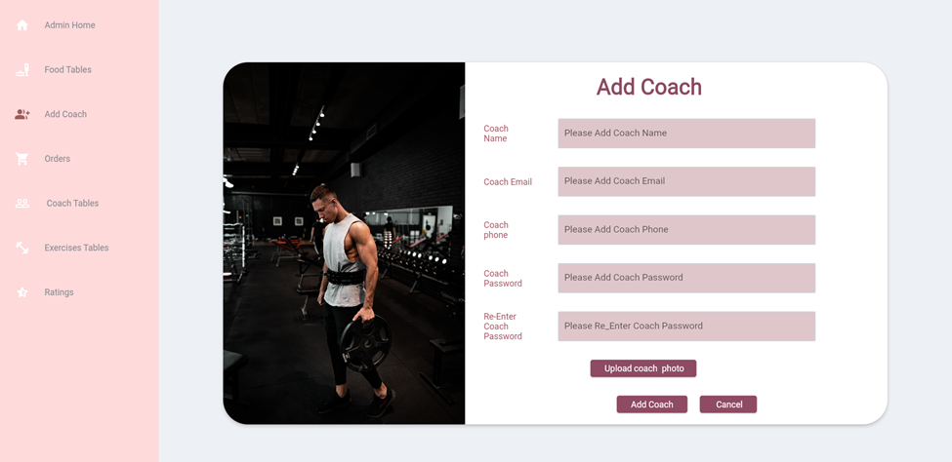
Add Coach

Slide 30
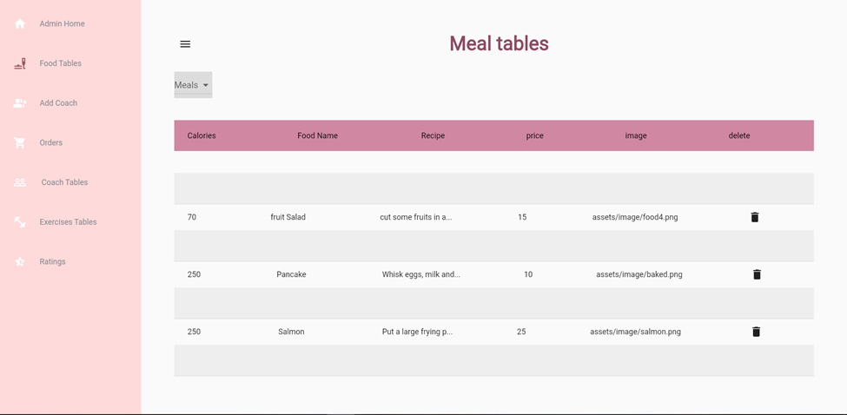
Food Tables

Slide 31
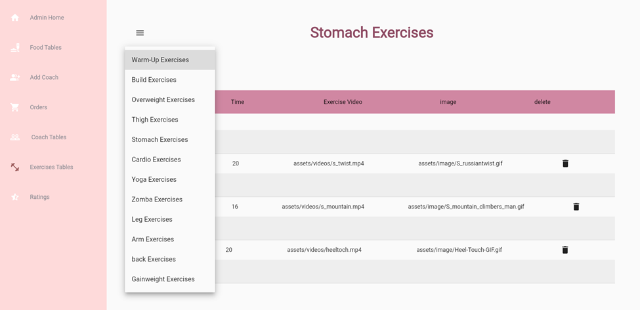
Exercises Tables

Slide 32
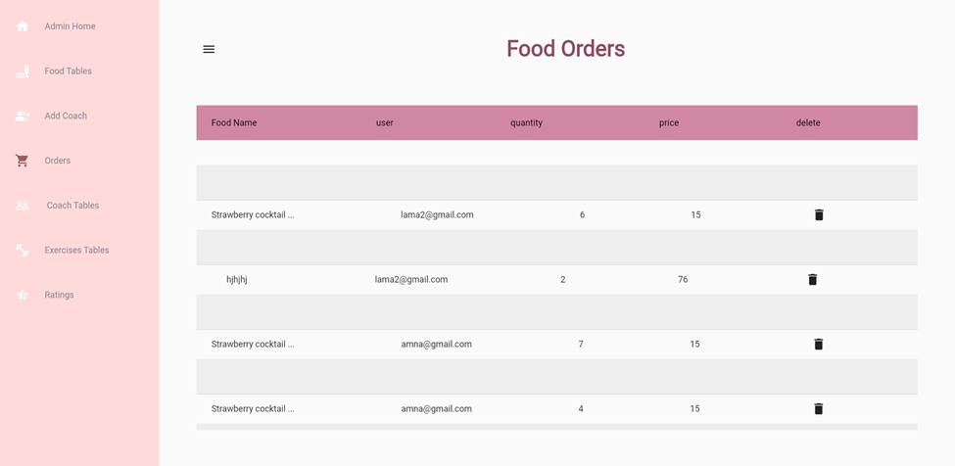
Orders Table

Slide 33
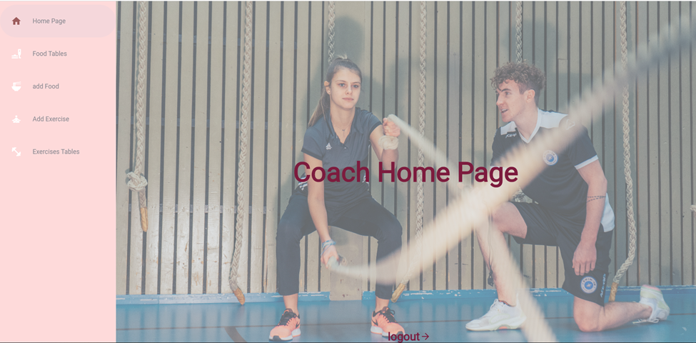
Coach Home Page
In this page the coach can add or remove food ,Exercise , and see the tables for food and exercises

Slide 34
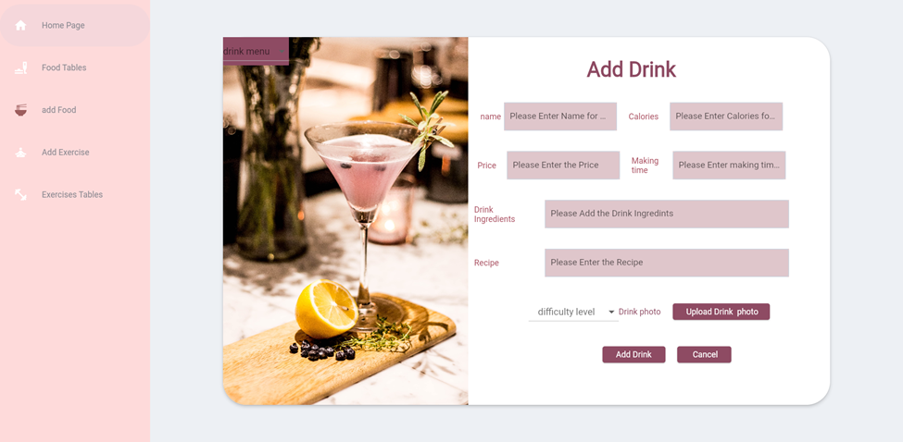
Add Food

Slide 35
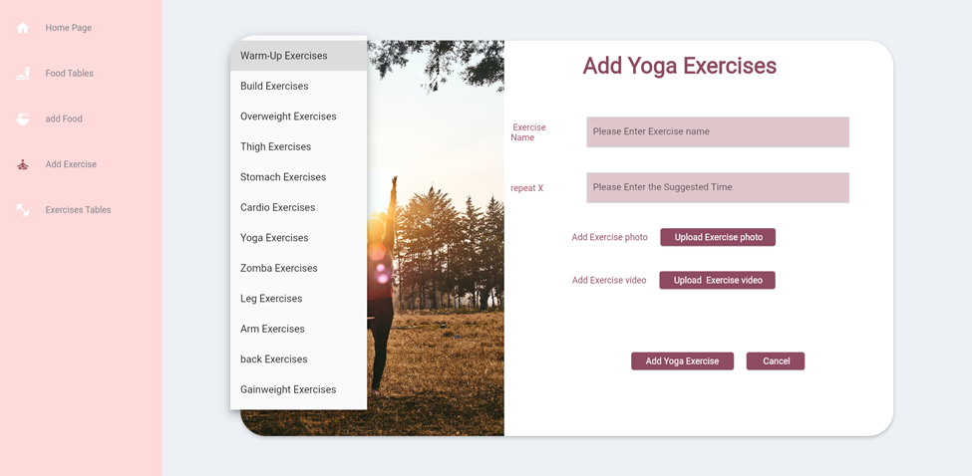
Add Exercises

Slide 36
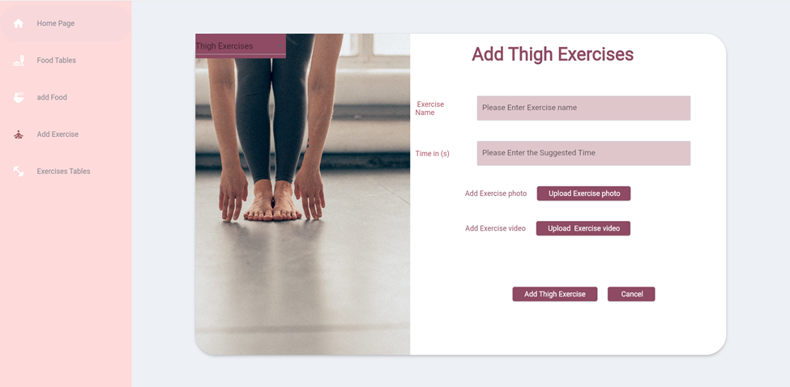
Add Exercises

Slide 37



Future work
Add the option to change the language of the application, add the Arabic language.
Add payment using visa card or PayPal
A shopping page to order sport tools and
gym machines

Slide 38
Mobile App Demo

Slide 39

Website Demo

Slide 40
THANK YOU

