Slide 1

Prepared by: Mostafa taha
Supervisor: Dr. Luai Malhis
Task Management System (TMS)

Slide 2
Outline
Introduction
Objectives
Development process
Methodology
Results and discussion
Conclusions and future works

Slide 3
Introduction
Since we live in the era of speed, where the time is very important especially for businessmen, managers, students, employees …etc.
It is very important to find a tool that can help in schedule and manage the time, meetings, and appointments.
The importance of this project comes from the need of using a single software that can be used to control many of the operations, tasks, appointments and meetings for individuals and also for teams and small companies.
This software will reduce the costs of buying several software’s.

Slide 4
Objectives
The importance of this project come from several points:
In this project, we are trying to develop a way to reduce the high cost of many already existing management tools and systems.
Using this project as calendar for appointments.
Manage projects using dashboards between team members.
Our project is an online task manager, online to do list that helps individuals and businesses effectively organize their projects and tasks.

Slide 5


System Architecture
JSON Data
Mobile
server

Slide 6

Development process
  Using Android:
  Widely used so My application support a lot of people.
  Contains a lot of packages and libraries.
  The development tools for the platform are free to download

Slide 7

Development process cont..
  Using CakePHP:
  It’s a foundational structure for programmers to create web applications.
  CakePHP is a free, open-source, rapid development framework for PHP.
  I use CakePHP version 2.7.0 because it easy to use and it has many features implicit within it.

Slide 8

Development process cont..
  Using JSON (JavaScript Object Notation) :
  It is a lightweight format that is used for data interchanging.
  The JSON format is often used for serializing and transmitting structured data over a network connection.
  It is used primarily to transmit data between a server and web application.

Slide 9
Methodology
Firstly, Web Server:
In the beginning I started gathering information to create a database.
XAMPP then installed, to run Appache server and MySQL database.
The most important key points in the CakePHP framework:
Firstly, MVC architecture that divides my software application into three interconnected parts, Model, View and Controller.
Secondly, Code generation by using console and ‘bake’ command to generate codes.
Finally, there is a more features that helped me like Email, cookie, Authentication, session, and request handling Components and much more.

Slide 10
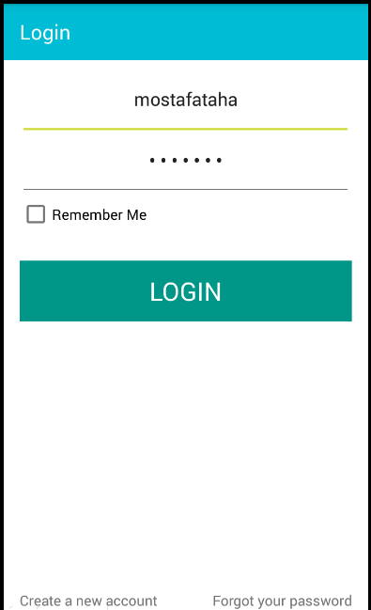
Methodology cont..
Secondly, Mobile Application:
When you run the application there is three choices Login, Registration or recover password.
If you already have an account you can log on by entering your name and password.
Also you can decide to go to the registration page to create a new account, and you can go to recovery page if you has forgotten your password.

Slide 11
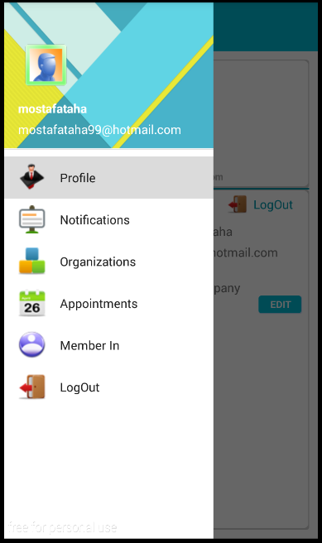
Methodology cont..
Main page:
This main page is divided into some parts the first part is the navigation bar.
The navigation bar has the user profile picture and simple information about him like his name and email.
The navigation bar contains some items are the ones which do all the functionalities required in this project.

Slide 12
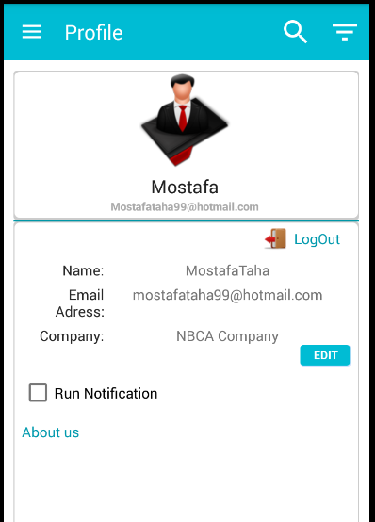
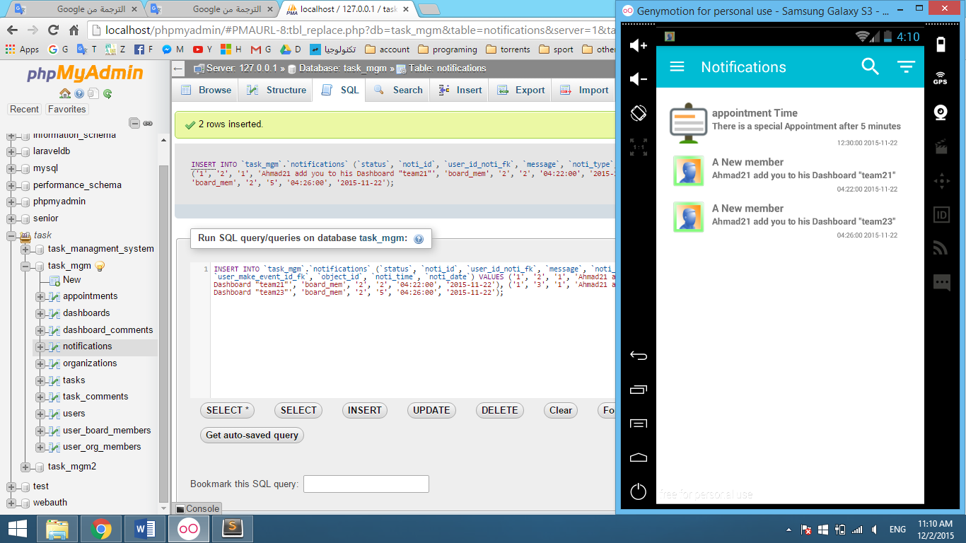
Methodology cont..
Profile Page:
This page show and presents all the needed information for the current user.
Also the user can choose if he can receive notifications or not.
Notification Page:
This page shows all notifications and events.
These notifications can be for the Appointments, Members and much more.

Slide 13
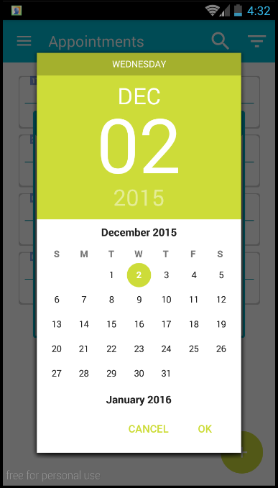
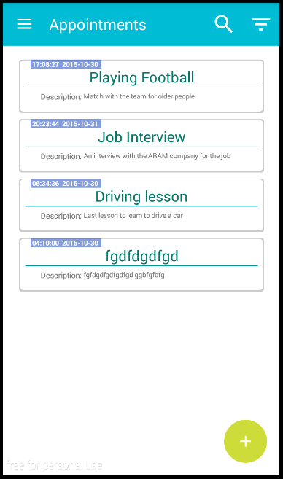
Methodology cont..
Appointments Page:
This page will allow the user to create a private appointments
Which allow him to organize appointments in the appropriate time and date.

Slide 14
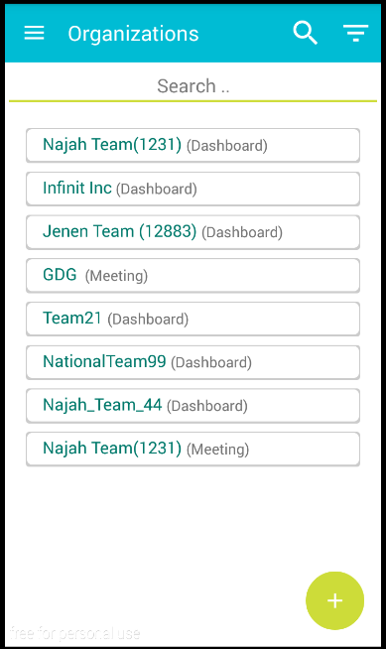
Methodology cont..
Groups Page (Organizations ):
This fragment shows and presents all groups that created by this user.
I focus on two types of groups Dashboards and Meetings.
And by clicking on one of these groups the user will be redirected to a specific activity related to these category.

Slide 15
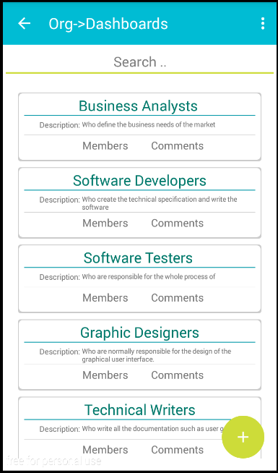
Methodology cont..
Dashboards:
The main role of this category is to help the teams to divide the work into parts in the form of boards.
Also, the distribution of team members in these boards.
All boards for this dashboard is displayed as a list of cards.
In each card we can see two buttons which are Comments and Members.

Slide 16
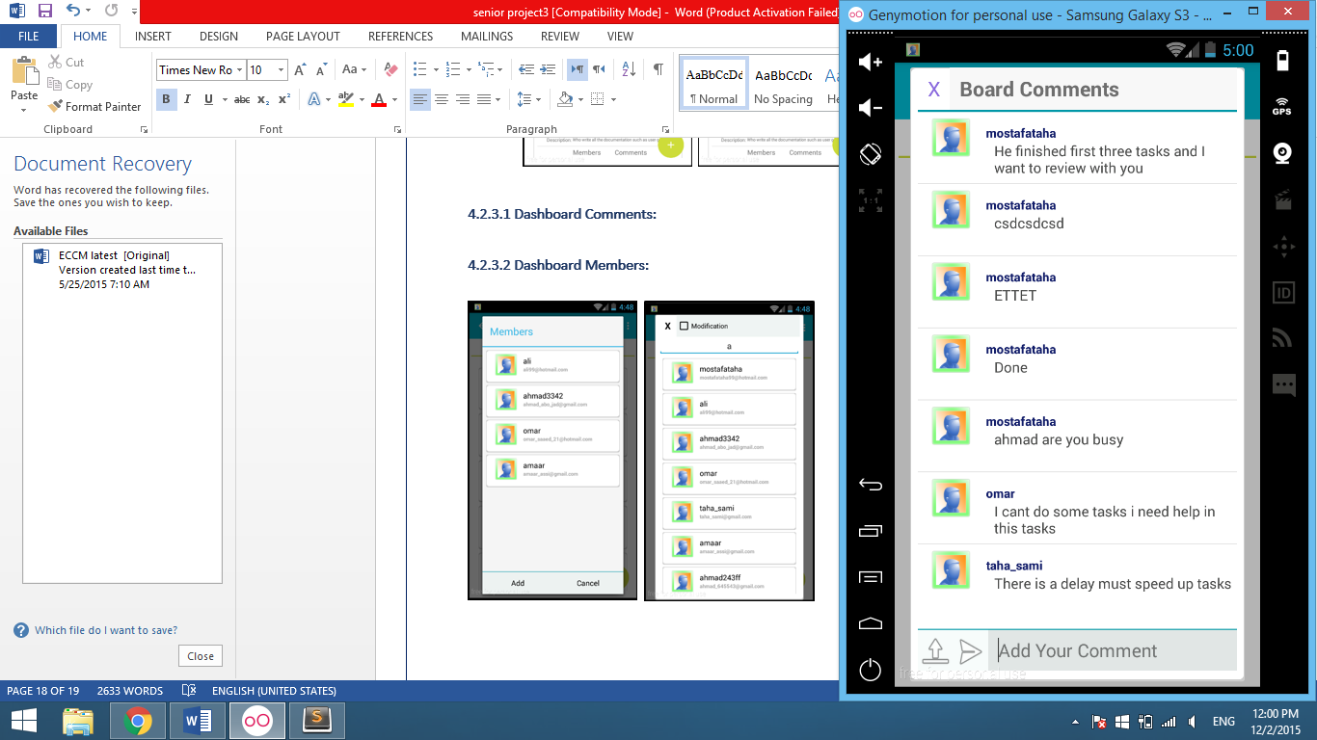
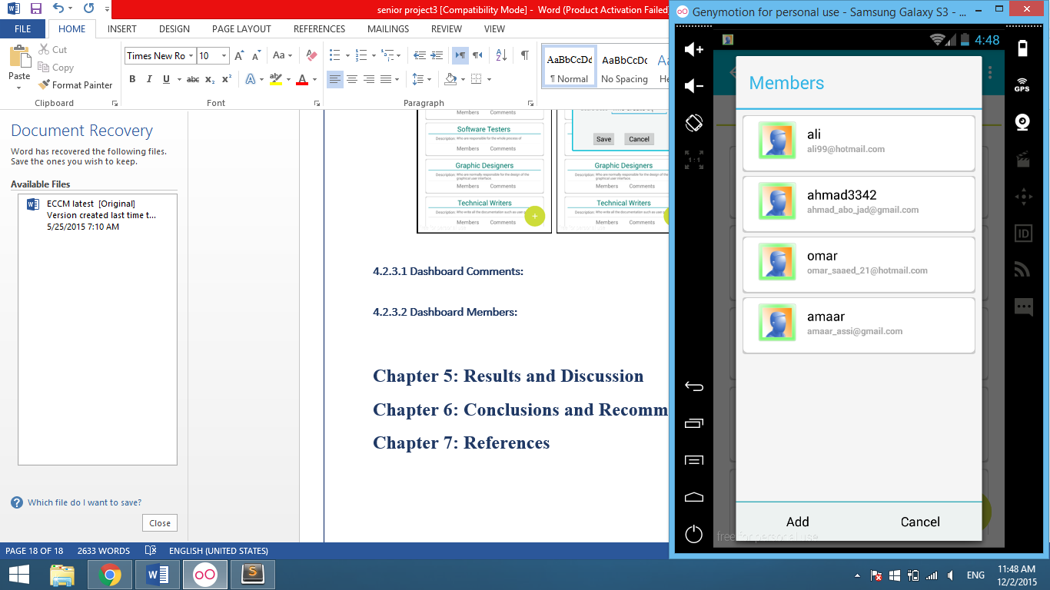
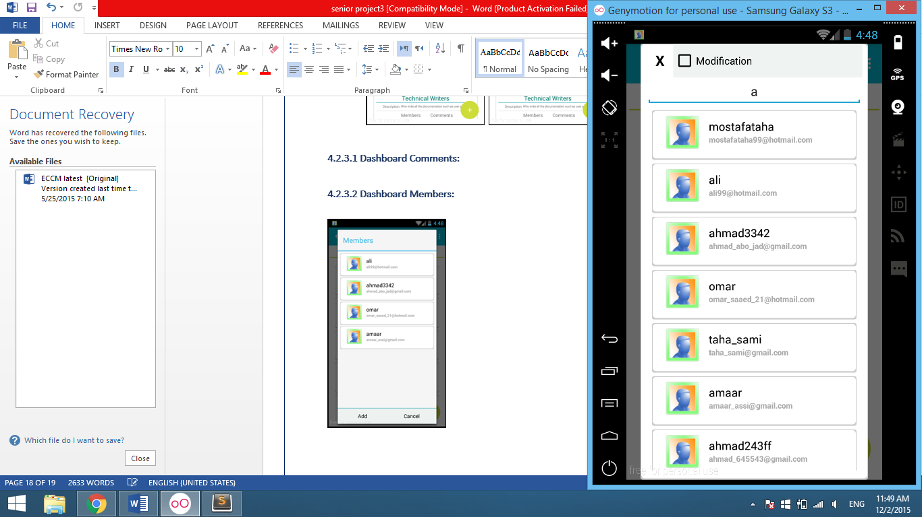
Methodology cont..
Board Comments:
Which represents a simple chat system to allow members to communicate with each other.
Only members of this panel can add comments thereon.
Board Members:
View the list of members of this board
Allows the user to add new members to the board

Slide 17
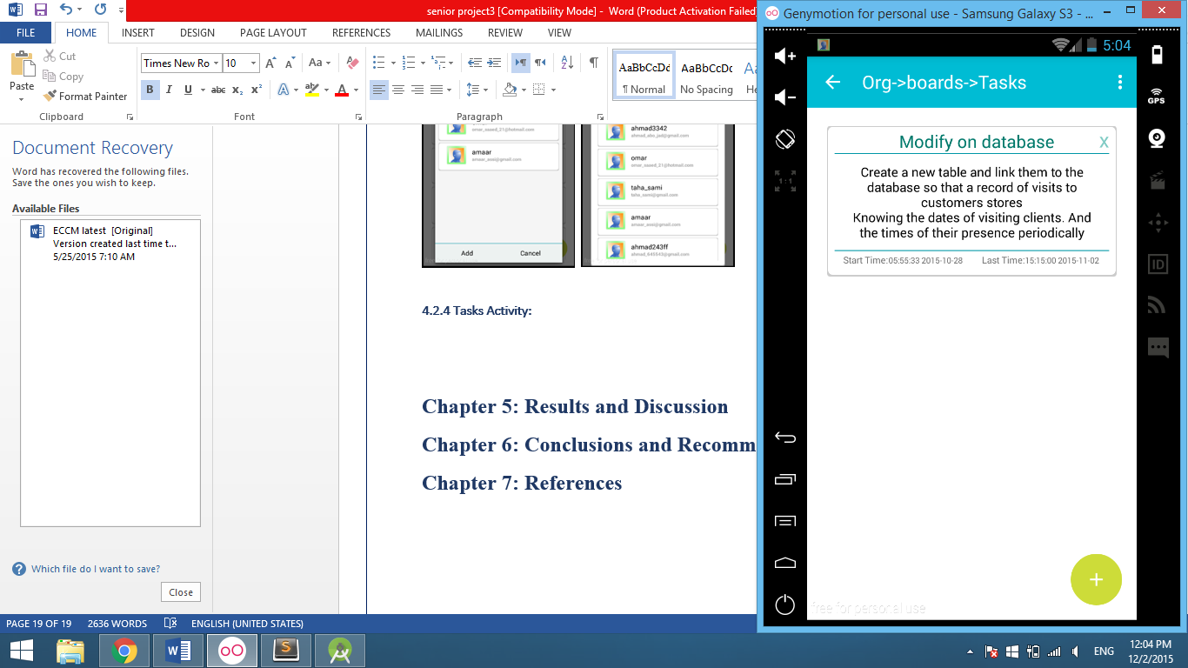
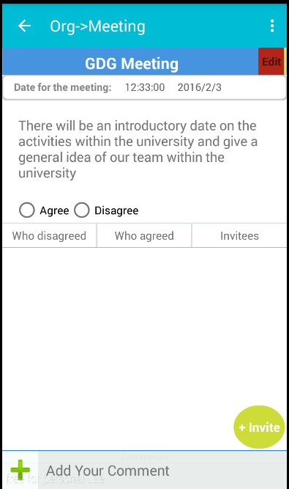
Methodology cont..
Tasks:
Each board represents the work as a set of tasks that looks like a list of cards.
Meetings:
The second category are meetings.
In this category the user can create a meeting and invite anyone needs in this meeting.
Then the user who was invited can take the approval or rejection decision on this invitation.
Members can add comments.

Slide 18
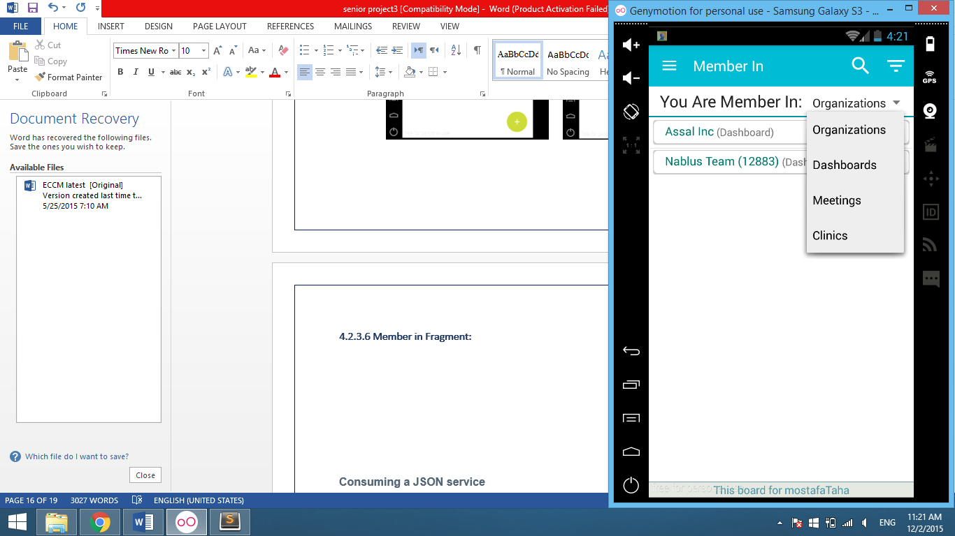
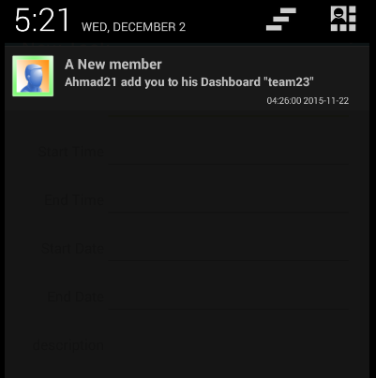
Methodology cont..
Member-In Page:
This part helps users to view all the groups to which the user is a member.
you can choose the type of group that you need to see it.
and you can deal with it and access it as if you were in your group.
Notifications Background Service:
This background service to send a request every period of time to the server to check notifications.
If there is a new notifications the user will be informed.

Slide 19
Results
I designed the application with a good vision of what I need and I did everything essential.
With this application, you can create boards to organize anything you're working on.
Finally, created an application with a good appearance and ease of use, So that the user does not find difficult to deal with it.

Slide 20
Conclusions
The program has been designed and developed to be online.
This software provide services for individuals and also for groups.
My project originated as a friendly and easy-to-use task management system that anyone can start using right away.

Slide 21
Future work
I need to make all the functionalities offline.
Can be developed that application by adding different categories of group.
Of course the most important things that must be completed is the need to create a web site.

Slide 22
Questions?

