Slide 1
Application For PLC using Sound Command
Prepared by : Rahma Faris
Rawan Abdullah
Abdulhaleem Dwaikat
Supervisor : Dr.Kamel Saleh

Slide 2
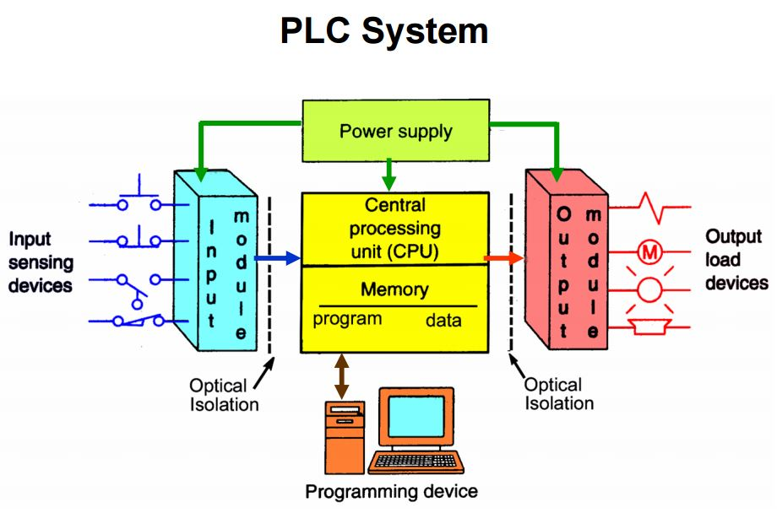
PLC
is a system which constantly monitors input devices in order to make decisions based on a customized PLC programming in order to control the state of output devices of a machinery, As a micro-computer, a PLC can only fully operate when all its components are in place. For the PLC programming to operate effectively, a basic PLC system must have the following:
Processor:
Rack/Mounting
Input Assembly
Output Assembly
Power Supply
Programming Device/Unit

Slide 3
PLC programming: used for Referred to as special computers, PLCs operate with the aid of PLC programming and are often used to control sensors and monitors.
focus about 2 main PLC programming languages in use today:
Ladder Logic: This is the most important part of PLC programming.it includes a number of terminologies which needs to be known in order to know how it operates , Y- Normal Output signals, M – Motor symbol, T – Timer, and C – Counter. This is the most commonly used language across all PLCs
Function Block: This programming language uses a graphical language for PLC. It is also very popular because it is an easy way to write programs like Ladder Diagram. They can be easily identified by boxes which consist of a number of lines of code.
Connect PLC to PC device :
It can utilize the serial port of PC to establish the connection between PLC and PC and incorporate the Modbus protocol while developing the software. If PC doesn’t have the serial port, then a USB-to-RS485 converter is needed which can establish the connection. If PLC has Modbus over TCP/IP then it can use LAN Port to establish the connection and develop software accordingly, then it can access the data using the Modbus registers and control PLC.

Slide 4
EATON (easy E4-ac-12rc1):
In the project this controller was used, which have the following properties:
 Rated Power Supply 100-240Volt DC/AC with 50/60Hz.
 Digital input Equal 8.
 4 Digital Output relay.
 With timer.
 With LCD-Display.
Ethernet port with Data transfer rate 10/100 Mbit/s,
Connections RJ45 plug, 8-pin and CAT5 cable.
 Supporting protocol for TCP/IP.
 Supporting protocol for MODBUS.

Slide 5
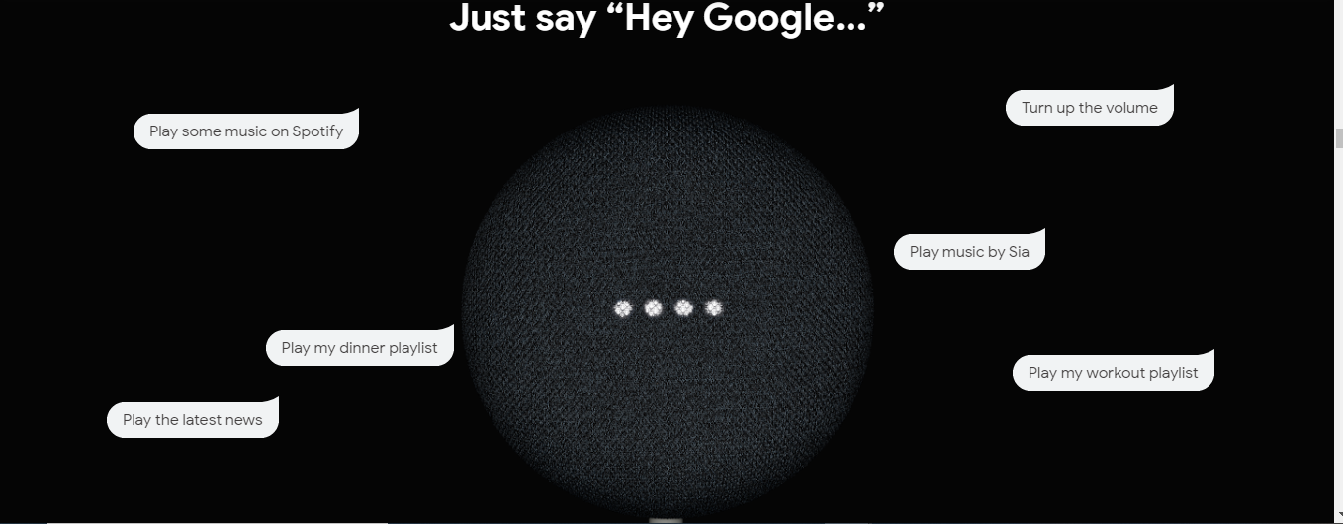
Google Home: is a line of smart speakers developed by Google under the Google Nest brand.The devices enable users to speak voice commands to interact with services through Google Assistant, the company's virtual assistant. allowing users to listen to music, control playback of videos or photos, or receive news updates entirely by voice.
Nest mini:
On October 15, 2019, Google unveiled a second-generation model branded as Nest Mini, which was released on October 22, 2019. It includes a larger speaker, an additional microphone, a machine learning chip that can catch voice recognition data for commonly-used commands locally, and "ultrasonic sensing". It is nearly-identical in design to the first-generation Home Mini, except its cover is now made from recycled plastic. The back of the Nest Mini contains a hole for wall-mounting with a screw, and it contains LED lights that highlight the touch areas for volume control. It is available in different colour .

Slide 6
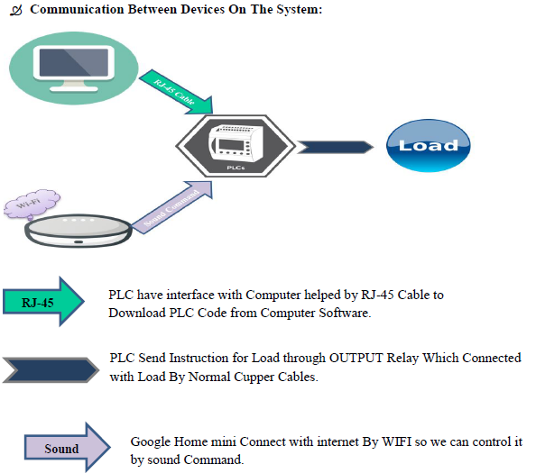

Slide 7
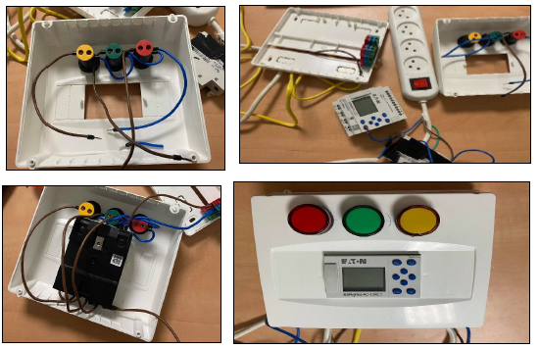
Electrical Connection:
In this part, will explain how connect PLC device with lamps theoretical and practically as shown in below figures

Slide 8
Software Overview:
KepserverEX6:
KEPServerEX6 is the industry’s leading connectivity platform that provides a single source of industrial automation data to all of your applications. The platform design allows users to connect, manage, monitor, and control diverse automation devices and software applications through one intuitive user interface. KEPServerEX leverages OPC (the automation industry’s standard for interoperability) and IT-centric communication protocols (such as SNMP, ODBC, and web services) to provide users with a single source for industrial data. The platform is developed and tested to meet our customers’ performance, reliability, and ease-of-use requirements.[4]
KEPServerEX6 provides data access for client applications (such as MES and SCADA) and IoT and Big Data analytics software via OPC, proprietary protocols (including GE NIO, SuiteLink/FastDDE, and Splunk), IT protocols (including MQTT, REST, ODBC, and SNMP), and flow measurement export to common Oil & Gas industry formats.

Slide 9
Node-Red:
is a flow-based development tool for visual programming developed originally by IBM for wiring together hardware devices, APIs and online services as part of the Internet of Things, It provides a browser-based editor that makes it easy to wire together flows using the wide range of nodes in the palette that can be deployed to its runtime in a single-click..
EasySoft7:
Eaton’s easySoft software is used to program easy controllers and displays. The software provides circuit diagram input and editing and the diagrams can be displayed in the format desired. An integrated offline simulation tool allows users to test a circuit diagram before commissioning. It supports users who are configuring, programming and defining parameters for all the intelligent relays and creating visualization functions for the MFD displays.

Slide 10
Ladder Diagram
Ladder logic was originally a written method to document the design and construction of relay racks as used in manufacturing and process control Each device in the relay rack would be represented by a symbol on the ladder diagram with connections between those devices, it has a several symbols with several Meaning
It is a language that can be dealt with easily, so it was chosen in this project using EasySoft7 program to control devices.

Slide 11
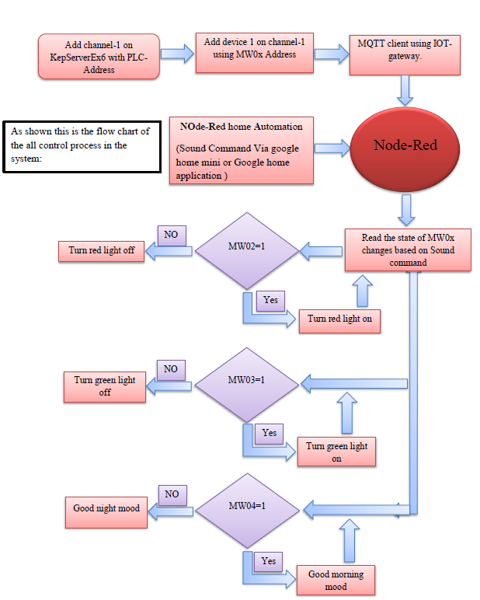

Slide 12
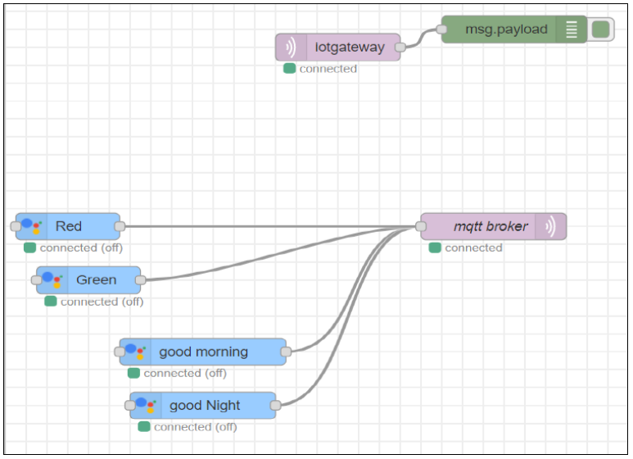
Google home-mini with PLC connection using Node-red:

Slide 13
Red Light

Slide 14
Green Light

Slide 15
Good Morning and Good night Mood:
Switch Node Properties for Good Morning mood,
PLC Ladder for Good morning and good night mood
Switch Node Properties for Good Night mood.

Slide 16
Display Of PLC :

Slide 17
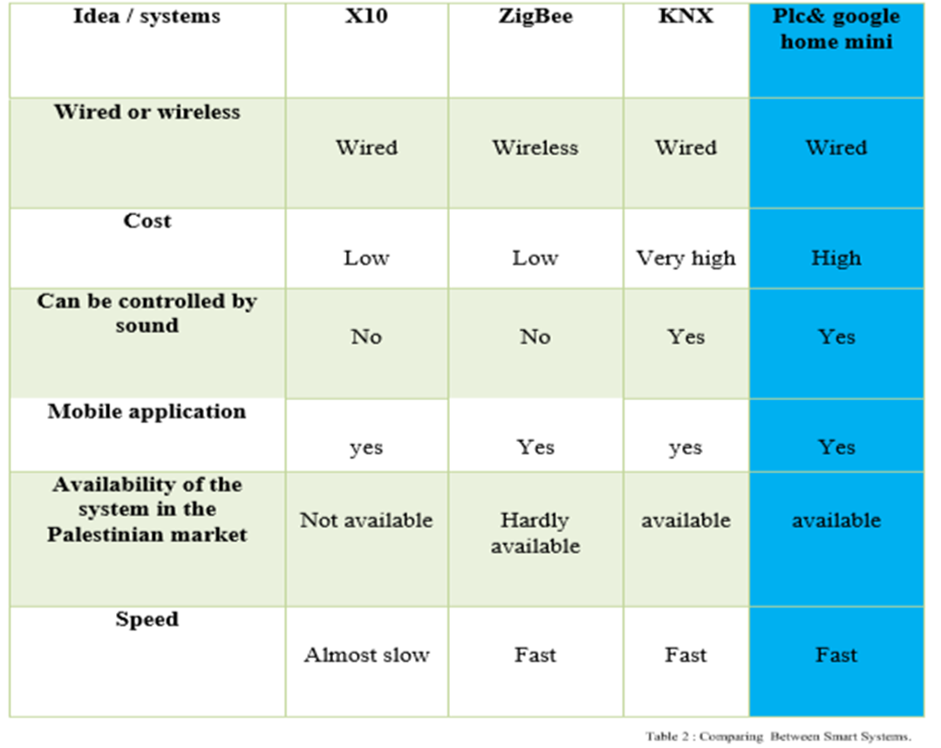
plc with other Controllers:
Now we will define the comparison between system that be chosen for this project, x10, ZigBee and KNX controllers, This table below will describe all advantages and disadvantages for all types:

Slide 18
Feasibility study

Slide 19
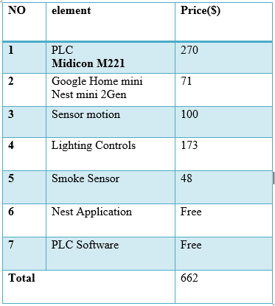
assume that the depreciation factor equal (0.1) for twenty years life cycle
The most important advantage of this project is decreasing the running cost because it does not need much maintenance as there are not many items

Slide 20
KNX System:
The biggest competitor and alternative solution to the project are KNX because it is available in the market.
The fixed cost for a home has the same load of this project will control it by using KNX system equal 2000$ approximate.
The reason for the high price of KNX system is:
fixed cost.
running cost. (Actuater , gateway , 2 power Supply )

Slide 21
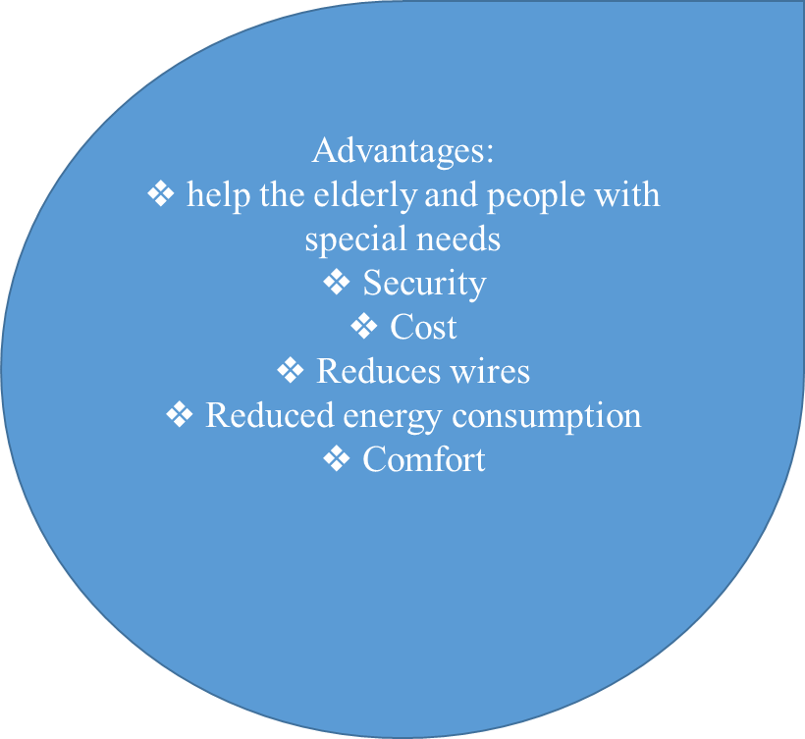
Advantages & Disadvantages:
Disadvantages:
Security.
lack of technological knowledge.
Cost.

Slide 22
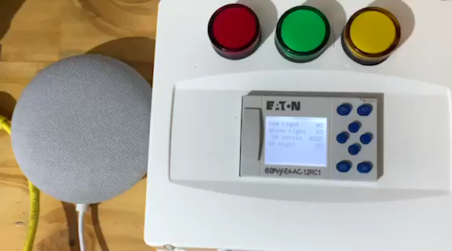
Result:

Slide 23
Conclusion:
This research aims to develop the concept of smart home by using the PLC & Google home mini , The world tends to make everything around it smart in general and private field homes, malls,and hotels, on the other hand, the cost is the biggest problem!increasing competition between companies will work to reduce the cost of these systems and this is what this project looking forward (low cost with high performance).
this project try to make a combination between Google Home and insert Sound Command to Smart Home using PLC as the main Controller.

Slide 24
Thanks!
Any Question?

