Slide 1
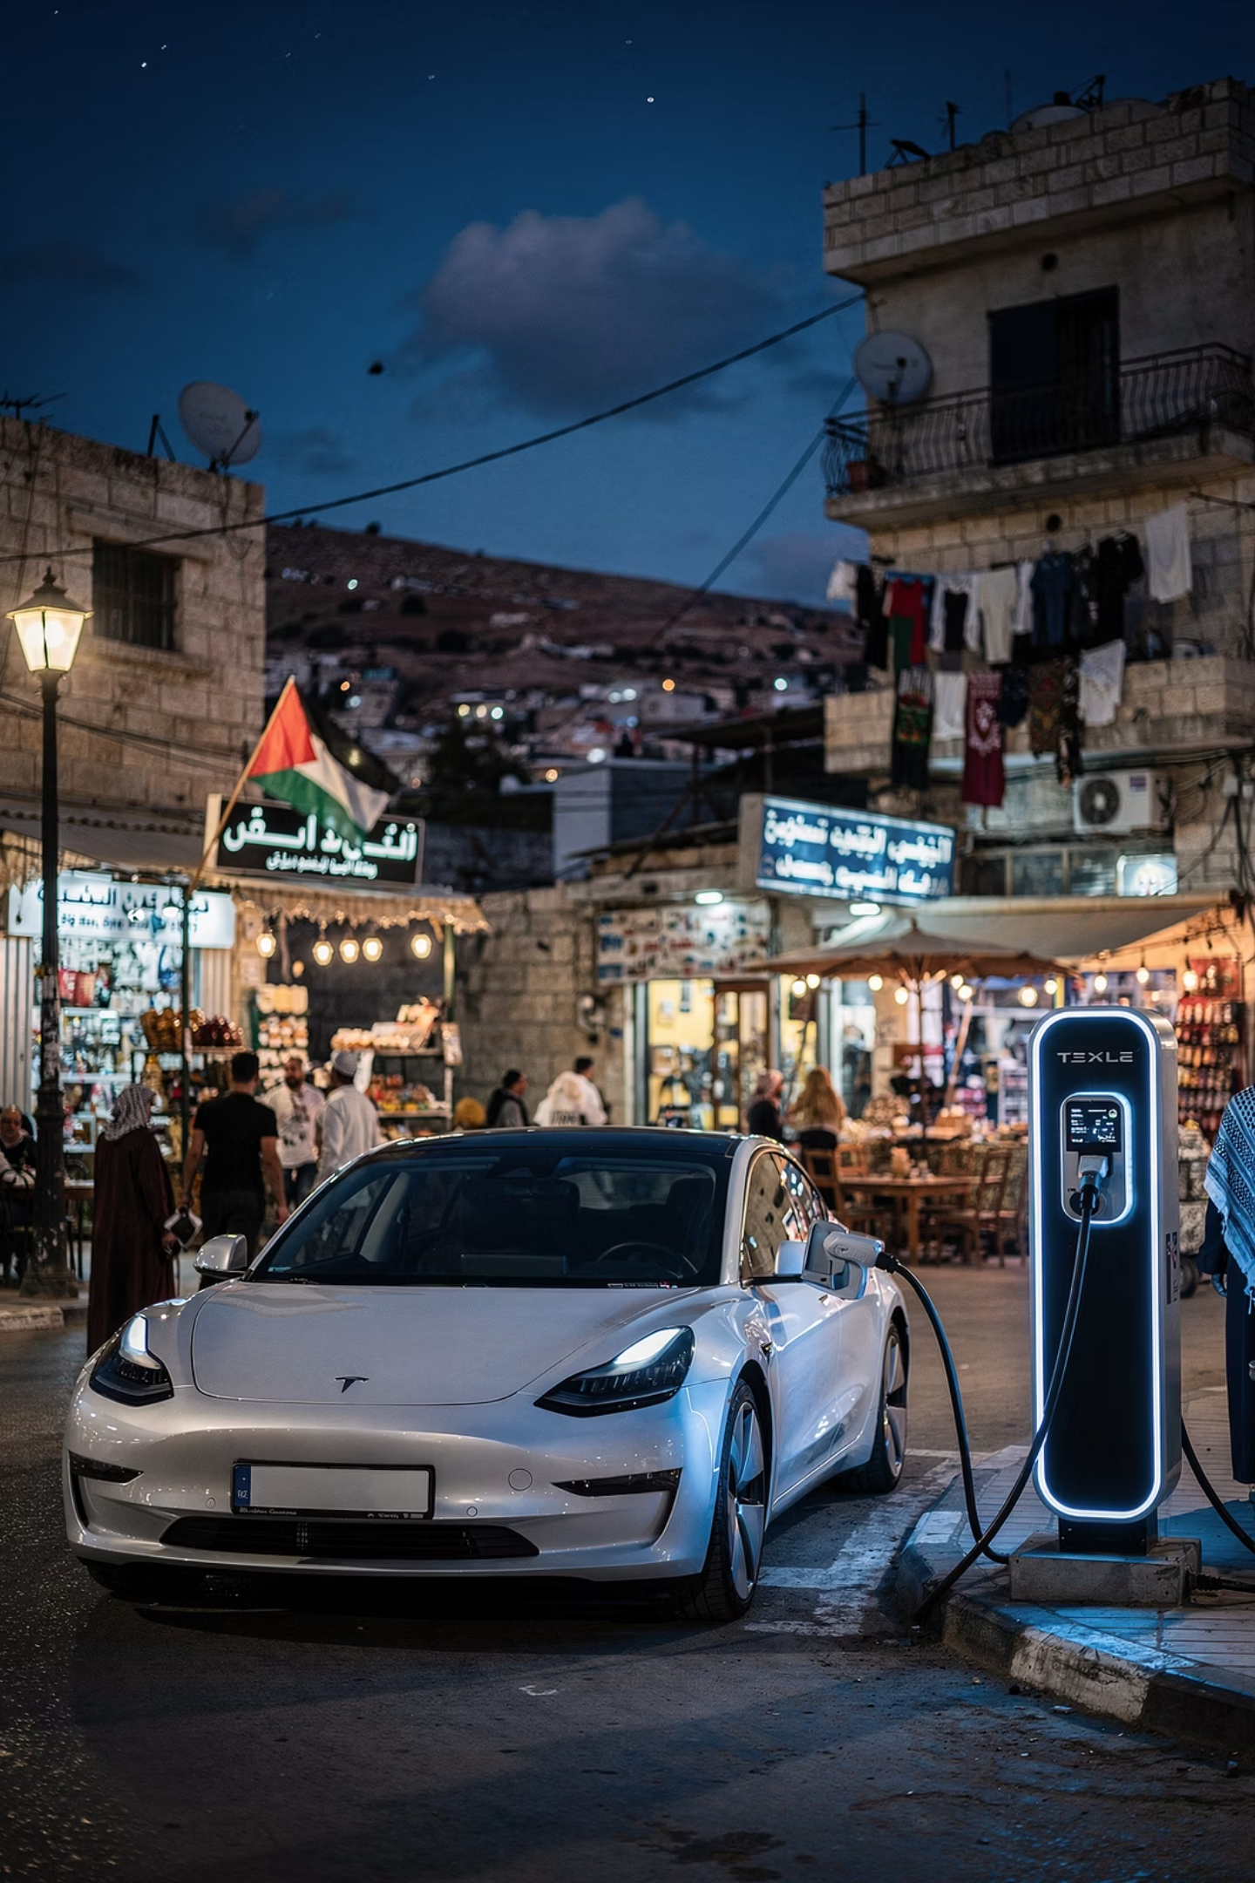

Electric Vehicle Inspection and Public Safety: Policies and protocols in Palestine
A comprehensive framework for policies and protocols to ensure safe EV adoption across Palestine
AN-NAJAH NATIONAL UNIVERSITY
GRADUATION PROJECT 2025/2026

Slide 2
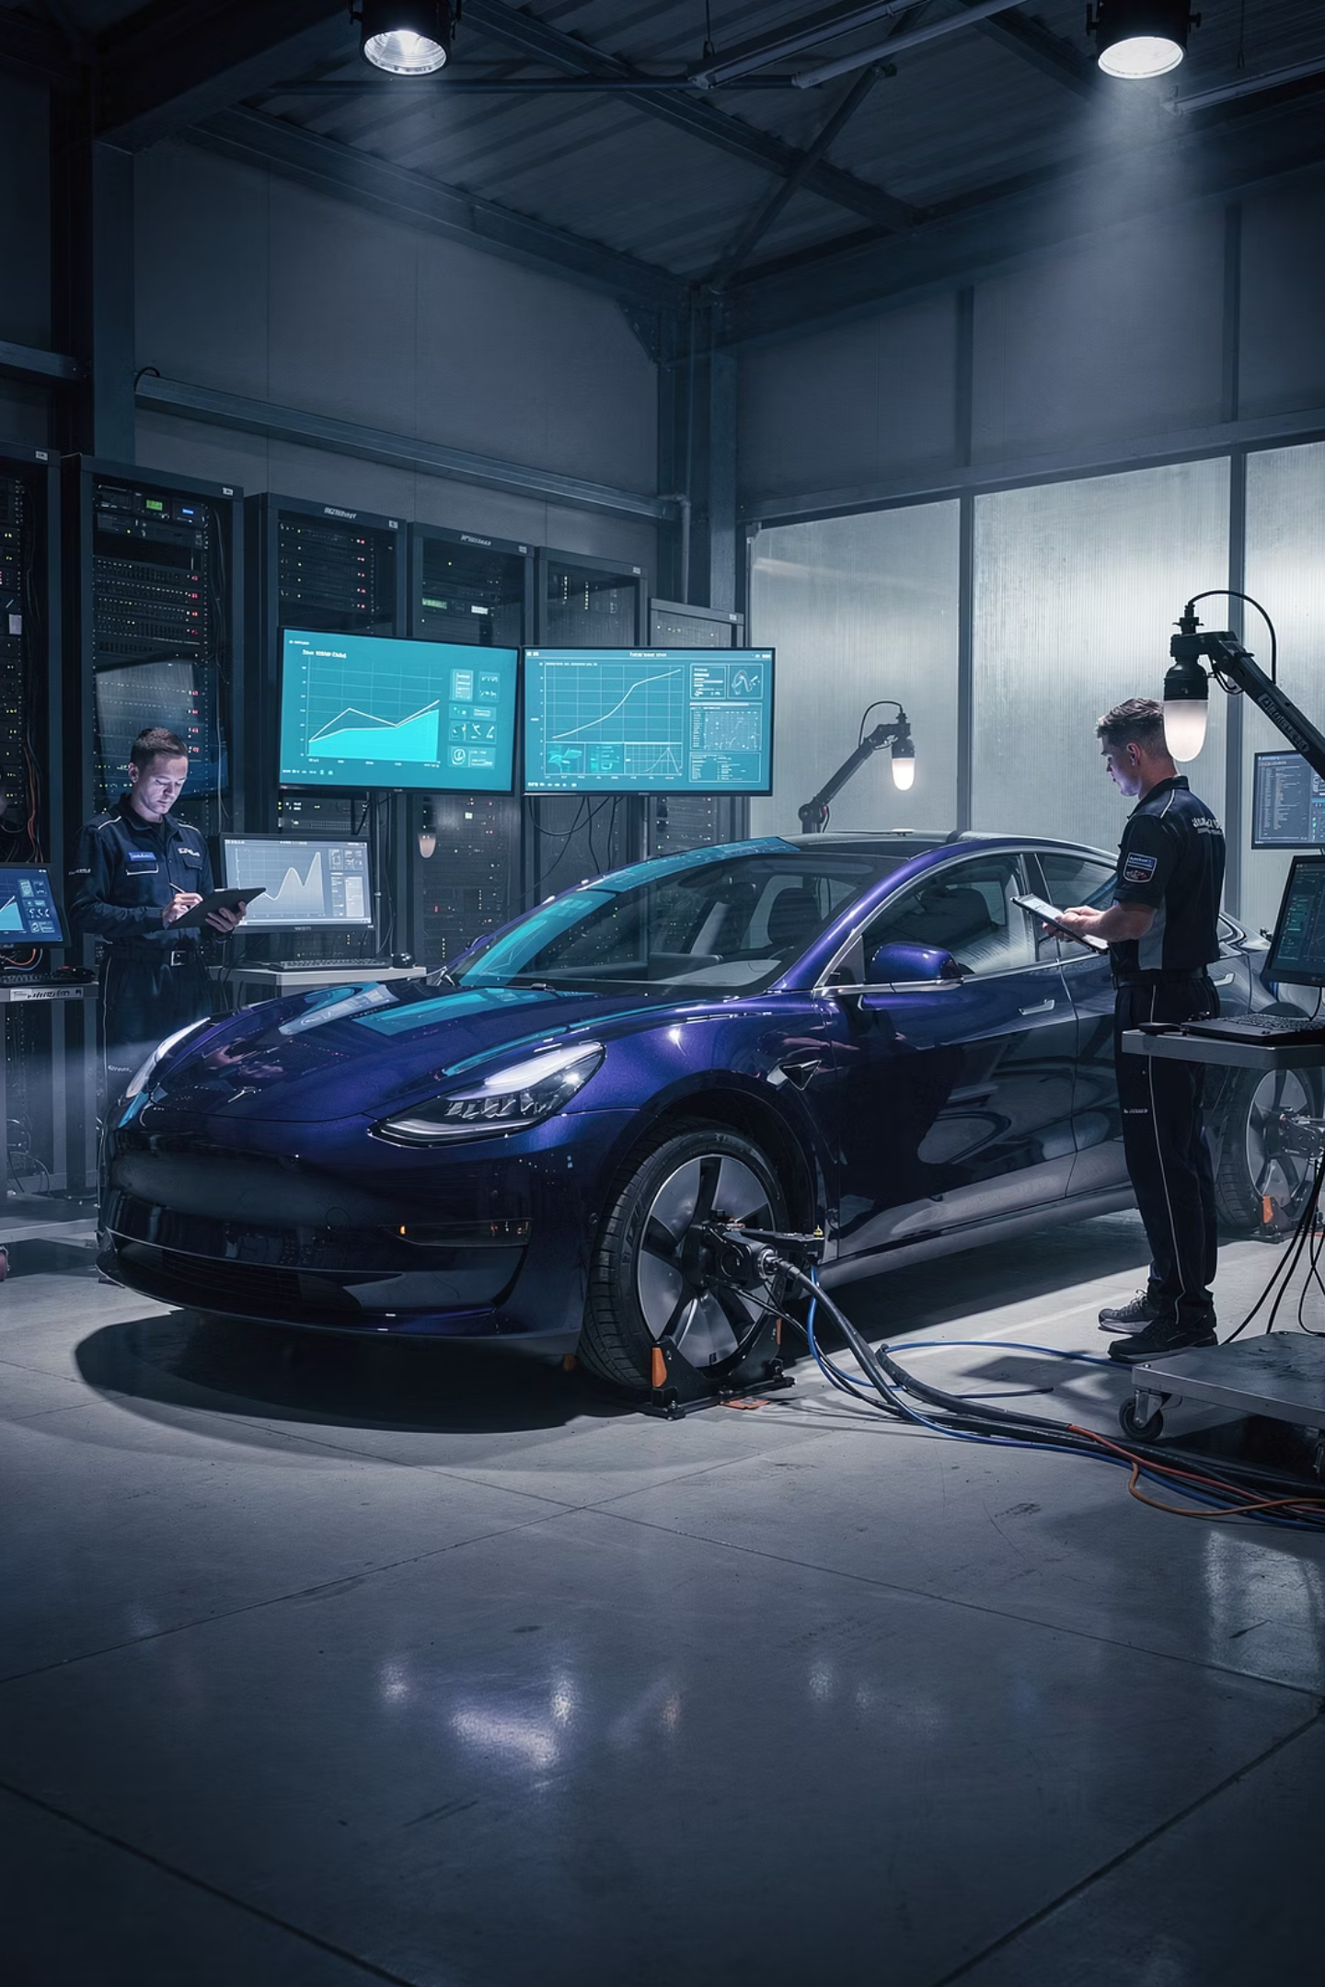
EXECUTIVE SUMMARY
Project Overview
Mission
Scope
Ensure public safety through comprehensive EV inspection protocols tailored to Palestinian infrastructure and regulatory needs
Evaluate current practices, identify gaps, and develop standardized frameworks aligned with international safety standards
Impact
Reduce EV-related accidents, improve vehicle efficiency, and support sustainable transportation transition
With increasing EV adoption in Palestine, this project addresses critical safety challenges by proposing inspection protocols that account for battery health, high-voltage systems, and software diagnostics. The work combines extensive literature review, field studies, stakeholder interviews, and comparative analysis with international best practices.

Slide 3

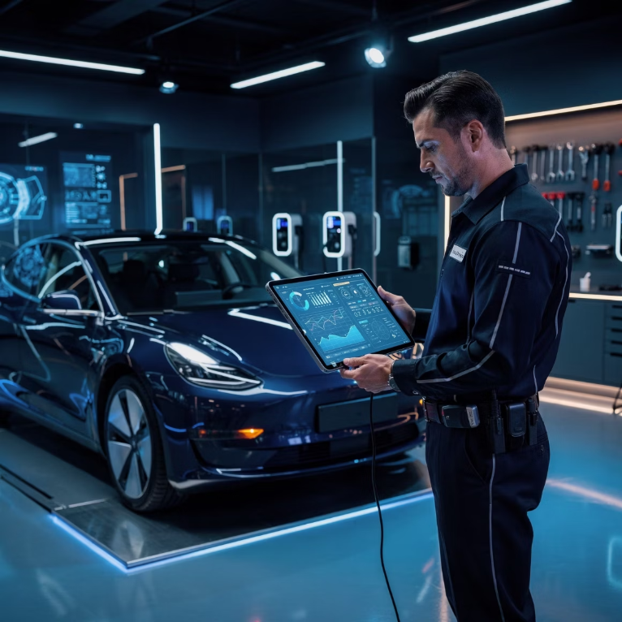
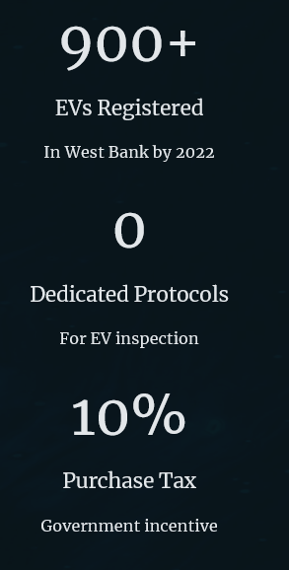

Problem Statement and Research Objectives
Primary Objectives
The Core Problem
Comprehensively evaluate current EV inspection practices across Palestine
Systematically identify critical gaps, vulnerabilities, and safety risks
Develop evidence-based regulatory framework recommendations
Establish training requirements for inspection personnel
Create public awareness and education strategies
Palestine currently lacks unified, standardized protocols for inspecting electric vehicles, creating serious risks to driver safety, passenger protection, and broader public welfare
Project Scope and Boundaries
This research concentrates specifically on mechanical and electrical inspection dimensions of electric vehicles, institutional regulatory structures, and public safety implications within Palestinian territories. The analysis encompasses battery health assessment, high-voltage system evaluation, charging infrastructure safety, and emergency response preparedness.

Slide 4

Regulatory Framework in Palestine
Palestine is gradually adapting its legal frameworks to accommodate EVs, though significant gaps remain in enforcement and technical capacity.
01
Traffic Law No. 5 of 2000
Primary legal foundation for vehicle regulation—currently under review to include EV-specific provisions for battery inspection and high-voltage safety
02
Charging Station Regulations
No national standardized regulation exists yet. Pilot projects in Ramallah and Nablus are testing public charging infrastructure
03
Customs and Import Policies
EVs benefit from reduced import duties (10% purchase tax + 16% VAT) to encourage adoption
04
Garage Licensing
No dedicated certification program for EV technicians—proposals under review for
high-voltage repair authorization

Slide 5




INTERNATIONAL STANDARDS
Global EV Inspection Best Practices
Leading automotive safety organizations have established comprehensive frameworks that Palestine can adapt to local conditions.
UN Regulation No. 100
NHTSA Guidelines
Mandates battery safety requirements, electrical protection standards, and performance testing under extreme conditions
Provides crash testing protocols and post-crash battery evaluation to mitigate fire and electrical shock risks
IEEE Standards
SAE International
Technical specifications for battery management systems, insulation resistance, and software validation
Industry standards for EV safety systems, charging protocols, and emergency response procedures

Slide 6
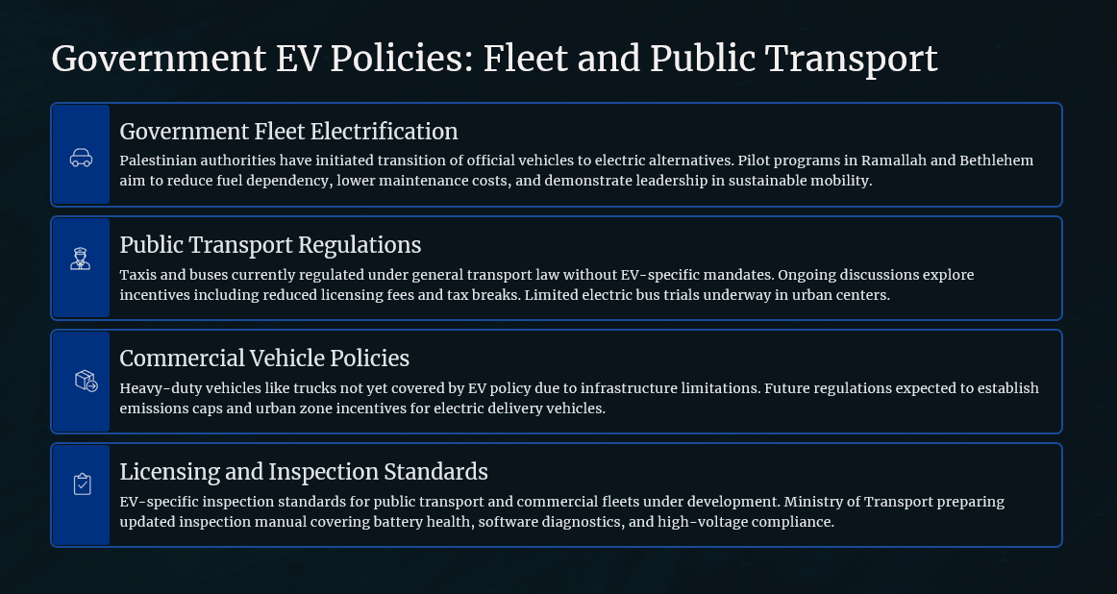

Slide 7





Critical Technical Inspection Criteria
Battery State of Health
SOH testing measures capacity degradation and predicts remaining lifespan
Electrical Isolation
Insulation resistance checks prevent high-voltage leakage and shock hazards
Charging System
Verify connector integrity and compliance with IEC 61851-1 standards
Regenerative Braking
Assess energy recovery system performance and mechanical integration
Software Validation
Firmware version control and BMS diagnostic reporting

Slide 8

METHODOLOGY
Research Approach
1
Desk Research
Comprehensive review of IEA, UNECE, NHTSA, IEEE, and SAE documentation on EV safety standards
2
Field Interviews
Consultations with government officials, transportation engineers, vehicle inspectors, and EV technicians
3
Site Observations
Visits to inspection centers to assess infrastructure, tools, and technician preparedness
4
Comparative Analysis
Evaluation of Palestinian practices against international best practices from EU, US, and regional markets

Slide 9
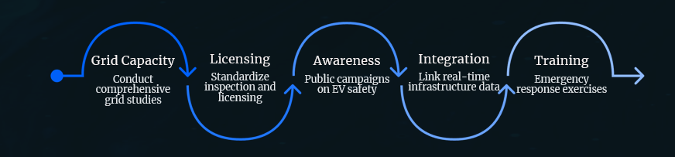
Field Study Recommendations
Conduct Comprehensive Grid Capacity Studies
Standardize Licensing and Safety Protocols
Develop Public Awareness Campaigns
Systematic assessment of electrical network resilience under projected EV charging loads, including neighborhood-level analysis and transformer capacity evaluation
Develop unified procedures coordinating NEC, Civil Defense, and MOT requirements with clear documentation and approval workflows
Educate citizens on safe charging practices, emergency procedures, and the importance of certified installations
Integrate Real-Time Infrastructure Data
Establish Emergency Response Training
Enhance Pal EV application with live station availability, safety certification status, inspection validity, and emergency contact information
Mandatory certification for Civil Defense personnel in EV battery fire suppression, thermal runaway management, and high-voltage safety

Slide 10

Survey Analysis: Public EV Orientation in Palestine
A comprehensive survey examining public knowledge, attitudes, and perceptions toward electric vehicles provides crucial insights for policy development and public awareness strategies. This analysis presents detailed findings from 102 respondents across Palestinian territories.
102
7
60%
Total Respondents
Cities Represented
Young Adults
Respondents aged 20-29 years
Survey participants across West Bank
Geographic distribution of responses

Slide 11




Survey Results: Public Awareness and Adoption
A comprehensive survey of 102 respondents revealed critical insights into EV knowledge, economic perceptions, and adoption barriers in Palestine.
59.8%
68.6%
Young Adopters
Purchase Intent
Ages 20-29 show highest interest in EVs
Willing to buy hybrid or electric vehicles
56.9%
58.8%
Cost Efficiency
Infrastructure Gap
Believe EVs are more efficient in energy consumption
Report no charging stations in their area

Slide 12
Economic Perceptions and Barriers
67.6%
26.5%
33.3%
Primary Concern
Maintenance Efficiency
Reliability Perception
High purchase price or maintenance costs identified as main barrier
View EVs as more cost-efficient in maintenance
Believe EVs have fewer breakdowns than traditional vehicles
While a majority recognize consumption advantages, uncertainty about maintenance costs and reliability remains. Only 33.3% believe EVs have fewer breakdowns, while 25.5% remain unsure—highlighting the need for better data transparency and public education.

Slide 13
Infrastructure and Technical Readiness Gaps
Charging Station Availability
Technician Readiness
58.8%
68.6%
No charging stations in their area
Insufficient skilled technicians for EV maintenance
These findings validate the critical need for infrastructure investment and technical capacity building as prerequisites for safe EV adoption
24.5%
26.5%
Maybe available
Maybe sufficient
16.7%
4.9%
Confirmed access
Adequate technician availability
These findings validate the critical need for infrastructure investment and technical capacity building as prerequisites for safe EV adoption.

Slide 14

Future Outlook: Optimism Despite Challenges
52.0%
43.1%
95.1%
Expect wide EV adoption in Palestine
Predict limited adoption
Overall optimism about EV future
Despite infrastructure challenges, cost concerns, and technical readiness gaps, there is strong optimism about EV adoption in Palestine. Younger users (ages 20-29) form a promising early-adopter group with 78.7% showing high adoption potential.

Slide 15

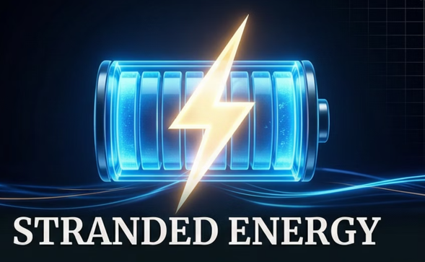

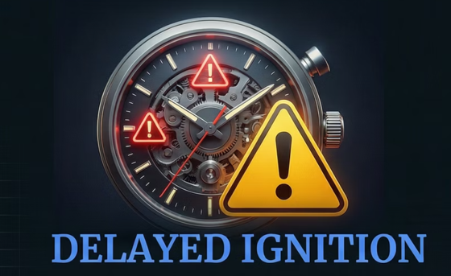

Emergency Response Challenges
The U.S. Fire Administration and FEMA have documented unique EV emergency risks that differ fundamentally from traditional vehicle incidents.
Lithium-ion batteries can experience uncontrolled heat generation, with no universally accepted extinguishing method
Damaged batteries retain hazardous electrical charge for hours or days after incidents
Fires can occur long after initial damage, during transport or storage
Battery combustion produces dangerous fumes requiring specialized protective equipment
These findings underscore the critical role of preventive inspection systems in identifying battery degradation and electrical faults before vehicles operate on public roads.

Slide 16
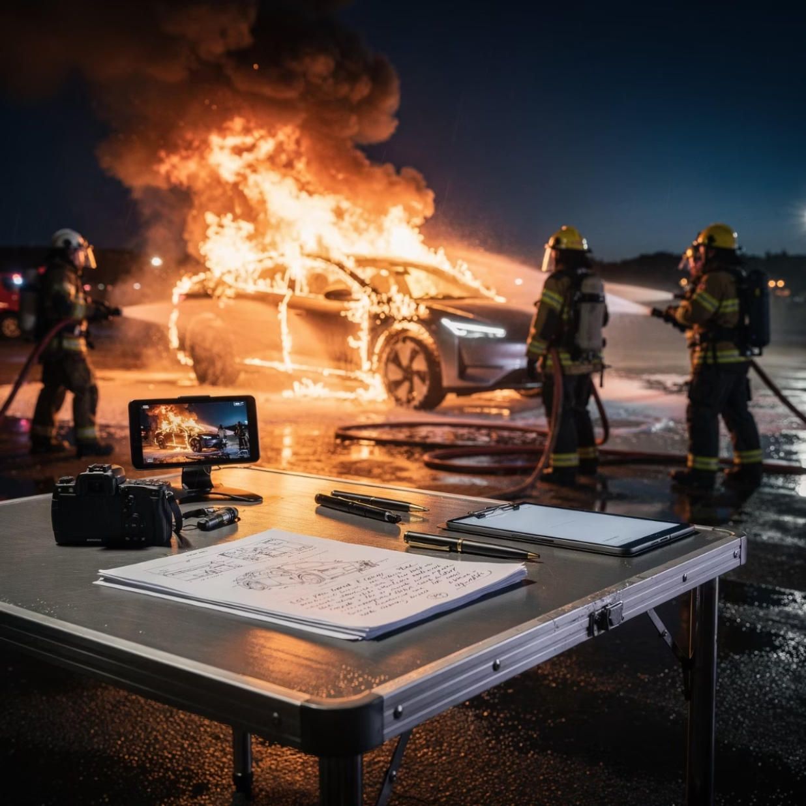
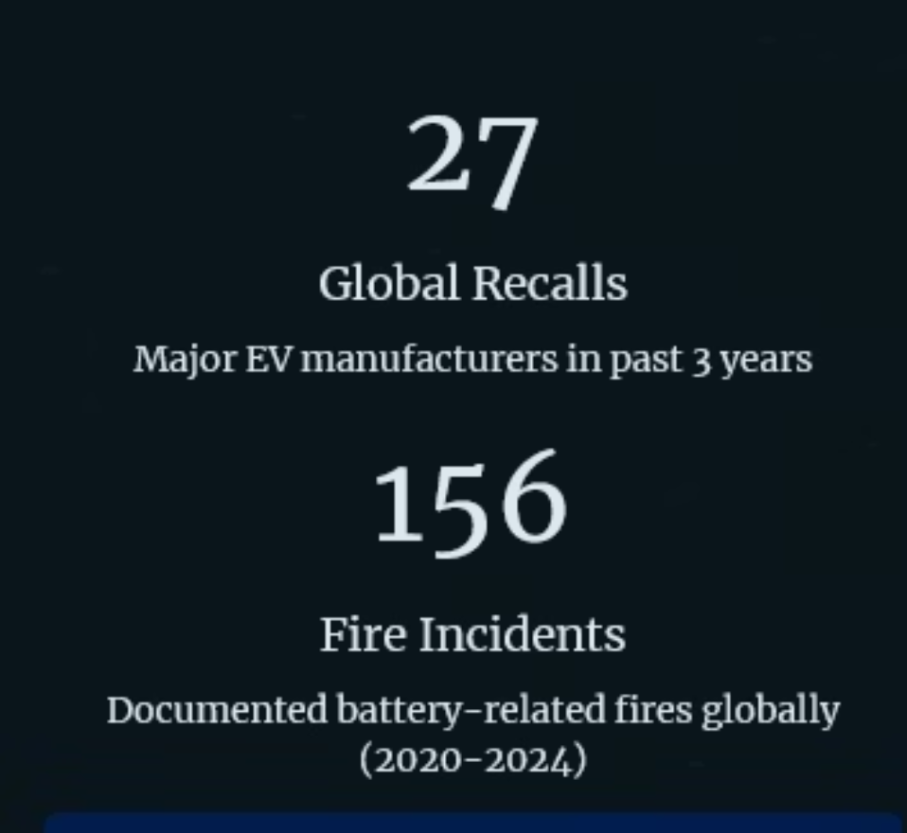
EV Safety Risks
Documented Hazards
Global Recalls
Case studies from IEEE, SAE International, and global safety agencies reveal critical risks from inadequate EV inspections
Major manufacturers have issued recalls affecting millions of EVs due to battery defects, highlighting the critical importance of regular inspection protocols

Slide 17




Battery Safety and International Compliance
Understanding battery characteristics, safety testing, and vehicle approval frameworks is essential for developing a national EV inspection system.
Battery Certification
Safety Data Sheets
Manufacturer declarations confirm battery chemistry (LiFePO₄), voltage (370V), capacity (165Ah), and compliance with industrial standards
SDS documents outline chemical properties, identified hazards, firefighting measures, and emergency response protocols
UN38.3 Testing
Hazard Classification
International transport safety standard requiring altitude simulation, thermal cycling, vibration, shock, and overcharge testing
Batteries classified as Class 9 Dangerous Goods requiring special handling, labeling, and storage protocols

Slide 18








UN38.3 Battery Safety Compliance Testing
The UN38.3 standard establishes comprehensive safety requirements for transporting lithium-ion batteries, ensuring they can withstand conditions encountered during shipping and handling. BYD batteries successfully passed all required evaluations.
T1: Altitude Simulation
T2: Thermal Cycling
Low-pressure exposure testing
Extreme temperature variation
T6: Crush/Impact
T3: Vibration
Physical deformation resistance
Mechanical stress simulation
T5: External Short Circuit
T4: Shock
Electrical fault tolerance
Sudden impact resistance
All tests achieved PASS status with no leakage, venting, rupture, disassembly, or fire observed—confirming battery suitability for operational use and transportation.

Slide 19
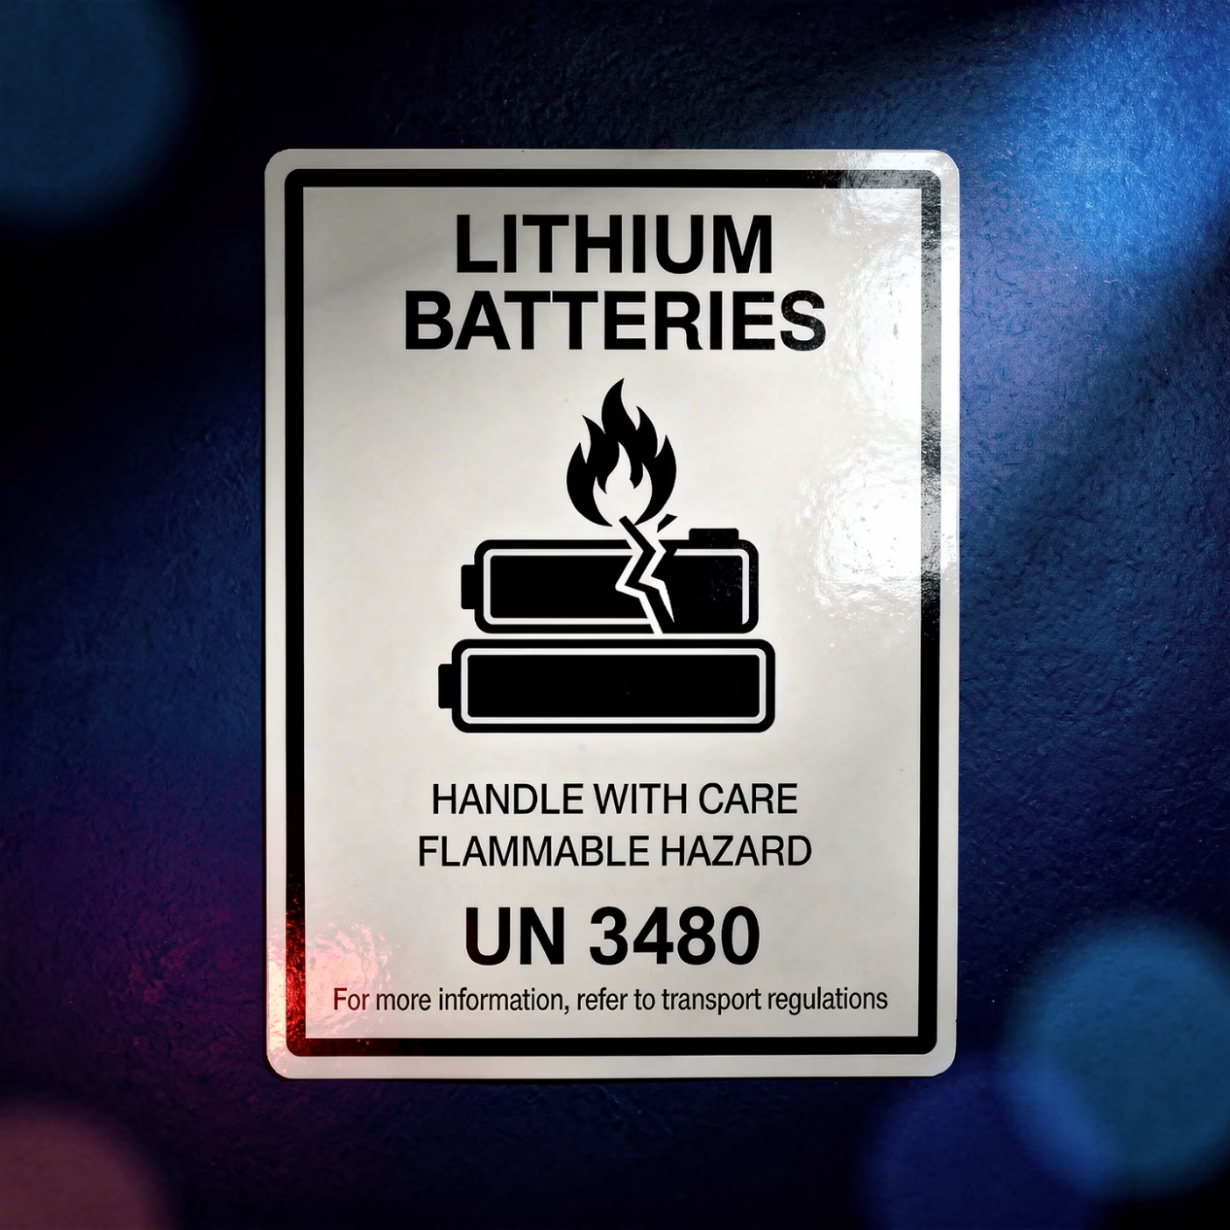
Hazard Classification and Transport Requirements
International transport regulations classify lithium-ion batteries as Class 9 Dangerous Goods, requiring specialized handling, labeling, and storage protocols.
Mandatory Requirements
Special handling procedures during all transport phases
Clearly visible hazard warning labels meeting UN specifications
Dedicated storage areas isolated from incompatible materials
Emergency response equipment readily available
Trained personnel for loading, unloading, and inspection
Inspection centers must implement appropriate risk management procedures acknowledging the inherent hazards of high-energy-density battery systems. All personnel handling EVs during inspection require specialized safety training.

Slide 20
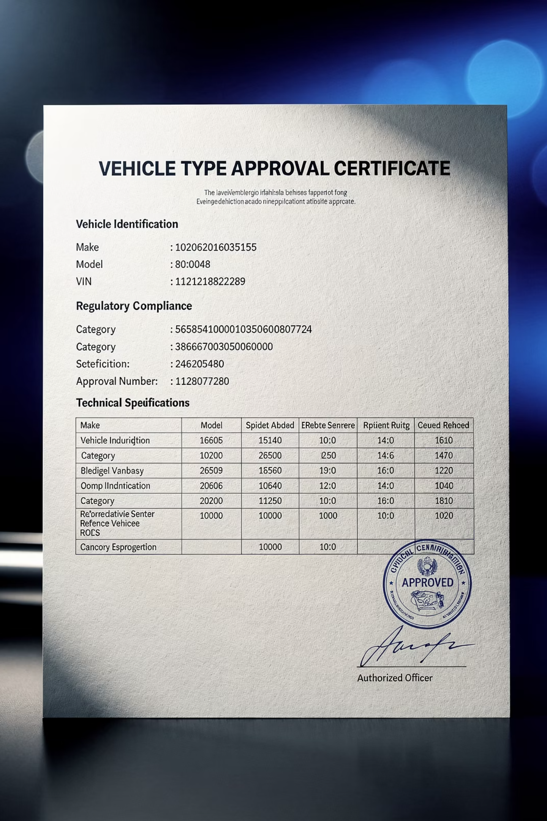
International Type Approval Framework
The EU Regulation 2018/858 and Framework Directive 2007/46/EC outline comprehensive requirements for vehicle conformity, safety, emissions, and component-level certification.
Required Documentation
EV-Specific Requirements
EC/EU Type Approval certificates
IEC 61851-1 charging connector compliance
Manufacturer technical files
Compliance documents for safety systems
External high-voltage warning labels
Onboard charging system documentation
Charging unit conformity certificates
Battery pack specifications
Battery management system specifications
High-voltage system markings
Insulation resistance verification
These standards provide an excellent model for establishing future Palestinian EV regulations and inspection protocols.

Slide 21
Comparison with International Emergency Standards
When comparing Palestinian practices with USFA/FEMA emergency response guidelines, significant regulatory and technical gaps become evident.
Aspect
Palestine – Current
International Standards
EV-specific regulations
None; ICE-based procedures applied
Dedicated EV emergency frameworks
Battery thermal runaway
Not evaluated during inspection
Critical risk requiring monitoring
Stranded energy detection
Not considered
Major post-incident hazard
High-voltage inspection
Limited or absent
Mandatory verification procedures
Inspector training
No formal EV certification
Mandatory training and certification
Civil Defense coordination
Minimal or informal
Integrated emergency coordination
Post-accident clearance
No defined protocol
Strict isolation and monitoring

Slide 22
KEY FINDINGS
Research Conclusions
Current State of EV Inspection in Palestine
No Official Regulations
Infrastructure Deficiencies
Limited Technical Capacity
No regulatory document exists from the Ministry of Transport specifically for electric vehicles. Existing procedures designed for ICE vehicles.
Inspection centers lack BMS diagnostic tools, high-voltage testers, thermal cameras, and battery isolation zones.
Technicians and inspectors report minimal EV-specific training. No certification programs available locally.
Minimal Coordination
Data Management Gap
Weak collaboration between government authorities, EV importers, manufacturers, and service providers.
No shared systems for collecting EV safety incidents, diagnostics, or failure data.

Slide 23
Legislative and Regulatory Recommendations
National EV Inspection Regulation
Traffic Law Amendment
International Standards Adoption
Include dedicated articles covering EV risks, emergency protocols, battery incidents, and post-accident handling procedures
Develop comprehensive regulation addressing high-voltage safety, insulation testing, charging-system compliance, and software diagnostics
Officially adopt UN R100, UN38.3, IEC 61851, SAE J2980, and IEEE 2030.1.1 as mandatory reference frameworks
Type Approval Requirements
Multi-Agency Approval
Require importers to submit complete documentation including UN38.3 battery certification, SDS, and charging-system conformity
Mandate approvals from Civil Defense, Municipality, and Electricity Company before EV registration
Establish a national battery-disposal facility complying with international recycling and hazardous-waste standards.

Slide 24
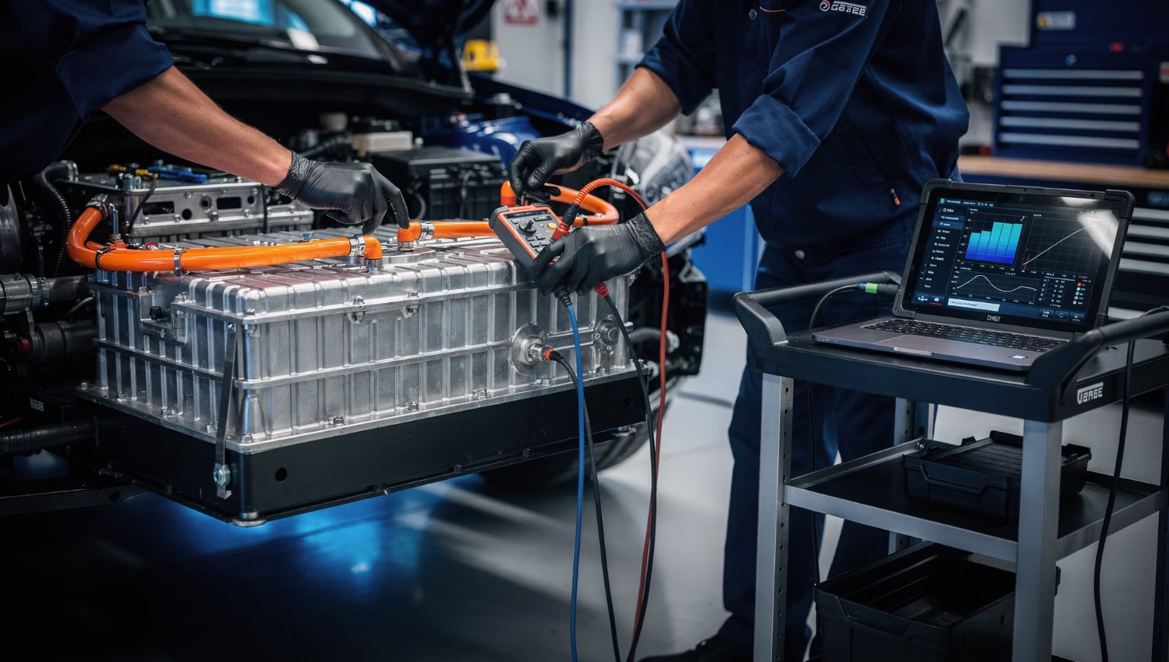
Technical Standards and Inspection Centers
National Inspection Manual
EV-Ready Facilities
High-voltage diagnostic tools
Thermal imaging cameras
BMS scanning equipment
Lithium-ion fire suppression systems
Battery isolation zones
Emergency ventilation systems
Insulation resistance testing protocols
Battery SOH evaluation procedures
BMS diagnostic requirements
Charging-system verification standards
Regenerative braking assessment
Software validation procedures

Slide 25




Digital Systems and Data Management
National EV Database
System Integration
Unified system storing inspection results, battery health data, operational incidents, and charging history
Connect database with MOT, insurance companies, electricity providers, and certified inspection centers
Pal EV Enhancement
Data Analytics
Expand application to include charger safety status, inspection validity, and battery alerts
Enable trend analysis, predictive maintenance, and safety incident tracking for policy improvement

Slide 26
Regulation and Licensing of EV Maintenance Garages
Create a national licensing system ensuring only qualified workshops handle high-voltage EV repairs.
01
02
03
Workshop Classification
Technician Certification
Equipment Standards
Introduce official designation: EV Category – High Voltage Authorized Garage
Require training and certification in high-voltage safety, EV diagnostics, and battery handling
Mandate insulated tools, PPE, BMS diagnostic devices, insulation testers, and lithium fire suppression systems
04
05
Periodic Inspections
Enforcement
Conduct regular facility audits by MOT, Civil Defense, and Electricity Company
Strictly prohibit unlicensed workshops from repairing EV batteries, high-voltage systems, or charging components

Slide 27
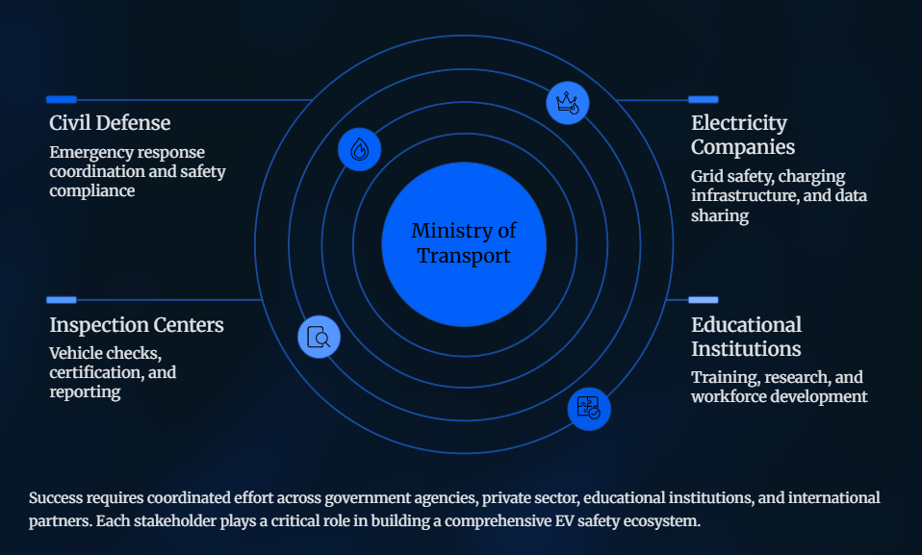
Stakeholder Collaboration Framework

Slide 28




Recommendations for Palestinian EV Inspection System Development
Establish Legal Framework
Develop dedicated national EV inspection legislation addressing high-voltage safety, battery certification, software diagnostics, and charging system compliance
Enforce International Standards
Require UN38.3 battery certification, IEC 61851-1 charging compliance, and EU Type Approval documentation for all imported EVs
Build Inspection Infrastructure
Equip centers with insulation testers, BMS diagnostic tools, thermal cameras, fire suppression systems, and dedicated battery isolation zones
Train Certified Inspectors
Establish national Certified EV Inspector (CEVI) program covering high-voltage safety, thermal runaway response, and emergency procedures
Create National Database
Track battery health, maintenance history, diagnostic events, and safety incidents for every registered EV with shared access for authorities

Slide 29






GOLDEN RECOMMENDATION
Final Comprehensive Policy Recommendations for Establishing a National EV Inspection and Licensing Framework in Palestine
Critical Implementation Principle
No electric vehicle should be registered or operated in Palestine unless it meets ALL of the following requirements:
Battery Certification
Charging Compliance
Multi-Agency Approval
Traction battery certified according to UN38.3 international transport safety standards
Charging system complies with IEC/EU international standards (IEC 61851-1)
Prior approval received from Civil Defense, Municipality, and Electricity Company
Certified Inspection
Driver Qualification
Passed comprehensive inspection at certified EV-ready testing center
Operated by person who passed updated theoretical and practical driving tests including EV-specific safety requirements

Slide 30



