Slide 1
STC Friend

Slide 2

Welcome, All!

Slide 3
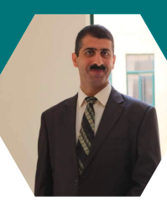


Dr. Alaa Al-Din
Rawan Hassoun
Amna Khdair

Slide 4

IOT
01
Reason of calling
02
Table of Contents
Our Project
03
Application
04
05
Features
06
Future Work
07
The End!

Slide 5
01
IOT

Slide 6

Internet of Thing
Sensors
Software
Hardware
Facilitate daily operations

Slide 7
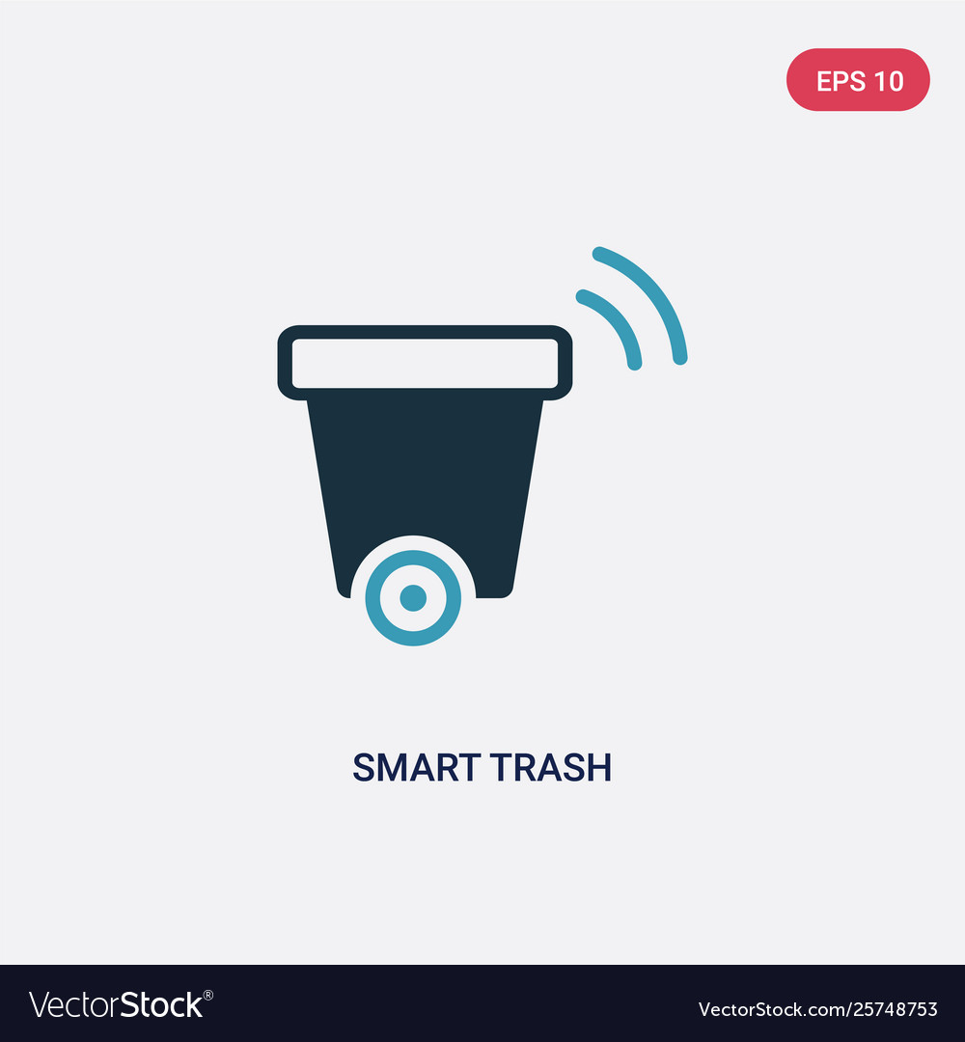
Hence we thought why not enter the trash in the IoT system too?

Slide 8
02
Reason of calling

Slide 9

STC Friends
Smart
Trash
Can

Slide 10
03
Our Project

Slide 11
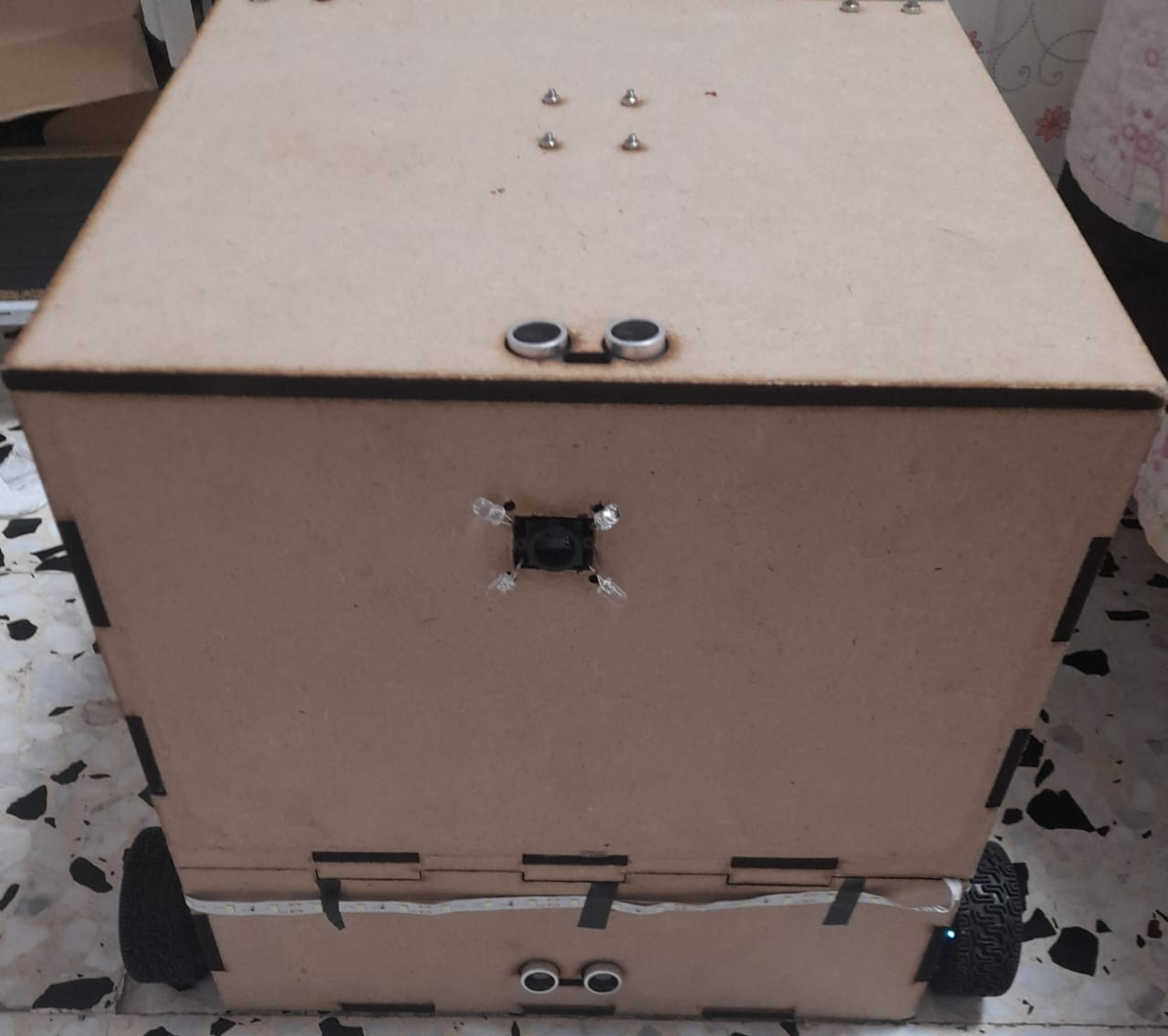
Smart Wastebasket
Vacuum
Mobile Application
Come here
lighting
Touch Less

Slide 12
04
Application

Slide 13
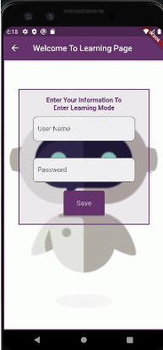
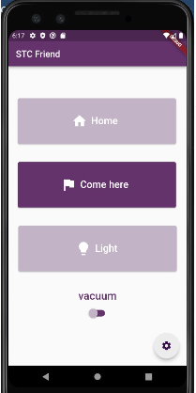
Do you want to use the application?
Do you want to control the robot?

Slide 14
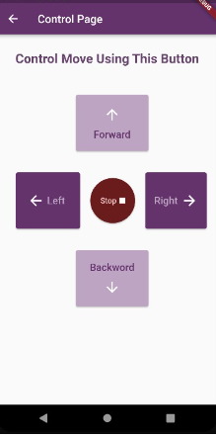
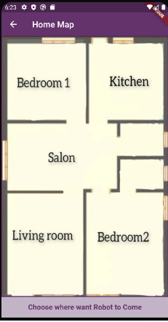

Call the robot to your room ☺
Control the robot movement !

Slide 15
05
Features

Slide 16

Come here!
01
This is the largest part of our project.
Call the robot to the target points.
Save the path at memory of ESP32.

Slide 17
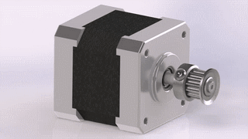
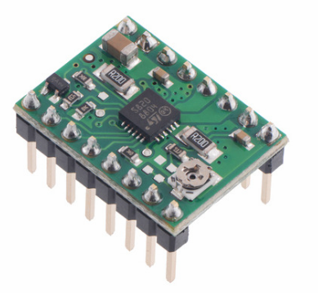
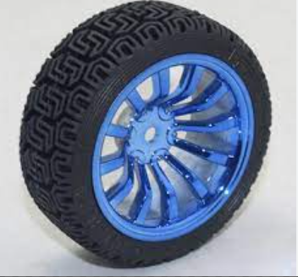
At movement part we use:
Stepper motor
Wheels
Drivers of stepper motor

Slide 18
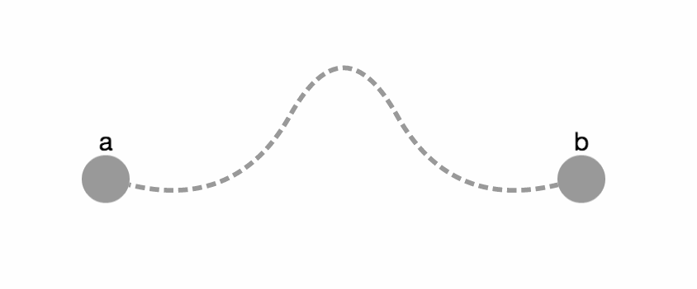
02
Back To Home

Slide 19
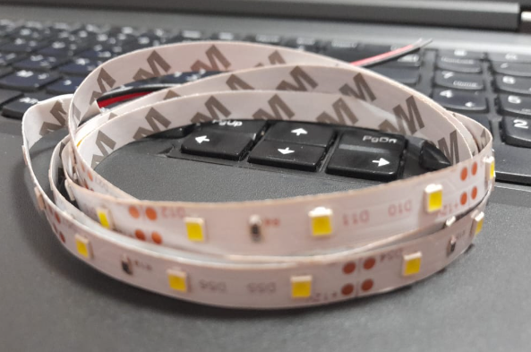

Lighting Led!
03
Controls by application
Connected to relay to connect with the esp32

Slide 20
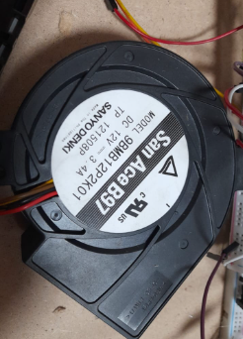
Vacuum
04
This part is used to suck dirt and dust from the ground.
We use turbo connected to relay

Slide 21
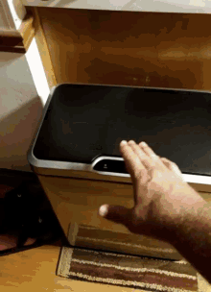
The trash can lid opens without being touched.
As soon as the hand gets close to the lid, it opens automatically.
05
Open without touch!

Slide 22
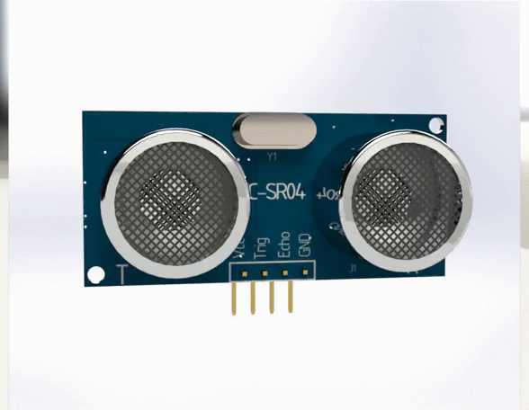
This feature is based on the Ultrasonic sensor

Slide 23
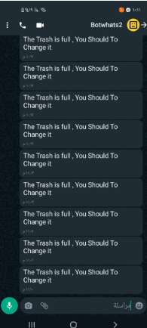
Check whether the bin is full of waste!
06
We use ultrasound to detect if the trash can is full of rubbish.
If the trash can is full, a message will be sent to whatsapp to alert you to change the bag.

Slide 24
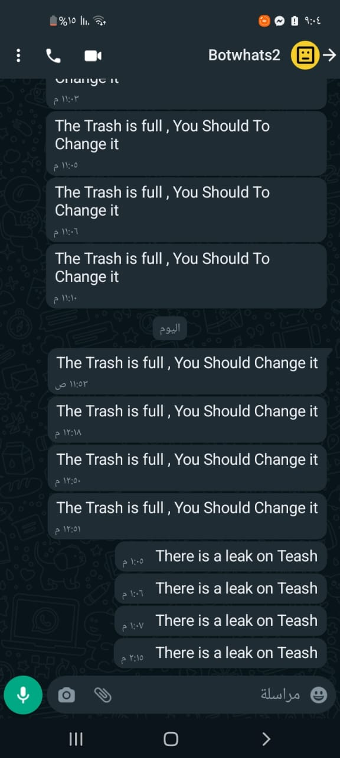
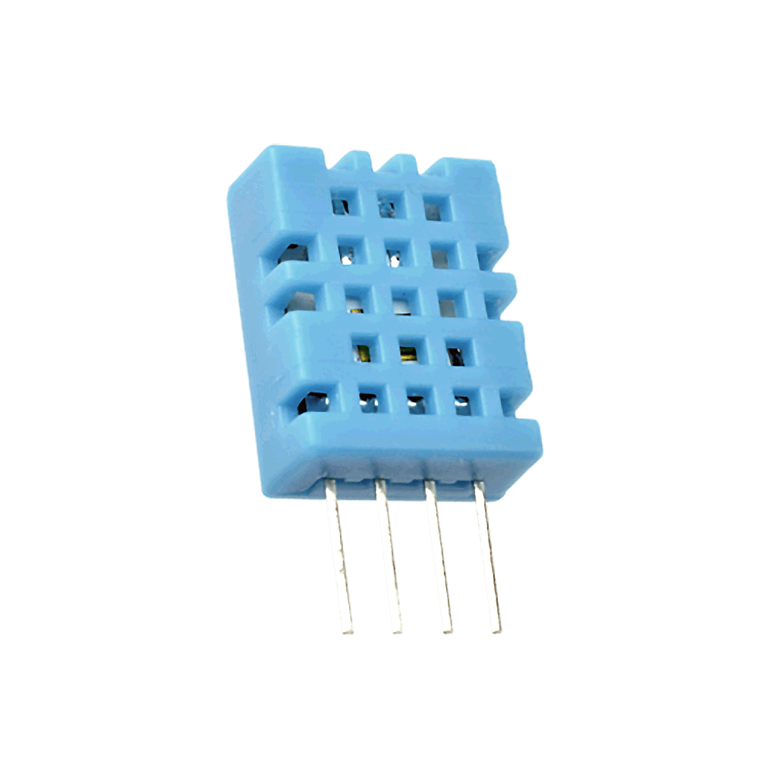
07
Check if there is a leak in the trash
Use Dht11 Sensor to sense the humidity of the trash can

Slide 25

08
Apply object avoiding
The robot definitely faces obstacles that hinder its movement, so we explored the algorithm that avoids these obstacles by relying on ultrasound.

Slide 26
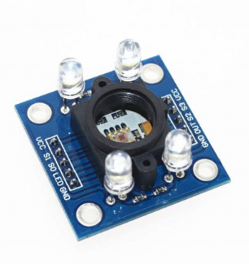
Make sure to follow the correct path by using the color sensor

Slide 27

Settings

Slide 28

Apply learning mode
After unboxing the robot, you need to make the robot setting!! ☺
The robot settings configuration is what make our project dynamic.

Slide 29
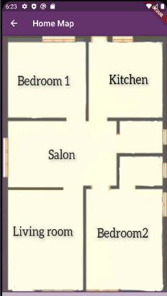
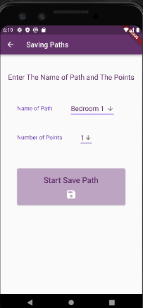
Setting configuration
Choose the plan of the house where you want to use the robot
Defines the paths you want the robot to take in the home
Determine the total number of points for each track

Slide 30

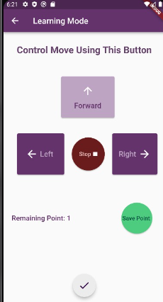
Setting configuration
Learn the robot on these paths by control direction page, and the bot, in turn, will memorize the number of steps and the directions it takes on each path in the memory.
Then the robot can be summoned to any point you specify by pressing the button on the map

Slide 31
06
Future Work

Slide 32
Use Digital Campus
Improved algorithm for saving paths
Add a sterilizer

Slide 33
07
The End!

Slide 34


