Slide 1

An-Najah National University
Faculty of Engineering and Information Technology
Industrial Engineering Department
Steps toward Applying Lean Manufacturing in Hijawi Printing Company
Supervised by: Eng. Walaa Johari

Slide 2
Our Team
Mohammed Nuirat
Mohammed Salameh
Mutaz Abu-Zahedah

Slide 3
Outline
Introduction
Problems
Lean Concepts
Lean in Printing Sector
Plant layout
Warehouse layout
recording
Opportunities
Methodology
Results
Project Conclusion & Recommendations

Slide 4
Introduction
Background
Hijjawi Company
Since 1935
Eastern industrial zone, Nablus, Palestine
Printing Industry
7 Product Families
170 Employees
Market : 40% of the local market with 10 competitors

Slide 5
Problems
Unorganized work areas
unused resources and non-added value activities
absence of preventive maintenance system
weak quality management system
Poor documentation system(maintenance, production and defects record)
Staff loyalty culture
Unorganized warehouse

Slide 6
Lean concepts
Definition
is a systematic method for waste minimization ("Muda") within a manufacturing system without sacrificing productivity or increasing cost

Slide 7
Lean concepts
Importance
Lean production has been adopted into various industries to promote productivity and efficiency in every changing market.

Slide 8
Lean in Printing Sector
Overview
There are many resources that can be used ineffectively such as paper, money, equipment, employees, energy, etc.
Lean management can make work environment more efficient and boost product quality by organizing the workplace and workflow.
Lean focuses the printing company towards leading a sustainable business life

Slide 9
Lean in Printing Sector
Historical studies and descriptive research surveys conclude that the main important tools in lean is, Total Productive Maintenance (TPM), 5S, Kaizen, one-piece flow, Just-in-Time (JIT), kanban, Total Quality Management (TQM), process mapping/value stream mapping.

Slide 10
Cases
By reading a rang of research and case studies, we came up with important information and key points

Slide 11
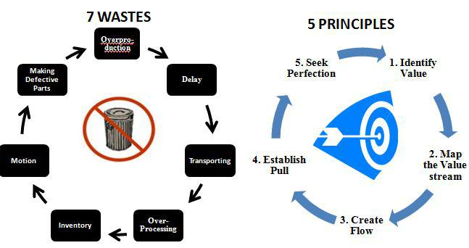
Cases
LEAN PRODUCTION APPLIED IN A LARGE COMPANY IN THE BRAZILIAN PRINTING INDUSTRY
The philosophy of lean production highlights seven important wastes that must be eliminated and five principles for guiding your implementation. This Figure shows the seven waste and the five principles.

Slide 12
Continue…
Results
After the implantation of the improvements, it was verified the following gains:
The time weighing the cars was reduced in average 80%
Reduction in mean flow of cars in more than 35%, i.e., from 204 to 132 trips per day due to the increased volume of cars.
The time of transport trolleys was reduced by 65%.
Reduction of labor, with a gain of six employees.
Improvement in working conditions.

Slide 13
 | Before the change | After the change
Rotating machines area | 122 s | 43 s
Printing machines area | 302 s | 123 s
Cutting machines area | 141 s | 64 s

Slide 14
Plant layout steps & consideration
The data about the new factory plan should be collected & the existing area for the new layout.
Number of printers to be installed and the type of it.
The data would be analyzed according to the new layout planning.

Slide 15
Plant layout types & strategies
Types
  Plant Layout
  Process Layout
  Product Layout
  Combination Layout
  Fixed Position Layout
Strategies
  I-line
  U-line
  S-line
  L-line

Slide 16
Warehouse layout
Steps
  Create a floor plan.
  select shelving's and standard solutions.
  Label racks, shelves, containers and any warehouse organization assets.
  Maximize space utilization.
  Schedule regular maintenance.
  conduct periodic audit and review.

Slide 17
General Problems
Facility Layout
  Super-size the Receiving Area
  Segmentation
  Set up bin locations and pick path
  ensure that the highest-selling inventory is easily accessible

Slide 18
Continued…
Seasonality in Demand
Inaccurate Inventory
Redundant Processes
barcode

Slide 19
Recording
The forms in printing industry could contain the details of the required information, where boxes have been placed for everything that is important and necessary such as:
  the number of defects
  the reason for their receipt
  the start times of manufacturing
  the responsible worker
  the date of the order
  the date of expiry
  the end of the order

Slide 20
Methodology
Overview
After doing a group of visits to the company and collecting data about the factory and its problems. A number of problems were observed.
information about production volume, machines dimensions, facility plant, process flow and number of machines and employees, and then used to draw facility plan and free space
Due to lack of data many forms must be established to collect data

Slide 21
Data collections
The were collected and some of it used as an input to BLOC PLAN Software to draw the plant layout and VISIO to draw the facility plant, process flow charts and the House of Quality (HOQ).

Slide 22
Machines & production
Also, data about average production volume for the main machines and the relationship between all machines was received

Slide 23
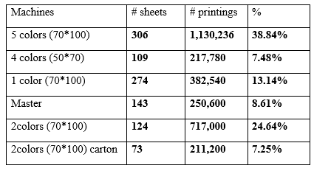
The production volume in July/2017 was 2,909,356 printings.

Slide 24
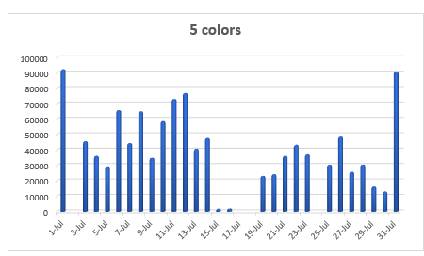
5 colors (70*100):
The distribution of daily production in that month for 1,130,236 units was as below:

Slide 25
House of Quality (HOQ)
Through the use of the House of Quality, we have been able to link the problems and solution and between these solutions and clarify their importance and ability to use them in addition to their evaluation, as shown in following drowns :

Slide 26
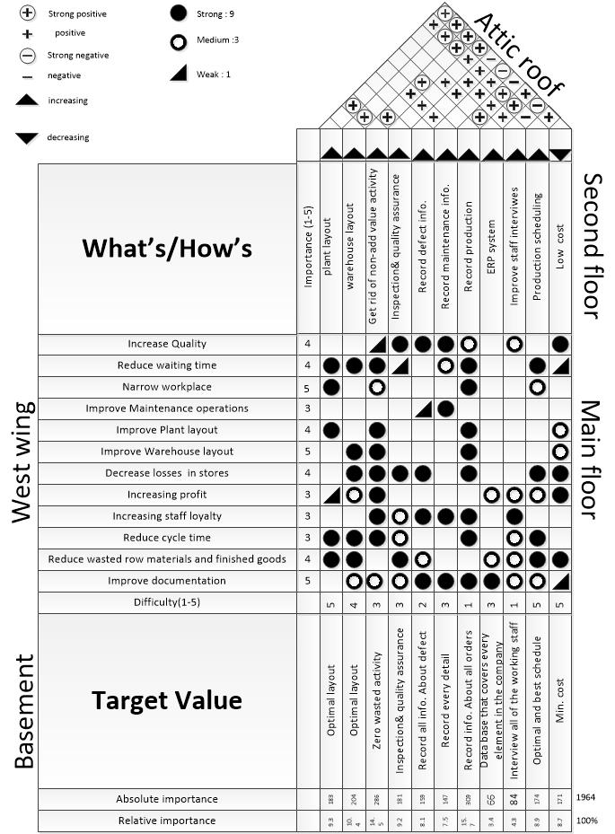

Slide 27
HOQ Conclusion
Based on the analysis of the HOQ it was clear that the most important point is the:
recording process -defect 8.1%
maintenance7.5%
production15.7%
ERP3.4%
which accounted for 34.7% of the total
Giving priority to the rest of the points, it has a high importance in order to facilitate the completion of the rest of the proposals.

Slide 28
Results
At the end of our work on this project we came out with a set of results, that is ;
Process flow chart
Facility plant layout
Production and warehouse forms
Warehouse layout

Slide 29
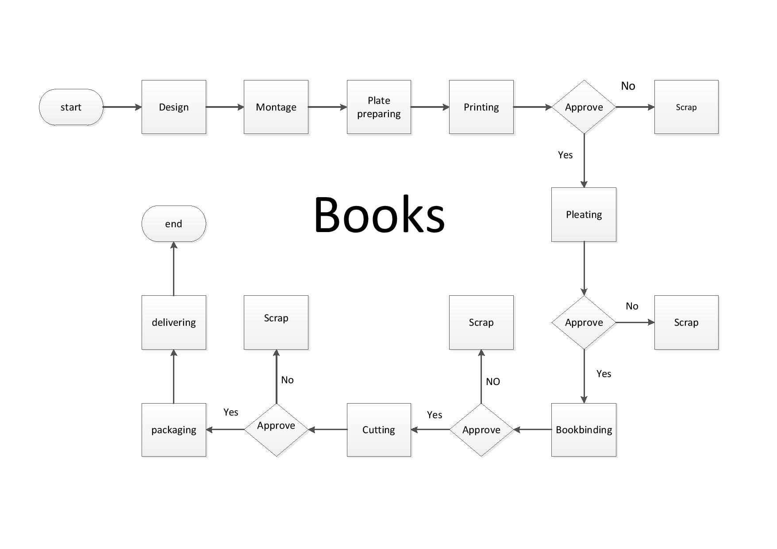
Process flow chart

Slide 30
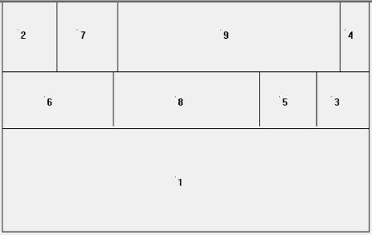
Plant layout
1- Print
2- Bend 1
3- Bend 2
4- Chtans 1
5- Chtans 2
6- Flexo
7- Chtans boobs
8- Glow
9- elevator

Slide 31
Production and warehouse forms
After a series of visits and interviews in the factory with workers and officials, there was a lack of registration of information
The models consist of questions about production volume, production times, production problems, maintenance operations, goods, causes of damage, and the delivery and receipt of goods in warehouses and work areas

Slide 32
اسم الماكنة :
اسم العامل :
 | اسم الزبون
 | نوع الطلبية
 | تاريخ الطلب
 | تاريخ التسليم
 | مواصفات الطلبية(الأبعاد, الألوان , مواصفات خاصة)
 | كمية الطلبية
 | وقت بدء العمل
 | وقت انتهاء العمل
 | ملاحظات في حال التوقف المؤقت
 | البضاعة التالفة (عدد, ملاحظات(سبب))
 | توقفة الماكنة عن العمل(السبب, الساعة, نوع العطل)
 | طريقة إصلاح المشكلة

Slide 33
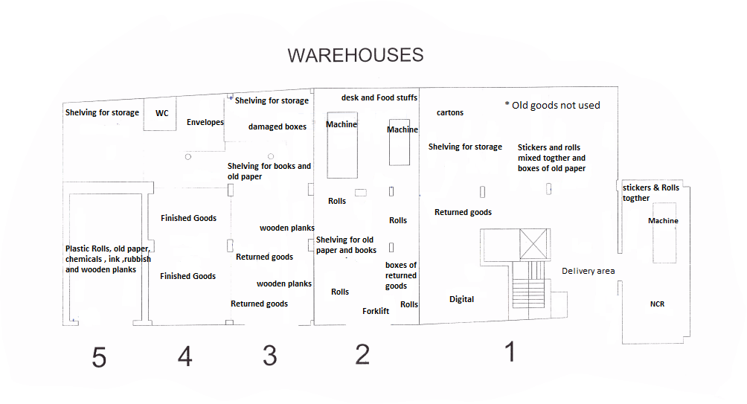
Warehouse layout current situation
the current situation of the warehouses of Al-Hijjawi company, we can see that goods, raw material and machines are arranged incorrectly

Slide 34
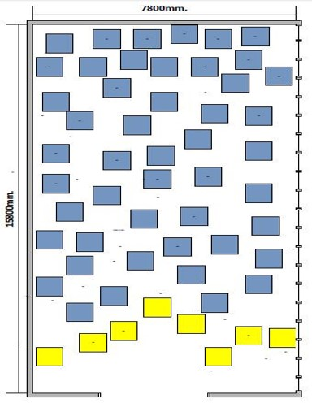
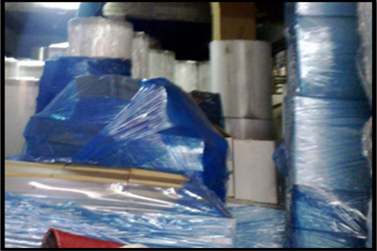
Warehouse 2 current status

Slide 35
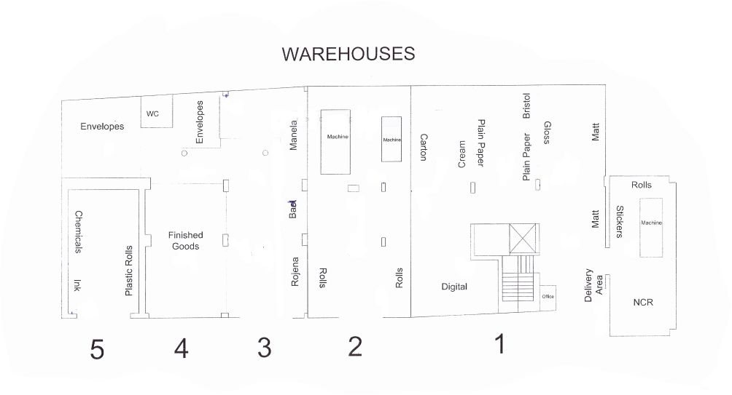
correct situation
the correct situation of the warehouses after the development process on the current situation of stores and arrange the goods and materials properly

Slide 36
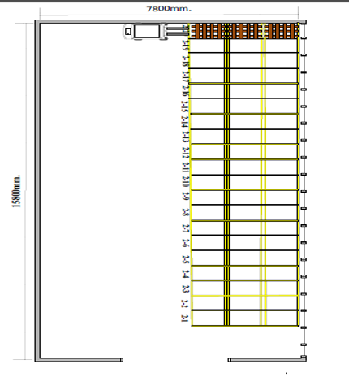
Warehouse 2 proposed order

Slide 37
Opportunities
  the machines layout that causes a waste, money and effort when raw materials or finished products are transports or handle.
  Warehouse: where it’s arranged randomly doesn’t take into account the preservation of goods and easy access
  Store what is used in the work area correctly
  Material handling and worker movement

Slide 38
project conclusion
project we can conclude that the site is suffering from disorder work place, a lot of waste generated in the working area and warehouses, lack of layout boarders, absence of maintainace scheduling (preventive) and missing good inspection criteria

Slide 39
Continue… desired outcomes
Establishing a system of documentation and recording of the necessary information and observations
Arrange and record this information
Educate the workers and the operational staff of the importance of registration and arrange information accurately and conceptually.
Educate the workers and the operational staff of the importance of registration and arrange information accurately and conceptually.
The current layout was bad
Make the process of movements within the facility more smoothly

Slide 40
Recommendations
improve the mechanism of dealing with customers
clarify the contract
We encourage them to claim the culture of workers and the idea of ​​belonging to work
Employing an experienced quality

Slide 41


Slide 42


