Slide 1
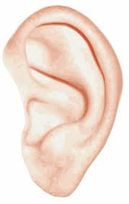
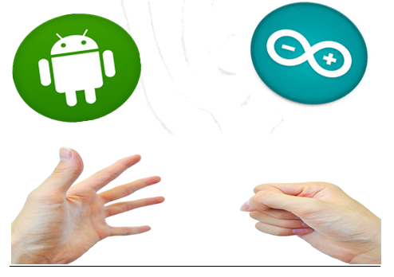
Enable Talk
Prepared By:
Alaa Mayyaleh
Shurouq Abu salhiah

Slide 2
Contents:
Project definition and purpose .
Equipment
Programs .
Project procedure .
Economical study.
The result (Demo) .

Slide 3
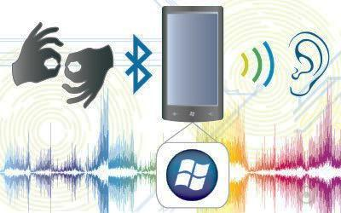
Talk Gloves:
Enable Talk is a creative project, whose main idea is to translate sign language into written and spoken words , by using a sensor glove.

Slide 4
Why Talk gloves?
To solve deaf-mute people problem by give a voice to the voiceless.
A new way for easy life , now you can talk and send messages to your friends without looking to your mobile screen , your hand in your pocket ! your eyes is free ! ..

Slide 5
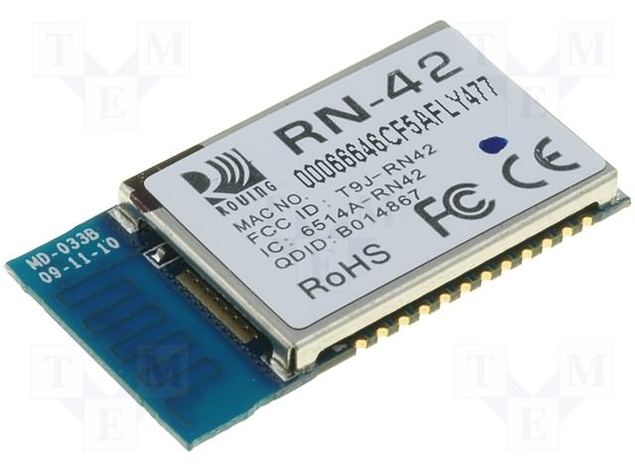
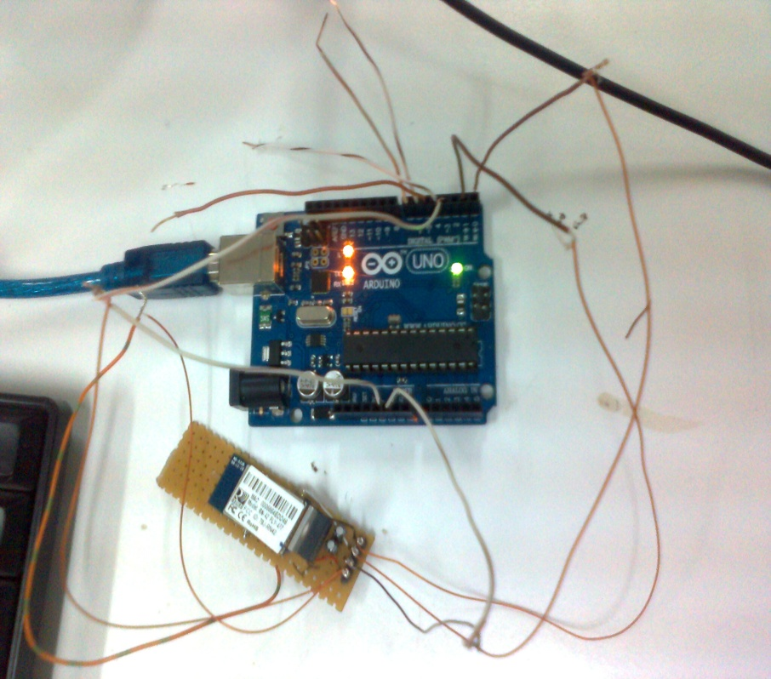
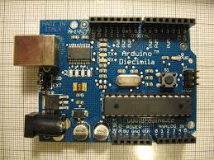
Equipment:
The devices we have used were :
+ ➔
Arduino It's a simple microcontroller board can be used to develop interactive objects, taking inputs from a variety of sensors.
RN42 provides a reliable method for creating a wireless serial communication interface between two devices as pc, mobile.
Arduino circuit
Bluetooth RN42

Slide 6
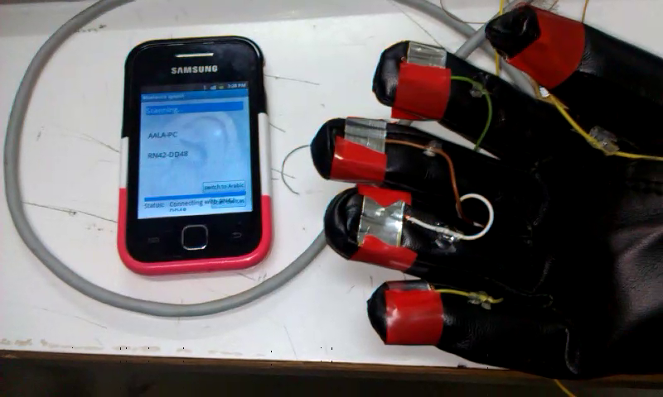
Equipment .(con+)
Sensor glove and android mobile phone
Android mobile that can accept and deal with our android application programming .
Glove that we set the touch sensors on .

Slide 7
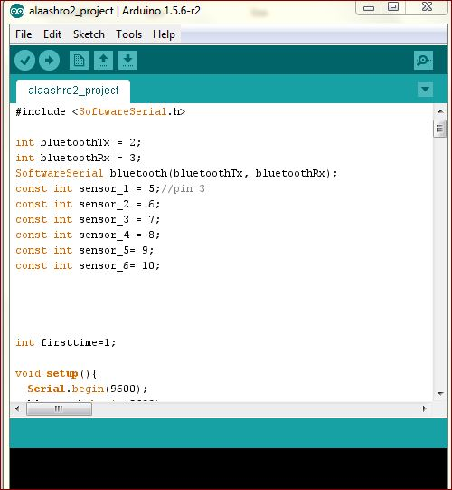
Programs :
1. Arduino Program :
a development environment
for writing software for the
arduino board.

Slide 8
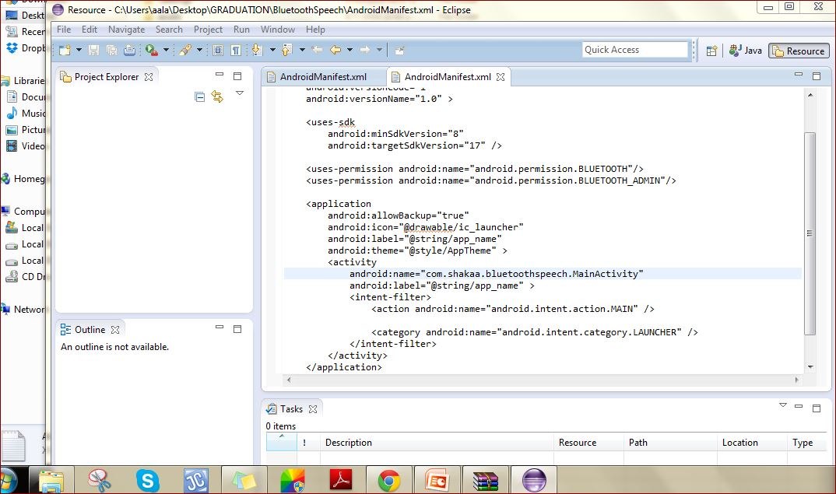
Programs :
2 . Android eclipse program :
Eclipse is a Java-based platform that allows us to create a customized development environment from plug-in components built by Eclipse members.

Slide 9
Project procedure
Design The glove with coppers sensors
Connect the arduino circuit and program it to deal with the glove sensors

Slide 10
Connecting the Bluetooth modular bins with the arduino pins and test the module
Develop an android application to deal with arduino-bluetooth data

Slide 11
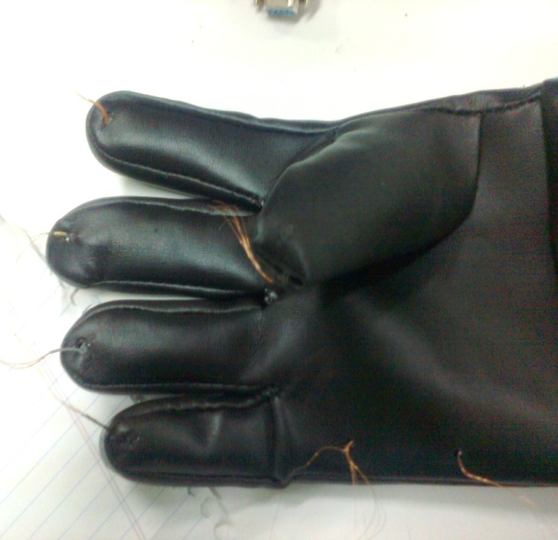
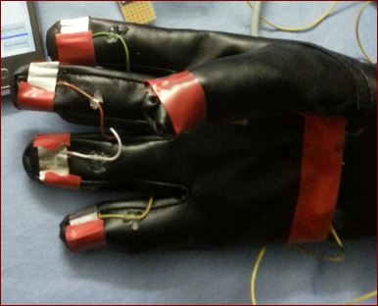
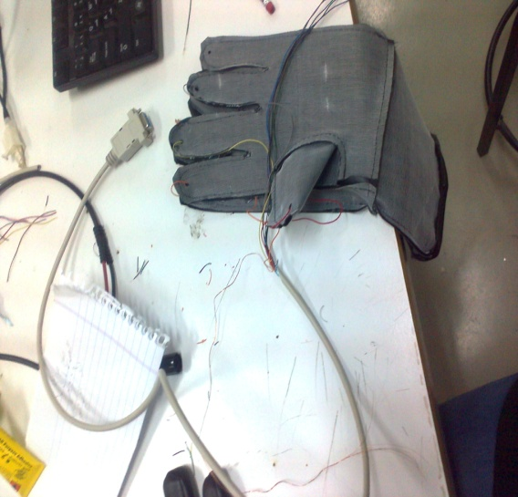
First:
We Design The gloves with coppers sensors separately 5 sensors connected each of them on the top of hand finger.
We have made the design as these sensors define the 2^5=32 probability for “ different characters that will be transmitted later through the bluetooth to the mobile “ in arduino code .
➔ ➔

Slide 12
Secondly: use Arduino circuit (hardware)
We connected the pins of the Rn42 bluetooth module (Tx,Rx,5v,Ground) with Arduino pins.
Taking in account that the Tx of arduino with the Rx of the bluetooth ,and Tx bluetooth➔Rx arduino . common 5v common 5v and common ground ).

Slide 13
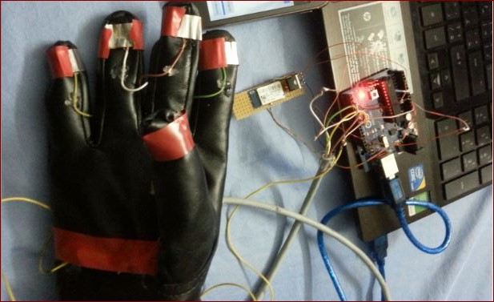
Con’t:
Connect the ends of the gloves sensor wires with arduino pins (5 input ).

Slide 14
Secondly: We used Arduino program (software)
The task of arduino code is to define the input pins , the bluetooth pins and serial commands for both ,all the pins are set to be 5 volt by default.
when we press any sensor on the glove side, the pins turns to zero , according to that it print on the screen a certain character or word and send it through the bluetooth to the paired device.

Slide 15
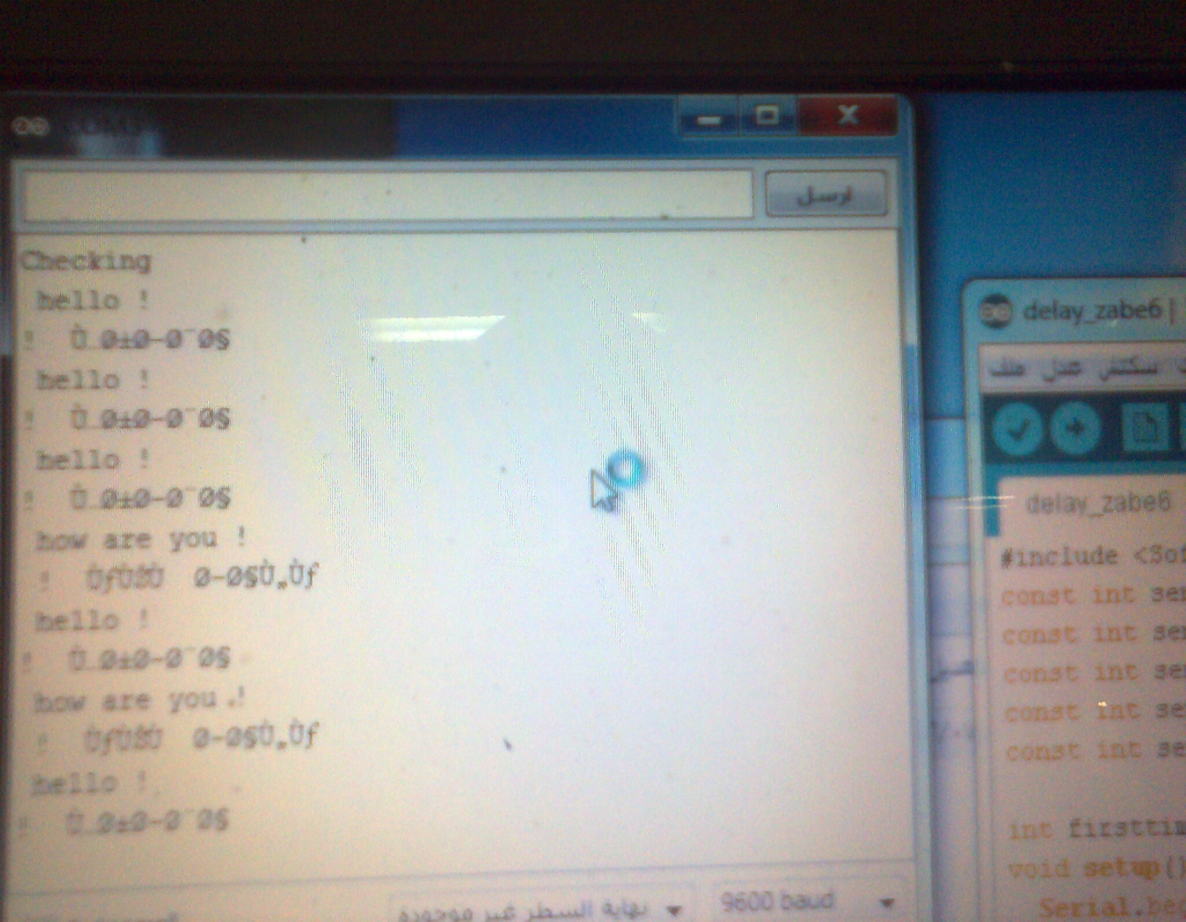
Example of the first time test
As we see , it can’t send words through the air ➔ Arabic words unacceptable .

Slide 16
So No Short Roads Here !
because we can’t send the whole word to the mobile application , we need to send some characters or numbers as zero-ones . And
To develop the android application to receive it and translate it to a certain words in the other side .
So we decided to send characters .

Slide 17
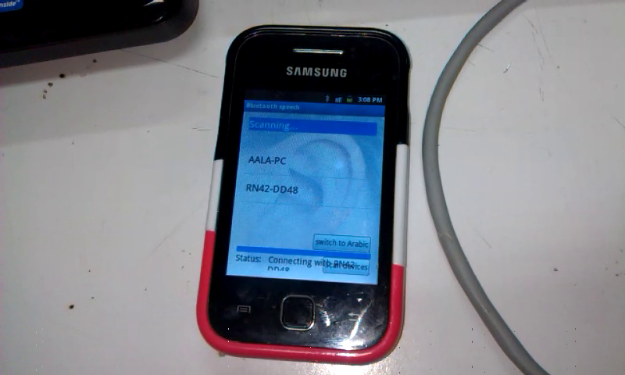
Develop an android application
The android application should make 3 tasks
First : to scan the around bluetooth devices .

Slide 18
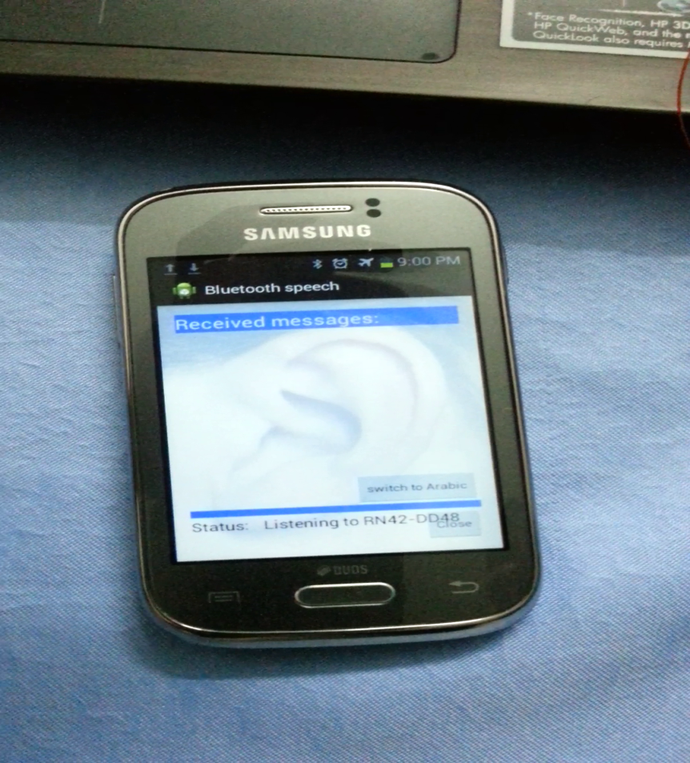
Second task for android application
To make pairing with the chosen device . Pc or mobile and connect to it waiting to receiving messages .

Slide 19
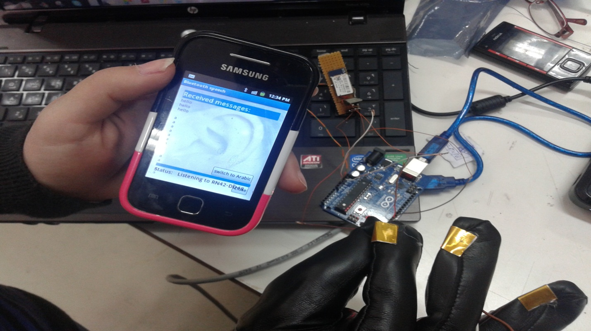
Third step
To receive the characters and translate it to words then to define how to speak it , then print it on the mobile screen and speak it in both languages , Arabic and English .

Slide 20
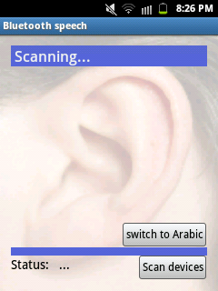
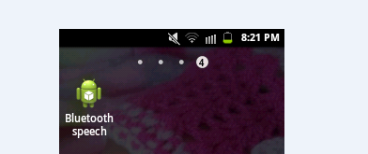
Application layouts:
Icon of apps
Layouts( starting screen)

Slide 21
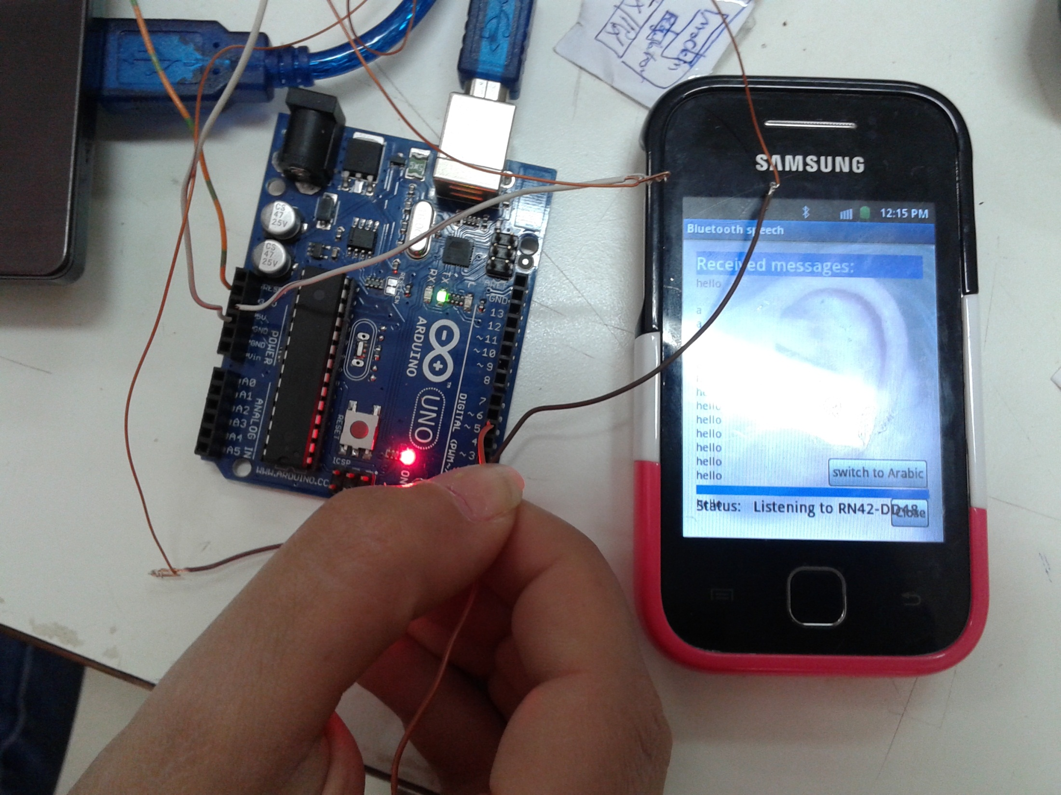
Listening to the Bluetooth, write the word then say it .

Slide 22
Economical studies
equipment | price
gloves | 5$
arduino | 25$
Bluetooth RN modular | 40$
We try to make our project with the least cost as we can

Slide 23
Thank you ..
Video

