Slide 1

An-Najah National University
Building Engineering Department
Integrated redesign of bravo supermarket in Nablus city.
Prepared By:
Sarah Saboubeh.
Noor Sadaqa.
Hanan Kittaneh.
Supervisor:
Eng. Haitham Sawalha

Slide 2
Contents :
Introduction
Site analysis
Architectural design
Economical aspects
Environmental design
Structural design
Electro-mechanical design

Slide 3
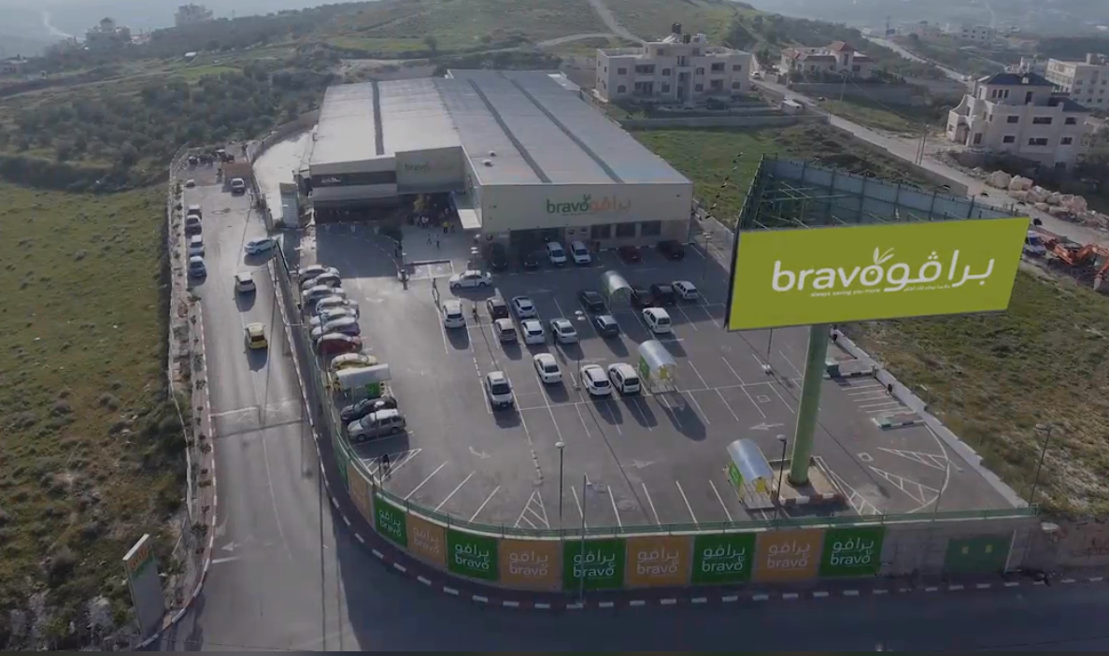
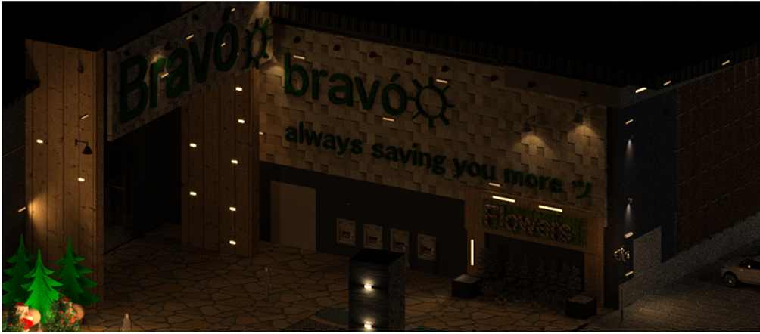
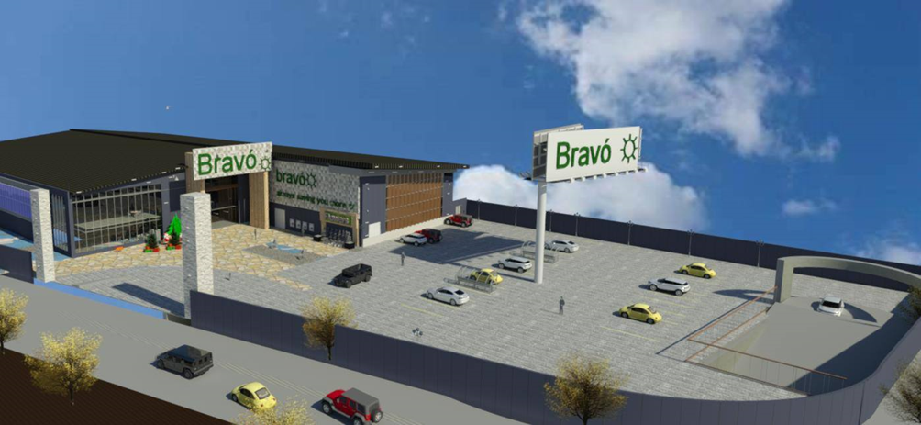
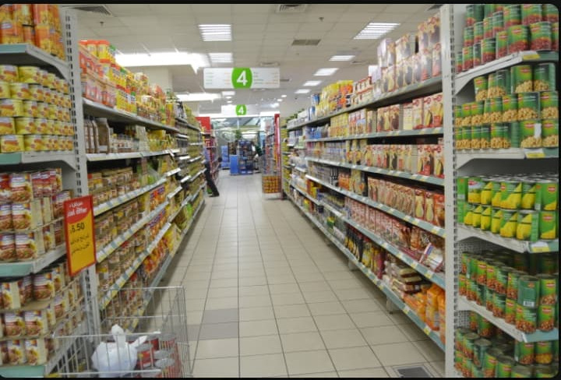
Introduction:

Slide 4
Site Analysis.

Slide 5
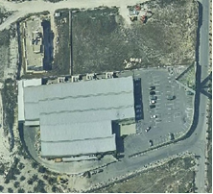
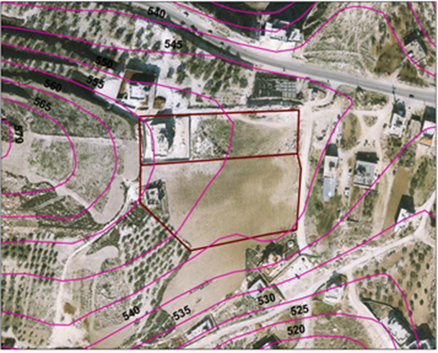
Site location:
The land stands on west of the Nablus city, at a distance about of 10 km from the center of the city.
The area of it is about 7500 m2.
located on light hills, at the average height from sea about 650 m.
it is surrounded by two streets, one of them is main street by width 10m, and the other is secondary by
width 12 m.

Slide 6
Architectural design

Slide 7
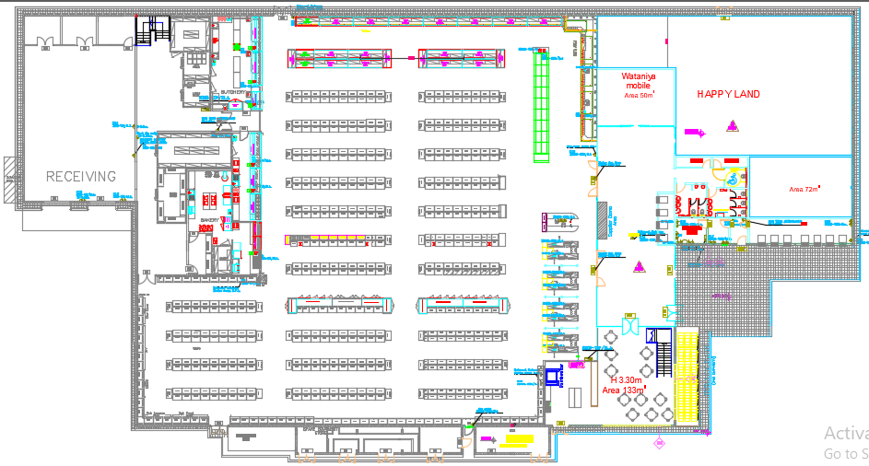
Ground floor (before Modifications)

Slide 8
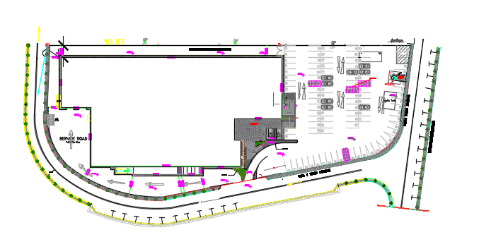

Site plan
(Before modifications.)
Problem in parking
N

Slide 9

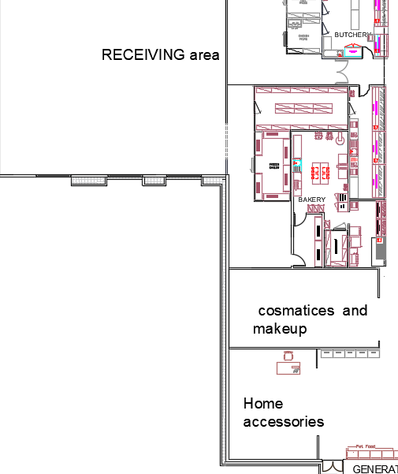
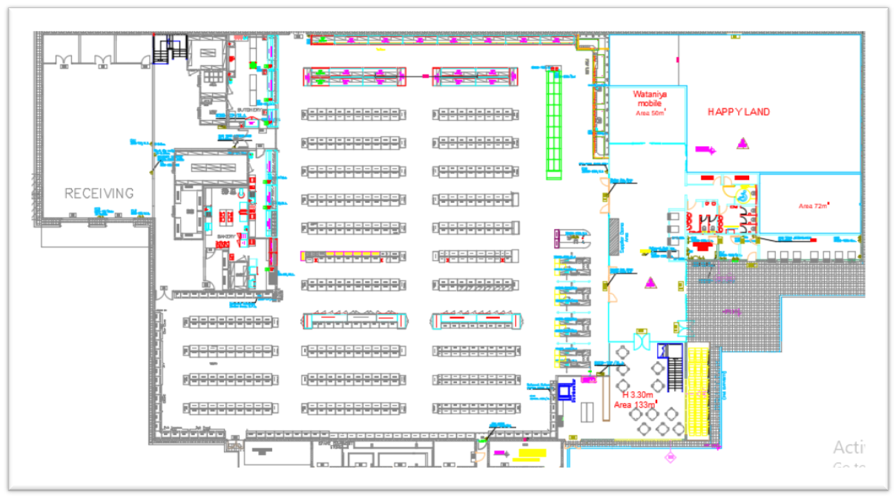
Problem and modification:
Added cosmetics and home accessories.
After.
Before.

Slide 10
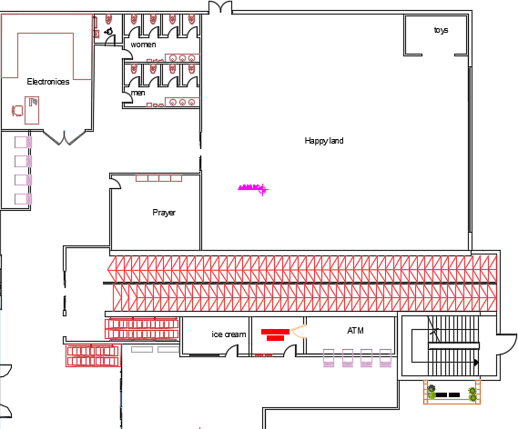
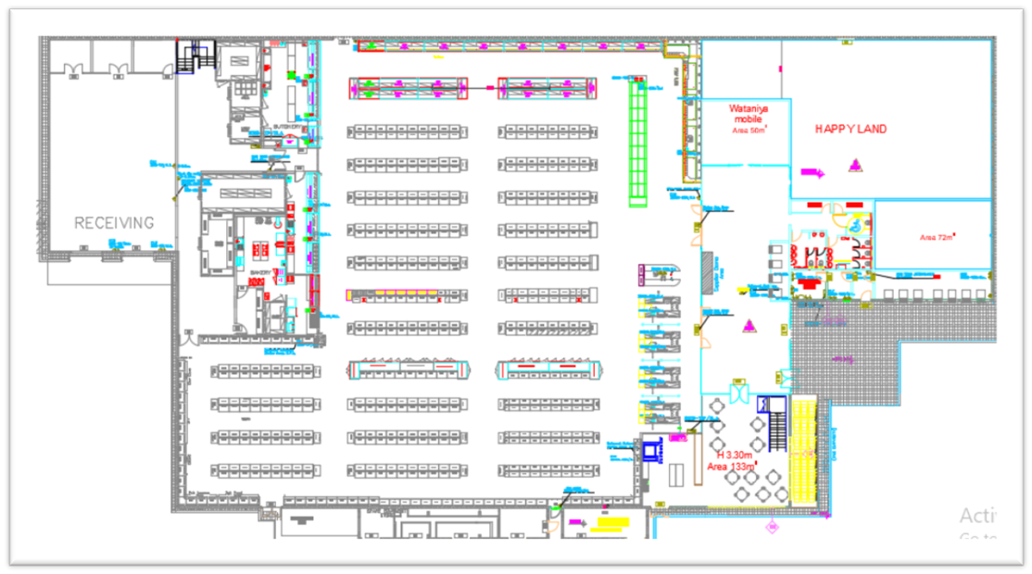
Added flower store ,prayer ,electronics ,ice cream space and water closet.
prayer

Slide 11
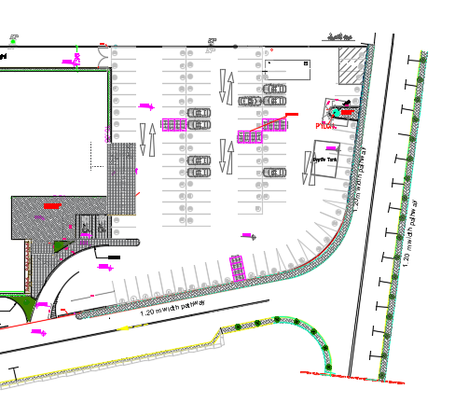
Parking :
Before
Number of parking 104.

Slide 12
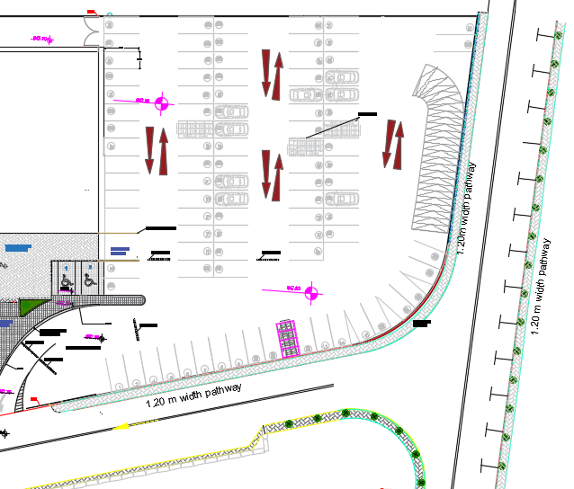
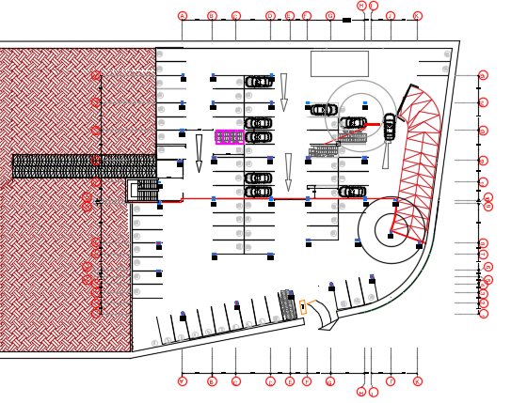
After modifications:
1- Number of parking become 190.
2-Added ramp 13%.
3-Added retaining wall.

Slide 13
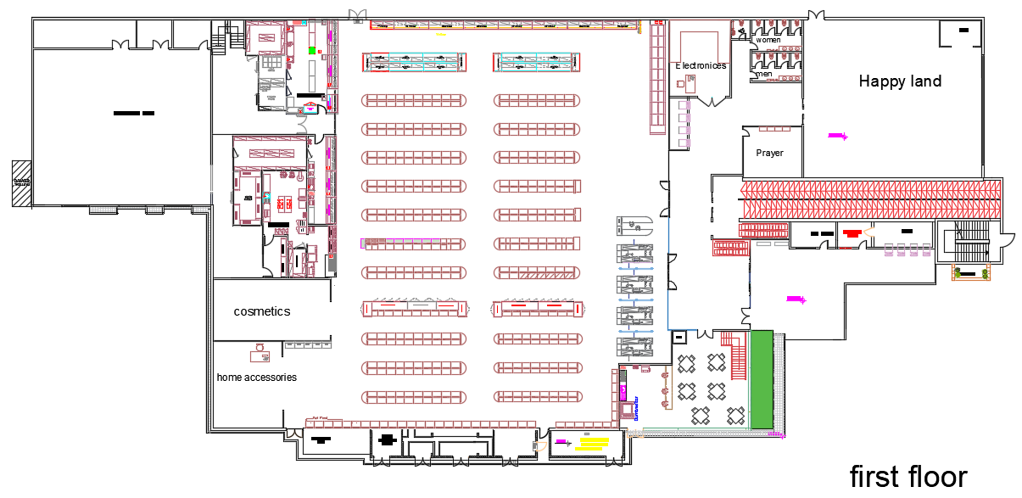
Added Electrical ramp
Change the shelves to rounded shelves:
After.

Slide 14
Electro-mechanical design

Slide 15
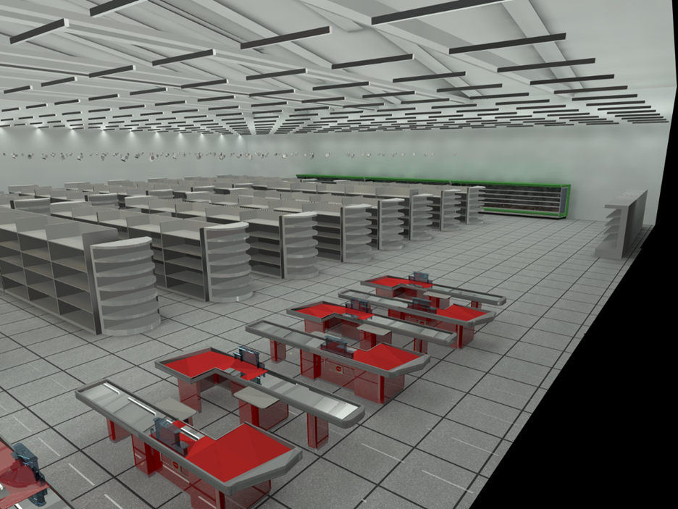
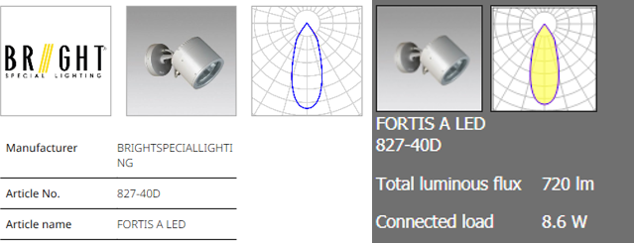
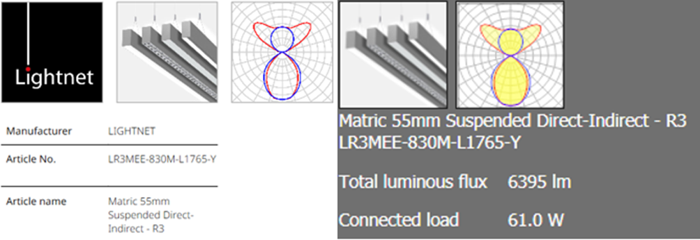
Artificial lighting:
*illuminance
*glare
*uniformity
Shopping area :
Calculation surface | Lux | Required lux | Uniformity | Required uniformity | Glare |  |  |  | Required glare
Shopping area | 541 | 500 | - | - | In front of corridor |  | Medium | End of corridor | < 22
Between shelves | 628 | (700-1000) | .9 | .6 | 16.3 | 15.5 |  | 13.4
Entrance | 594 | 500 | .6 | .6

Slide 16
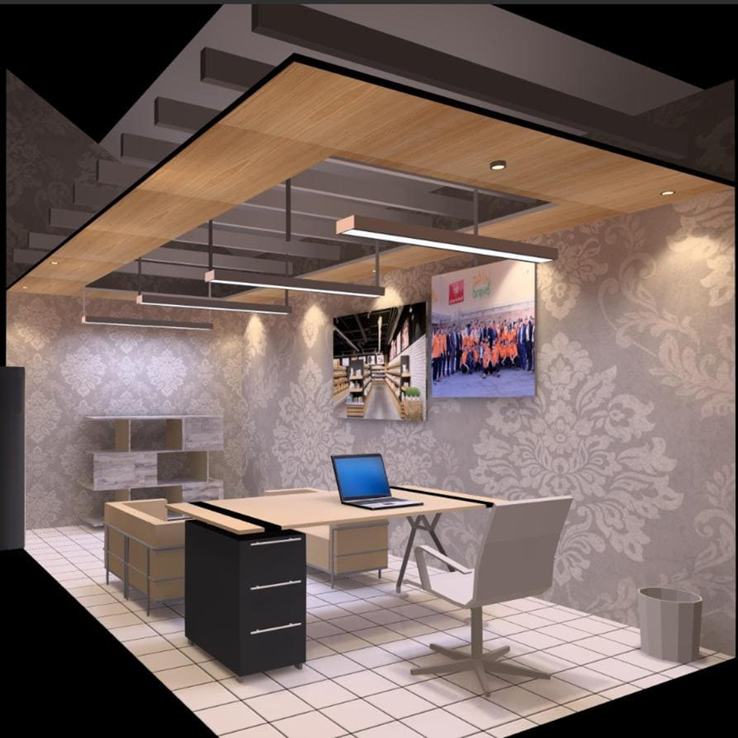
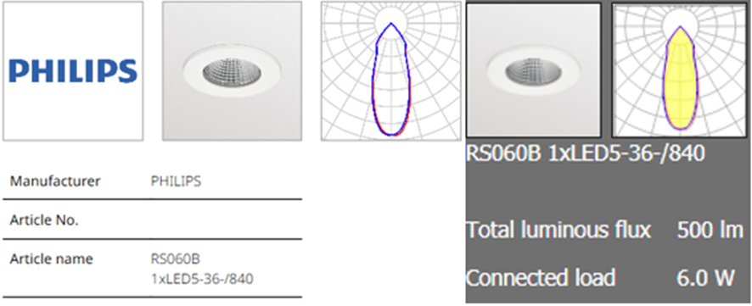
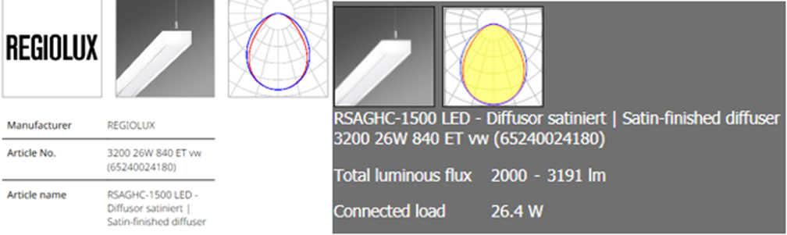
Office :
Calculation surface | Lux | Required lux | Uniformity | Required uniformity | Glare | Required glare
Office | 500 | 500 | 0.61 | .6 | 15 | < 22

Slide 17
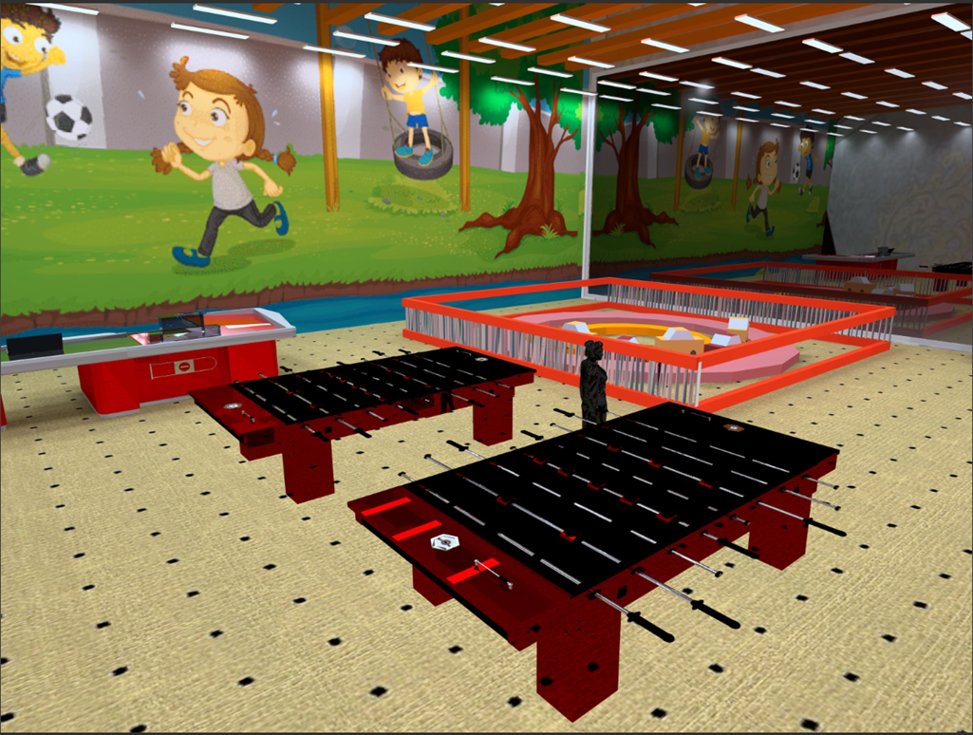
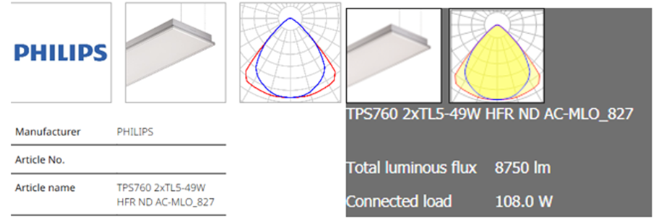
Happy land :
-The happy land considered as sport halls.
Calculation surface | Lux | Required lux | Uniformity | Required uniformity | Glare |  | Required glare
Happy land | 631 | 300 | 0.5 | 0.52 | 13.2 | 12.4 | < 22

Slide 18
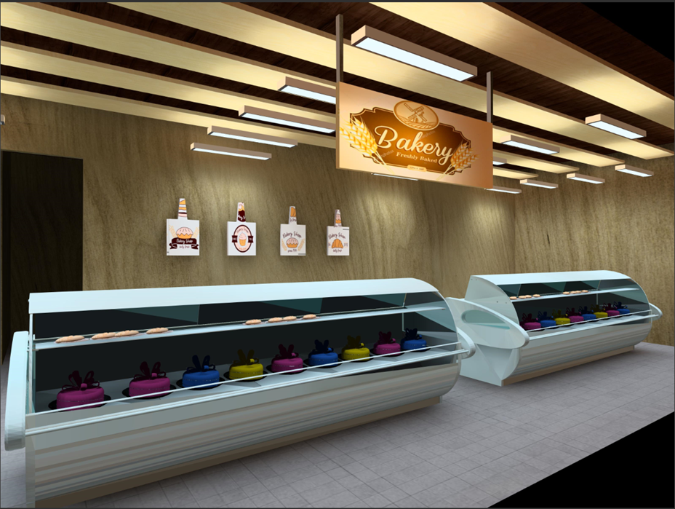
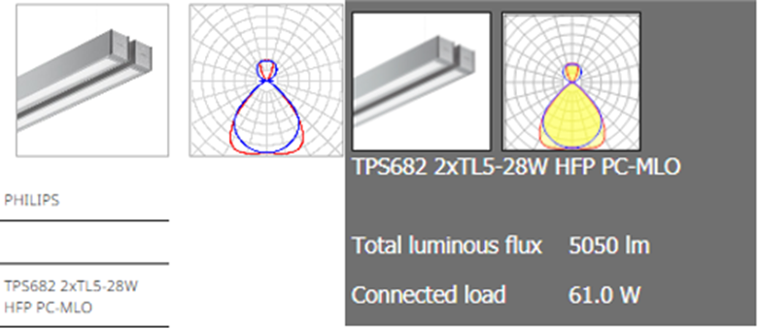
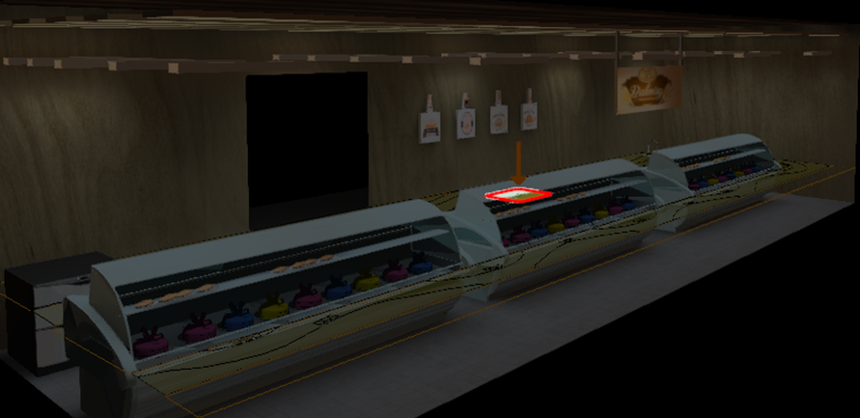
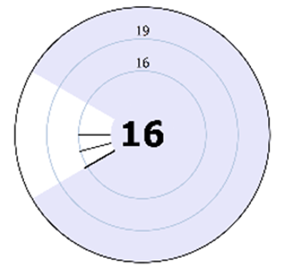
Bakery :
Calculation surface | Lux | Required lux | Uniformity | Required uniformity | Glare | Required glare
Bakeries | 566 | 500 | 1.0 | 0.7 | 16.3 | 22

Slide 19
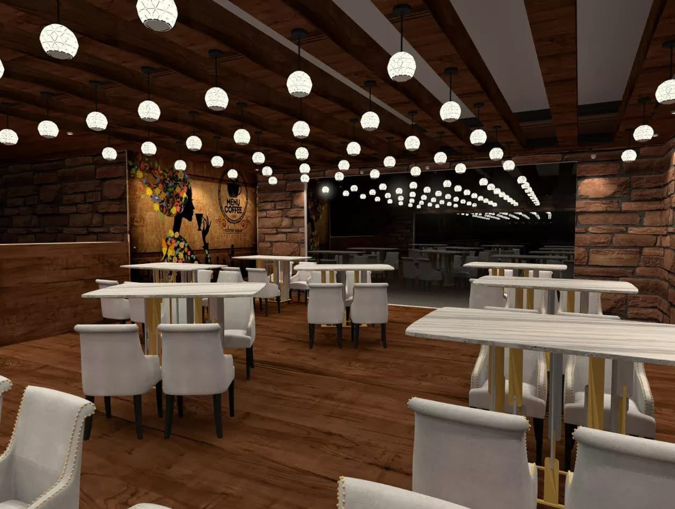
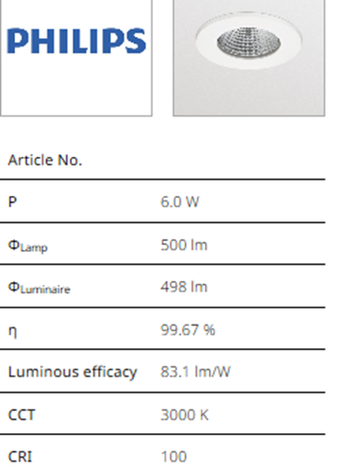
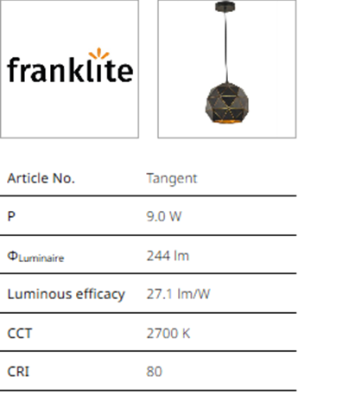
Jasmin café :
Calculation surface | Lux | Required lux | Uniformity | Required uniformity | Glare |  | Required glare
Café | 191 | 150 | 0.4 | .01 | 21.5 | 21.2 | 22

Slide 20
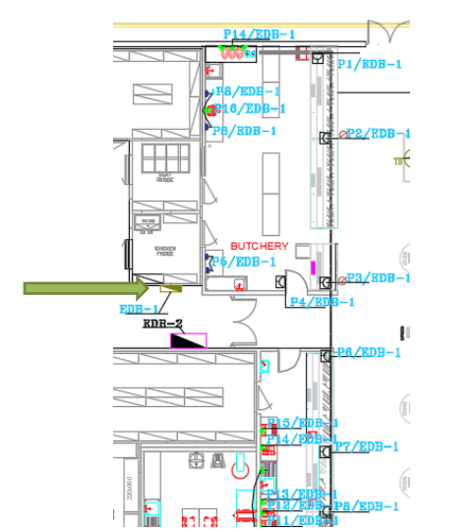
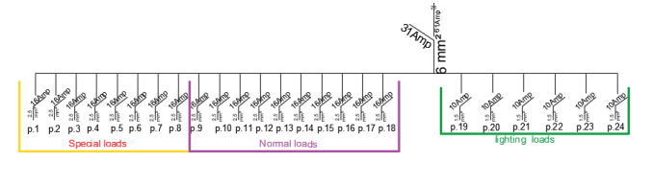
The electrical load of power and lighting in the electrical distribution board 1:
 | M.D.B 1 | Special load | Normal load | Light load | Total power | I load | I C.B | I cable | C.B | Cable (IEC )
EDB-1 |  | Watt | Watt | Watt | Watt | Amp | Amp | Amp | Amp
 | 3-phase | 10560 | 3500 | 1525 | 12830 | 20.58 | 23.66 | 27.21 | 25 | (31A ) ,6 mm2

Slide 21
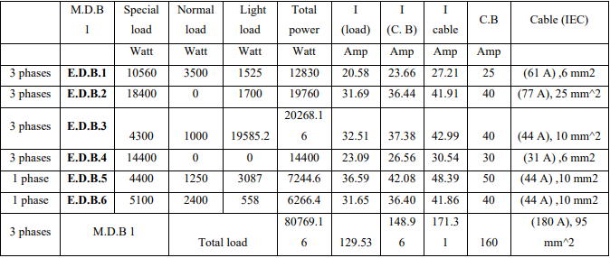
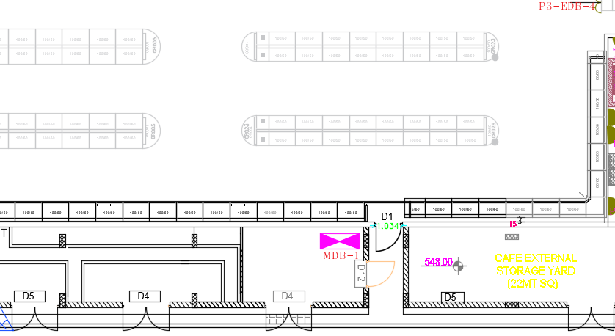
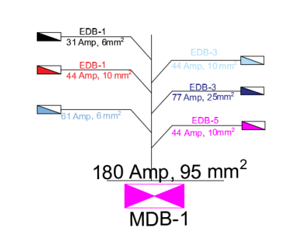
The electrical load of power and lighting in the supermarket:
The electrical load of HVAC system:
 | M.D.B 2 | Special load | Normal load | Light load | Total power | I load | I C.B | I cable | C.B | Cable (IEC )
HVAC |  | Watt | Watt | Watt | Watt | Amp | Amp | Amp | Amp
 |  | 39000 | 0 |  | 39000 | 62.54628 | 71.92822 | 82.71745 | 25 | (77 A ) ,25 mm2

Slide 22
Acoustical- design.

Slide 23
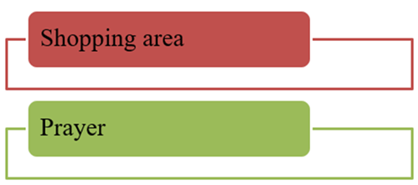
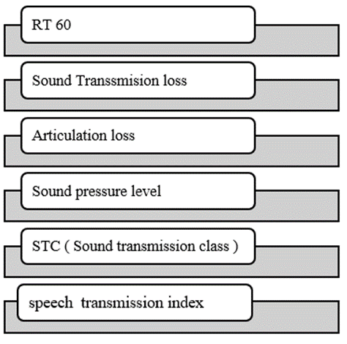
The spaces that were designed :
The parameters should be studied:

Slide 24
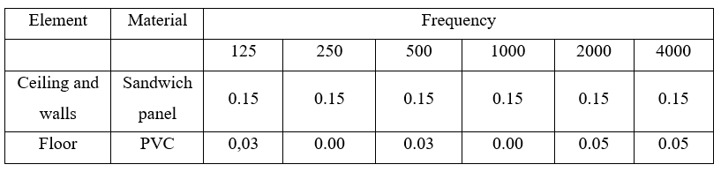
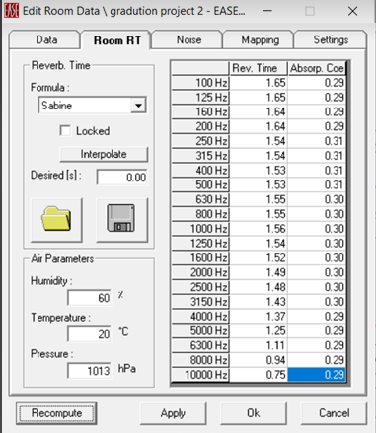
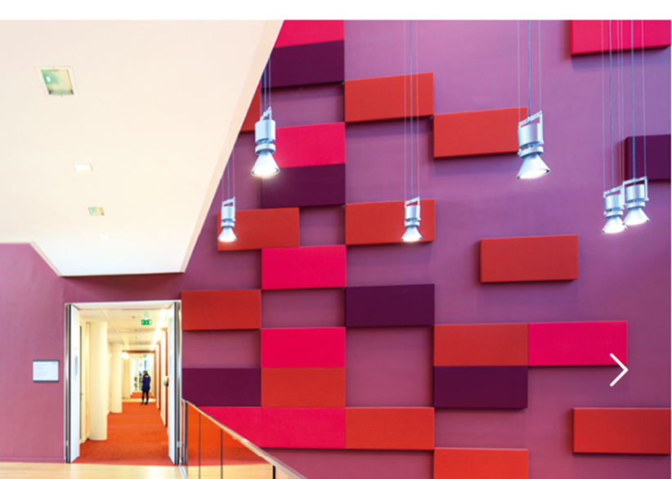
Shopping area :
Absorption coefficient for material:
Panels was added to the walls in order to decrease RT60

Slide 25
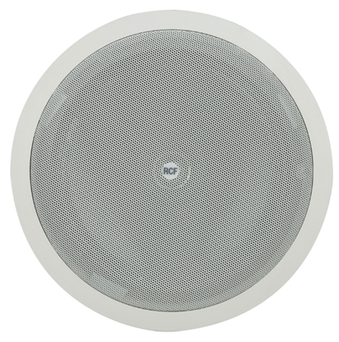
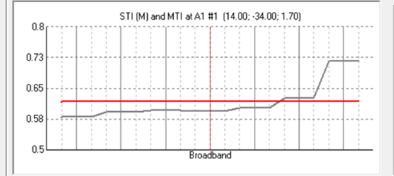
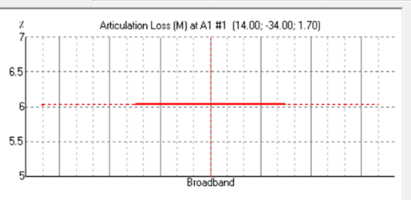
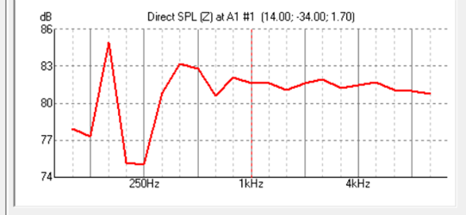
Loud speaker :
Model | Coverage area | Max SPL @1m | System sensitivity
PL 8X | 80 | 90 | 90
Result :
SPL= around 85
AL= 7%
STI=.8

Slide 26
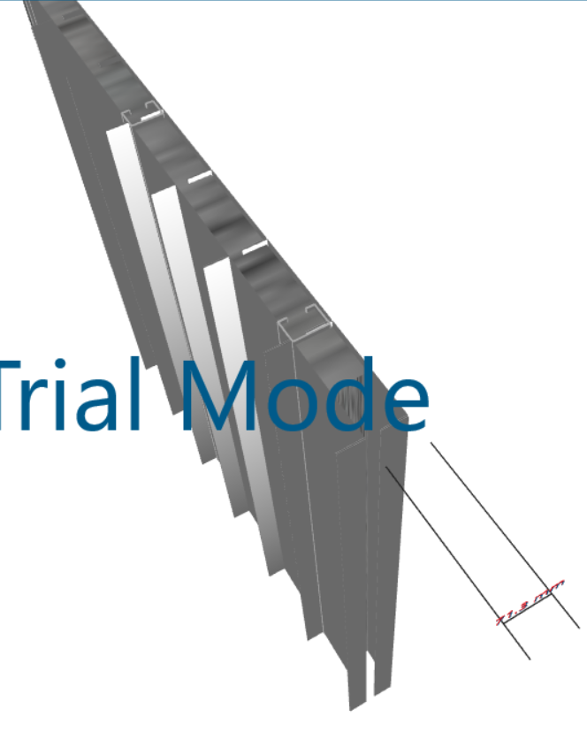
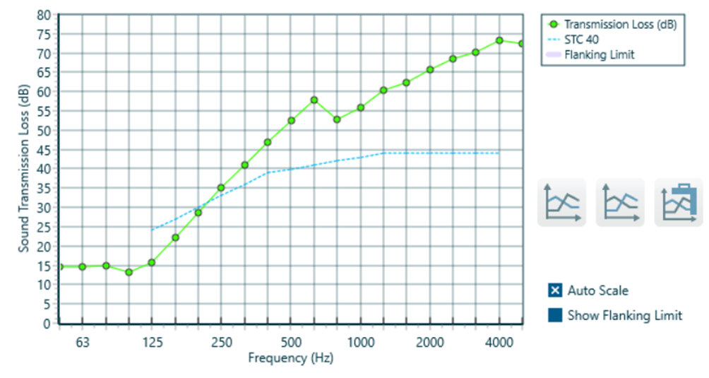
STC :
Layers for exterior wall : aluminum sheet (12mm)+polyethylene + aluminum sheet 12mm

Slide 27
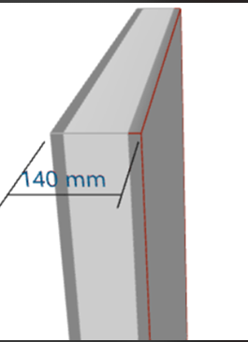
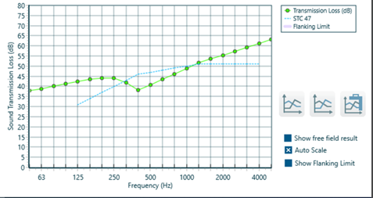
STC :
Layers of the interior wall:20 mm Sand/Cement render (plaster) + 100 mm CMU+ 20 mm Sand/Cement render (plaster).

Slide 28
Environmental design.

Slide 29
The basic parameter in the environmental assessment:
Day lighting
Thermal
Analysis
Photovoltaic analysis and design

Slide 30
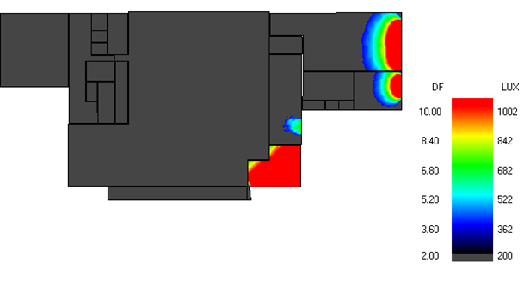


Day lighting analysis
After modification
Before modification

Slide 31



Environmental Modifications
Skylight on the roof
Vertical louvers on the eastern facade
Horizontal louvers on the southern façade

Slide 32
Thermal analysis

Slide 33




Ground floor:U- value = 3.64 (W/m2-K).
Roof : U-value = 0.409 (W/m2-K).
External wall : U-value = 0.349 (W/m2-K).
Internal wall : U-value = 2.372(W/m2-K).

Slide 34


  Heating design:
Total heating load capacity =322.360 KW.
  Cooling design:
Total cooling load capacity= 597.51 KW.

Slide 35

The comfort graph for the supermarket from Design Builder
The building achieves the comfort when the PMV graph be with range between (-0.05 _0.05)

Slide 36
Photovoltaic analysis and design

Slide 37


Sun analysis:
In winter:
In summer:

Slide 38

Distribution of the PVs on the roof :

Slide 39
PV Syst Results:

Slide 40


Cumulative cash flow from RET Screen:
for south elevation
For roof
the pay pack period equals 6 years
the pay pack period equals 4 years

Slide 41
Heating, ventilation, and air conditions system
design (HVAC)

Slide 42





The system used for HVAC design is “ VRF system ” Variable refrigerant flow with cooling load capacity =597.51 KW.
Entrance area:
Air Curtain HVAC systems:
Shopping area:
Air handling units::
Diffuser:
Outdoor unit:
Fan coil unit:

Slide 43



Slide 44



Mechanical system :
The fresh water consumption in stores (included butchery & bakery) = 12 m³/day
The daily average of fresh water consumption = 80 L/day/person
Volume of basement water tank =150 m³.
Final selection first floor :
 | vertical | Horizontal | branch
diameter | 2" | 1½ " | ¾ "
losses | 0.34 | 0.43 | 0.61
Final selection for ground floor :
 | Horizontal | Main branch | Sub-branch
diameter | 2 ½ " | 2" | ¾ "
losses | 2.82 | 1.56 | 0.73

Slide 45


Water drainage:

Slide 46
Structural design

Slide 47
Material
Concrete with compressive strength of 28 MPa (B350),and compressive strength of 32MPa.
Steel with yield stress of 248 MPa and Ultimate strength 400 MPa.
  Design Codes
ASCE ,2010 for load design
ACI 318-14
Seismic design UBC 97
AISC360-10 for steel analysis,

Slide 48

Distribution of column in basement:
Loads for concrete structure:
Loads | kN/m2
L.L | 4
SID | 0.5

Slide 49

ETABS model of concrete structure

Slide 50


Checks:
Deflection check :
design check:
 | From etabs | Limitation | check%
Block 1 | 14 mm | 43 | Ok.
Block 2 | 17 mm | 43 | Ok.

Slide 51
Design elements
concrete:
1. solid Slab: flat plate without beams with thickness 30 cm.
Column: three groups of column will be used:
Edge column (50*30)
Interior column (60*40) and (80*30)

Slide 52
Checks
(Equilibrium) (Internal force)
Loads | ETABS | Manual | Error%
live | 10462.80 | 10440.28 | 0.2%
SID | 1307.12 | 1305.03 | 0%
Dead | 257524.41 | 25726.95 | 0.1%
Structural element | From ETAB | Manual calculation | Error
internal Column | 1098KN | 1162 | 7.5 %
edge Column | 525.85 KN | 507.29 | 3.5 %

Slide 53


Checks for seismic design:
Base shear check:
Drift check:

Slide 54

Details for the structural element:
Slab details:

Slide 55




Slide 56




Footing details:

Slide 57



Column details:
Details for column (50*30):
Details for column (60*40):
Details for column (80*30):

Slide 58

Steel structure:

Slide 59

SAP2000 model of steel structure, for shopping area:
Loads:
Roof loads:
Live load = 6kN/m.
Super imposed dead = 3.19kN/m.
Wind load on roof = 3.6kN/m.
For lee word= 2.19kN/m.
Snow load = 10.8kN/m.

Slide 60


Design elements
Steel:
Section for column tube(240× 240 × 12 mm).
Section for top chord (Tube 400*200*12)
Section for bottom chord (Tube 240× 168 ×12.5)
Section of the diagonal (Tube 120*60*8).
Section Post (Tube 100*50*6).
Bracing column(100*60*3).
Top bracing(120*80*3.6).
Tube Section:

Slide 61

Checks
(compatibility):

Slide 62
Checks
Equilibrium check:
 | From etabs: | From hand calculation: | Error%:
Live | 3185.14 | 3168.00 | 0.5%
Snow | 5702.00 | 5702.4 | 0%
SID | 1936.79 | 1936.79 | 0.7%
Internal force check:
 | From etabs: | From hand calculation: | Error%:
Axial force | 1501.9 | 1414 | 6%

Slide 63

Design of connection:

Slide 64




Design of connection (B):
AutoCAD drawing, joint B
3D Tekla detail
Members detail
3D Tekla detail

Slide 65






Design of connection (G):
AutoCAD drawing, joint G
3D Tekla detail
3D Tekla detail

Slide 66




Design of connection (N):

Slide 67



Design of connection (k):
Top view connection K
Side view connection

Slide 68


Design of connection (k):
3D Tekla connection

Slide 69



Design of connection (I):
3D Tekla connection
Details drawing AutoCAD

Slide 70



Connection between bracing:
Details drawing AutoCAD:

Slide 71


Connection between column and bracing:
3D Tekla connection

Slide 72


Anchors and base plate design:
3D Tekla connection
Top view, AutoCAD detailed

Slide 73
Fire fighting- design.

Slide 74




Fire alarm system:
Beam smoke detectors:

Slide 75

Fire alarm system:
Beam smoke detectors:

Slide 76


Fire suppression system:
Distribution of the extinguishers in the shopping area:

Slide 77


Fire suppression system:
Distribution of the sprinklers in the shopping area:

Slide 78

Fire suppression system:
FM200 system

Slide 79
Quantity Surveying and Cost Estimation

Slide 80
Summery of each work total cost in BRAVO
The total cost of the Bravo 5600000 NIS and the total area of the BRAVO is 3200 m2 which means that the total unit cost per m2 is 1750 NIS/ m2.
Type of work | Total cost of work (NIS)
Earth work | 216815
Substructure work | 448503
Superstructure work | 2119113
Electrical work | 431401
Fire system | 113950
Mechanical work | 53662
HVAC system | 448000
Total project cost | 5600000

Slide 81
Summery of each work total cost in Basement
The total cost of the Basement is 1796261 NIS and the total area of the Basement is 2800 m2 which means that the total unit cost per m2 is 641 NIS/ m2
Type of work | Total cost of work (NIS)
Earth work | 401527
Substructure work | 598485
Superstructure work | 665304
Finishing | 130945
Total cost | 1796261

Slide 82
Thank you

