Slide 1


Businessmen forum in Nablus
Prepared By: Supervisor:
Mahmoud Abd-Albaqi
Yazeed Atallah
Osama Dawood Eng.AbdelHakim
ALJawhari .

Slide 2
Contents:
Architectural Design.
Structural design.
Environmental Design.
Electrical design.
Mechanical design .
Acoustical design

Slide 3
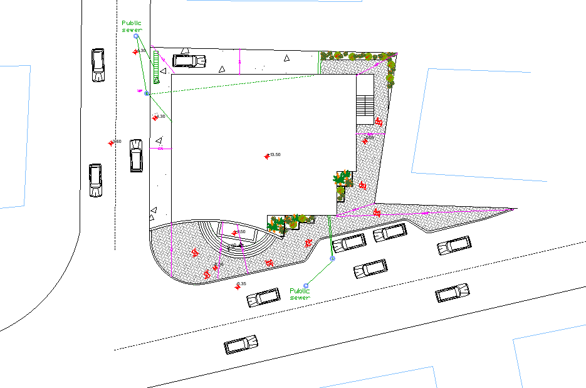
Architectural Design:
Site plan:
N

Slide 4
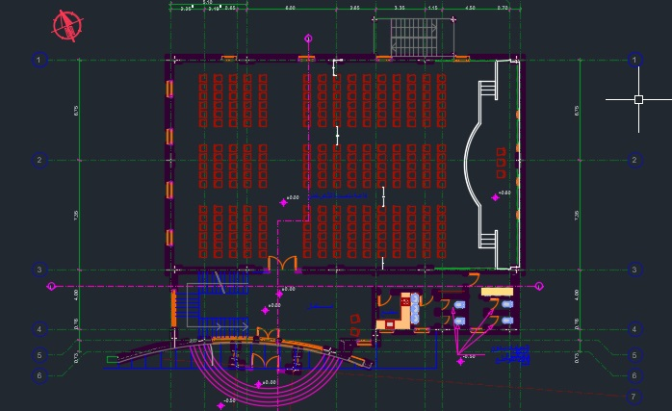
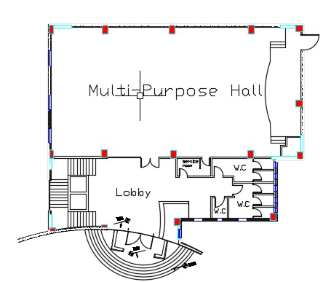
Architectural Design:
Ground Floor:

Slide 5
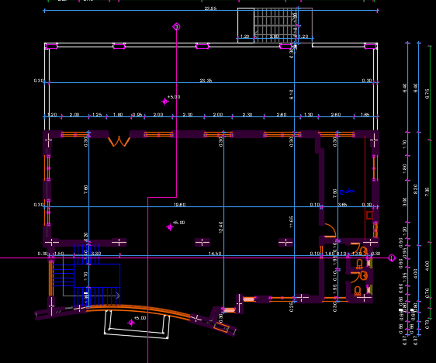
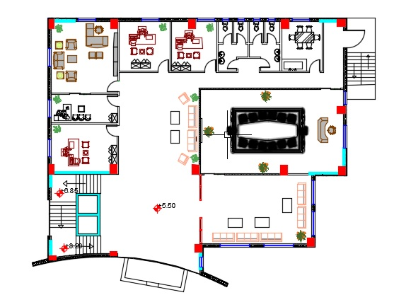
Architectural Design:

Slide 6
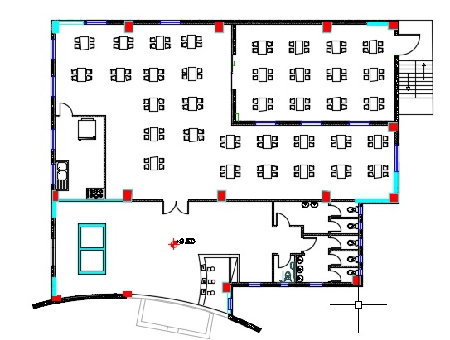
Architectural Design:
Second Floor:

Slide 7
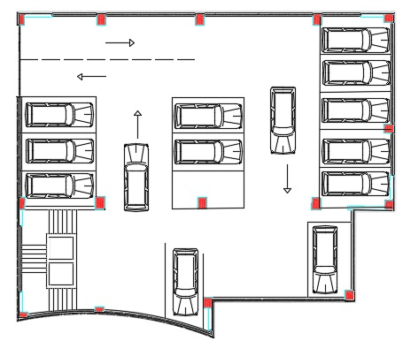
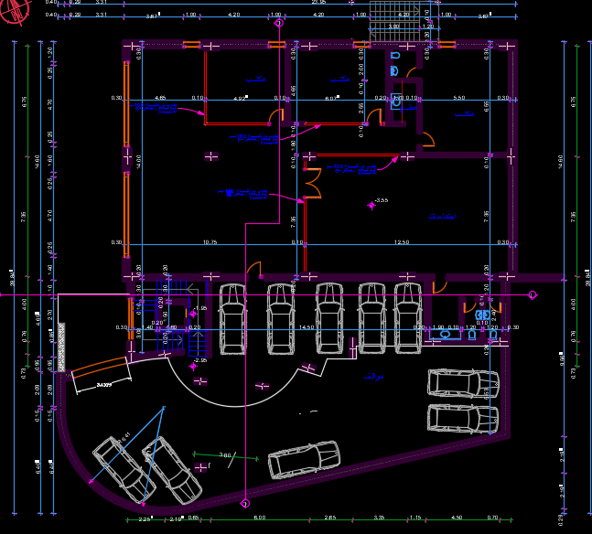
Architectural Design:
Basement 1:

Slide 8
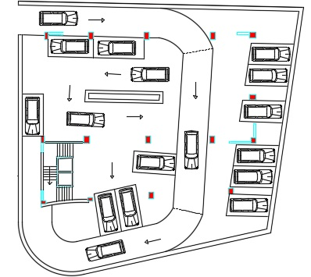
Architectural Design:
Basement 2:

Slide 9
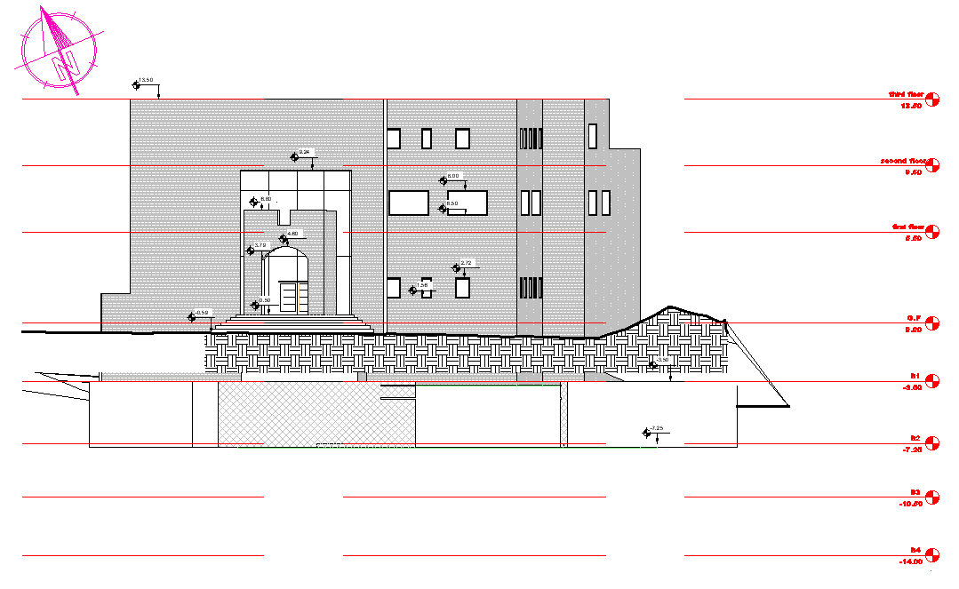
Architectural Design:
Elevations:
Southern Elevation.

Slide 10
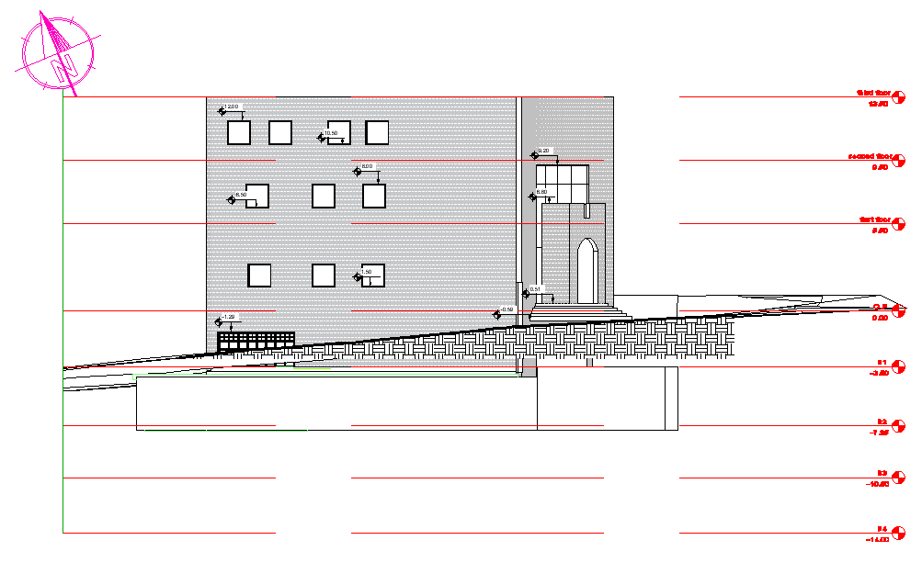
Architectural Design:
Elevations:
Eastern Elevation.

Slide 11
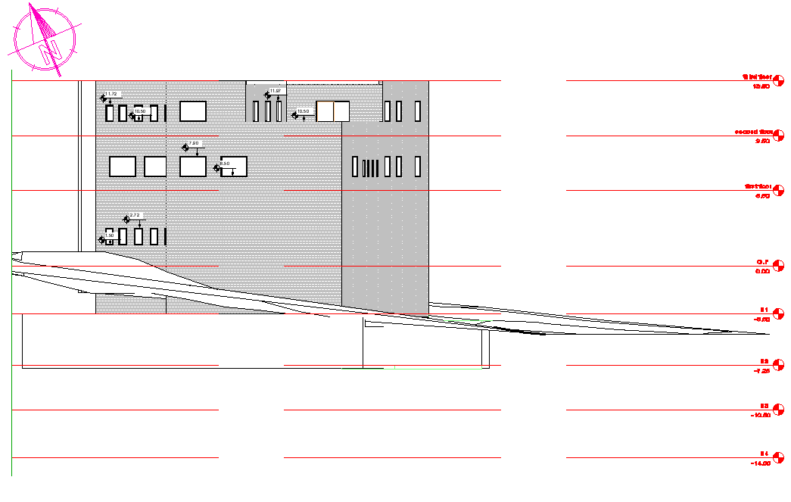
Architectural Design:
Elevations:
Western Elevation.

Slide 12
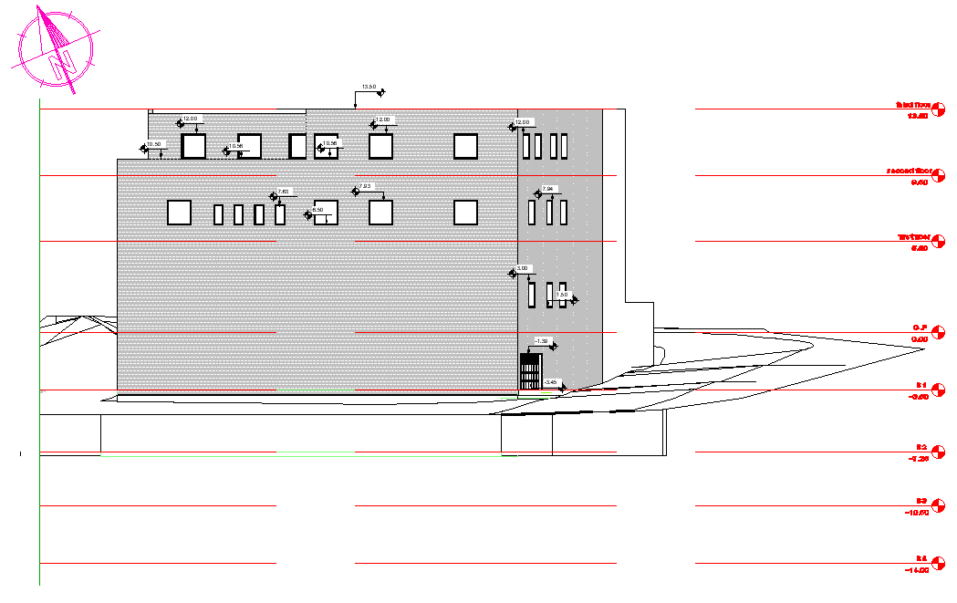
Architectural Design:
Elevations:
North Elevation.

Slide 13
Structural Design:
Codes and Standards:
ACI 318-14 for reinforcement.
UBC-97 for seismic design and its load combinations.

Slide 14
Structural Design:
Materials :
Concrete strength for columns, andshear wall f′c= 40MPa, and 24MPa for beams , slabs and footing.
Steel yield strength Fy= 420MPa.
Bearing capacity for soil = 300 kN/m²

Slide 15
Structural Design:
Loads :
Dead load.
Super imposed dead load =4 kN/m² .
Live load = 5 kN/m² .

Slide 16
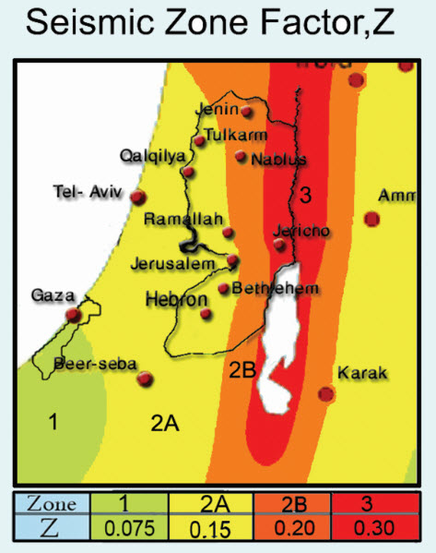
Structural Design:
Lateral loads:
Nablus City.
Seismic zone is 2B (z=0.2)
Soil profile is S_{c}
Acceleration seismic coefficients, Ca=0.24
Velocity seismic coefficients, Cv= 0.32
Importance factor, I=1.25
Force reduction factor, R=5.5

Slide 17
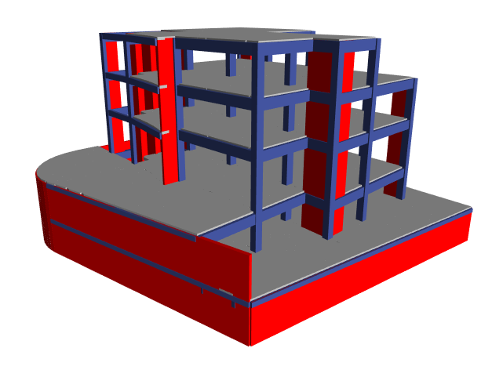
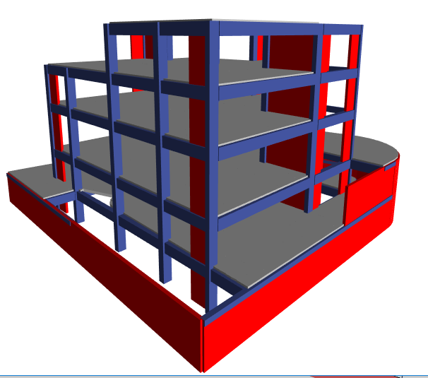
Structural Design:
Model in ETABS program :

Slide 18
Structural Design:
Checks:
Compatibility check.
Equilibrium check.
Internal forces check.
Deflection check.
Period check.
period from ETABS = 0.59 sec. , period from hand calc.= 0.46sec

Slide 19
Structural Design:
Sections Dimensions:
Member | width | depth
Slab | 40 cm Thickness
Main Beams | 50 cm | 90 cm
Sec. Beams | 50 cm | 90 cm
Column1 | 80cm | 60cm
Shear wall | 25 cm Thickness

Slide 20
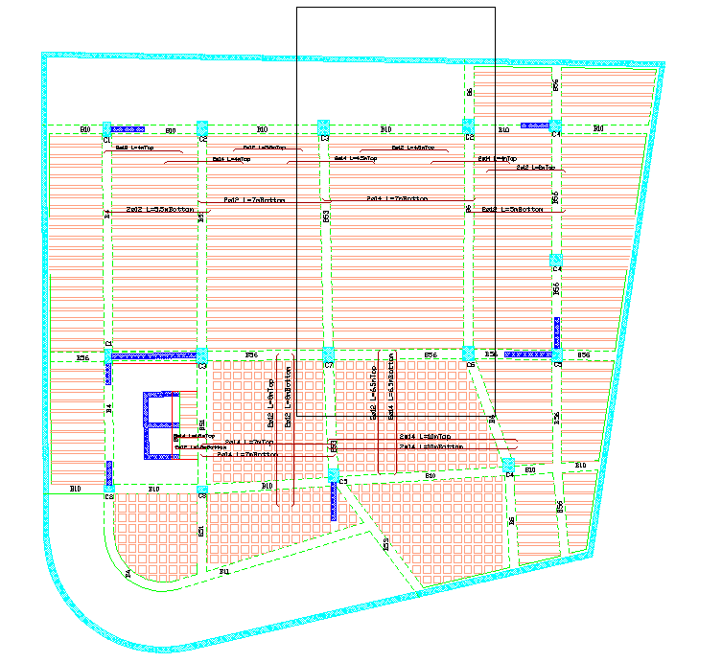
Structural Design:
Basement2 beams distributions :

Slide 21
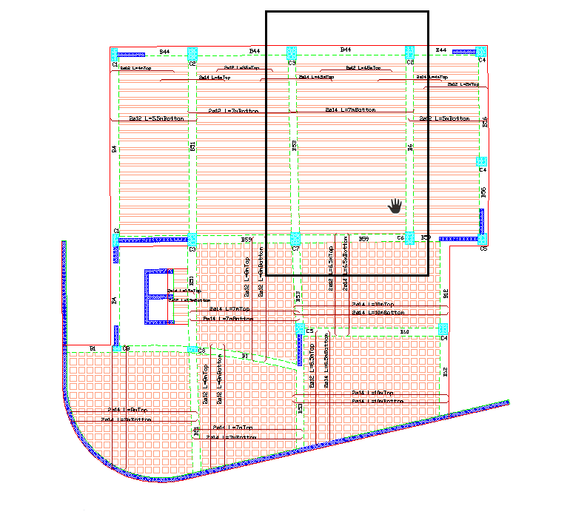
Structural Design:
Basement1 beams distributions :

Slide 22
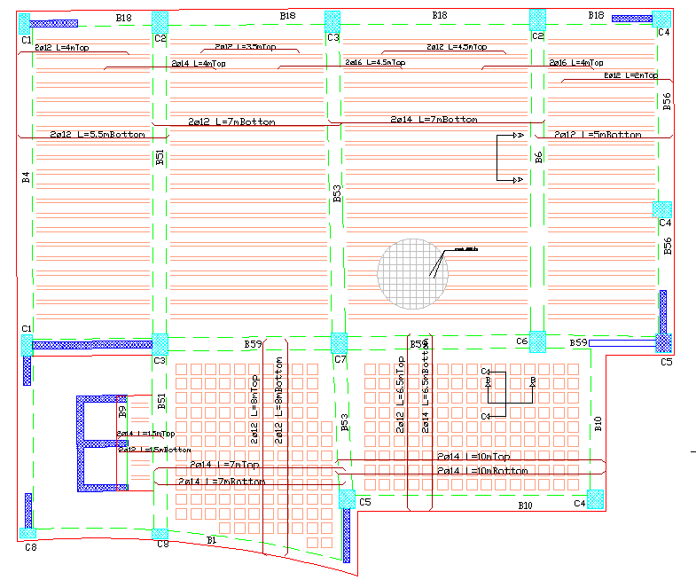
Structural Design:
G.F beams distributions :

Slide 23
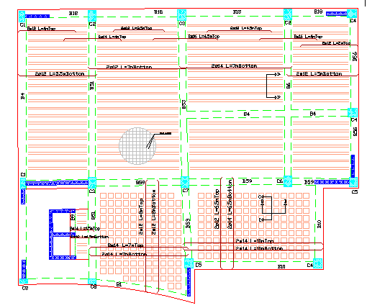
Structural Design:
F.1 beams distributions :

Slide 24
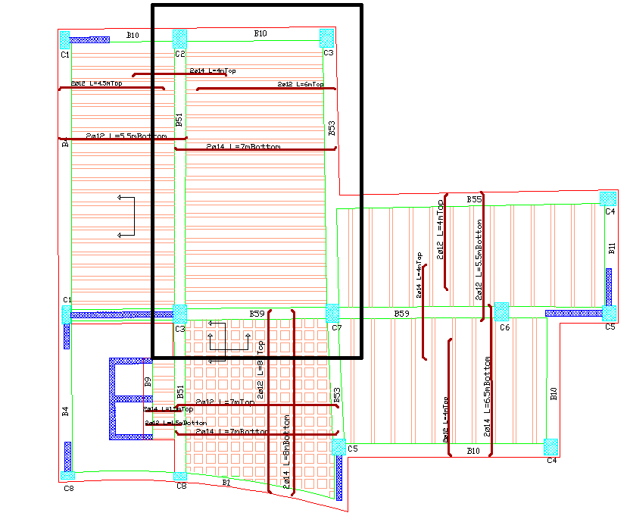
Structural Design:
F.2 beams distributions :

Slide 25
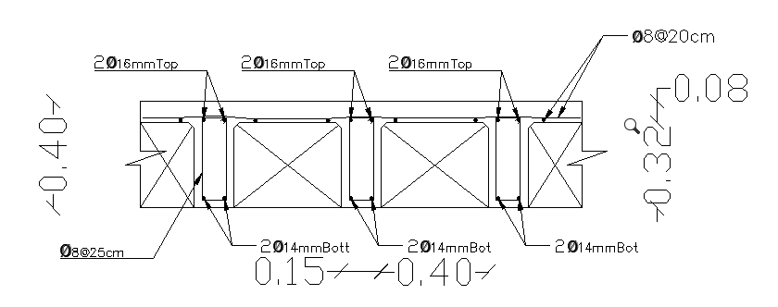
Structural Design:
Slab Reinforcements:

Slide 26
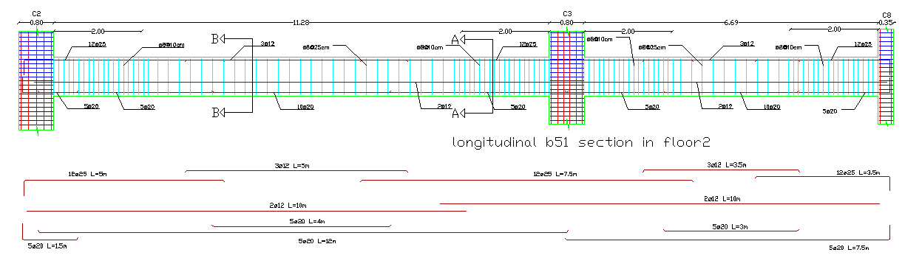
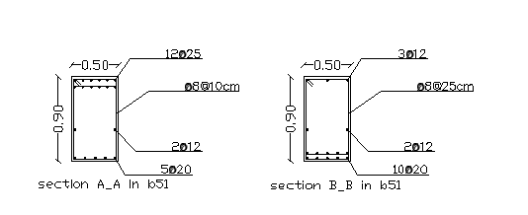
Structural Design:
Beams Reinforcements:

Slide 27
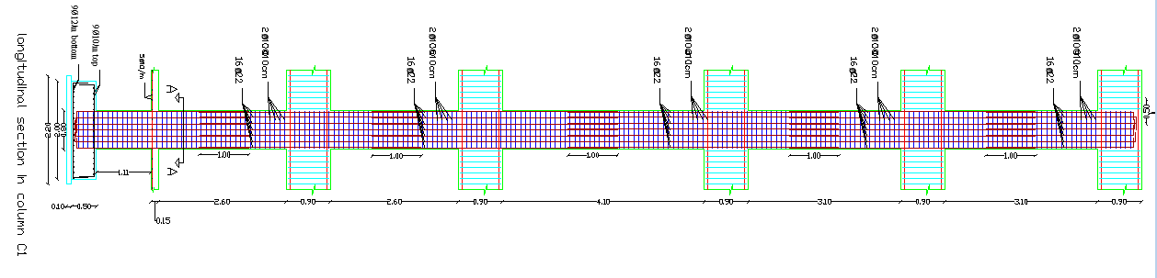
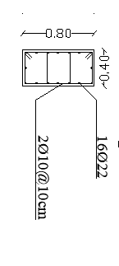
Structural Design:
Columns Reinforcements:

Slide 28
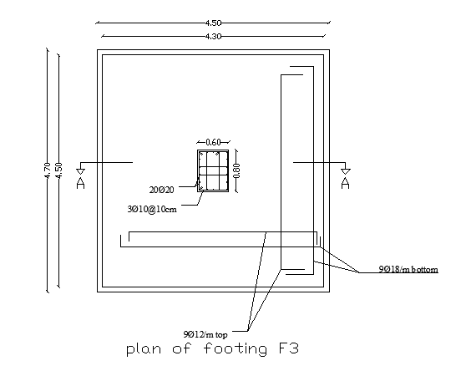
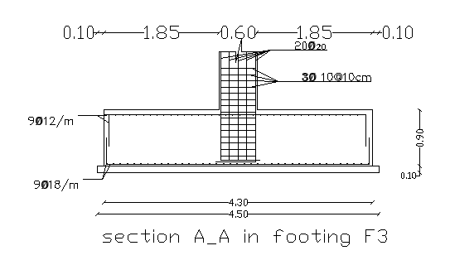
Structural Design:
Footing Reinforcements:

Slide 29
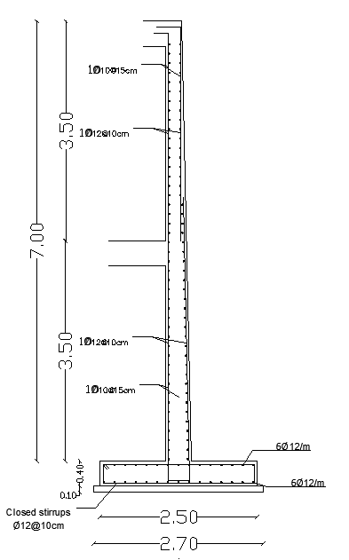
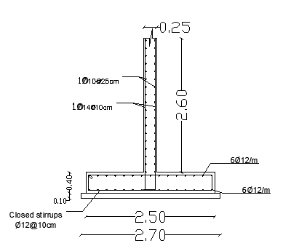
Structural Design:
Shear,and basement wall Reinforcements:

Slide 30
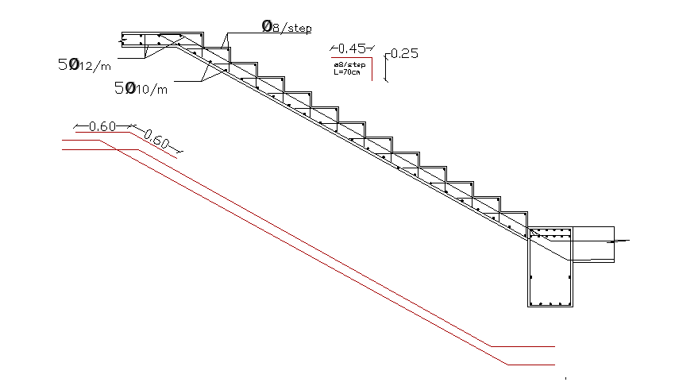
Structural Design:
Stairs Reinforcements:

Slide 31
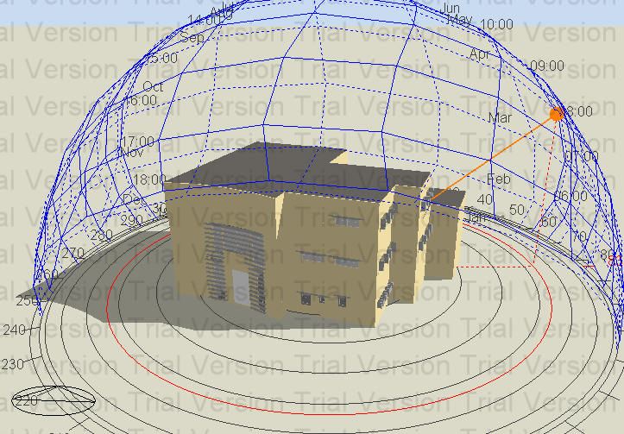
Environmental Design:
Thermal Design
Acoustical Design
Lighting Design

Slide 32
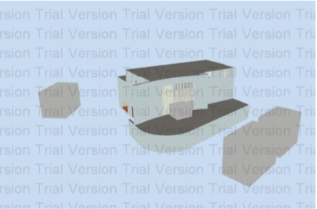
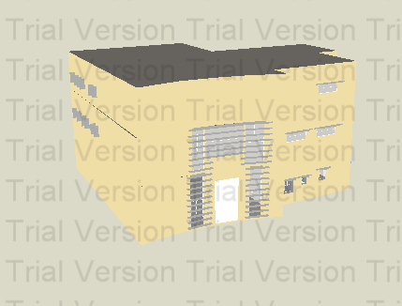
Thermal Design:
After re – design
After re – design
After re – design
Design Builder program ( 3D Model ):
Before re-design
After re–design

Slide 33
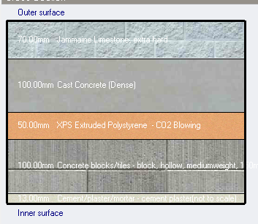
Thermal Design:
Materials :
External walls Partition
U value = 0.521 W/m2.K. U value = 1.5W\m2.K.

Slide 34
Thermal Design:
Materials :
Ceiling Ground floor
U value= 1.229 W/m2.K. U value = 0.286 W/m2.K.

Slide 35
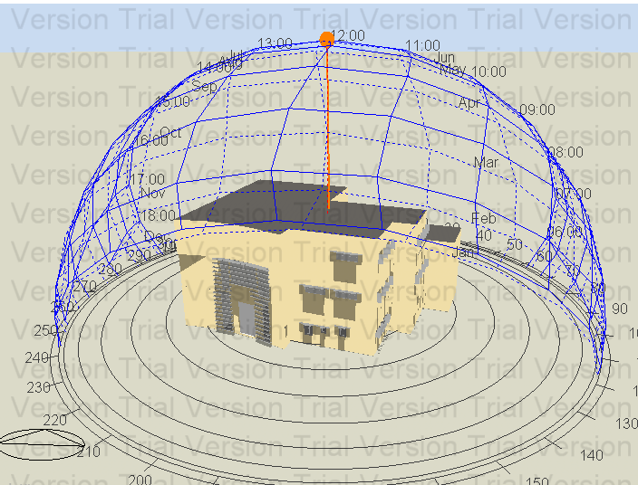
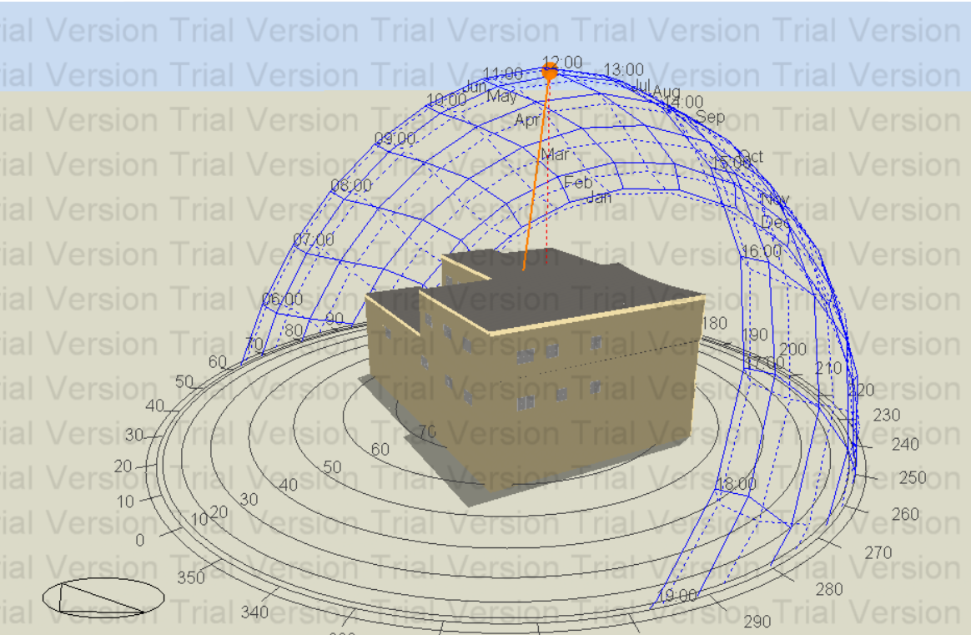
Thermal Design:
Shading:
Shading in winter (21St/January)
At 8:00 AM. At 12:00 PM.

Slide 36
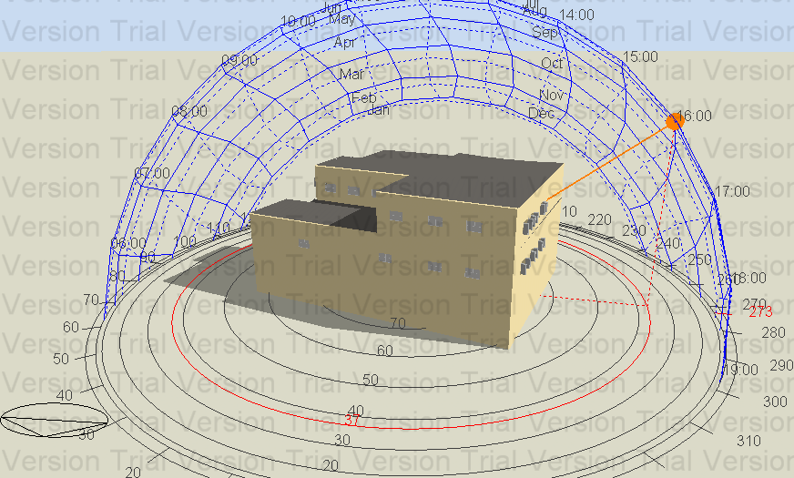
Thermal Design:
2) Shading in summer (21St/Jun)
At 8:00 AM At 12:00 PM

Slide 37
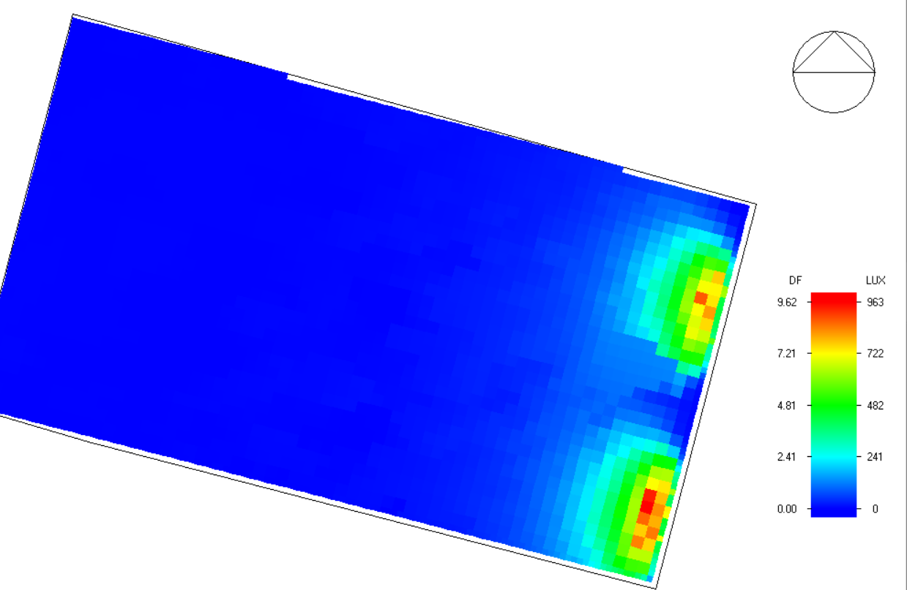
Thermal Design:
Natural daylight analysis.
D.F % | Function
2.84 | Meeting room

Slide 38
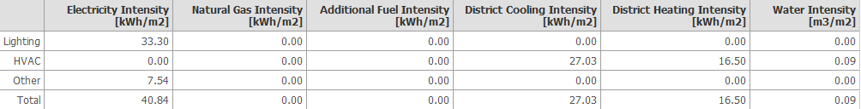
Thermal Design:
Heating and cooling Capacities.
59.7KW | Cooling
69.19KW | Heating
The value of heating and cooling in simulation building
.
.

Slide 39
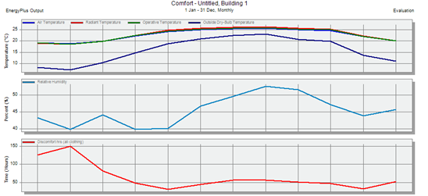
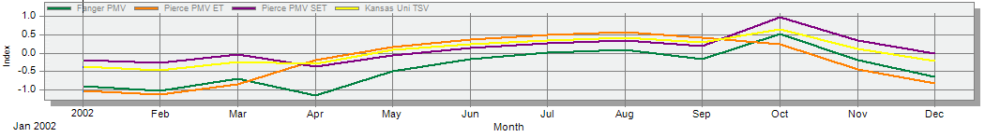
Thermal Design:
simulation:

Slide 40
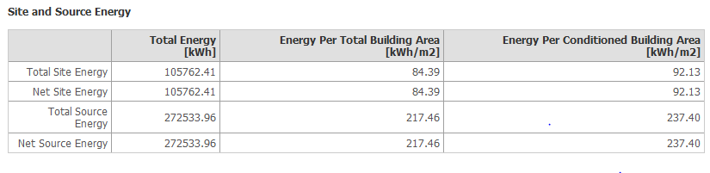
Thermal Design:
Site energy.
The standard max power intensity= 84 kW\m2, in comparison to re-design values 74 kW\m2 ,the reason is that re-design was not a fully designed building on the one hand cooling and heating.

Slide 41
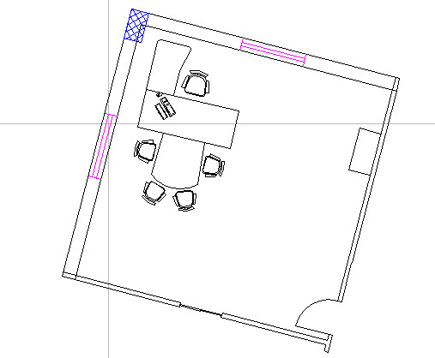
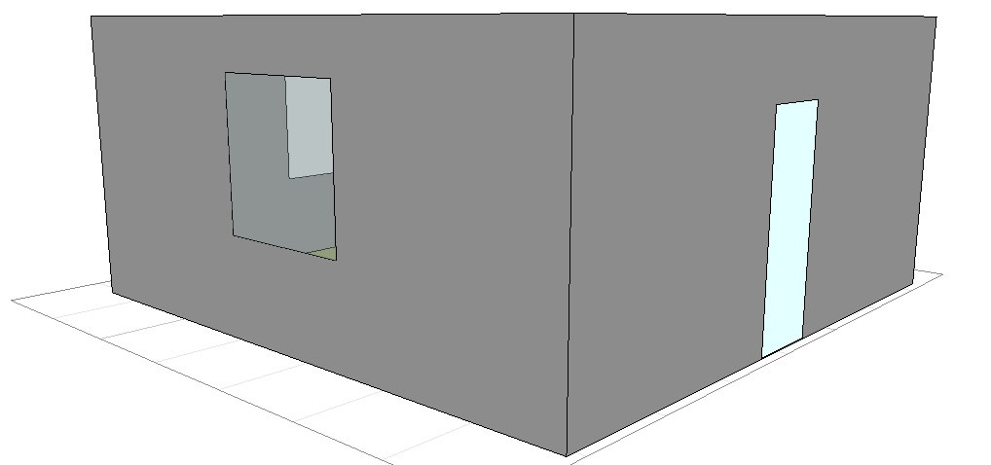
Acoustical Design:
Reverberation Time (RT60):
Ecotect Software used for calculation of RT60. four zones were taken into consideration:
1 - Office Room: The required RT60 for this zone is between (0.6 – 1.0), we used normal layers in walls, linoleum in the floor and acoustical ceiling panels to meet the requirements value.

Slide 42
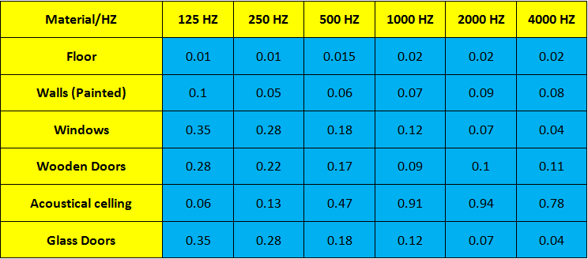
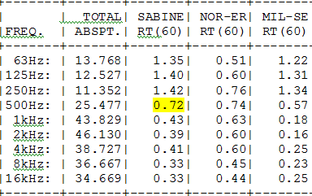
Acoustical Design:
Layers:
RT 60 values when the office is totally empty .

Slide 43
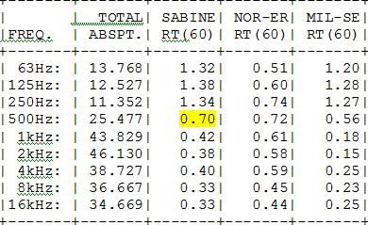
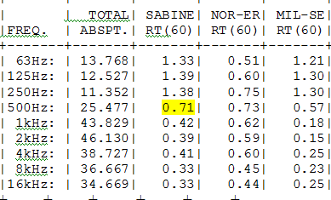
Acoustical Design:
Reverberation Time when the office is 50% occupied
Reverberation Time when the office is full
The value of RT60 in three cases in the range

Slide 44
Acoustical Design:
Comparison between acoustical in first project and required acoustical in second project :
It is worth mentioning the RT60 before redesign stage was 0.58 Sabine, while the new value is 0.72 Sabine and both values are in the acceptable range of the offices which is from (0.6- 1 Sabine, so both values are accepted. The reason of this difference due to the change in the dimensions, replacing plaster with paint, adding new window and adding acoustical ceiling

Slide 45
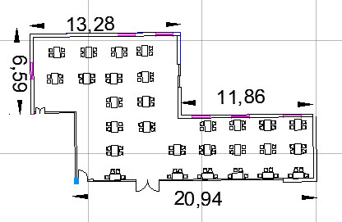

Acoustical Design:
2- Dining room : The required RT60 for this zone is between (0.6 – 1.0), we used normal layers in walls, linoleum in the floor and acoustical ceiling panels to meet the requirements value.

Slide 46

Acoustical Design:
Layers:
RT 60 values when the Dining hall is totally empty .

Slide 47


Acoustical Design:
RT 60 values when the dining hall is full :
RT 60 values when the dining hall is 50% full
The value of RT60 in three cases in the range

Slide 48


Acoustical Design:
3 – Multipurpose-hall: : The required RT60 for this zone is between (0.6 – 1.4), we used normal layers in walls, linoleum in the floor and acoustical ceiling panels to meet the requirements value.

Slide 49

Acoustical Design
Layers:
RT 60 values when the multipurpose hall is empty

Slide 50


Acoustical Design:
  RT 60 values when the multipurpose hall is semi full
RT 60 values when the multipurpose hall is full
The value of RT60 in three cases in the range

Slide 51
Acoustical Design:
Comparison :
It is worth mentioning the RT60 before redesign stage was 1.04 Sabine, while the new value is 0.86 Sabine, and these values lies in the acceptable RT60 range which is( 0.6 – 1.4) Sabine, so both values are acceptable. The reason of the change between the two values related to changes of the dimensions, adding tiles, paint and acoustical ceiling.

Slide 52



Acoustical Design:
Sound Transmission Class (STC):
We use Insul Software in order to achieve the required design.
1- External Walls : The required STC for the wall is (46-56), and the designed value by using Insul software is 54 dB.

Slide 53
Acoustical Design:
Comparison :
The recommended value of the STC is 46-56, so this value of STC lies in the range.
When comparing the old value of STC from graduation project 1 which was 37, while the new value of STC is 54, so the new value is better than the old one.
.

Slide 54



Acoustical Design:
Impact Insulation Class (IIC): The components of the slab used in this project as shown in this Figure , resulted IIC for the slab is 52 dB which is good.

Slide 55
Acoustical Design:
Comparison :
When comparing the old value of IIC from graduation project 1 which was 27, while the new value of IIC is 52, so the new value is better than the old one.

Slide 56

Acoustical Design:
Loud Speakers:
1- Multipurpose Room : We used PRO-180RPC In-ceiling speakers with 100 coverage angle.

Slide 57


Lighting Design:
Artificial Design:
We use DIALux Software to achieve the required artificial deign, three zones were taken into consideration.
1- Parking: the required value of luminance is 100 lux, the design value was 164 lux with uniformity of 19% and UGR is 16.2 which is less than the allowed 25.
Surface | Finish material | Reflection factor
Ceiling | 7043(Traffic grey B) | 80%
Wall | 7043(Traffic grey B) | 70%
Floor | 7043(Traffic grey B) | 30%

Slide 58



Lighting Design:
2- Eating room :
  E = 476lx > 400 lx.
  U = 72% >= 60%.
Surface | Finish material | Reflection factor
Ceiling | 8012(Red brown) | 80%
Wall | 8012(Red brown) | 70%
Floor | Tiles beige | 30%

Slide 59

Lighting Design:
3D Views:

Slide 60
Lighting Design:
3- Office room :
  E = 561 lx > 400 lx.
  U = 62% > 60%.
  UGR = 18.1 < 22.
Surface | Finish material | Reflection factor
Ceiling | 1014(Ivory) | 70%
Wall | 1014(Ivory) | 50%
Floor | Carpet beige | 30%

Slide 61

Lighting Design:
3D Views:

Slide 62
Electrical Design:
Lighting Arrangement.
Sockets Arrangement.

Slide 63

Electrical Installation Design:
Lighting Arrangement:
1- Parking:

Slide 64

Electrical Installation Design:
2- Ground Floor:

Slide 65

Electrical Installation Design:
3- First Floor:

Slide 66

Electrical Installation Design:
4- second Floor:

Slide 67

Electrical Installation Design:
Sockets Arrangement:
1- Parking:

Slide 68

Electrical Installation Design:
2- Ground Floor:

Slide 69

Electrical Installation Design:
3- First Floor:

Slide 70

Electrical Installation Design:
4- second Floor:

Slide 71

Elevators

Slide 72
 | 2500/350 | 2500/400 | 3000/350 | 3000/400 | 3500/350 | 3500/400
Passenger capacity (P) | 13 | 13 | 16 | 16 | 19 | 19
Round trip (RT) | 130 | 124 | 141 | 135 | 152 | 147
Handling capacity (hc)=300*P/RT | 30.00 | 31.45 | 34.04 | 35.56 | 37.50 | 38.78
Number of cars in system(N)=HC/hc | 1.12 | 1.07 | 0.99 | 0.95 | 0.90 | 0.87
N' | 1 | 1 | 1 | 1 | 1 | 1
Check number 1: Percent handling capacities (PHC) = N'*hc/population | 13% | 14% | 15% | 16% | 17% | 17%
Check number 2: I = RT/N' | 28 | 30 | 34.04 | 35.56 | 37.50 | 38.78
suitable elevator could be chosen is 2500/350 and number of elevators is 1.

Slide 73
Water supply distribution:
Riser 1
 | diameter chosen (in) | losses
meter | 1 | 2.2
Vertical pipe | 2 | 1.6
Horizontal pipe | 1.5 | 0.3
Branch pipe | 0.75 | 0.3
 | Total | 4.4

Slide 74
Riser 2
 | diameter chosen (in) | losses
meter | 1 | 1.8
Vertical pipe | 2 | 1.4
Horizontal pipe | 1.5 | 0.1
Branch pipe | 0.75 | 0.6
 | Total | 3.9

Slide 75

Drainage system:

Slide 76
Side 1: it is connected with second floor and ground floor and extends to the public sewer.
Second floor: contains of 6 W.Cs and 6 wash sinks.
Ground Floor: contains of 6 W.Cs and 6 was sinks.
 | Second floor |  |  | Ground Floor
Details | W.C | Wash sink | total | W.C | Wash sink | total | Stack | Table
Drainage fixture unit | 4 | 2 | 36 | 4 | 2 | 36 | 72 | 22.2 (Shown in figure 5.2)
Diameter (in) | 4 | 2 | --- | 4 | 2 | --- | 4 | 22.3 (Shown in figure 5.3)
Slope | 1% |  |  | 1% |  |  | --- | 22.5 (Shown in figure 5.4)

Slide 77
Side 2: it is connected with Second floor and extends to the public sewer.
First floor: contains of 1 kitchen sink.
 | Second floor
Details | Kitchen sink | Stack | Table
Drainage fixture unite | 2 | 2 | 22.2 (Shown in figure 5.2)
Diameter (in) | 2 | 4 | 22.3 (Shown in figure 5.3)
Slope | 1% | --- | 22.5 (Shown in figure 5.4)

Slide 78
Side 3: it is connected with first floor and extends to the public sewer.
Second floor: contains of 4 W.Cs, 4 wash sinks and 1 kitchen sink.
 | Second floor
Details | W.C | Wash sink | Kitchen sink | total | Stack | Table
Drainage fixture unit | 4 | 2 | 36 | 23 | 23 | 22.2 (Shown in figure 5.2)
Diameter (in) | 4 | 2 | 2 | --- | 4 | 22.3 (Shown in figure 5.3)
Slope | 1% |  |  |  | --- | 22.5 (Shown in figure 5.4)

Slide 79

Distribution of fire Extinguisher system in ground floor:

Slide 80

Distribution of fire Extinguisher system in first floor:

Slide 81
Electrical Installation Design:
3- First Floor:

Slide 82
Electrical Installation Design:
4- second Floor:

Slide 83

Mechanical Design:
HVAC Design:
VAV system was used
for all buildings rooms
Main component of VAV
system is:
1- Outdoor unit.
2- Controller.
3- Fan coil (indoor units).
4- Ducts.
5- Diffusers.

Slide 84

Mechanical Design:
VAVDesign:
Cooling load for building = 59.7 kW
Outdoor unit was selected from Petra Company:

Slide 85

Mechanical Design:
VAV Design:
Balance pressure drop method was used to find duct sizing.
For library, cooling load = 59.7kW so that ύ =3.4m³/s
The fan coil was selected from Petra Company, DC12 with ύ = 3.4m³/s.
Kvadra diffuser was selected from Systemair Company with volumetric flow rate 0.1m³/s.

Slide 86


Mechanical Design:
VAV Design:

