Slide 1

An-Najah National University
Building Engineering Department
Design of Primary School
Presented By: Supervisor:
Mohammad Ghannam Eng. Fadi Fatayer
Obadah Hamdan
Mousa Al-Atrash Date: May 20, 2019

Slide 2
Presentation Outline
Architectural Design
Structural Design
Environmental Design
Mechanical Design
Safety and Security Design
Radial Design
Electrical Design
Quantity Surveying and Cost Estimation

Slide 3
Architectural Design

Slide 4
Architectural Spaces (Ground Floor)
Space | Number | Area
Teachers Room | 1 | 75
W.C 1 | 1 | 18
W.C 2 | 1 | 22
Multipurpose Hall | 1 | 118
Meeting Room | 1 | 48
W.C 3 | 1 | 38
Kitchen | 1 | 10
Manager Room | 1 | 5
Secretary Room | 1 | 15
Reception | 1 | 12
Classroom | 3 | 26

Slide 5
Architectural Spaces (First Floor)
Space | Number | Area
Initiative room | 1 | 75
W.C 1 | 1 | 18
W.C 2 | 1 | 22
Library | 1 | 118
Cafeteria | 1 | 48
Classroom | 3 | 46
Science Lab | 1 | 76

Slide 6
Architectural Spaces (Second Floor)
Space | Number | Area
Initiative room | 1 | 75
W.C 1 | 1 | 18
W.C 2 | 1 | 22
Cafeteria | 1 | 48
Classroom | 3 | 46
Computer Lab | 1 | 76

Slide 7
Architectural Spaces (Third Floor)
Space | Number | Area
Initiative room | 1 | 75
W.C 1 | 1 | 18
W.C 2 | 1 | 22
Cafeteria | 1 | 48
Classroom | 3 | 46
Art Room | 1 | 76

Slide 8
Site Plan

Slide 9
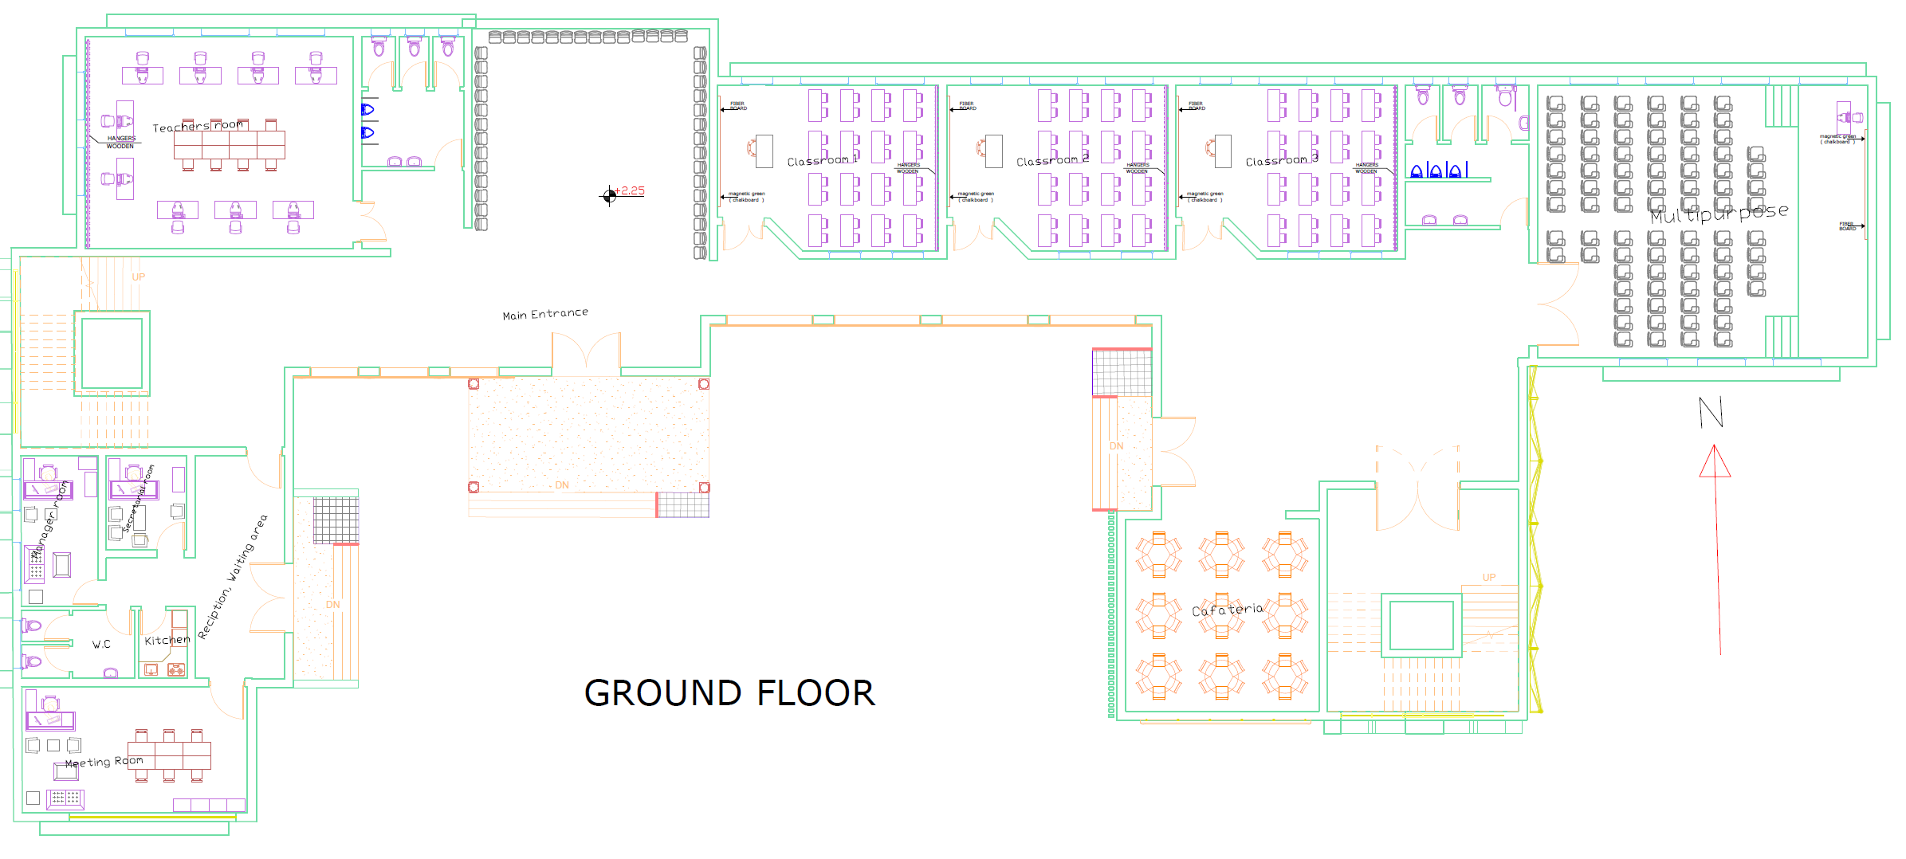
Ground Floor

Slide 10
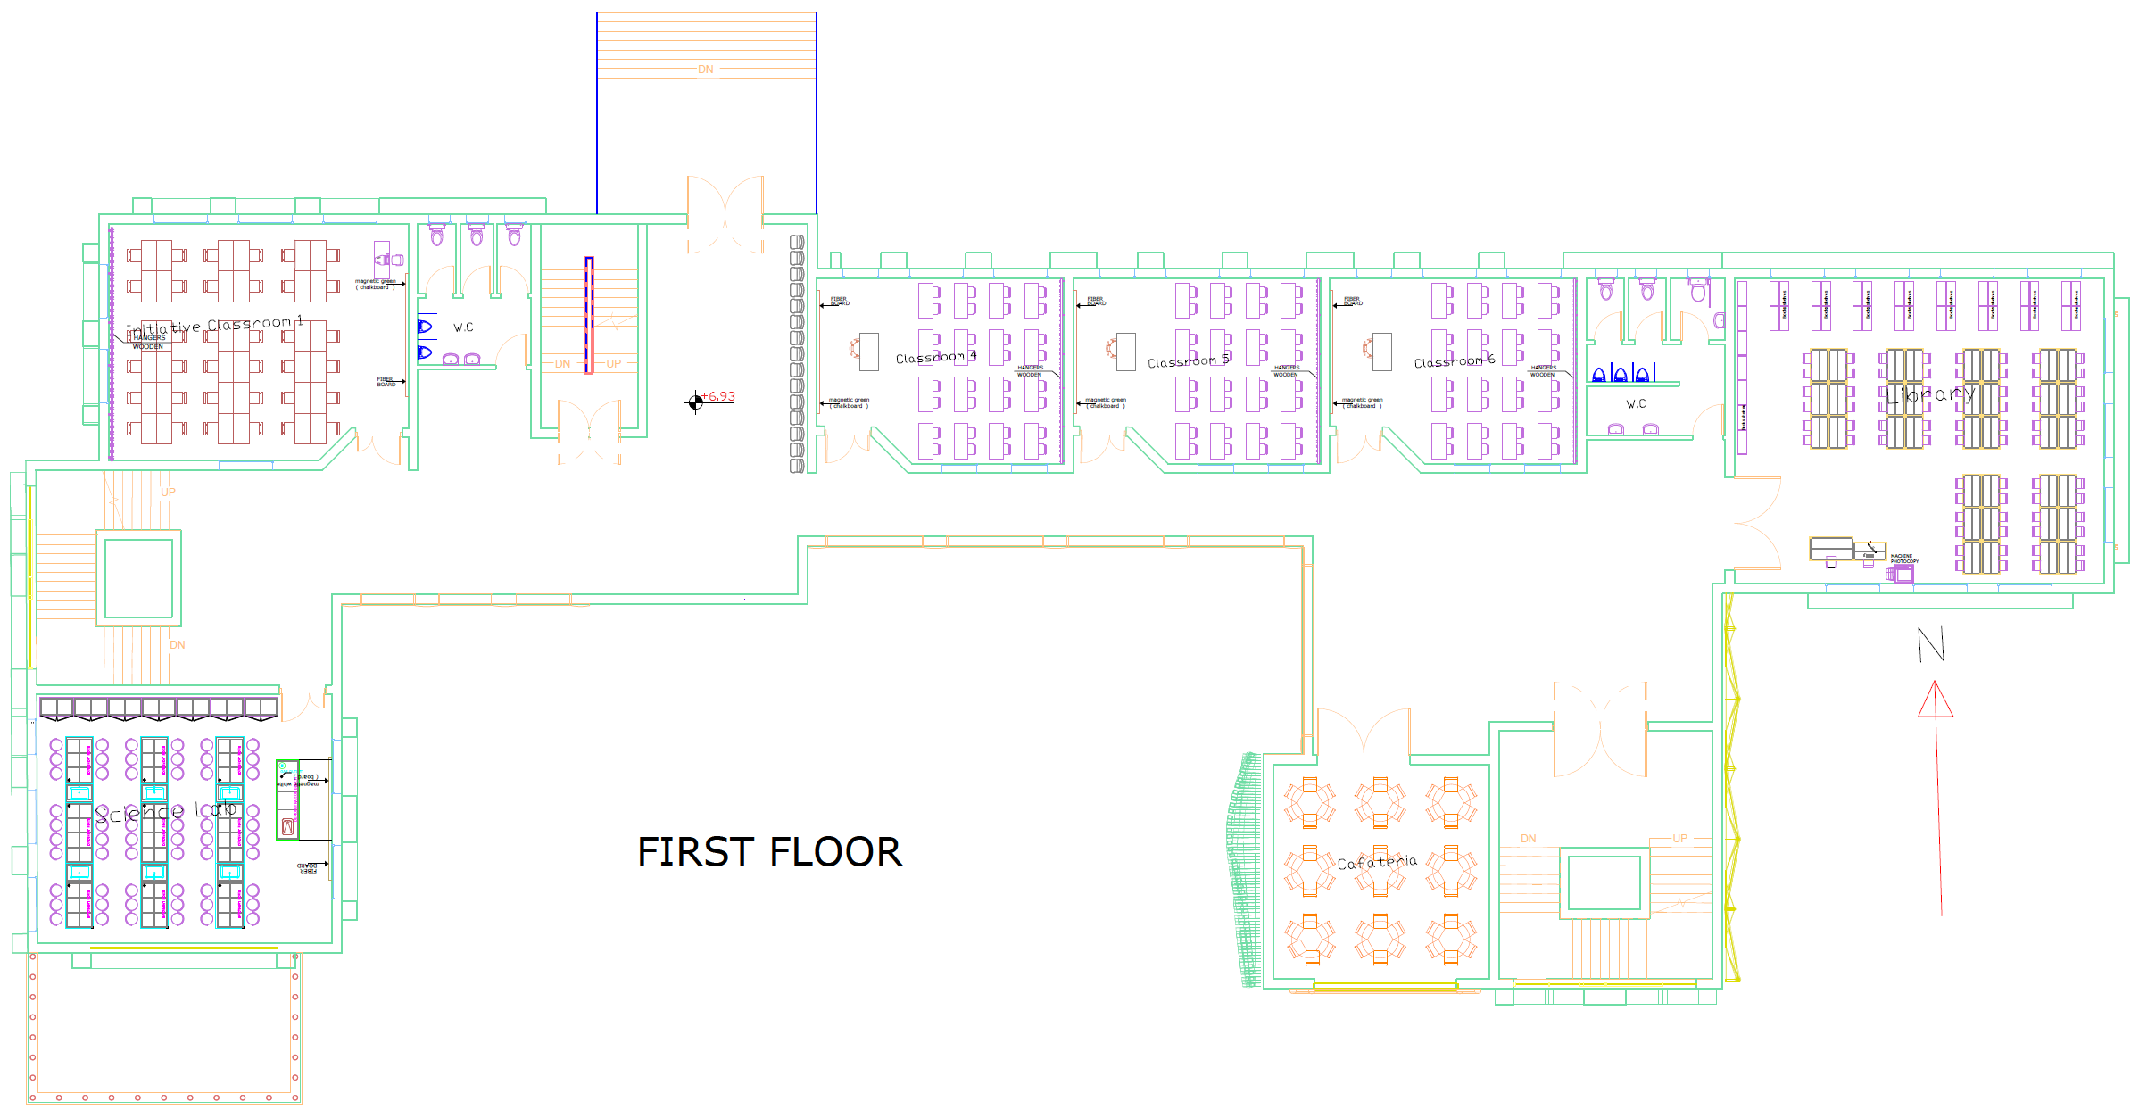
First Floor

Slide 11
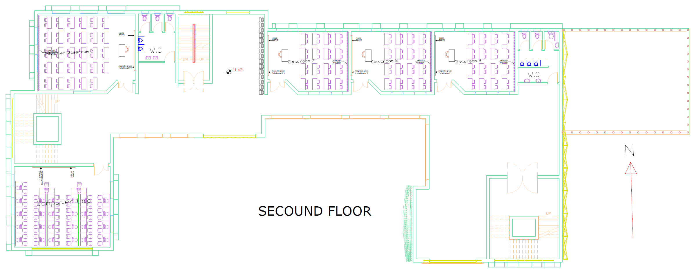
Second Floor

Slide 12
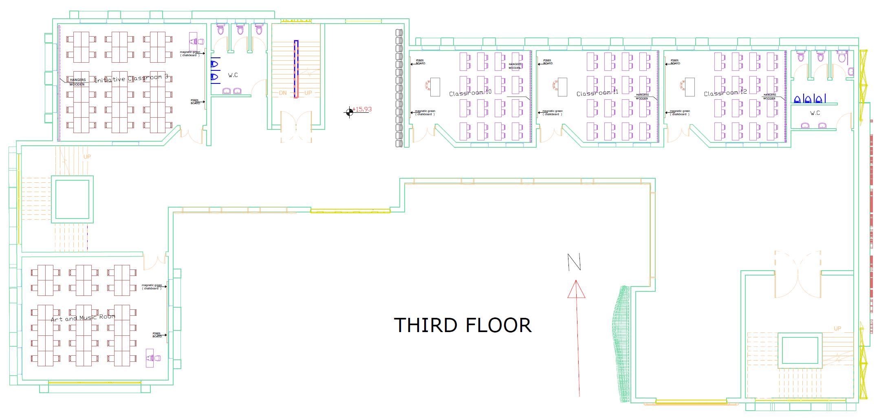
Third Floor

Slide 13
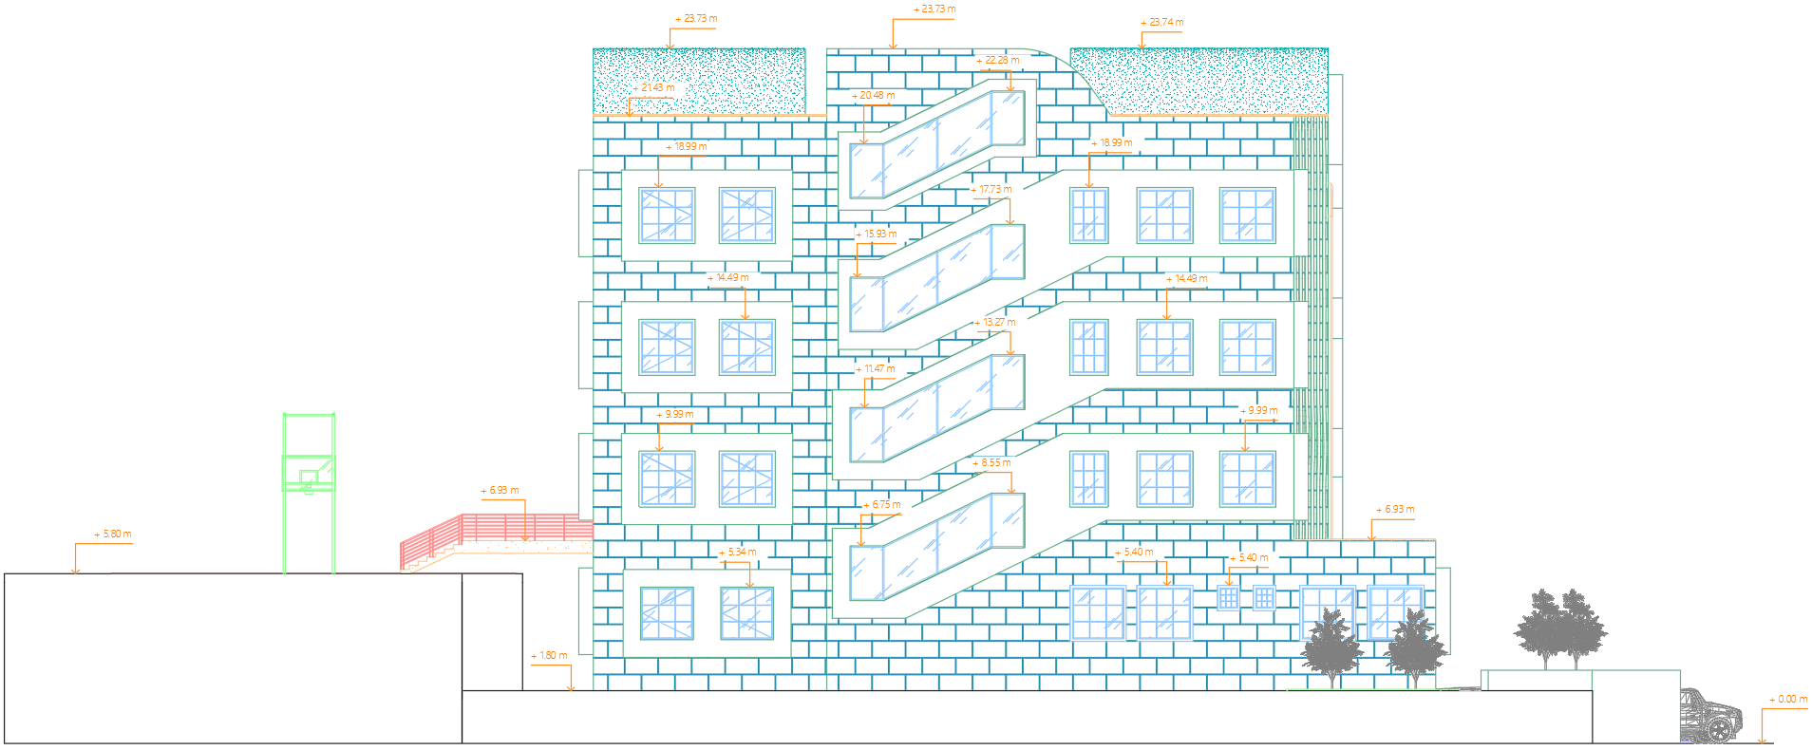
Western Elevation

Slide 14
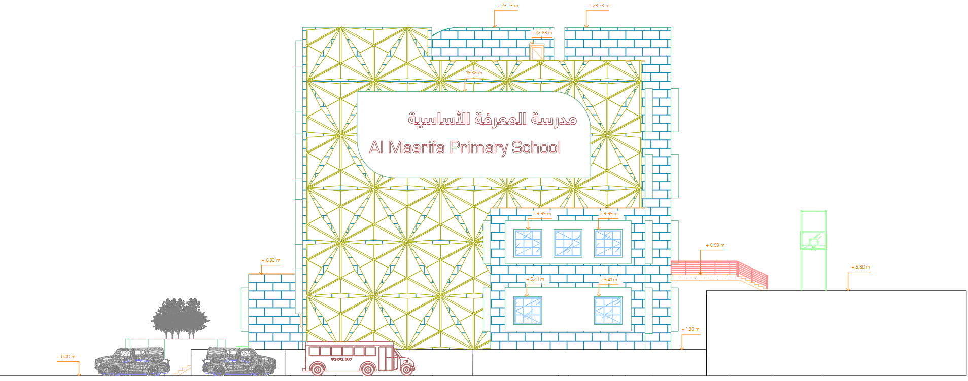
Eastern Elevation

Slide 15
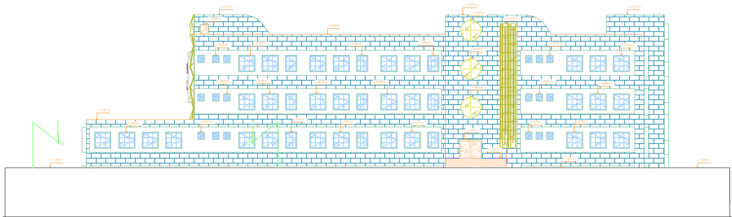
Northern Elevation

Slide 16
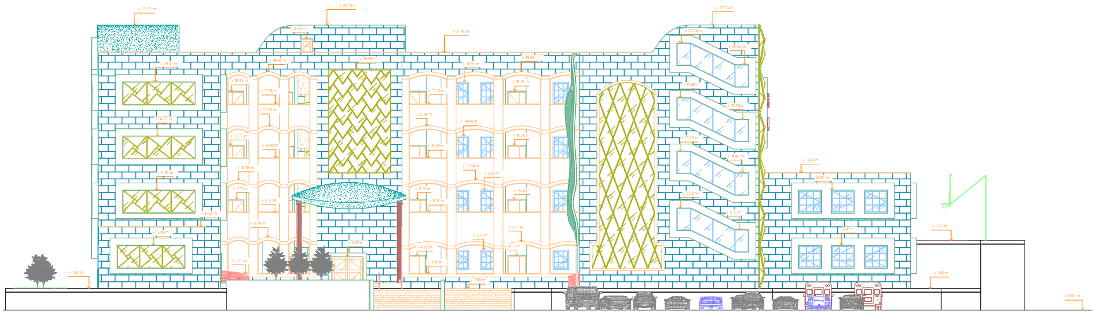
Southern Elevation

Slide 17
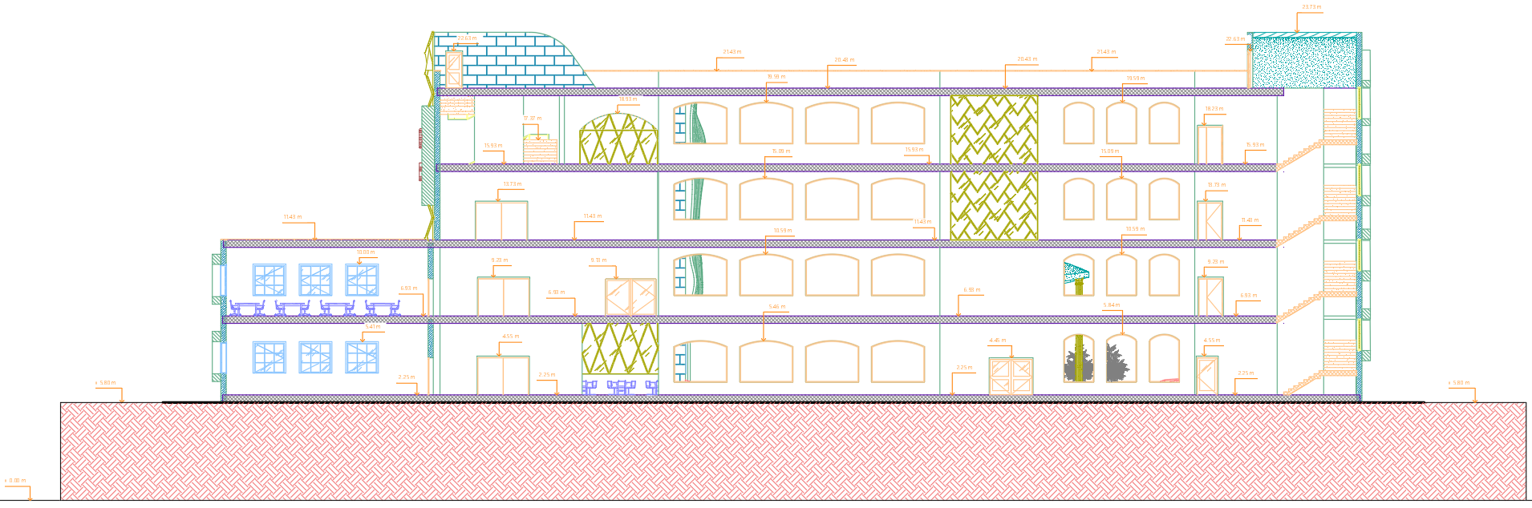
Section A-A

Slide 18
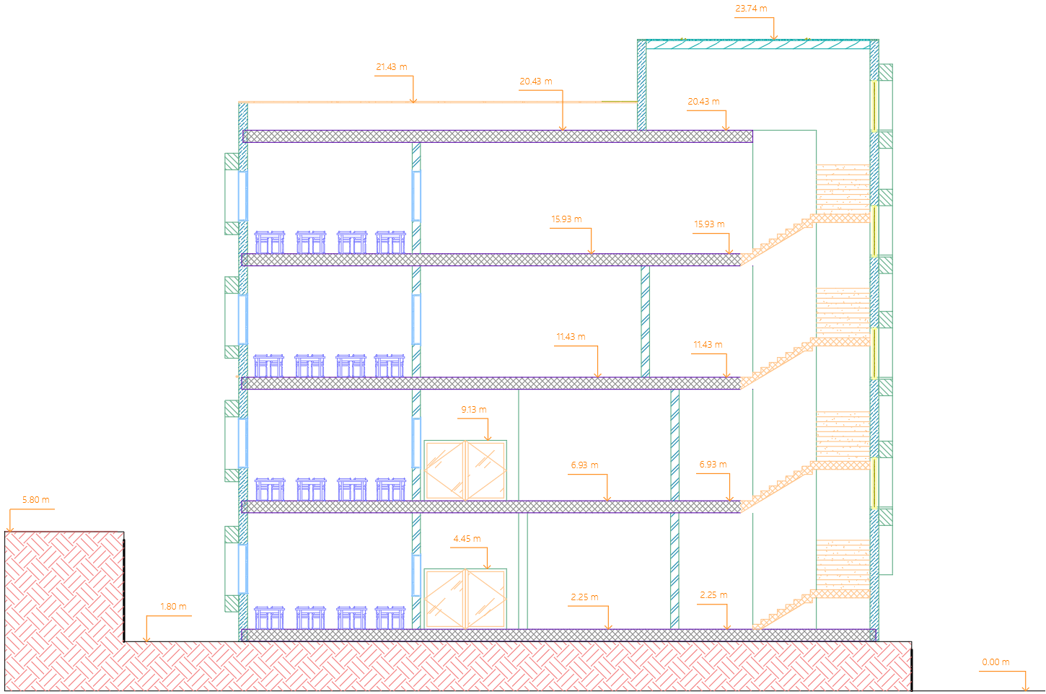
Section B-B

Slide 19
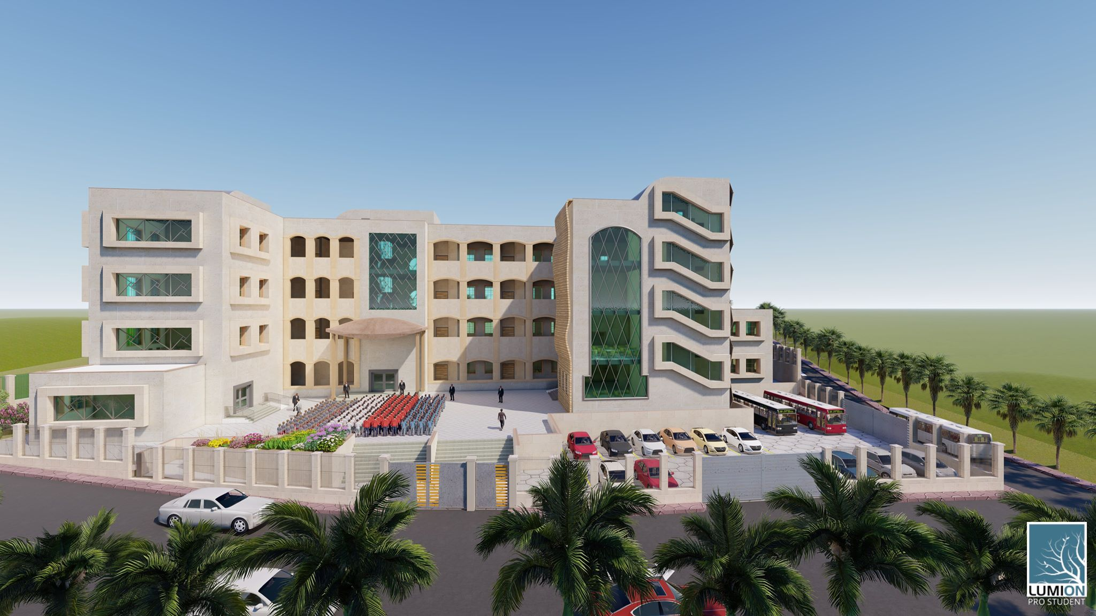

Slide 20
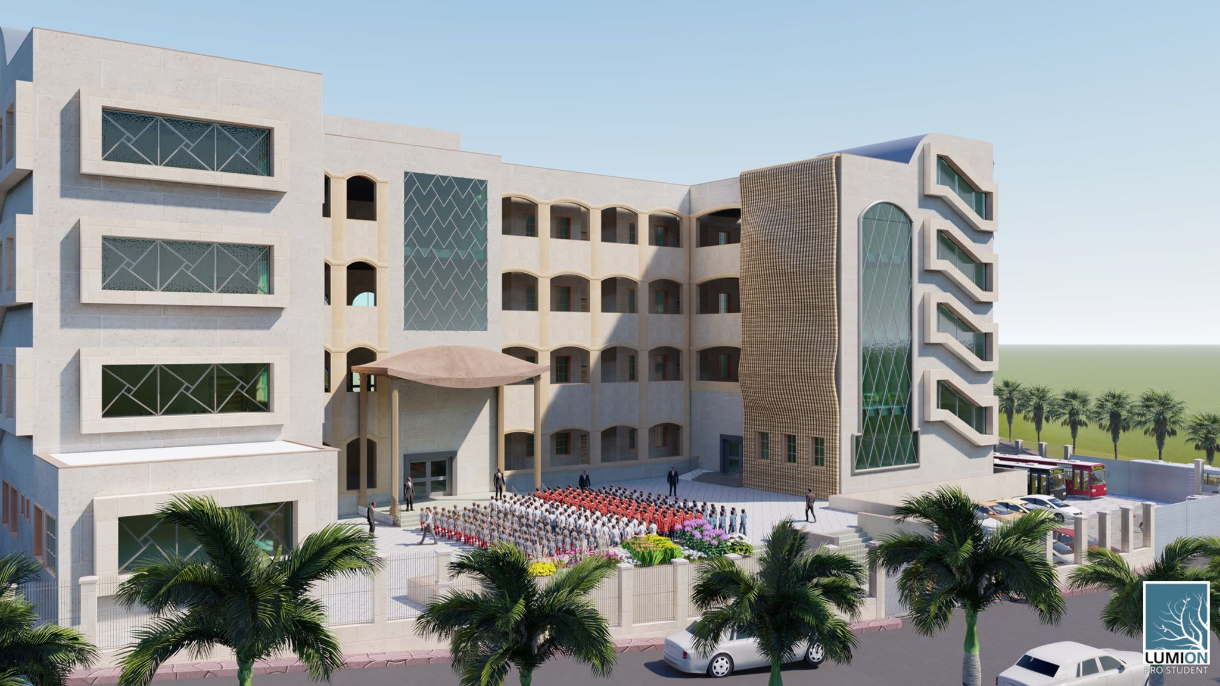

Slide 21
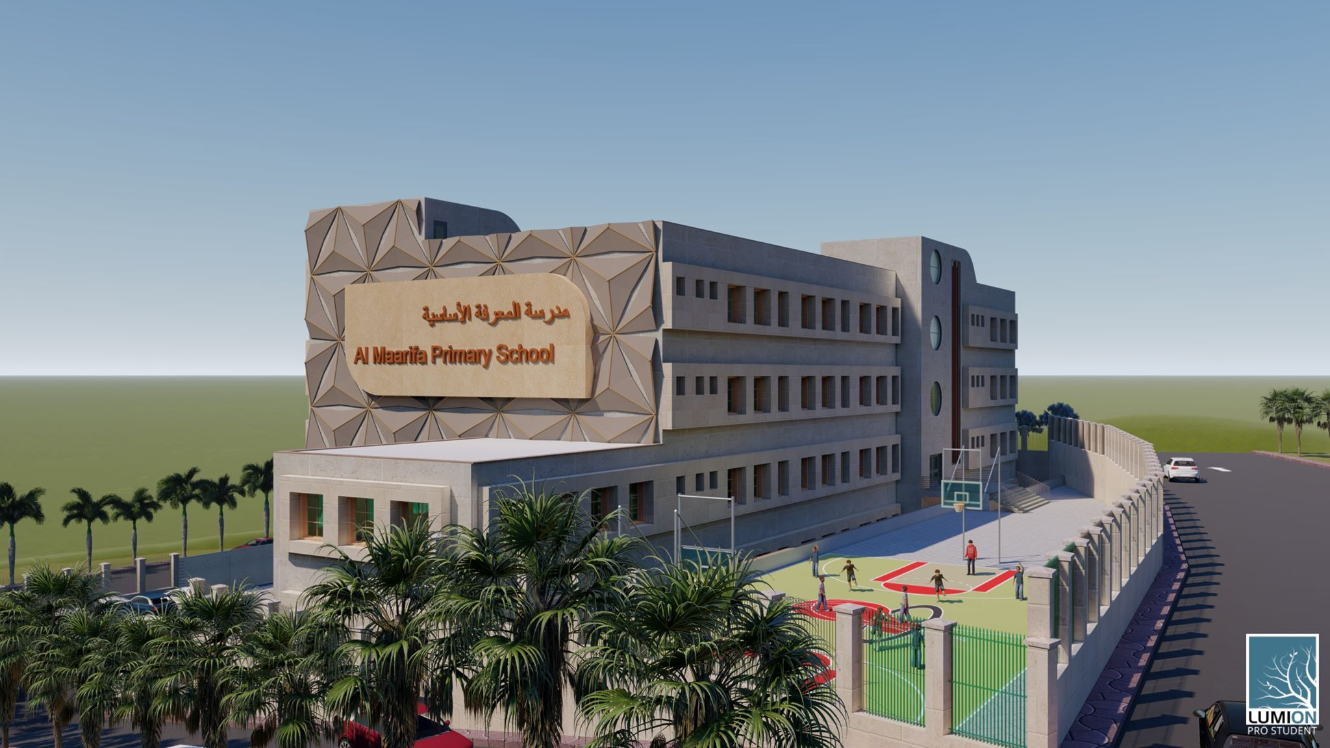

Slide 22
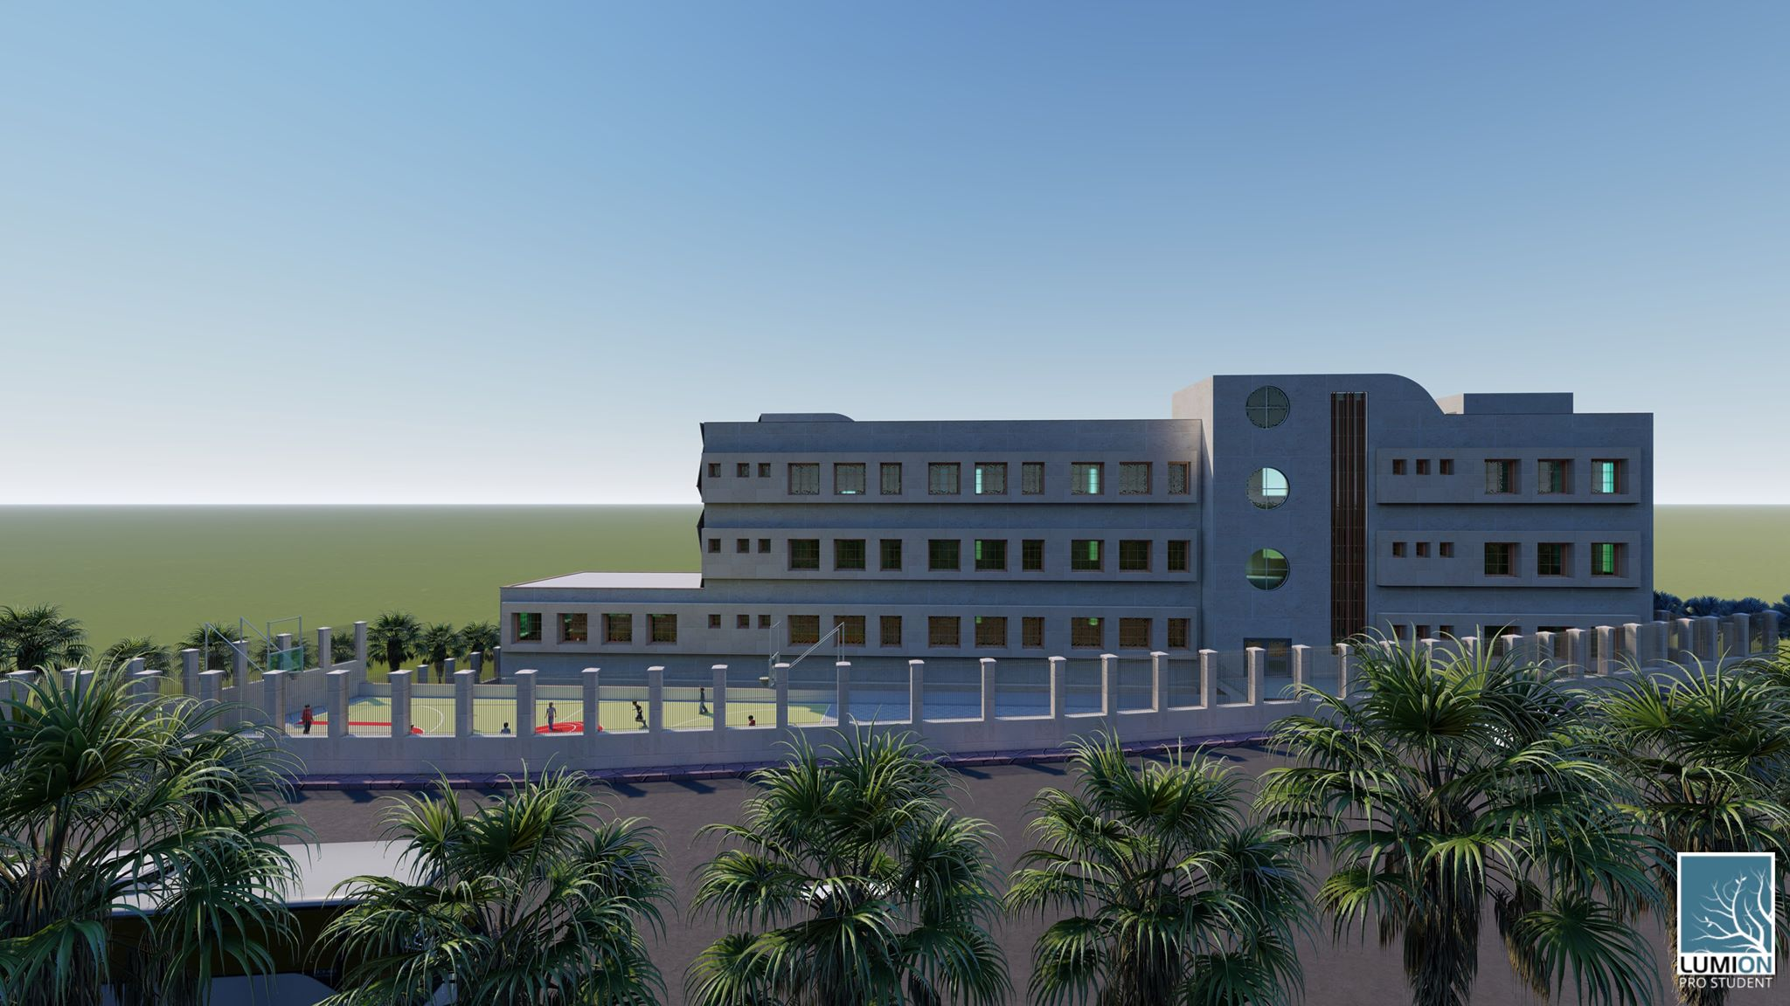

Slide 23
Structural Design

Slide 24
Codes and Structural System
Codes
ACI 318-14 for reinforced concrete design
UBC 97 for seismic design and its load combinations
ASCE 7 for load combinations
Structural System
One Way Ribbed Slab

Slide 25
Structural Design Data
Loads
Dead Loads
Superimposed Load = 6.2 kN/m²
Live Load = 5 kN/m²
Wall Load = 26.2 kN/m²
Seismic Load
Materials
Compressive Strength of Concrete = 24 MPa
Yield Strength of Steel= 420 MPa
Soil Bearing Capacity = 250 kN/m²

Slide 26
Structural Design Data
Sections Dimensions
Member | Width | Depth
Slab | 30 cm Thickness
Main Beam (Group One) | 70 cm | 60 cm
Main Beam (Group Two) | 75 cm | 35 cm
Secondary Beam | 45 cm | 30 cm
Column | 60 cm | 40 cm
Shear Wall | 30 cm Thickness

Slide 27
Structural Design Data
Seismic Analysis Parameters
Seismic Zone: 2B (Z=0.2)
Soil Profile: S_{c}
Acceleration Seismic Coefficients C_{a} = 0.24
Velocity Seismic Coefficient C_{v} = 0.32
Importance Factor I = 1.5
Force Reduction Factor R = 5.5

Slide 28
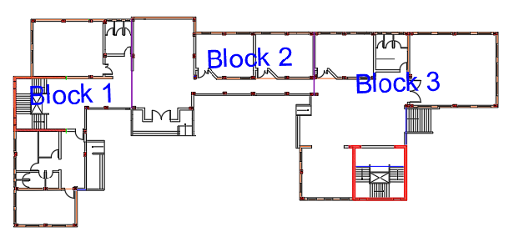
Building Blocks

Slide 29
Model Checking
Compatibility Check (Block 1)

Slide 30
Model Checking
Compatibility Check (Block 2)

Slide 31
Model Checking
Compatibility Check (Block 3)

Slide 32
Model Checking
Equilibrium Check (Block 1)
Load | Manual (kN) | ETABS (kN) | Error % | Assessment
Dead Load | 10940 | 10479 | 4.39 % | OK
Live Load | 4513.6 | 4553.96 | 0.88 % | OK
Superimposed Load | 11285.5 | 11113.8 | 1.5 % | OK

Slide 33
Model Checking
Equilibrium Check (Block 2)
Load | Manual (kN) | ETABS (kN) | Error % | Assessment
Dead Load | 10009.8 | 10408.04 | 3.86 % | OK
Live Load | 6327.6 | 6225.6 | 0.13 % | OK
Superimposed Load | 14069.4 | 14018.045 | 0.36 % | OK

Slide 34
Model Checking
Equilibrium Check (Block 3)
Load | Manual (kN) | ETABS (kN) | Error % | Assessment
Dead Load | 12973.6 | 13168 | 1.4 % | OK
Live Load | 6397 | 7112.22 | 2.4 % | OK
Superimposed Load | 15283.1 | 14633 | 4.4 % | OK

Slide 35
Model Checking
Internal Forces Check (Block 1)
Element | Manual (kN.m) | ETABS (kN.m) | Error % | Assessment
Beam 1 | 311 | 288.2 | 7.9 % | OK
Beam 2 | 748.8 | 720.9 | 3.9 % | OK
Column 1 | 417.19 | 397.9 | 4.8 % | OK
Column 2 | 2324.34 | 2492.23 | 6.75 % | OK
Slab 1 | 32.18 | 33.1 | 2.7 % | OK

Slide 36
Model Checking
Internal Forces Check (Block 2)
Element | Manual (kN.m) | ETABS (kN.m) | Error % | Assessment
Beam 1 | 205.9 | 188.8 | 9 % | OK
Beam 2 | 838.9 | 759.2 | 4 % | OK
Column 1 | 955.9 | 959.3 | 0.44 % | OK
Column 2 | 1760.8 | 1813.5 | 2.9 % | OK
Slab 1 | 32.18 | 27.4 | 5.5 % | OK

Slide 37
Model Checking
Internal Forces Check (Block 3)
Element | Manual (kN.m) | ETABS (kN.m) | Error % | Assessment
Beam 1 | 1006.8 | 944.5 | 1.3 % | OK
Beam 2 | 643.7 | 663 | 2 % | OK
Column 1 | 1012.2 | 1034.3 | 2.17 % | OK
Column 2 | 2854.4 | 2778.1 | 2.75 % | OK
Slab 1 | 1719.4 | 1674.5 | 2.7 % | OK

Slide 38
Model Checking
Deflection Check
Block No. | Deflection (mm) | Limit (mm) | Assessment
Block 1 | 9.37 | 33.6 | OK
Block 2 | 20.5 | 34.88 | OK
Block 3 | 30.34 | 41.33 | OK

Slide 39
Model Checking
Period Check
Block No. | T_{Manual} (sec) | T_{ETABS} (sec) | Assessment
Block 1 | 0.597 | 0.729 | OK (Small Difference)
Block 2 | 0.597 | 0.572 | OK (T_{ETABS} < T_{Manual})
Block 3 | 0.597 | 0.767 | OK (Small Difference)

Slide 40
Model Checking
Base Shear Check
Block No. | Base Shear | Manual (kN) | ETABS (kN) | Assessment
Block 1 | V_{x} | 4145.8 | 4156.01 | V Manual < V ETABS OK
 | V_{y} | 4331.6 | 4331.6 | V Manual ≤ V ETABS OK
Block 2 | V_{x} | 4204.4 | 4204.41 | V Manual ≤ V ETABS OK
 | V_{y} | 4512.76 | 4729.38 | V Manual < V ETABS OK
Block 3 | V_{x} | 4602.7 | 4602.72 | V Manual ≤ V ETABS OK
 | V_{y} | 5152.1 | 5243.5 | V Manual < V ETABS OK

Slide 41
Model Checking
Drift Check
Block No. | Story | Δm_{x} (mm) | Δm_{y} (mm) | Limitation (mm) | Assessment
Block 1 | GF | 6.0 | 28.1 | 90 | OK
 | F1 | 3.6 | 13.9 | 90 | OK
 | F2 | 7.7 | 19.2 | 90 | OK
 | F3 | 8.1 | 17.3 | 90 | OK
Block 2 | GF | 5.1 | 4.5 | 90 | OK
 | F1 | 8.4 | 8.1 | 90 | OK
 | F2 | 10.7 | 10.4 | 90 | OK
 | F3 | 10.4 | 10.5 | 90 | OK
Block 3 | GF | 20.7 | 2.6 | 90 | OK
 | F1 | 31.8 | 4.0 | 90 | OK
 | F2 | 28.7 | 12.5 | 90 | OK
 | F3 | 32.8 | 9.1 | 90 | OK

Slide 42
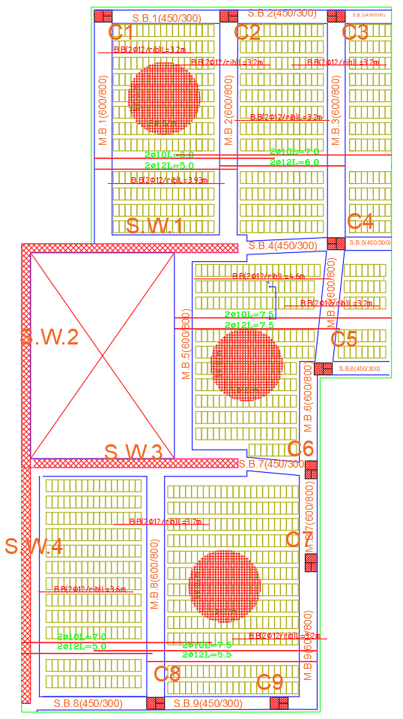
Design and Reinforcement
Slab Layout (Block 1)

Slide 43
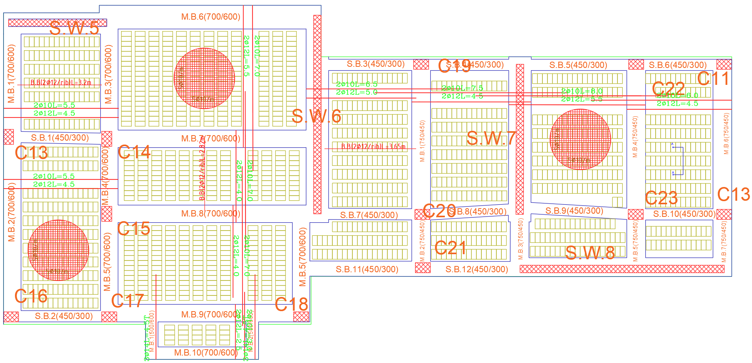
Design and Reinforcement
Slab Layout (Block 2)

Slide 44
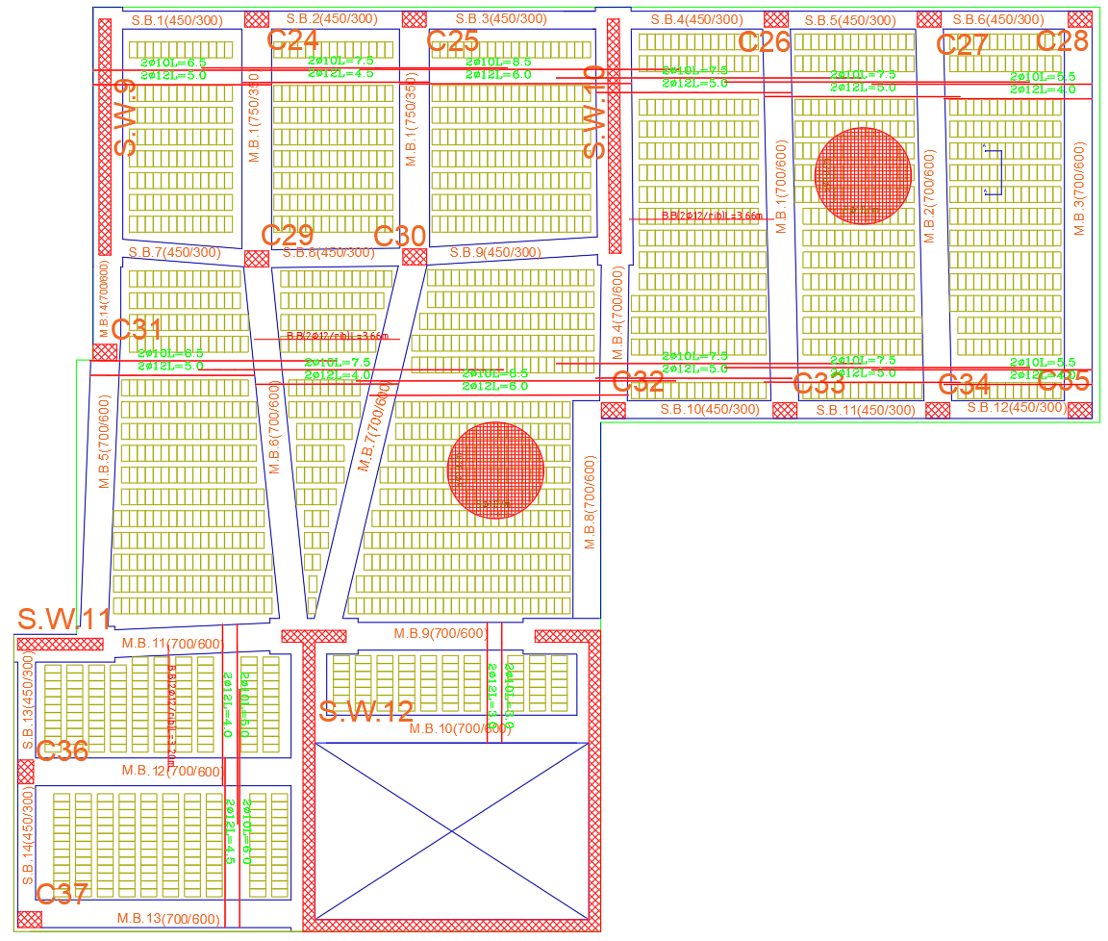
Design and Reinforcement
Slab Layout (Block 3)

Slide 45
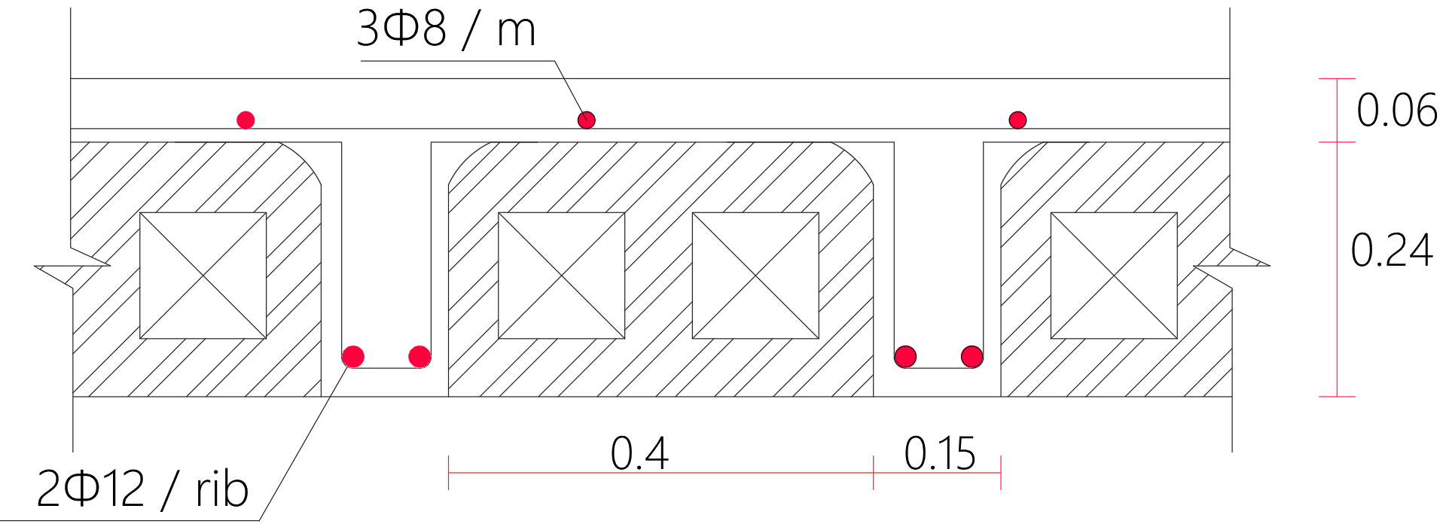
Design and Reinforcement
Slab Detailing

Slide 46
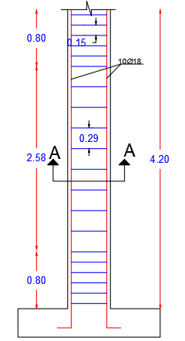
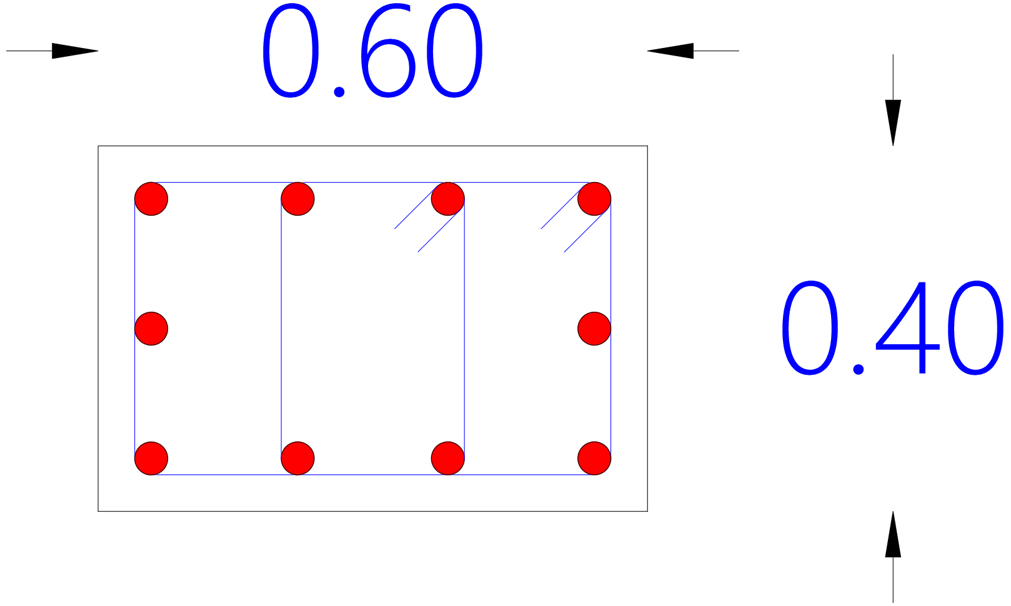
Design and Reinforcement
Column Detailing

Slide 47
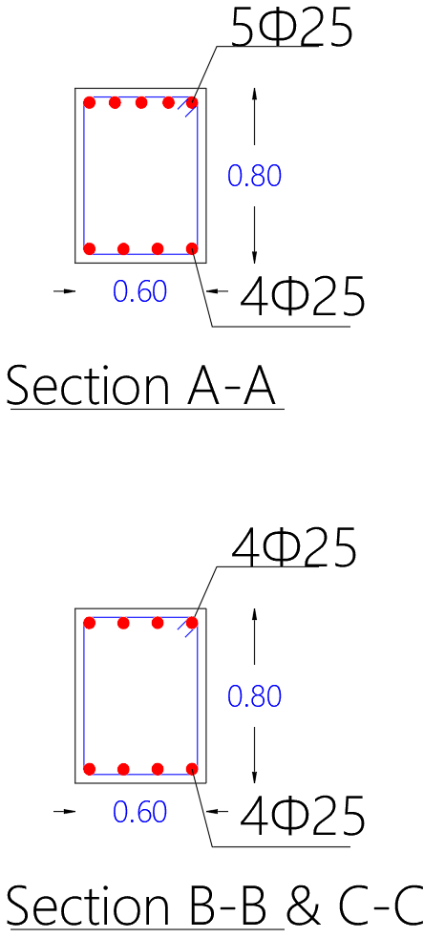
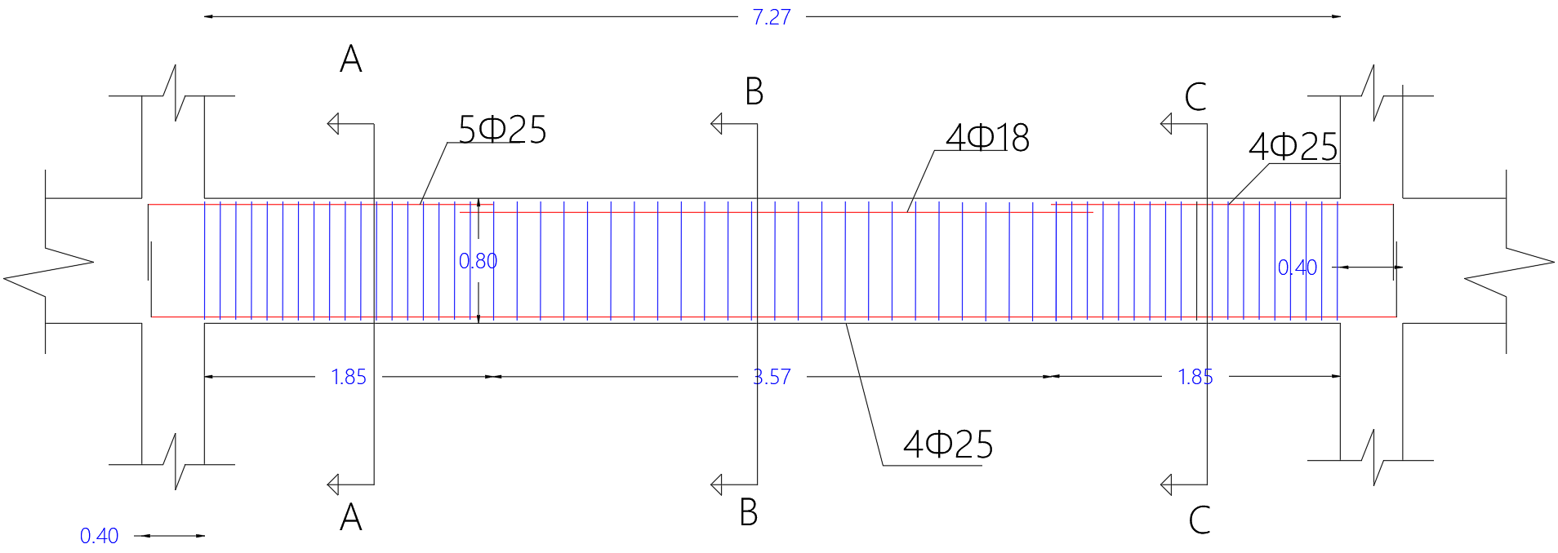
Design and Reinforcement
Beam Detailing

Slide 48
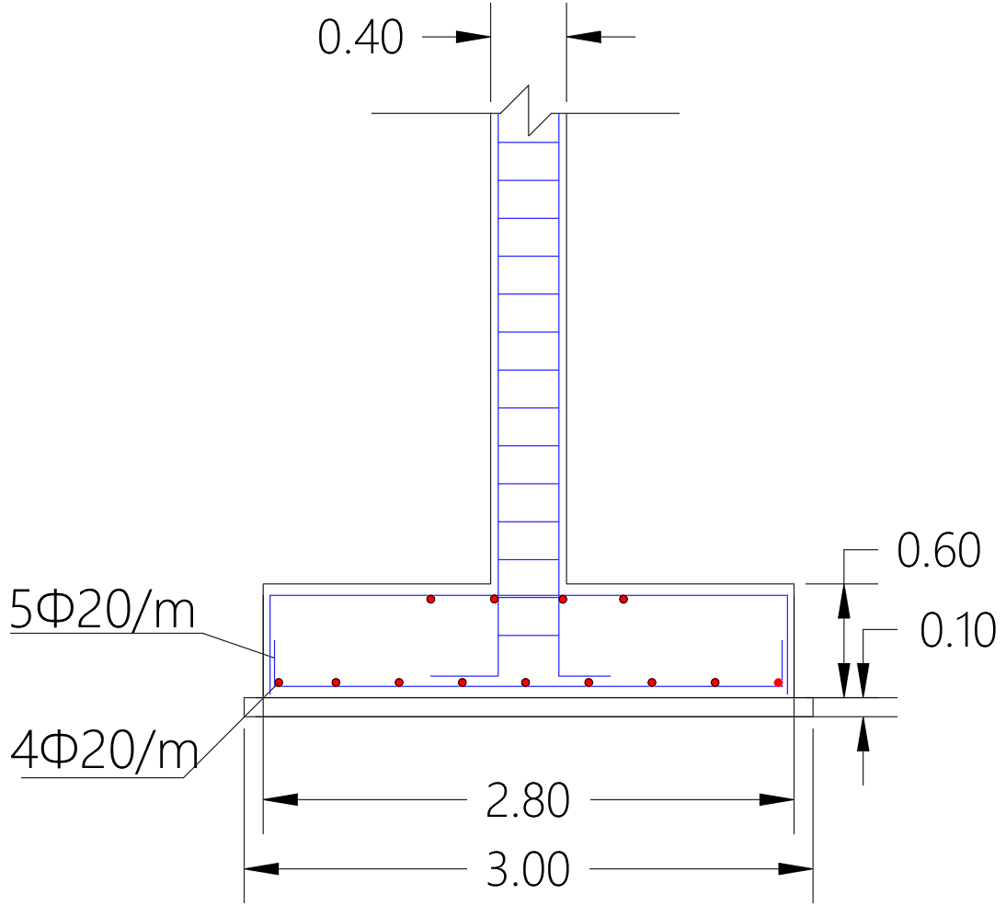
Design and Reinforcement
Footing Detailing

Slide 49
Environmental Design

Slide 50
Thermal Design
U-Value for Building Envelope
Component | U-value (W/m².k)
External Wall | 0.491
Internal Wall | 1.188
Floor | 0.508
Roof | 0.456
Windows | 1.761

Slide 51
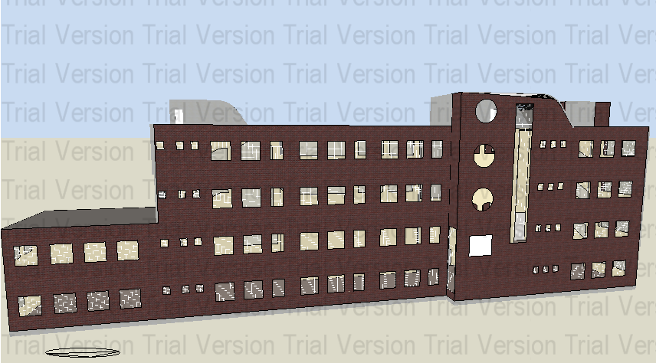
Thermal Design
3D Model in DesignBuilder

Slide 52
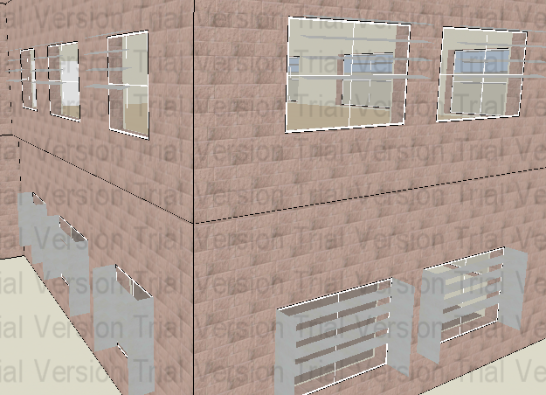
Thermal Design
Shading
Louvers System

Slide 53
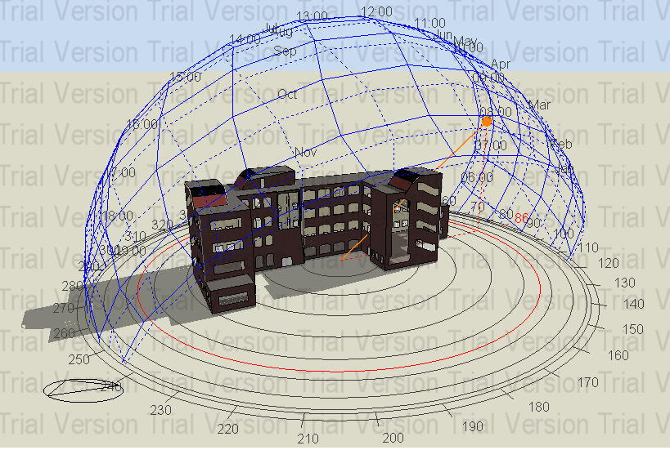
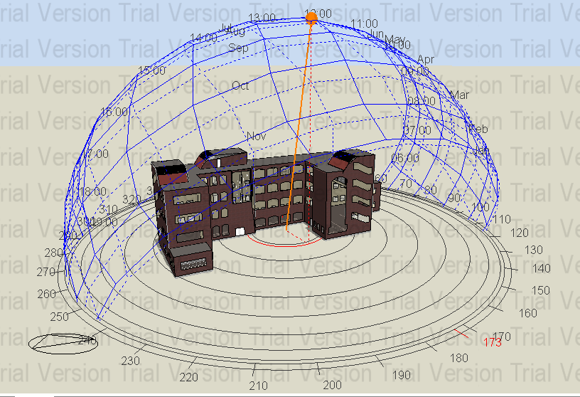
Thermal Design
Shading
In Summer Day
21 June at 8 AM
21 June at 12 PM

Slide 54
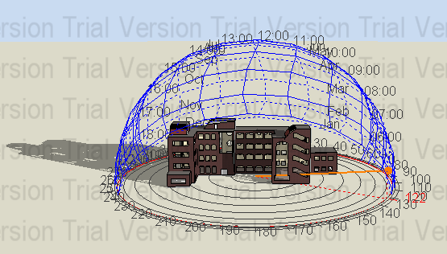
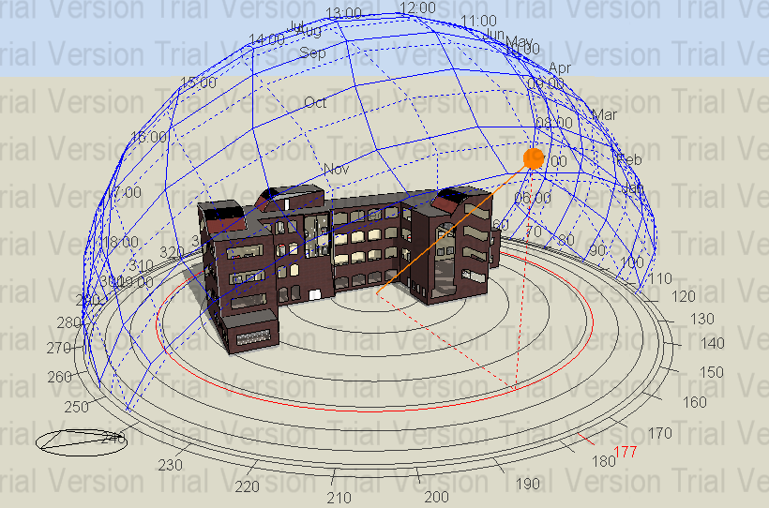
Thermal Design
Shading
In Winter Day
21 January at 8 AM
21 January at 12 PM

Slide 55
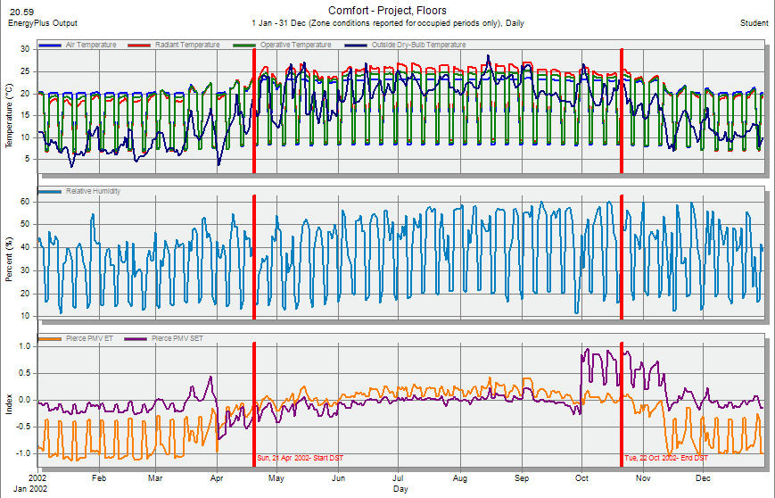
Thermal Design
Comfort PMV-Set

Slide 56
Thermal Design
Heating and Cooling Loads
Total Cooling Load = 131.44 kW
Total Heating Load = 130.72 kW
Site and Source Energy
 | Total energy (kWh) | Energy per total building area (kWh/m²) | Energy per conditioned building area (kWh/ m²)
Total Site Energy | 985766.94 | 57.75 | 57.75
Net Site Energy | 985766.94 | 57.75 | 57.75
Total Source Energy | 239653.31 | 114.52 | 114.52
Net Source Energy | 239653.31 | 114.52 | 114.52

Slide 57
Thermal Design
Comfort and Setpoint Not Met Summery
 | Facility (Hrs)
Time setpoint not met during occupied heating | 70
Time setpoint not met during occupied cooling | 65
Time not comfortable based on simple ASHREAE 55-2004 | 750

Slide 58
Acoustical Design
Absorption Coefficient
Element | Finish Material | Absorption Coefficient (α)
 |  | 63 Hz | 125 Hz | 250 Hz | 500 Hz | 1000 Hz | 2000 Hz | 4000 Hz | 8000 Hz | 16000 Hz
Walls | Plaster | 0.03 | 0.04 | 0.05 | 0.06 | 0.08 | 0.04 | 0.06 | 0.05 | 0.06
Floor | Tile | 0.01 | 0.02 | 0.06 | 0.14 | 0.37 | 0.6 | 0.65 | 0.6 | 0.7
Roof | Plaster Decorative Panels | 0.1 | 0.2 | 0.22 | 0.18 | 0.15 | 0.15 | 0.16 | 0.15 | 0.16
Doors | Hollow Core Plywood | 0.44 | 0.41 | 0.35 | 0.25 | 0.2 | 0.15 | 0.15 | 0.13 | 0.12
Windows | Double Glaze 6 mm | 0.12 | 0.10 | 0.06 | 0.04 | 0.03 | 0.03 | 0.03 | 0.04 | 0.04

Slide 59
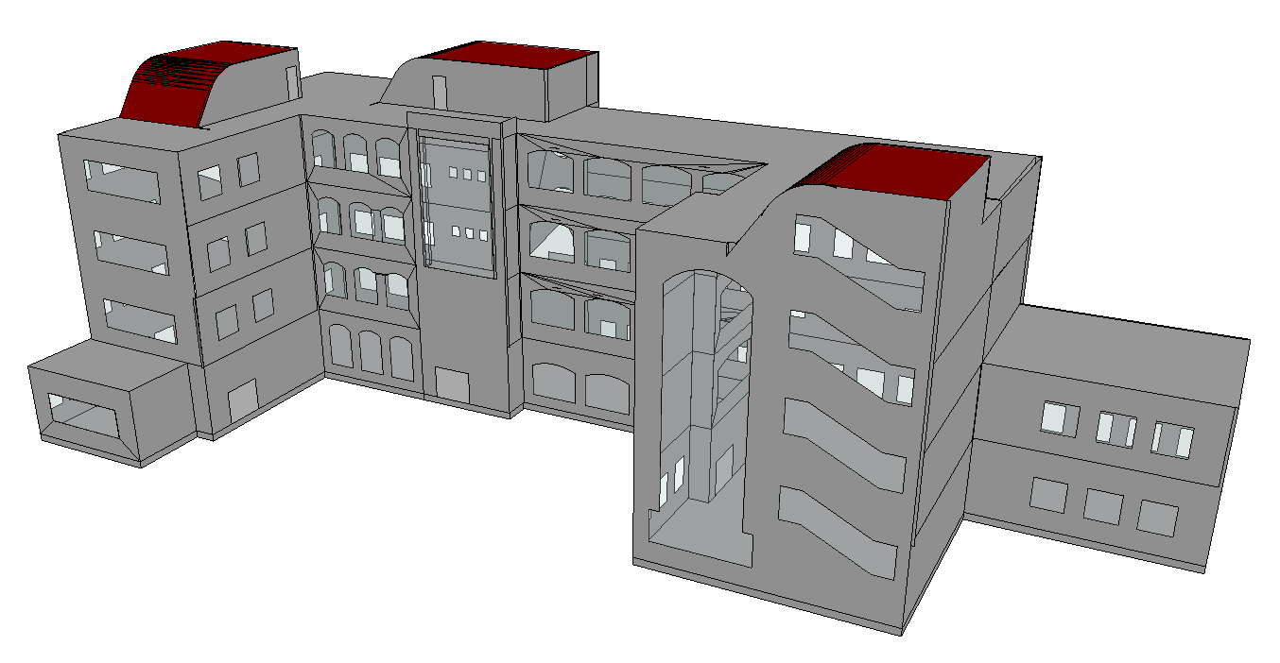
Acoustical Design
Ecotect Model

Slide 60
Acoustical Design
Reverberation Time (RT₆₀)
Room | Room Volume (m³) | Occupancy | RT₆₀ Range (At 500 Hz) | Recommended Range | Assessment
Classroom | 231.76 | 30 | 0.51 – 0.57 | 0.4 – 0.8 | OK
Teachers Room | 373.75 | 22 | 0.63 – 0.67 | 0.4 – 0.7 | OK
Manager Room | 82.20 | 2 | 0.55 – 0.56 | 0.4 – 0.6 | OK
Meeting Room | 194.11 | 25 | 0..50 – 0.56 | 0.4 – 0.7 | OK
Multipurpose Hall | 585.13 | 66 | 1.48 – 1.81 | 1.4 – 1.9 | OK
Science Lab | 370.92 | 32 | 0.60 – 0.65 | 0.4 – 0.7 | OK

Slide 61
Acoustical Design
Sound Transmission Class (STC)
Type | STC Value (dB) | Assessment
Classroom External Wall (Without Windows) | 44 | OK
Classroom External Wall (With Windows) | 39 | OK
Library External Wall (Without Windows) | 44 | OK
Library External Wall (With Windows) | 38 | OK
Wall (Between Classroom and Corridor) | 39 | OK
Wall (Between Classroom and other Classroom) | 40 | OK
Wall (Between Manager Room and Secretary Room) | 40 | OK

Slide 62
Acoustical Design
Impact Insulation Class (IIC)
Type | IIC Value (dB) | Assessment
Floor | 46 | OK
Art Room Roof | 69 | OK

Slide 63
Acoustical Design
Loud Speakers
Used Type: PRO-180RPC In-ceiling Speakers

Slide 64
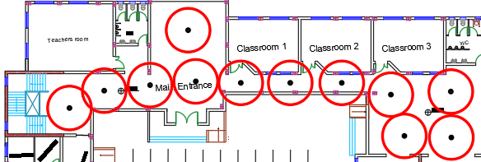
Acoustical Design
Speakers Distribution in Corridors

Slide 65
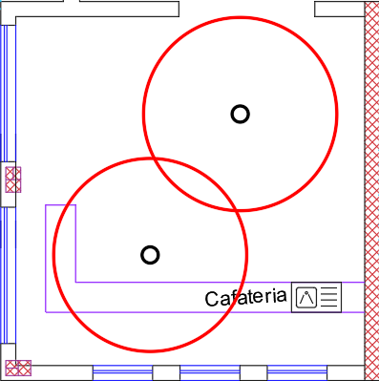
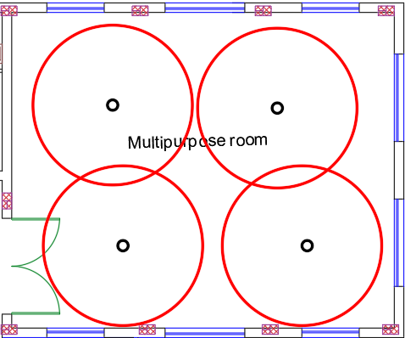
Acoustical Design
Speakers Distribution in Cafeteria and Multipurpose Hall
Cafeteria
Multipurpose Hall

Slide 66
Mechanical
Design

Slide 67
Water Supply System
Fixture Unit
 | Ground Floor | First Floor | Second Floor | Third Floor
Number of F.U in Zone 1 | 36 | 32 | 32 | 32
Number of F.U in Zone 2 | 44.5 | 41.5 | 27 | 27
Number of F.U in Floor | 81.5 | 73.5 | 59 | 59
Total F.U in All Floors = 273

Slide 68
Water Supply System
Pipes Diameter and Losses
 | Ground Floor | First Floor | Second Floor | Third Floor
Vertical pipes | 2″ | 2″ | 2.5″ | 3″
Horizontal pipes | 1″ | 1″ | 1.5″ | 1.5″
Branches pipes | 0.75″ | 0.75″ | 1″ | 1″
Total losses | 9 | 4.6 | 0.88 | 0.75
Allow losses | 13.9 | 7.9 | 1.47 | 0.8 Psi (Use pump 6 Psi)
Assessments | OK | OK | OK | OK

Slide 69
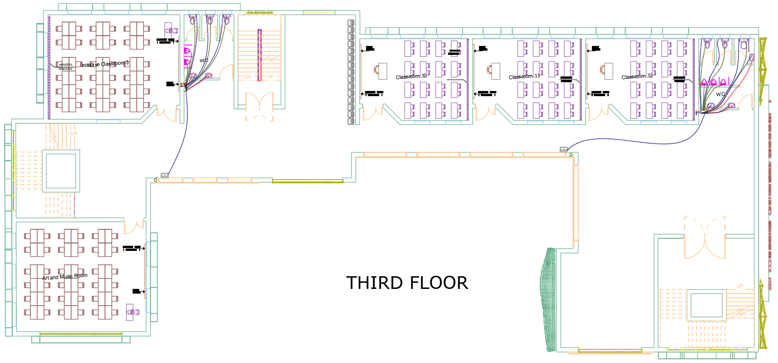
Water Supply System
Water Supply System Plan (Third Floor)

Slide 70
Drainage System
Total DFU’s
Floor | No. of Fixtures | DFU
Ground Floor | 13 W.C, 6 Lav, 2 Kitchen, 10 Drinking | 45 W.C, 6 Lav, 4 Kitchen, 5 Drinking
First Floor | 11 W.C, 11 Lav, 10 Drinking | 44 W.C, 11 Lav, 5 Drinking
Second Floor | 11 W.C, 5 Lav | 44 W.C, 5 Lav
Third Floor | 11 W.C, 5 Lav | 44 W.C, 5 Lav
Total | 46 W.C, 27 Lav, 2 Kitchen , 20 Drinking | 177 W.C, 27 Lav, 4 Kitchen, 10 Drinking
Total DFU`s = 218

Slide 71
Drainage System
Information about pipes in the system
Pipe | Diameter | Slope | Type of Pipe
Vent | 4" | 0%(90°) | PVC
Drainage | 4" | 1% | PVC
Stack | 4" | 0%(90°) | PVC
Sewer | 2" | 1% | PVC

Slide 72
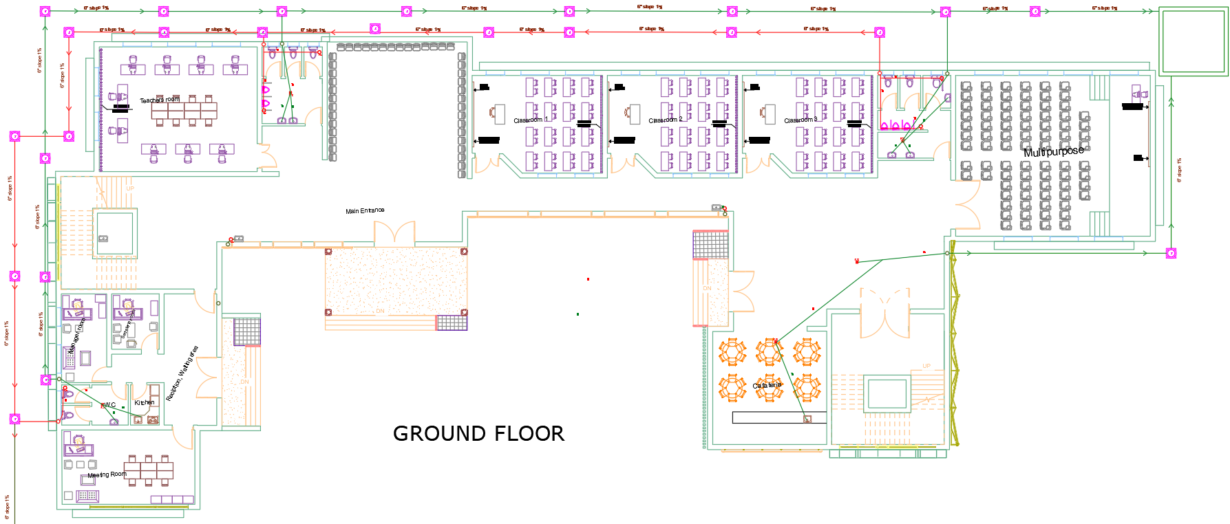
Drainage System
Manholes Plan

Slide 73
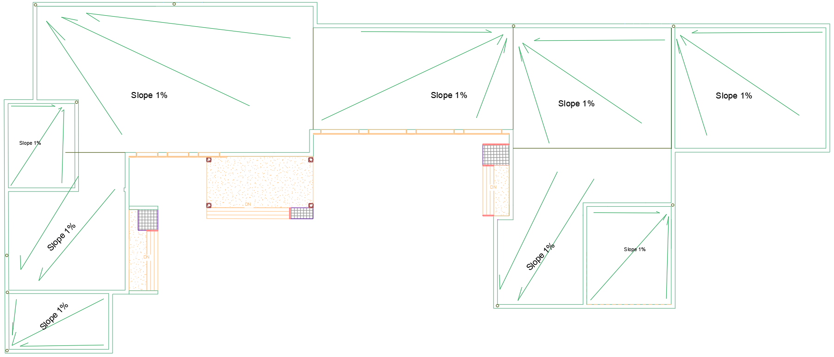
Drainage System
Rain Water Plan

Slide 74
Elevators Design
Required Number N' = 2
Car Capacity = 2500 lb.
Car Speed = 350 fpm.
Car Passenger Capacity P = 13

Slide 75
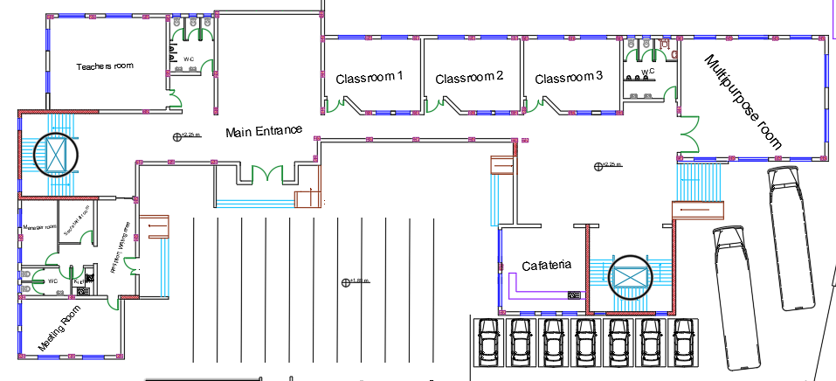
Elevators Design
Elevators Location

Slide 76
Safety and
Security Design

Slide 77
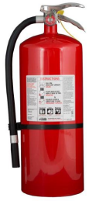
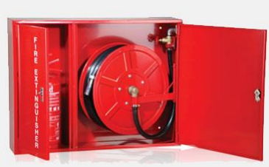
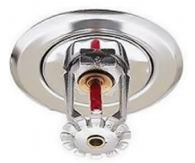
Firefighting System
Fire Extinguishers
Hose Stations
Sprinklers

Slide 78
Firefighting System
Automatic Sprinkler System
Level Hazard and Coverage Area
Hazard | Low | Moderate | High
Coverage area (m2) | 21 m² | 12 m² | 9.3 m²
Distance (m) | 4.6 m | 3.6 m | 3.6 m

Slide 79
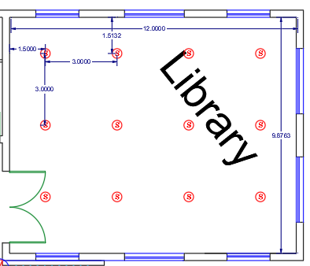
Firefighting System
Sprinkler Distribution in Library

Slide 80
Emergency Fire Protection System
Fire Fighting Systems Plan (Ground Floor)

Slide 81
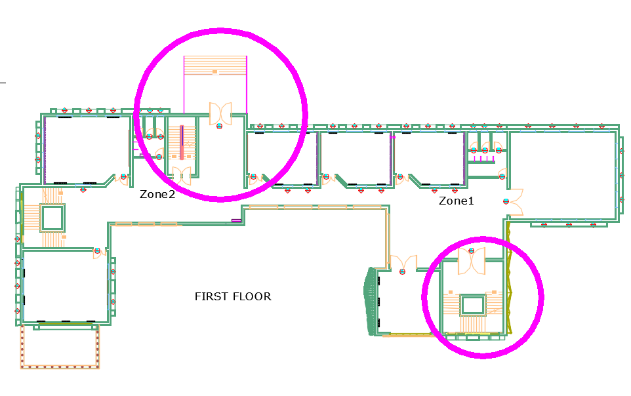
Emergency Egress System
Emergency Stairs

Slide 82

Emergency Egress System
Emergency Exit Signs

Slide 83
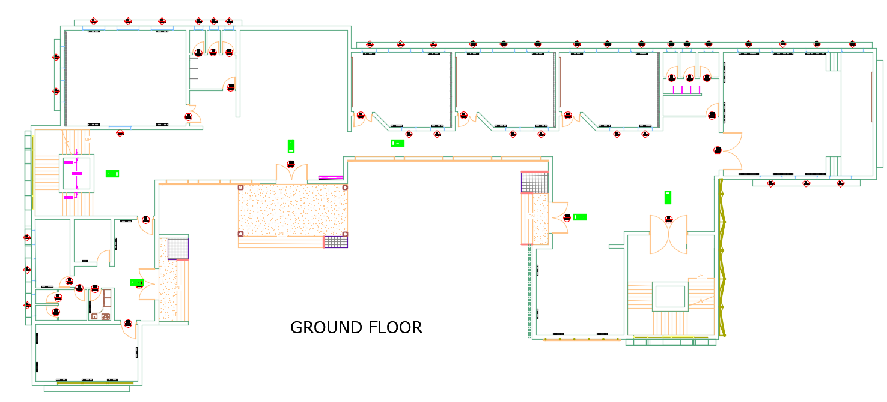
Emergency Egress System
Emergency Exit Signs in Ground Floor

Slide 84
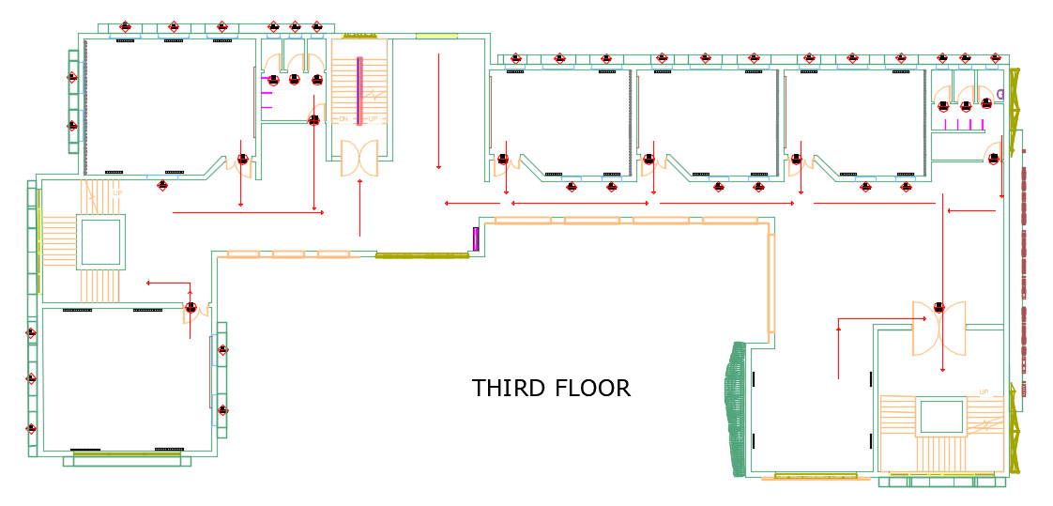
Emergency Egress System
Emergency Egress Route in Third Floor

Slide 85
Radial Design

Slide 86
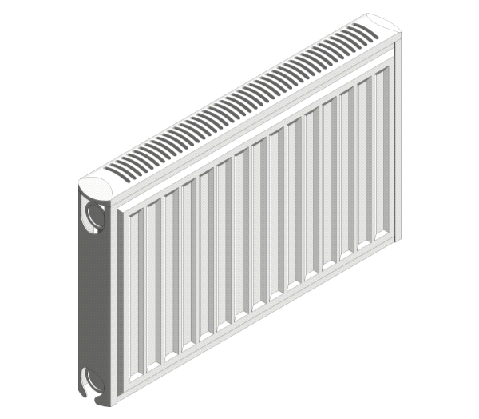
Radial System
Radiator Selection
Used Type: Soft line H P+-Brag box from Stelrad Company

Slide 87
Radial System
Radiators and Power in Each Floor
Floor | Number of Radiators | Actual Q_{rad} (Watt)
Ground Floor | 39 | 52734
First Floor | 24 | 32963
Second Floor | 25 | 32692
Third Floor | 25 | 34169

Slide 88
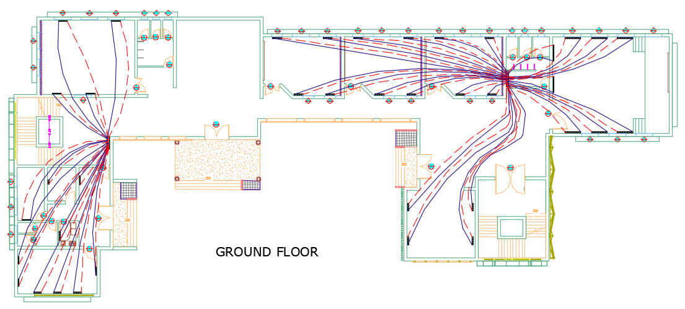
Radial System
Radiators Distribution in Ground Floor

Slide 89
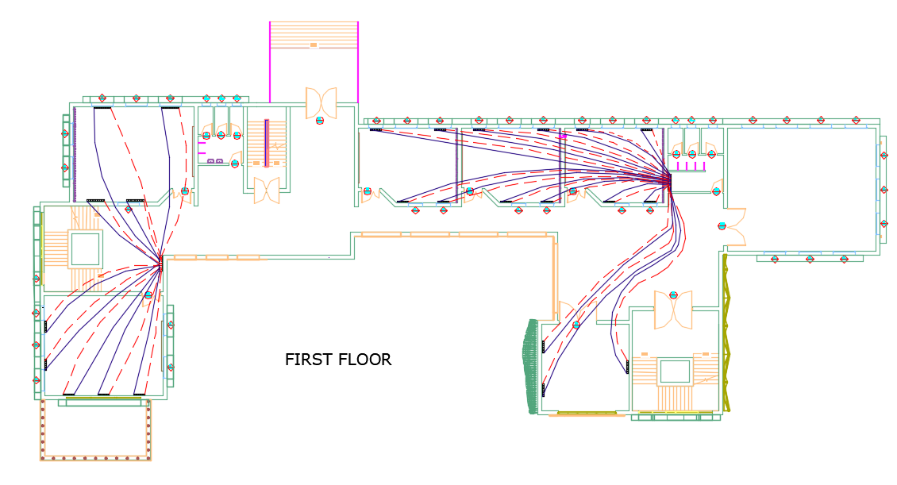
Radial System
Radiators Distribution in First Floor

Slide 90
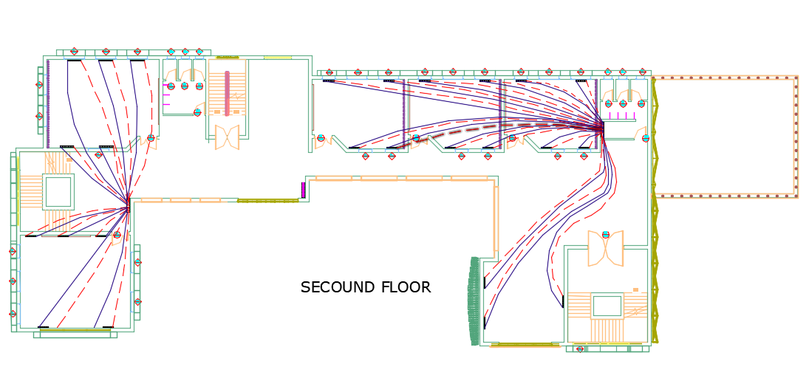
Radial System
Radiators Distribution in Second Floor

Slide 91

Radial System
Radiators Distribution in Third Floor

Slide 92
Electrical Design

Slide 93
Lighting Design
Daylight Factor
Facility | Standard DF % | Average DF in School % | Decision
Classroom | 2 – 4 | 2.474 | OK
Computer lab | 3 – 5 | 3.197 | OK
Library | 3 – 5 | 3.2 | OK
Teachers room | 2 – 4 | 2.3 | OK
Meeting room | 2 – 4 | 3.84 | OK
Manager room | 2 – 4 | 4 | OK
Multipurpose | 3 – 5 | 3.67 | OK
Cafeteria | 3 – 5 | 3.49 | OK

Slide 94


Lighting Design
Luminaires Types

Slide 95
Lighting Design
Illuminance
Room | Illuminance (Lux) | UGR
Classroom | 464 | OK
Library | 437 | OK
Computer Lab | 436 | OK
Manager Room | 275 | OK
Teachers Room | 303 | OK
Cafeteria | 382 | OK
Meeting Room | 313 | OK
Multipurpose Hall | 422 | OK
Initiative Classroom | 345 | OK

Slide 96



Lighting Design
3D Rendering from DIALux
Classroom
Library
Computer Lab

Slide 97



Lighting Design
3D Rendering from DIALux
Manager Room
Teachers Room
Cafeteria

Slide 98



Lighting Design
3D Rendering from DIALux
Meeting Room
Multipurpose Hall
Initiative Classroom

Slide 99


Lighting Design
Luminaires Distribution
Classroom
Library

Slide 100



Lighting Design
Luminaires Distribution
Computer Lab
Manager Room
Teachers Room

Slide 101


Lighting Design
Luminaires Distribution
Cafeteria
Meeting Room

Slide 102


Lighting Design
Luminaires Distribution
Multipurpose Hall
Initiative Classroom

Slide 103
Lighting Design
Lighting Power
Floor | Total Power Lighting (W) | Total Loads (amp)
Ground floor | 4043.1 | 88
First floor | 3719.1 | 76
Second floor | 3179.1 | 120
Third floor | 3179.1 | 58
Total | 14111.4 | 342

Slide 104

Electrical Loads
Power Plan (Third Floor)

Slide 105

Electrical Loads
Main Distribution board (Second Floor)

Slide 106

Electrical Loads
Distribution board for UPS (Second Floor)

Slide 107
Quantity Surveying and Cost Estimation

Slide 108
Cost Estimation
Total Building Area = 3150 m²
Direct Unit Cost = 5540958/3150
= 1759 NIS/m²
Direct Unit Cost = 350 JOD/m²
Total Direct Project Cost | 5,540,958

Slide 109
Done!
Thanks a Lot

