Slide 1

" Assessment and Redesign For Establishment Of Manage & Development Orphans Funds in Ramallah City "
An-Najah National University
Faculty of Engineering
Building Engineering Department
Prepared By:
Abdullah Adele
Ali Abu-Taha
Arif Asayra
Supervisor: Dr. Mutasim Baba

Slide 2
Contents
Introduction
Site analyses
Architectural aspects
Environmental aspects
Electromechanical aspects
Structure aspects
Quantity aspects

Slide 3
Introduction
Managing and development orphans funs is an office building
Has 7 story with total area 3000 m^2.
it works all year round part-time at an average of 8 hours per day(8am-3pm).

Slide 4
Site Analysis

Slide 5
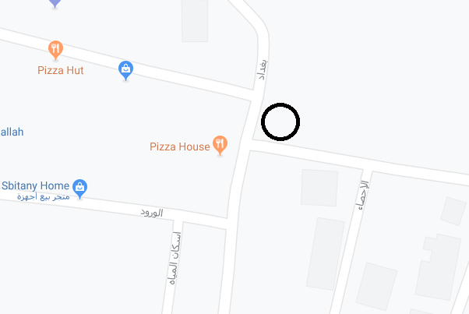
Site analysis
The site is located in Ramallah city in AL- Balo’o area, near bagdad street, Ramallah is about 850 m above sea level.
Area of the land 870 m^{2.}

Slide 6
Architectural Aspects

Slide 7
comment | Existing Width | Standard Width | Existing area | Standard Area | Room
ok |  |  | 15m² | (12-15) m² | office
ok |  |  | 40 m² | (20-30) m² | Managers room
ok | 1.4-1.7 m | 1.4m |  |  | Corridors
ok | 1.3m | 1.3m |  |  | staircase
 |  |  | 1.65m² | 1.6m² | Water closet
ok |  |  | 4.5m² | 3m² | Kitchen
ok |  |  | 72m² | 50-60 m² | Meeting room

Slide 8
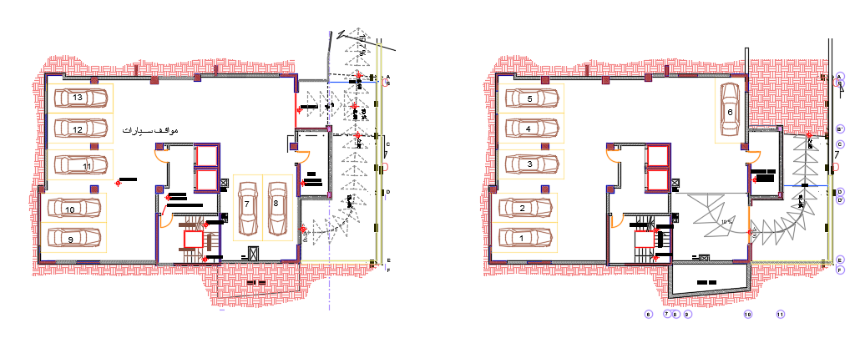
Architectural Aspects
Project plans
Basement 2
Basement 1
Basement 1 and 2 still as they are

Slide 9
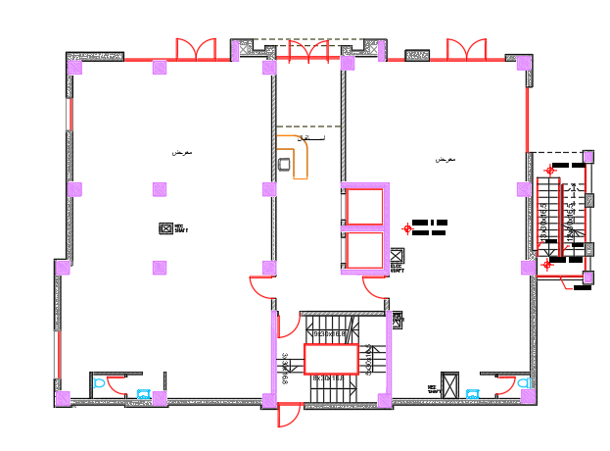
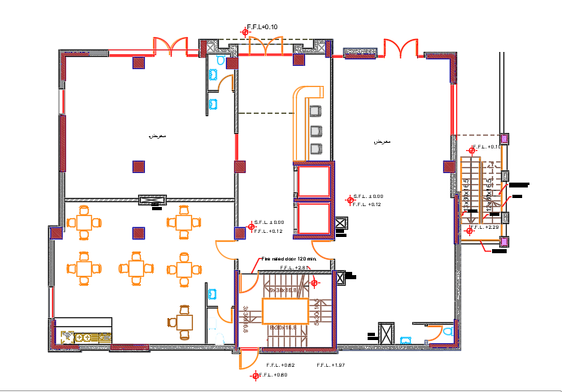
Architectural Aspects
Old design for ground floor
New design for ground floor

Slide 10
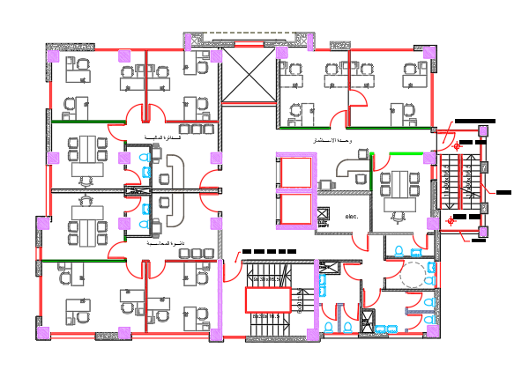
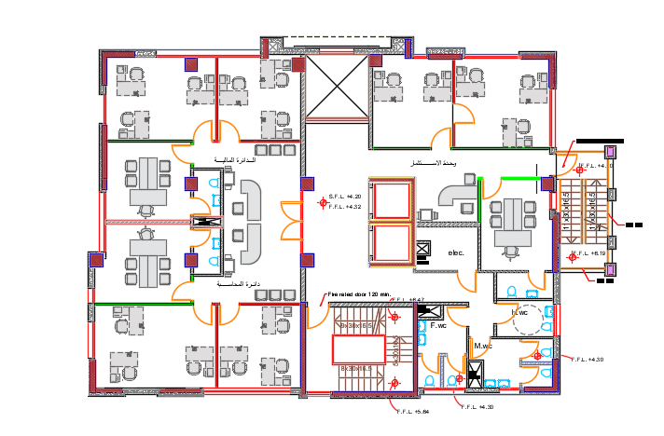
Architectural Aspects
Old design for first floor
New design for first floor

Slide 11
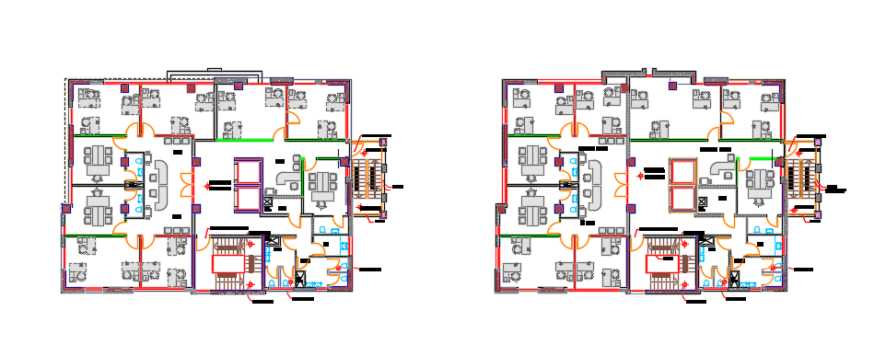
Architectural Aspects
Third floor
Second floor

Slide 12
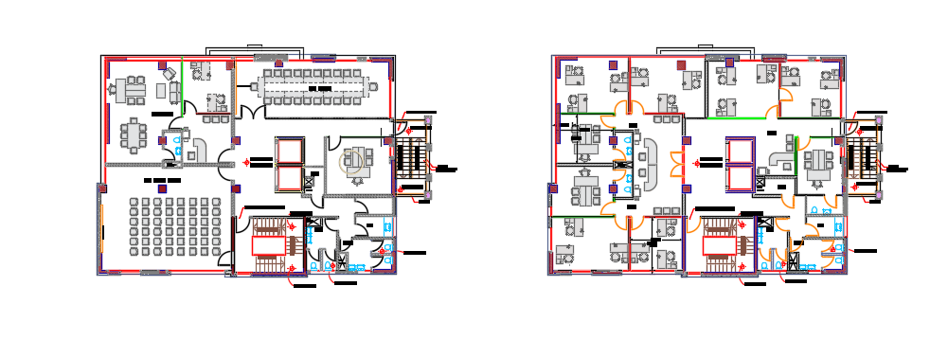
Architectural Aspects
Fifth floor
Forth floor

Slide 13
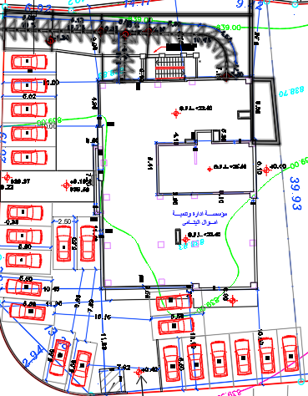
Architectural Aspects parking aspect
Project consents 13 parking in basements
And 22 in site.
35 and standard needs 30 parking

Slide 14
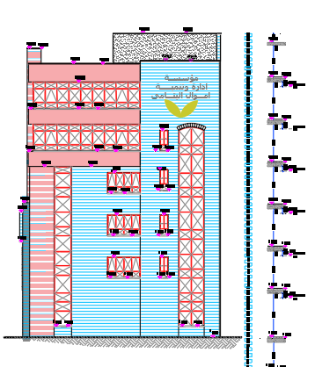
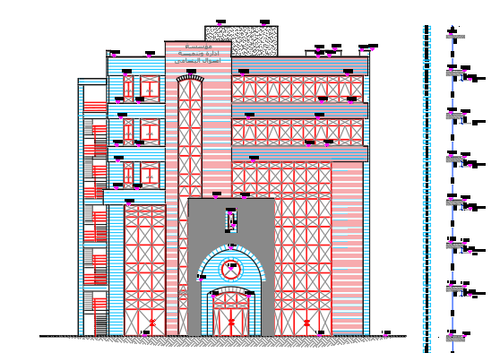
Architectural Aspects
Project elevations
SE
NE

Slide 15
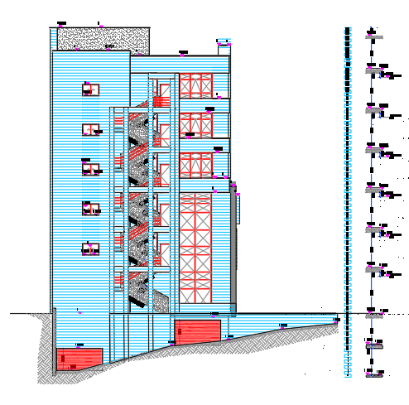
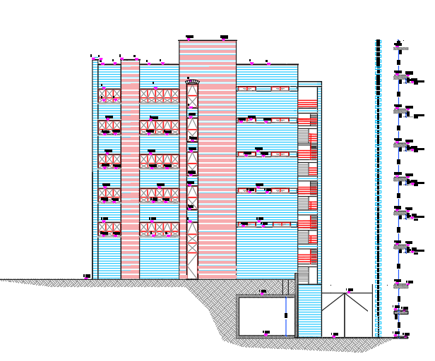
Architectural Aspects
SW
NW

Slide 16
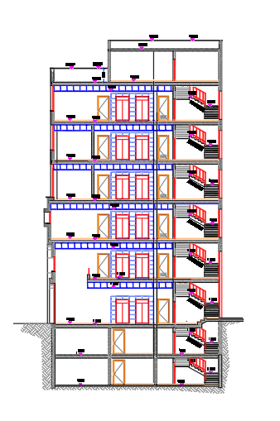
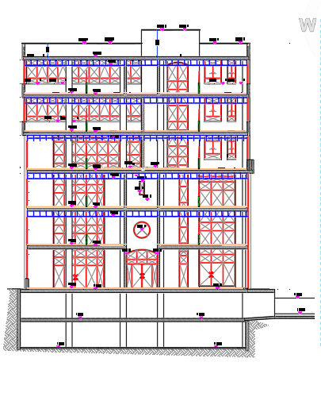
Architectural Aspects
Section 1
Section 2

Slide 17
Environmental Aspects

Slide 18
Environmental Aspects
Shading.
Solar analysis.
Daylight.

Slide 19
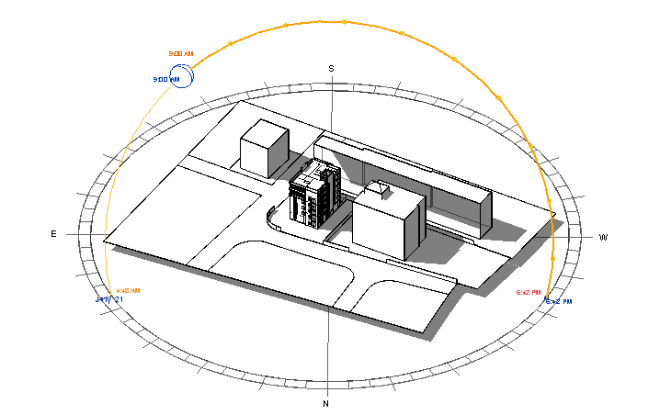
Shading
shadows from building in 21/7 at 9:00 am

Slide 20
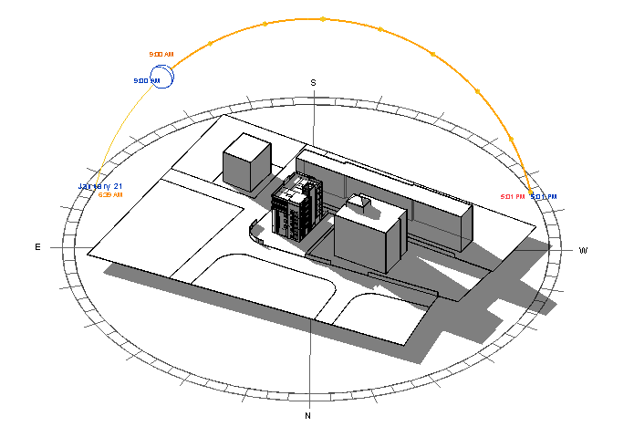
Shadows from building in 21/1 at 9:00 am

Slide 21
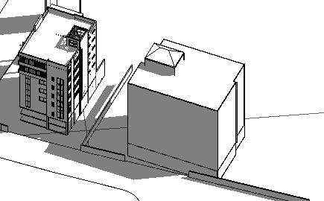
shading on the building from others
From Western North
The closest building is about 20m apart
Occur shading on the building at 3:00 pm .

Slide 22
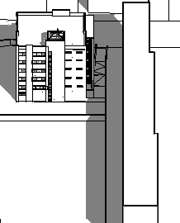
shading on the building from others
From Southern West
The closest building is about 12m apart
Occur shading on the building after noon.

Slide 23
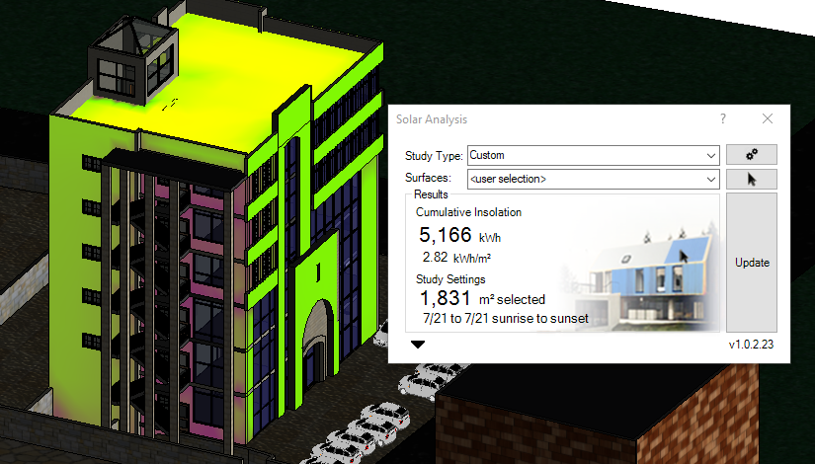
Solar analysis
This figure show the total of solar insolation that are on the building.
In the Summer season

Slide 24
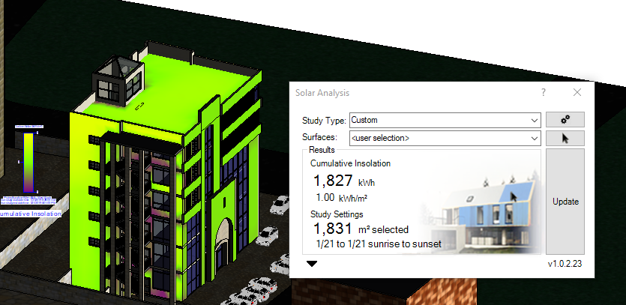
In the Winter season:

Slide 25
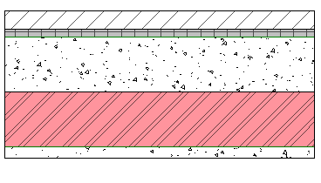
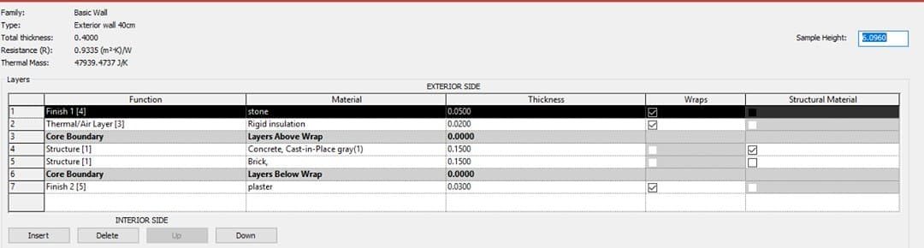
    Envelope construction details for the building:
External Wall layers:
U-value =1.11 w/m²-k

Slide 26
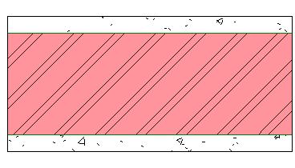
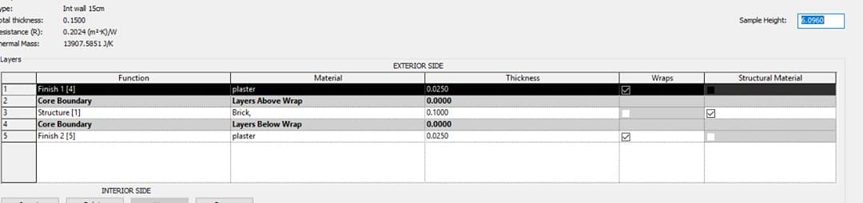
Internal Wall layers:

Slide 27
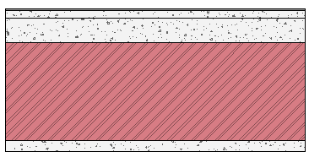
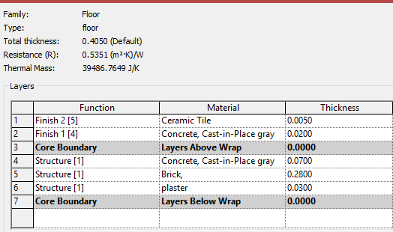
Celling

Slide 28
Lighting
Lighting analysis through the "Revit" program will be based on the principle of day light Factor, the rate of day light Factor (2% - 6%) , and we will obtain the day light factor for all room by "Revit" program, and we will compare the results before and after the simulation.
Rooms that higher than range will be treated by later mentioned, while rooms with less than range will be treated with artificial lighting until we obtained the required amount of artificial and natural lighting.

Slide 29
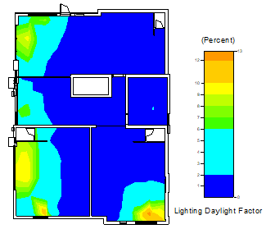
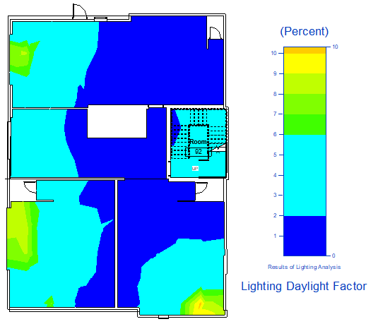
These figures shown the ground floor that Lack of natural lighting in the internal rooms and staircase, and the gradual natural lighting irregular
.
before after
Before
After

Slide 30
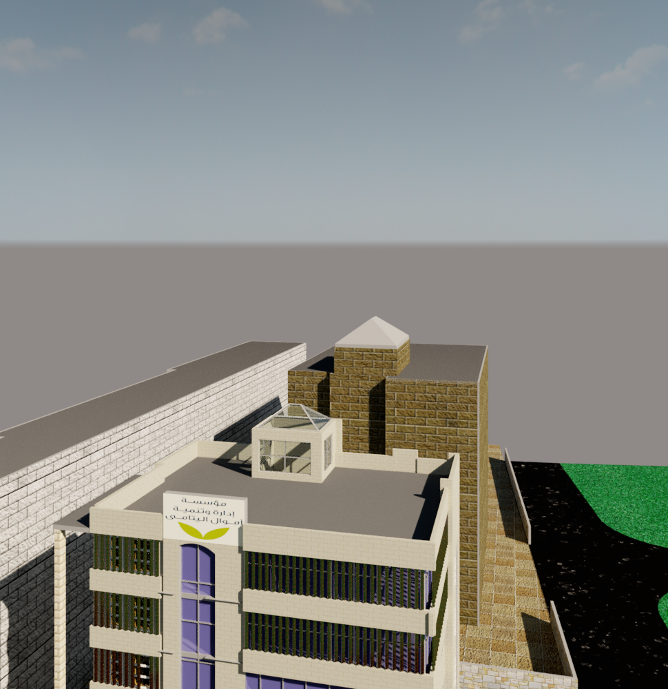
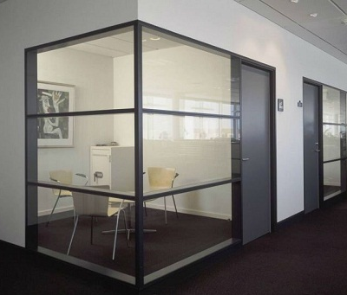
In the previous analysis, we have done interior glass partition, and to solve the problem of the staircase, it was made from glass to achieve natural lighting

Slide 31
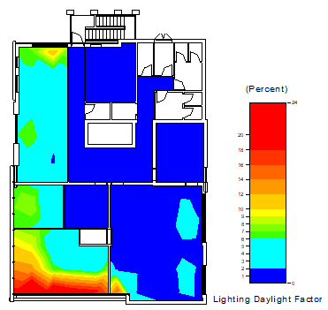
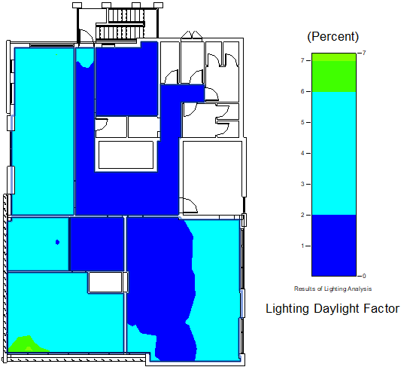
These figures shown the 5th floor that the extremely glare in the nearly of opening glass, In addition to natural lighting higher than the required.
after
before

Slide 32
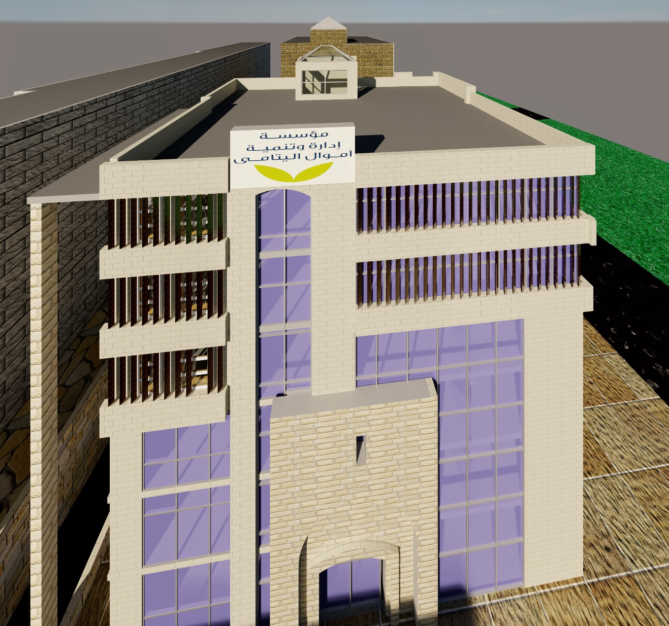
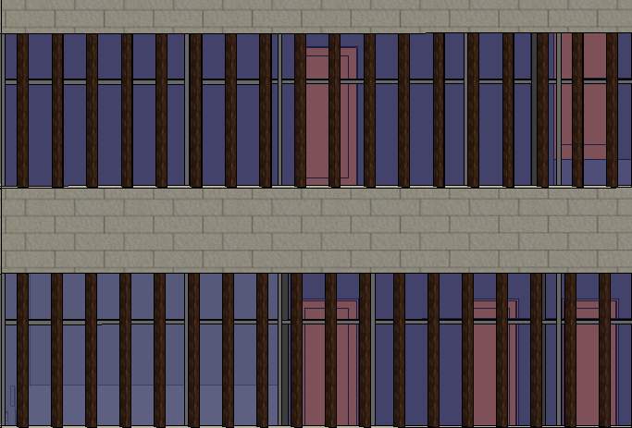
In the previous analysis we found that in some areas near the glass opening have high light and radiation, this was addressed by placing vertical louvers on the facades that are exposed to large rays, also modified the specifications of the glass by reducing the ratio of glass transparent to light. louvers, made of wood and louvers tilted on the facades at a 65-degree angle until to achieve the shading and property lighting

Slide 33
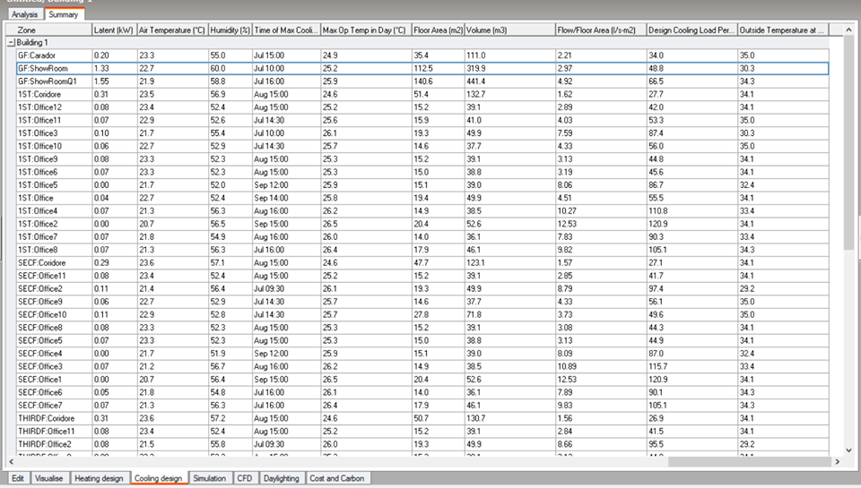
Simulation by design builder
1- Cooling load calculation

Slide 34
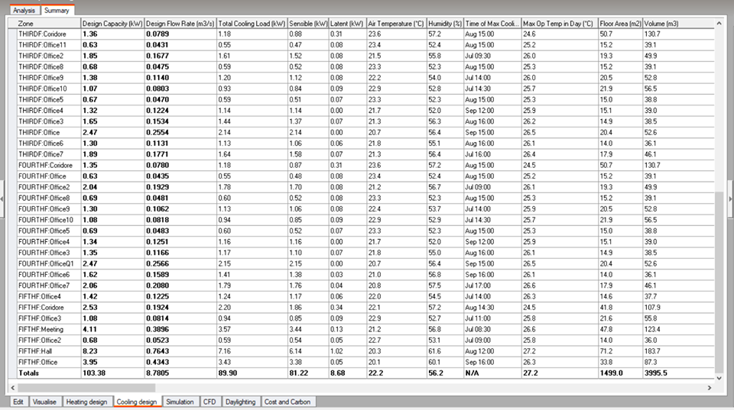
1- Cooling load calculation

Slide 35
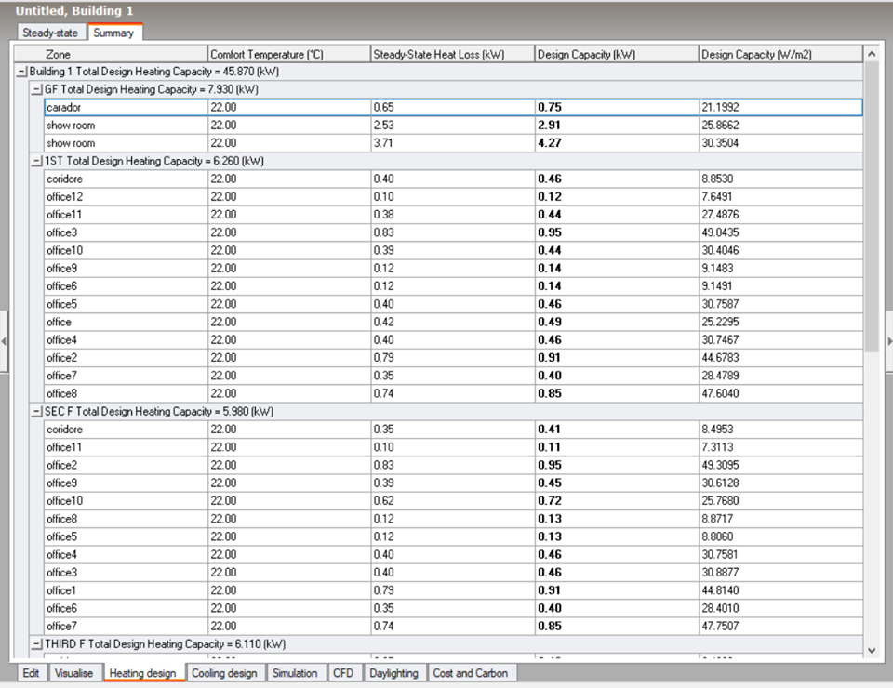
2- Heating load calculation

Slide 36
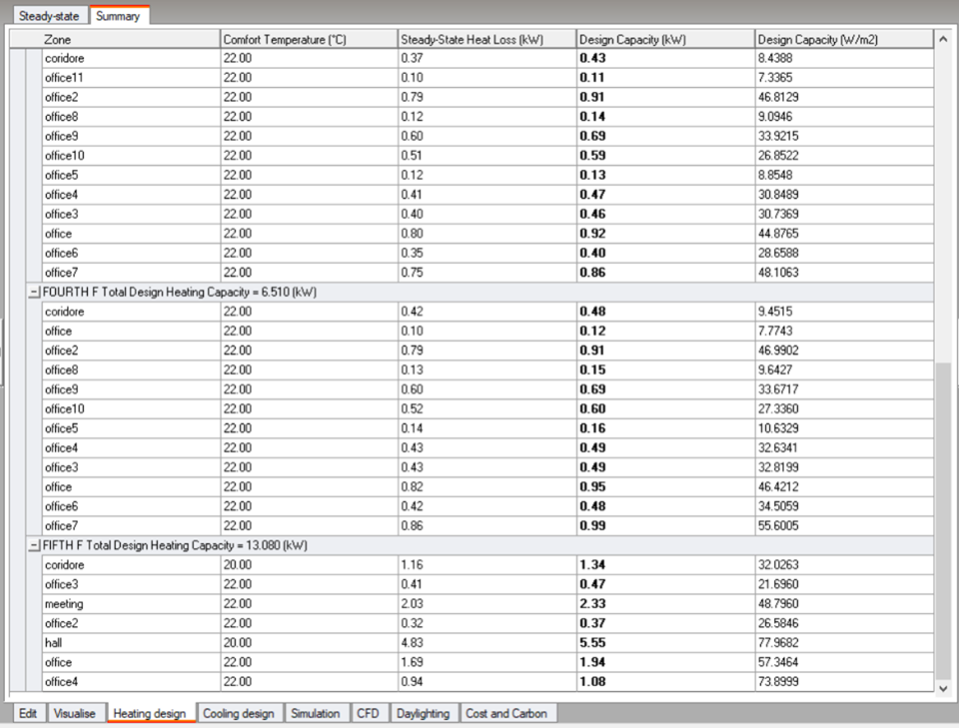
2- Heating load calculation

Slide 37
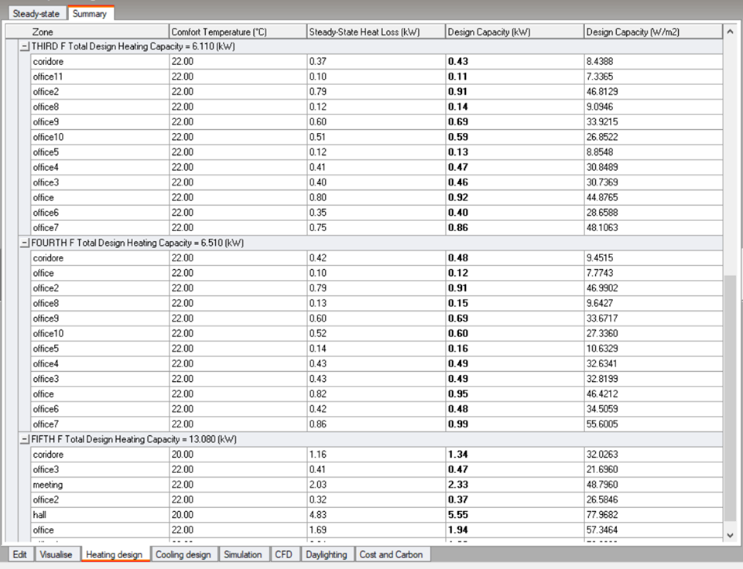
2- Heating load calculation

Slide 38
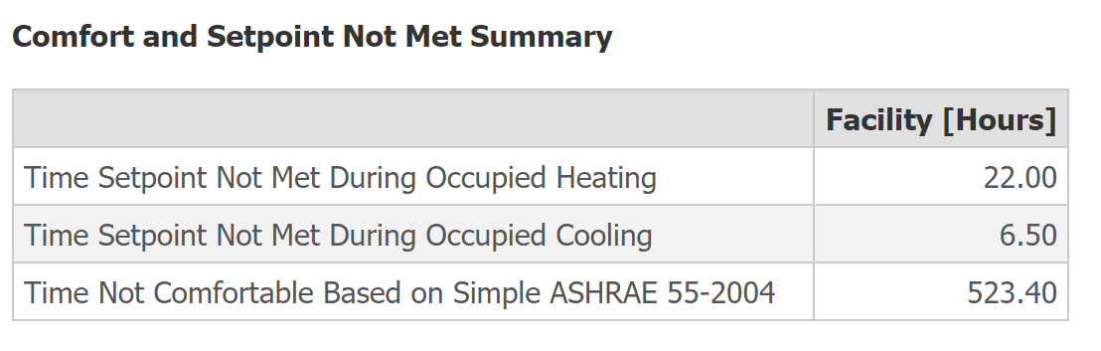
3- CFD

Slide 39
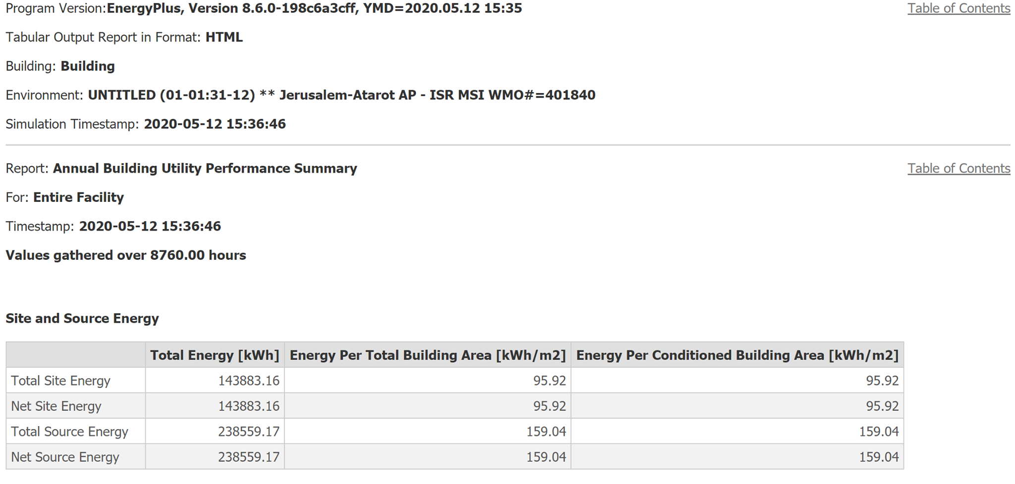
4- Total consumption Energy:

Slide 40
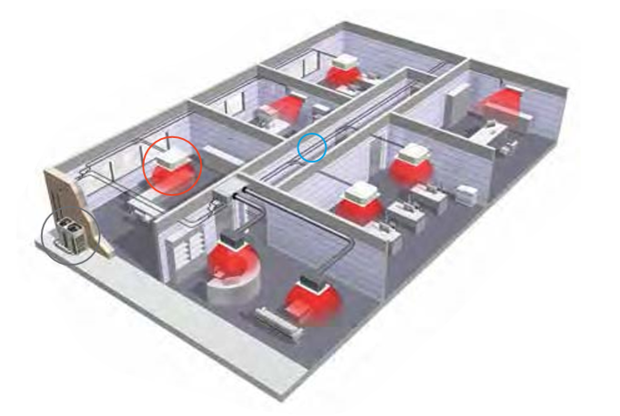
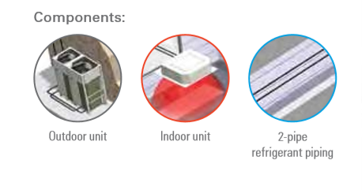
Electromechanical aspect
1- HVAC system
VRF System

Slide 41
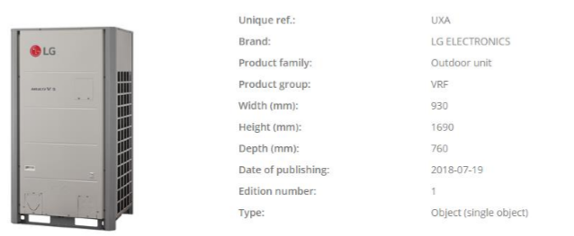
Selection unit:
The outdoor unit capacity 50 kW. The we need five outdoor units with capacity in roof of the building

Slide 42
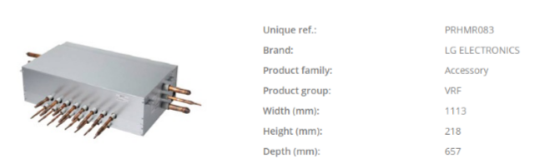
Collector

Slide 43
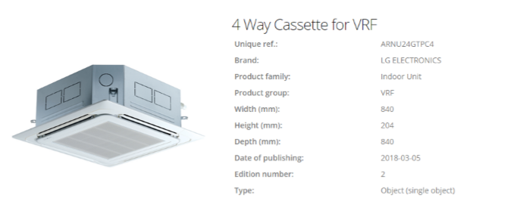
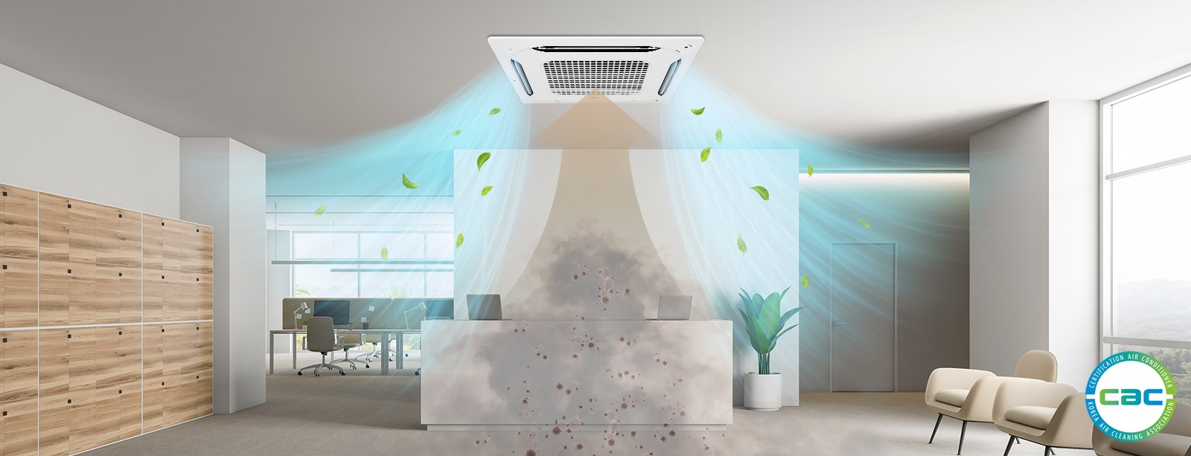
indoor unit:

Slide 44
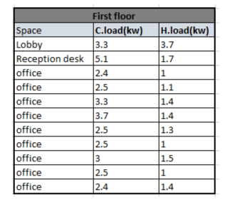
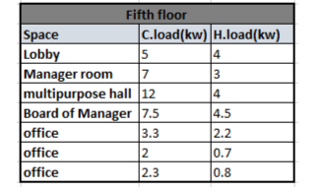
Result :

Slide 45


Distribution of Diffuser

Slide 46
2-Fire safety systems
Smoke detector
Fire suppression systems
Fire hoses
Sprinkler system
Manual fire alarm station
Fire extinguishers

Slide 47


Basement

Slide 48


First Floor
Fire extinguishers

Slide 49


3- Drainage system
Calculation Of Dfu’s for our Project :
The total Dfu’s = 101 Dfu’s
Drainage system pipe
2

Slide 50

First Floor

Slide 51


4- Elevators
the number of elevators that should be used in the building 2 elevators, capacity for each elevator 2500/400

Slide 52
5-Electrical Design
Electrical
Design
Control panel
Socket Distribution
Artificial Lighting

Slide 53


Socket Distribution

Slide 54




Specifications of luminaires:
In corridor
In bathroom & staircase
In the Parking
In office

Slide 55


Lighting Distribution

Slide 56



Slide 57




Slide 58
Spaces | Illuminance | Uniformity
Office | 500 | 0.6
General maneger office | 400 | 0.8
Corridor | 200 | 0.4
Bathroom | 100 | 0.6
Standards aspects
Design
Spaces | Illuminance | Uniformity
Office | 644 | 0.55
Meeting | 457 | 0.55
Corridor | 265 | 0.6
Bedrooms | 181 | 0.47

Slide 59

All system

Slide 60



6-Water system

Slide 61


Total fixture unit and pipe diameters
Fixture type | Occupancy | Type | Weight in fixture unit | No. of units | Total (FU's)
Water closest | Public | Flush tank | 5 | 11 | 55
Lavatory | Public | Faucet | 2 | 11 | 22
Kitchen sink | Public | Faucet | 3 | 2 | 6
Total (FU's) | 83
Fixture type | Occupancy | Type | Weight in fixture unit | No. of units | Total (FU's)
Water closest | Public | Flush tank | 5 | 5 | 25
Lavatory | Public | Faucet | 2 | 7 | 14
Kitchen sink | Public | Faucet | 3 | 1 | 3
Total (FU's) | 42

Slide 62

Second Floor

Slide 63

Water supply network result

Slide 64
7- Acoustical Aspect
Acoustical Aspect
Architectural analysis
Electroacoustic design

Slide 65

Architectural analysis
B- Articulation Loss AL%
Frequency | 125 Hz | 250 Hz | 500 Hz | 1000 Hz | 2000 Hz | 4000 Hz
AL% | 15 | 14 | 12 | 7 | 7 | 7
Recommended: AL % < 20 %
Office Plan
A- Reverberation Time RT60:
Frequency | 125Hz | 250Hz | 500Hz | 1000Hz | 2000Hz | 4000Hz
RT60 (second) | 1.2 | 1.1 | 0.95 | 0.81 | 0.73 | 0.78
Standard: 0.60 < RT₆₀ < 1.20

Slide 66




C- Sound transmission class (STC)
Standard = 38 dB
Gypsum board wall
Block wall
D- Impact sound transmission (IIC)
Standard = 40 dB
Ceiling

Slide 67


Electroacoustic design
Speaker type
Corridor plan

Slide 68

Speakers distribution

Slide 69
Structural Aspects

Slide 70
Structural Aspects
Limitation for design :
1- fc=28 MPa. For columns and shear wall and 24MPa for slabs and beams .
2- Fy= 420MPa. For all structural element of project.
3- Number of floors are 7 and Floors height= 3.65 m. and 2.8 for basements.
4- Live load = 5 𝐾𝑁/𝑚^2 .
5- SI.Dead load = 4 𝐾𝑁/𝑚^2
6- External wall load = 20 KN/m
Standards/Codes:
→ The American concrete institute code ACI 318-0.
→ The Uniform Building Code -UBC-97
for seismic design and its load combinations

Slide 71


Structural Aspects
Slab used is one way ribbed slab.
With thickness 35cm.
And solid slab for basement 2 with thickness 25 cm
Simulation software is Etab 2016

Slide 72
Structural Aspects
Beam used are hidden
Beam | Dimensions(mm)
Main | (900*350)
secondary | (600*350)

Slide 73

Structural Aspects
one type of columns with dimension (600*600)

Slide 74

Structural Aspects
Model checks
Compatibility check
all members move with each other, so it is ok.

Slide 75
Structural Aspects
2. Equilibriums check
Weight of building manually should be equal Weight from Etab with percent of error less than 10%
Equilibrium check
Load case | Etab | Manually | Error(%)
Dead | 27486.65 | 27061.2 | 1.54
Live | 13594.75 | 13600 | 0.03
SID | 17510.04 | 17510.1 | 0.039
Wall | 8072.14 | 7356 | 8.87

Slide 76
Structural Aspects
3. Stress-strain check(Columns)
To check the load distribution process correctly
Columns stress strain checks
Column | Etab | Manually | Error(%)
C1 | 1418.8 | 1351.024 | 4.77
C2 | 3040.4 | 2931.28 | 3.58
C3 | 4137.3 | 3754.93 | 9.24

Slide 77
Structural Aspects
Stress-strain check(Beams)
Beams stress strain checks
Beam | Etab | Manually | Error(%)
B1 | 126.09 | 116.77 | 7.97
B2 | 641.14 | 603.61 | 6.21
B3 | 248.78 | 254.3 | 2.16

Slide 78
Structural Aspects
Stress-strain check(Spans)
Spans stress strain checks
Span | Etab | Manually | Error(%)
span1 | 67.27 | 62.87 | 6.53
span2 | 68.71 | 62.875 | 8.49
span3 | 20.775 | 22.635 | 8.95

Slide 79

Structural Aspects
Deflection check
Allowed limits:
Immediate Deflection = 17 mm
Long–term Deflection = 25 mm
Deflection from ETAB = 14 mm
SO , it is OK

Slide 80

Structural Aspects
Seismic analysis
Seismic zone : 2A with (Z = 0.15)
Soil profile : SD.
Acceleration-dependent seismic coefficients Ca=0.22.
Velocity-dependent seismic coefficients Cv= 0.32.
Importance factor I=1.
Force reduction factor R=5.5

Slide 81
Structural Aspects
Seismic load checks
Period check
T manually = 1.4*(0.0488(28) ^ (3/4)) = 0.832 sec
T etabs = 0.9 sec ok, because other checks ok.
2. Drift check
ΔM (Drift) =0.7 * R * Δ _{s}
Drift limitation = 2 % times story height.
Story | Height | Dis_x | Dis_y | Dis_x | Dis_y | Delta-x(mm) | Delta-y(mm) | Delta limit(mm)
0 |  | 0 | 0
1 | 2800 | 0.119 | 0.203 | 0.119 | 0.203 | 0.45815 | 0.78155 | 56
2 | 4200 | 0.192 | 0.355 | 0.073 | 0.152 | 0.28105 | 0.5852 | 84
3 | 3640 | 2.015 | 2.082 | 1.823 | 1.727 | 7.01855 | 6.64895 | 72.8
4 | 3640 | 4.83 | 3.35 | 2.815 | 1.268 | 10.83775 | 4.8818 | 72.8
5 | 3640 | 7.788 | 6.845 | 2.958 | 3.495 | 11.3883 | 13.45575 | 72.8
6 | 3640 | 10.609 | 9.271 | 2.821 | 2.426 | 10.86085 | 9.3401 | 72.8
7 | 3640 | 13.23 | 11.68 | 2.621 | 2.409 | 10.09085 | 9.27465 | 72.8
8 | 3640 | 16.76 | 14.74 | 3.53 | 3.06 | 13.5905 | 11.781 | 72.8

Slide 82
Structural Aspects
3. Modal mass participate ratio check (MPMR) check
The MMPR check according to UBC code must be greater than 90% to use response spectrum analysis.
Case | Mode | Period | UX | UY | Sum UX | Sum UY
 |  | sec
Modal | 29 | 0.035 | 0.0216 | 0.1028 | 0.765 | 0.8657
Modal | 30 | 0.033 | 0.0935 | 0.0336 | 0.8585 | 0.8993
Modal | 31 | 0.032 | 0.0408 | 0.0019 | 0.8993 | 0.9011
Modal | 32 | 0.031 | 0.0106 | 0.0023 | 0.9099 | 0.9035
Modal | 33 | 0.03 | 0.0001 | 4.87E-06 | 0.91 | 0.9035
Modal | 35 | 0.028 | 0.0004 | 0.0001 | 0.9112 | 0.9042

Slide 83
Structural Aspects
4. Base shear check
For this check make sure base shear from response spectrum cases equal or more than base shear from equivalent static method through modifying scale factor.
Axis | T | T_LIMIT | T_used | V_mannual | V_Etab | Old Scale factor | New ,S.F
X | 1.028 | 0.84 | 0.84 | 3627.84814 | 2413.516 | 1783 | 2681
Y | 0.854 | 0.84 | 0.84 | 3627.84814 | 2927.375 | 1783 | 2210

Slide 84


Structural Aspects
Design of structural elements
1. Slabs :
Ribbed slab
Solid slab

Slide 85


Structural Aspects
Design of structural elements
1. Slabs :

Slide 86

Structural Aspects
Design of structural elements
1. Slabs :

Slide 87


Structural Aspects
Design of structural elements
2. Beams :
beam | positin | As | As(min) | As used | Bar used | Area bar | # of bars | spacing
M.B.2 | (-) left | 1858 | 899.1 | 1858 | 16 | 200.96 | 10 | 76
 | (+) | 1157 | 899.1 | 1157 | 16 | 200.96 | 6 | 149
 | (-) right | 2187 | 899.1 | 2187 | 16 | 200.96 | 11 | 67

Slide 88

Structural Aspects
Design of structural elements
3. Columns:
12∅20
3∅10/15cm

Slide 89


Structural Aspects
Design of structural elements
4. Shear walls

Slide 90

Structural Aspects
Design of structural elements
4. Mat foundation

Slide 91

Structural Aspects
Design of structural elements
4. Mat foundation

Slide 92


Structural Aspects
Design of structural elements
5. Staires

Slide 93
Cost Estimation
Project Total cost = 3,380,980 NIS .
Project total area = 3000 m^2
Cost /unit = 1127 NIS / M^2

