Slide 1

Designing a Power Station Based on CSP Technology in Nablus Governorate
Prepared by:
Aman Zreaq
Safaa Sarsour
Sahar hannoon
Supervisor:
Dr. Aysar Yasin

Slide 2
Outline:
Introduction.
Objectives.
Concentrating Solar Power Technology
Research Methodology.
Site selection criteria.
Discussion and analysis

Slide 3
Introduction:
Palestine suffers from shortage of energy
Environmental impact of fossil fuel
CSP depends on solar energy that abundant and everywhere.

Slide 4
Objectives
The objective of this research is to investigate the technical and economic feasibility for thermal solar power generation plant with 1 mw capacity in Nablus governorate

Slide 5
Objectives
The importance of this research is to answer some questions:
what are the main conditions and requirements needed for implementing CSP systems?
What is the importance of setting up the station?

Slide 6
Concentrating Solar Power Technology
CSP components
Collectors
Receiver
Reflectors
Power blocks
Heat transfer fluids and thermal storage

Slide 7
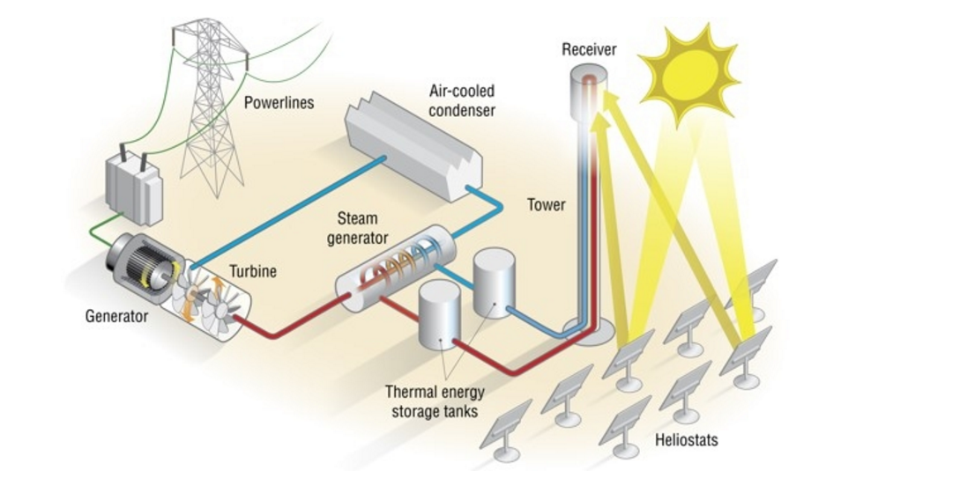
Concentrating Solar Power Technology

Slide 8
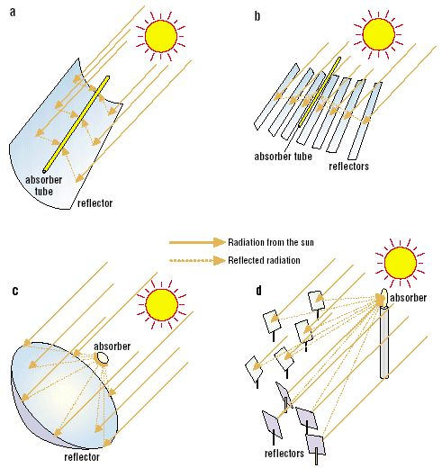
Concentrating Solar Power Technology
CSP plants classification

Slide 9
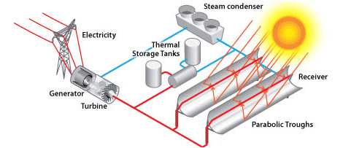
Concentrating Solar Power Technology
Parabolic trough technology

Slide 10
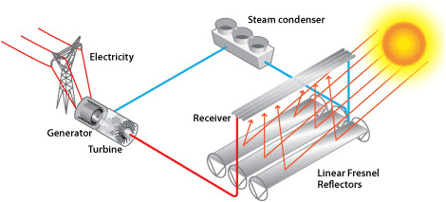
Concentrating Solar Power Technology
Linear Fresnel Reflector

Slide 11
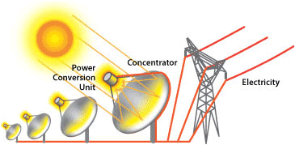
Concentrating Solar Power Technology
Dish/engine systems

Slide 12
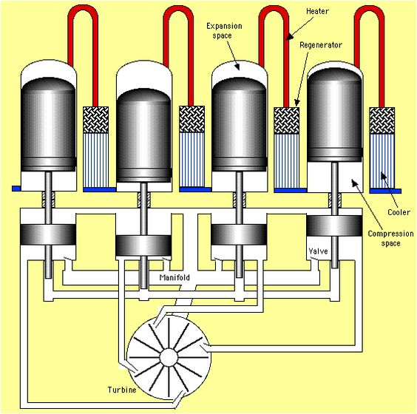
Concentrating Solar Power Technology
Stirling engine

Slide 13
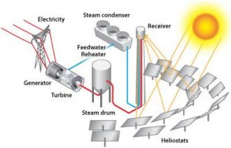
Concentrating Solar Power Technology
Solar Power Tower

Slide 14
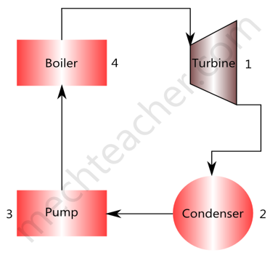
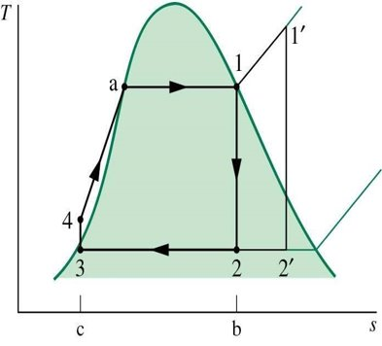
Concentrating Solar Power Technology
RANKINE CYCLE -PRINCIPLE:

Slide 15
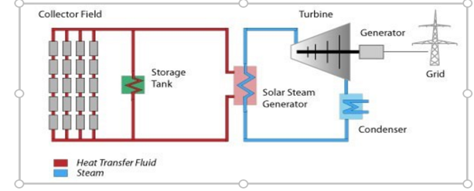
Concentrating Solar Power Technology
The process:

Slide 16
CSP Storage
THERMAL STORAGE SYSTEM ALLOWS PROVIDE POWER DURING PERIODS OF ABSENCE OF DIRECT SUN ORIENTED RADIATION,
THE MAIN CHALLENGE FACING THE RENEWABLE SOURCES OF ENERGY IS THE ENERGY STORAGE, CONCENTRATING SOLAR POWER CSP SYSTEM PROVIDE A SOLUTION BY THERMAL STORAGE WITHOUT NEEDING TO USE BATTERY THAT HAVE A LOT OF PROBLEMS

Slide 17
Heat transfer fluids
WATER (550 C°) AND (160 BAR)
HEAVY OIL (440C°)
MOLTEN SALT IS A MIXTURE OF NITRATE SALTS (MAINLY SODIUM NITRATE NANO3 AND POTASSIUM NITRATE KNO3 AT A 60-40 (230C°)

Slide 18
CSP Storage
SEVERAL THERMAL ENERGY STORAGE TECHNOLOGIES THAT HAVE BEEN IMPLEMENTED FOR CSP PLANTS ARE MAINLY:
TWO-TANK (DIRECT AND INDIRECT)
SINGLE-TANK SYSTEMS.

Slide 19
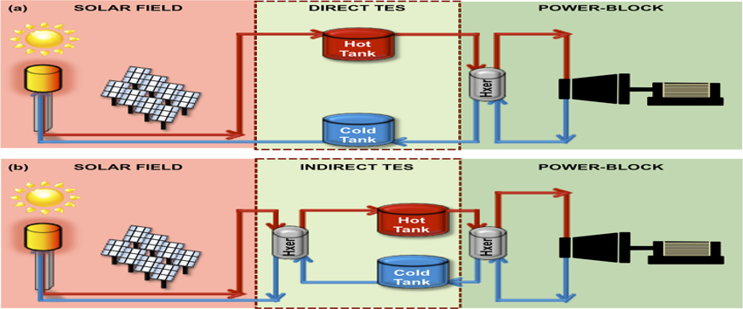
TWO-TANK (DIRECT AND INDIRECT)

Slide 20
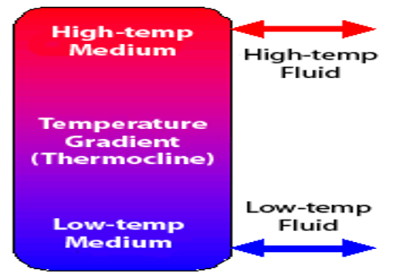
SINGLE-TANK THERMOCLINE SYSTEM

Slide 21
Research Methodology
Data collection
Feasibility study
Design CSP
Station
Conclusions
& Recommendations
further study for CSP technology
Site selection criteria for the CSP Station

Slide 22
Site selection criteria:
The selected sites for CSP systems have to comply with certain requirements. These requirements :
Solar radiation potential: a minimum requirement for CSP of around 2,000 kWh/m² is commonly cited.
Land cover and slope: the specific surface area for a CSP plant in average is about 25000 m²/MW . The slope is ranged about 1-2% for Linear focus and up to 3-4% for point focus technologies. For Nablus the slope is nearly to 2% .

Slide 23
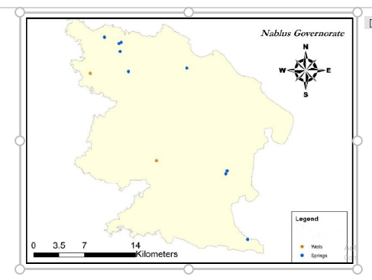
Water availability: Water Availability for concentrating power plants is essential, particularly if they are equipped with wet cooling systems.

Slide 24
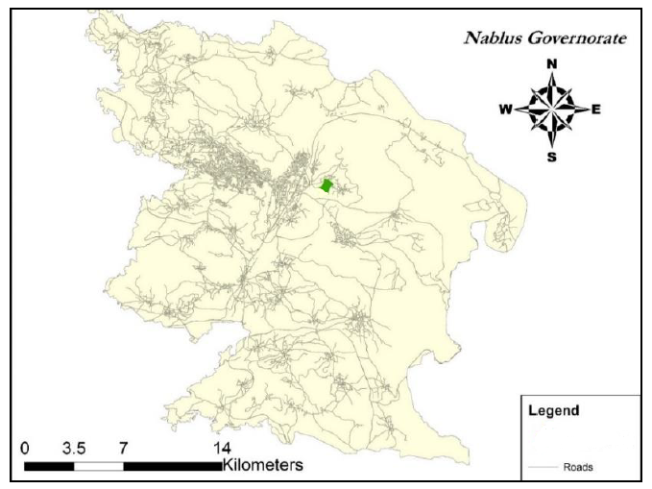
4.Transportation:Access roads must be suitable for transporting the different and heavy equipment’s to the site like turbine, generators, reflectors, pipes etc.

Slide 25
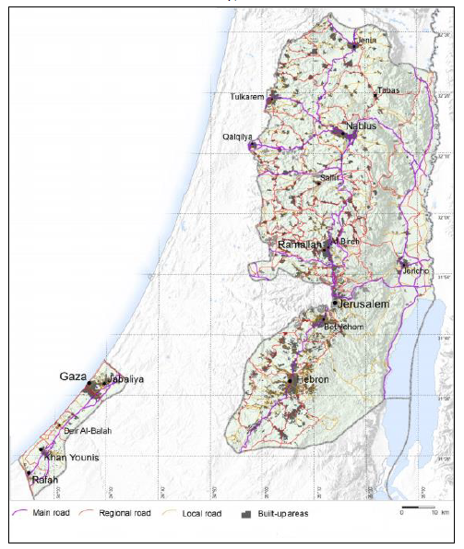

Slide 26
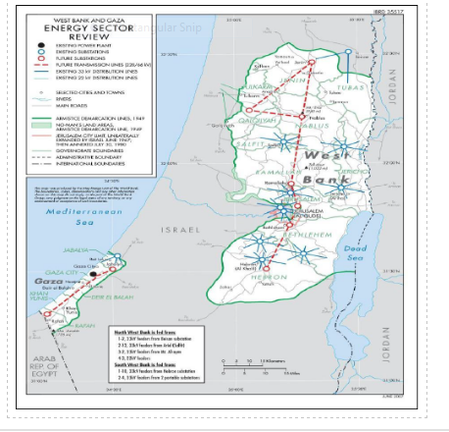
5. Power transmission line: Large CSP plants require high voltage lines to transmit the generated electrical power to consumers.

Slide 27
6. Other meteorological:
Wind: The performance and structural design of the solar field is affected by high winds due to the solar field is not intended to work at winds of more than 8.3 to 19.5 m/s and it depends on the selected CSP technology. The average wind speed of Nablus Governorate is within the range 1.76 m/s .
Ambient temperature and humidity : The efficiency of the sun oriented field depend on the convective losses of the heat transfer fluid and the collectors to the ambient air.

Slide 28
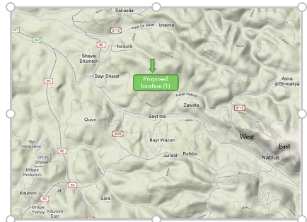
Scenarios for station structure:
A stand alone station with 1 Mw capacity supply in the Wastewater Treatment Plant:

Slide 29
Wastewater treatment plant:
It's located at the western part of the Nablus city which located at Wadi Zeimar near Dayr Sharaf. With area of the plant is 32560 m2.
The maximum influent flow rate to the plant is 17000 m³/d, with quality of total suspended solids of 784 mg/L, and biological oxygen demand of 656 mg/L
The plant is designed to give effluent quality of 20/30 (Biological oxygen demand per total suspended solids)
The effluent flow rates are 16264,38 and 4899 m³/d, of treated water, sludge and biogas respectively.
The length of the wastewater network is 230 km including the transfer line.
The waste water network covers about 93% of the total area of Nablus city, and thus 96% of total population benefit from this service.
The purposes of wastewater treatment plant are to protect the environment, to save water resources and to use the treated water in agricultural application and others.

Slide 30
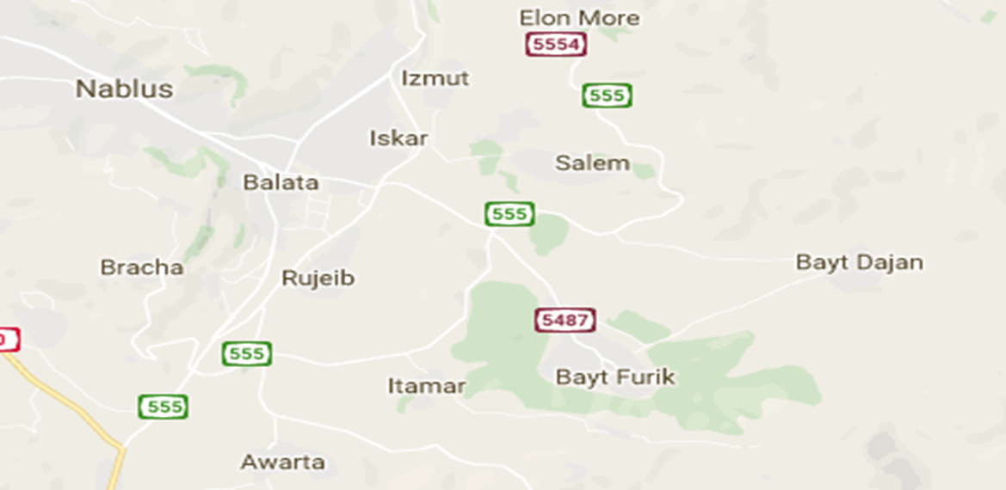
2-The second choice Are the group of lands their own total areas roughly 40 donmes it's located in Nablus city in Rougebe zone :

Slide 31
Discussion and analysis:
We will use many Software and Codes for Analysis of Concentrating Solar Power Technologies the following a summary of models and software that can be used to analyze various concentrated solar technologies:
SAM
TRNSYS
RET screen

