Slide 1
In a Nutshell LTE
LTE is the first technology designed explicitly for the NGN (Next Generation Network) and is set to become the de-facto NGN mobile access network standard. It takes advantage of the NGN's capabilities to provide an always-on mobile data experience comparable to wired networks.

Slide 2
LTE supports peak data rates of up to 100 Mbps on the downlink and 50 Mbps on the uplink when using a 20 MHz channel bandwidth, a single transmit antenna at the user equipment (UE), and two receive antennas at the Base Station.
LTE generates three to four times the throughput on the downlink and two to three times the throughput on the Uplink relative to 3GPP Release 6.

Slide 3
LTE in a Nutshell
OFDM is a technology that dates back to the 1960’s. It was considered for 3G systems in the mid-1990s before being determined too immature.
In addition to OFDM, LTE implements multiple-antenna techniques such as MIMO (multiple input multiple output) which can either increase channel capacity (spatial multiplexing) or enhance signal robustness (space frequency/time coding).

Slide 4
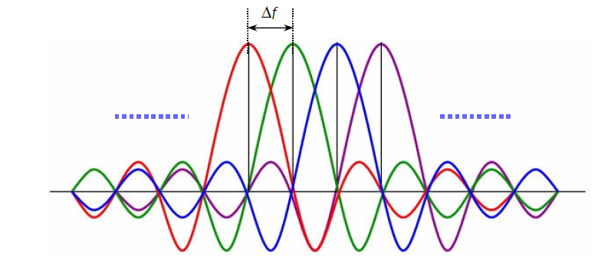
OFDM
The OFDM technology is based on using multiple narrow band sub-carriers spread over a wide channel bandwidth. The sub-carriers are mutually orthogonal in the frequency domain which mitigates intersymbol interference (ISI) .
FIGURE 1. OFDM SUBCARRIER SPACING.

Slide 5
Advantages of OFDM in a mobile system
Long symbol time and guard interval increases robustness to multipath and limits intersymbol interference.
Eliminates the need for intra-cell interference cancellation.
Allows flexible utilization of frequency spectrum.
Increases spectral efficiency due to orthogonality between sub-carriers.

Slide 6
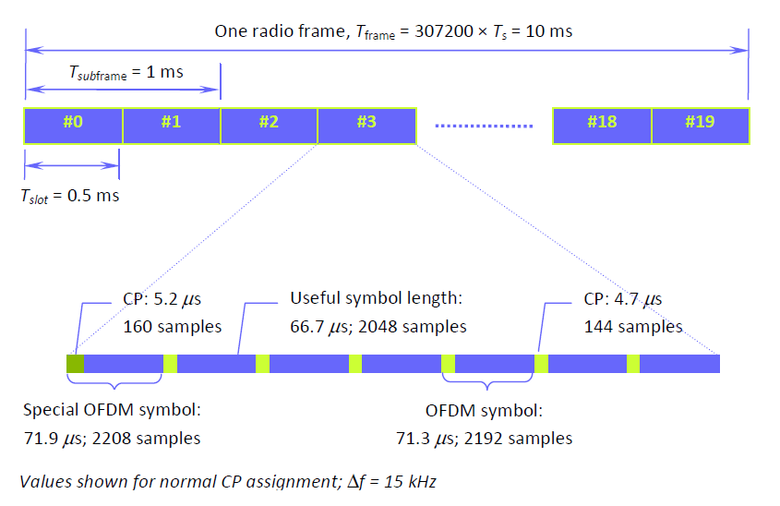
Radio frame Structure in time domain:

Slide 7
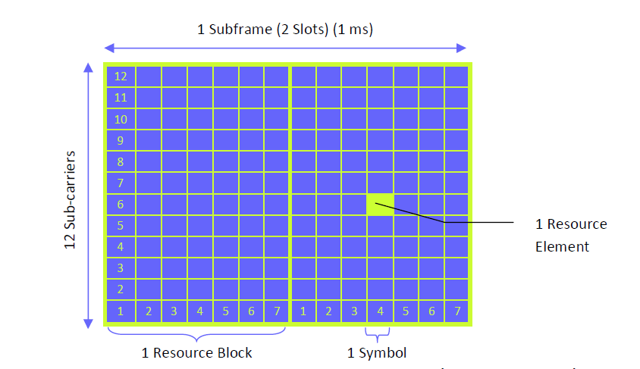
FIGURE 2. RESOURCE BLOCK AND RESOURCE ELEMENT DEFINITION (NORMAL CP MODE).

Slide 8
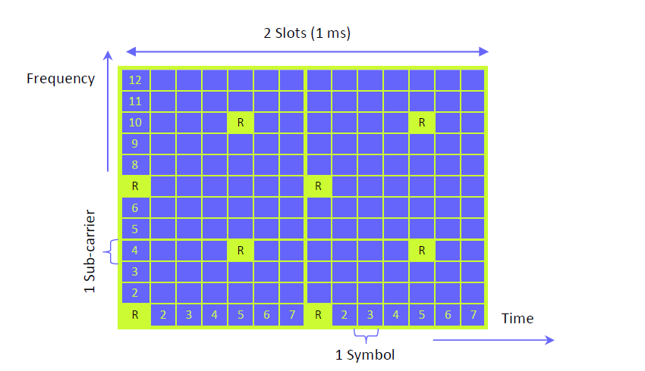
Reference signals
FIGURE 3. LOCATION OF REFERENCE SYMBOLS WITHIN A RESOURCE BLOCK FOR A ONE
ANTENNA SYSTEM IN THE CASE OF A NORMAL CP.

Slide 9
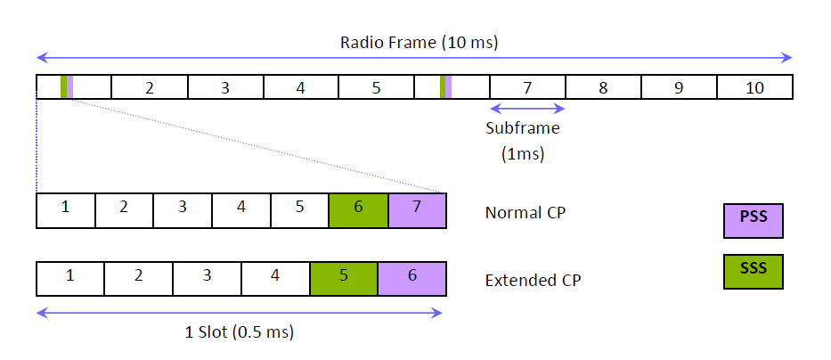
Synchronization Signal
FIGURE 4. SYNCHRONIZATION SIGNAL FRAME AND SLOT STRUCTURE IN TIME DOMAIN.

Slide 10
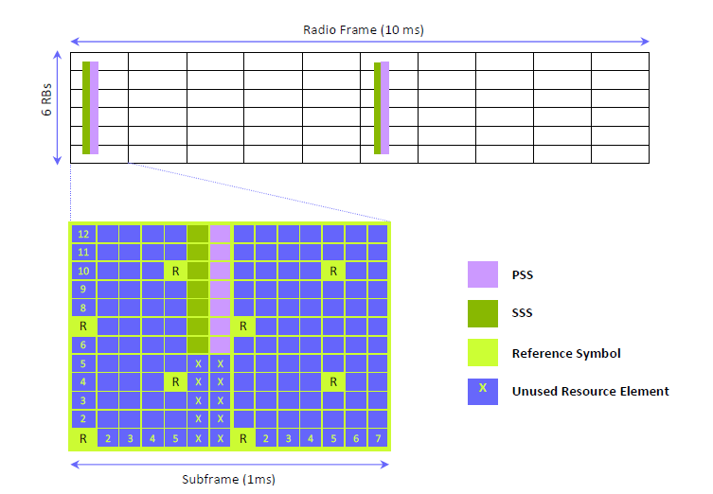
FIGURE 5. SYNCHRONIZATION SIGNALS FRAME STRUCTURE IN FREQUENCY

Slide 11
Physical channels
LTE defines a number of downlink physical channels to carry information blocks received from the MAC and higher layers. These channels are categorized as
TRANSPORT CHANNELS
CONTROL CHANNELS

Slide 12
Transport Channels
Physical Broadcast Channel (PBCH)
Physical Downlink Shared Channel (PDSCH)
Physical Multicast Channel (PMCH)

Slide 13
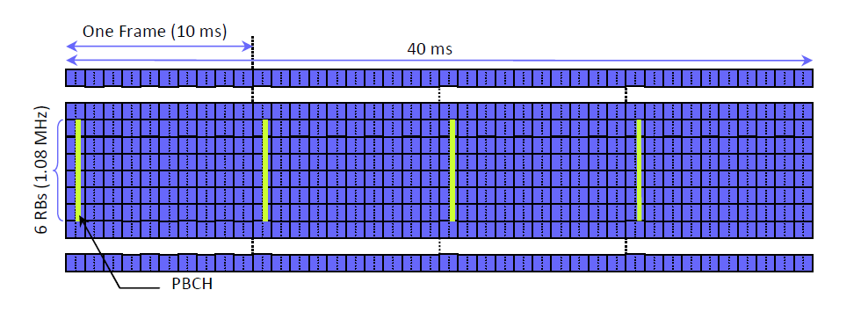
FIGURE 6. PBCH STRUCTURE.

Slide 14
Control Channels
Physical Downlink Control Channel (PDCCH)
Physical Control Format Indicator Channel (PCFICH)
Physical Hybrid ARQ Indicator Channel (PHICH)

Slide 15
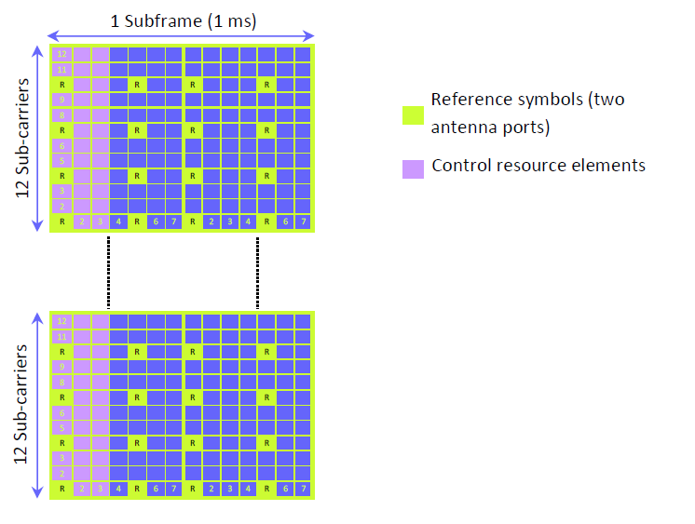
FIGURE 7. CONTROL CHANNEL SIGNALLING REGION (3 OFDM SYMBOL EXAMPLE).

Slide 16
Dynamic resource management in the fourth generation wireless
Next generation wireless communications systems will seek to support a wide range of services, including high-rate data applications such as web browsing, file downloading. In contrast to the voice users, data applications can usually sustain some amount of packet delay, as long as the throughput over a long interval is sufficient. The relative delay tolerance of data applications, together with the bursty traffic characteristics, opens up the potential for scheduling transmissions to optimize the throughput. It is a critical issue to improve the spectrum efficiency and system throughput in the wireless data transmission systems. Dynamic resource management has been becoming a hot area for it improves the system performance greatly.

Slide 17
The forward link channel is divided into 1.67ms slots. The access terminal (AT) predicts the SINR, computes the supported rate, and sends it to the access point (AP). A scheduler at the AP determines next terminal to be served based on the reported data rate request from the AT and the amount of data that has been transmitted to each terminal. The HDR scheduler performance is studied by many and it is shown that every data user shares the almost same amount of slots and the optimal throughput is achieved under some idealizing assumptions.

Slide 18
Coordinate Multipoint (CoMP)
What is CoMP
In the second generation the bandwidth was divided into multiple cells, each given a certain frequency thus, the inter-cell interference problem occurred. In 4th Generation LTE, the cells were all given the same frequency, the interference happened at the edges of the cell where the transmission is equal from different cells to the same users. A solution to this problem is Coordinate Multipoint. CoMP works cell edge by allowing not only the UE's serving cell, but also other cell(s) to communicate with the UE, through cooperation with one another.

Slide 19
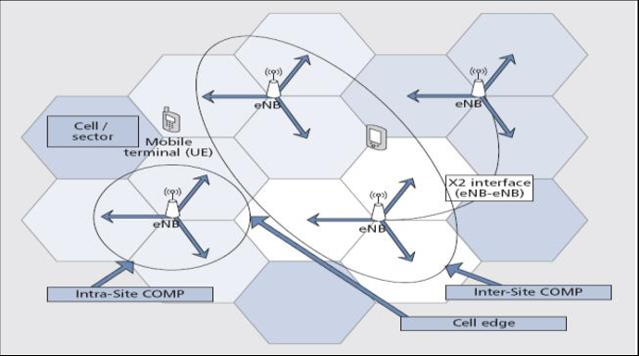
Types of CoMP
Intra-cell site
Inter-cell site
Figure 8. Basic CoMP Technology; Inter-site CoMP and intra-site CoMP

Slide 20
Ways of operation for CoMP in Downlink.
Joint Processing (JP):
Using this element of LTE CoMP, data is transmitted to the UE simultaneously from a number of different eNBs. The aim is to improve the received signal quality and strength. It may also have the aim of actively cancelling interference from transmissions that are intended for other UEs.
This form of coordinated multipoint places a high demand onto the backhaul network because the data to be transmitted to the UE needs to be sent to each eNB that will be transmitting it to the UE. This may easily double or triple the amount of data in the network dependent upon how many eNBs will be sending the data. In addition to this, joint processing data needs to be sent between all eNBs involved in the CoMP area.

Slide 21
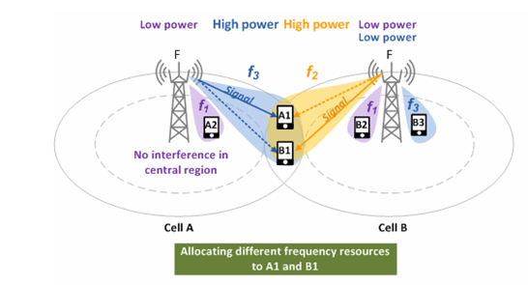
Coordinated scheduling(Cs)
Figure 9. Coordinated Scheduling(CS)

Slide 22
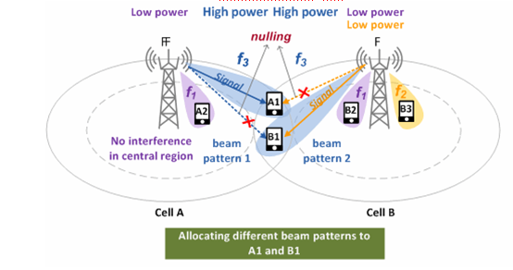
Coordinated Beamforming(Cb)
Figure 10 . Coordinated beamforming(CB)

Slide 23
Advantages of Coordinate Multipoint (CoMP)
To improve the coverage.
To improve the cell edge throughput.
To increase the overall system throughput.

Slide 24
Joint Dirty Paper Precoding and User Scheduling for Downlink Coordinated
The idea of cooperative multicell transmission or coordinated multipoint transmission/reception (CoMP) has been proposed and studied to mitigate the inter-cell interference and enhance the cell edge users’ performance. The cooperative multicell downlink channel is closely related to the multiple-input multiple-output (MIMO) broadcast channel (BC), whose capacity region is achieved by Costa’s dirty paper coding (DPC) principle .

Slide 25
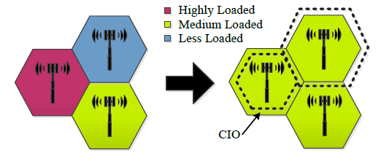
Mobility Load Balancing
Mobility load Balancing (MLB) is part of a Self Organizing Network (SON).

Slide 26
Purpose of using SON
• Scalability: Scalability of the solution is its ability to reduce complexity.
Stability: a solution is considered stable if it avoids oscillations
Agility: is also a key feature of SON systems reflecting the system adaptability in its operational environment changes.

Slide 27
MLB
The source cell A’s load exceeds the predefined threshold to trigger MLB.
• The neighboring cell B has enough available resources to accept cooperating and handle the cell A’s traffic excess.

Slide 28
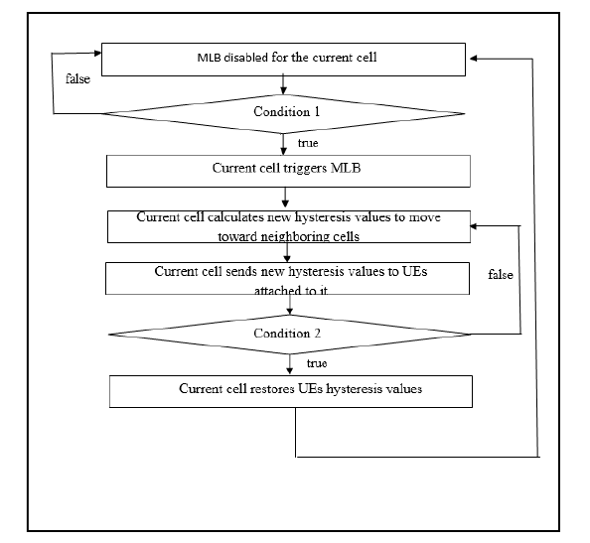
MLB suggested algorithm

Slide 29
Conclusion
The results of the algortithm shows that the global network throughput provided by Alg_MLB1 and Alg_MLB2 is greater than that provided by Alg_without_MLB for different UEs densities.
Another interesting observation can be done is that the MLB certainly improves the global network throughput for different loads but this improvement is not very significant for high load. The explanation of such behavior is that for such load it’s very likely that neighboring cells (of an overloaded cell requesting their cooperation for possible load balancing) are themselves overloaded.

