Slide 1
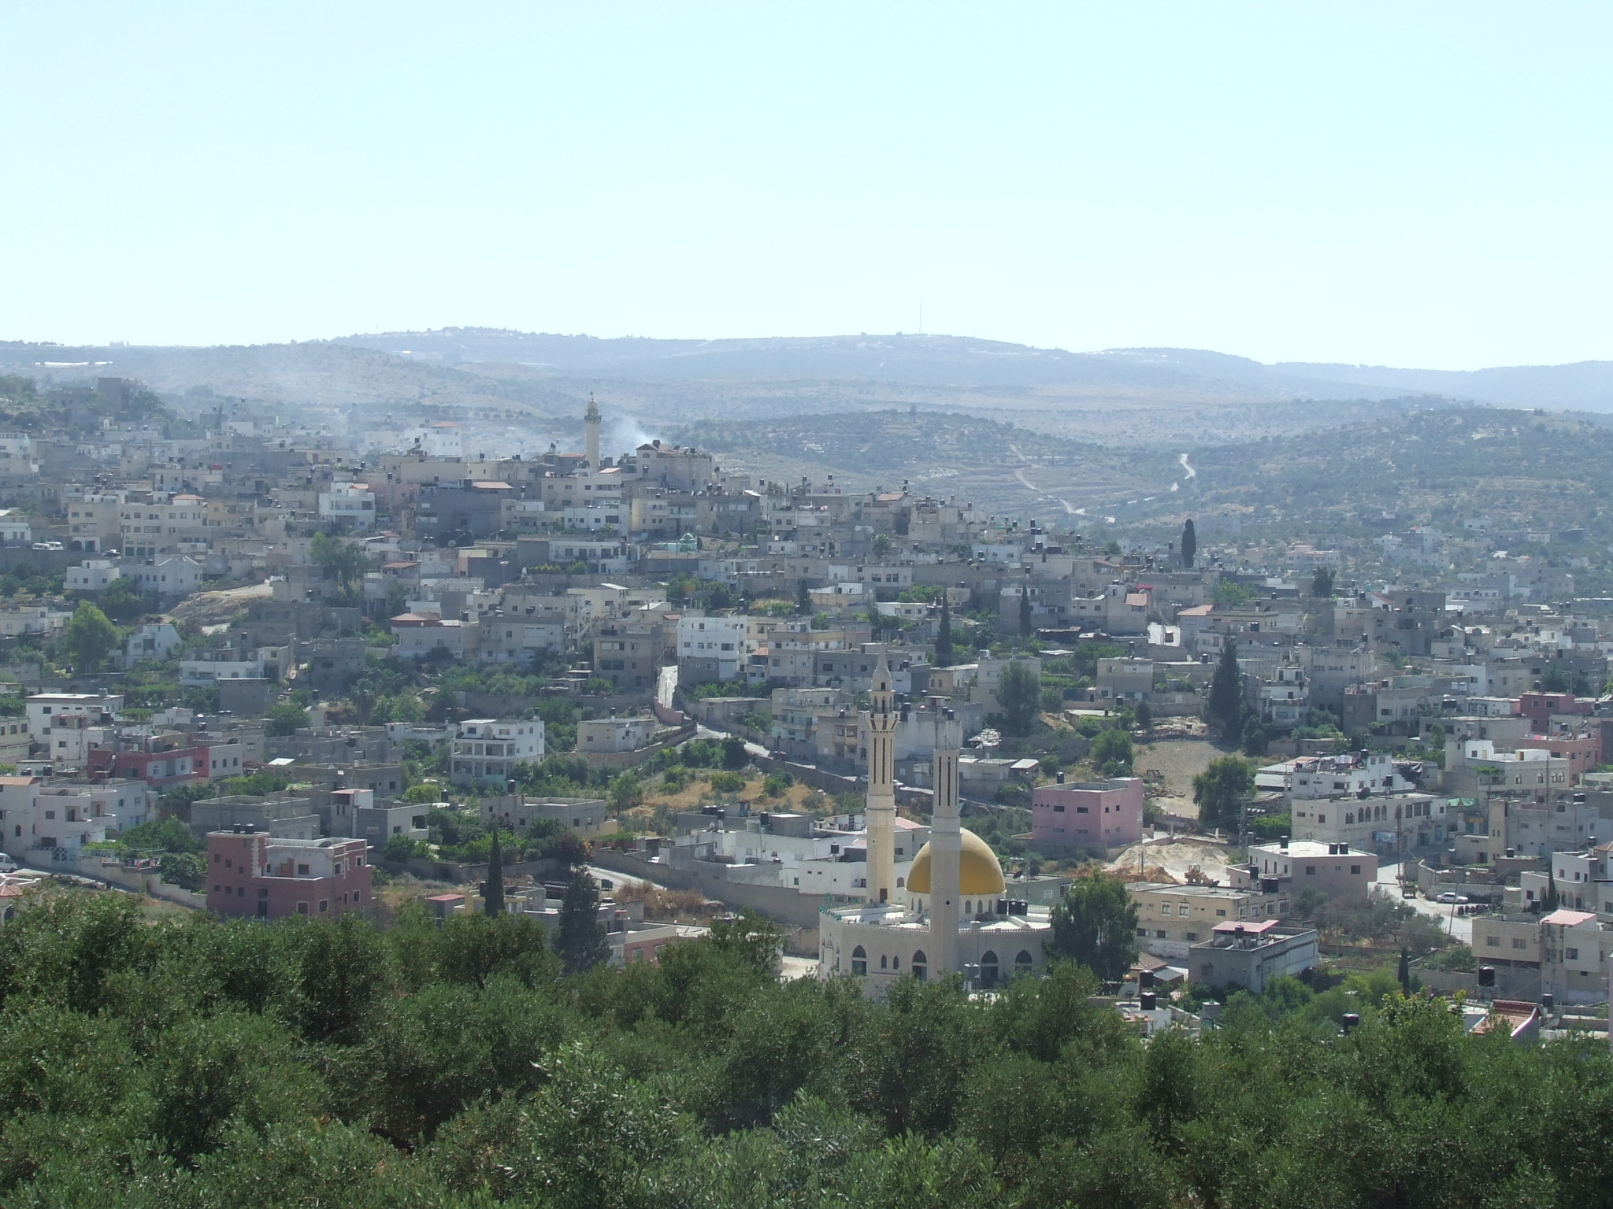

An-Najah National University
Faculty Of Engineering
Civil Engineering Department
“Design of A Wastewater and A Storm water collection Network's for Al-Yamon Town”
Prepared By:
Al’a Arman
Mu’een Arman
Moath Abo Hassan
Supervision : Dr. Mohammad Almasri

Slide 2
OUTLINE
1. Background
2. Study area
3. Project objectives
4. Methodology for W.W.N
5. Results and cost estimation
6. Methodology for S.W.N
7. Results and comparison
8. Conclusions and recommendation

Slide 3
Background
Water is necessary to stay alive.
After using the water ,it becomes wastewater
The common practice is to dispose the wastewater by using cesspits
And this has negative impacts

Slide 4
Background
When rain falls on the roofs and reaches of the streets, it becomes a runoff (storm water)
This happen when the water is not collected
And this causes many problems

Slide 5
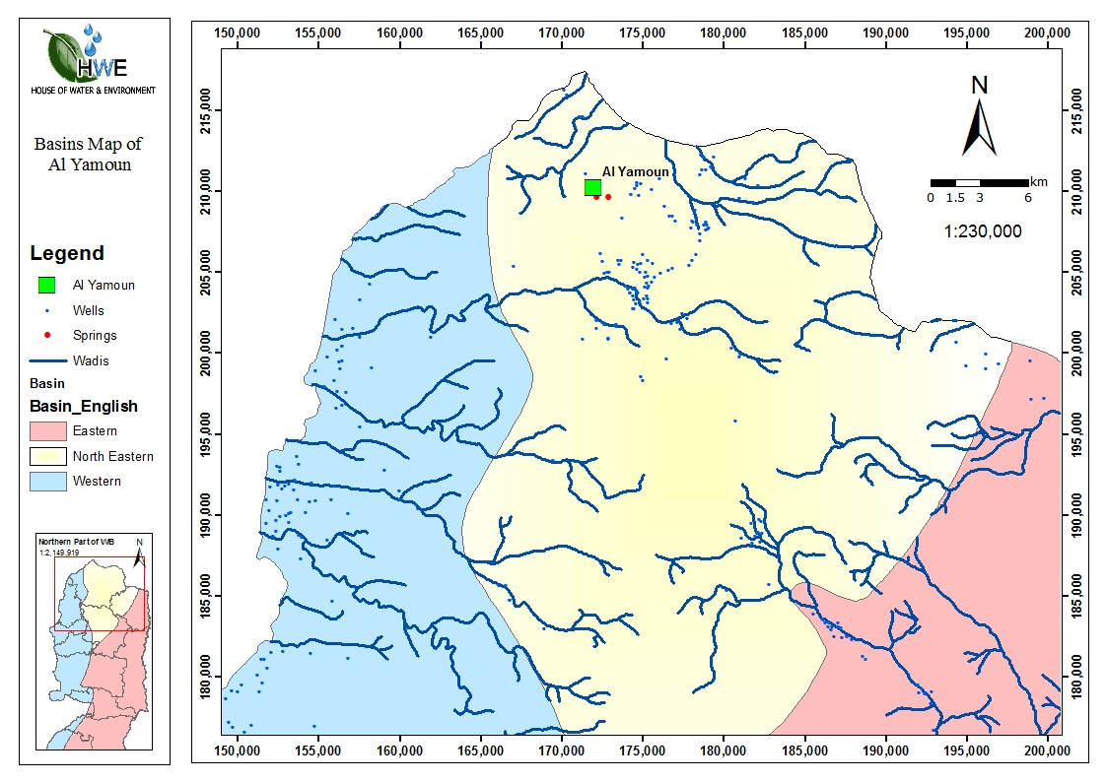
Study Area (Al-Yamon Town)
location
Location

Slide 6
Study Area (Al-Yamon Town)
Minimum 100 AMSL
Maximum 250AMSL
No waste and storm water collection Networks
Average rain fall 550 mm
20,000 capita

Slide 7
Objectives
Design wastewater and stormwater collection networks

Slide 8
Methodology
Study area
Data Collection
Place Manholes
Connect manholes
Conclusions
Design by SewerCAD
Analysis of results
Cost calculation
Wastewater loads

Slide 9
Selection of the study area
►We selected Al-Yamon Town as the study area because:
It does not have a Wastewater collection Network
Fund is available to construct the Network
Data is available in the needed format
► After selection we did site investigations

Slide 10
Data collection
Type | Format | Source | Use
Contours | AutoCAD | Local council | Elevations of manholes
Road net work | AutoCAD | Local council | Sewers route
Houses distribution | AutoCAD | Local council | Compute demand and position of manholes
Water consumption | Tables | P.C.B.S | Calculate demand
Average family size | Tables | Local council | Calculate demand

Slide 11
Determination of Manholes Locations
♦ Manhole locations were determined according to a certain criteria
♦ Locations were determined to :
Compute the loads of wastewater at each manhole
Connect the manholes

Slide 12
Calculation of wastewater loads at each manhole
Label | # of houses | Pop | total Avg W.Wflow | Infiltration | max hourly flow | design value
MH-1 | 4 | 72 | 5760 | 1152 | 17280 | 18432
MH-2 | 3 | 54 | 4320 | 864 | 12960 | 13824
# of population = #of house X # of stories X #of apartment X Average family size
Total average W.W flow = # of population X average water consumption X 80%
Infiltration = total average W.W flow X 20%
Max hourly flow = total average W.W flow X max hour factor
Design value = Infiltration + Max hourly flow

Slide 13
Connections Between Adjacent Manholes
■ Each sewer connects between two adjacent manholes
■ For each sewer :
● Minimum diameter is 8 inches
● Material is uPVC

Slide 14
Design Of The Network Using SewerCAD
Criteria which control the design
Velocity (0.6-3.0) m/s
Slope (1-12)
%
Cover (1-3.5) m

Slide 15
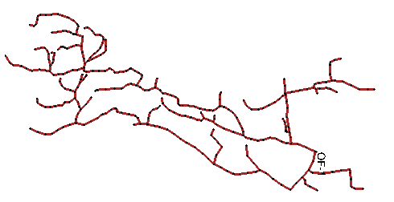
Results
  Plan

Slide 16
Results
Summary table
# of manholes | 333
# of conduit | 332
Conduit | Number | Length(m)
8’’ | 298 | 5088
10’’ | 3 | 72
12’’ | 1 | 6
Total | 332 | 5166

Slide 17
Results
Summary table
Conduit | Velocity(m/s) | Slope (%) | Cover(m)
Minimum | .24 | 1 | 1
maximum | 3.1 | 12 | 5.7

Slide 18
Results
Tables
Sewer table
Label | Diameter (In) | Slope (%) | Velocity (Average) (m/s) | Cover (Start) (m) | Cover (Stop) (m)
CO-1 | 8 | 3.24 | 0.6 | 1 | 1.63
CO-2 | 8 | 3.903 | 0.6 | 1.63 | 1.44
CO-3 | 8 | 11.092 | 0.94 | 1.44 | 1.11
CO-4 | 8 | 12 | 1.04 | 1.11 | 1
CO-5 | 8 | 12 | 1.08 | 1.06 | 1

Slide 19
Results
Velocity

Slide 20
Results
Slope

Slide 21
Results
Cover

Slide 22
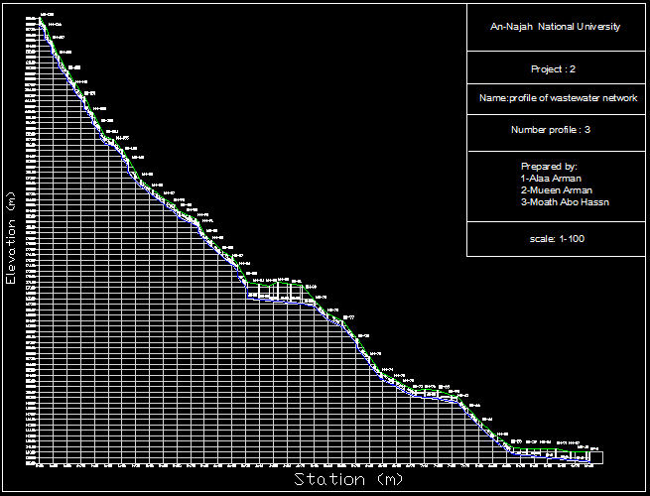
Results

Slide 23
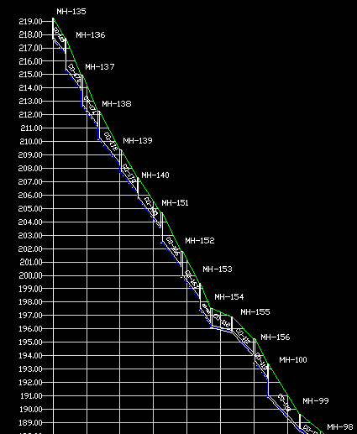
Results

Slide 24
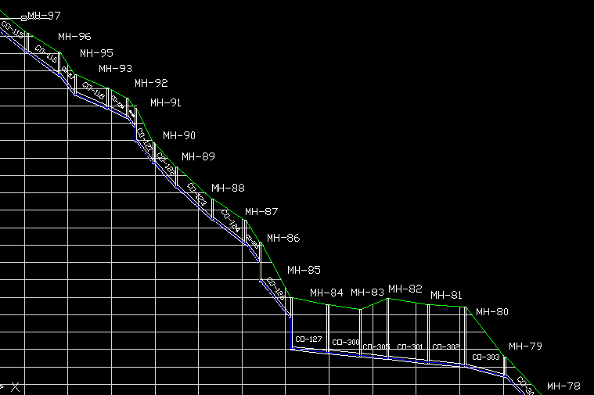
Results

Slide 25
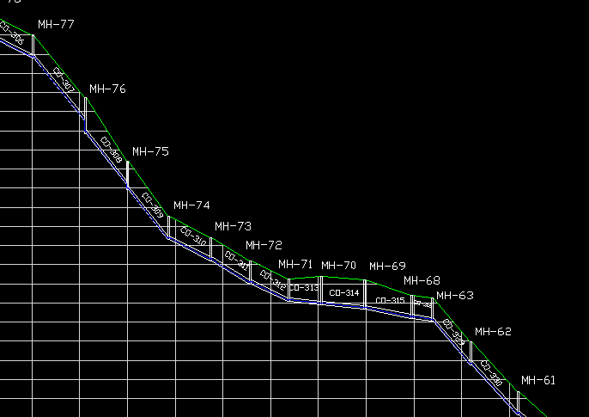
Results

Slide 26
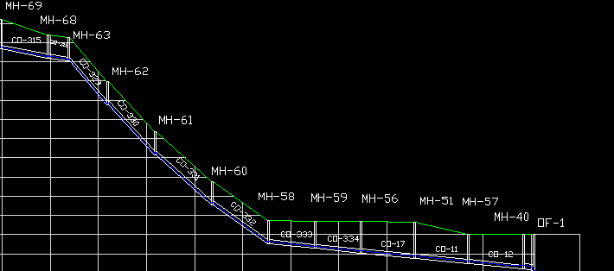
Results

Slide 27
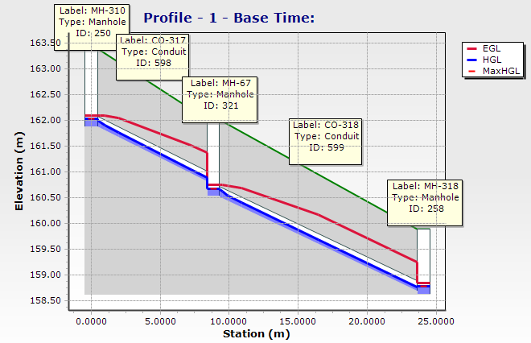
Results

Slide 28
Prices
Description | Price
Cost of Excavation | 23 $/m
Cost of installation for manhole , conduit | 85 $/m , 3 $/m
Cost of conduit | 10 $/m
Cost of base coarse | 10 $/m^3
Cost of sand | 21 $/m^3
Pavement for thickness 7 cm | 18.5 $/m
Get rid of excavation of material | 3 $/m^3
Back filling with compaction | 5.5 $/m

Slide 29
Prices
Parts | Dimension | Price (NIS)
Base | 100*75 | 125.5
Ring | 100*30 | 68.5
 | 100*40 | 71.5
 | 100*50 | 74.2
cone | 100*75 | 125.5

Slide 30
Summary of calculation
Description | Total cost $ | $/KM | % from total cost
Cost of Excavation | 118,000 | 22,800 | 21
Cost of installation for manhole , conduit | 43,000 | 8350 | 7.5
Cost of conduit | 51,650 | 10,000 | 30
Cost of manhole | 118,440 | 22,930
Cost of base coarse | 60,900 | 11790 | 10.5
Cost of sand | 34,000 | 6,590 | 6
Pavement for thickness 7 cm | 95,900 | 18,600 | 17
Get rid of excavation of material | 16,300 | 3,150 | 3
Back filling with compaction | 29,500 | 5,700 | 5
Total | 567,690 | 109,910

Slide 31
Methodology
Study area
Collection data
catchment area was determined
Connect catchbasins
Conclusions
Put All element in program
Analysis of results
Catch basin locations

Slide 32
Catch basin determined
Set the maps as background layers
Define the catch basin by entering the dimension and its type
insert elevation of catch basin

Slide 33
connections catch basin
Define the conduit material and diameters
The minimum diameter is 8 inches
Connections between adjacent catch basin

Slide 34
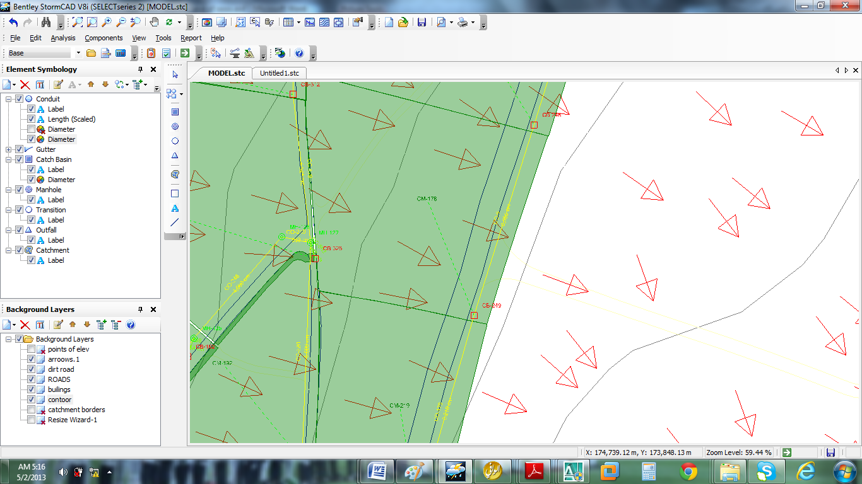
Catchment are determined
Use the arrows or Draw lines perpendicular to the contour lines to identify the sub catchments of each catch basin.

Slide 35
All Elements of design were inserted on StormCAD program
Design constrains
Criteria which control the design
Velocity
(0.6-3.5)
m/s
Slope
(1-12)
%
Cover
(1-3.5)
m

Slide 36
All elements of design were inserted on StormCAD program
Rainfall data
Duration (min) | 2 Year (mm/h) | 5 Year (mm/h) | 10 Year (mm/h) | 20 Year (mm/h) | 100 Year (mm/h)
10 | 27.352 | 33.227 | 36.492 | 38.547 | 43.289
20 | 19.273 | 25.93 | 30.109 | 33.375 | 42.016
30 | 15.516 | 20.898 | 24.586 | 27.352 | 34.648
40 | 13.031 | 17.148 | 19.977 | 22.18 | 27.203
50 | 11.406 | 14.945 | 17.43 | 19.273 | 24.313
60 | 10.422 | 13.391 | 15.516 | 17.148 | 21.398
120 | 7.297 | 9.063 | 10.344 | 11.266 | 13.891
180 | 5.945 | 7.297 | 8.289 | 8.992 | 10.922
240 | 5.172 | 6.445 | 7.297 | 8 | 9.773

Slide 37
All elements of design were inserted on StormCAD program

Slide 38
All elements of design were inserted on StormCAD program
Dimensions of elements
Return period
Time of concentration
Use the tables of rational coefficient C to identify the value

Slide 39
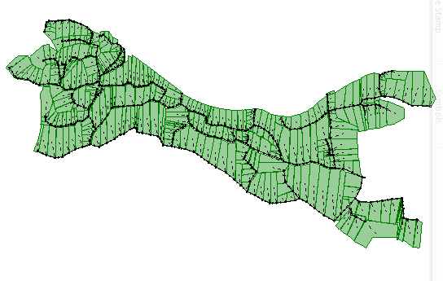
Plan with catchments

Slide 40
Results
Length (m) | Diameter (inch)
6 | 21
200 | 18
900 | 15
3000 | 12
285 | 10
3420 | 8

Slide 41
Comparisons
Stormwater network |  | Wastewater network |  | Location
.77 | 8’’ | .6 | 8” | At the beginning
1.68 | 10’’ | 2.22 | 8’’ | In the middle (1)
1.48 | 15’’ | 2.71 | 8’’ | In the middle (2)
1.93 | 21’’ | 1.46 | 12’’ | In the end

Slide 42
Conclusion
The flow in the proposed wastewater and stormwater collection network is driven by gravity
The pipe material is uPVC .And the most diameter is 8’’ in sewer network
A few pipe do not satisfy the minimum velocity criterion at the beginning
Many sewers do not satisfy the maximum cover criteria in flat area

Slide 43
Conclusions
The total cost of the project 567,700 $
109,000 $/km
the slope of pipes followed the slope of ground to decrease the construction cost of the network.

Slide 44
Recommendation
During the execution of the network, suitable layer of sand should be put around the pipes
should be obligatory to adhere to the design slopes to ensure flow by gravity.

Slide 45
Recommendation
In order to take advantage from storm and sewer networks, its recommended to build treatment plant and a collection well
For pipe diameter < 400 mm use UPVC pipes and for pipe diameter > 400 mm use concrete pipes

Slide 46
Recommendation
provide enough spacing between the pipes network and existing water pipes and electrical network.
Make a periodic full maintenance and change the damaged pipes
Use catch basin to catch water where possible

Slide 47
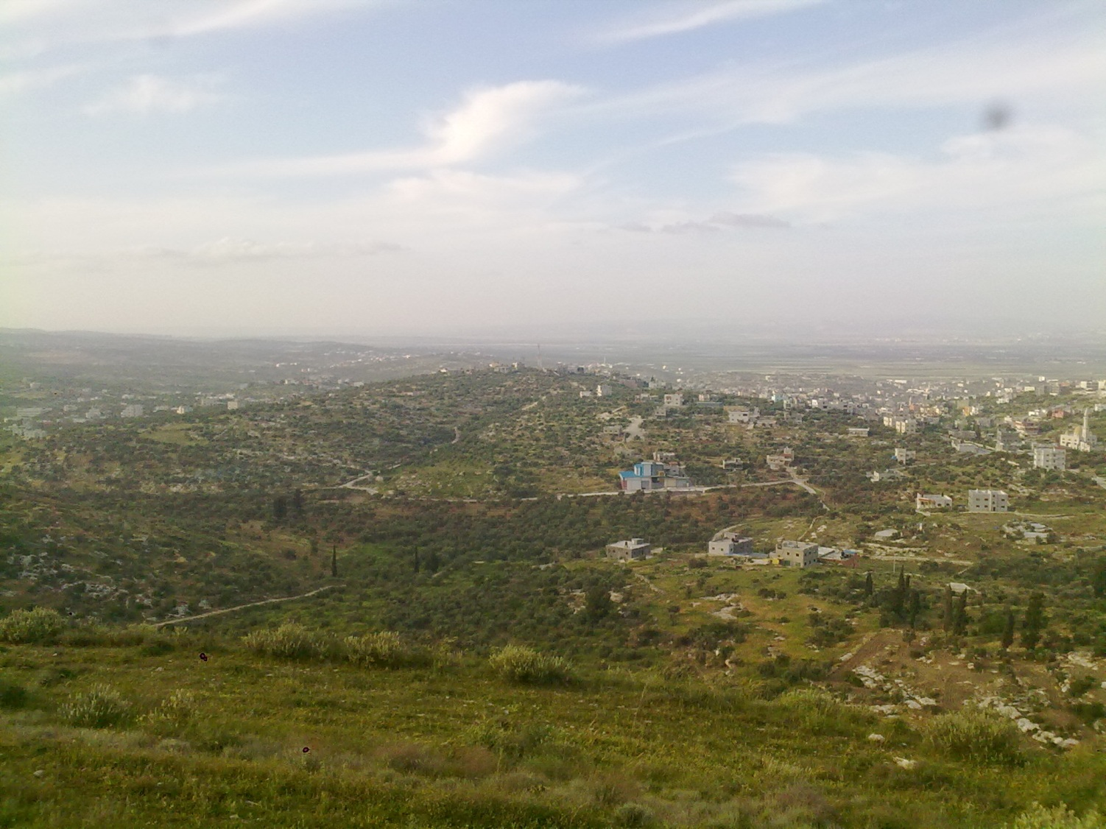
Thank You

