Slide 1
Take a moment and look around. How many plastic objects can you count ?

Slide 2
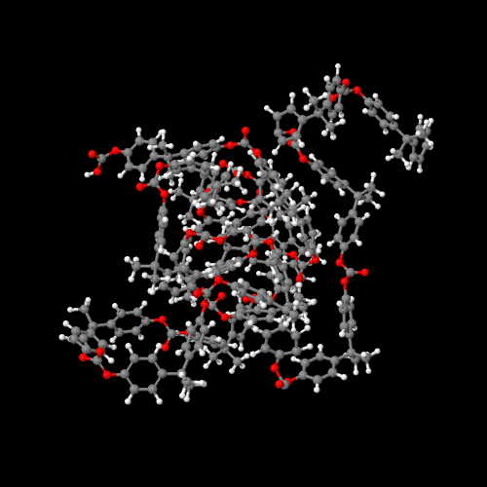
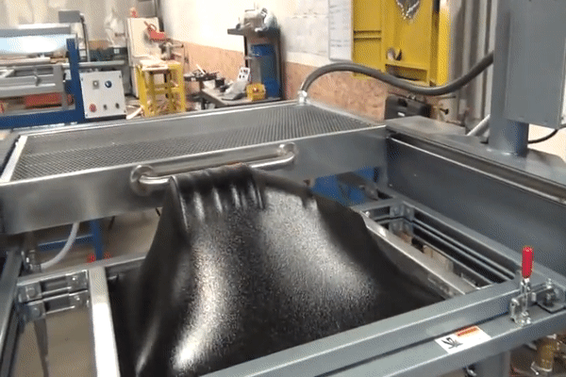
Why Plastic ?

Slide 3
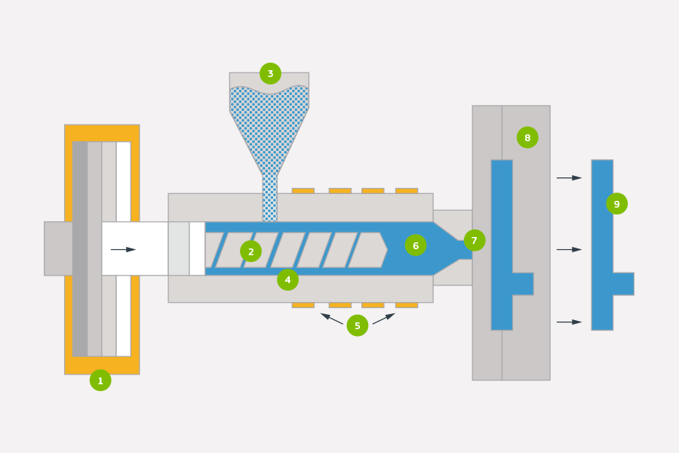
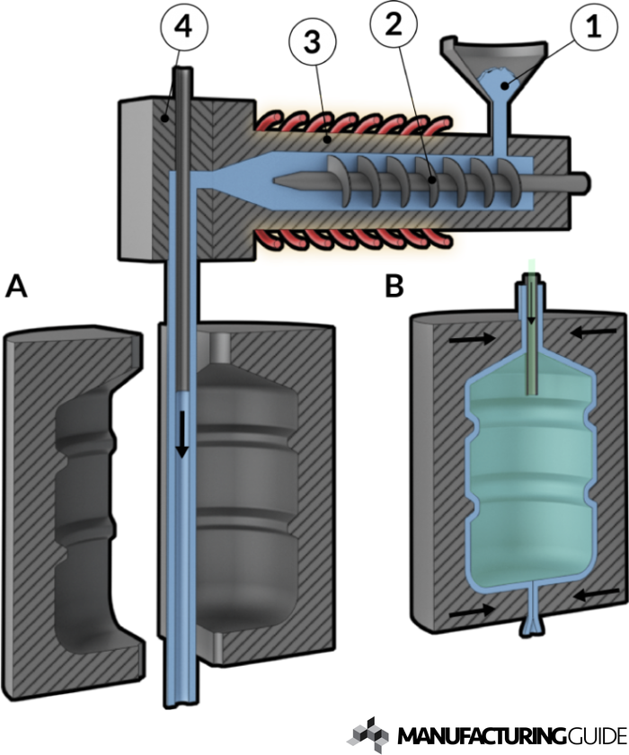
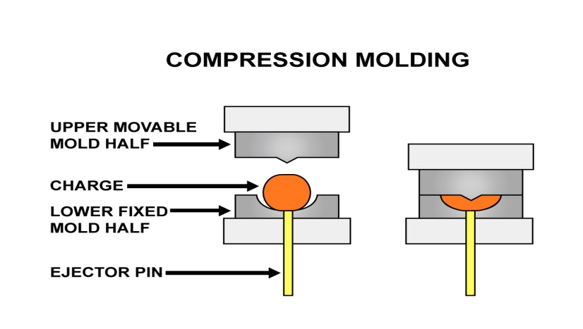
Plastic forming processes
Injection Forming
Extrusion Blow Forming
Plastic Compression Forming

Slide 4
Vacuum Forming Vacuum
Supervisor: Dr. Mahmoud Dwikat
Ahmad Hamadneh
Hamdan Awayes

Slide 5
Outline:
Vacuum Forming
Plastics & molds.
Process.
Heating and Vacuum Systems
Limitations and Solutions.
Future and development

Slide 6
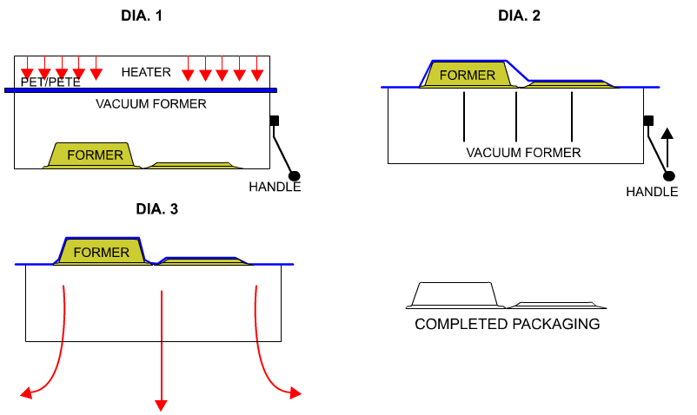
Basic principle
Fig1: Sketch of the vacuum forming process

Slide 7
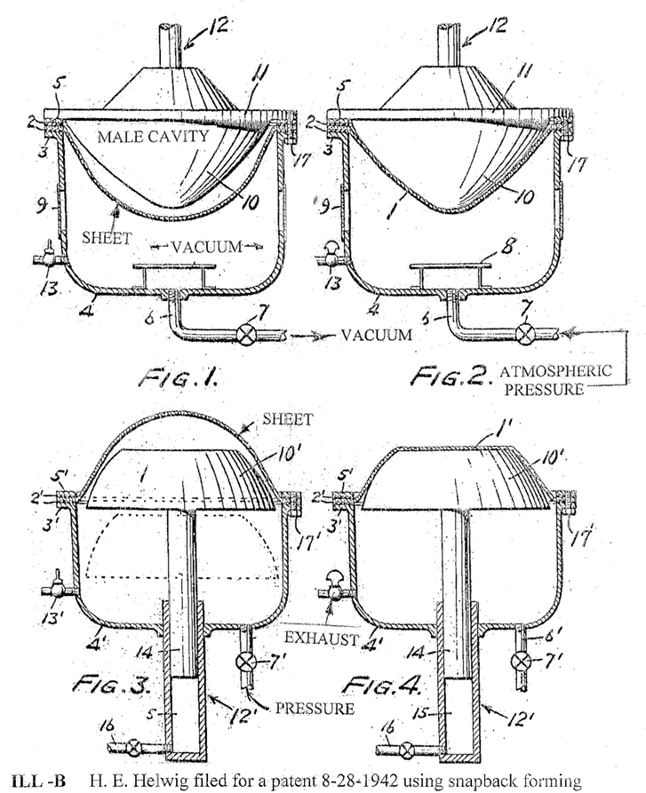
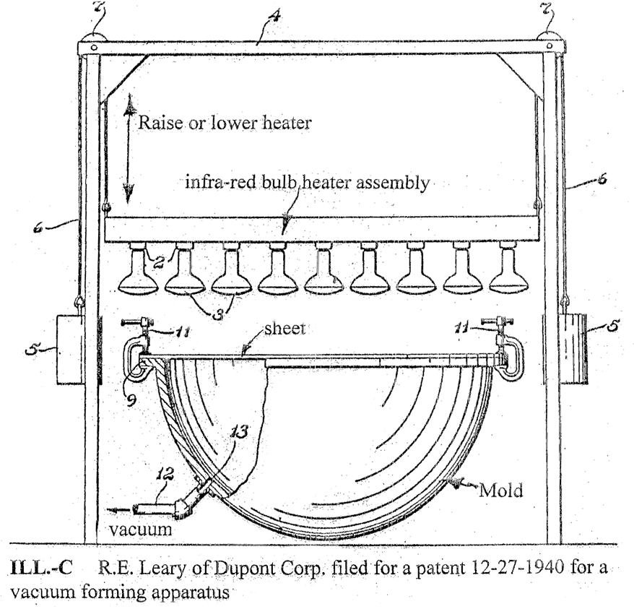
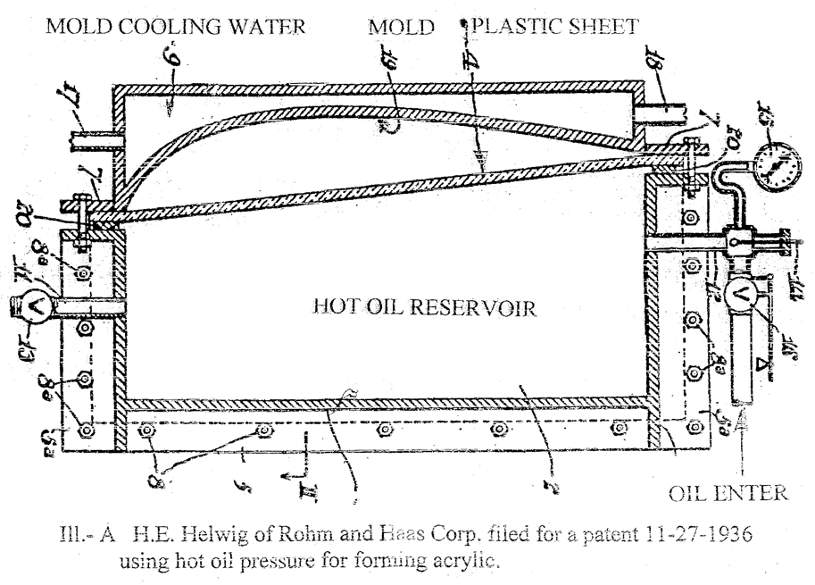
Development and History
1930s – 1950s
Fig3: Helwing’s method Forming acrylic canopy using hot oil pressure in 1936.
Fig4: Leary’s Vacuum forming tools in 1940.
Fig5: Helwing’s method using snap-back forming in 1942

Slide 8
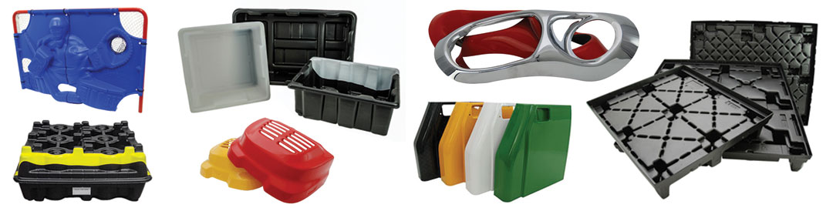
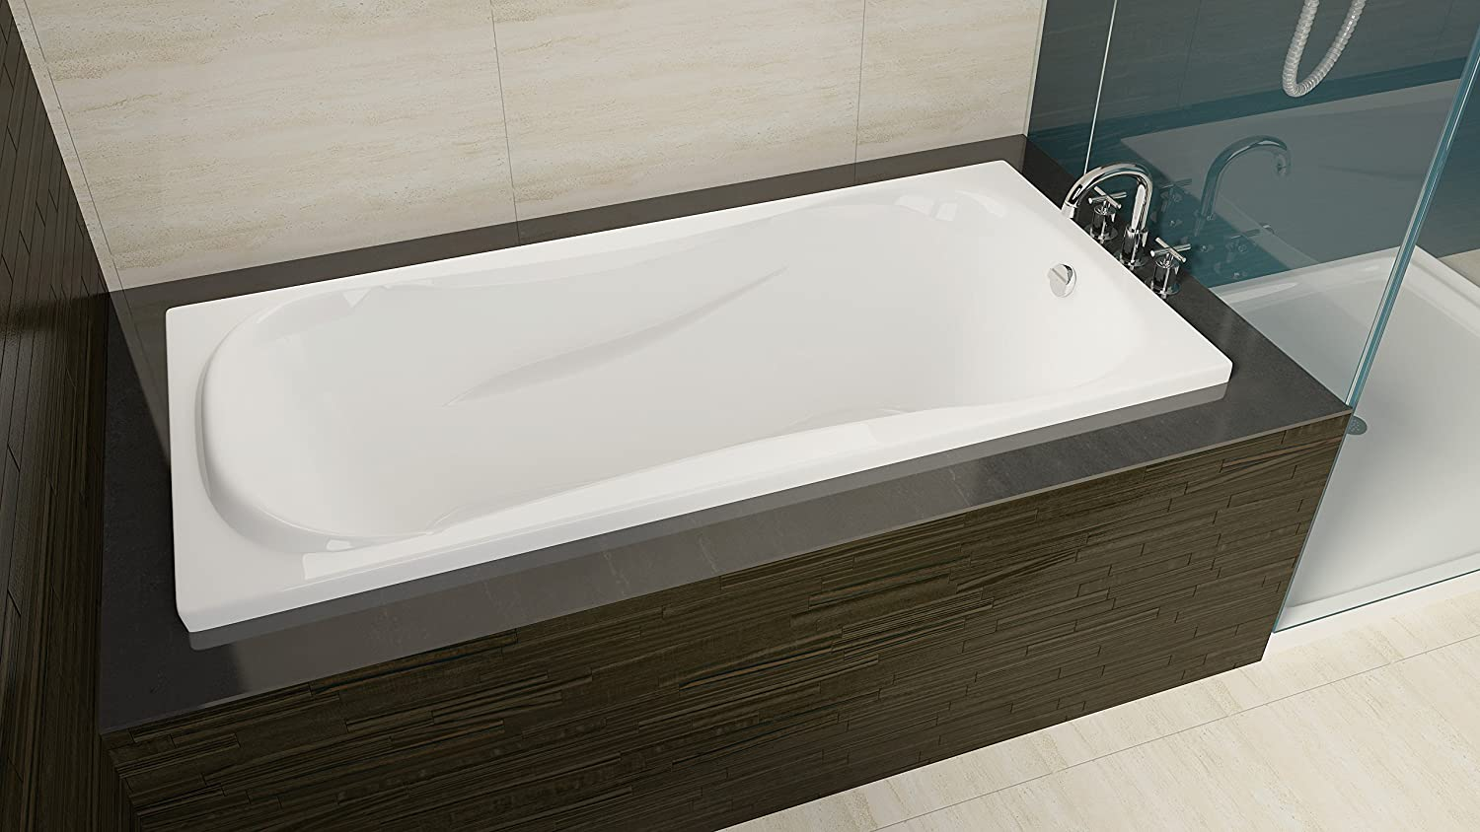
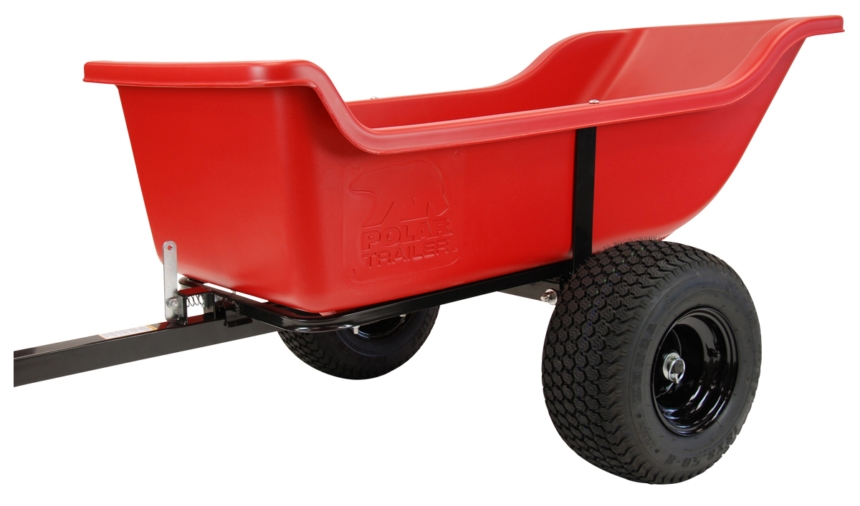
Applications
Where it Begins
Variety of Shapes
PVC
ABS
Construction
PET
HIPS
Outdoor
HDPE
PETG
Packaging

Slide 9
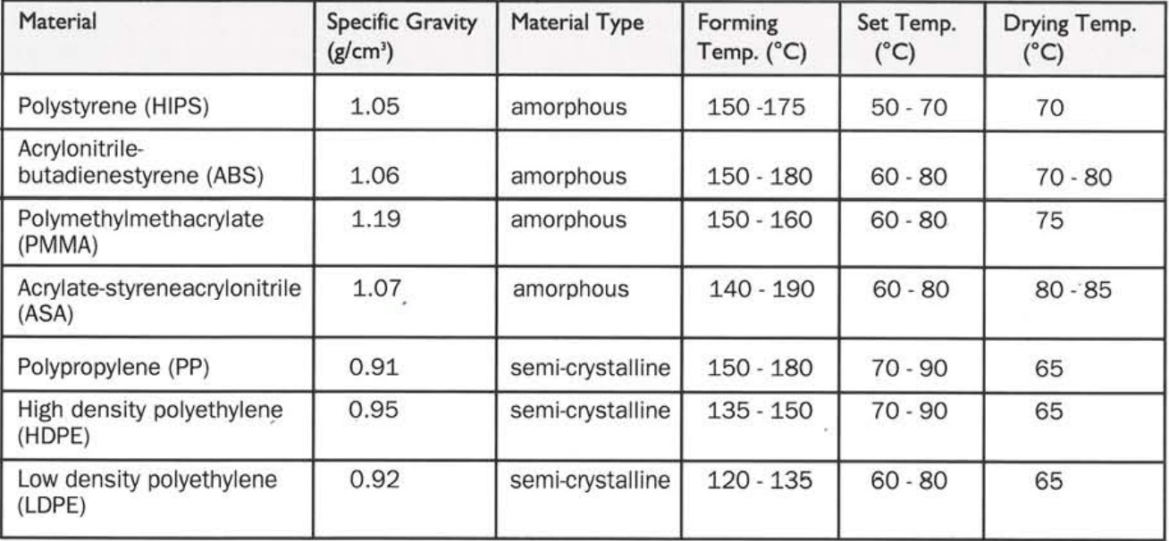
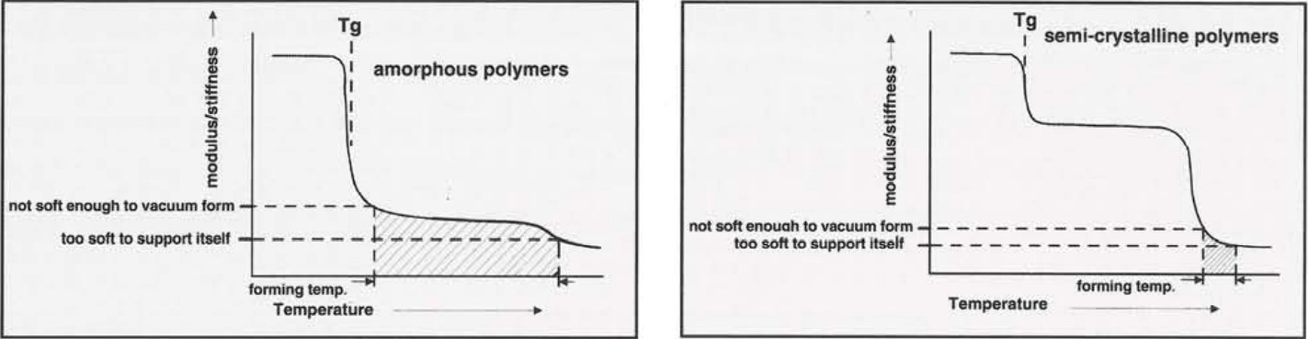
Thermoplastics
Fig7: Stiffness as a function of temperature for amorphous polymers
Table1: Processing parameters for selected thermoplastics
Fig8: Stiffness as a function of temperature for crystalline polymers

Slide 10
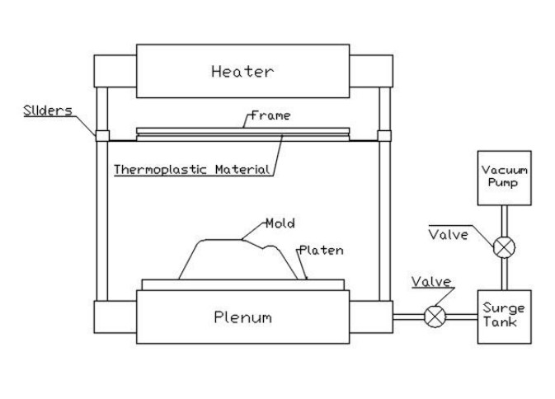
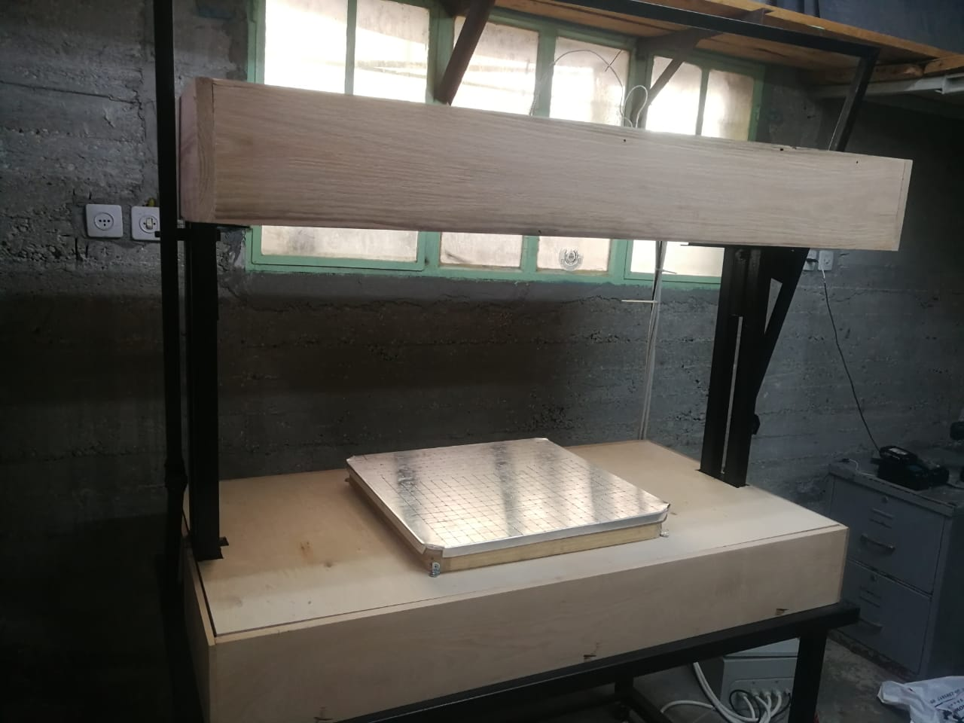
Machine
Fig9: Sketch for a vacuum forming machine
Actual Machine

Slide 11
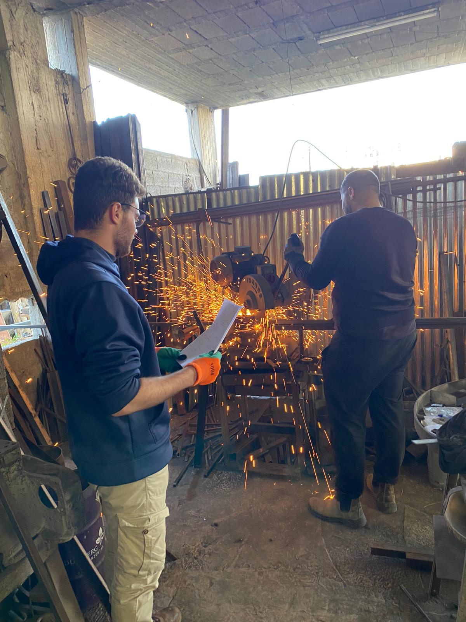
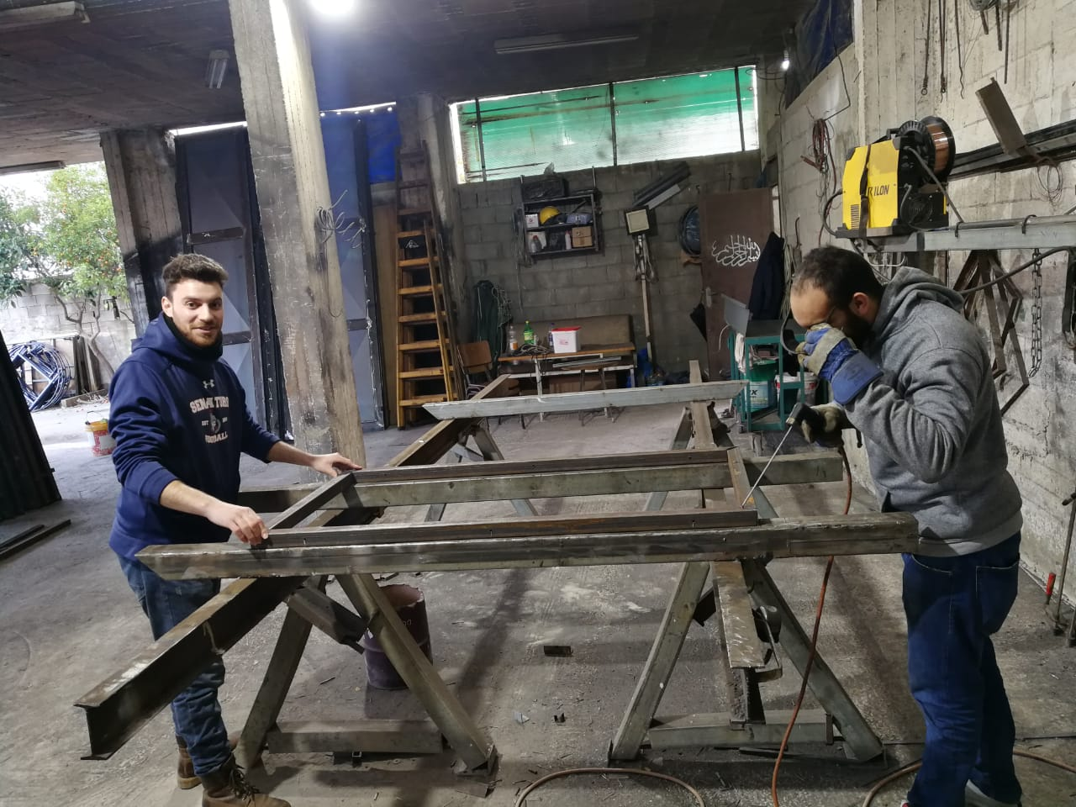
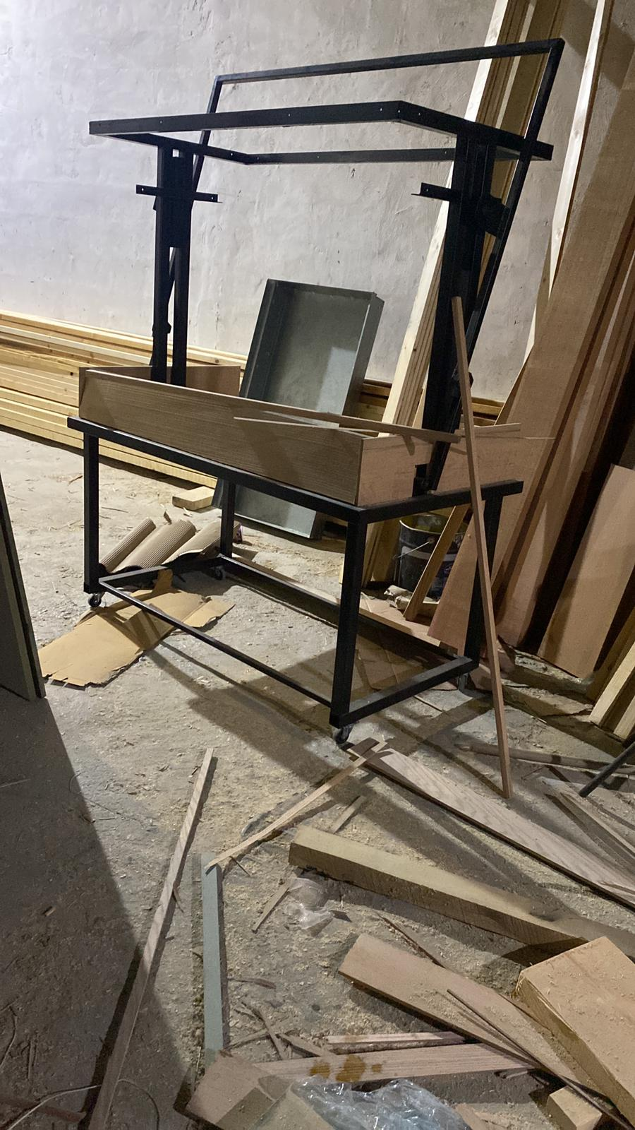
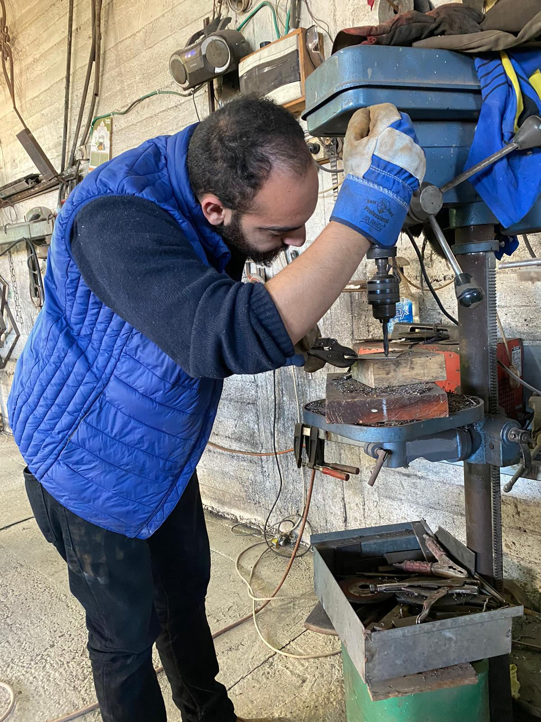

Mechanical Design

Slide 12
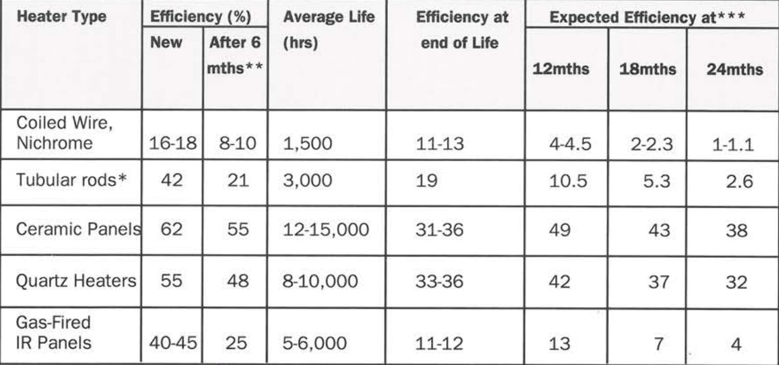
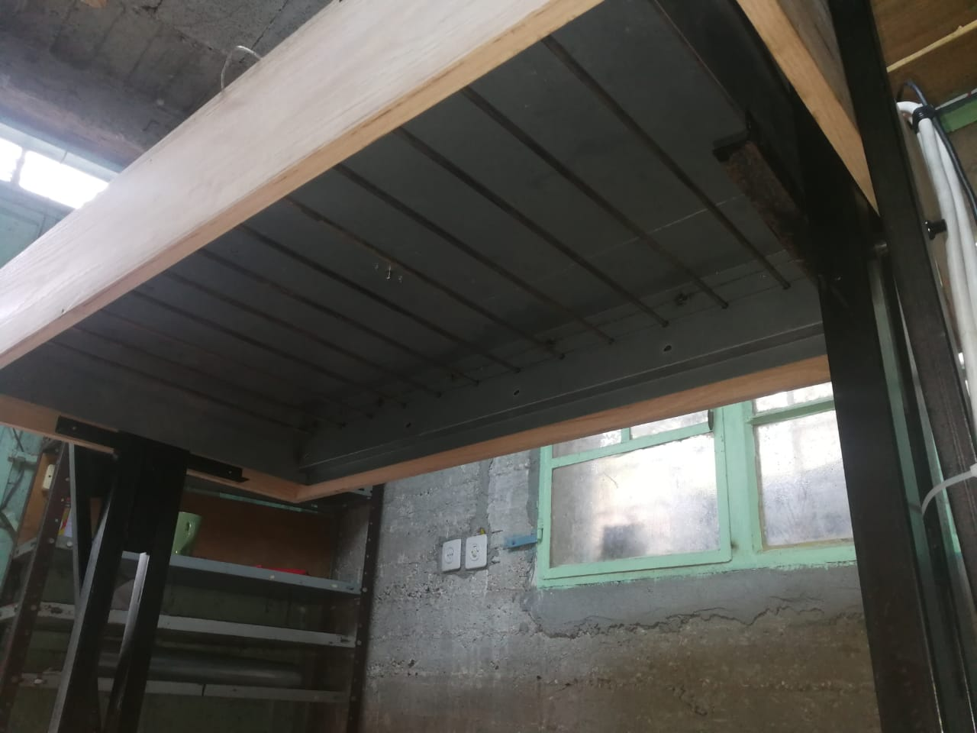
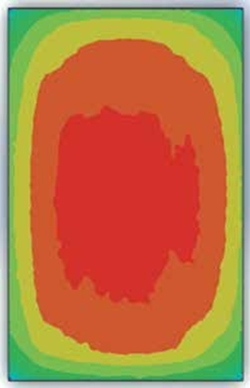
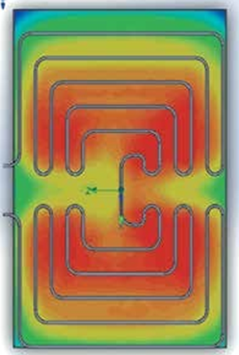
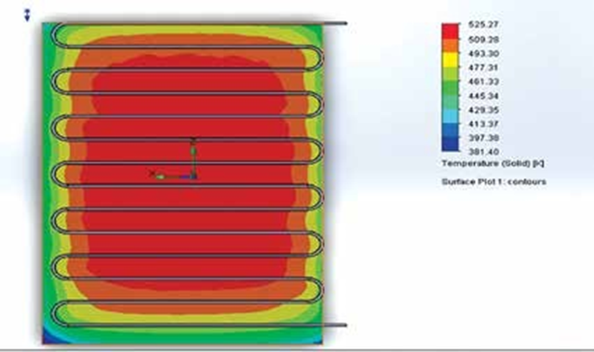
Heating System
Table2: Radiant Heaters Efficiencies
Shapes of Heating elements
Fig10: Heater
Rate of production
Sheet thickness
1 month indicates 440 hours.

Slide 13
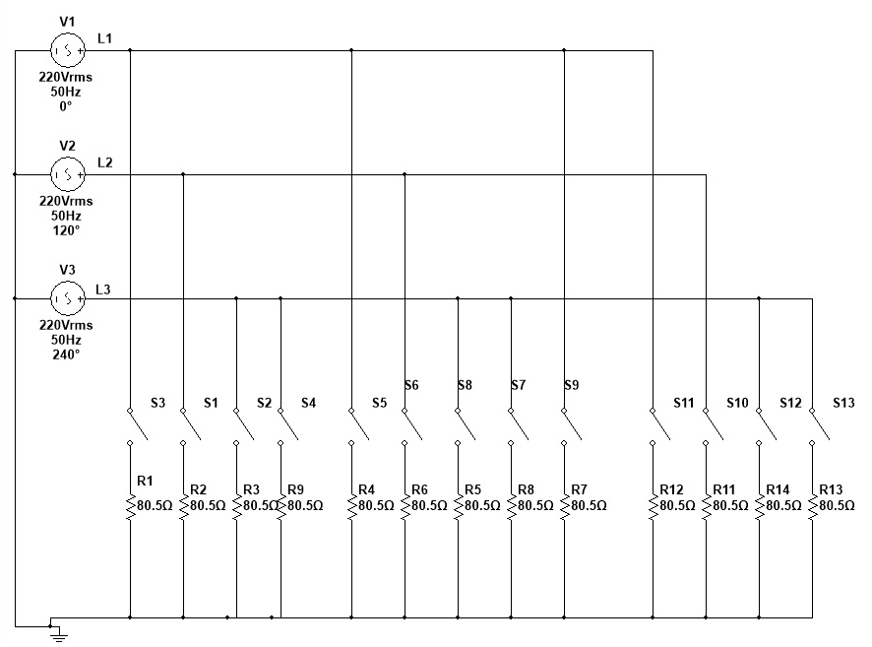
Electrical Connection
Fig11: Heating Element Electrical Connection

Slide 14
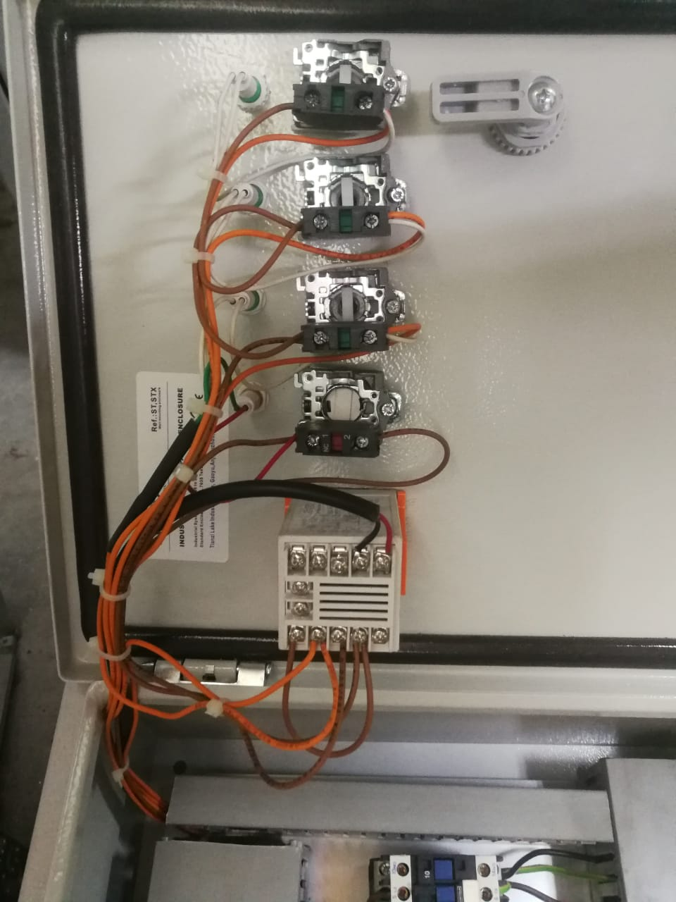
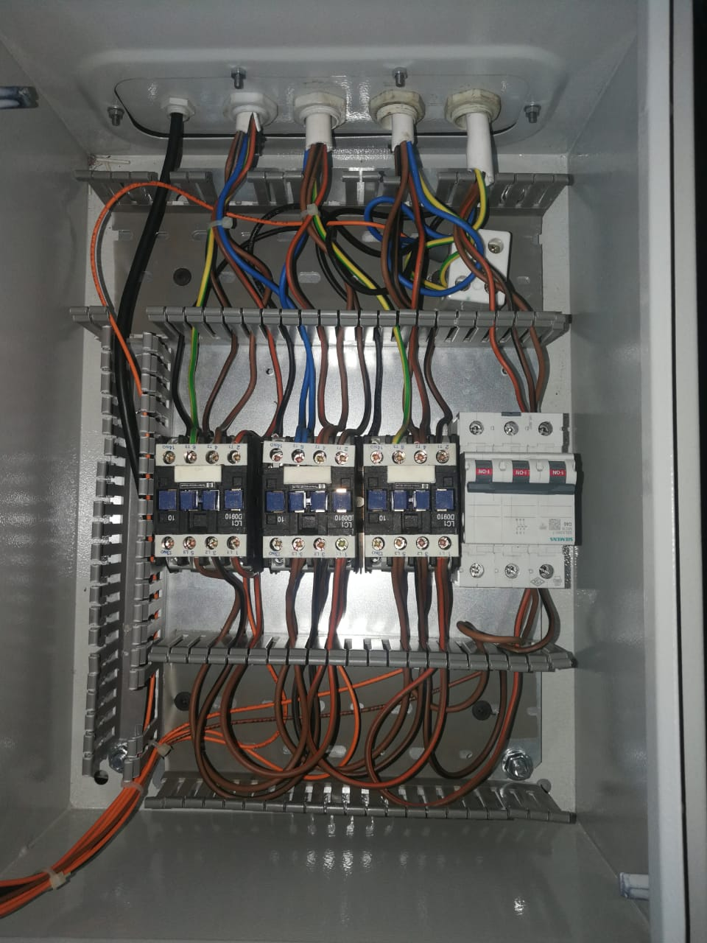
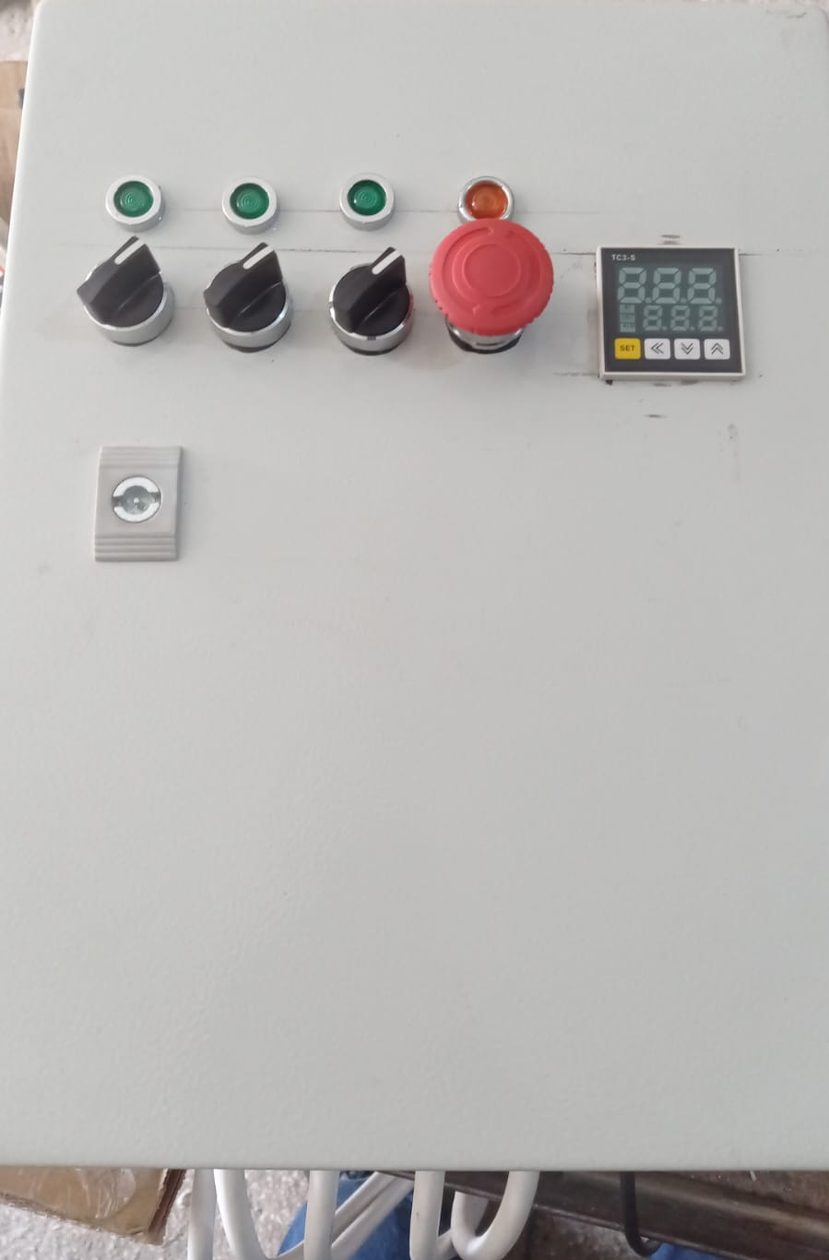
Heater control
Zone Control
Temperature Control
Emergency Stop
Fig12: Switches and PID Controller
Fig13: Breaker and Electrical Contactors

Slide 15
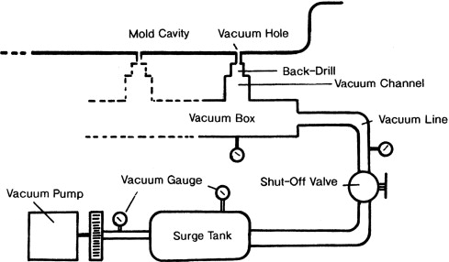
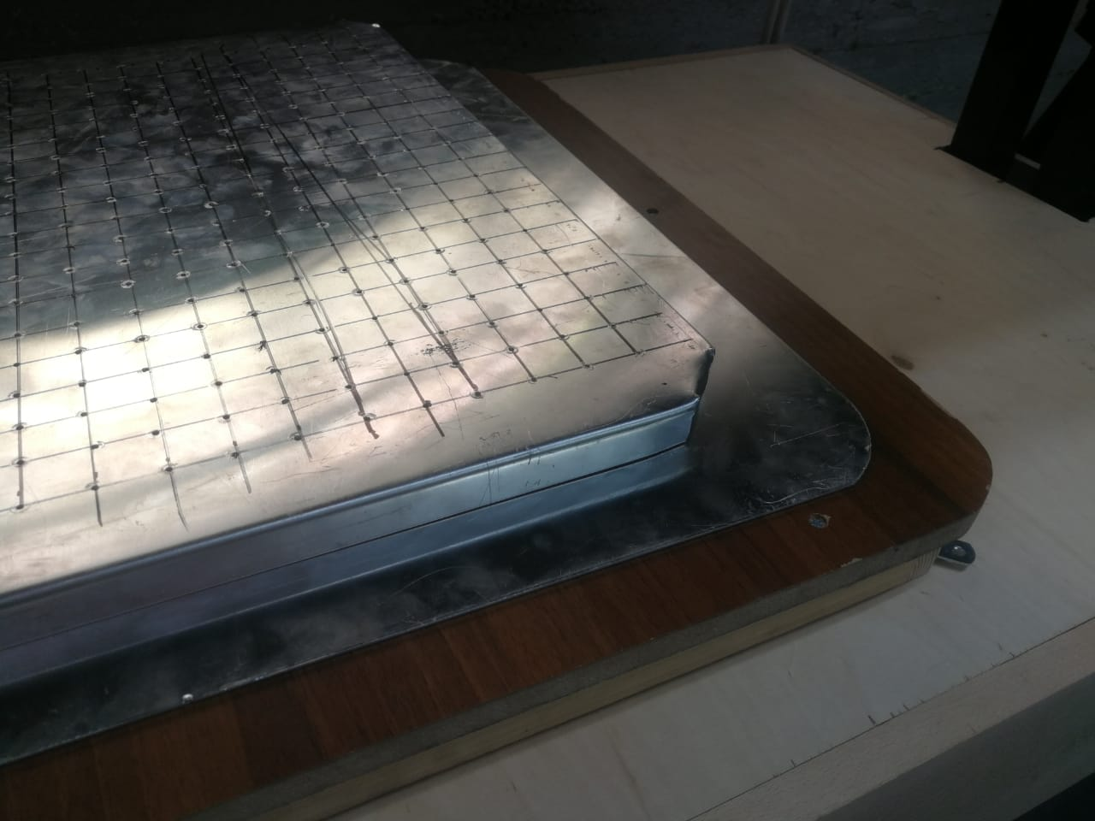
Vacuum System
Fig14: The vacuum system
Fig15: Platen and vacuum box design

Slide 16
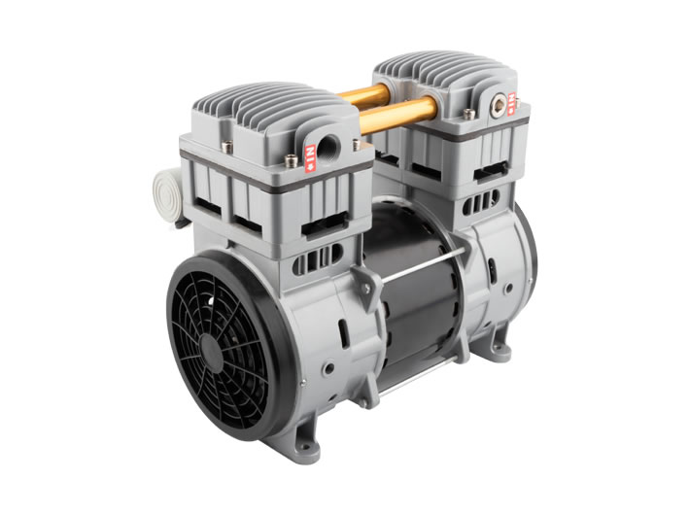
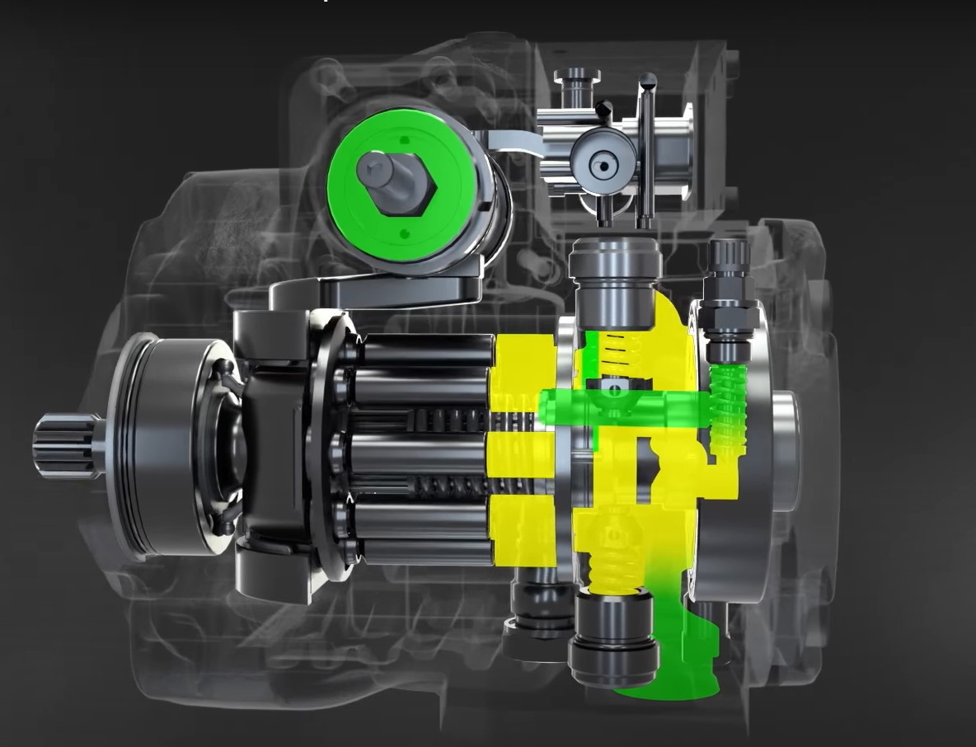
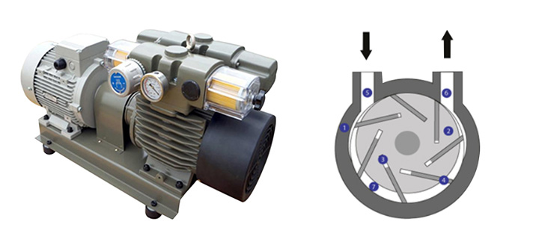
Vacuum pumps
Fig16: Oiless Piston Pumps
Fig17: Dry Rotary Vane Pumps
Positive displacement
maximum vacuum of 27-28.5 IN.HG.
low maintenance, and good service life.
Low flow
Best used with a storage tank
Positive displacement
Pull 26 - 27 inches of vacuum.
With lubrication, vacuum level can be increased to 28.5 IN.HG.
Better flow
More expensive
The term "vacuum" is used to describe the zone of pressure below atmospheric pressure

Slide 17
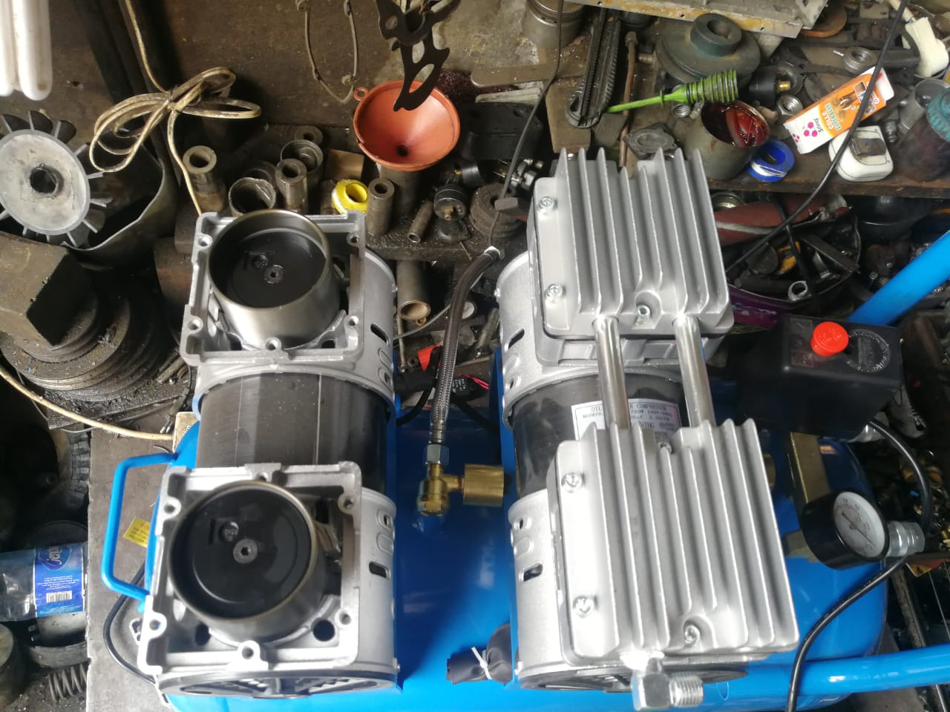
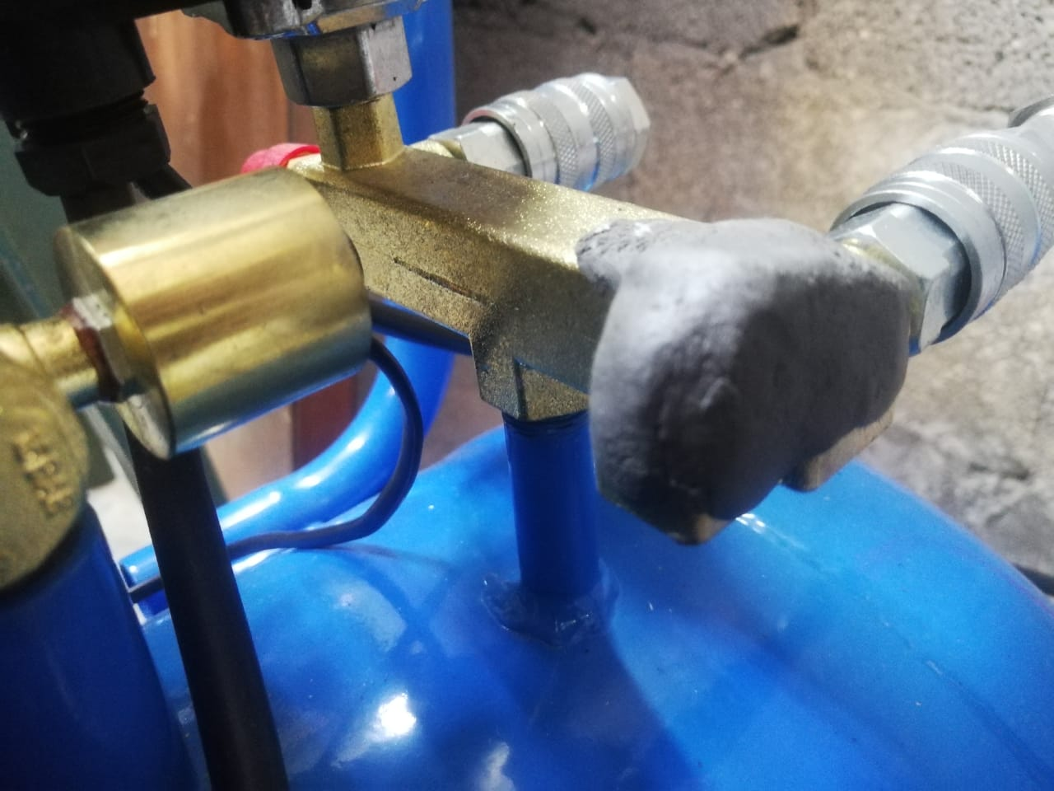
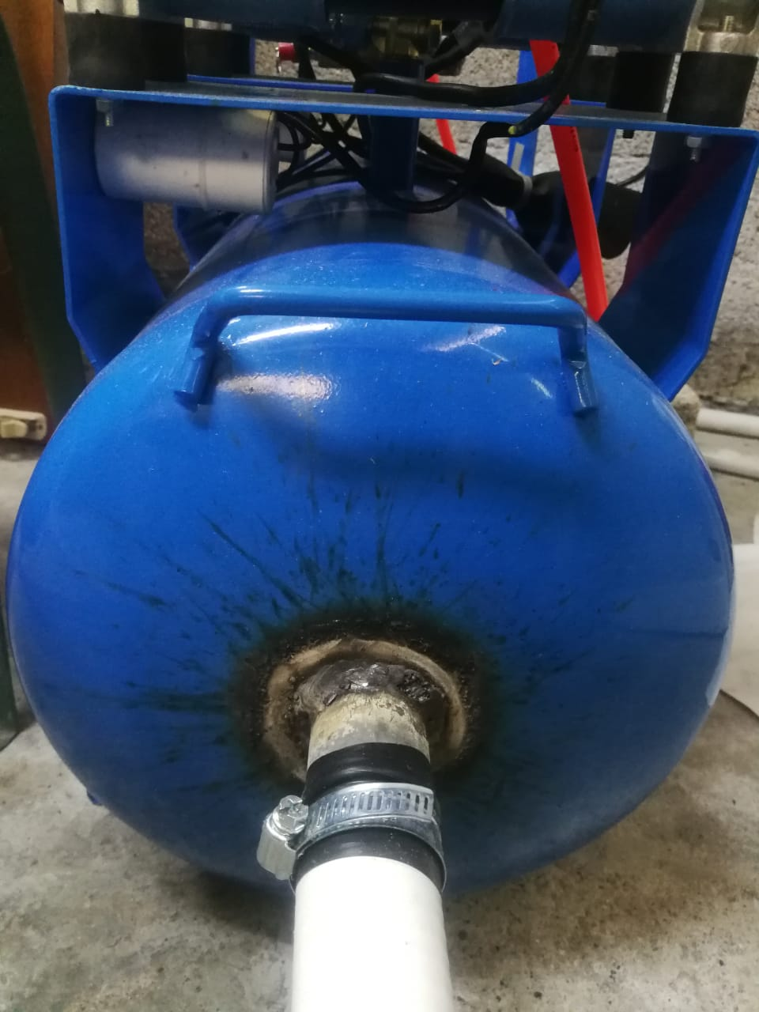
Converting the air compressor
Fig18: Inverting the head
Fig19: The standard output of the tank
Fig20: Drilling a new output

Slide 18
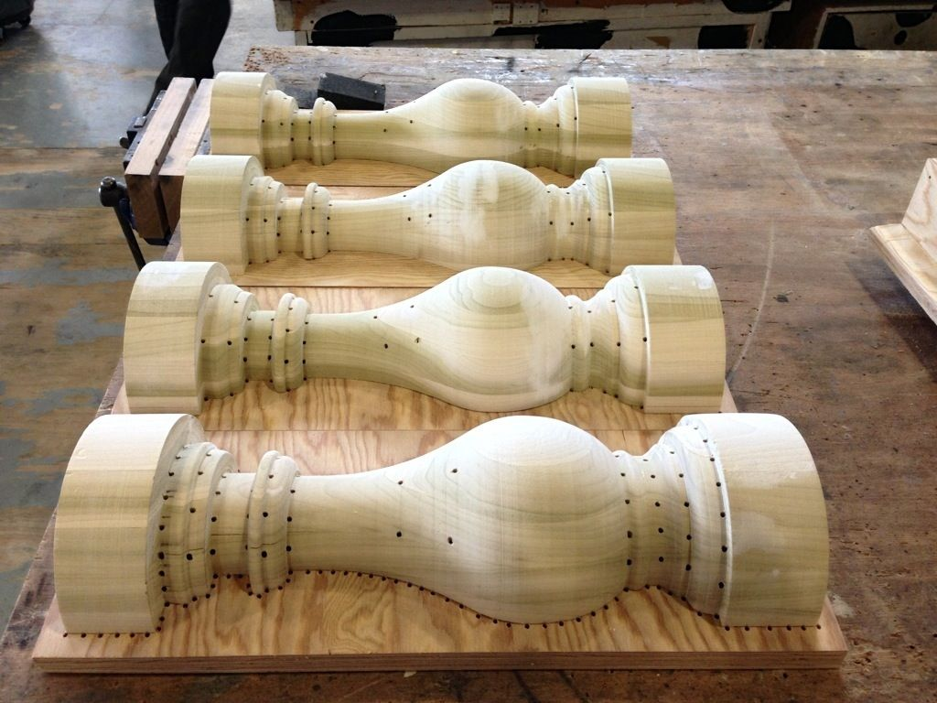
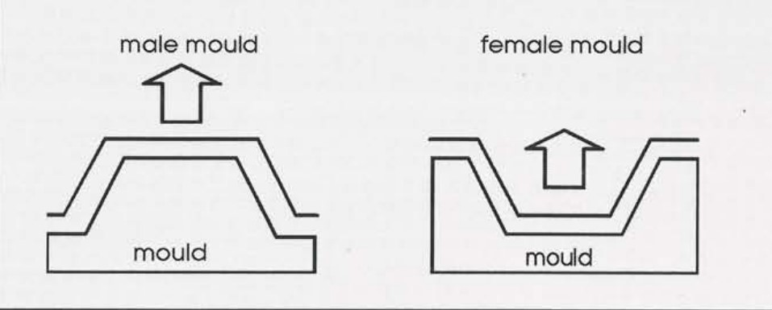
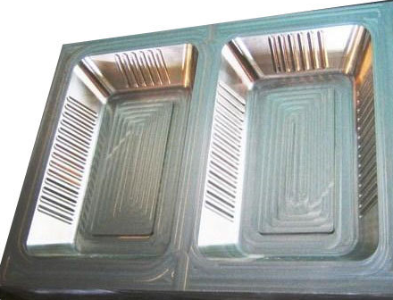
The mould
Fig22: Male wooden mould
Fig21: Male and female forming
Mould Materials:
1. Wood 2. Plaster 3. Resin 4. Aluminum 5. 3D printed Plastic
Fig23: Female aluminum mould

Slide 19
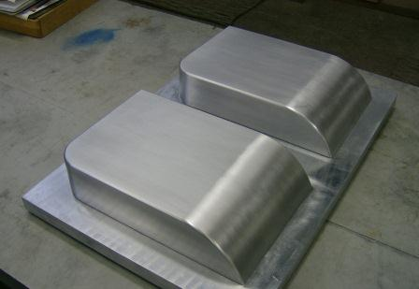
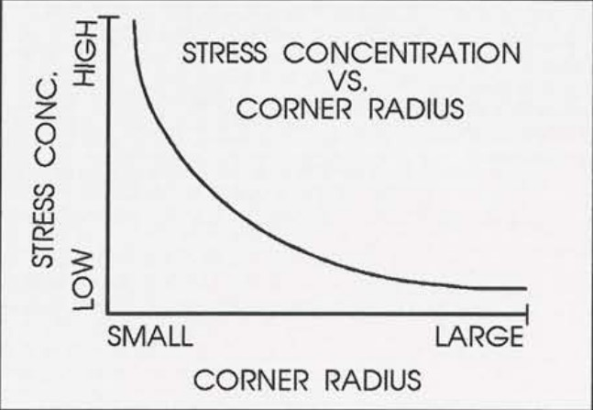
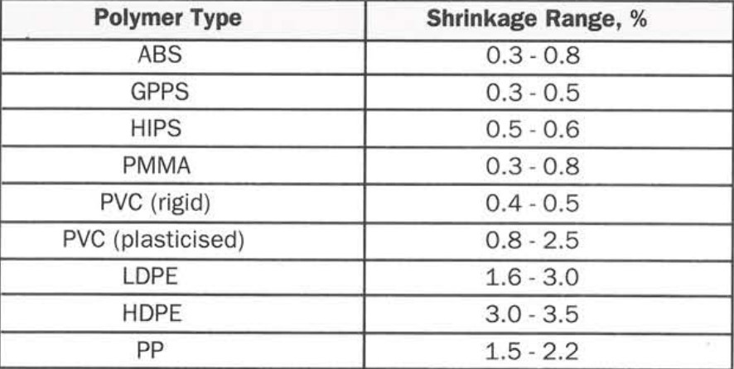
Mold Stress concentration and size
Molds must account for the shrinkage in the plastic after cooling.
Fig24: Stress concentration vs corner radius
Radii should at least equal the wall thickness and never less than 0.8mm.
Table3: Shrinkage range for each polymer

Slide 20
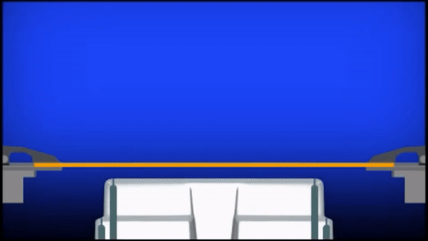
Limitation
Tall or deep parts cause thinning and weakening at the walls;
Solution
Pre stretch
Heat control
Fig25: Over stretching during forming

Slide 21
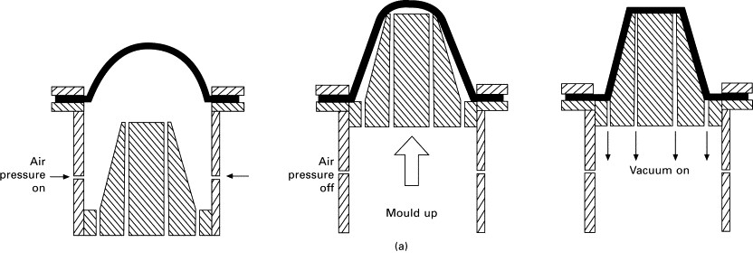
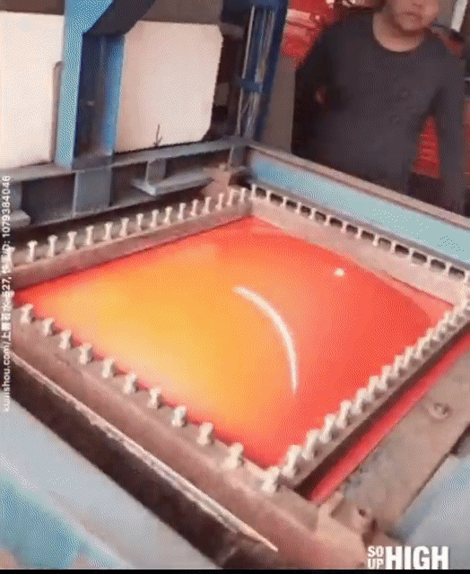
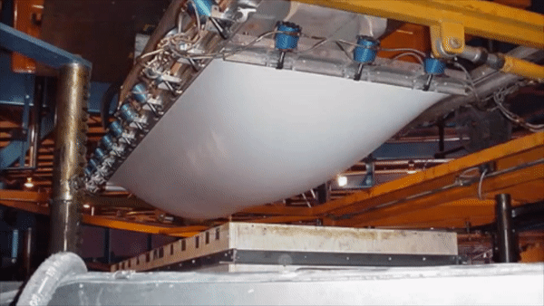
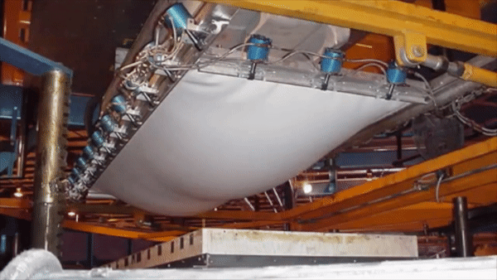
Pre-stretch
Fig26: Pre stretching a sheet of plastic before suction
Fig27: Plastic sheet pre-stretched before suction
Heat control
Fig28: Heat Evenly Distributed
Fig29: Heat control

Slide 22
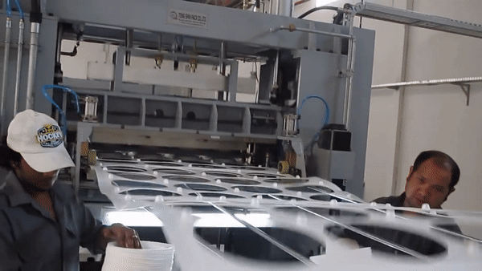
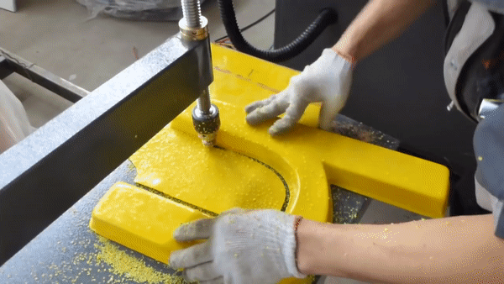



Trimming and final products
Fig30: Automatic trimming for high production
Fig31: Manual Trimming
Fig32: Car exterior
Fig33: Bag after assembly
Fig34: Packaging

Slide 23



Future Work
Fig35: 1 Inch Electronic Valve
Fig36: Stepper Motor for the arm
Fig37: Automatic Feed

Slide 24
Demo

Slide 25
Thank you for your time

