Slide 1

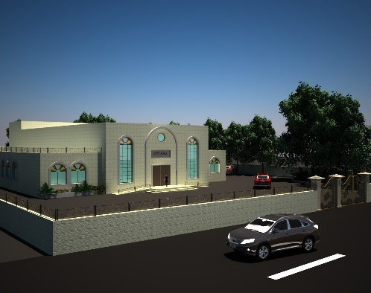



Environmental Friendly Multi purpose–Hall Design
An-Najah National University
Faculty of Building Engineering
Jan 2013

Slide 2
Prepared By :
Nada Fuqha- Yousef ALashqar- Zeyad Masoud
Graduation Project
Supervised By :
Eng. Amer Sharif
An-Najah National University
Faculty of Building Engineering
Jan 2013

Slide 3
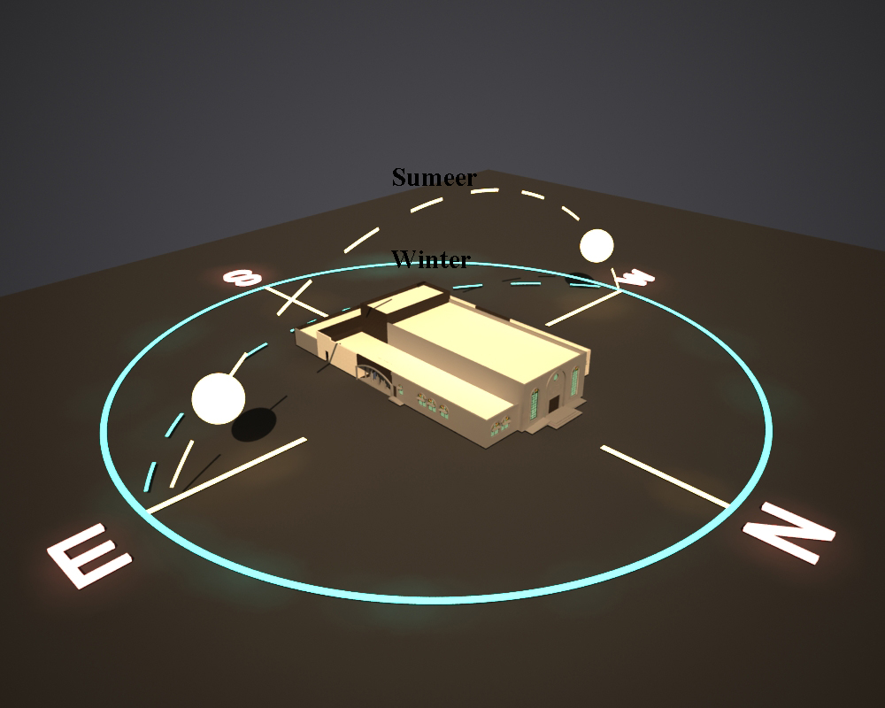
Presentation Outline
Project General Information.
Architectural Design.
Environmental Design.
Electrical Design.
Mechanical Design.
Structural Design.
An-Najah National University
Faculty of Building Engineering
Jan 2013

Slide 4
1- Project Information
A- General Overview
This Graduation Project Interested in designing Friendly Environment Multi purpose Hall design instead of typical designs.
An-Najah National University
Faculty of Building Engineering
Jan 2013

Slide 5
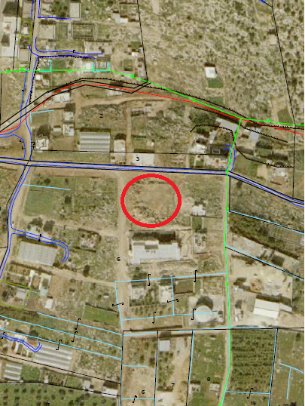
1- Project Information
B- Location & Site Plan
N
An-Najah National University
Faculty of Building Engineering
Jan 2013

Slide 6
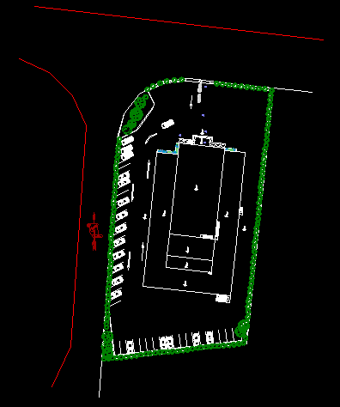
1- Project Information
B- Location & Site Plan
An-Najah National University
Faculty of Building Engineering
Jan 2013

Slide 7
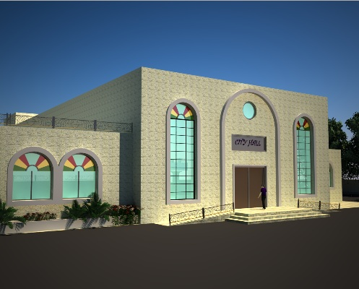
A- Architectural Design
An-Najah National University
Faculty of Building Engineering
Jan 2013

Slide 8
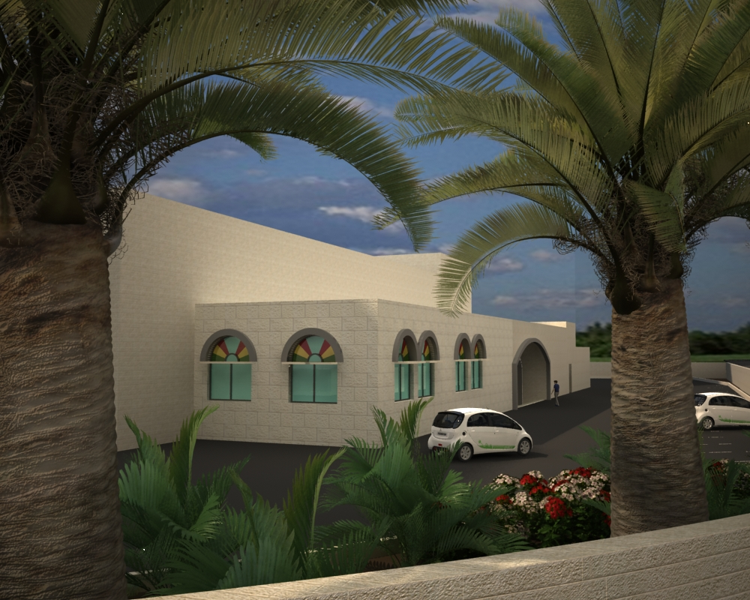
A- Architectural Design
To achieve :-
Maximum comfort.
Lowest energy consumption.
Appositive relationship between the building and the surrounding environment.
An-Najah National University
Faculty of Building Engineering
Jan 2013

Slide 9
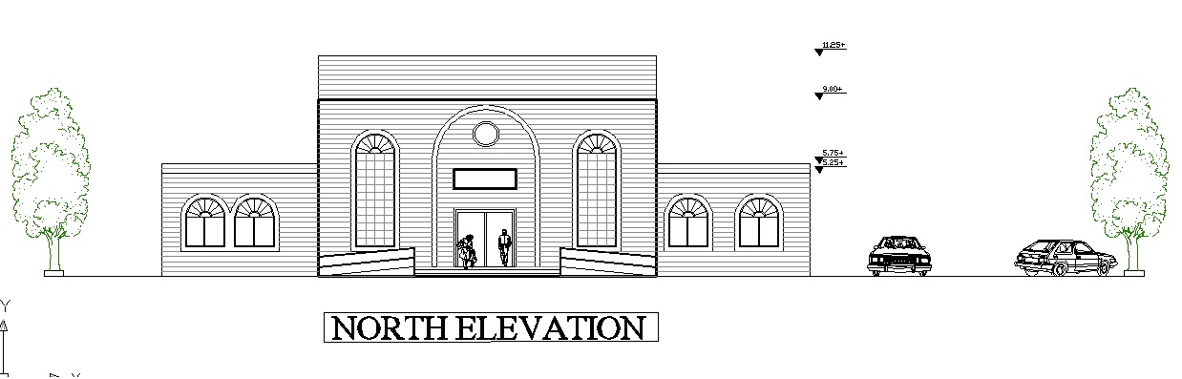
A- Architectural Design
An-Najah National University
Faculty of Building Engineering
Jan 2013

Slide 10
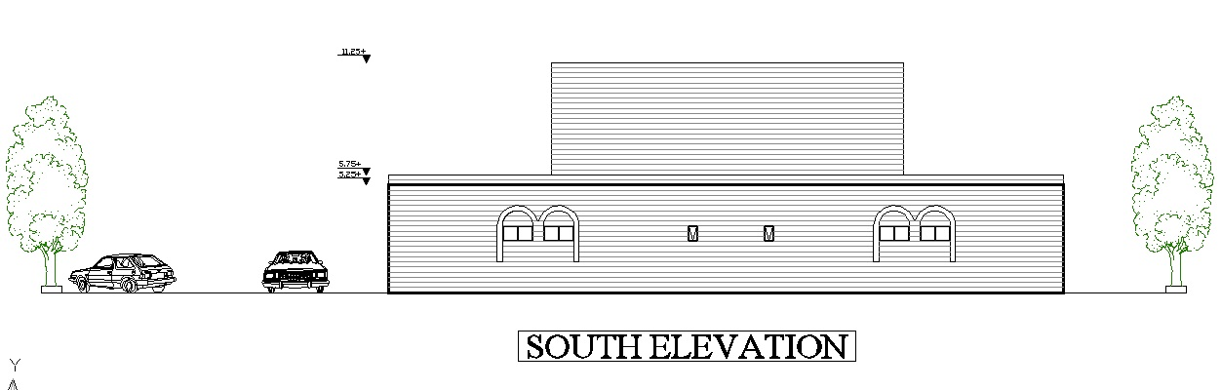
A- Architectural Design
An-Najah National University
Faculty of Building Engineering
Jan 2013

Slide 11
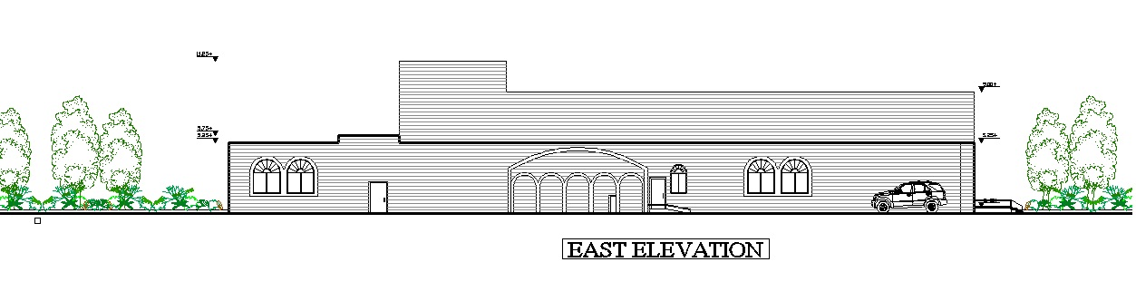
A- Architectural Design
An-Najah National University
Faculty of Building Engineering
Jan 2013

Slide 12
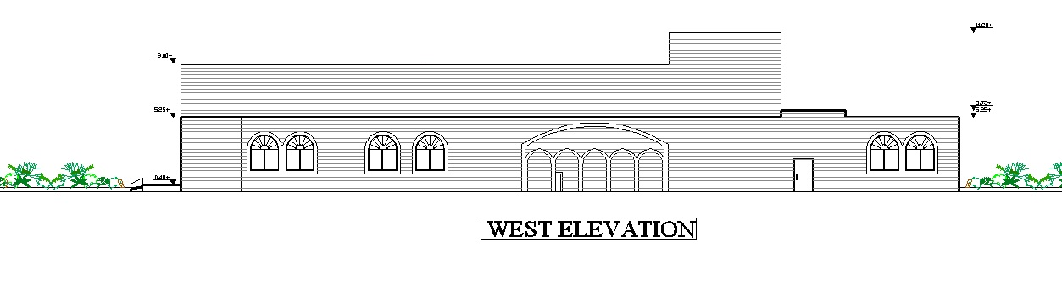
A- Architectural Design
An-Najah National University
Faculty of Building Engineering
Jan 2013

Slide 13
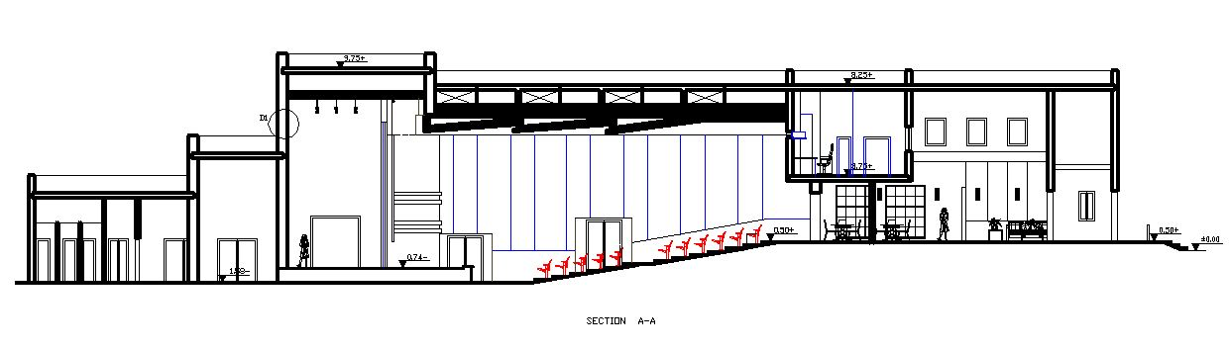
A- Architectural Design
An-Najah National University
Faculty of Building Engineering
Jan 2013

Slide 14
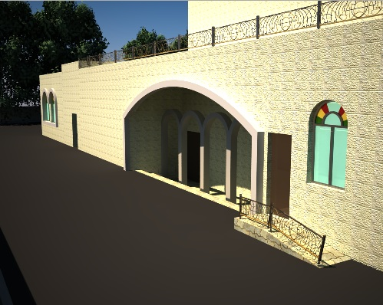
2- Environmental Design Steps & Simulation
B-Environmental Design-Simulation by ECOTECT
1) Orientation
3) Ventilation
2) Landscaping
4) Thermal insulation
An-Najah National University
Faculty of Building Engineering
Jan 2013

Slide 15
2- Environmental Design Steps & Simulation
B-Environmental Design-Orientation
An-Najah National University
Faculty of Building Engineering
Jan 2013

Slide 16
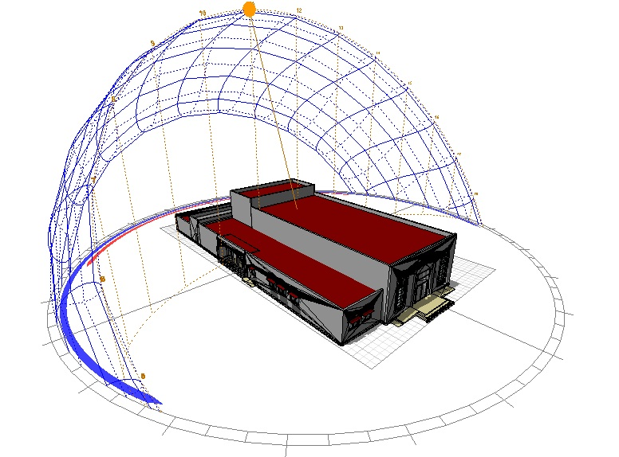
2- Environmental Design Steps & Simulation
B-Environmental Design-Sunbath
An-Najah National University
Faculty of Building Engineering
Jan 2013

Slide 17


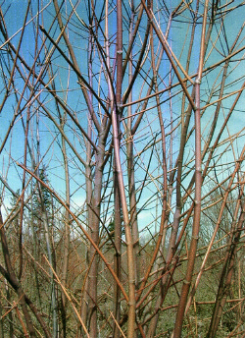

2- Environmental Design Steps & Simulation
B-Environmental Design- Landscaping
• Environmentally Appropriate Landscaping
• Native Plants.
• Protection of Existing Vegetation
• Re-use of Grey Water
Rose
Cypress
Pine trees
nuts
An-Najah National University
Faculty of Building Engineering
Jan 2013

Slide 18
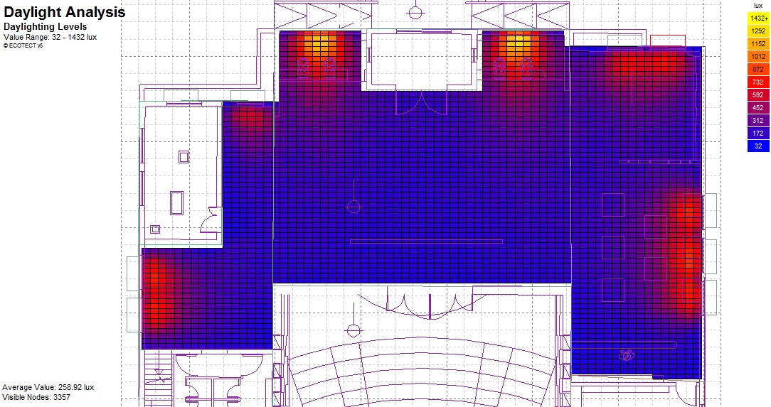
2- Environmental Design Steps & Simulation
B-Environmental Design- Day light
An-Najah National University
Faculty of Building Engineering
Jan 2013

Slide 19
2- Environmental Design Steps & Simulation
B-Environmental Design- Thermal insulation
 |  | heating | cooling
 |  | Kw | Kw
with insulation | PER M² | 0.491 | 34.089
without insulation | PER M² | 2.903 | 38.940
Section used:
- sandstone 7cm
- concrete 13cm
- Polyurethane 2cm
- Block 10cm
- Plaster 1.5cm
U-value=0.95 w/m2.k.
An-Najah National University
Faculty of Building Engineering
Jan 2013

Slide 20

3- Lighting
DIALUX software was used to design the lighting system
Artificial lighting
Emergency lighting
Natural lighting
An-Najah National University
Faculty of Building Engineering
Jan 2013

Slide 21
3- Lighting
Lighting design
Natural lighting
All of illuminance value are reduced to the half to take into account the natural lighting
For artificial lighting
Technical values for design
illuminance value(Lx)
type of room | Illuminance at work plane (lux) | Work plan height (cm)
Stairs | 100 | 0
Bath Room | 100 | 0
Restaurant | 100 | 60
Waiting Room | 150 | 50
Reception | 300 | 60
Hall | 300 | 60
Store | 30 | 50
Projection room | 150 | 60
Stages | Special lighting | 60
Entrance hall and exits | 100 | 0
Dressing room | 150 | 60
2. Room element reflectance
Room element | reflectance
Ceiling | 0.7
Walls | 0.5
Floor | 0.2
An-Najah National University
Faculty of Building Engineering
Jan 2013

Slide 22

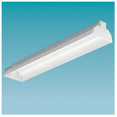
3- Lighting
Lighting design
Artificial lighting
Florescent lamp
Louvers luminaries
An-Najah National University
Faculty of Building Engineering
Jan 2013

Slide 23
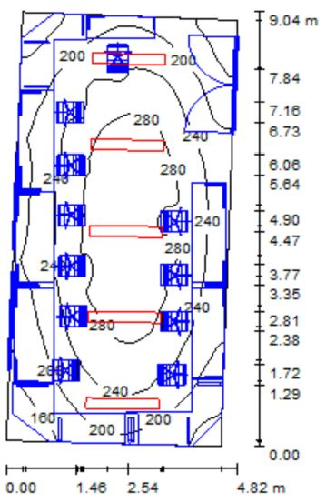
3- Lighting
Laminar distributed
Lighting design
Artificial lighting
E_{av} [lx]
232
An-Najah National University
Faculty of Building Engineering
Jan 2013

Slide 24
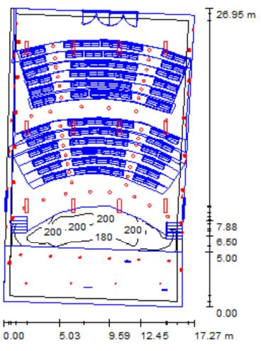
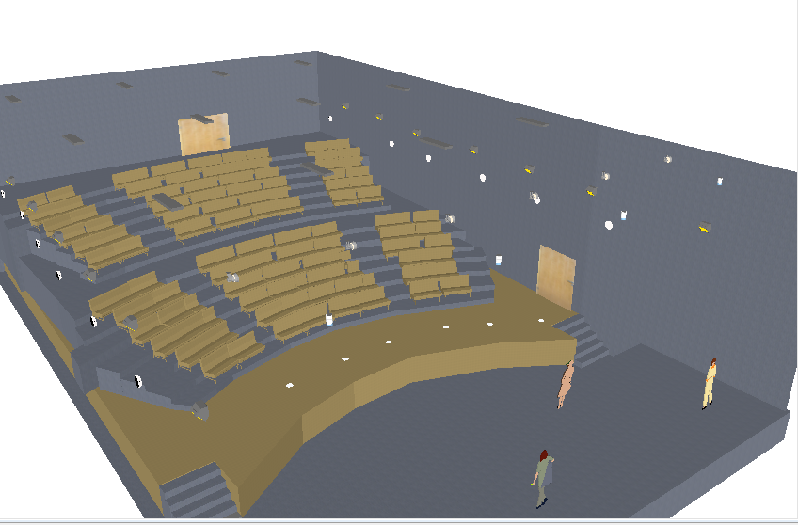
3- Lighting
Laminar distributed
Lighting design
Artificial lighting
E_{av} [lx]
184
An-Najah National University
Faculty of Building Engineering
Jan 2013

Slide 25
3- Lighting
Lighting design
Emergency & information lighting
Design of emergency lighting
At each intersection of corridors.
At each exit door.
On each staircase so that each flight of stairs receives direct light.
An-Najah National University
Faculty of Building Engineering
Jan 2013

Slide 26
4- Mechanical Design
Water supply
Sanitation system
Grey water
Black water
Rain water
Heating Design
Fire fighting
An-Najah National University
Faculty of Building Engineering
Jan 2013

Slide 27
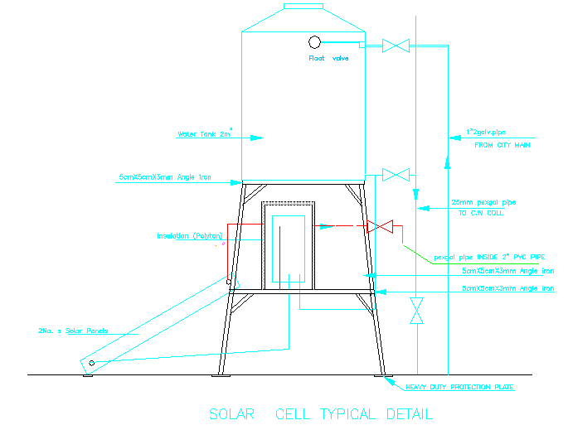
4- Mechanical Design
Water supply
An-Najah National University
Faculty of Building Engineering
Jan 2013

Slide 28
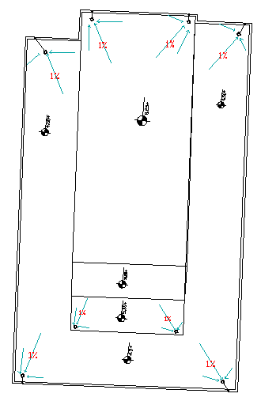
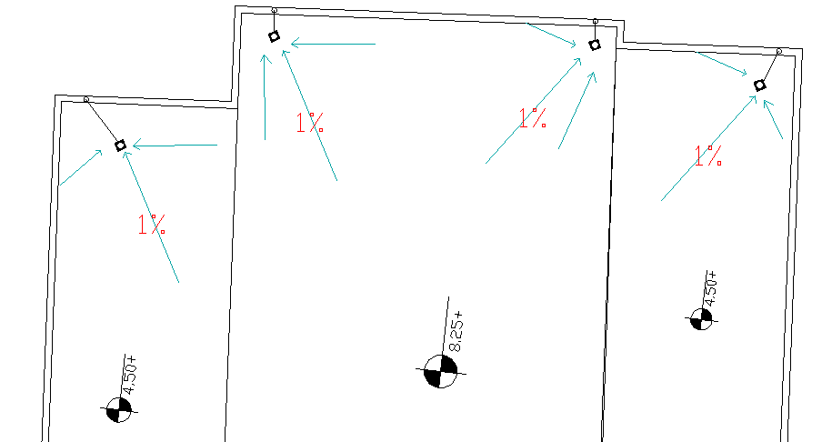
4- Mechanical Design
Sanitation system
Rain water
An-Najah National University
Faculty of Building Engineering
Jan 2013

Slide 29
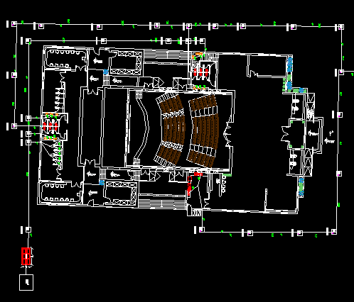
4- Mechanical Design
Sanitation system
Black & Grey water
An-Najah National University
Faculty of Building Engineering
Jan 2013

Slide 30
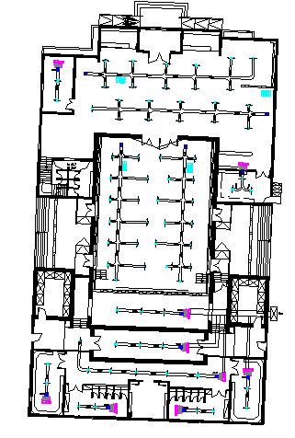
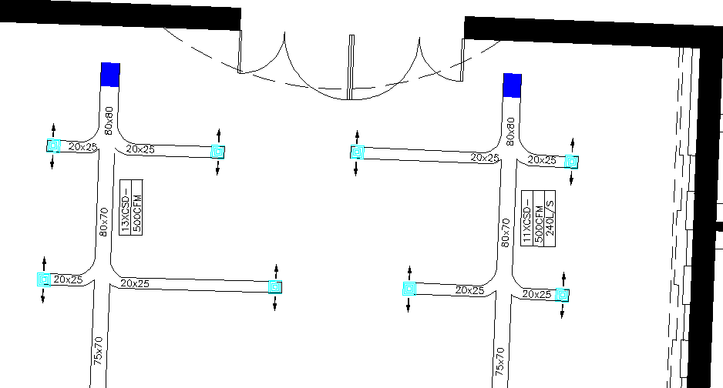
4- Mechanical Design
Heating Design
Fan coil unite System
An-Najah National University
Faculty of Building Engineering
Jan 2013

Slide 31
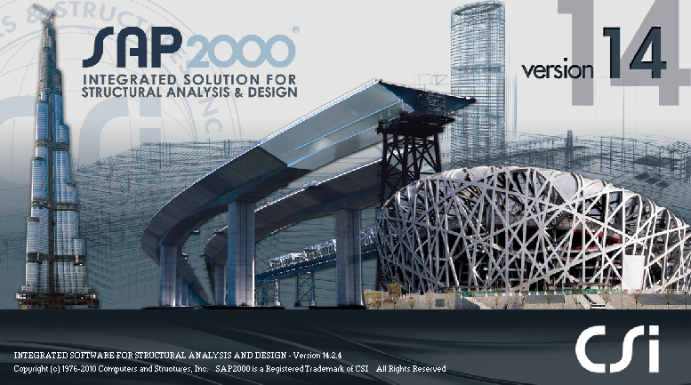
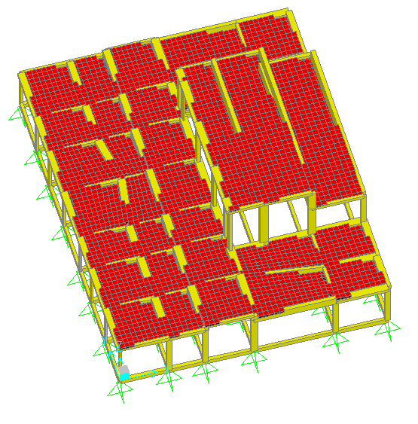
5- Structural Design
An-Najah National University
Faculty of Building Engineering
Jan 2013

Slide 32
5- Structural Design
Design Codes:
The structural design will be according to :
1) the American Concrete Institute code ACI 318-08 .
2) the seismic design according to UBC-97.
Design will include the following elements :
1) slab ( one way rib slab).
2) beam ( main, secondary ) .
3) column .
4) footing.
An-Najah National University
Faculty of Building Engineering
Jan 2013

Slide 33
5- Structural Design
Design data
Compressive strength of concrete (f\c)
beams
columns
Footing
Slaps
f\c =300 kg/cm²
B350
2. Yielding strength of steel (Fy)
fy = 4200 kg/cm2
3. Bearing capacity of soil= 2 Kg/cm².
An-Najah National University
Faculty of Building Engineering
Jan 2013

Slide 34
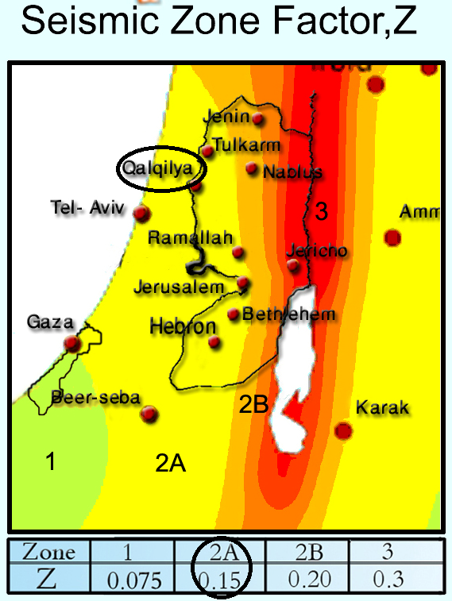
5- Structural Design
Seismic analysis & design
Seismic Importance Factor: I = 1….
(Special Building).
Structural System Coefficient: R = 3.5.
Seismic Coefficient: (C_{v} ), ( C_{a}).
Cv=0.32
Ca=0.22
Soil profile type S_{D}
An-Najah National University
Faculty of Building Engineering
Jan 2013

Slide 35
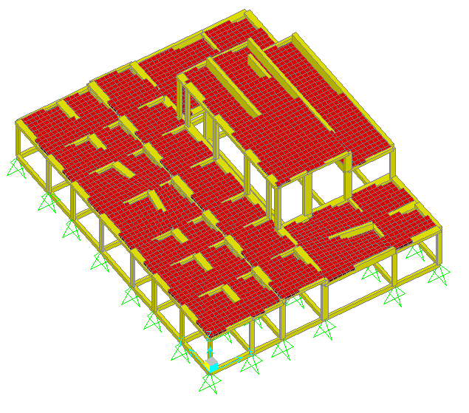
5- Structural Design
Loads
Superimposed dead load=300 kg/m²
Live load =300 kg/m²
Weight of external walls=0.35t/m
SAP MODEL
An-Najah National University
Faculty of Building Engineering
Jan 2013

Slide 36
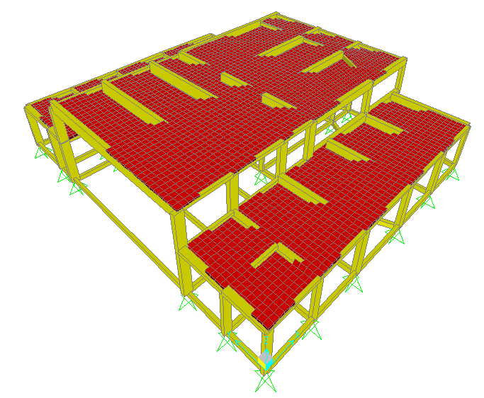
5- Structural Design
Loads
Superimposed dead load=300 kg/m²
Live load =300 kg/m²
Weight of external walls=0.35t/m
SAP MODEL
An-Najah National University
Faculty of Building Engineering
Jan 2013

Slide 37
5- Structural Design
Preliminary dimensions
Slab thickness= 35 cm
Beam dimension
Main beam→ (35*70) cm
Secondary beam→ (30*35) cm
Column dimension
Column → (50*20) cm
→ (60*30) cm
→ (70*30) cm
→ (80*30) cm
An-Najah National University
Faculty of Building Engineering
Jan 2013

Slide 38
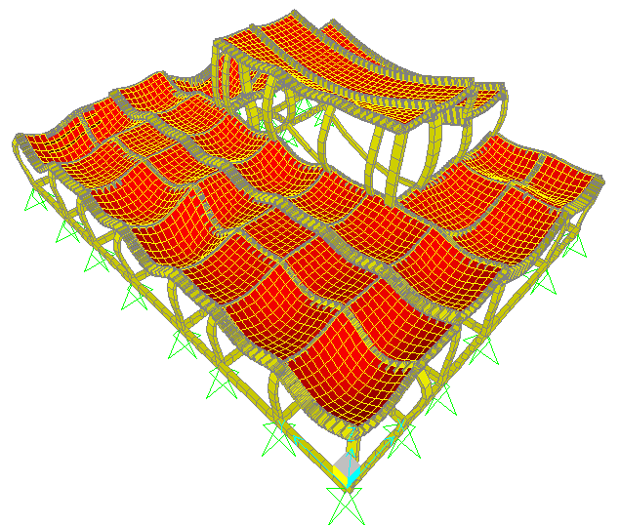
5- Structural Design
Checks for SAP model
Compatibility check
1st block
An-Najah National University
Faculty of Building Engineering
Jan 2013

Slide 39
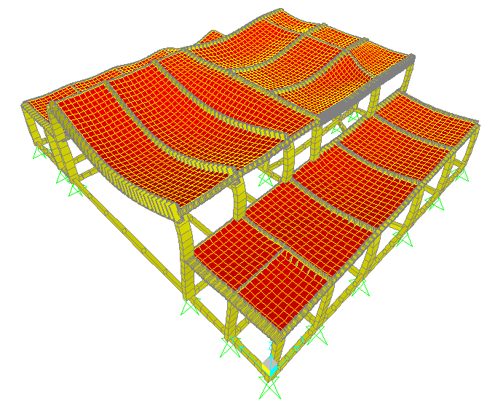
5- Structural Design
Checks for SAP model
Compatibility check
2nd block
An-Najah National University
Faculty of Building Engineering
Jan 2013

Slide 40
5- Structural Design
Equilibrium Checks:
For first block | From SAP (ton) | Manual (ton) | Difference (%)
D.L | 1319.3 | 1273.1 | 3.5
L.L | 250.54 | 253.76 | 1.27
For second block | From SAP (ton) | Manual (ton) | Difference (%)
D.L | 1103.7 | 1160.35 | 4.8
L.L | 275.4 | 267.5 | 2.8
An-Najah National University
Faculty of Building Engineering
Jan 2013

Slide 41
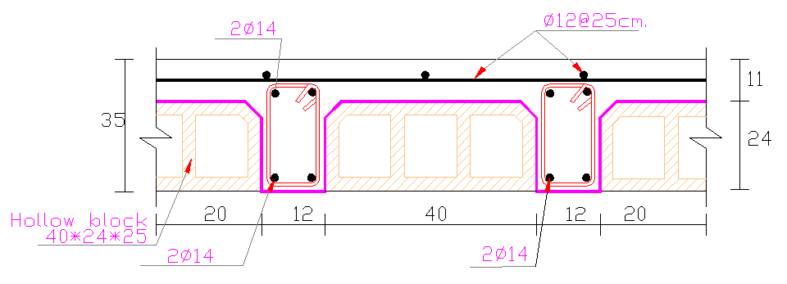
5- Structural Design
Reinforcement Details
Slab design
Slabs are designed as one way ribbed slab with thickness =35cm
An-Najah National University
Faculty of Building Engineering
Jan 2013

Slide 42
5- Structural Design
 | +ve | -ve
Main beam (40 X 120)cm | 9ɸ25 | 4ɸ14
Main beam (50 X 80)cm | 8ɸ20 | 8ɸ20
Main beam (30 X 80)cm | 3ɸ18 | 4ɸ14
Main beam (70 X 35)cm | 5ɸ14 | 8ɸ14
Main beam (60 X 35)cm | 5ɸ14 | 8ɸ14
Secondary beam (30 X 35)cm | 3ɸ14 | 3ɸ14
Tie beam (30 X 50)cm | 3ɸ14 | 5ɸ14
An-Najah National University
Faculty of Building Engineering
Jan 2013

Slide 43
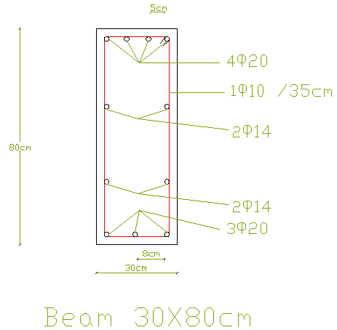
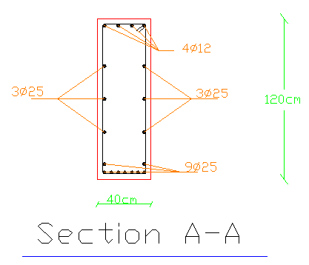
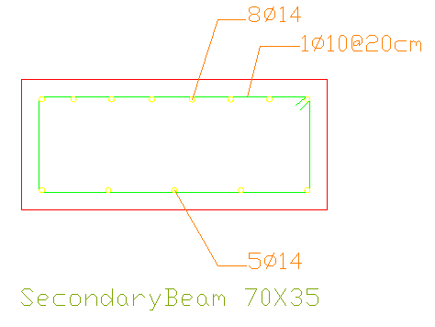

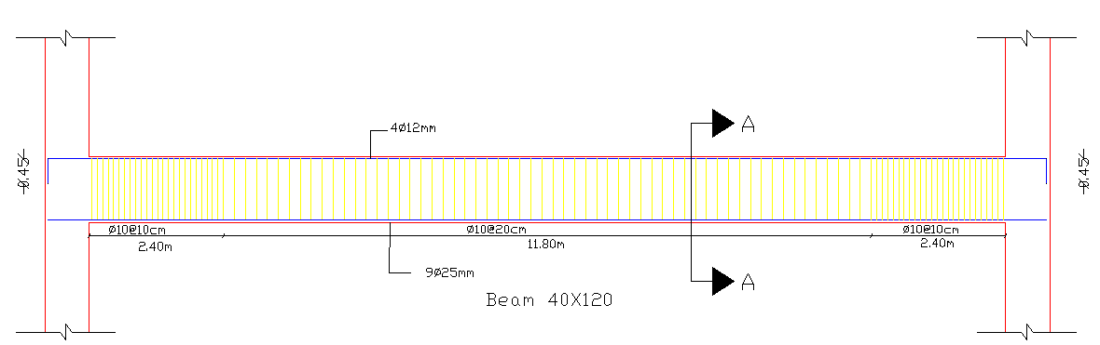
5- Structural Design
Beam design details
An-Najah National University
Faculty of Building Engineering
Jan 2013

Slide 44
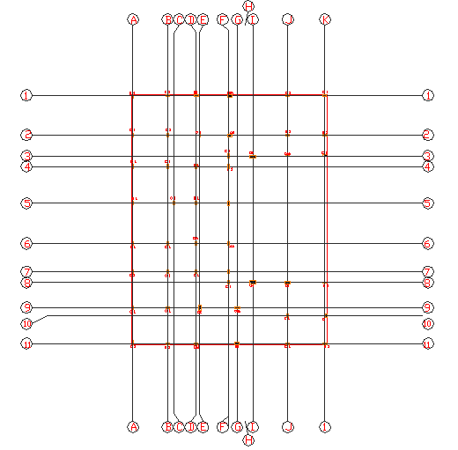
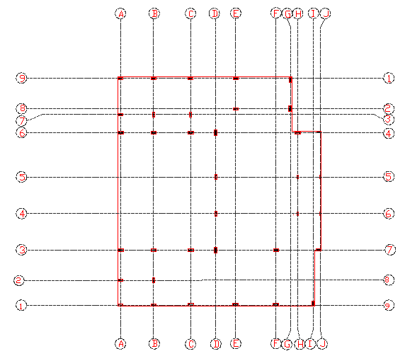
5- Structural Design
Column design
Centre plan & Detail
An-Najah National University
Faculty of Building Engineering
Jan 2013

Slide 45
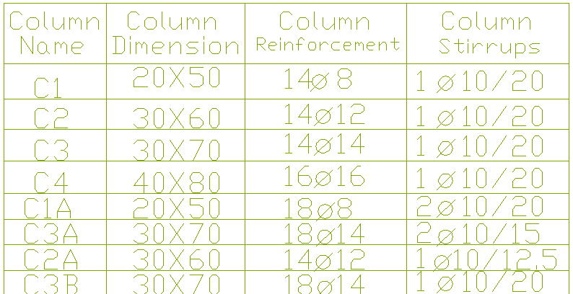
5- Structural Design
Column design
An-Najah National University
Faculty of Building Engineering
Jan 2013

Slide 46
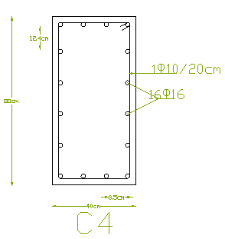
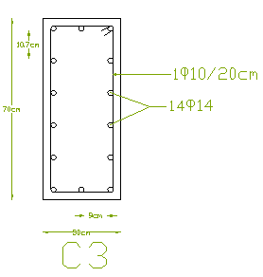
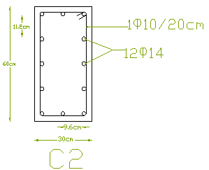
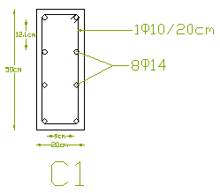
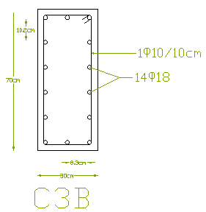
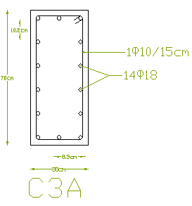
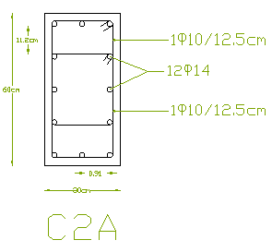
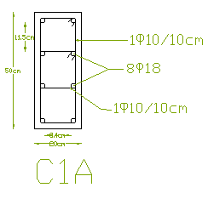
5- Structural Design
Column design
An-Najah National University
Faculty of Building Engineering
Jan 2013

Slide 47
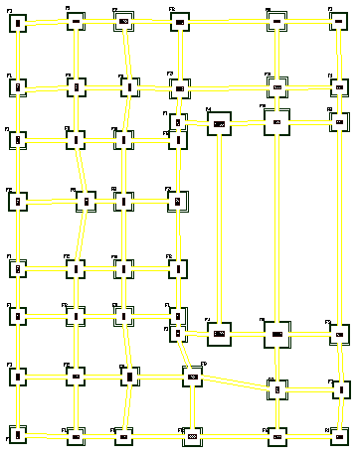
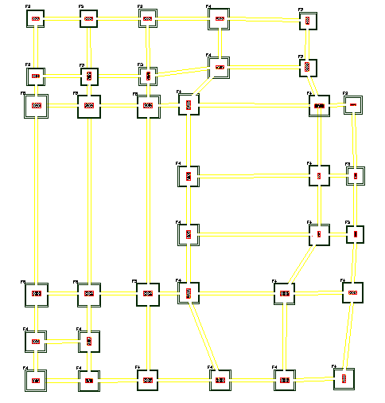
5- Structural Design
Footing design
Centre plan
Centre plan
Details
An-Najah National University
Faculty of Building Engineering
Jan 2013

Slide 48



5- Structural Design
Footing design
Details
An-Najah National University
Faculty of Building Engineering
Jan 2013

Slide 49


5- Structural Design
Footing design
Details
An-Najah National University
Faculty of Building Engineering
Jan 2013

