Slide 1





CNC System for Wood and Plastic Engraving
Supervisor:
Dr. Sufyan Samara

Slide 2




Introduction
Our project is a CNC machine designed for carving and engraving on wood and plastic. It combines mechanical, electronic, and software systems to create precise and reliable results. The machine is controlled using G-code, and we can operate it from a computer or phone. This project focuses on accuracy, easy operation, and future flexibility for different materials and designs.

Slide 3
main idea
Designing and building a versatile CNC machine capable of precise carving and engraving on wood and plastic, controlled via G-code and a flexible interface (PC or phone), with a well-engineered mechanical structure and integrated software to ensure accuracy, minimize vibrations, and enhance overall performance.

Slide 4
SIMULATION
We made a simple simulation using Python to show how the machine moves. It takes commands from SVG images (a common type of drawing file) and turns them into G-Code instructions. The simulation shows the movement on the X, Y, and Z axes, so we can see and check the design before using the real machine.

Slide 5
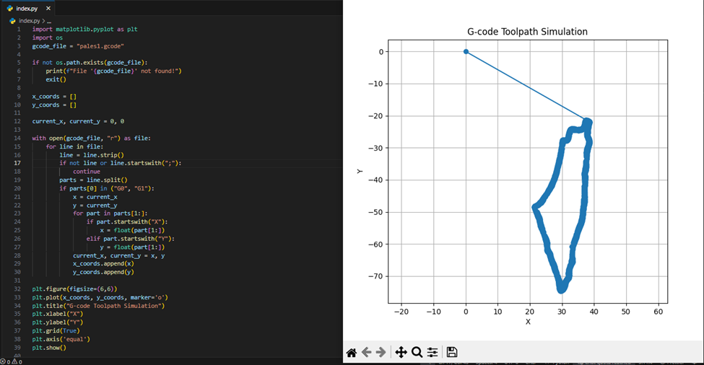
SIMULATION

Slide 6
GRBL WEB MASTER
We use the GRBL Web API to set engraving options like depth, speed, and size, and then generate G-Code. The machine uses this G-Code to carve or engrave precisely. Since GRBL Web was originally for drawing, we modified it to handle engraving commands correctly, making the G-Code suitable for our CNC machine.

Slide 7
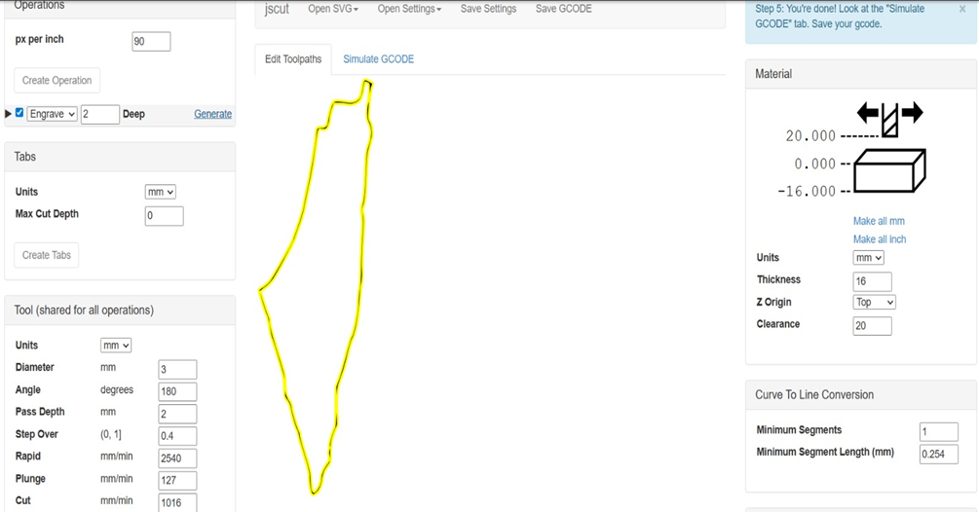
GRBL WEB MASTER

Slide 8
Sending G-Code to the Machine
We used the modified GRBL Web system to send the G-Code to the CNC machine. For testing and viewing the movement before real cutting, we used UGS (Universal G-code Sender). It has an easy interface that helps check the G-Code and make sure everything works correctly before running the machine.

Slide 9
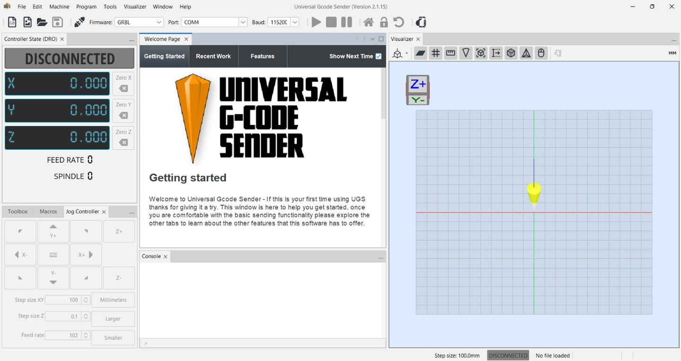
UGS

Slide 10
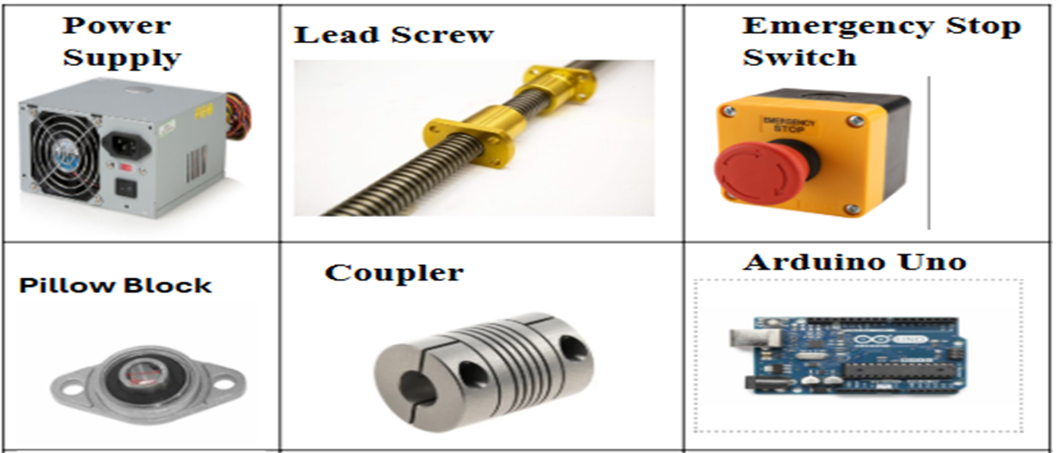
COMPONENTS

Slide 11
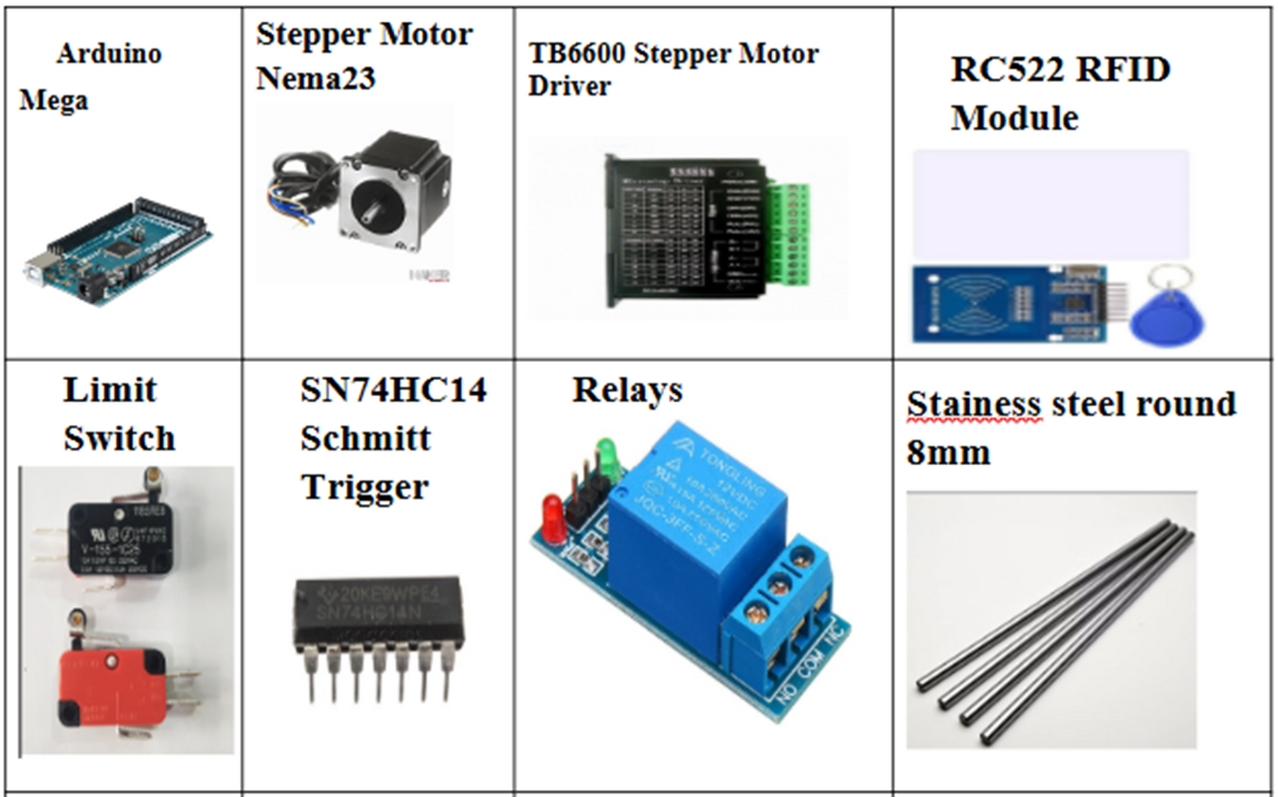
COMPONENTS
Stainless steel rods

Slide 12
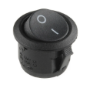
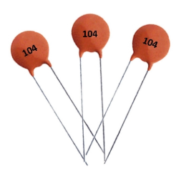
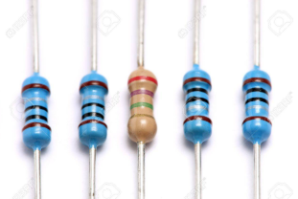
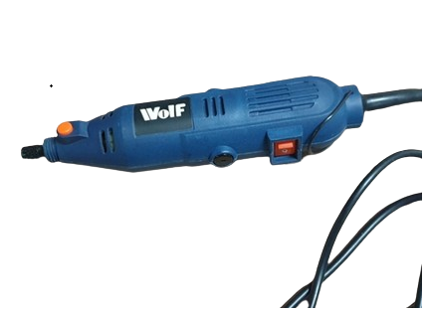
COMPONENTS
round rocker switch
capacitors
resisters
Spindle wolf mini grinder

Slide 13
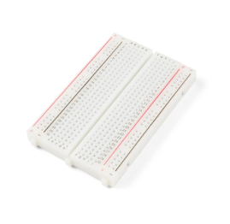
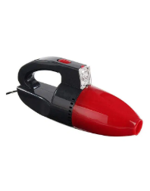
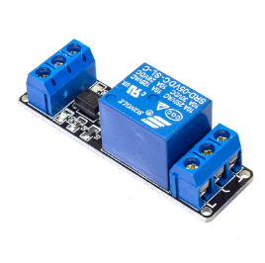
COMPONENTS
optocoupler
breadboard
Vacuum Cleaner

Slide 14
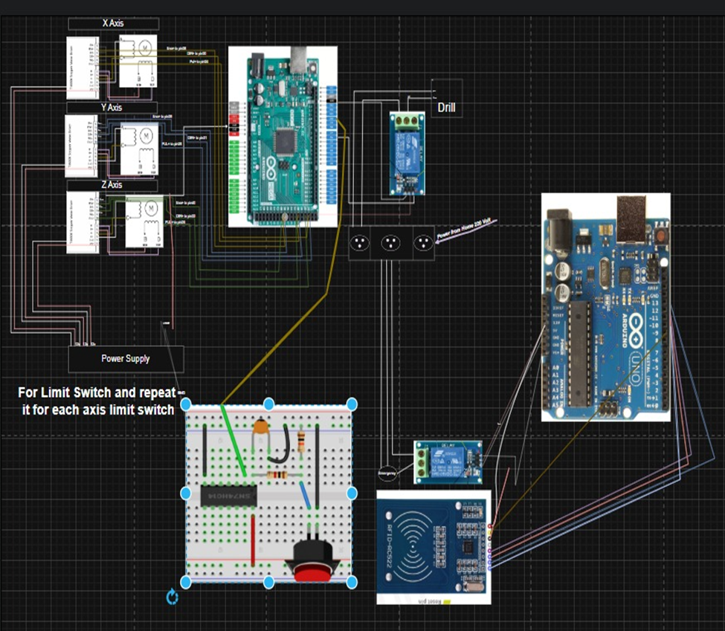
CNC Machine Control Circuit

Slide 15
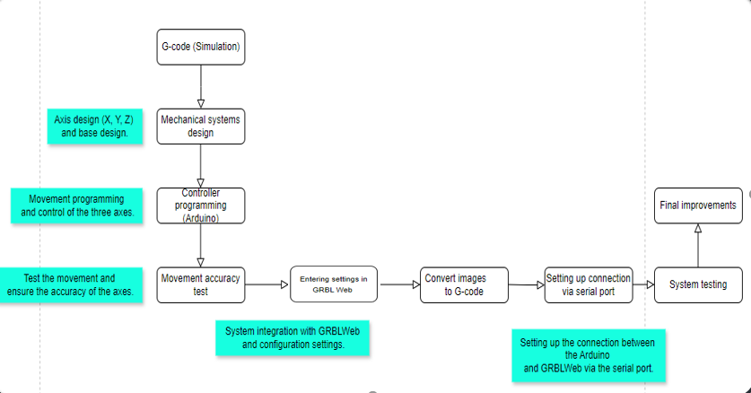
Project Implementation Stages

Slide 16
FEATURES
  Drilling System: Precise drilling.
  RFID: Secure access.
  Emergency Button: Stop machine in emergencies.
  Vacuum System: Remove dust during engraving.
Limit Switches:
  Set starting position (homing).
  Keep position if power is lost.
  Prevent moving outside allowed area.

Slide 17
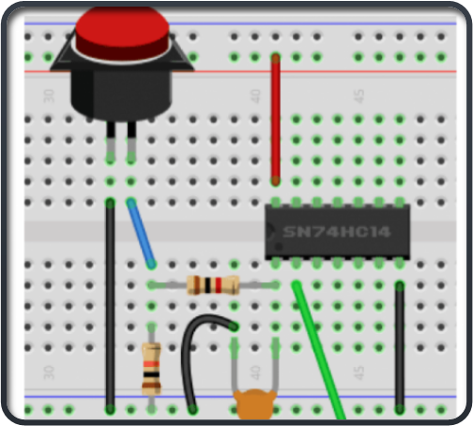
CHALLENGES
We faced an issue with switch bouncing. When pressing a switch, the signal sometimes bounced and created multiple unwanted triggers. This made it hard for the machine to correctly detect button presses. We solved this problem by debouncing the switches using an SN74HC14 Schmitt Trigger circuit, which made the buttons work reliably.

Slide 18
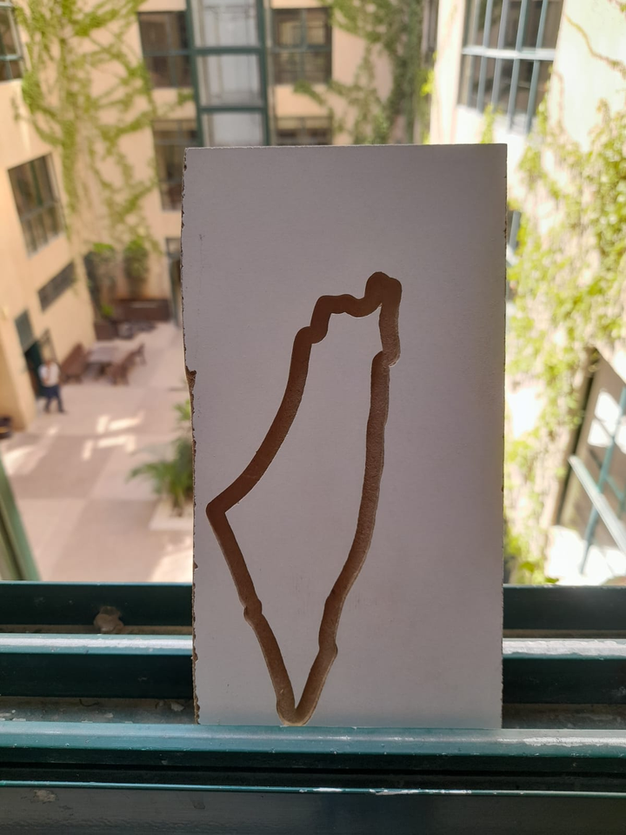
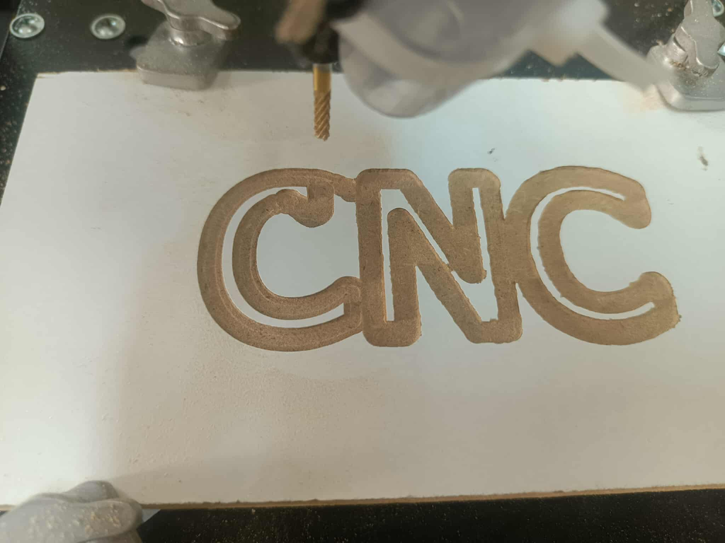
Result

Slide 19
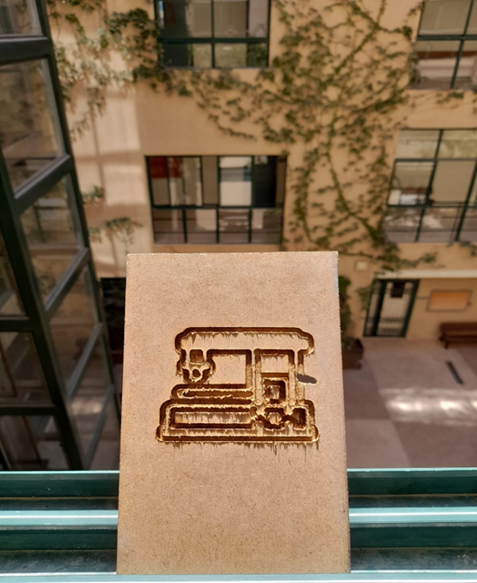
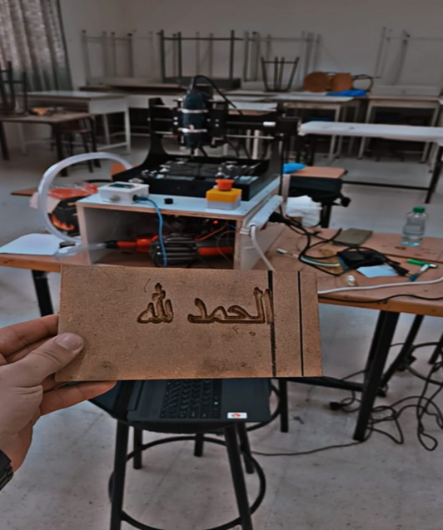
Result

Slide 20
Future Work
  Add cooling system.
  Work with more materials.
  Choose between cutting or engraving.

Slide 21

Thank You

Slide 22
QnA Time

