Slide 1


Design of a wastewater collection network for Urif Village
Prepared by:
Heba Daraghmeh.
Mariam Sabbah.
Supervisor:
Dr.Mohammad AL Masri

Slide 2

Introduction
Water is the most important substance for humans life, people consume water and produce wastewater. The traditional way in Palestine to dispose of wastewater is cesspits which have serious environmental and economical problems.

Slide 3

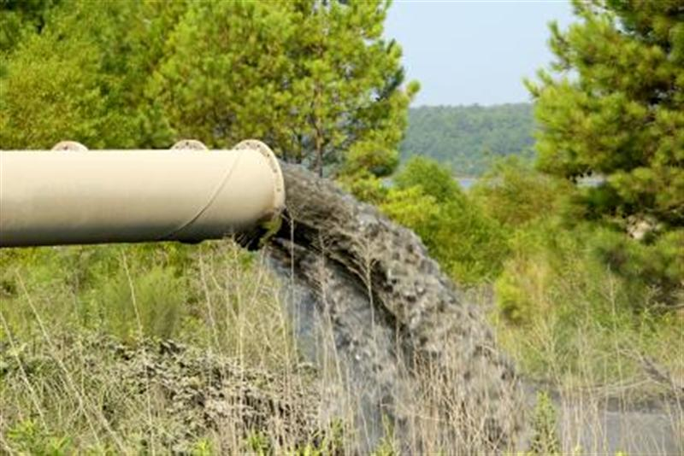
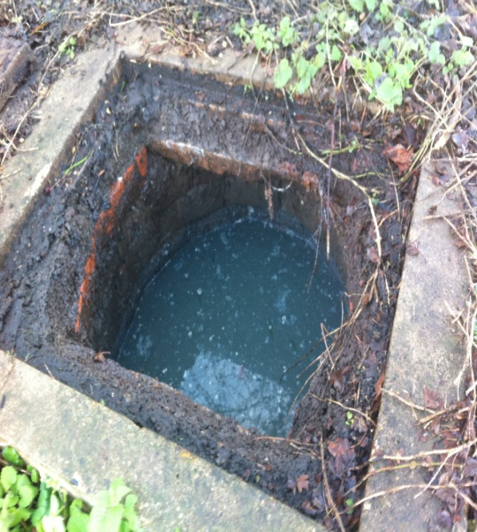
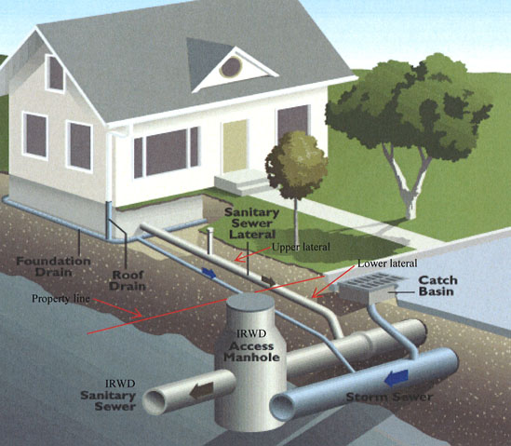

Introduction
The suitable way to dispose of wastewater is wastewater collection network.

Slide 4
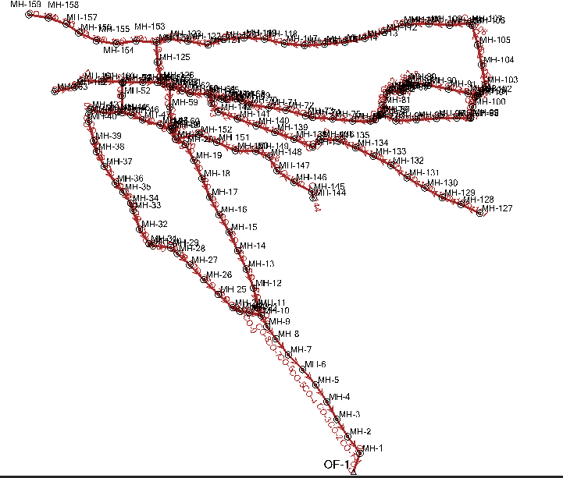

Objectives
Design a wastewater collection network for Urif Village using SewerCAD.
Estimate the cost of the construction of this network.
Determine the best location of the WWTP

Slide 5

Methodology
Define the problem
Collect data for the study area
Preparing profiles
Training on SewerCAD
Design WWCN
Estimate the cost of WWCN
Determine the best location of WWTP
Selection of the study area

Slide 6
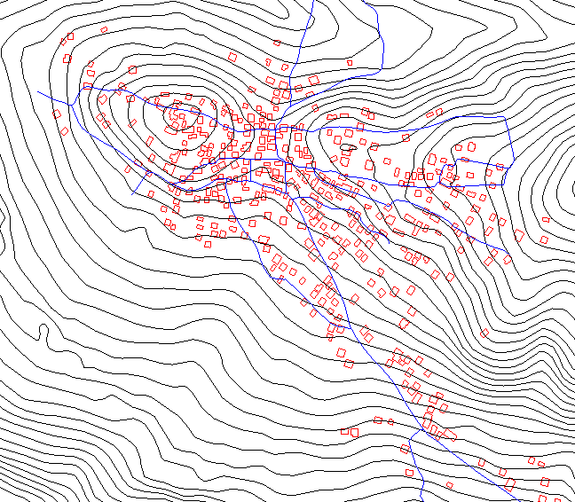
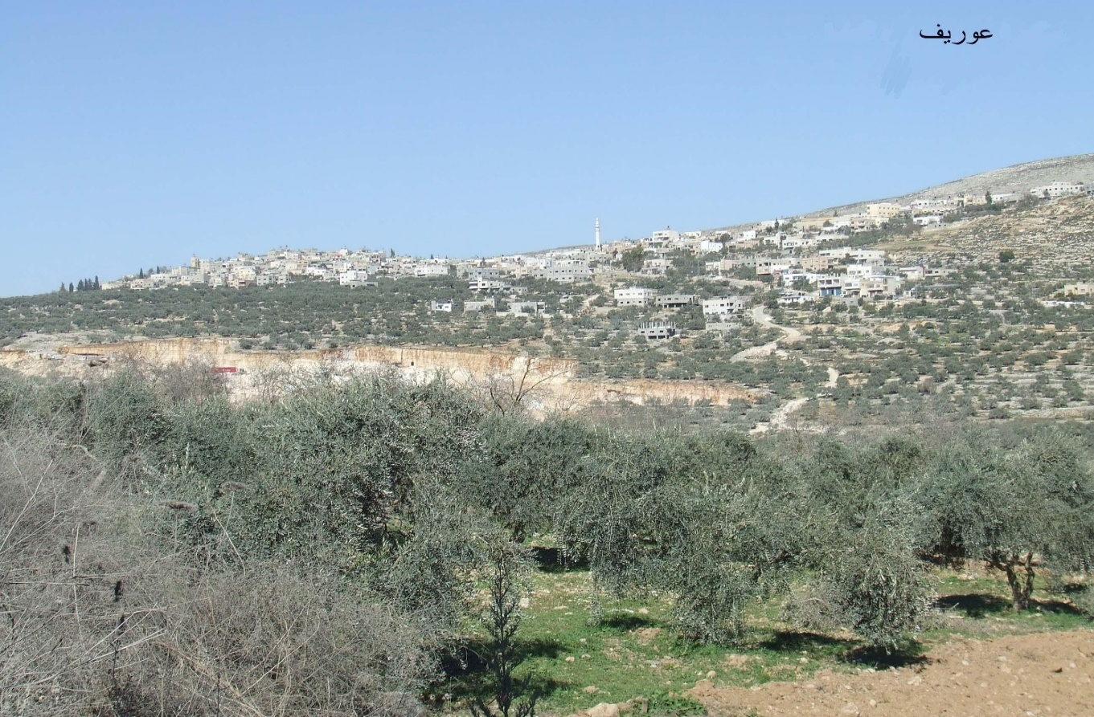
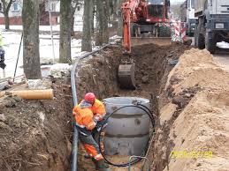
Selection of the study area
The place where one of us lives
There is no WWCN in it
Available data

Slide 7
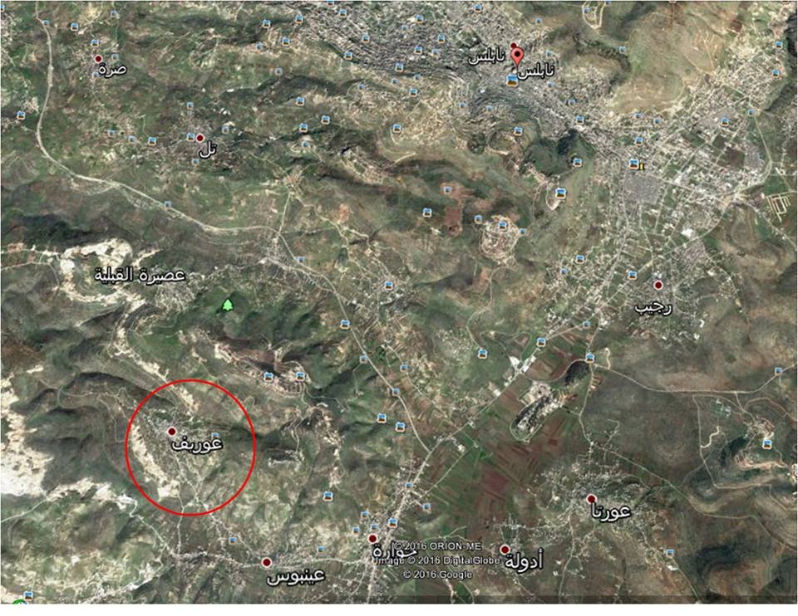


Description of the study area
Topography
location
population
climate

Slide 8
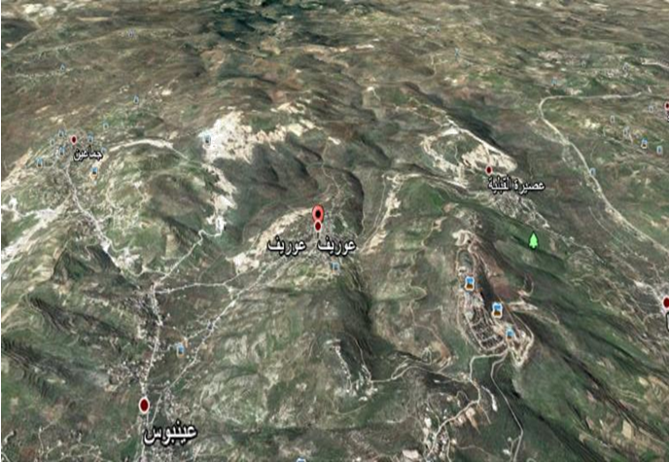
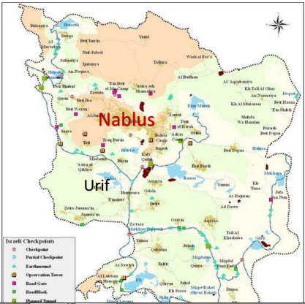
Location

Slide 9
Population

Slide 10
Climate
year | Dec | Nov | Oct | Sep | Aug | Jul | Jun | May | Apr | Mar | Feb | Jan | Month
21.9 | 16.4 | 21.6 | 25.7 | 26.6 | 28 | 29.6 | 28.1 | 25.5 | 20.8 | 16.1 | 12.1 | 12.4 | average high c
17.8 | 13.1 | 17.5 | 20.5 | 22.5 | 24.4 | 24.8 | 24 | 20.7 | 16.6 | 11.9 | 8.8 | 9 | daily mean c
13.3 | 9.3 | 13.8 | 16.4 | 17.5 | 19.1 | 18.8 | 17.4 | 15.2 | 11.8 | 8.2 | 6.1 | 6.2 | average low c
656 | 158 | 60 | 17 | 2 | 0 | 0 | 0 | 5 | 34 | 90 | 135 | 115 | average precipitation(mm)
62.7 | 69 | 54 | 62 | 73 | 62 | 65 | 50 | 47 | 55 | 66 | 75 | 74 | average relative humidity%

Slide 11
Data collected
contour map and the roads network.
other data like population, topography and roads slope.

Slide 12


Why SewerCad?
  SewerCad has the ability for both design and analysis of the network.
  Import and export AutoCAD , Excel and GIS files.
  Profiles can be made using it.

Slide 13
Development of the WWCN

Slide 14
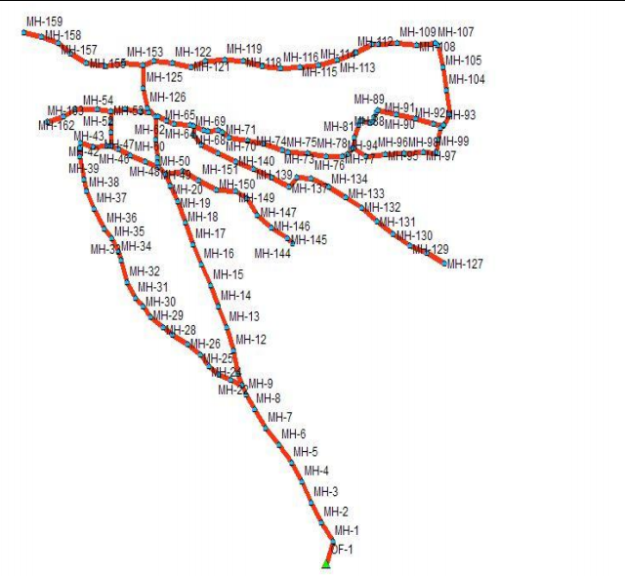
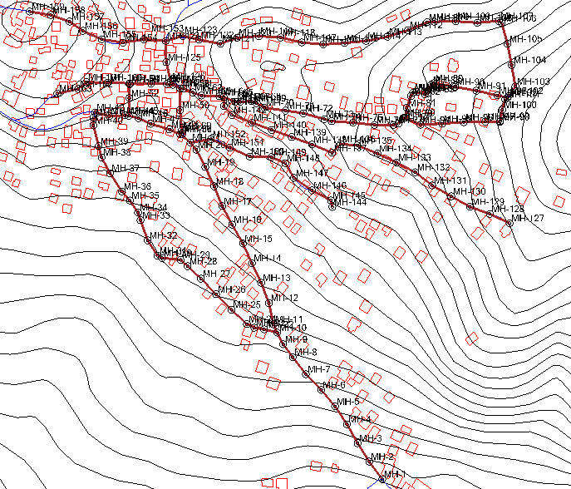
Development of WWCN

Slide 15

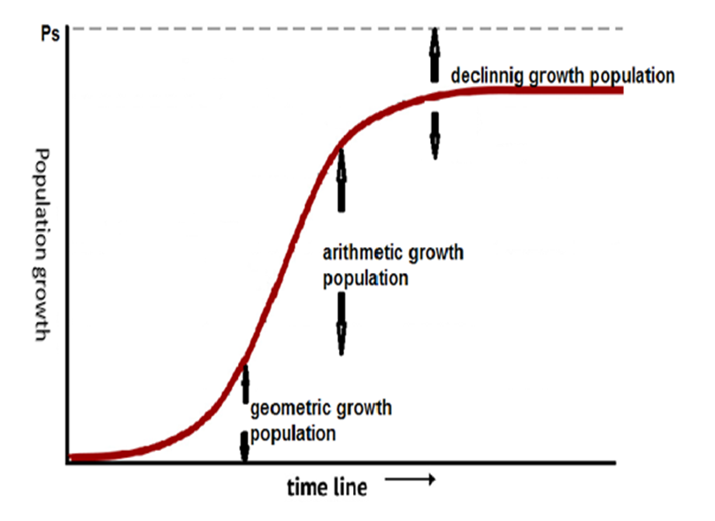
Calculation of population
Constant growth rate method.
Geometric growth phase.
Arithmetic growth phase.
Declining growth phase.

Slide 16

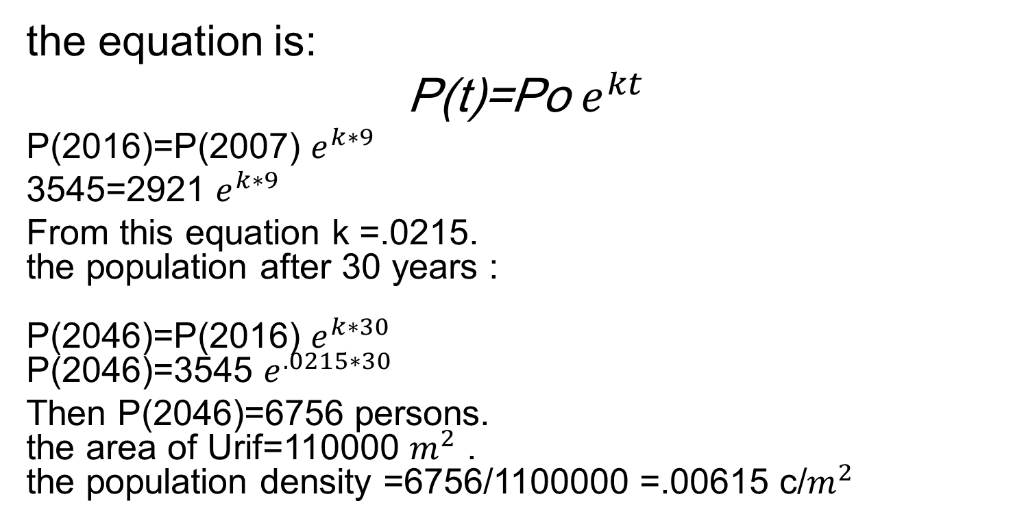
Geometric growth phase
the equation is:
P(t)=Po $e^{kt}$
P(2016)=P(2007) $e^{k∗9}$
3545=2921 $e^{k∗9}$
From this equation k =.0215.
the population after 30 years :
P(2046)=P(2016) $e^{k∗30}$
P(2046)=3545 $e^{.0215∗30}$
Then P(2046)=6756 persons.
the area of Urif=110000 $m^{2}$ .
the population density =6756/1100000 =.00615 c/$m^{2}$

Slide 17

Load per manhole
Thiessen polygon method.
Equal distribution method.
Gravity distribution method.

Slide 18
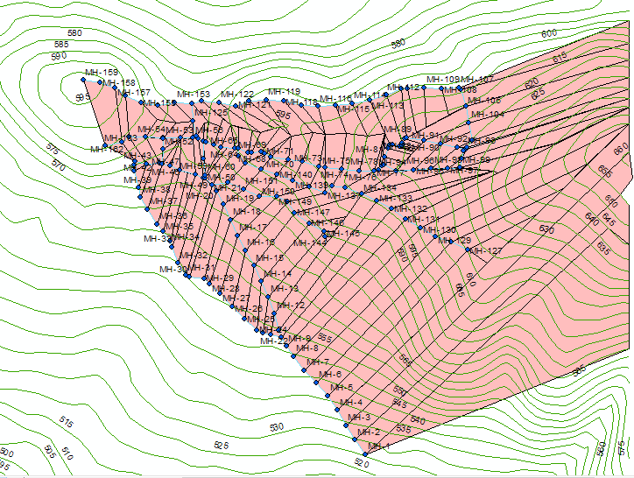

Gravity distribution method

Slide 19


Load calculation
Load per manhole = Population per manhole (water consumption x% of wastewater generation x PHF + infiltration x water consumption x% of wastewater generation)
where:
water consumption: 125 L/c.d.
% of waste water generation= 80%.
PHF=(2-4) use 4.
Infiltration =5%.

Slide 20
Load calculation
Load\manhole (m³\d) | Pop\manhole | Population density (c\m²) | Area (m²) | Infiltration (%) | PHF | % waste of water consumption | Water consumption (L\c.d) | LABEL
132.84 | 328 | 0.00615 | 53220 | 5 | 4 | 80 | 125 | MH-1
46.98 | 116 | 0.00615 | 18707 | 5 | 4 | 80 | 125 | MH-2
59.535 | 147 | 0.00615 | 23761 | 5 | 4 | 80 | 125 | MH-3
54.27 | 134 | 0.00615 | 21668 | 5 | 4 | 80 | 125 | MH-4
30.78 | 76 | 0.00615 | 12241 | 5 | 4 | 80 | 125 | MH-5
24.705 | 61 | 0.00615 | 9835 | 5 | 4 | 80 | 125 | MH-6

Slide 21
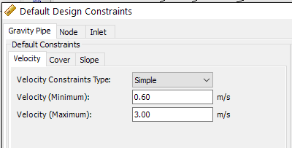
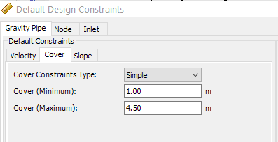
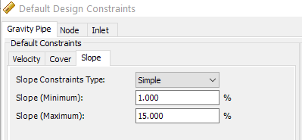
Design constraints
velocity
Cover depth
slope

Slide 22

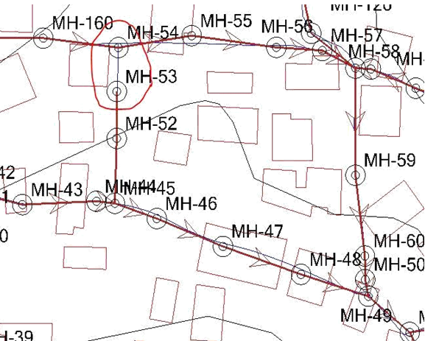
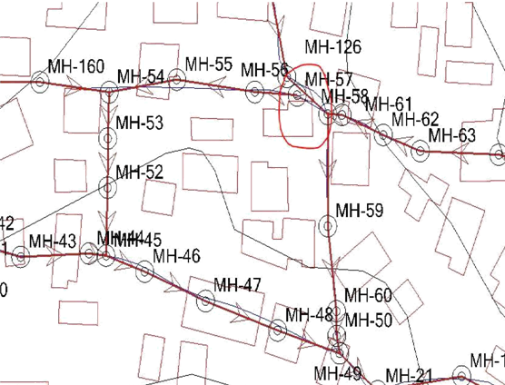
Solving the problems of cover depth and velocity

Slide 23

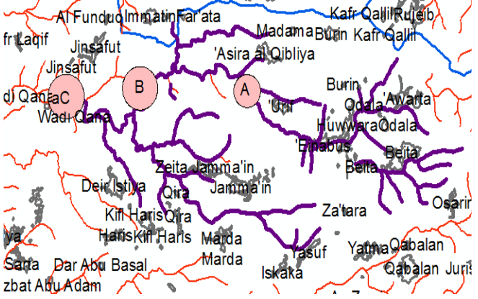
Determining the location of WWTP

Slide 24
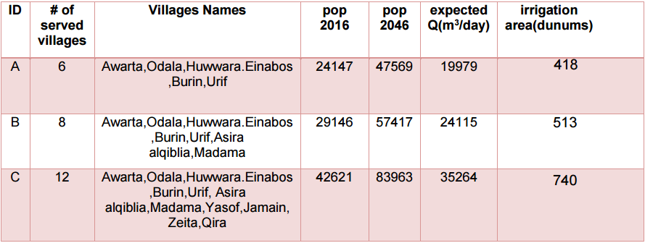
Determining the location of WWTP

Slide 25
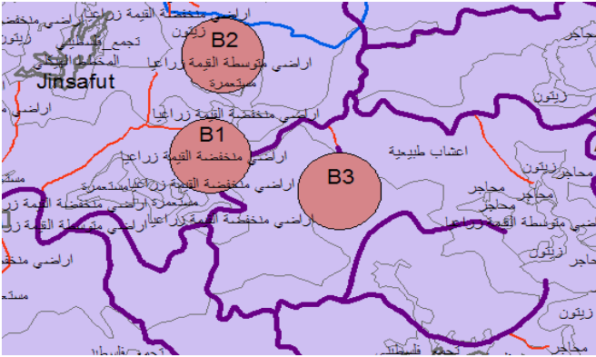
Determining the location of WWTP

Slide 26

Criteria for choosing WWTP
weight | Constraints
10 | Environmental
15 | Economical
20 | Close to the services
15 | Not in sensitive areas
20 | Availability of infrastructure
20 | Political

Slide 27

Criteria for choosing WWTP
Evaluation |  |  | Constraints
Site B2 | Site B1 | Site B3
5*10 | 10*10 | 5*10 | Environmental
10*15 | 10*15 | 10*15 | economical
10*20 | 10*20 | 10*20 | Close to the services
10*15 | 10*15 | 10*15 | Not in sensitive areas
10*20 | 10*20 | 10*20 | Availability of infrastructure
5*20 | 5*20 | 10*20 | political
850 | 900 | 950 | Total
So the best alternative is B3

Slide 28



Cost of constructing the WWCN
Cost
Material
Labor
Manholes
Manholes
Pipes
Pipes ($\m)
Excavation
Pavement ($\m2)
Pavement
Sand ($\ m3)
Sand

Slide 29
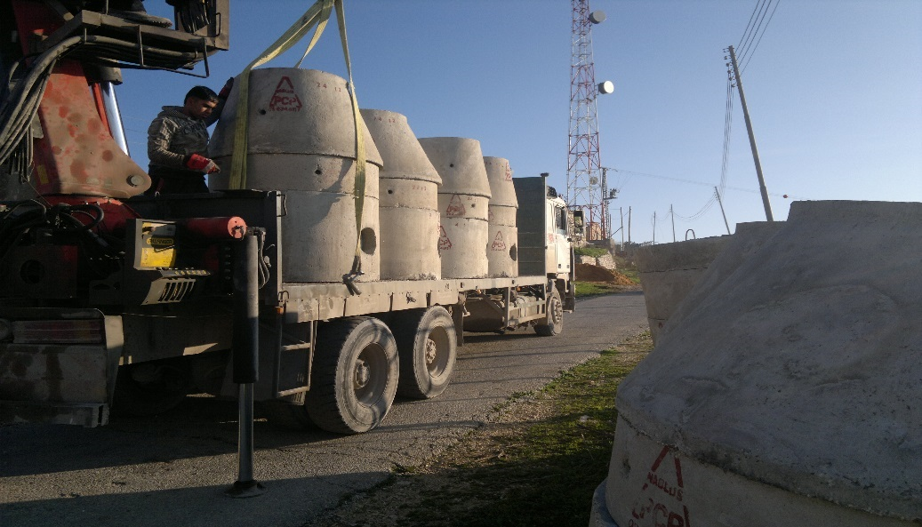
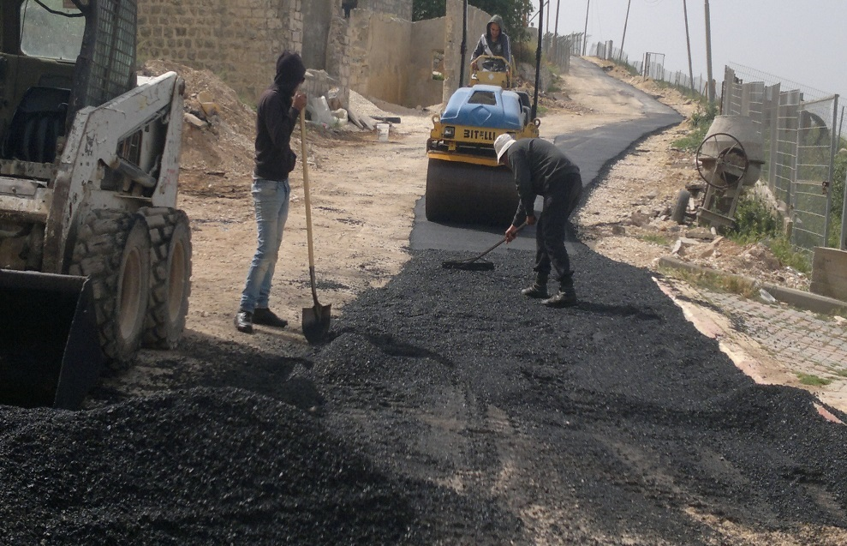
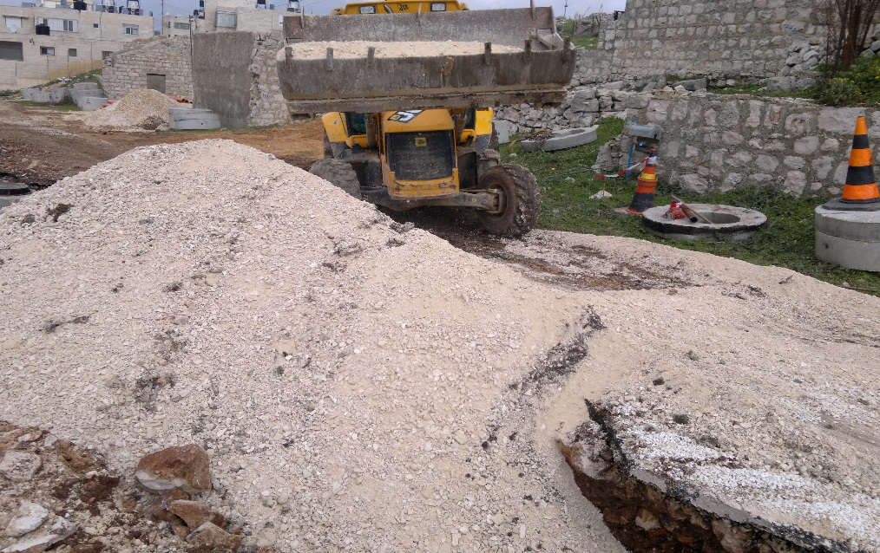
Cost of material for WWCN
$ Cost | Material
50954 $ | Manholes
39116 $ | Pipes
48774 $ | Excavation
$ 48006 | Pavement
$ 14580 | Sand
$ 201430 | Material total cost

Slide 30
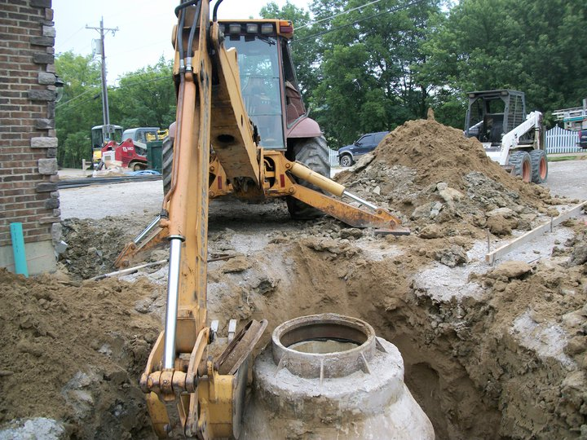
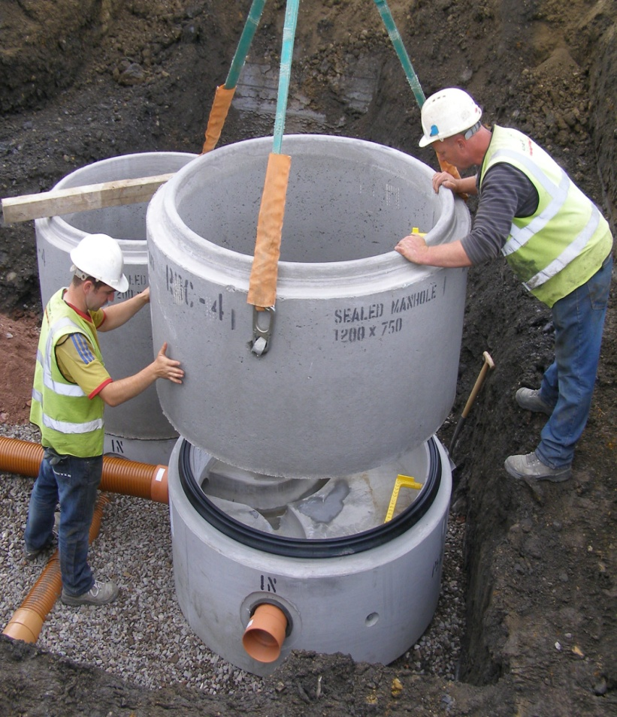
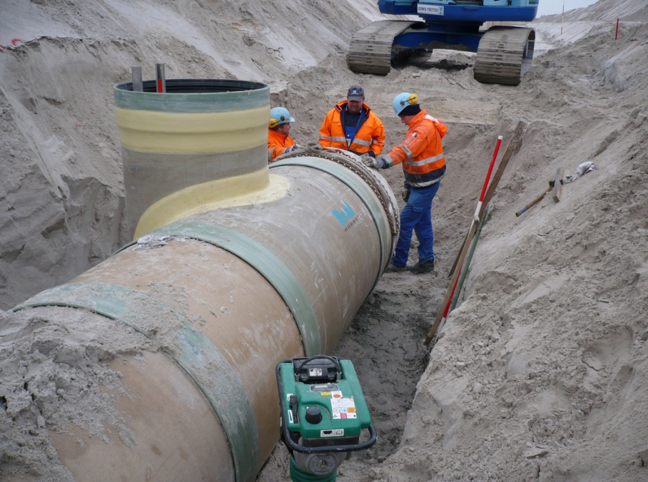
Cost of labor for WWCN
$ Cost | Cost per unit | Material
4890 $ | 30 $\man | Manholes
53340 $ | 15 $\m | Pipes
$ 40005 | 15 $\m2 | Pavement
$ 1778 | 5 $\m3 | Sand
100013 $ |  | Labor total cost

Slide 31

Results
Count
162 | Manholes
161 | Conduits
1 | Outfalls

Slide 32
Results
Results of manholes:
Hydraulic Grade Line (In) (m) | Depth (Structure) (m) | Structure Type | Diameter (m) | Flow (Total Out) (m³/day) | Elevation (Invert) (m) | Elevation (Rim) (m) | Elevation (Ground) (m) | Label
523.34 | 2.46 | Circular Structure | 0.9 | 1,071.63 | 523.25 | 525.7 | 525.7 | MH-1
528.44 | 1.2 | Circular Structure | 0.9 | 938.79 | 528.35 | 529.55 | 529.55 | MH-2
532.64 | 1.2 | Circular Structure | 0.9 | 891.81 | 532.55 | 533.76 | 533.76 | MH-3
536.42 | 1.2 | Circular Structure | 0.9 | 832.27 | 536.34 | 537.54 | 537.54 | MH-4
539.93 | 1.2 | Circular Structure | 0.9 | 778.01 | 539.85 | 541.05 | 541.05 | MH-5
542.55 | 1.2 | Circular Structure | 0.9 | 747.23 | 542.47 | 543.67 | 543.67 | MH-6

Slide 33
Results
Results of conduits:
Velocity (m/s) | Flow (m³/day) | Manning's n | Diameter (in) | Slope (%) | Invert (Stop) (m) | Invert (Start) (m) | Cover (Stop) (m) | Cover (Start) (m) | Length (Scaled) (m) | Stop Node | Start Node | Label
2.34 | 938.79 | 0.013 | 8 | 12.877 | 528.35 | 524.5 | 1 | 1 | 30 | MH-2 | MH-1 | CO-1
2.37 | 891.81 | 0.013 | 8 | 14.076 | 532.55 | 528.35 | 1 | 1 | 29.8 | MH-3 | MH-2 | CO-2
2.25 | 832.27 | 0.013 | 8 | 12.794 | 536.34 | 532.55 | 1 | 1 | 29.7 | MH-4 | MH-3 | CO-3
2.15 | 778.01 | 0.013 | 8 | 11.878 | 539.85 | 536.34 | 1 | 1 | 29.4 | MH-5 | MH-4 | CO-4
1.92 | 747.23 | 0.013 | 8 | 8.872 | 542.47 | 539.85 | 1 | 1 | 29.5 | MH-6 | MH-5 | CO-5
1.89 | 722.52 | 0.013 | 8 | 8.818 | 545.1 | 542.47 | 1 | 1 | 30 | MH-7 | MH-6 | CO-6

Slide 34
Results
Results of outfall:
Flow (Total Out) (m³/day) | Elevation (Invert) (m) | Elevation (Rim) (m) | Elevation (Ground) (m) | Label
1,071.63 | 518.95 | 520.15 | 520.15 | OF-1

Slide 35
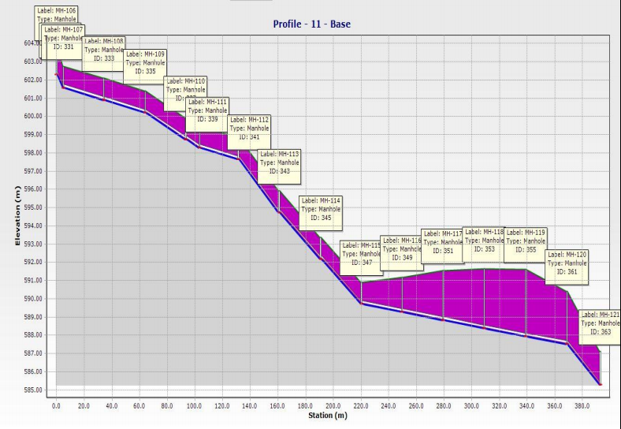
Results

Slide 36
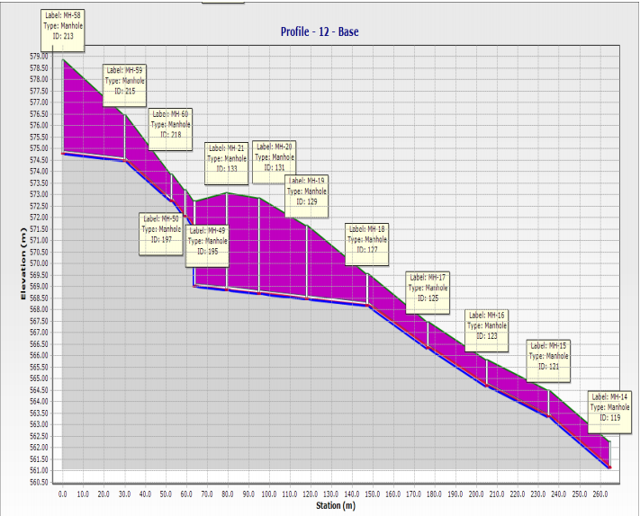
Results

Slide 37
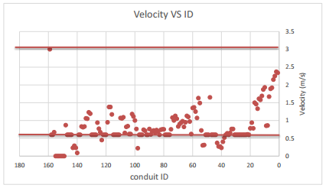
Results

Slide 38
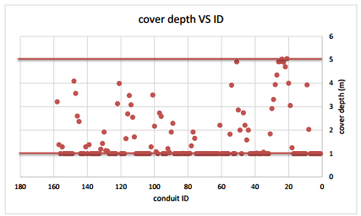
Results

Slide 39
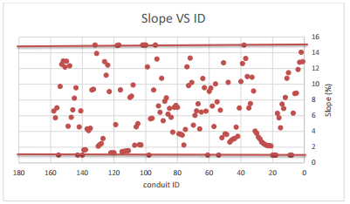
Results

Slide 40


Conclusion
We highly recommended of constructing the WWCN for its advantages
The total cost of constructing the WWCN is 301,443 $
The total length if the network conduit is 3556 m
The unit cost is 85$ per meter

Slide 41


