Slide 1

AN-Najah National University
Faculty of Engineering
Civil Engineering Department
Graduation Project
The Jerusalem Tower
Structural Analysis and Design
By: Shafiq Fawzi Aysi; Sameh Shaheen; Fuad Abu Al Hayyat
Supervisor: Dr. Samir H. Helou
Dec 2013

Slide 2
Content
Project Statement
Chapter 1: Introduction
Chapter 2: The Numerical Model
Chapter 3: Analysis and Verification
Chapter 3: Dimensional analysis and Design
Conclusion

Slide 3
Project Statement
This project aims at providing state of the art reinforced concrete structural design of a commercial and residential building in the city of Bethlehem; dubbed The Jerusalem Tower Building has already been designed and constructed in Bethlehem. However, the present design exercise will be conducted with absolutely no reference to any other propriety design.

Slide 4
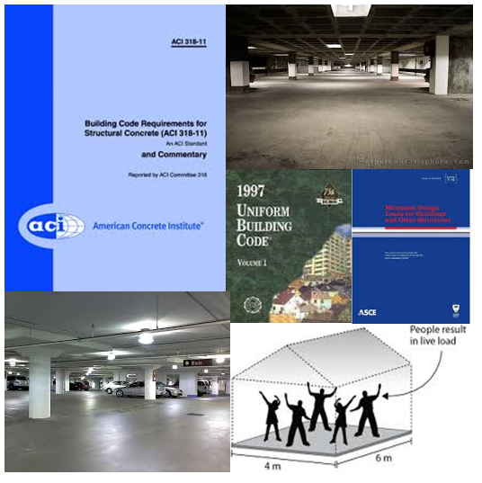
Chapter One
Introduction

Slide 5
  Building Description:
This building has a total area of 11293.96 m². The building consists of 13 stories ,the [Table] shows the areas of the floors:
Floor | Area(m²) | Height(m) | Occupancy
Third basement | 1110.54 | 3 | packing
Second basement | 1110.54 | 3 | packing
First basement | 1110.54 | 3 | packing
Ground | 1110.54 | 3 | Storage
First | 955.8 | 3 | offices
Second | 955.8 | 3 | offices
Third | 857.36 | 3 | offices
Fourth | 899.13 | 3 | restaurant
Fifth | 830.5 | 3 | residential
Sixth | 830.5 | 3 | residential
Seventh | 830.5 | 3 | residential
First roof | 553.08 | 3 | restaurant
Second roof | 139.13 | 3 | restaurant
Total Area | 11293.96
    Site Location:
The building is located in al-Mahed Street-Haret al tarajmeh (see in Appendix A).
    Architectural plans:
    All Architectural plans are included in Appendiix B

Slide 6
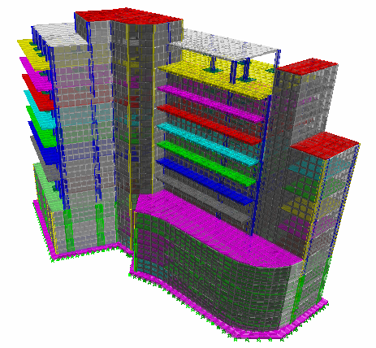
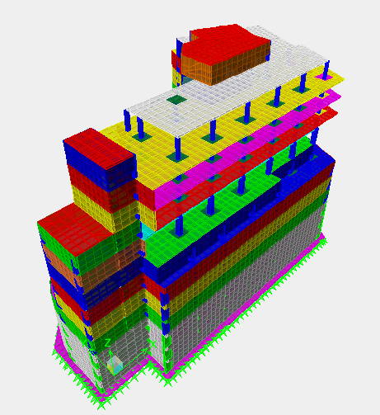
The 3D extruded view of building’s model
  Structural Topology:
In the following project, the structure is designed using a three dimensional structural model. The different elements are designed using the ultimate strength method with proper load combinations and using ETABS and SAFE.

Slide 7
  Materials:
Structural materials:
Concrete:
Concrete strength for all concrete parts is 28 MPa.
Modulus of elasticity (E) equals 24870 MPa.
Unit weight equals 25 KN/ m³.
Steel bars: Steel bars and stirrups reinforcement is 420 MPa.
Non-structural materials:
The unit weight of the structural and non-structural materials used in the project is shown in Table.
Materials | Unit weight (KN/ m²)
Reinforced concrete ( γ_{C} ) | 25
Normal Blocks ( γ_{B} ) | 12
Mortar ( γ_{M} ) | 23
Plastering ( γ_{P} ) | 23
Tiles ( γ_{T} ) | 26
Fill ( γ_{F} ) | 18

Slide 8
  Method of Construction:
The structural system in the building parts is comprised of a flat plate with drop panel to be suitable for large spans and the parking facility
  Codes and Standards:
The following codes and standards are used:
ACI 318-08: American Concrete Institute for reinforced concrete structural design.
ASCE/SEI 7-10: American Society of Civil Engineers.
UBC-97: Unified Building Code for seismic load parameters determination.

Slide 9
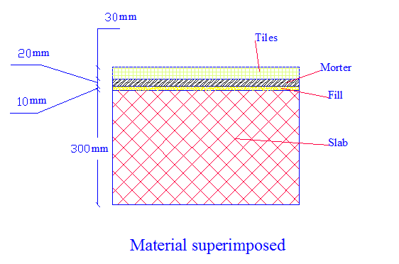
  Loads :
    Loads
Gravity loads
1. Dead loads:
Own weight of structural elements that have been calculated by ETABS
Superimposed Dead Load = 3.5 KN/m²
2. Live loads:
The values of live loads that will be used in this project are shown in [Table1].
Lateral loads
the earth pressure against retaining walls
Type of Occupancy | Live load in Code (KN/m²) | Assumption used
Garage | 1.92 | 2.5
Storage | 4.79 | 5
Offices | 2.4 | 2.5
Restaurant | 4.79 | 5
Apartment | 2.4 | 3
Mechanical area | 1.92 | 2.5

Slide 10
  load combinations:
Comb 1 = 1.4DL
Comb 2 = 1.2DL + 1.6L L
Comb 3 = 1.2D L+ 1 LL
Comb 4 (Service) = DL + LL
Comb 5 = ENV (Comb1, Comb2, Comb3, Comb4).
    Where: DL = Dead load.
    L L = Live load.

Slide 11
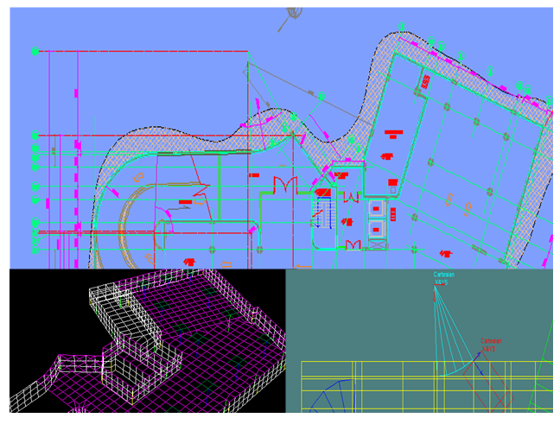
Chapter Two
The Numerical Model

Slide 12
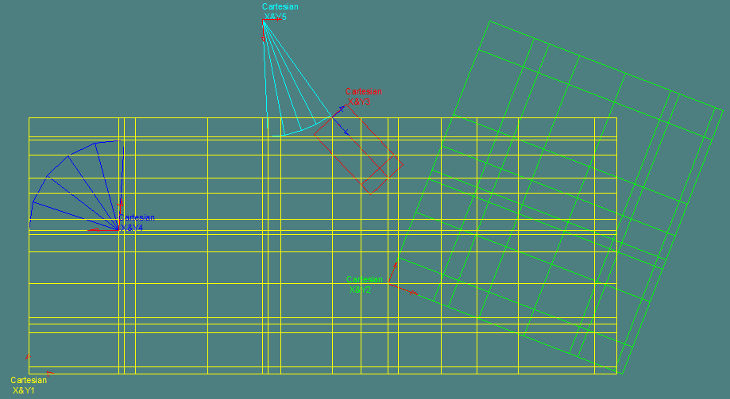
  Grid Definition:
The AutoCAD drawings are exported to ETABS. This process achieved by dividing the project into five coordinate systems as shown in Figure below

Slide 13
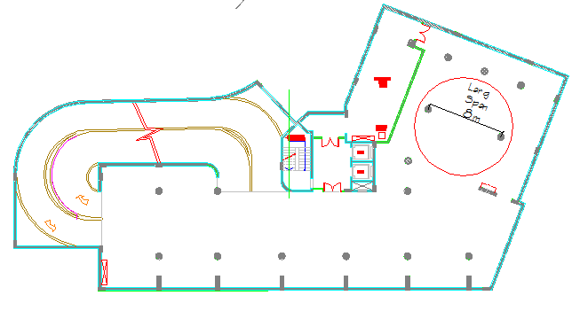
  Preliminary Design of Elements:
    Slabs:
The thickness of the slab depends on the type of slab and the length of span. In this project the type of slab is a two way flat plate; its maximum span length is 8 m.

Slide 14
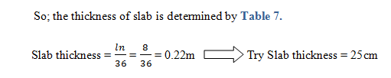
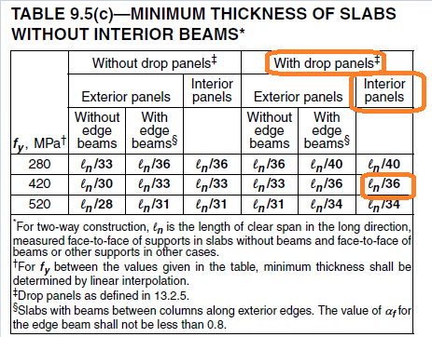
    Drop Panels:
All drop panels used in floors, to resist punching shear, are (2x2) m² and depth of 30 cm. the same area used for the mat foundations with a depth of 40 cm.

Slide 15
    Columns:
Circular columns: using in parking with diameter of 70 cm .
Rectangular columns: using in around perimeter of building of many types:
  Column 40×120 cm using in (B3, B2, B1).
  Column 30×90 cm using in( GF, F1, F2, F3, F4)
  Column 30×60 cm using in (F5, F6, F7)
  Column 30×40 cm using in (FR1, FR2)
Square columns: using in the middle of the building of many types:
  60×60 cm using in (GF, F1, F2, F3, F4).
  40×40 cm using in (F5, F6, F7, FR1 ,FR2)
    Shear walls:
The Shear walls around the periphery of the building. Shear Walls reduce sway and add stiffness to the structure.

Slide 16
  Meshing of Area:
There are many shapes used to form the meshing area.
The strips of meshing must located at the centre of the column.
  Preparing Storey Levels:
Replicating stories: slabs in different story levels are given different names. This is desired and simplifies load application.
Addition loads to slabs: every slab have different types of loads as shown in Table .

Slide 17
load type |  |  | Live | Super imposed
Story Name | Slab Name | Occupancy
Base | S25B3G | Garage | 2.5 | 0
 | S25B3W | Water | 30 | 0
Base3 | S25B3G | Garage | 2.5 | 0
 | S25B3M | Mechanical | 5 | 3.5
Base2 | S25B3G | Garage | 2.5 | 0
 | S25B3S | Storage | 5 | 3.5
Base1 | S25B3S | Storage | 5 | 3.5
 | S25B3S | Storage | 5 | 3.5
Ground Floor | S25FGO | Offices | 2.5 | 3.5
 | S25FGS | Storage | 5 | 3.5
 | Roof Ramp | Water | 2 | 0
Floor1 | S25F1O | Offices | 2.5 | 3.5
 | S25F1S | Storage | 5 | 3.5
Floor2 | S25F2O | Offices | 2.5 | 3.5
 | S25F2S | Storage | 5 | 3.5
Floor3 | S25F3R | Restaurant | 5 | 3.5
 | S25F3R | Restaurant | 5 | 3.5
Floor4 | S25F4A | Apartment | 3 | 3.5
 | S25F4A | Apartment | 3 | 3.5
Floor5 | S25F5A | Apartment | 3 | 3.5
 | S25F5A | Apartment | 3 | 3.5
Floor6 | S25F6A | Apartment | 3 | 3.5
Floor7 | S25F6A | Apartment | 5 | 3.5
1st Roof | S25FR1M | Mechanical | 2.5 | 3.5
 | S25FR2W | Water | 2 | 0
2rd Roof | S25FR2W | Water | 2 | 0

Slide 18
Chapter Three
Analysis and Verification

Slide 19
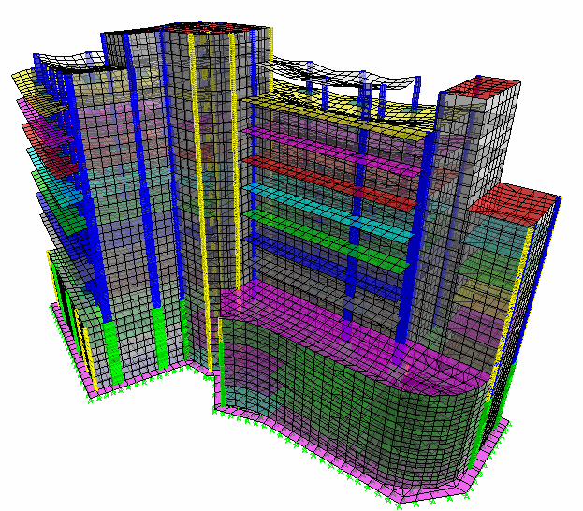
  Compatibility:
Compatibility is Ok

Slide 20
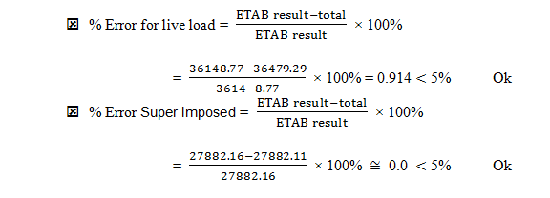
  Equilibrium:
This check is done by two ways
Equilibrium of Testing point load: the point load put on the second roof
Test Load Check Equilibrium
 |  |  | ETABS Results
Test Dead | X | 500 | -500
Load (KN) | Y | 600 | -600
 | Z | -1000 | 1000
Test Live | X | 1000 | -1000
Load (KN) | Y | 1200 | -1200
 | Z | -2000 | 2000
Equilibrium area loads: the process of transfer the model from ETABS to AutoCAD to calculate the areas of all stories

Slide 21
Area Check Equilibrium
 |  | L Load(not include Ramp Load) |  |  | Super Imposed
 |  | Area | Load | total | Area | Load | total
Base | S25B3G | 790.0481 | 2.5 | 1975.12 | 790.0481 | 0 | 0
 | S25B3W | 68.503 | 30 | 2055.09 | 68.503 | 0 | 0
Base3 | S25B3G | 790.0481 | 2.5 | 1975.12 | 790.0481 | 0 | 0
 | S25B3M | 68.503 | 5 | 342.515 | 68.503 | 3.5 | 239.7605
Base2 | S25B3G | 790.0481 | 2.5 | 1975.12 | 790.0481 | 0 | 0
 | S25B3S | 68.503 | 5 | 342.515 | 68.503 | 3.5 | 239.7605
Base1 | S25B3S | 799.1391 | 5 | 3995.696 | 799.1391 | 3.5 | 2796.987
 | S25B3S | 68.503 | 5 | 342.515 | 68.503 | 3.5 | 239.7605
Ground Floor | S25FGO | 749.2453 | 2.5 | 1873.113 | 749.2453 | 3.5 | 2622.359
 | S25FGS | 40.0504 | 5 | 200.252 | 40.0504 | 3.5 | 140.1764
 | Roof Ramp | 184.0093 | 2 | 368.0186 | 184.0093 | 0 | 0
Floor1 | S25F1O | 839.8813 | 2.5 | 2099.703 | 839.8813 | 3.5 | 2939.585
 | S25F1S | 40.0504 | 5 | 200.252 | 40.0504 | 3.5 | 140.1764
Floor2 | S25F2O | 839.8813 | 2.5 | 2099.703 | 839.8813 | 3.5 | 2939.585
 | S25F2S | 40.0504 | 5 | 200.252 | 40.0504 | 3.5 | 140.1764
Floor3 | S25F3R | 741.2289 | 5 | 3706.145 | 741.2289 | 3.5 | 2594.301
 | S25F3R | 40.0504 | 5 | 200.252 | 40.0504 | 3.5 | 140.1764
Floor4 | S25F4A | 683.3839 | 3 | 2050.152 | 683.3839 | 3.5 | 2391.844
 | S25F4A | 40.0504 | 3 | 120.1512 | 40.0504 | 3.5 | 140.1764
Floor5 | S25F5A | 791.8869 | 3 | 2375.661 | 791.8869 | 3.5 | 2771.604
 | S25F5A | 40.0504 | 3 | 120.1512 | 40.0504 | 3.5 | 140.1764
Floor6 | S25F6A | 791.8869 | 3 | 2375.661 | 791.8869 | 3.5 | 2771.604
Floor7 | S25F6A | 791.8869 | 5 | 3959.435 | 791.8869 | 3.5 | 2771.604
1st Roof | S25FR1M | 492.0866 | 2.5 | 1230.217 | 492.0866 | 3.5 | 1722.303
 | S25FR2W | 27.7272 | 2 | 55.4544 | 27.7272 | 0 | 0
2rd Roof | S25FR2W | 120.5126 | 2 | 241.0252 | 120.5126 | 0 | 0
 |  | Total |  | 36479.29 | Total |  | 27882.11
 |  | ETAB Results |  | 36148.77 | ETAB Results |  | 27882.16

Slide 22
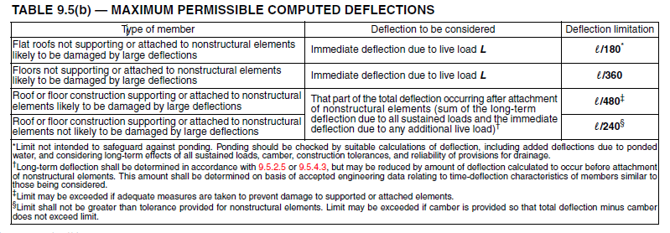

Serviceability
The deflection is calculated on case 3 in Table and the longest span (8m) because they are the critical cases.

Slide 23

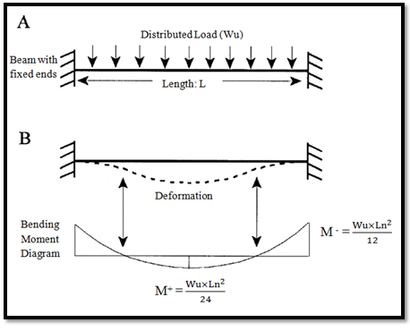
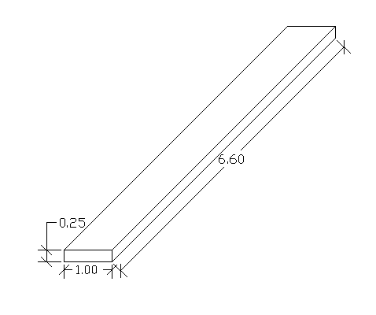

Check of Bending Moment Values
Slab dimensions = 1 m x 0.25 m and length = 6.6 m
Ultimate load in the slab per meters: Wu
W_{D}: Own weight of slab = 0.25 x 25 x 1 = 6.25 KN/m
W_{L}: Live load = 2.5 x 1 = 2.5 KN/m
Wu = 1.2 W_{D} + 1.6 W_{L}
= 1.2 x 6.25 + 1.6 x 2.5 = 11.5 KN/m

Slide 24
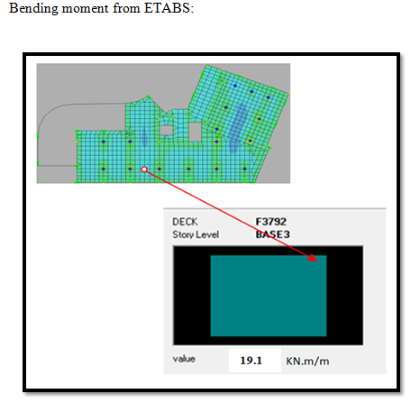

Bending moment from ETABS=19.1 KN.m/m
OK

Slide 25
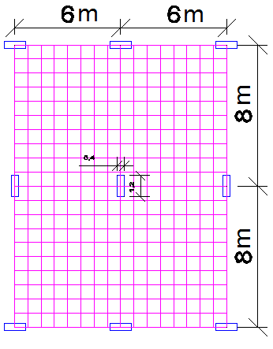
  Punching shear:
Type of load | Value (KN/m²)
Live Load | 5
Super imposed | 3.5
It is checked by SAFE software and hand calculations
    1. Simple Model check.
The process of making simple model that has the same properties and loads of the project. The objective from the simple model is to check the property of exporting ETABS files to SAFE. The simple model is analyzed by SAFE only, then the same model is done by ETABS one and exported to SAFE. The tow results have been compared for stress ratio.

Slide 26
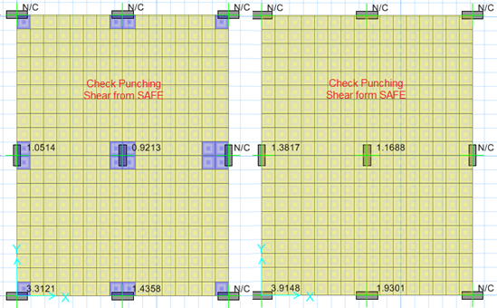
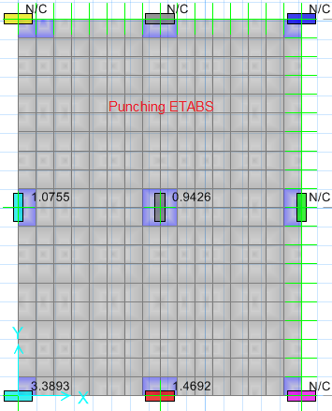
The ETABS exported to SAFE has relatively high ratio than the SAFE one; and this is safer .

Slide 27
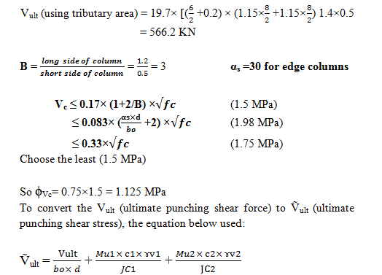
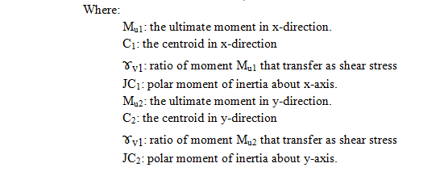
checks using hand calculation

Slide 28
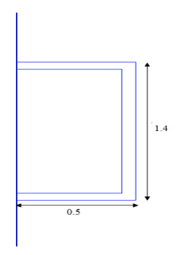
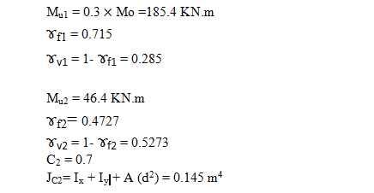
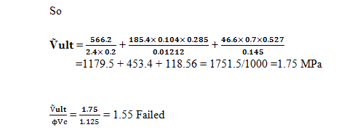
I. For edge column:

Slide 29
2.Project Model
According to preliminary design, some of slabs and mat foundations have drop panel and some of them have not. The results are shown in Appendix C.
  Where
  Stress ratio is the ratio between ultimate load and the nominal strength.
  N/C: NOT CALCULATED
  If stress ratio ˂ 1 punching shear check is okay.
  If stress ratio ˃ 1 punching shear check is Failed.

Slide 30
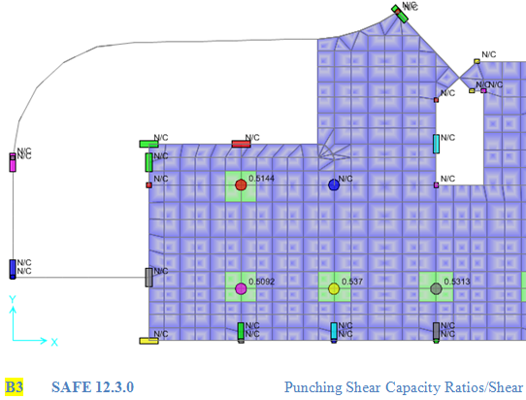

Slide 31
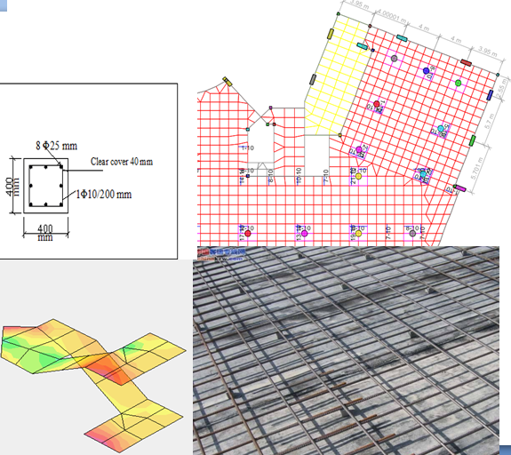
Chapter Four
3D Dimensional analysis and Design

Slide 32
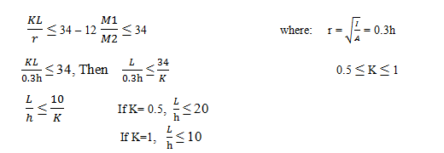
    Design of columns.
Check slenderness
Thus if the height to width ratio is less than 15 (the mean value) the column is classified as short
In the project, all columns is used as short columns due to ratio between the length and smaller
width less than15.

Slide 33
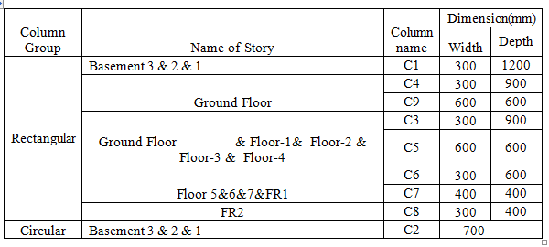
Columns grouping:
Regard to the area of steel, the columns is divided into two groups (rectangular and circular).

Slide 34
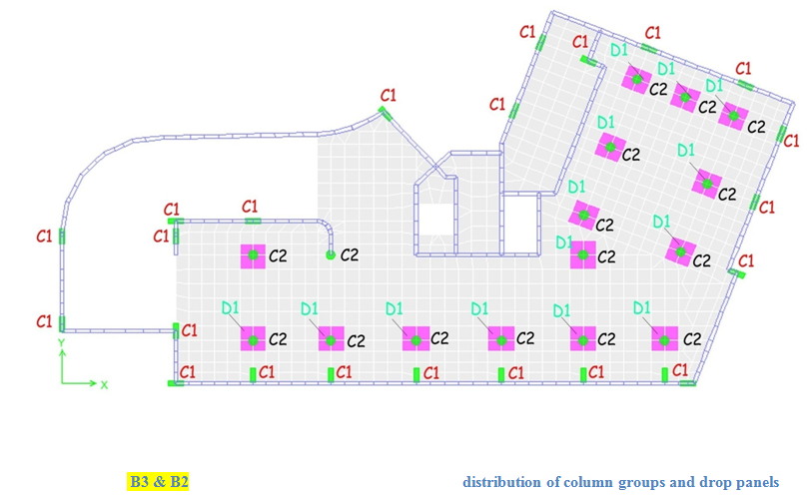

Slide 35
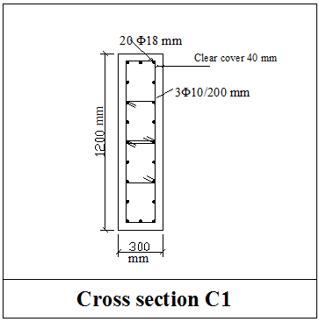
Reinforcement of Rectangular columns:
Column 1 (1200 x 300) mm is taken to design longitudinal
and shear reinforcement.
Longitudinal Reinforcement :
Area of steel longitudinal = 4800 mm²
Maximum spacing between bars = 150 mm.
Concrete clear cover = 40 mm.
The total number of bars in column calculated as follow:
Number of bars in depth (120 mm) = 9 bars.
Number of bars in width (300 mm) = 3 bars.
Total bars in the column equal 20 bars.
Area of one bar which must use = = 240 mm^{2.}
Area of bar Φ18 = 254 mm^{2.}
So, use 20 Φ18 mm is used
Shear reinforcement:
Shear reinforcement in all columns equals zero, but ACI – code recommend using minimum area of steel.
Spacing between ties is the smallest of:
S ≤ Least column dimension
≤ 16 d_{b} d_{b}: diameter of longitudinal bar
≤ 48 d_{s} d_{s} : diameter of stirrups = 10 mm²
S ≤ 300 mm
≤ 16 x 16 = 256 mm
≤ 48 x 10 = 480 mm
So, use 3 Φ 10 mm / 200 mm

Slide 36
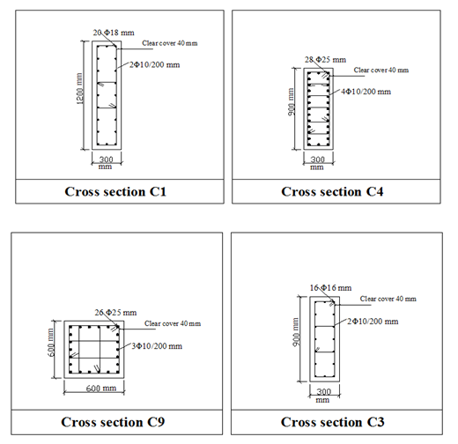
Cross Section of column

Slide 37
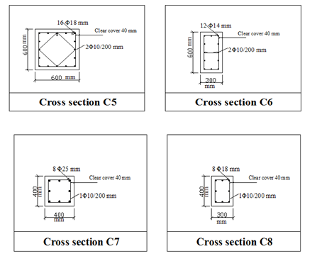
Cross Section of column

Slide 38
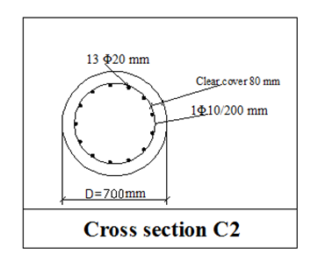
Reinforcement of circular columns:
Column2 (700) mm is taken to design longitudinal and shear reinforcement.
ACI code recommended the following:
Maximum clear spacing of the spirals is 75 mm.
Minimum clear spacing is not less than 25 mm or 1.33 mm the nominal size of the coarse aggregate.
Spirals should not be less than 10 mm.
Spiral reinforcement shall be provided by
1.5 turns of spiral bar at each end of support.
Area of steel = 3848 mm²
Rebar percentage = 1%
Number of bars = = 12 bars.
Area of bar = = 287 mm²
Area of bar Φ20 mm = 314 mm²
So, use 12 Φ20 mm is used

Slide 39
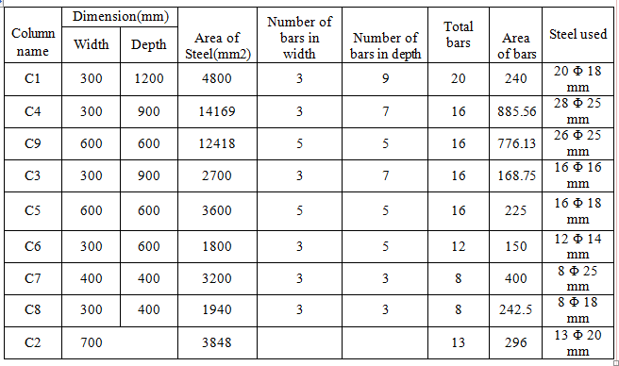
Steel of column

Slide 40
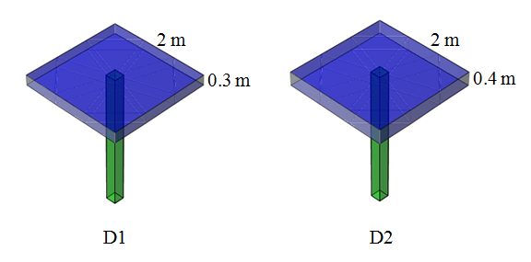
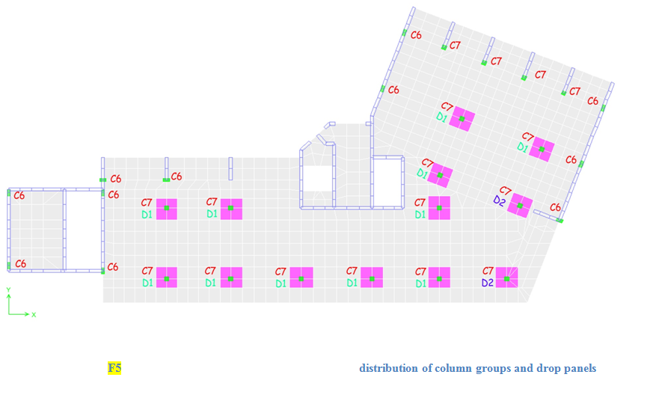
    Design of slabs.
Punching shear:
The thickness of drop panels is redesigned
to be safe for punching shear.

Slide 41
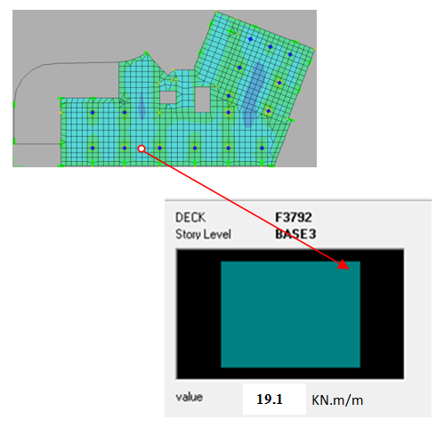
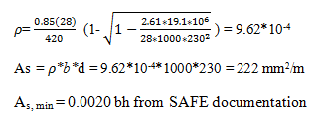
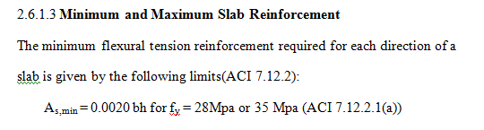
Flexure reinforcement:
comparing the moment and area of steel in ETABS and in SAFE.
From ETABS:
Positive moment = 19.1 KN-m/m
d = 230 mm b= 1000 mm
A_{s, min} = 0.0020 (1000) (250) = 500 mm²/m
Then, Use A_{s, min}

Slide 42
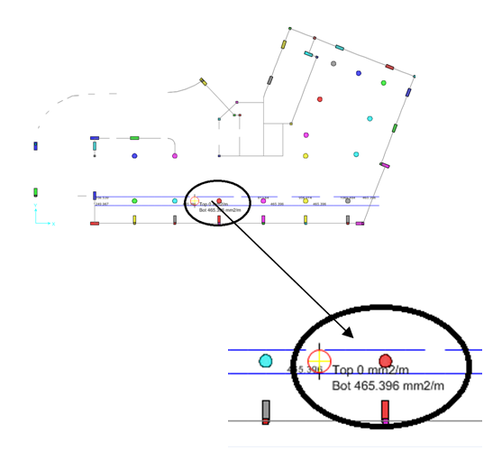
From SAFE:
The column strip is taken as one meter strip.
The area of steel is equal to the ETABS calculations
SAFE slab design tracking a typical uniform reinforcing
is used 1 Φ12 each 200 mm in each direction(X and Y).
Additional bars (Top and Bottom) needed for the column
strip and middle strip in both directions.
The additional bars shall be extended 0.35 Ln
(as maximum value in the ACI Code) in both directions .

Slide 43
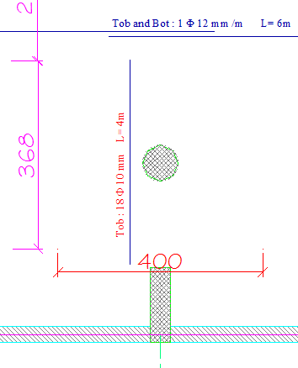
    Detailing of Slab

Slide 44
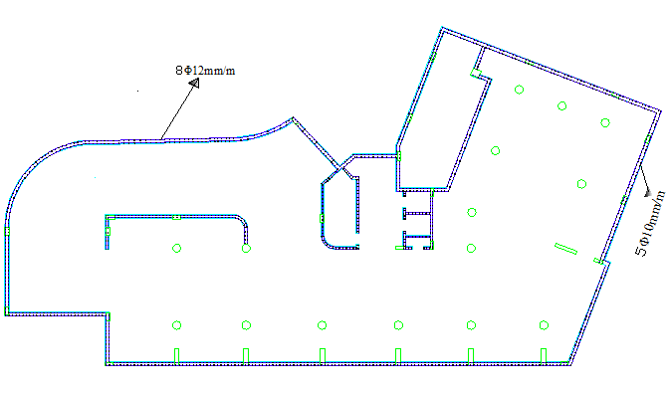
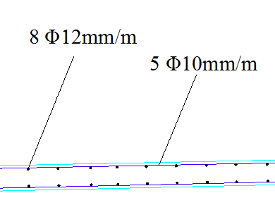

    Design of Shear Walls
The shear wall reinforcement designed for
ultimate moment from ETABS program in both
directions (vertical and horizontal) .
Horizontal direction(M₁₁):
maximum moment = 35 K.m/m
As = 360 mm²/m
As = As _{min} Use As _{min}
Use bar Φ10mm so, L_{dt} =50*10 = 500mm
So, use 5 Φ10mm/m L=6m
Vertical direction(M₁₁):
maximum moment = 45 KN.m/m
As = 465 mm²/m
As<As _{min} Use As _{min}
Use bar Φ12mm so, L_{dt} =50*12= 600mm
So, use 8 Φ12mm/m L=6m
As _{min} = As _{shrinkage} = 0.0012bh=360 mm²/m

Slide 45
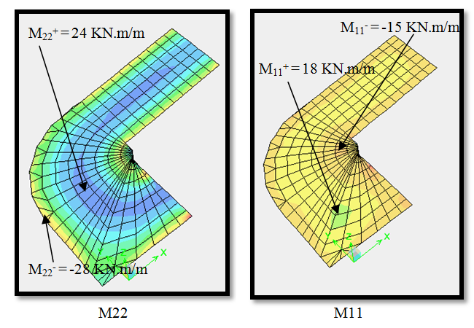

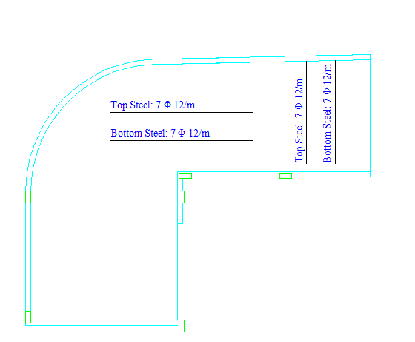
    Design of Ramp
The Ramp reinforcement designed for ultimate
moment from ETABS program in both directions
(X and Y)
X- direction(M₁₁):
maximum moment = 18 KN.m/m
As = 229 mm²/m
As<As _{min} Use As _{min}
Use bar Φ12mm so, L_{dt} =50*12 = 600mm
So, use 7 Φ12mm/m
Y- direction(M₁₁):
maximum moment = 28 KN.m/m
As = 359 mm²/m
As<As _{min}
Use As _{min}
Use bar Φ12mm so, L_{dt} =50*12= 600mm
So, use 7 Φ12mm/m

Slide 46
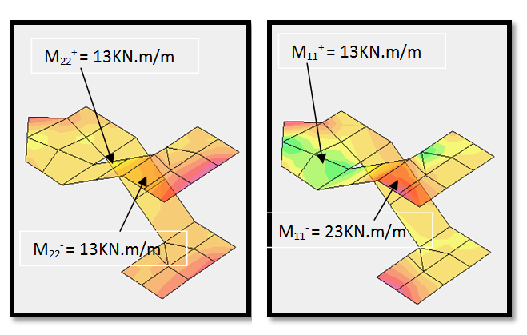
    Design of stairs
The stairs reinforcement designed for ultimate
moment from ETABS program in both directions
(X and Y)
X- direction(M₁₁):
maximum moment = 23 KN.m/m
As = 293 mm²/m
As<As _{min}
Use As _{min}
Use bar Φ12mm so, L_{dt} =50*12 = 600mm
So, use 7 Φ12mm/m
Y- direction(M₁₁):
maximum moment = 13 KN.m/m
As =165 mm²/m
As<As _{min}
Use As _{min}
Use bar Φ12mm so, L_{dt} =50*12= 600mm
So, use 7 Φ12mm/m

Slide 47
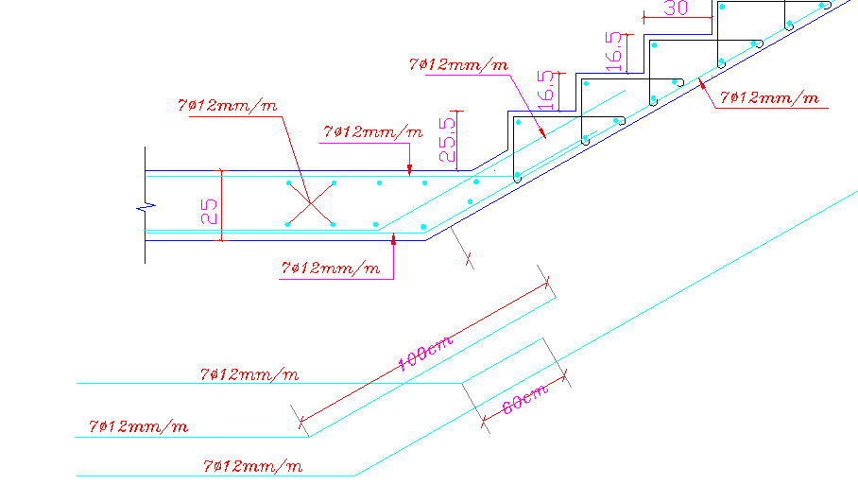
    Typical Section of Stairs

Slide 48
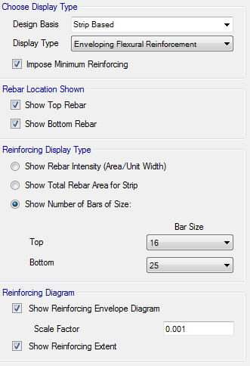
    Design of mat foundation
The allowable stress under the building is q_{all} = 250KN/m²
SAFE Mat foundation design tracking a typical rebar
Top Φ16 and Bottom Φ25 reinforcing is used in
each direction (X and Y).

Slide 49
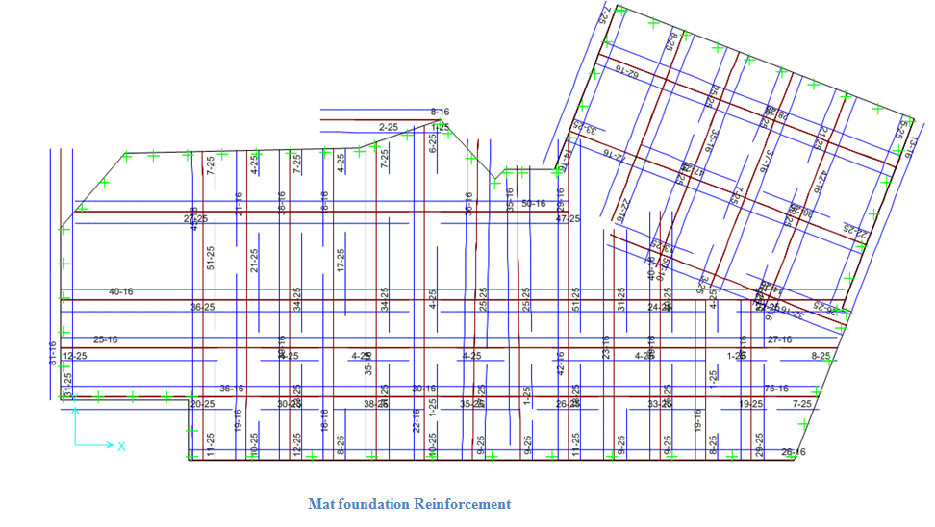

Slide 50
    conclusion
It is obvious that most of reinforcement we use is equal to minimum steel which means the thickness of the structural elements like slabs may be further reduced without affecting the punching shear safety recommendations. The punching shear can be reduced by using column capitals drop panel; so the thickness of slab can be reduced.
As a result in our project we use bars with diameters more than 12 mm to be sure that the bars will widely spaced while masons and helpers work and to minimize the number of bars in our section to simplify the work.
After finish the project ,dimensions of some columns are changed as follows:
the circular column diameter (70cm) changed to smaller diameter ,the result that the steel ratio increased but in the rectangular columns lies near the shear wall when decreasing there dimensions, the steel ratio decreased. This means that the shear wall carries the load carried by columns

Slide 51
Thank you
Any Question ?

