Slide 1

Filling Machine
Prepared By
Omar Asaad
Ahmad Ghazi
Supervisor
Dr.Kamel Saleh

Slide 2
Table of Content
Introduction
Objectives
Hardware Components
System Installation
Conclusion

Slide 3
Introduction
This project is to design and build a filling machine. In this presentation we are going to discuss the design and building for an automatic machine.
Is to design a machine to fill liquids to objects sizes that are not discussed yet with the company.also it is economically low and easy for maintenance and repair since it is locally made.

Slide 4
Introduction
The Filling machine is considered as a very essential component of the industrial production lines, therefore we have been manufacturing this machine with a very simple parts that assures high quality products

Slide 5
Objectives
Limiting The Cost.
Achieve affordable Optimum Design.
Achieve The possible Efficiency of our local market industrial usage.

Slide 6
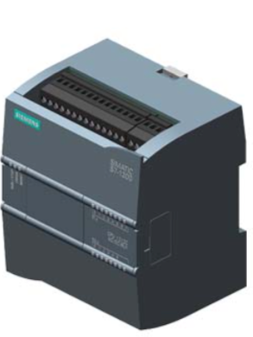
Hardware Components
PLC Kit

Slide 7
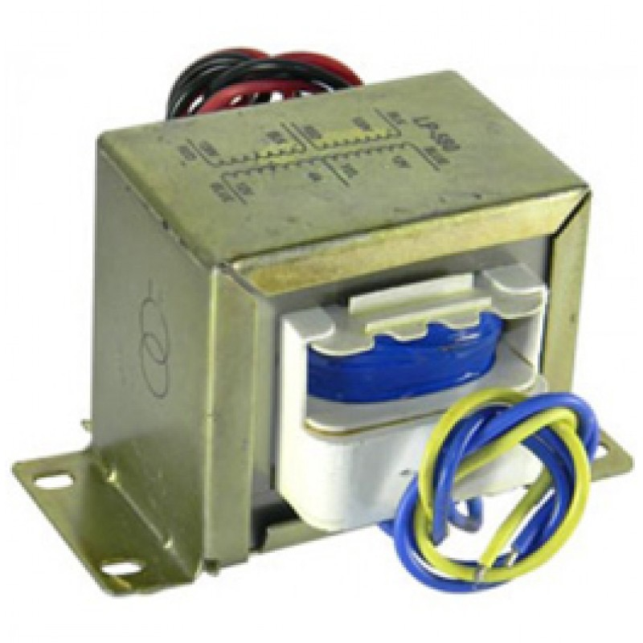
Hardware Components
Step-Down Transformer

Slide 8
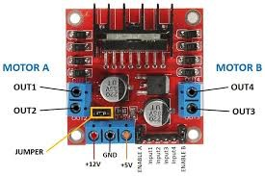
Hardware Components
Motors Driver

Slide 9
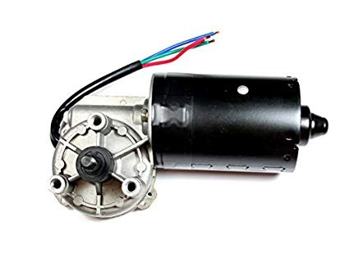
Hardware Components
DC Motor

Slide 10
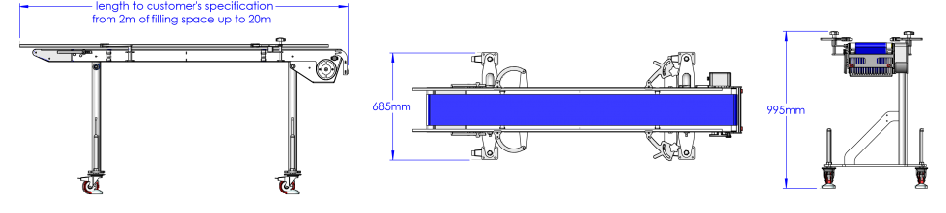
Hardware Components
Conveyor Belt

Slide 11
Other Components
Fuses & Circuit Breaker
Gears
Relays
Lamp & Indicators
Timers & Counters
Sensors

Slide 12
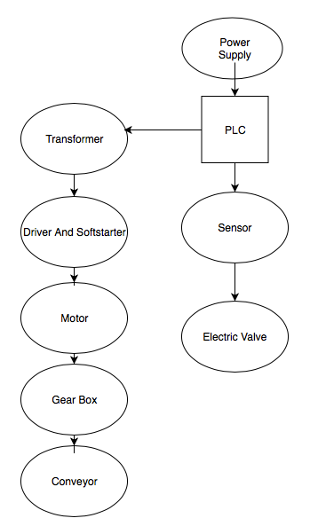
System Installation

Slide 13
Conclusion
The Palestinian industrial sector has faced many difficulties and problems related to the structure , size of the industry and the inability to create markets for its products , in addition to the problems of lack necessary financing and equipment, industrial supply ,lack of row materials of industry , high prices ,the industrial sector has witnessed a decline in the efficiency and productivity.

Slide 14
THANK YOU

