Slide 1
The Effect of Pyrolized Carbon Black from Waste Tire in Concrete
Prepared by: Supervisor: Dr. Osayd Abdul Fattah
Hassan Zaeem
Majd Bakri
Qasem Nazzal

Slide 2
Agenda
Introduction
Objectives
Experimental work program
Results and discussions
Conclusion
Recommendations

Slide 3
Introduction
Concrete is the most widely used in construction material in the world. It is obtained by mixing cementitious materials, water and aggregates in required proportions.
Waste tire is one of the most important problems that face many countries in the world, especially with the growth of the auto-related industries.

Slide 4
Introduction
Pyrolysis Process:
Pyrolysis is thermos chemical decomposition, turns waste into energy rich fuels by heating the waste, like waste tires under controlled conditions at elevated temperatures in the absence of oxygen.

Slide 5
Objectives
Investigate the ability of using PCB as additive in concrete.
Obtain the optimum combination of concrete and PCB concentration in mixture that leads to be a better performance of concrete.
Determine the performance characteristic of concrete mixture with PCB.
Investigate the effect of adding PCB of different concentration on blank concrete.

Slide 6
Experimental Work Program
Materials:
The type of concrete that used in this study is B300, it consists of three main components, Cement, Sand and Aggregate.
Pyrolized Carbon Black (PCB):
A by-product that result from the pyrolysis process of waste tires, The sample considered as an improving and binding agent in our project between cement and aggregate.

Slide 7
Experimental Work Program
Methodology:
The basic material in this project is the PCB, so the considered tests are related to this material, where the concentration of adding PCB, and the ratio of the consideration black carbon are changed in order to see the differences between the blank concrete and concrete with the presence of PCB. The comparison is based on compression test, slump test and absorption test.

Slide 8
Experimental Work Program
Two main steps:
Step1: Preparing concrete specimens:
w/c= 75%.
Study effect of different ratios of PCB (3%, 3.5%, 4%, 4.5%, 5%, 6%, 10% and 15%) on the blank concrete.
Material | Cement | Sand | Aggregate
Percentage | 1 | 2 | 4

Slide 9
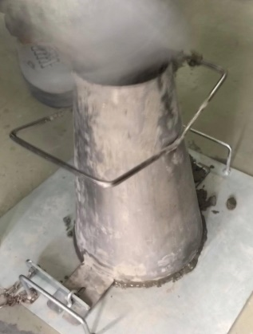
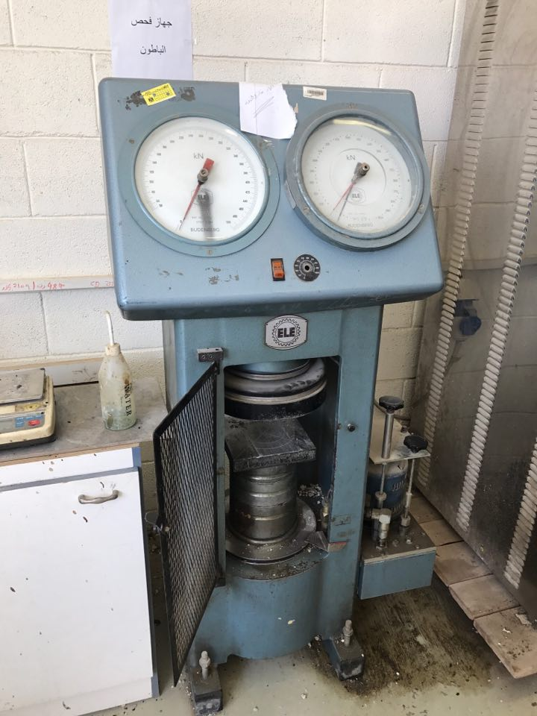
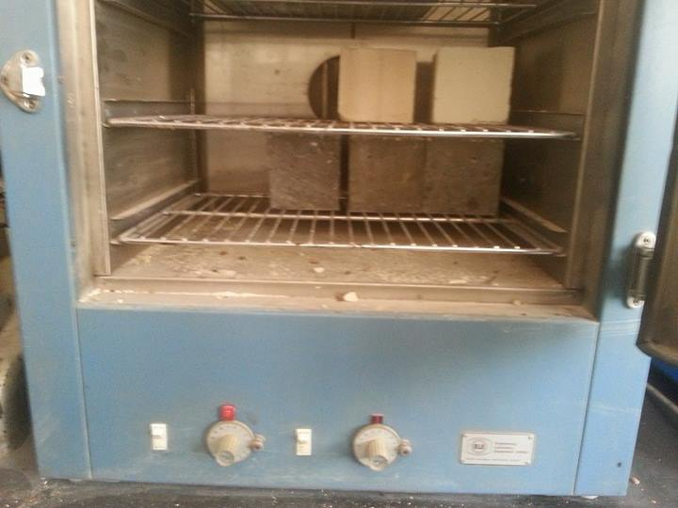
Experimental Work Program
Step 2: Testing the samples:
Slump test, Compression test and Absorption test were conducted.

Slide 10
Results and Discussions
For each percent three cubes were prepared for each age, at first stage a percentage of PCB was suggested as (5%, 10% and 15%) to obtain the optimum strength of concrete (MPa) with PCB.
Compression test:
Ratios | 7 days | 14 days | 28 days
0% | 61.5 | 77.55 | 86.73
5% | 66.3 | 88.36 | 100.6
10% | 54 | 74.48 | 88.36
15% | 44.89 | 63.26 | 76.83

Slide 11
Results and Discussions
Slump test in centimeter:
ratios | 0% | 5% | 10% | 15%
Slump test | 18 | 12 | 16 | 17

Slide 12
Results and Discussions
Second stage was done with 4% and 6%:
Slump test in centimeter:
Ratios | 7 days | 14 days | 28 days
4% | 96.42 | 112.24 | 118.97
6% | 62.55 | 82.65 | 94.18
Ratios | 4% | 6%
Slump test | 8 | 16

Slide 13
Results and Discussions
Third stage was done with 3%, 3.5% and 4.5%:
Slump test in centimeter:
Ratios | 7 days | 14 days | 28 days
3% | 76.5 | 84.69 | 91.83
3.5% | 81.63 | 92.85 | 100
4.5% | 91.5 | 100.05 | 109.74
Ratios | 3% | 3.5% | 4.5%
Slump test | 12 | 14 | 12.5

Slide 14
Results and Discussions
The carbon’s ratio was stabilized with decreasing of cement ratio in order to reach the blank strength with lower cement ratio, by reducing 5% and 10% of cement ratio:
Slump test in centimeter:
Ratios | 7 days | 14 days | 28 days
-5% | 60.2 | 72.45 | 83.67
-10% | 41.83 | 48.98 | 53.06
Ratios | -5% | -10%
Slump test | 16 | 10

Slide 15
Results and Discussions

Slide 16
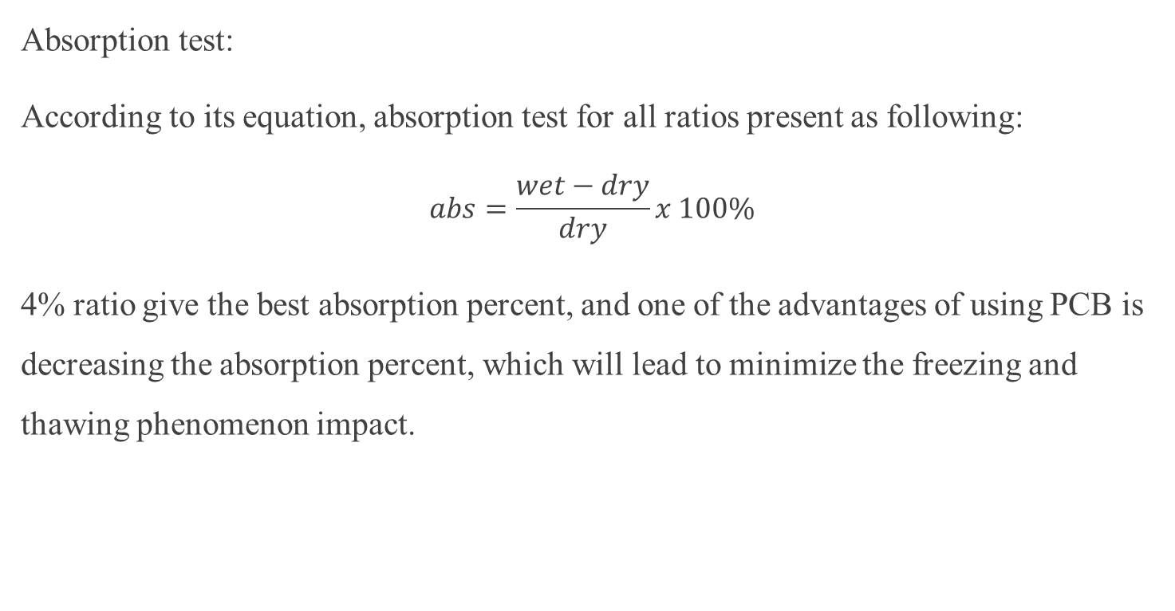
Results and Discussions
Absorption test:
According to its equation, absorption test for all ratios present as following:
$$abs=\frac{wet−dry}{dry}x 100\%$$
4% ratio give the best absorption percent, and one of the advantages of using PCB is decreasing the absorption percent, which will lead to minimize the freezing and thawing phenomenon impact.

Slide 17
Results and Discussions
PCB ratios | Dry (g) | Wet (g) | Abs test %
0% | 2113.66 | 2284.16 | 8.01
3% | 2105 | 2203 | 4.65
3.5% | 1923 | 2024.5 | 5.28
4% | 2131 | 2283.16 | 3.28
4.5% | 2048 | 2125.9 | 3.8
5% | 2262 | 2361.8 | 4.41
6% | 2132 | 2303.03 | 8.02
10% | 2268 | 2403.66 | 5.98
15% | 2284 | 2454.53 | 7.46
-5% | 2598 | 2721.67 | 4.76
-10% | 2500 | 2675 | 7.01

Slide 18
Conclusion
The PCB of waste automobile tires may be one of the most desirable techniques for the economic and environmental stand point.
The PCB has a positive trend on the concrete tests, where the blank concrete is mixed with PCB with their respective percentages.
Lastly, a PCB content of 4% of the weight of concrete mix will be recommended to have the best enhancement for concrete characteristics

Slide 19
Recommendations
Dealing with PCB requires special and careful controlled procedure because most of the carbon black content was disturbed in air during the process.
According to concrete a sufficient mixing must be provided in the laboratory, because a separation of PCB in concrete might happen.
Additional laboratory studies for more range sizes and concentration of PCB should be considered.

