Slide 1



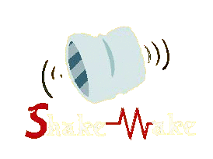
Group Members:
Ala’ Saleh & Nariman Abu Sneineh
Supervisor:
Dr. Ashraf Armoush
© ShakeWake 2014

Slide 2
Outline:
Why/What is ShakeWake?
Literature Review
Methodology
  The Software Part
    Data Storage
    Graphical User Interface
    Implementation
  The Hardware Part
    Design
    Implementation
Future Work
Demo Time

Slide 3
Outline:
Why/What is ShakeWake?
Literature Review
Methodology
  The Software Part
    Data Storage
    Graphical User Interface
    Implementation
  The Hardware Part
    Design
    Implementation
Future Work
Demo Time

Slide 4

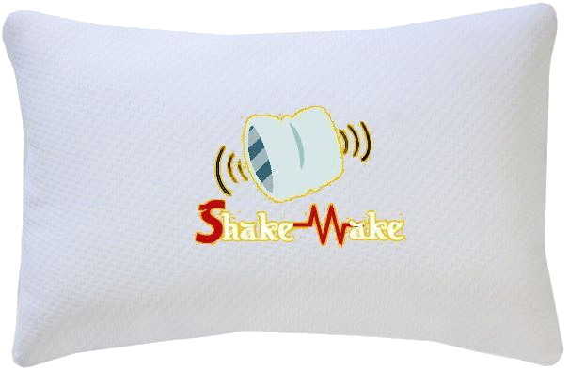
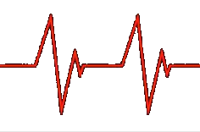
Why/What is ShakeWake?

Slide 5
Outline
Why/What is ShakeWake?
Literature Review
Methodology
  The Software Part
    Data Storage
    Graphical User Interface
    Implementation
  The Hardware Part
    Design
    Implementation
Future Work
Demo Time

Slide 6
Polysomnography
Polysomnography is a sleep study monitors you as you sleep, it records your body movements.
There are two states of sleep:
Cycling between NREM and REM sleep does in about 90 minutes.
Rapid eye movement (REM)
Non-rapid eye movement (NREM)

Slide 7
Outline
Why/What is ShakeWake?
Literature Review
Methodology
  The Software Part
    Data Storage
    Graphical User Interface
    Implementation
  The Hardware Part
    Design
    Implementation
Future Work
Demo Time

Slide 8
Methodology
Software
Hardware
Data Storage
GUI
Implementation
Design
Implementation

Slide 9
Outline
Why/What is ShakeWake?
Literature Review
Methodology
  The Software Part
    Data Storage
    Graphical User Interface
    Implementation
  The Hardware Part
    Design
    Implementation
Future Work
Demo Time

Slide 10
Software Part
Data Storage
Implementation
Graphical User Interface

Slide 11
Outline
Why/What is ShakeWake?
Literature Review
Methodology
  The Software Part
    Data Storage
    Graphical User Interface
    Implementation
  The Hardware Part
    Design
    Implementation
Future Work
Demo Time

Slide 12
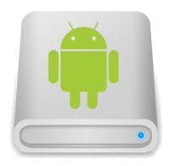

The Data Storage
In our application we used the local data storage to store :
Users alarm clocks.
Sleep graphs data.
Shared Preferences

Slide 13
Outline
Why/What is ShakeWake?
Literature Review
Methodology
  The Software Part
    Data Storage
    Graphical User Interface
    Implementation
  The Hardware Part
    Design
    Implementation
Future Work
Demo Time

Slide 14
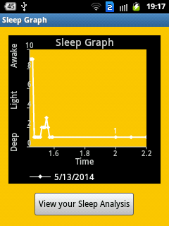
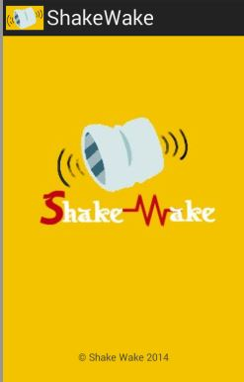
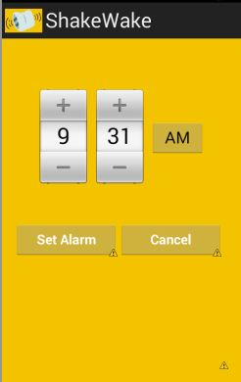
GUI
We build the GUI using targeted android SDK version API-14 “android 4.0: IceCreamSandwich” integrated with the XML tags.
We used the external library “achartengine-1.1.0” to draw sleep graphs.

Slide 15
Outline
Why/What is ShakeWake?
Literature Review
Methodology
  The Software Part
    Data Storage
    Graphical User Interface
    Implementation
  The Hardware Part
    Design
    Implementation
Future Work
Demo Time

Slide 16
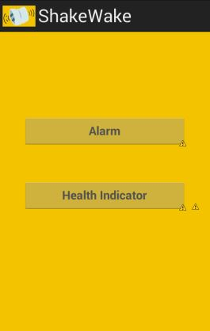
  Implementation
Our application consists of two main features:
Both of them sends the commands to Arduino via Bluetooth.
Alarm Clock Feature.
Health Indicator Feature.

Slide 17
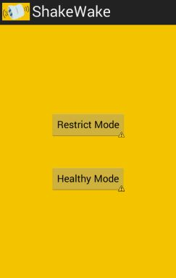
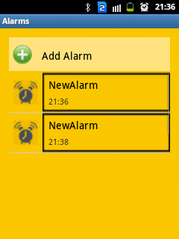
  Alarm Clock Feature
This feature has two modes:
Strict Mode
Healthy Mode
The Known alarm clock.
Depend on sleep cycles.

Slide 18
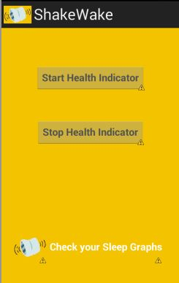
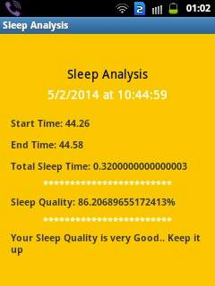
  Health Indicator Feature
This feature concerns in:
Receiving and storing the movement values and the time when happen
Drawing the sleep graphs
Analyzing each sleep graph

Slide 19
Outline
Why/What is ShakeWake?
Literature Review
Methodology
  The Software Part
    Data Storage
    Graphical User Interface
    Implementation
  The Hardware Part
    Design
    Implementation
Future Work
Demo Time

Slide 20
Hardware Part
Design.
Implementation.

Slide 21
Outline
Why/What is ShakeWake?
Literature Review
Methodology
  The Software Part
    Data Storage
    Graphical User Interface
    Implementation
  The Hardware Part
    Design
    Implementation
Future Work
Demo Time

Slide 22
Design
The design has two phases:
Components
Packaging

Slide 23
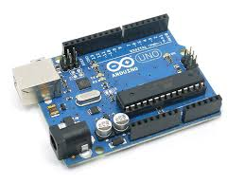
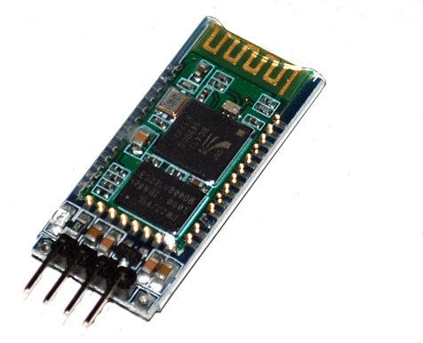
Components
The total cost of our project is: 550 NIS
  Arduino Uno “ATMEGA328P-PU”
  Bluetooth Chip Module “HC-06”
The microcontroller in the project.
1 item X 180 NIS.
The communication chip
Used to make connection between Android and Arduino.
1 item X 120 NIS

Slide 24
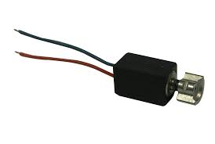
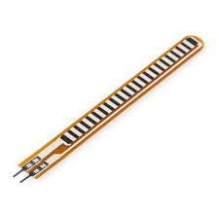
Components
  Vibrating Motors
  Flex Sensors
Used to make the pillow vibrates
2 items X 10 NIS
Used to check and get the state of the pillow.
3 items X 48 NIS / one of them damaged.
Used instead of pressure sensor because of the wide area it covers.

Slide 25
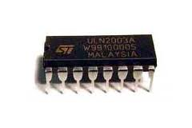
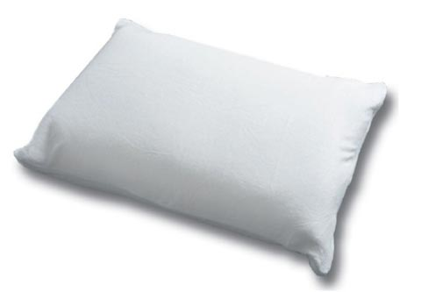
Components
  Open Collector “ULN2003AP0”
  Normal Pillow
  Resistors, Wires, Sockets, Board & Packaging Materials.
Used to protect the motors and the Arduino from being damaged when they’re connected to the Arduino.
1 item X 10 NIS
1 item X 25 NIS
51 NIS

Slide 26
Packaging
The three constraints in our project design:
The size of the controller unit
Vibrating motors
Flex sensors

Slide 27
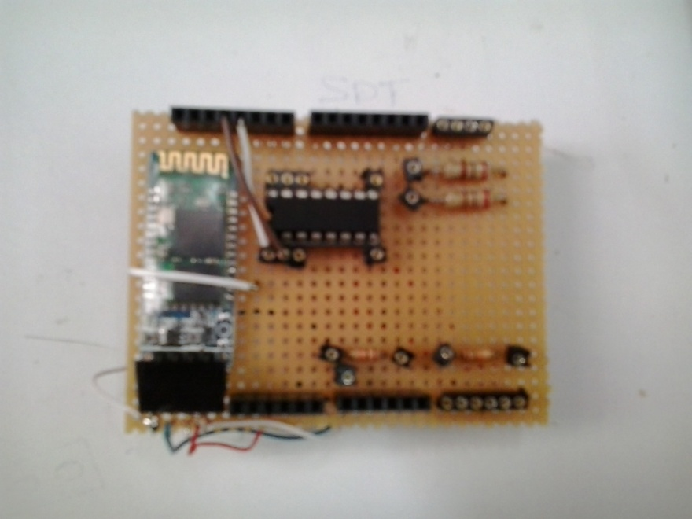
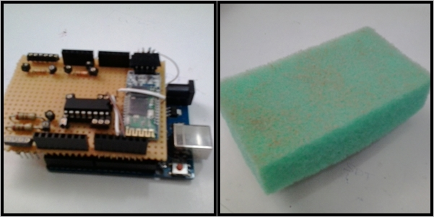
Packaging
The Controller Unit:
The Shield over the Arduino
Pillow Controller Packaging

Slide 28
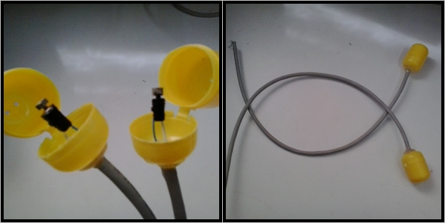
Packaging
Vibrating Motors Packaging:

Slide 29
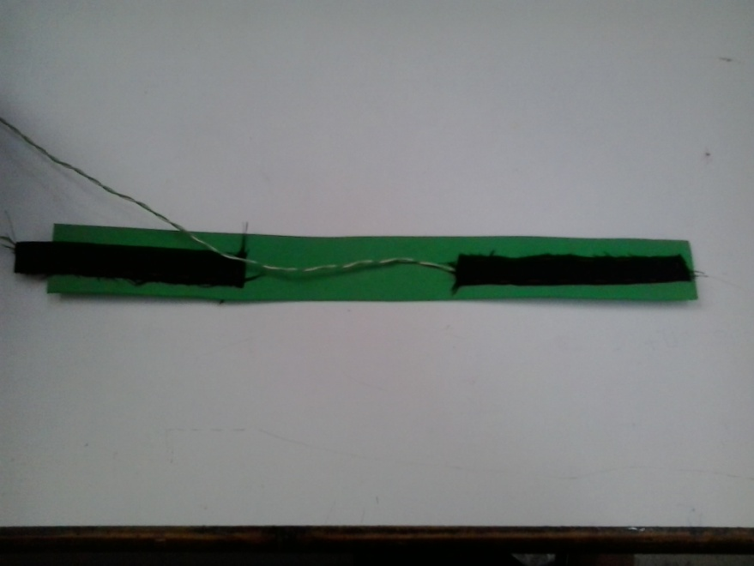
Packaging
Flex Sensors Packaging:

Slide 30
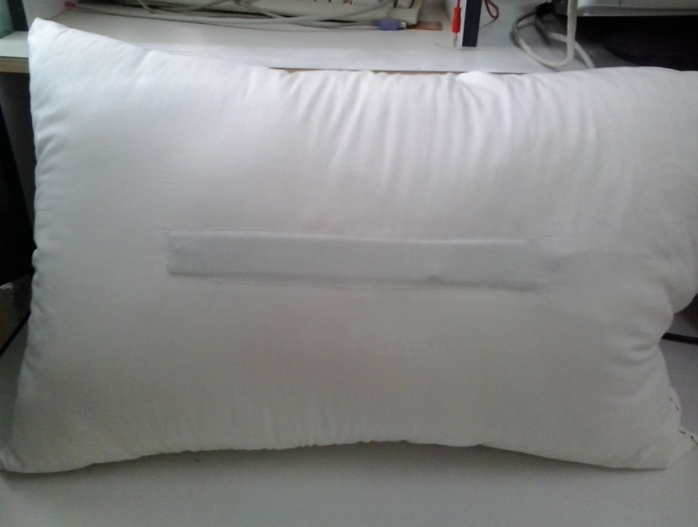
Packaging
Final View:

Slide 31
Outline
Why/What is ShakeWake?
Literature Review
Methodology
  The Software Part
    Data Storage
    Graphical User Interface
    Implementation
  The Hardware Part
    Design
    Implementation
Future Work
Demo Time

Slide 32
Implementation
We broke our project into two pieces and tested each one individually:
Alarm Clock Feature.
Health Indicator Feature.
Both of them communicate with the Android via Bluetooth.

Slide 33
  Alarm Clock Feature
Receives command from Android
Turns on the vibrating motors
Checks the state of the flex sensors
Keeps checking until the user wakes up

Slide 34
  Health Indicator Feature
Receives command from Android
Starts reading the flex sensors values
Checks if there is a change in the data and sends it to android
Keeps reading and checking until the user stops it

Slide 35
Outline
Why/What is ShakeWake?
Literature Review
Methodology
  The Software Part
    Data Storage
    Graphical User Interface
    Implementation
  The Hardware Part
    Design
    Implementation
Future Work
Demo Time

Slide 36
  Future Work
Cross Platform Application
Displayable LEDs
Playing Music.

Slide 37
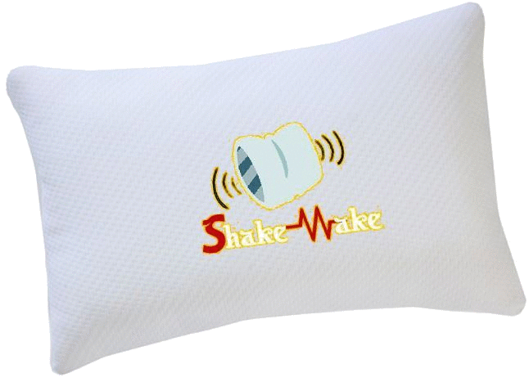
Thank You!

