Slide 1
Air Hockey Robot
Supervisor:
Dr. Ashraf Armoush
Students:
Maysam Mousa
Abdelrahman Baba

Slide 2
TABLE OF CONTENTS
01
02
03
04
Main Idea
Features
Hardware Components
05
06
Construction
Future Work
Robot
Strategy

Slide 3
01
Main Idea

Slide 4
Air Hockey Gameplay with a robot as the opponent.
Multiple modes for the robot:
  Defense
  Attack

Slide 5
02
Features

Slide 6



Object Detection
Air hockey robot
Goal Detection
Pixy2 cam
NEMA 17 steppers, A4988 drivers
IR sensors,
ESP

Slide 7
03
Hardware Components

Slide 8
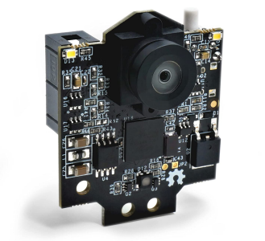
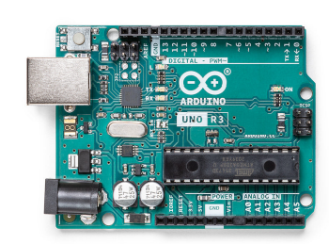
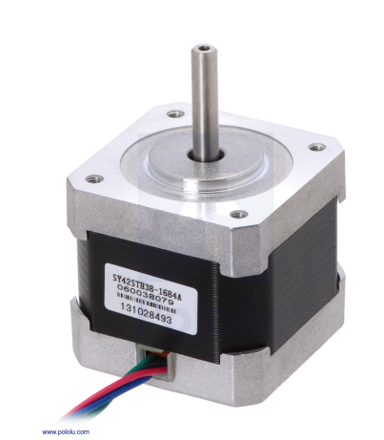
Pixy2 cam
Arduino UNO
NEMA 17 stepper

Slide 9
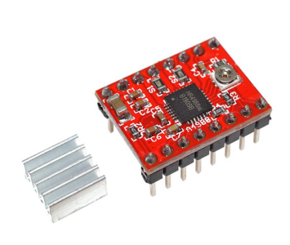
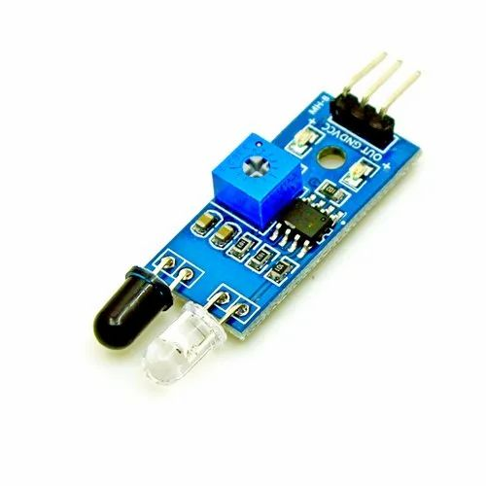
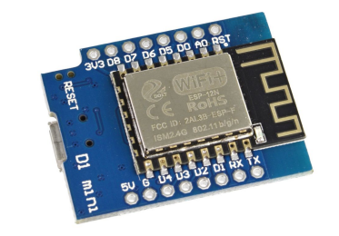
A4988 Driver
IR sensor
ESP 12-f

Slide 10
04
Construction

Slide 11
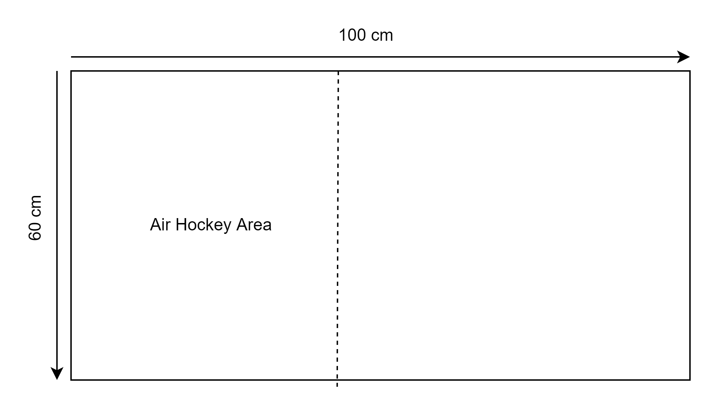
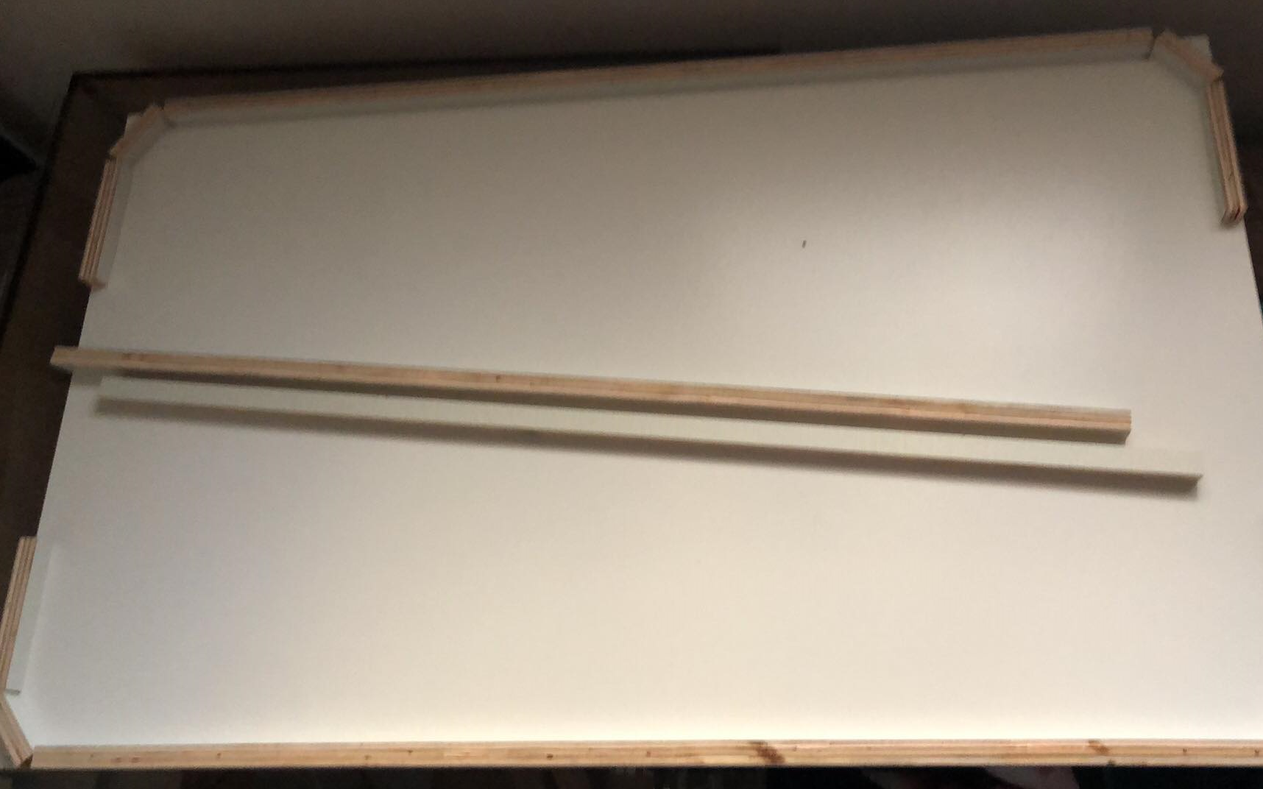
Table

Slide 12
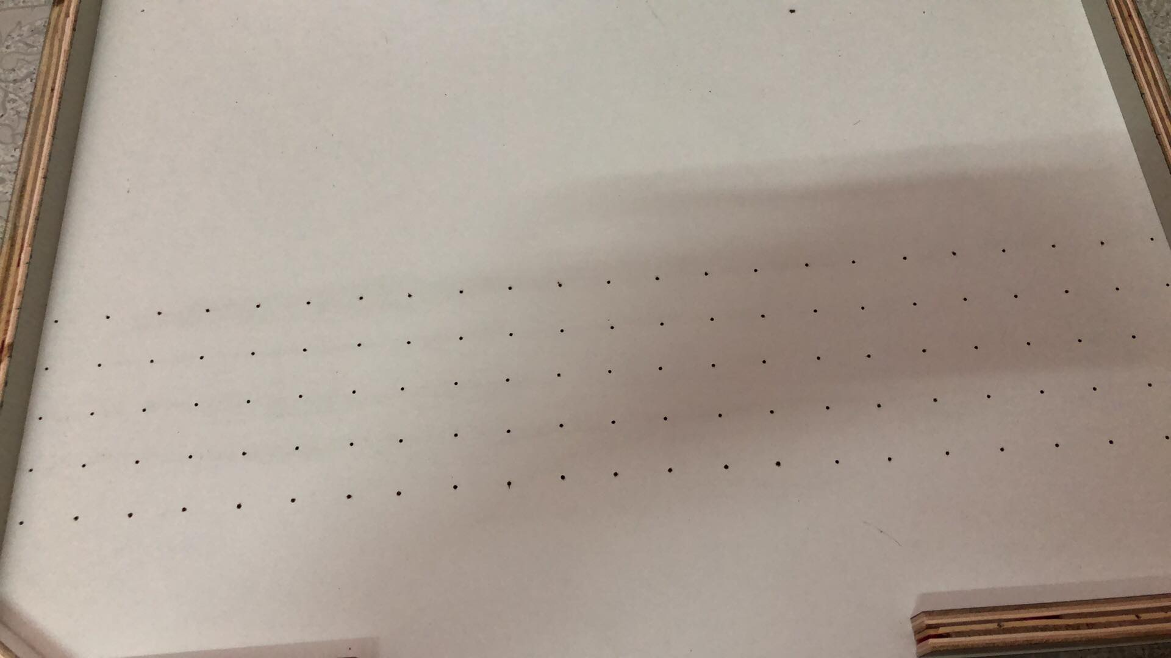
Holes
1.5 mm holes
34 rows
22 holes a row

Slide 13
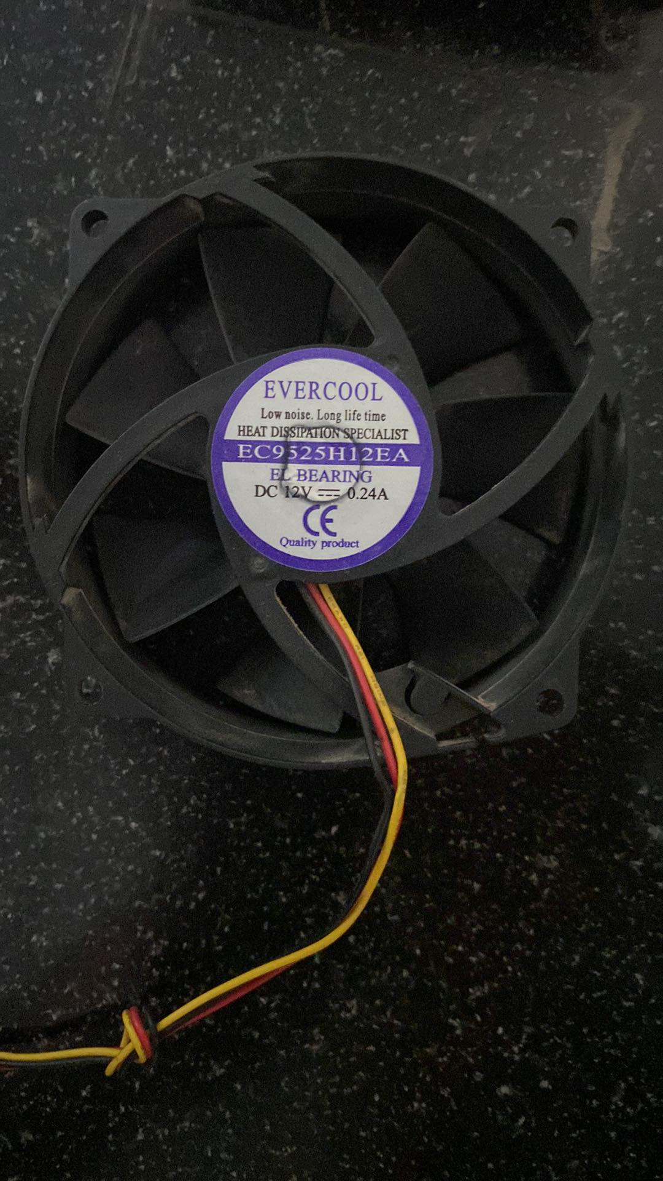
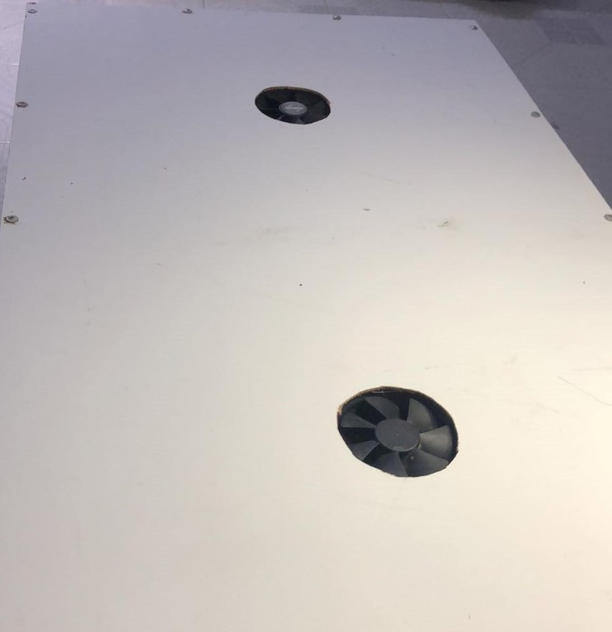
Fans
2 Fans
90mm diameter
0.24 A

Slide 14
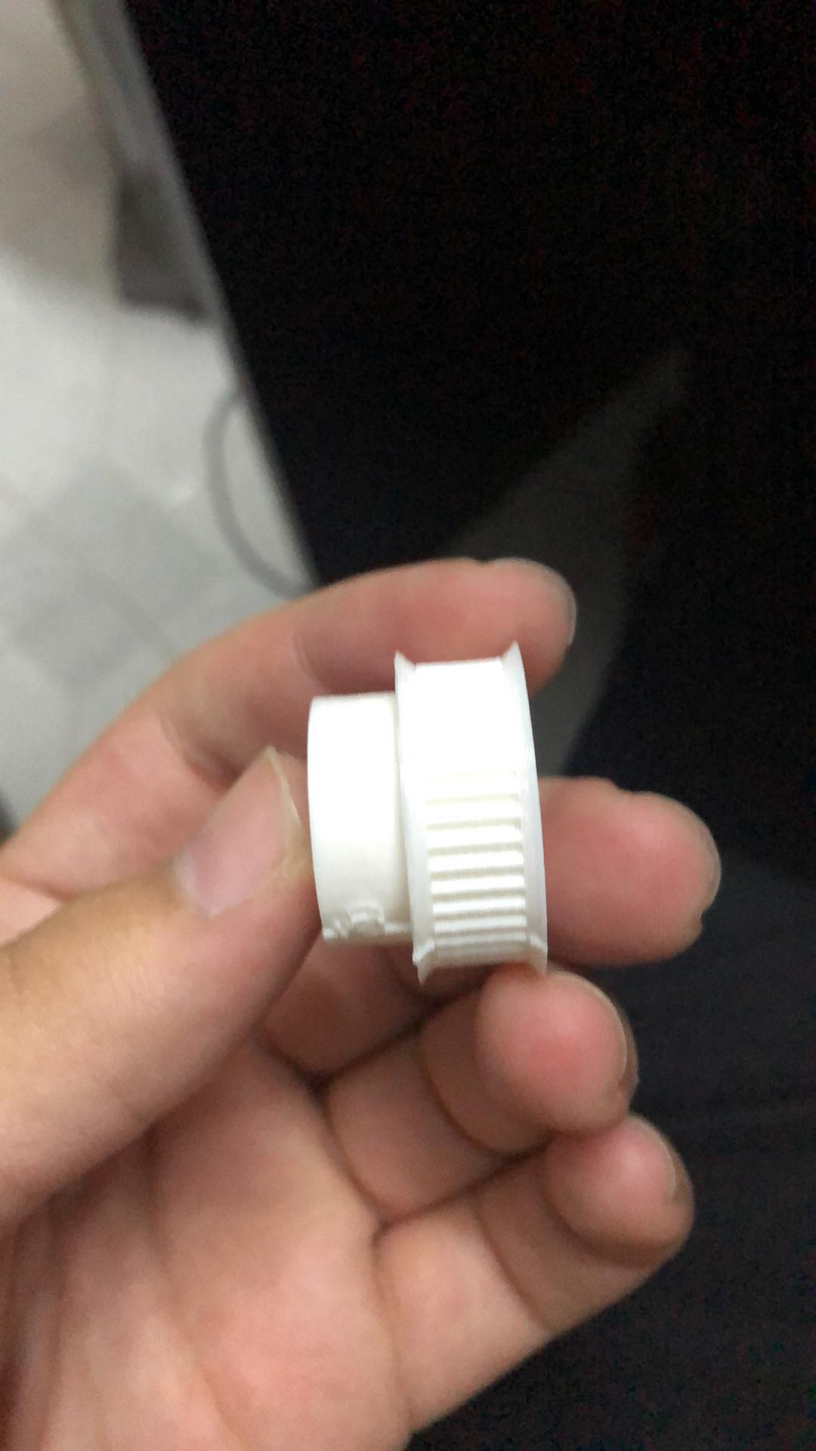
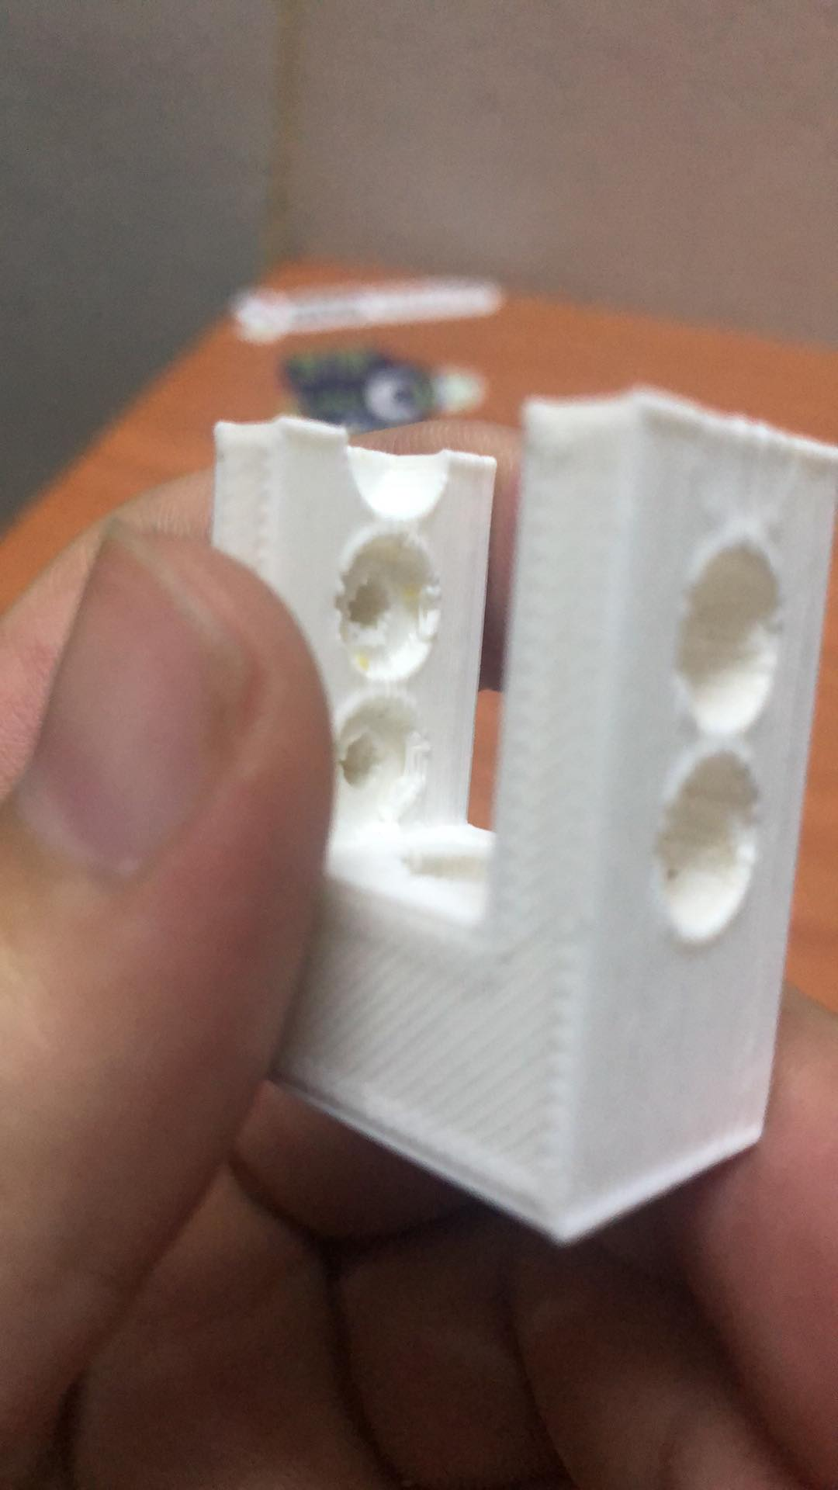
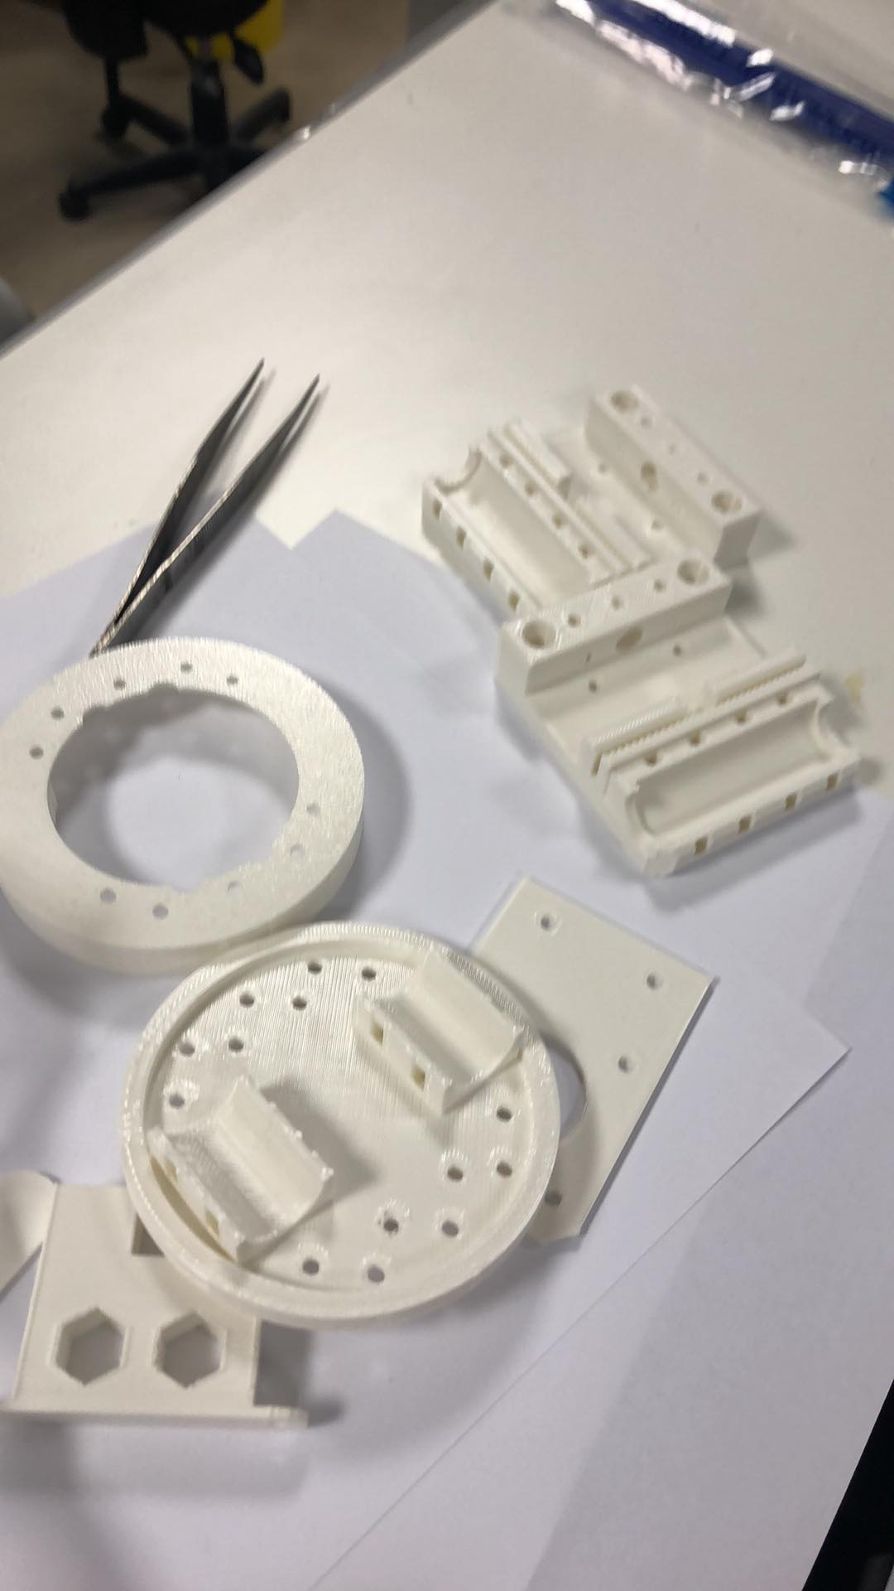
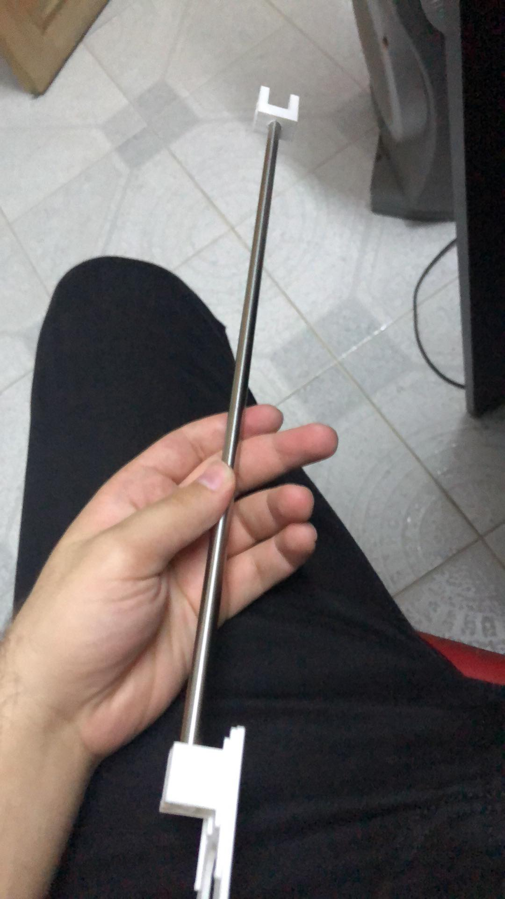
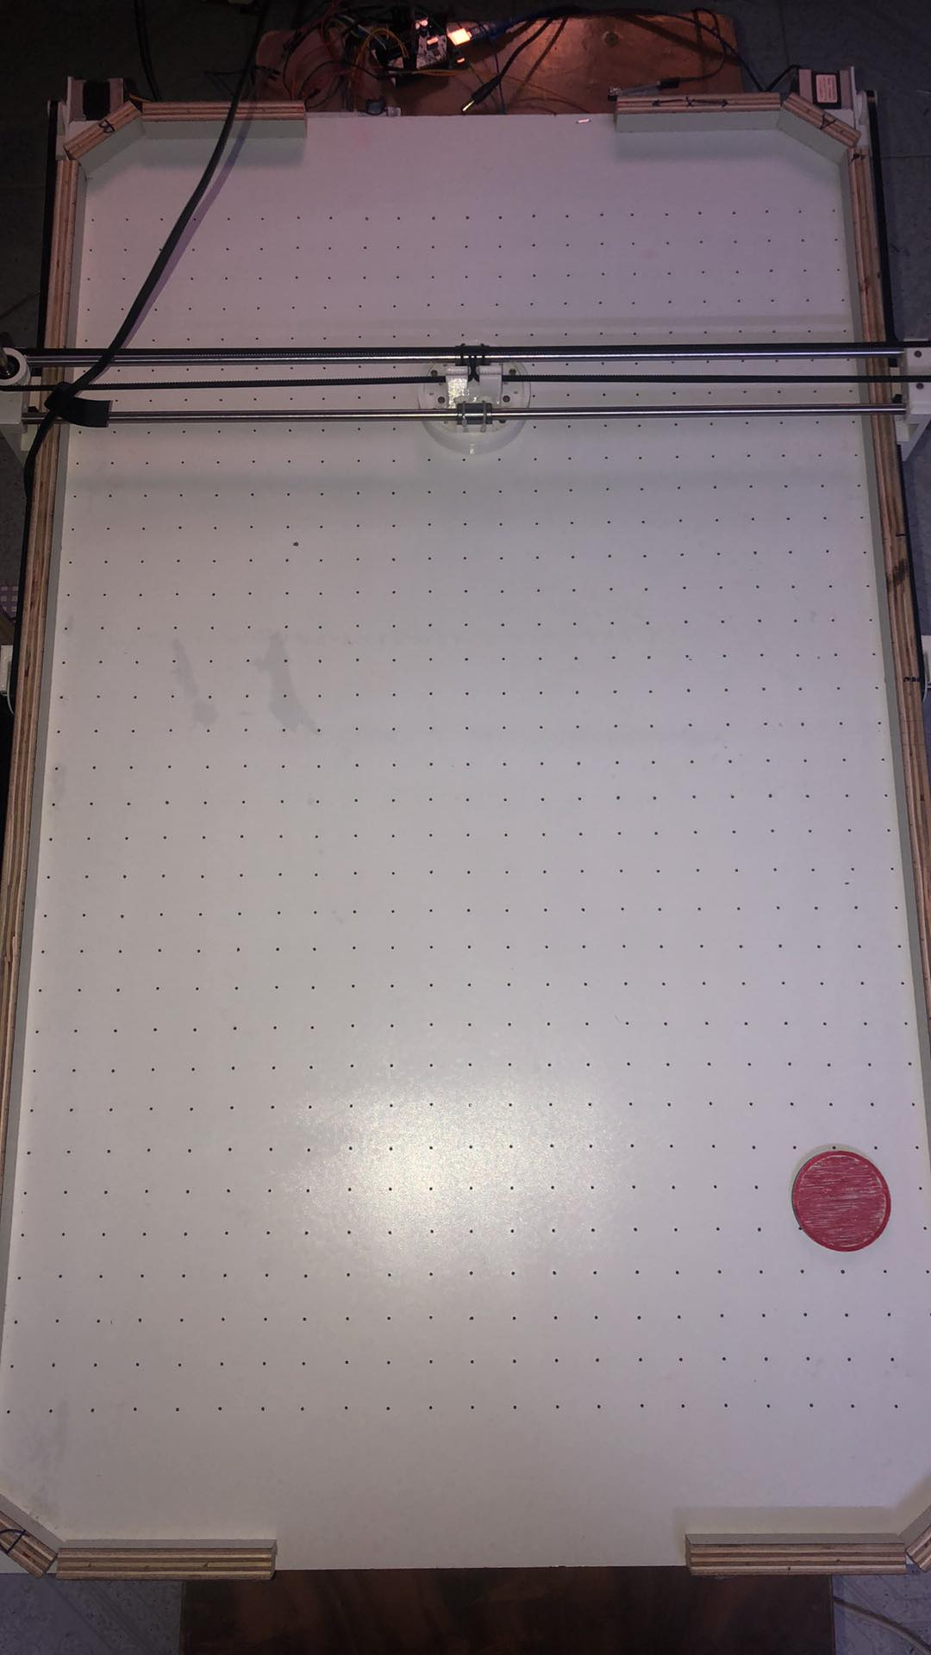
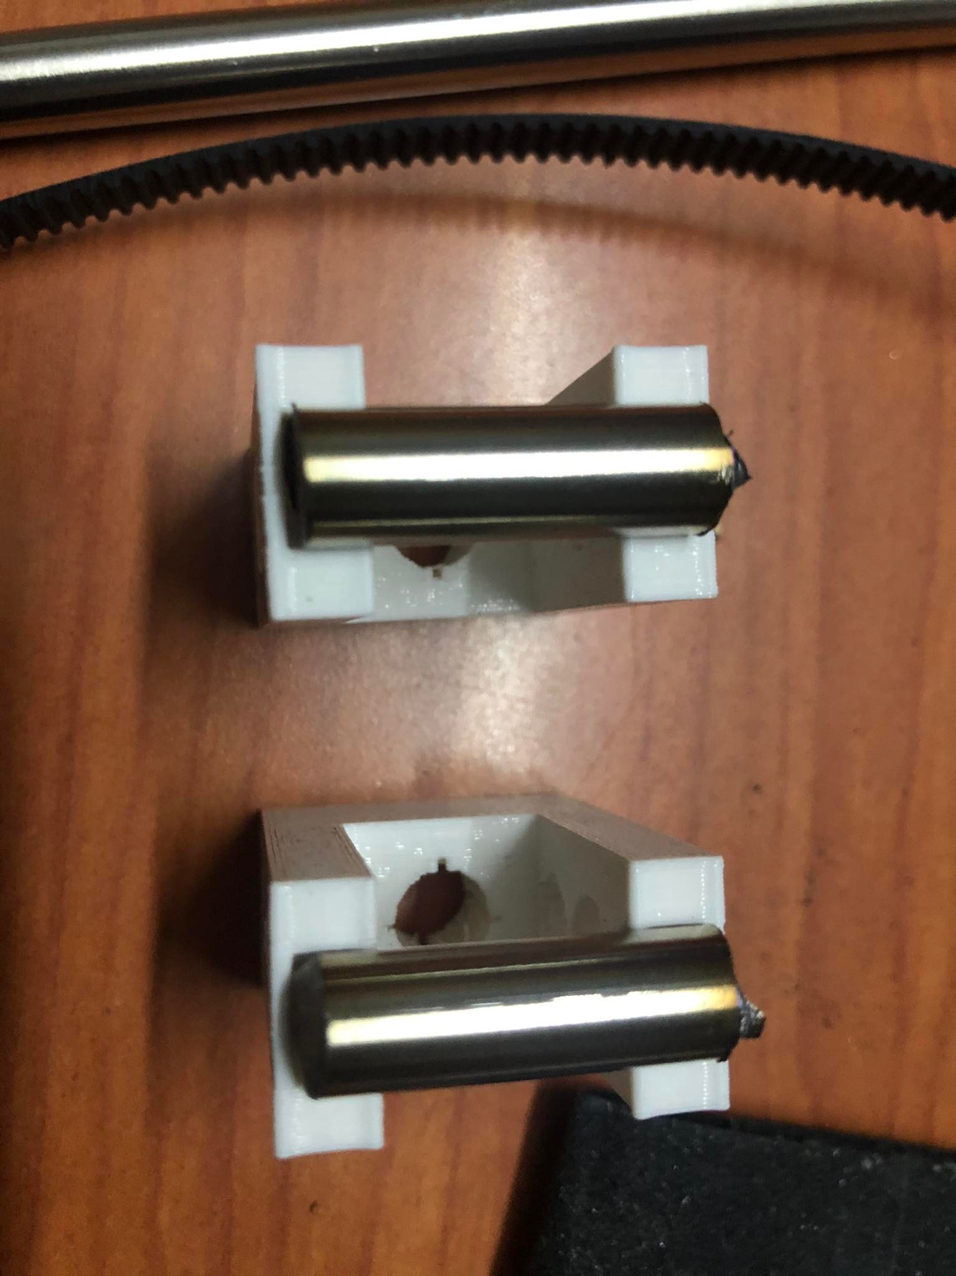
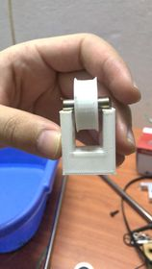
Gathering up the motors and 3D printed parts together

Slide 15
05
Robot Strategy

Slide 16



Steps Flow
01
02
03
Object
Detection
Processing
Robot Movement
Getting the x and y coordinates of the puck
Calculating the next position of the robot
Moving the robot to the calculated position

Slide 17

Steps Flow
01
02
03
Object
Detection
Processing
Robot Movement
Getting the x and y coordinates of the puck
Calculating the next position of the robot
Moving the robot to the calculated position

Slide 18
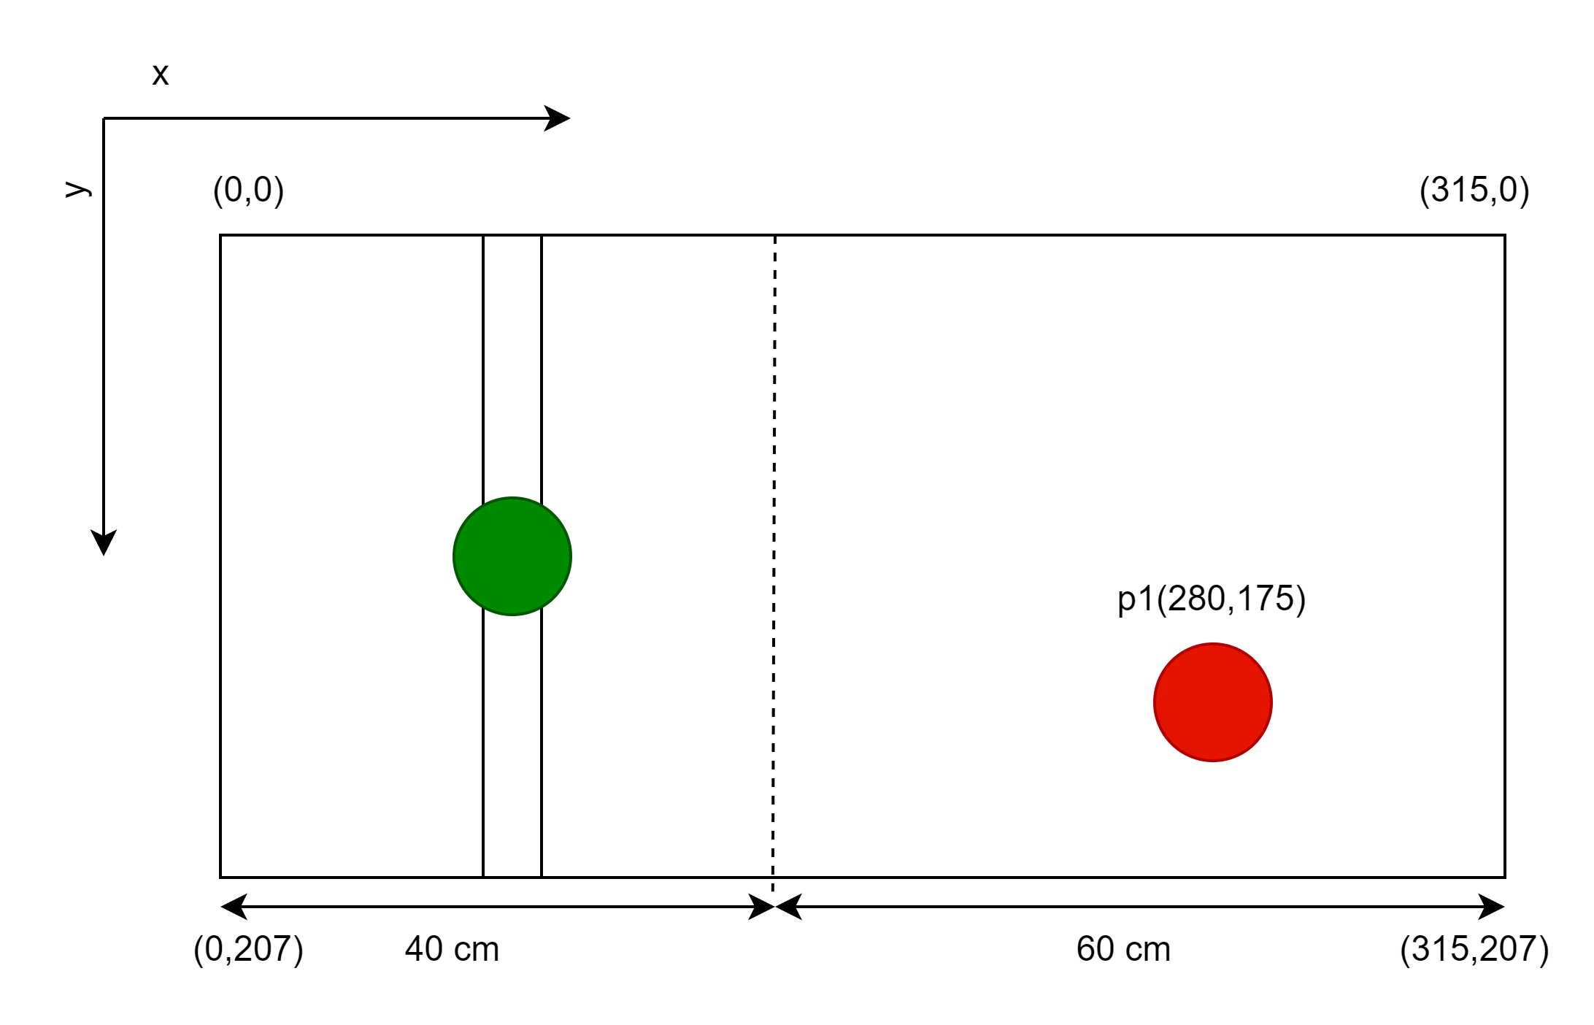
Object Detection Info.
60 FPS
Operates on 1KHz
315 pixels on x-axis
207 pixels on y-axis
2.75 mm = 1 pixel on y
3.0 mm = 1 pixel on x

Slide 19
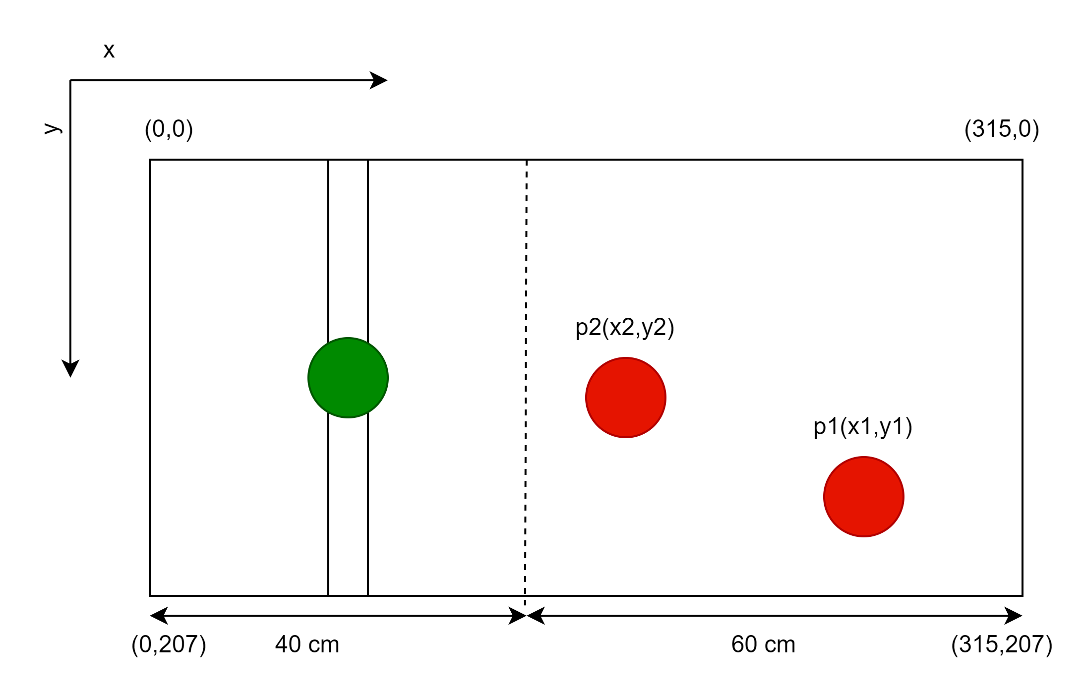
Object Detection Coordinates
xOld
yOld
xNew
yNew

Slide 20

Steps Flow
01
02
03
Object
Detection
Processing
Robot Movement
Getting the x and y coordinates of the puck
Calculating the next position of the robot
Moving the robot to the calculated position

Slide 21


Processing
01
02
Setting Puck State
Calculate Target Position

Slide 22

Processing
01
02
Setting Puck State
Calculate Target Position

Slide 23
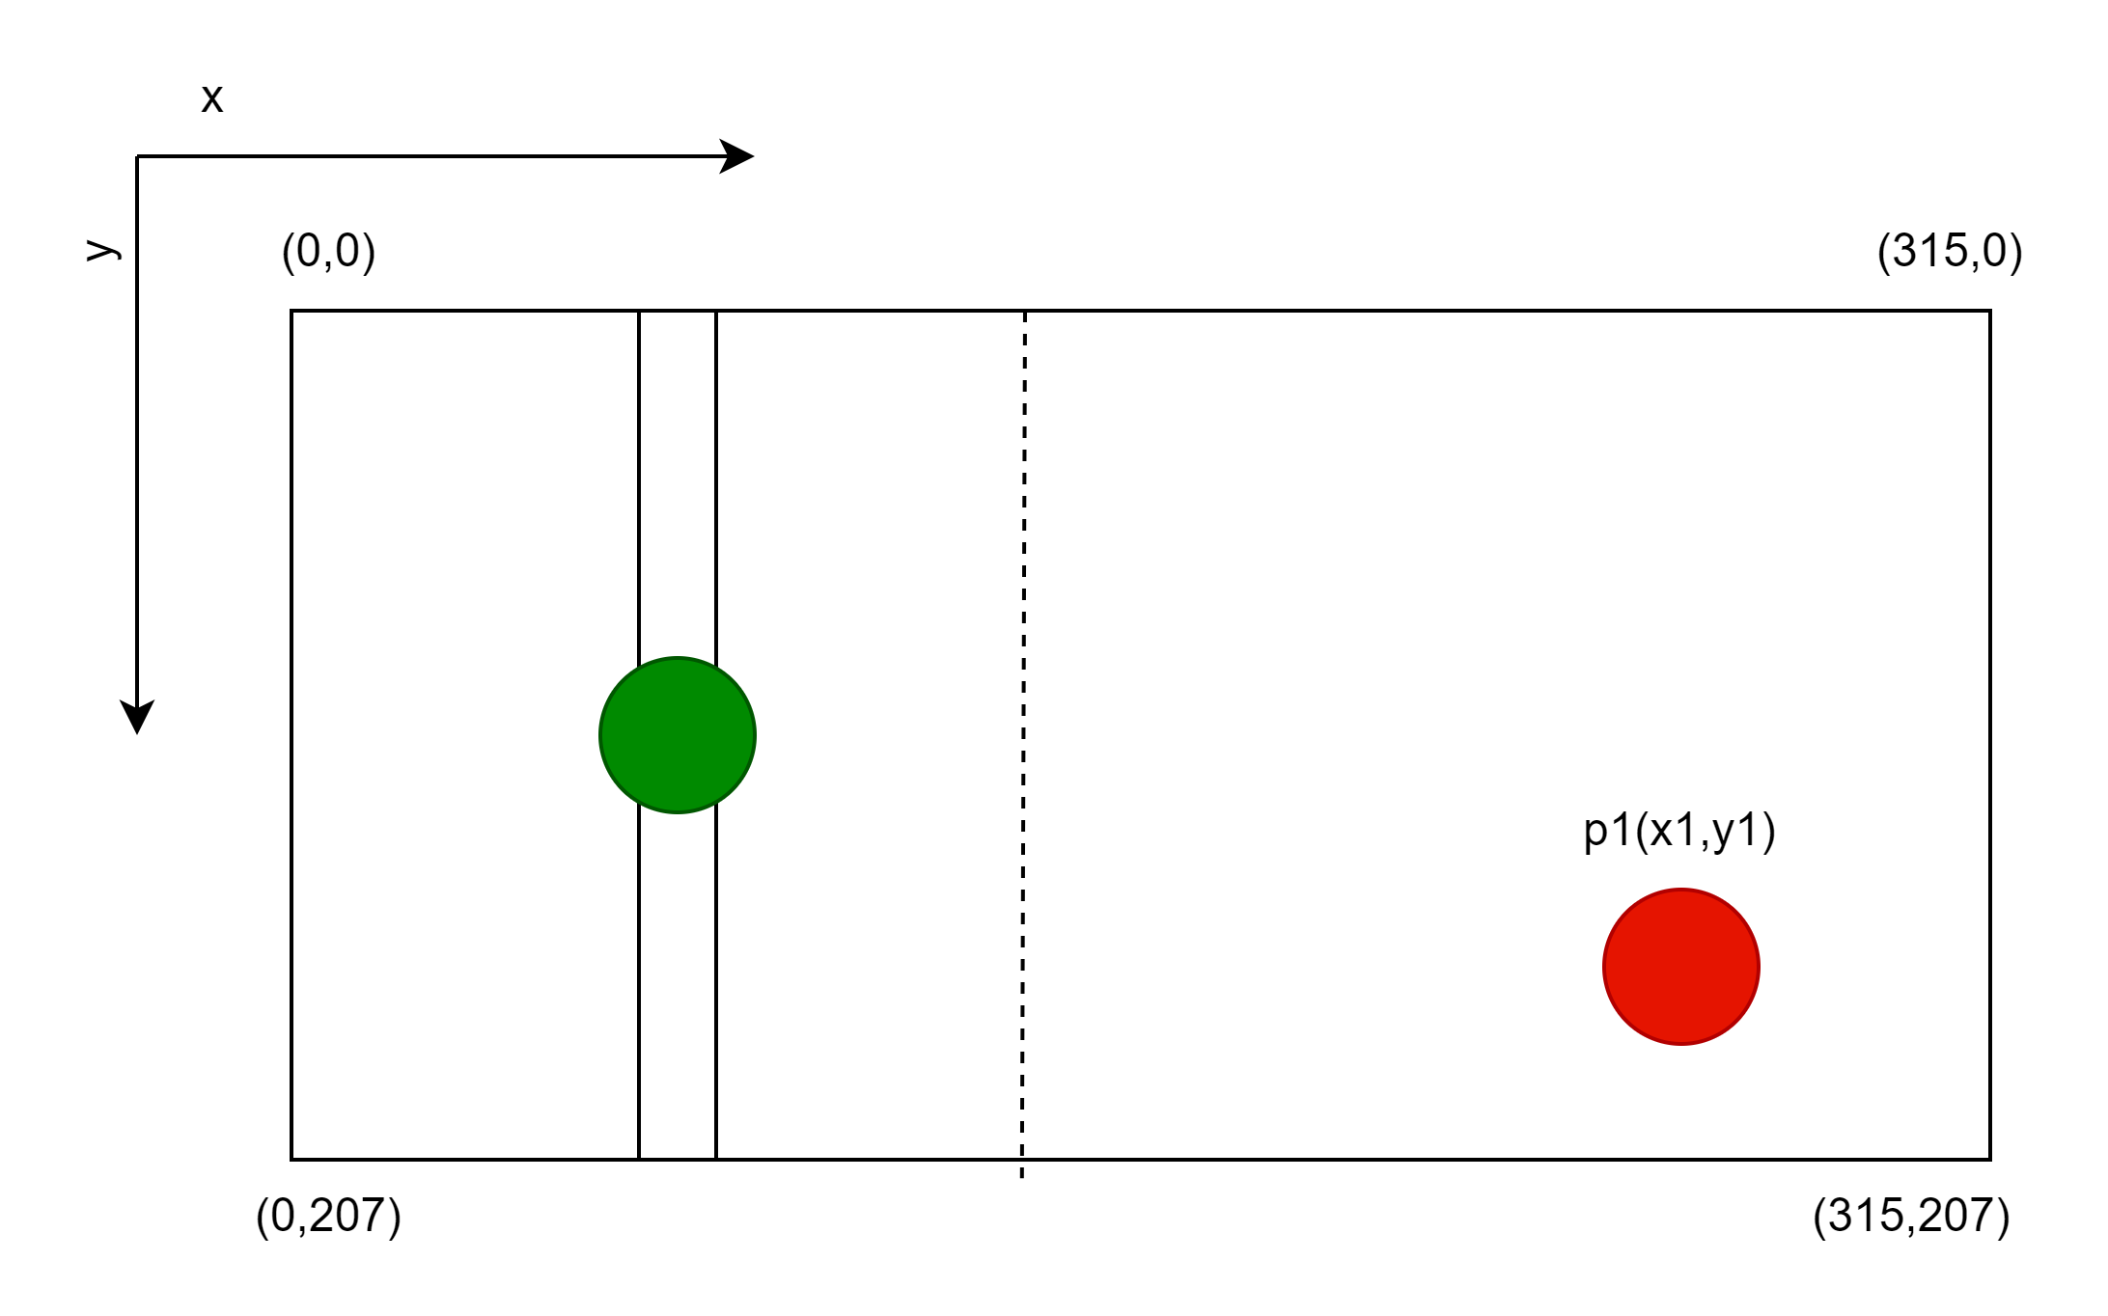
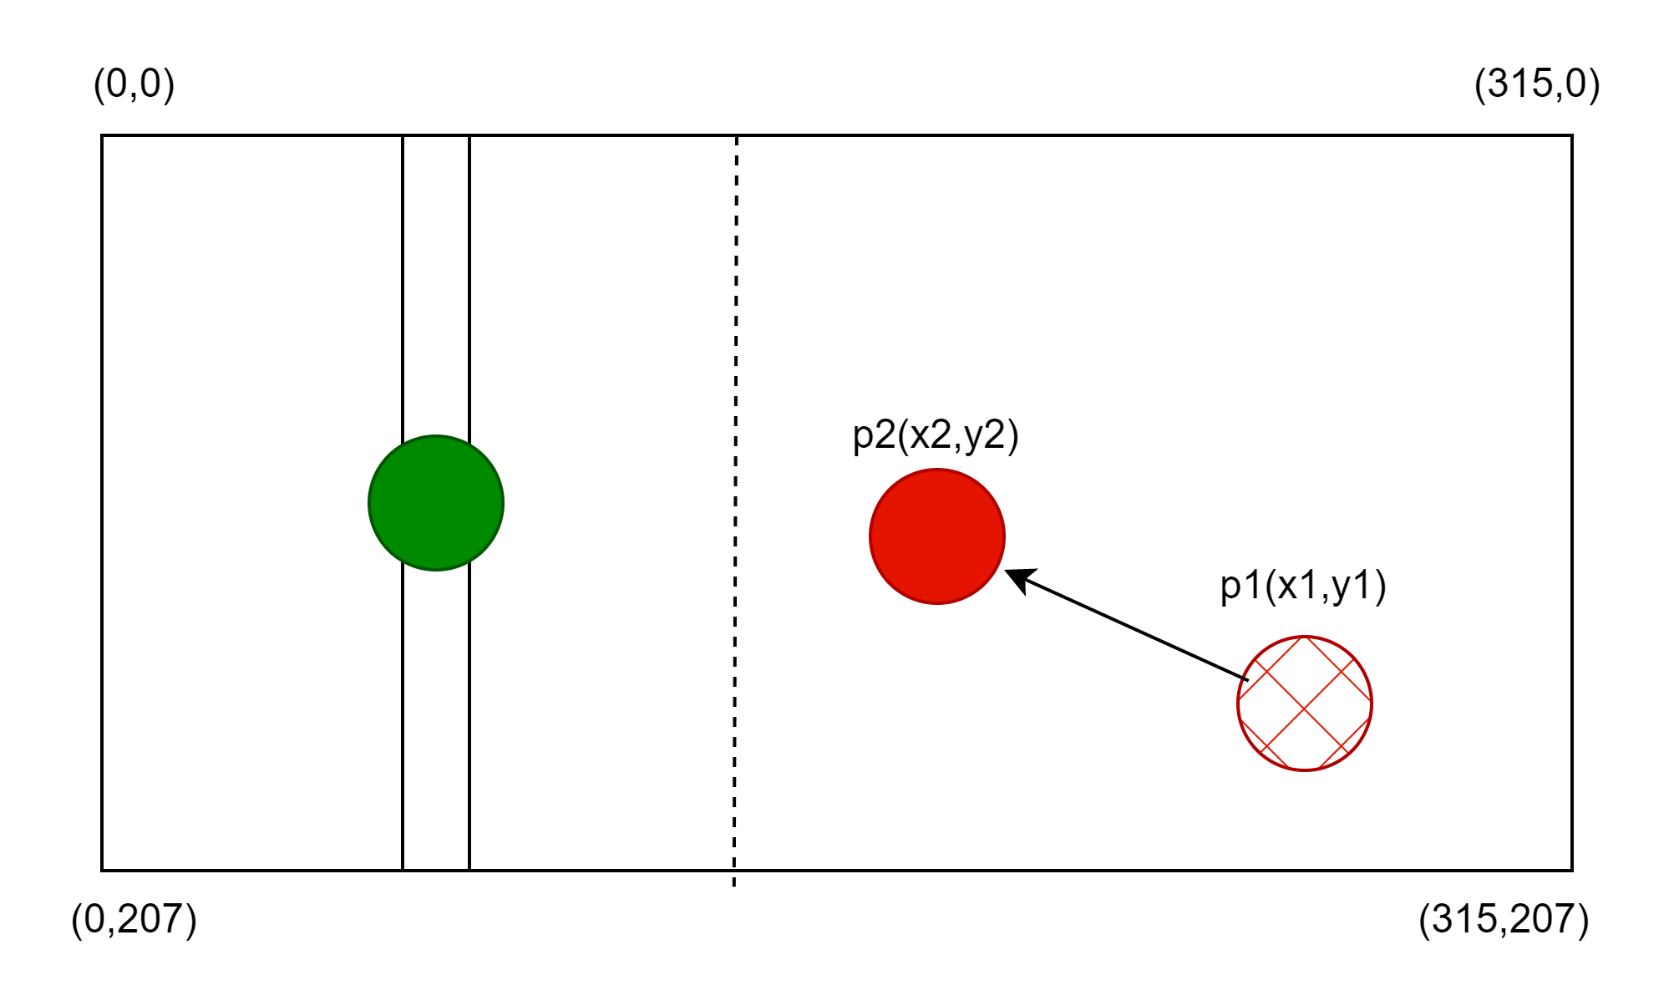
Processing Puck States
01
02
PUCK_NOT_MOVING
PUCK_HEADING_TO_ROBOT

Slide 24
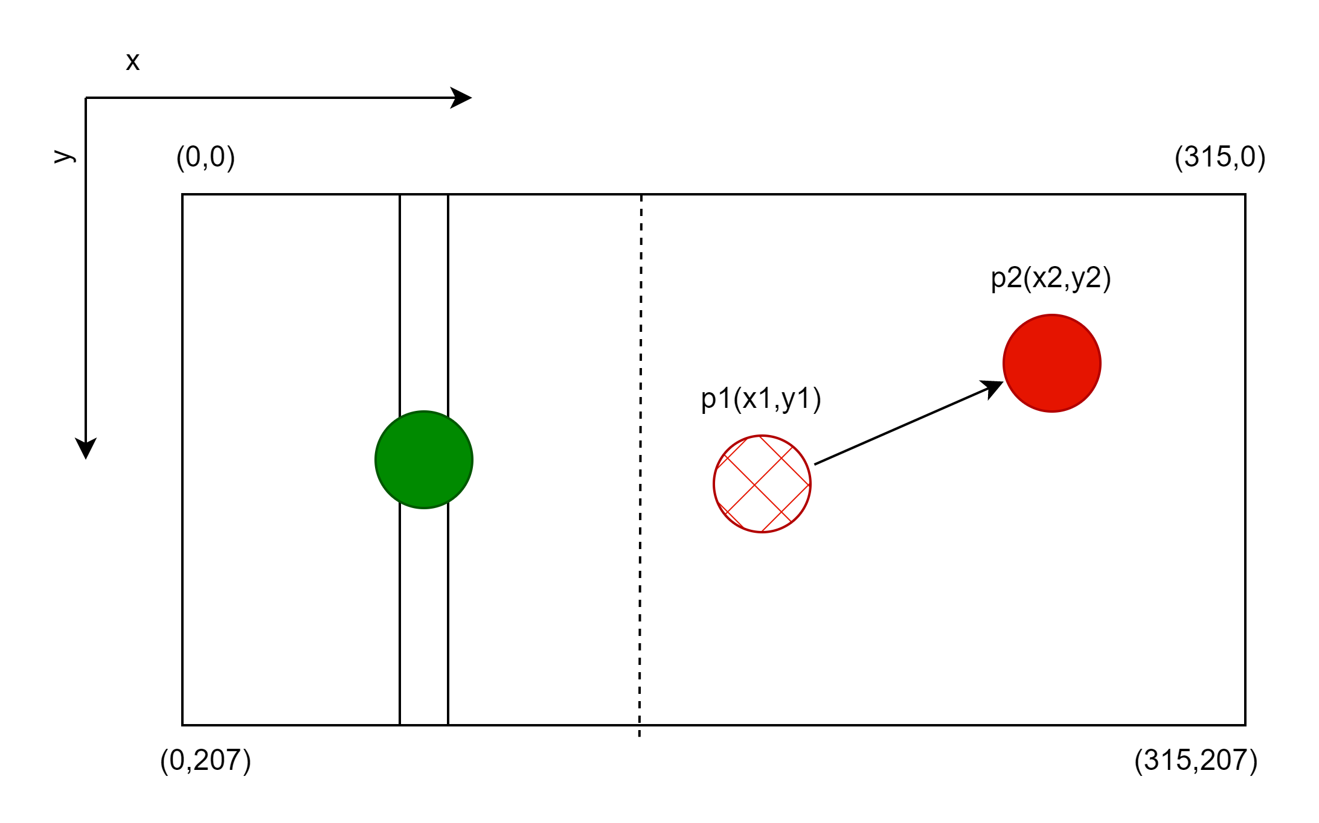
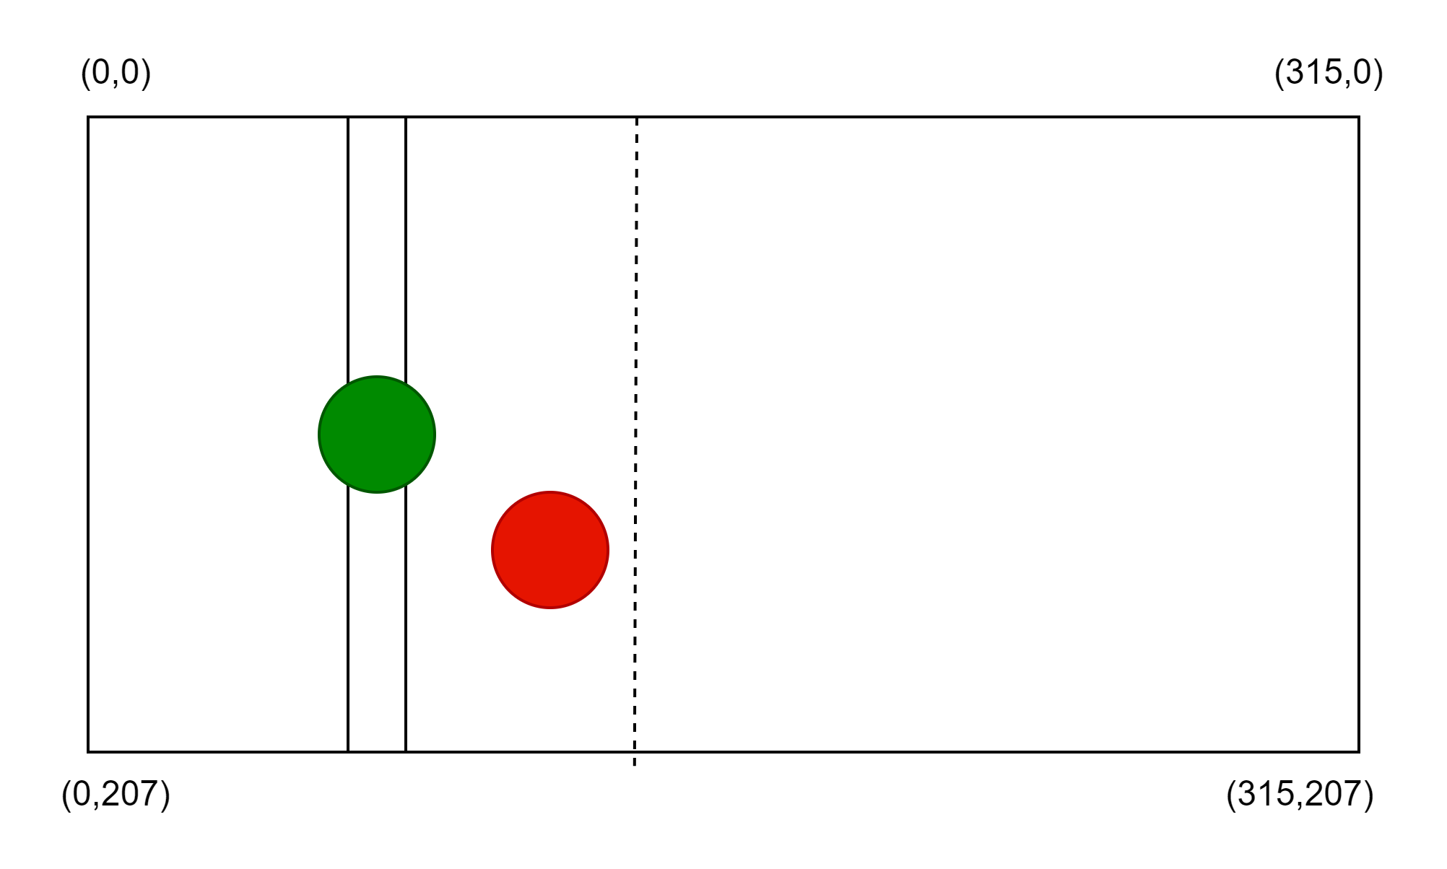
Processing Puck States
03
04
PUCK_GOES_AWAY
ATTACK_PUCK

Slide 25

Processing
01
02
Setting Puck State
Calculate Target Position

Slide 26
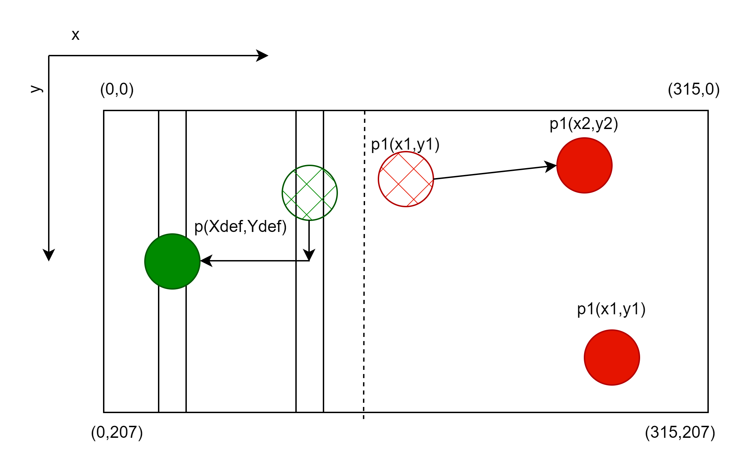
Processing Calculations
PUCK_NOT_MOVING
PUCK_GOES_AWAY

Slide 27
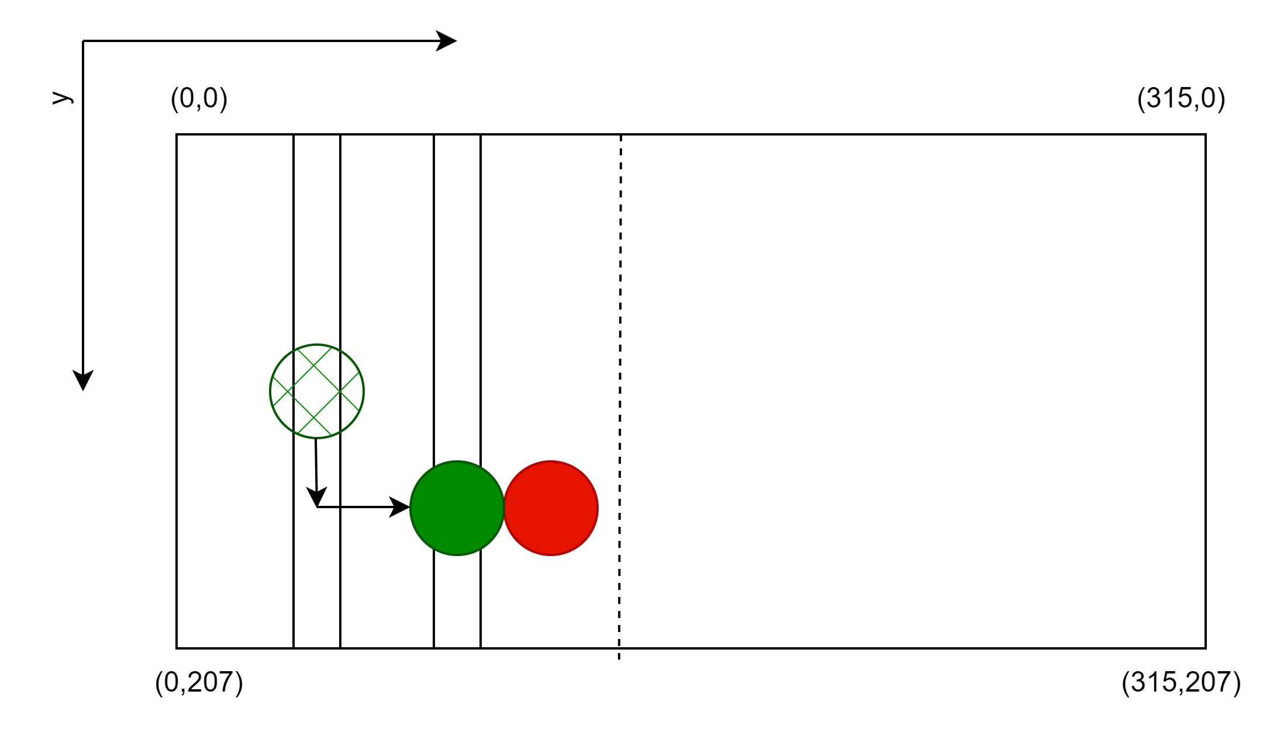
Processing Calculations
ATTACK_PUCK

Slide 28
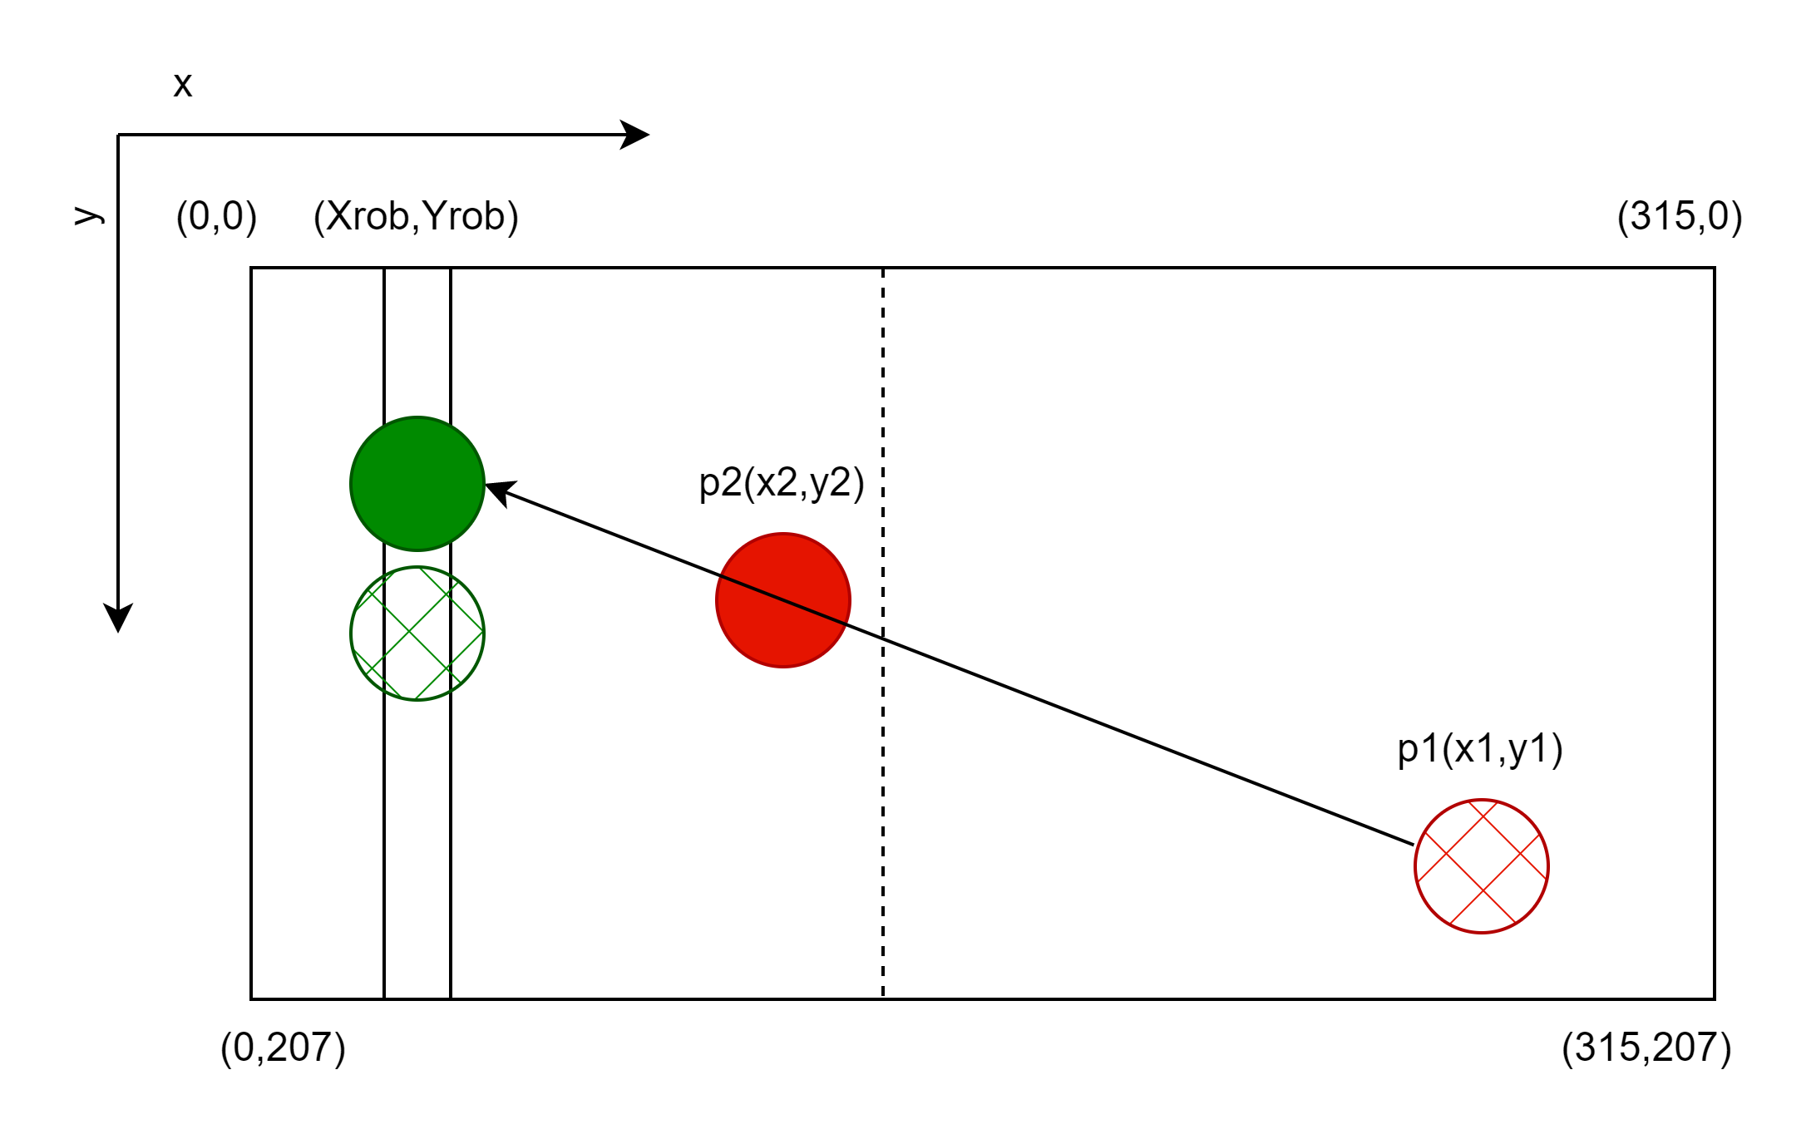
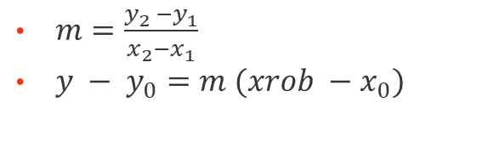
Processing Calculations
DEFENSE MODE
$m=\frac{y_{2} −y_{1}}{x_{2}−x_{1}}$
$y − y_{0}=m (xrob −x_{0})$
PUCK_HEADING_TO_ROBOT

Slide 29
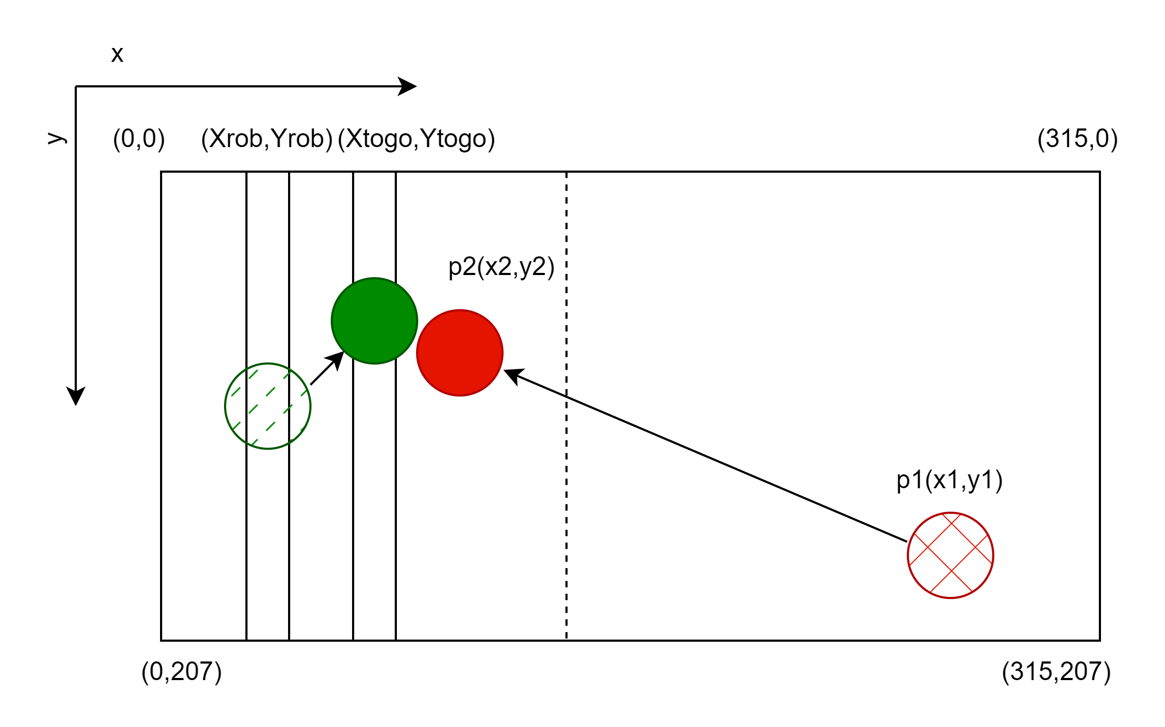
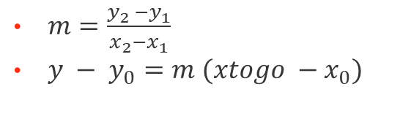
Processing Calculations
ATTACK MODE
$m=\frac{y_{2} −y_{1}}{x_{2}−x_{1}}$
$y − y_{0}=m (xtogo −x_{0})$
PUCK_HEADING_TO_ROBOT

Slide 30

Steps Flow
01
02
03
Object
Detection
Processing
Robot Movement
Getting the x and y coordinates of the puck
Calculating the next position of the robot
Moving the robot to the calculated position

Slide 31
06
Future Work

Slide 32

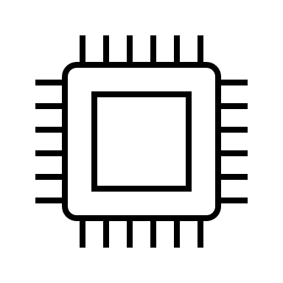


Accuracy Optimization
Software Handles Hardware Errors
Smart Air Hockey Robot
Attack and Defense Mode

Slide 33
THANKS!
Do you have any questions?

