Slide 1
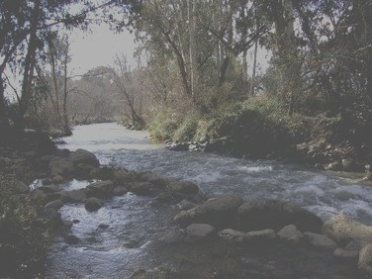

Engineering Faculty – Department of Civil Engineering
Graduation Project II
Artificial Groundwater Recharge at Al-Faria Catchment.
Presented By:
Dalia Rami Al-Khatib
Hala Adnan Quzaih
Ruba Basil Al-Qadi
Under the supervision of : Dr. Mohammad N. Almasri

Slide 2
Outline
Problem Identification.
Objectives.
Faria Catchment Characteristics.
Methodology.
HEC-HMS Modeling.
Best Artificial Recharge Location & Method.
Up to Date Rainfall Analysis.
Overview of Benefit-Cost Analysis.
Conclusion & Recommendations.

Slide 3
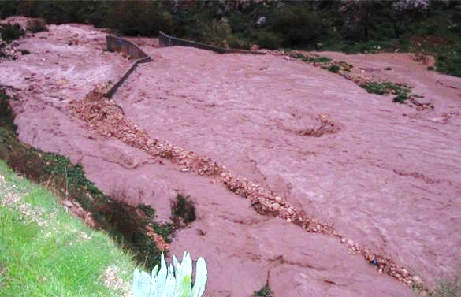
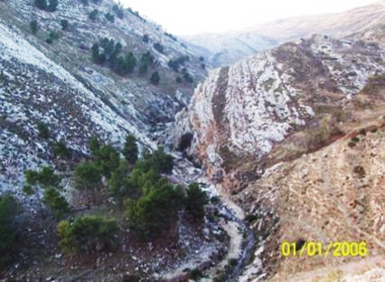

Problem Identification:
**
Winter
Summer

Slide 4
OBJECTIVES
Quantify Runoff
HEC-HMS model
Best A.R. method
Possible A.R. Locations
Benefit Cost Analysis

Slide 5
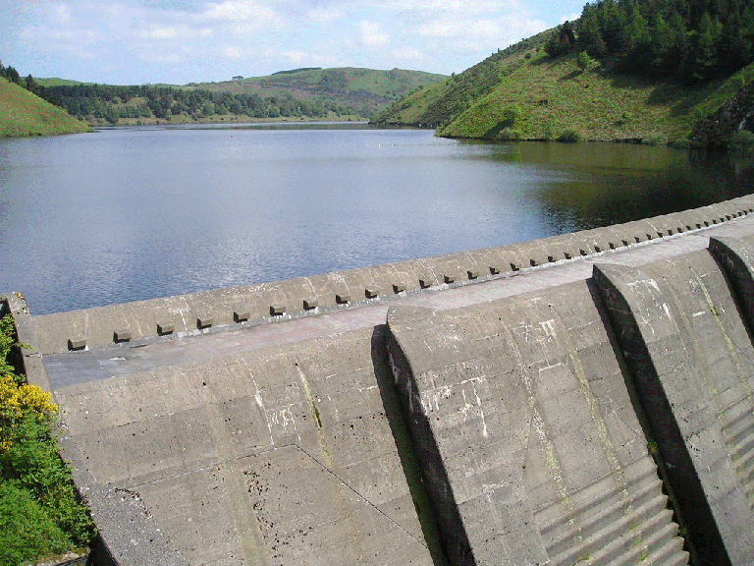
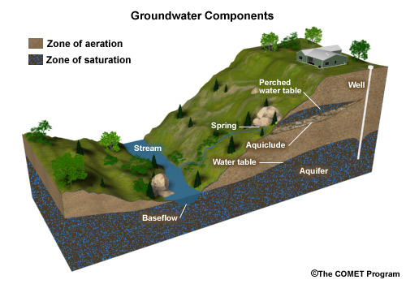
Why artificial recharge
Surface Reservoir
Aquifer

Slide 6
Why Al-faria catchment ?
Previous studies
Increase agricultural lands
Available data
Huge amount of runoff
Easy to reach
+ water for domestic use

Slide 7
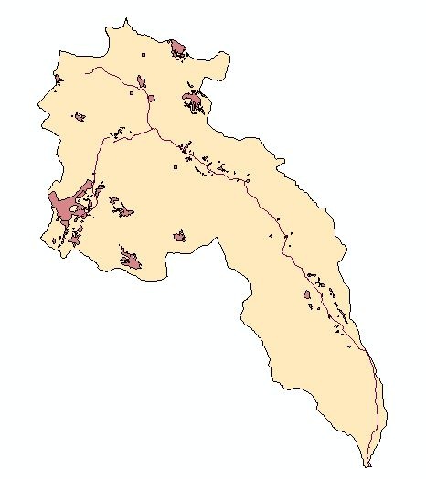
Area and Population
Nablus
124780 C
28.6 km²
Tammoun
10629 C
98 km²
Tubas
15906 C
500 km²
Beit Fourik
10228 C
4.6 km²
Population is estimated at about 210900 capita
Total Area = 320 km²

Slide 8
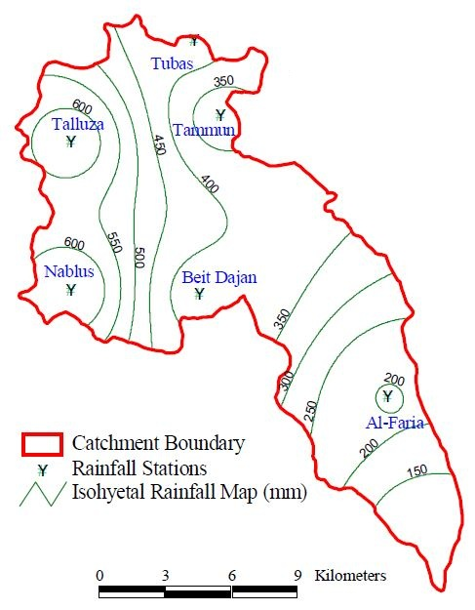
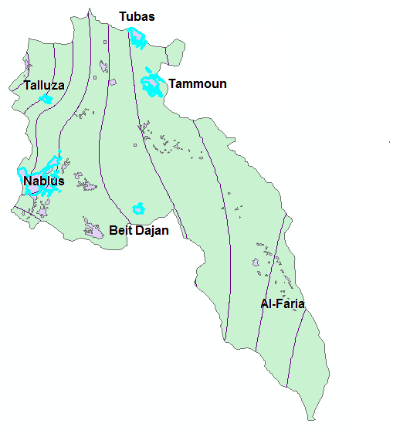
Rainfall
Rain gages
distribution

Slide 9
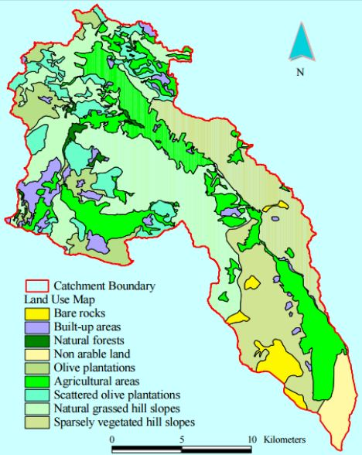
Landuse, Irrigation and Plantation
3.3% Non Arable Lands
2.8 Bare Rocks
0.9% Natural Forests
4.7% Built up Areas
6.4% Olive Plantations
22.1% Agricultural Areas
28.3% Natural Grassed Hill Slopes
23.3% Sparsely Vegetated hill slopes
8.2% Scattered Olive Plantations

Slide 10
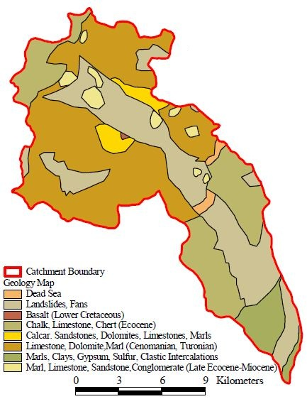
Geological Formation

Slide 11
Problem Identification
HEC-HMS Modeling and Calibration. (2004)
Model Verification (2005)
Choosing Best Artificial Recharge Locations and Method
Overview of Benefit Cost Analysis
Data Collection “Background Research”
Up to date rainfall analysis
METHODOLOGY

Slide 12
DATA COLLECTION
**
Graph
Table

Slide 13
Future agricultural land expansion
Increase future water supply
Choosing best method to benefit from
the generated runoff
Quantify runoff
HEC-HMS
Model
**

Slide 14

Why HEC-HMS?
**
Free of charge
Simulates reality
Easy to use
Available manual

Slide 15
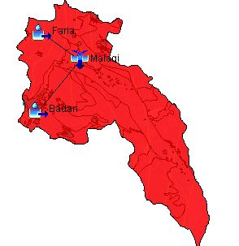
Runoff Quantification

Slide 16
2004 Rainfall event Parameters before calibration
Badhan Subcatchment
Area 85.82 km²
Loss Method:
SCS - CN
Curve Number
55
Initial Abstraction
8
Transform Method:
SCS Unit Hydrograph
Lag Time
60 minutes
Impervious %
0

Slide 17
Al-Faria Subcatchment
Area 64 km²
Loss Method:
SCS - CN
Curve Number
55
Initial Abstraction
8
Transform Method:
SCS Unit Hydrograph
Lag Time
60 minutes
Impervious %
0

Slide 18

Data before calibration

Slide 19
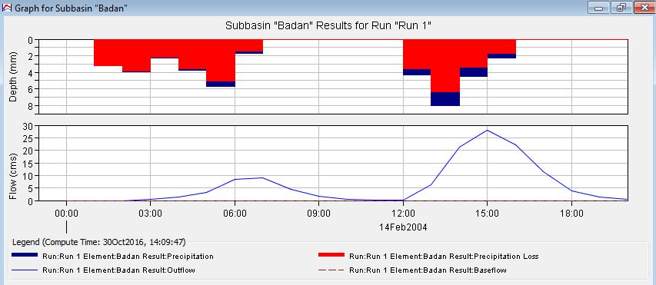

Slide 20
2004 Rainfall event parameters after calibration
Badhan Subcatchment
Area 85.82 km²
Loss Method:
SCS - CN
Curve Number
55
Initial Abstraction
10
Transform Method:
SCS Unit Hydrograph
Lag Time
60 minutes
Impervious %
4

Slide 21
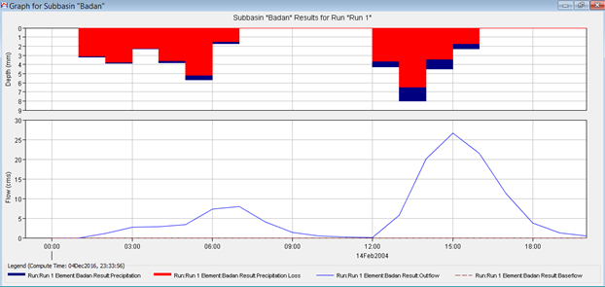
Results after calibration (2004)

Slide 22

Peak Discharge:

Slide 23
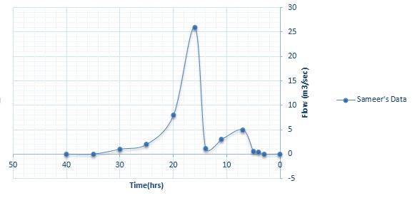
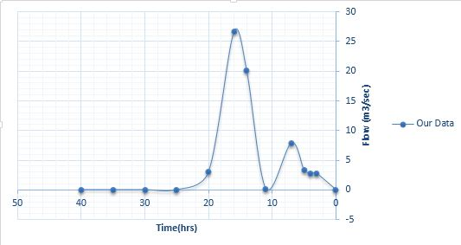
Calibrated Results:
**
Reference Study
Our Study

Slide 24
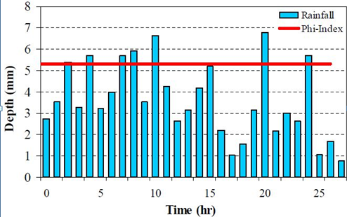
Verification (2005)
Rainfall Hyetograph
HEC-HMS Model

Slide 25
Parameters before verification
Badhan Subcatchment
Area 85.82 km²
Loss Method:
SCS - CN
Curve Number
55
Initial Abstraction
10
Transform Method:
SCS Unit Hydrograph
Lag Time
60 minutes
Impervious %
4

Slide 26
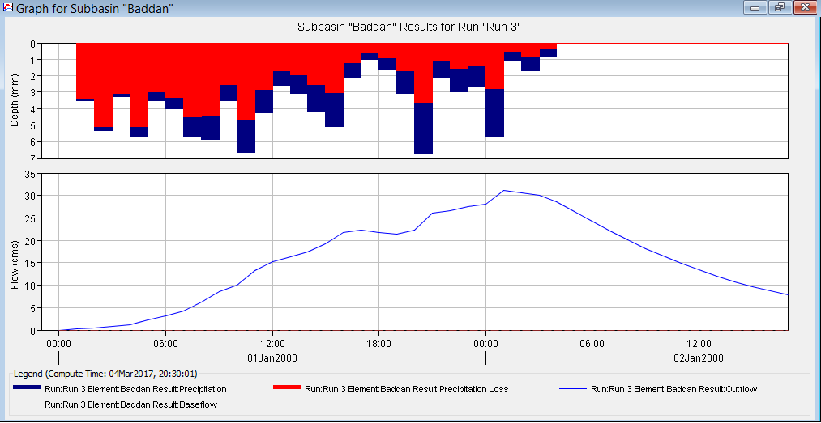
Runoff Hydrograph

Slide 27
Parameters after Model Enhancement
Badhan Subcatchment
Area 85.82 km²
Loss Method:
SCS - CN
Curve Number
30
Initial Abstraction
3
Transform Method:
SCS Unit Hydrograph
Lag Time
60 minutes
Impervious %
1.8

Slide 28
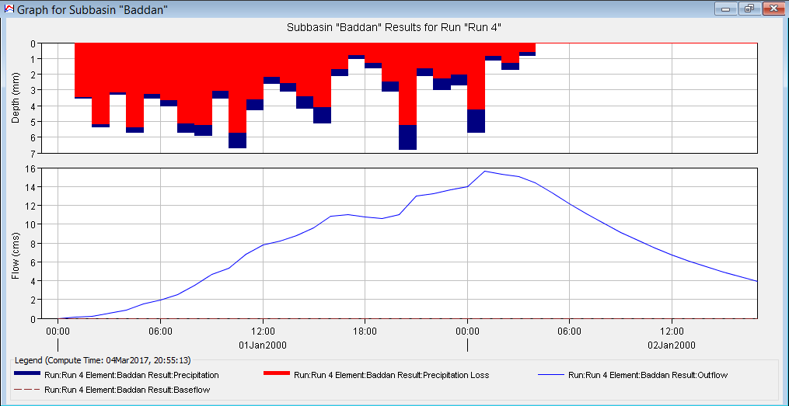
Runoff Hydrograph for 2005 rainfall after enhancement

Slide 29
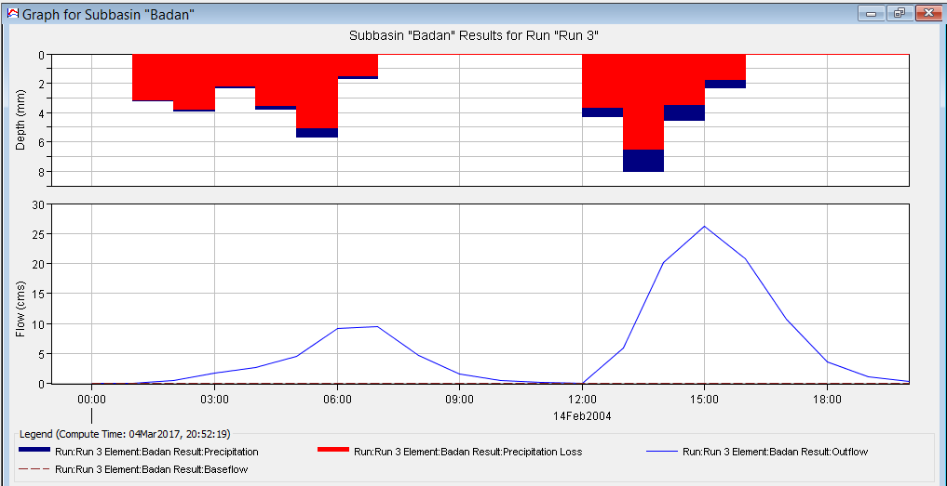
Runoff Hydrograph for 2004 rainfall after enhancement
**

Slide 30
Criteria FOR SELECTING BEST ARTIFICIAL RECHARGE LOCATION
1. Water Quality
5. Ownership
2. Availability of nearby Agricultural areas
6. Laws & Regulations
3. Geological Formation
7. Recharge System
4. Surface Area Provided
8. Economic Considerations

Slide 31
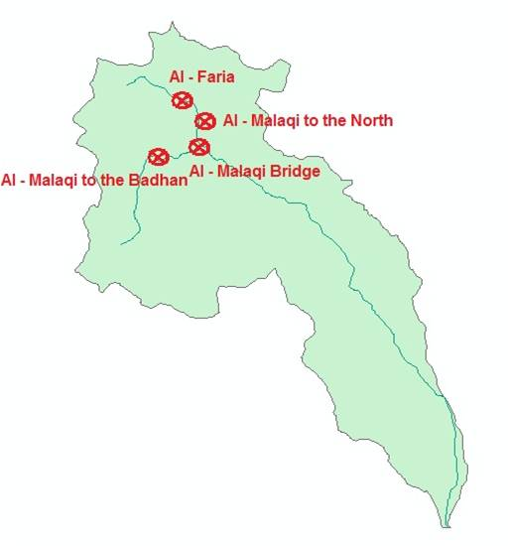
Proposed ARTIFICIAL RECHARGE LOCATIONS

Slide 32
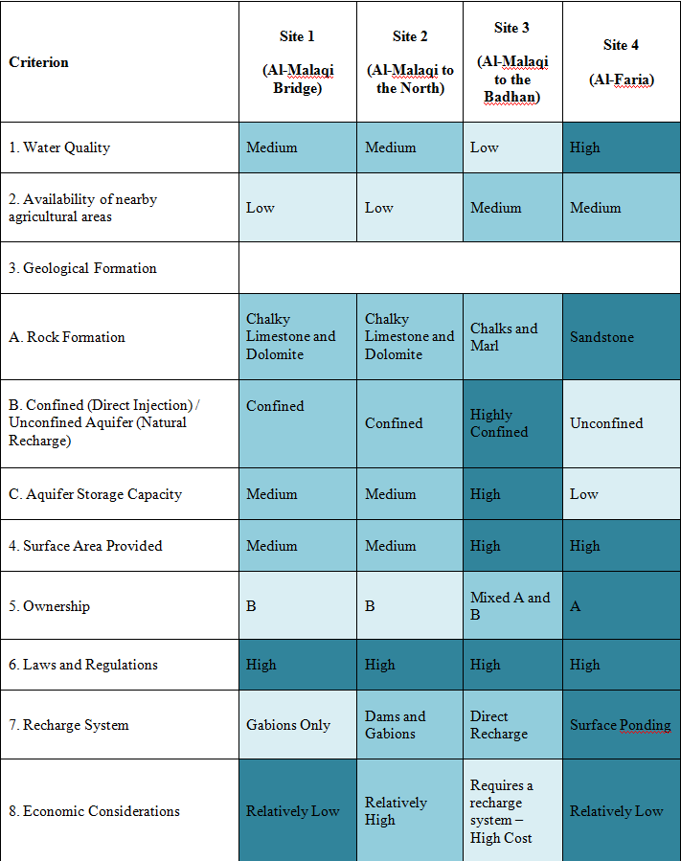

Slide 33
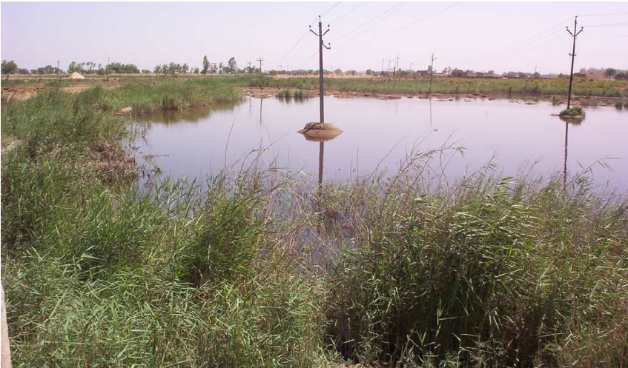
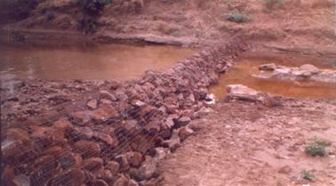
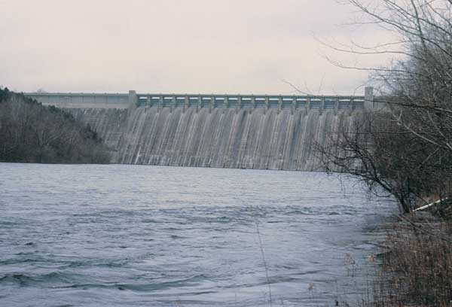
Proposed Artificial recharge systems
**
Gabions
Dams
Surface Ponding

Slide 34
Up to date rainfall analysis

Slide 35
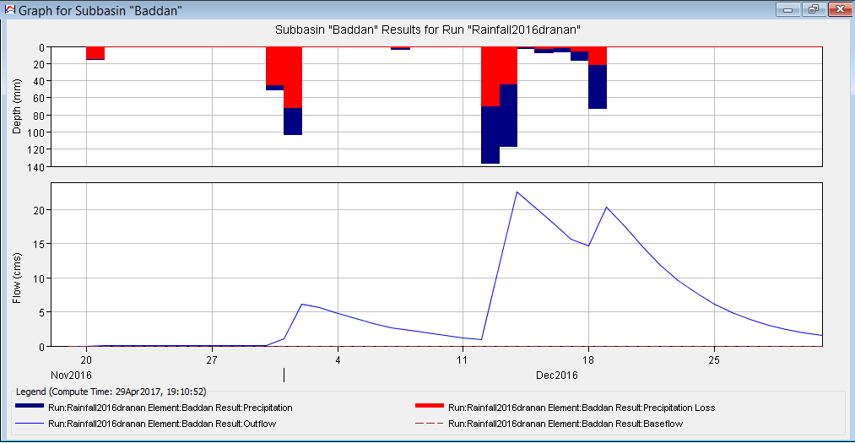
Runoff Hydrograph
**

Slide 36





An overview of benefit Cost Analysis
Benefits
Disbenefits
Cost

Slide 37
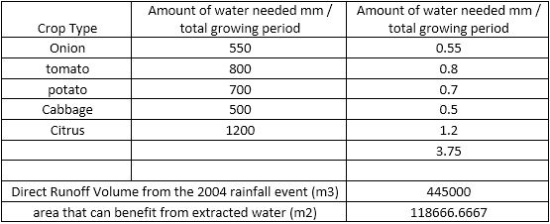
A real life example

Slide 38
Conclusions and recommendations

Slide 39
Thank you

Slide 40
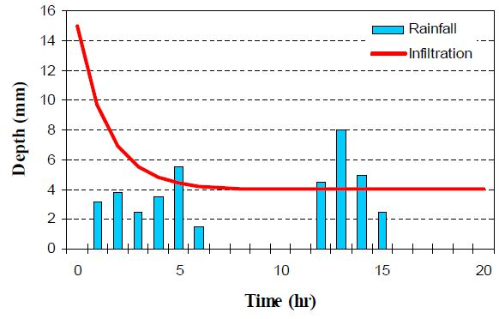

Slide 41
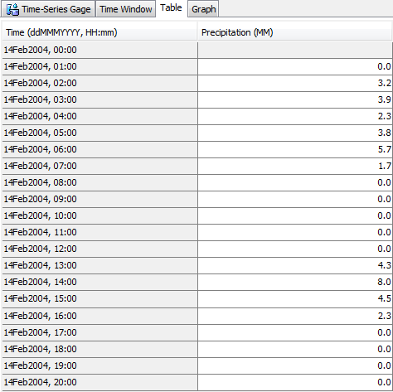
Slide 14

