Slide 1
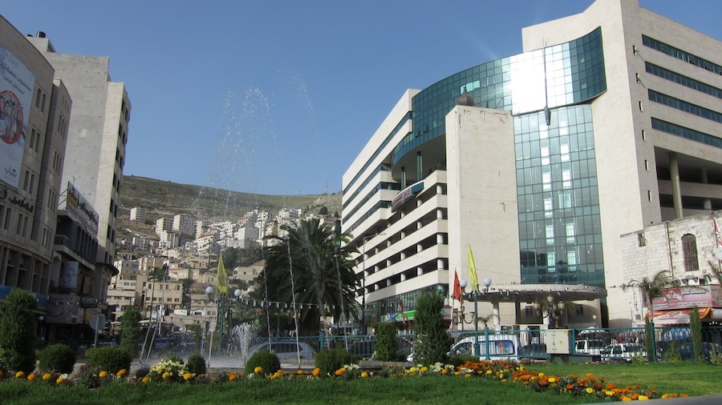

Slide 2


An-Najah National University
Mobile Wi-Max Network
In cooperation with Jawwal
Abed EL-Rahman Sholi
Mohammad Baddad
Supervisor:
Dr.saed Tarapiah
2014

Slide 3
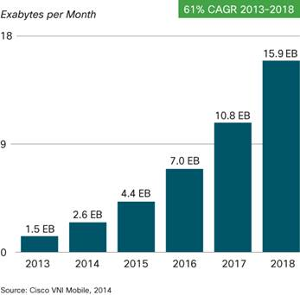
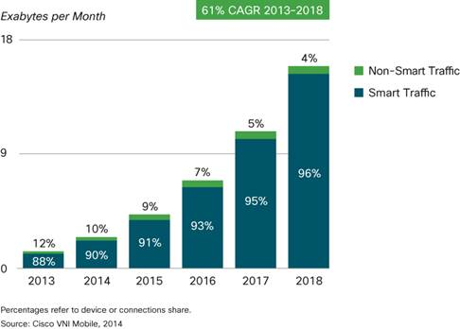
Existence Problem.
› Mobile data traffic growth
› Due to increased usage on Smartphone’s, Smartphone’s will reach 66 percent of mobile data traffic by 2018.
› In the recent years there has been a skyrocket rise in mobile data usage especially due to the large number of smartphones in use.

Slide 4
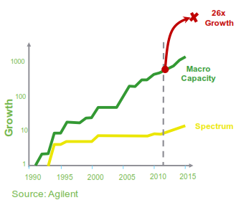
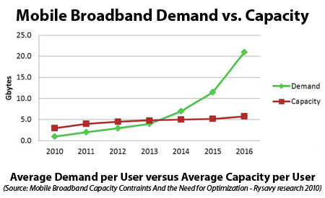
Capacity and Spectrum
› Overall capacity is not keeping pace with data demand.
› That means future networks supporting the mobile internet will need to integrate smaller cell architectures to scale.
› The telecoms operators and providers followed accordingly.

Slide 5
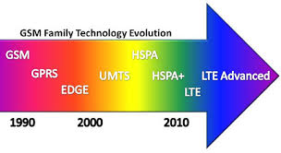


Possible Solutions
› To solve this problem; dramatic increasing in mobile data traffic; there are several solutions
› Upgrade the existence infrastructure.
› Offloading to Femto-cells
› Wi-Fi networks.
› Wi-Max.

Slide 6
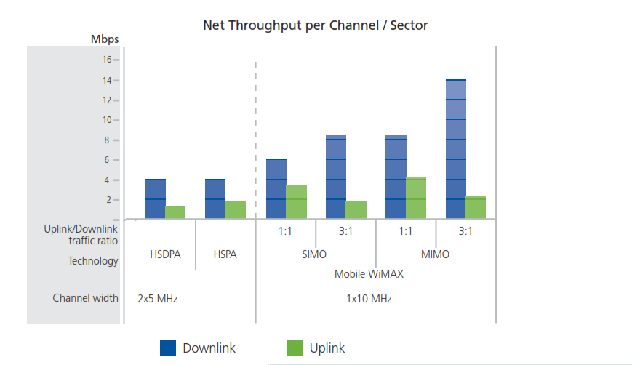
Wi-Max VS HSPA

Slide 7
Feature | Deployment options
Used spectrum | 2.3, 2.5, 3.3, 3.5, etc. GHz
Bandwidth | 1.25 – 20 MHz
Duplex | TDD or FDD
Sub channel/frequency reuse | 1/3, 1/4 , 1 (PUSC/FUSC)

Slide 8
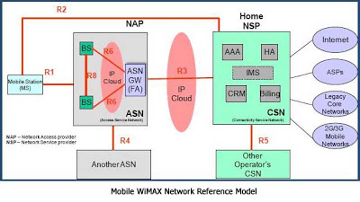
Mobile Wi-Max System Architecture
› ASN
› CSN
› MS

Slide 9
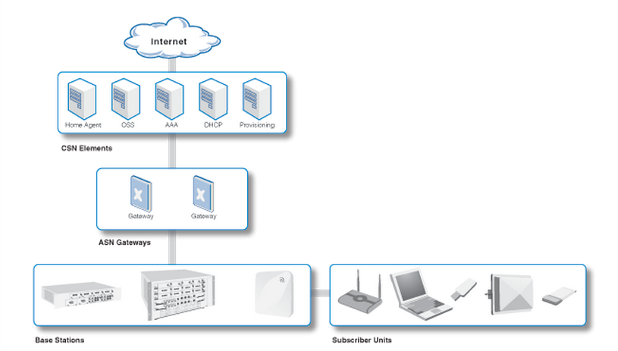
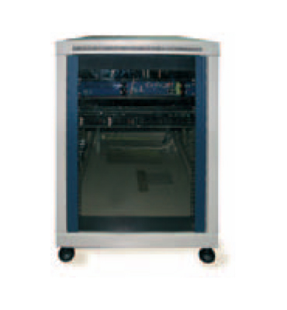
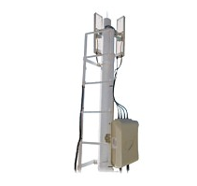
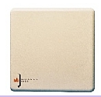
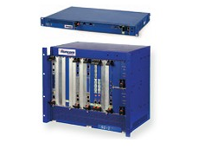
Base Station: RNU4000
External Antenna: MT – 344092/NVH
ASN : RN-ASN-SG-X Runcom
CSN RN-NOC-XXX Runcom

Slide 10
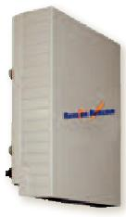
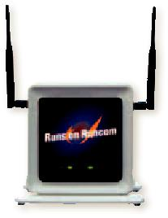
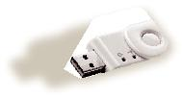
Subscriber Unit
RNU300ETH-MIMO Residential Indoor CPE
RNU303-USB USB Dongles nomadic or mobile
RNU300ODU Residential Outdoor CPE

Slide 11


Planning Process

Slide 12
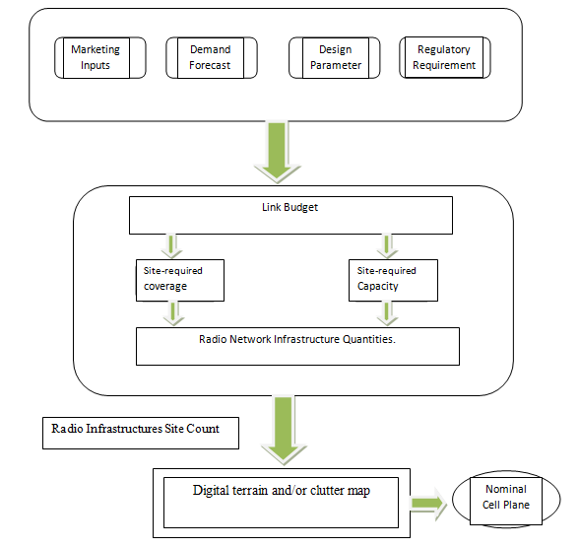
Site Planning: Planning Process

Slide 13
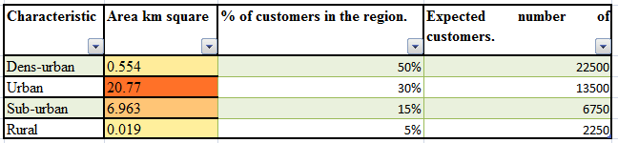
Geographical area

Slide 14
Spectrum Selection
For this project work, licensed bands 2.5GHz is therefore assumed for the deployment. channel bandwidth 10 MHz TDD, and spectrum 30MHz.
Feature | Deployment options
Used spectrum | 2.5,GHz
Bandwidth | 10 MHz
Duplex | TDD
Sub channel/frequency reuse | 1/3, 1/4 , 1 (PUSC/FUSC)

Slide 15
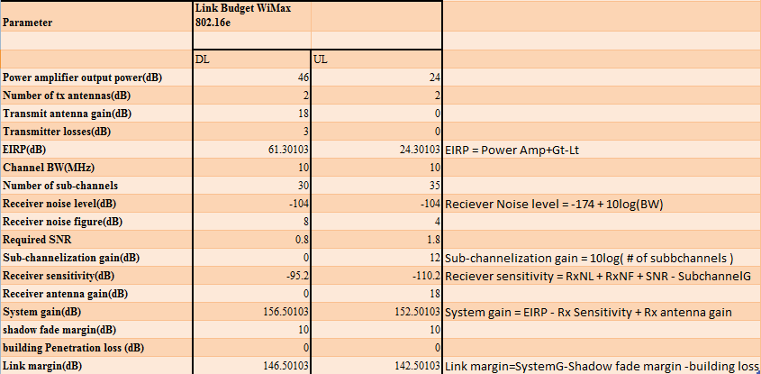

Slide 16
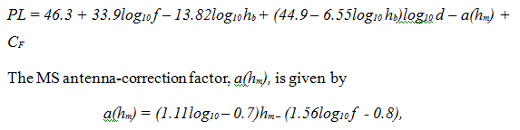
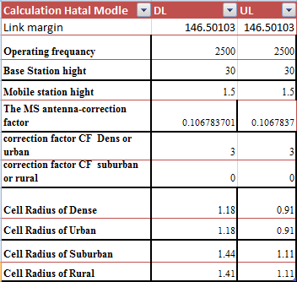
Cell Radius COST-231Hata Model

Slide 17
Coverage Deployment

Slide 18
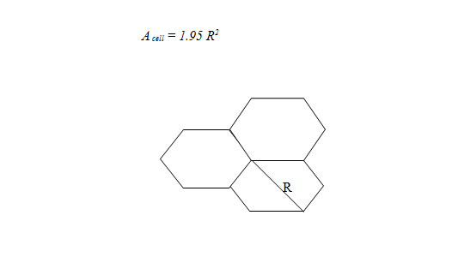
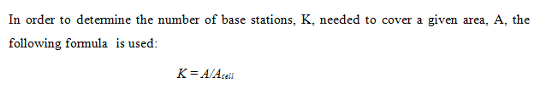

Slide 19
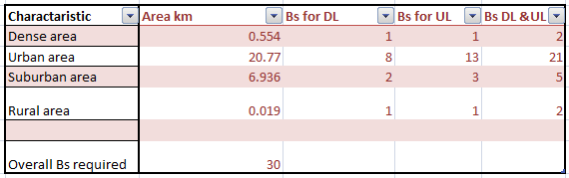

Slide 20
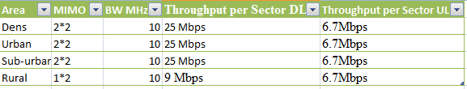
Antenna Configuration
Since mobile Wi-MAX uses shared resources, the data rate per sector is shared equally among all users currently served under the cell.
Due to the low probability that all customers are going to be served in a single base station, it is assumed that at least 10 customers can be served per sector.

Slide 21
Capacity Deployment

Slide 22
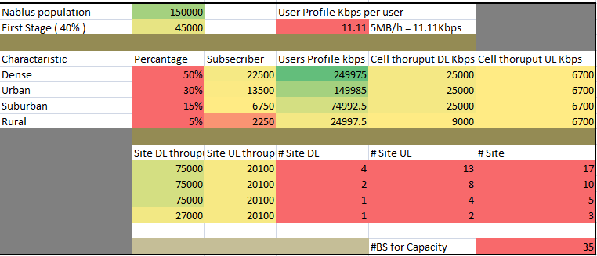

Slide 23
Frequency Reuse

Slide 24
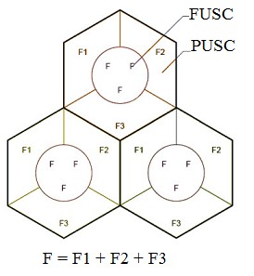
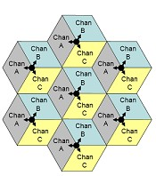
      Frequency Reuse Scheme:

Slide 25

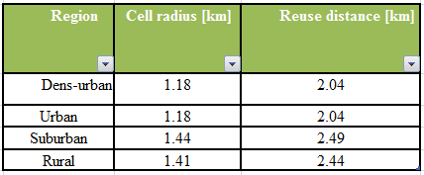
      Frequency reuse distance
Where R is the radius of the cell, and N is the number of cells per cluster

Slide 26
Network Design

Slide 27
Equipment Report& Visibility Study

Slide 28
Where Can be Used

Slide 29
Future Work

Slide 30
Conclusion

Slide 31
Thank You
Any Questions ?

