Slide 1

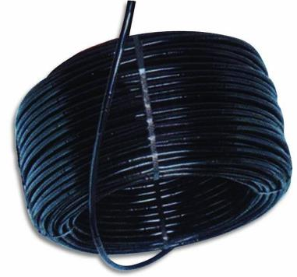
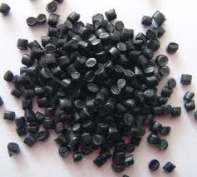

Graduation project 2
High Density Polyethylene Pipes Quality Improvement
Prepared by:
Aseel Omar.
Hiba Barhoush.
.Nour Ali
Samah .Hashaykeh

Slide 2
Project outline
about the project.
Six Sigma.
Project flow chart.
DMAIC .
Major findings.
Limitations.
Conclusions.
Recommendations.

Slide 3
about the project?
The project purpose is to study the quality related problems in the extrusion PE pipes products and improving its quality by using Six Sigma methodology.
The work in this project will be depending at the historical data from the manufacturing department, and our understanding of the extrusion process, by using the 6σ methodologies and the approach of the design of experiment in order to reach company goals.

Slide 4
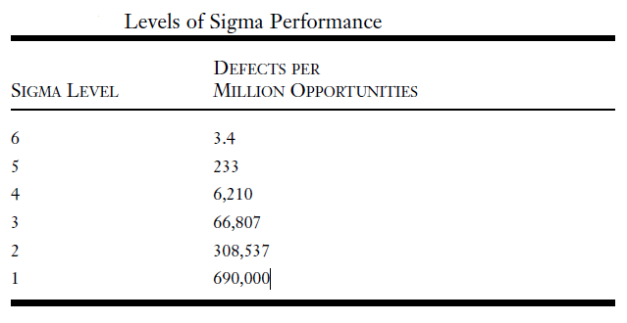
Six Sigma
What 6б ?
Six Sigma, it`s a new smart method & approach which most of the companies now are working to implement it ,and the main goal of this method is to obtain the required quality that satisfy customer needs and specifications.

Slide 5
Benefits of 6б using
Improving quality.
Reducing cost.
Reducing losses.
Increase competitiveness.
Improve productivity.
Increase the employee's & customers satisfaction.

Slide 6
6б Methodology:
Define
Improve
Control
Measure
Analyze
DMAIC

Slide 7
In this project the focus will be about the polyethylene pipes 16 mm black, the main issue for this search is to improve the quality of the final products by working to reduce the wall thickness of the pipes into the minimum within the range, this reduction will affect the cost and the raw materials consuming.
Reduce wall thickness
ٌReduce raw materials
Reduce Cost & price
Increase the competitiveness

Slide 8
Project Flow Chart

Slide 9
Historical data.
Theoretical study about 6б & DOE
Labors experience.
ISO Specifications.
Process study.
Current state analysis and problem define.
Materials study.
Define
Define problem.
Set Goals & Objective.
DMAIC phases & DOE conducted
Measure
Taking samples.
Use tables to take the desired information's. (DOE concepts).
Control
Improve
Analyze
Control process variations.
Develop strategy to monitor & to control the improved process implement of systems.
"See Problem. Kill
Problem"(Folks).
Starting to solve problem by eliminating variations.
Planning & achieving results.
Analyze data using: Scatter plot, hypothesis testing, ANOVA, DOE.
DOE. Set: levels, factors, responses, Factorial design method.

Slide 10
Define
To better under standing of the process and to determine which is the significant product .of the search

Slide 11
The main products with its quantities that produced with the defects quantities for the last two years are classified and analyzed as shown below:
Type OF Product | Total quantity Produced (Kg) | Total defects (Kg) | Defects Percentage
R.C.P.P | 182806.57 | 2075.06 | 0.2425
H.D.P.E | 225221.3 | 6143.1 | 0.7180
PEX | 23262.06 | 338.17 | 0.0395
 |  | 8556.33

Slide 12
Percentage type of pipes production and defect

Slide 14
Percentage HDPE production and defect

Slide 16
Measure
Thickness is in the best factor to measure the defect in the pipe. As per customer's specification.
Measurement System Analysis was conducted of the CMM to ensure its adequacy to measure the thickness of the part.
The process capability study was performed in order to determine whether the current process has the capability to meet established customer specifications

Slide 17
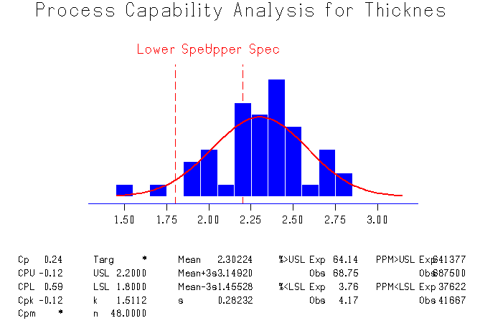
Process capability

Slide 18
Analyze
The team went throw a brain storming session to identify the most likely sources of the thickness defect. The outcome was summarized in a cause –and-effect diagram

Slide 19
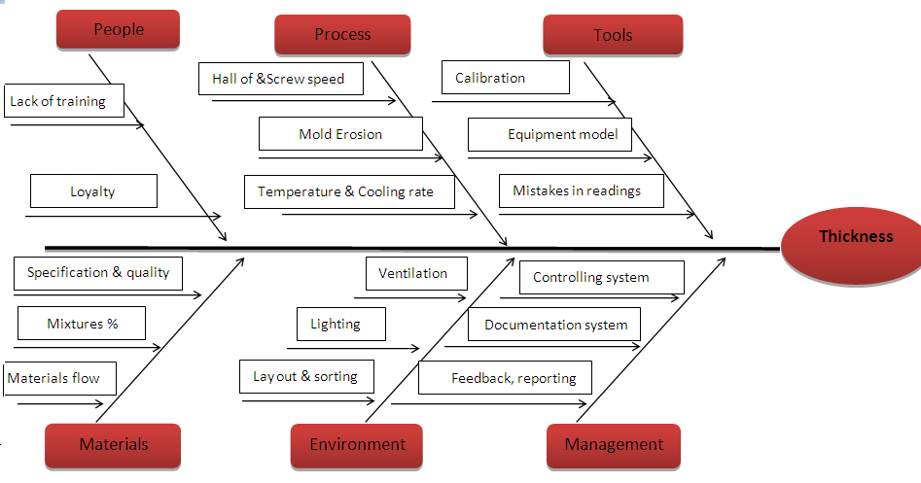

Slide 20
Improve
Machine and extruder reconstruction were not considered to be cost effective in the initial phase. Hence, it was decided to work on process parameters to deal with the thickness defects. DOE was chosen as an improvement tool to reduce the thickness problem by finding optimum process parameter settings. It was used to determine the most influential process parameters and their interactions which cause parts to be over or lower thickness.

Slide 21
Steps taken to complete the DOE are discussed below:
Step 1
Define the goal/objective of the experiment

Slide 22
Step 2
Specify the input parameters and output response to be measure

Slide 23
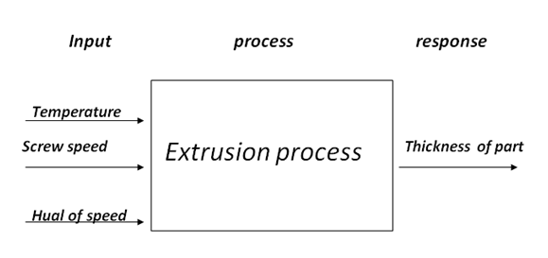
. The range of the part with the thickness between ( 1.8mm - 2.2mm ) does not consider as defected

Slide 24
Process diagram of full factorial design of thickness.
Factors | Low level | High level
Temperature of head (ºC) | ≤ 200 | >200
Haul off speed (m/min) | <7 | ≥7
Screw speed (rpm) | ≤ 155.9 | ≥ 161.9

Slide 25
Step 3
Develop and run the experiment

Slide 26
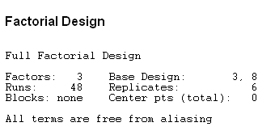
Considering time, resources, cost, that will be involved in the experiment, simple three factors, two levels full factorial design was used for the experiment.

Slide 27
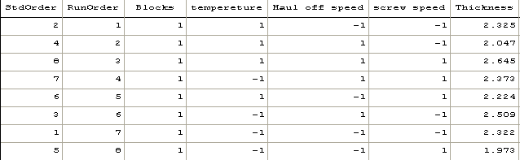
Design matrix with thickness value obtained from Minitab

Slide 28
Step 4
Collect and analyze the experimental data

Slide 29
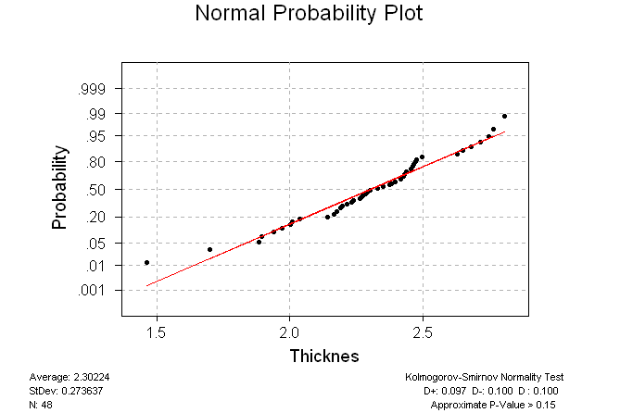

Slide 31
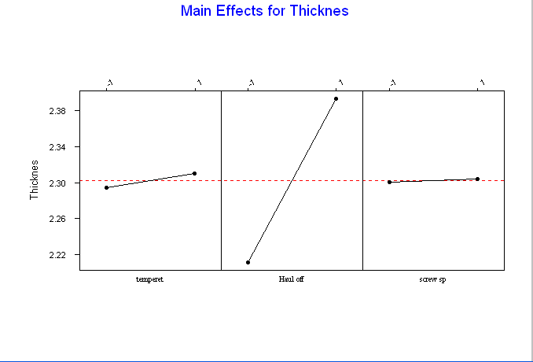
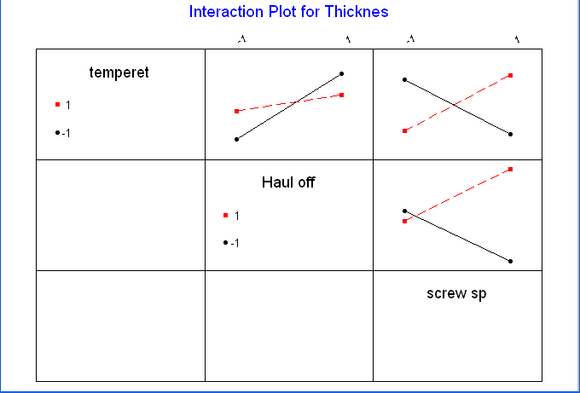

Slide 32
Step 5
Identify significant and non-significant factors

Slide 33
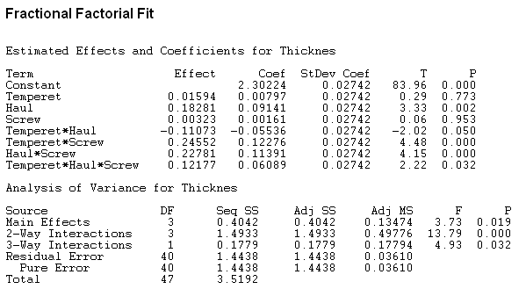
The P value from this analysis indicates that the Haul off speed has a high degree of statistical significance and other factors are not significant. Factors whose P value is less than the alpha (α = 0.05) value is considered to be statistically significant.

Slide 34
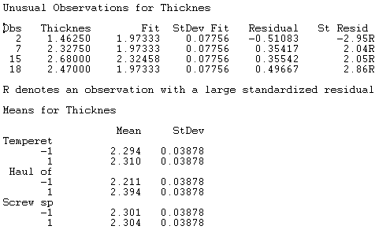

Slide 35
Step 6
Define the optimum condition and solution
Based on the analysis, the production run should set the temperature of head at high level (>200), haul off speed at low level (<7) and speed screw at high level (≥161.9) in order to reduce the defects in the pipes

Slide 36
Control
Control must be implemented to insure that over time the optimum setting determine does not get loss. Following steps were taken to sustain the gain obtained.
Master cycle sheet will be maintained so that parameter setting will be in place.
In-process inspection will be performed to measure the thickness of the pipes to make sure pipe is not defect.
Control chart will be plotted of the thickness data to monitor to improve process.

Slide 37
Major findings:
Six Sigma DMAIC approach can be used to improve a quality of extrusion plastic pipe product.
Six Sigma tools such as Pareto chart, Cause-and-Effect diagram, Measurement System Analysis, Process Capability Study, Design of Experiment are very useful on improving the quality of product.
Design of Experiment is a very useful tool to find the optimum setting of an extrusion machine parameter to reduce thickness defect on plastic pipe product.
The combination of Six Sigma DMAIC approach and knowledge of extrusion process can be used to solve defect in process.

Slide 38
Limitations:
The result of the study is limited to Palestine Plastic Industries Company.
The study is limited to only one product manufactured in Palestine Plastic Industries Company.
Only thickness defect on the plastic pipe part was studied.
The analysis and results are based upon the researcher’s knowledge and experience.

Slide 39
Conclusions
Six Sigma DMAIC approach can be used to improve the quality of the products in plastic industry. The result of this study proved that the quality of product in a plastic industry can be improved by using Six Sigma approach. Adapting Six Sigma as a part of business strategy definitely helps the organizations to achieve sustainable growth.

Slide 40
Recommendations Related to the Case Study:
The Palestine Plastic Industries Company is recommended to prepare a cycle sheet of the extrusion process parameters obtained from DOE. The cycle technicians are recommended to set the process parameter as per the cycle sheet so as to obtain the thickness of the part within customer specification. This will result in minimum thickness parts.

Slide 41
Recommendations for Future Study:
Six Sigma DAMIC approach can also be used to solve other types of extrusion defects besides thickness. It is recommended to use the DAMIC approach and Six Sigma tools for quality improvement in not just extrusion companies but in other types of manufacturing and service industries as well.
Six Sigma combined with lean manufacturing, continuous improvement, total quality management methods can be used in different industries to improve quality of products and services and reduce the cost with improved customer satisfaction.

Slide 42

Thanks for your attention
Please feel free to ask questions

