Slide 1
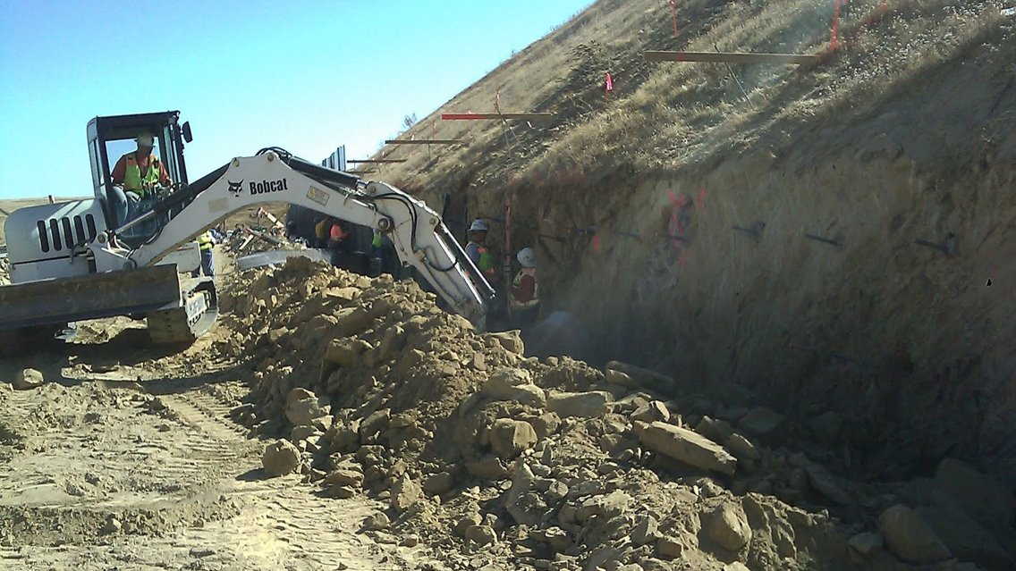
Graduation Project 1
10601598
Excavation Support Systems and Safety in Excavation
Prepared and Presented By:
Aws Kaffini (11821904) Nima Dawood Abu-Assab (11844657)
Tala Qadri (11820711) Luna Abdullah Al-Taher (11819550)
Maya Mohammad Al- Dhoon (11819897)
Under the Supervision of: Dr. Isam Jaradneh

Slide 2

Graduation Project 2
10601598
Designing an Excavation Support System
Prepared and Presented By:
Aws Kaffini (11821904) Nima Dawood Abu-Assab (11844657)
Tala Qadri (11820711) Luna Abdullah Al-Taher (11819550)
Maya Mohammad Al- Dhoon (11819897)
Under the Supervision of: Dr. Isam Jaradneh

Slide 3
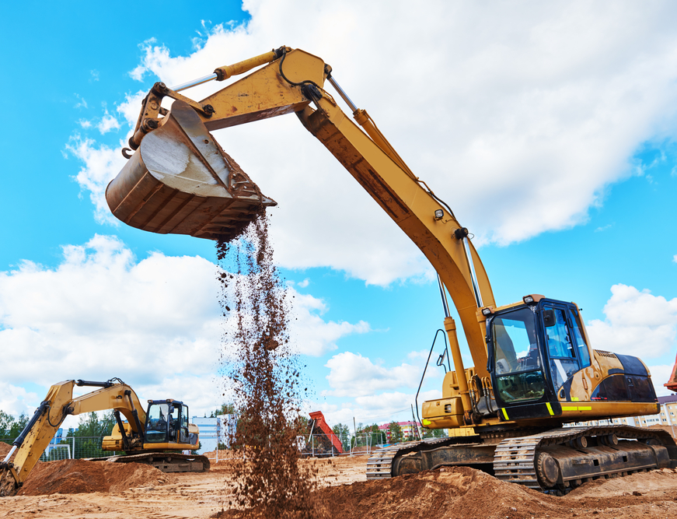
Introduction
It has been decided to take a case in Nablus city in order to be studied and to design an excavation support system for it. A site has been found and visited by the work team, this site is located near AL-Baik Sweets store, where exists Leddawi’s Building. Before starting building it, excavation works have been performed to level the ground, but unfortunately, a failure has occurred in the soil surface

Slide 4
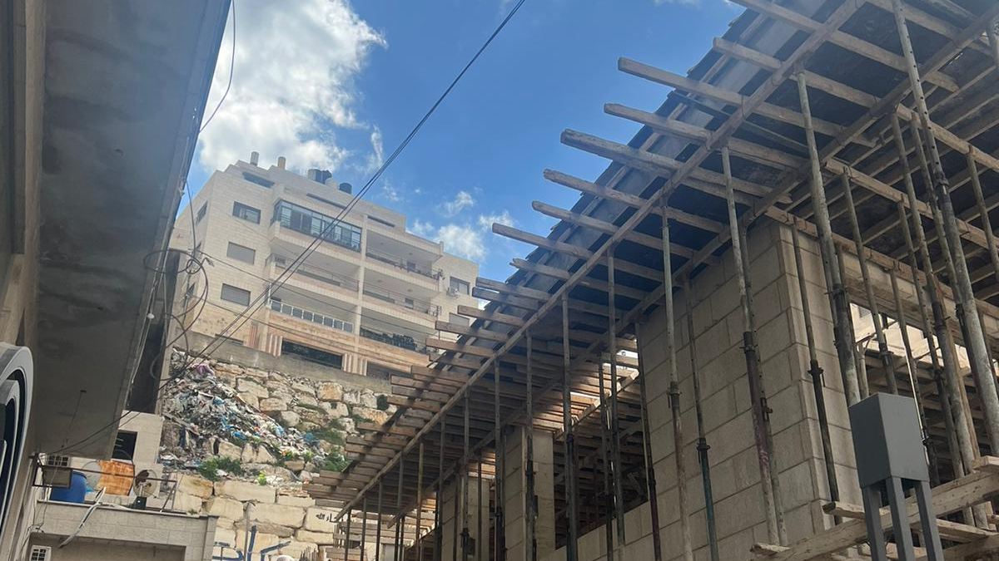
Study Area

Slide 5
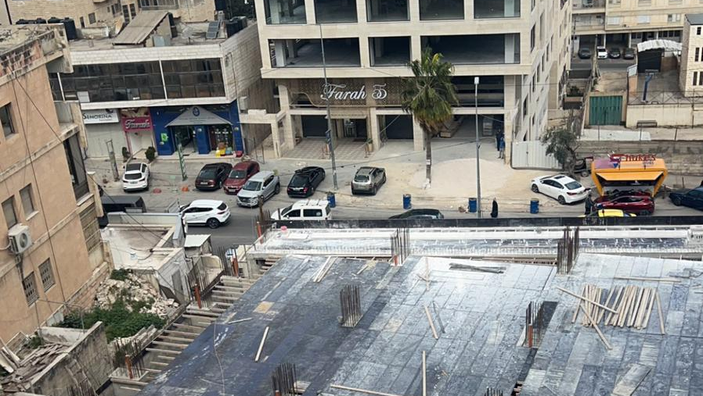

Slide 6
Soil Parameters
BH No. | Sample No. | Depth m | Natural Moisture Content % | Plasticity Index | Cohesion kN/m² | Angle of Internal Friction (φ°)
1 | 1 | 0.0 – 0.5 | - | -
 | 2 | 0.5 – 3.5 | 68 | 7.1 | 12 | 22
 | 3 | 3.5 – 14 | - | NP | 7 | 25
2 | 1 | 0.0 – 0.5 | - | -
 | 2 | 0.5 – 4.5 | 81 | 13.2 | 14 | 19
 | 3 | 4.5 – 14 | 78 | 11.4
3 | 1 | 0.0 – 8 | 64 | 6.9 | 10 | 22
4 | 1 | 0.0 – 5.5 | 72 | 7.5 | 11 | 22
 | 2 | 5.5 – 19 | - | NP

Slide 7

Methodology
PLAXIS 2D software is a finite element geotechnical engineering software which can be used for 2D analysis of deformation and stability in geotechnical engineering and rock mechanics. PLAXIS is used worldwide by top engineering companies and institutions in the civil and geotechnical engineering industry. PLAXIS 2D is ideal for a range of applications from excavations, embankments, and foundations to tunneling, mining, oil and gas, and reservoir geomechanics

Slide 8
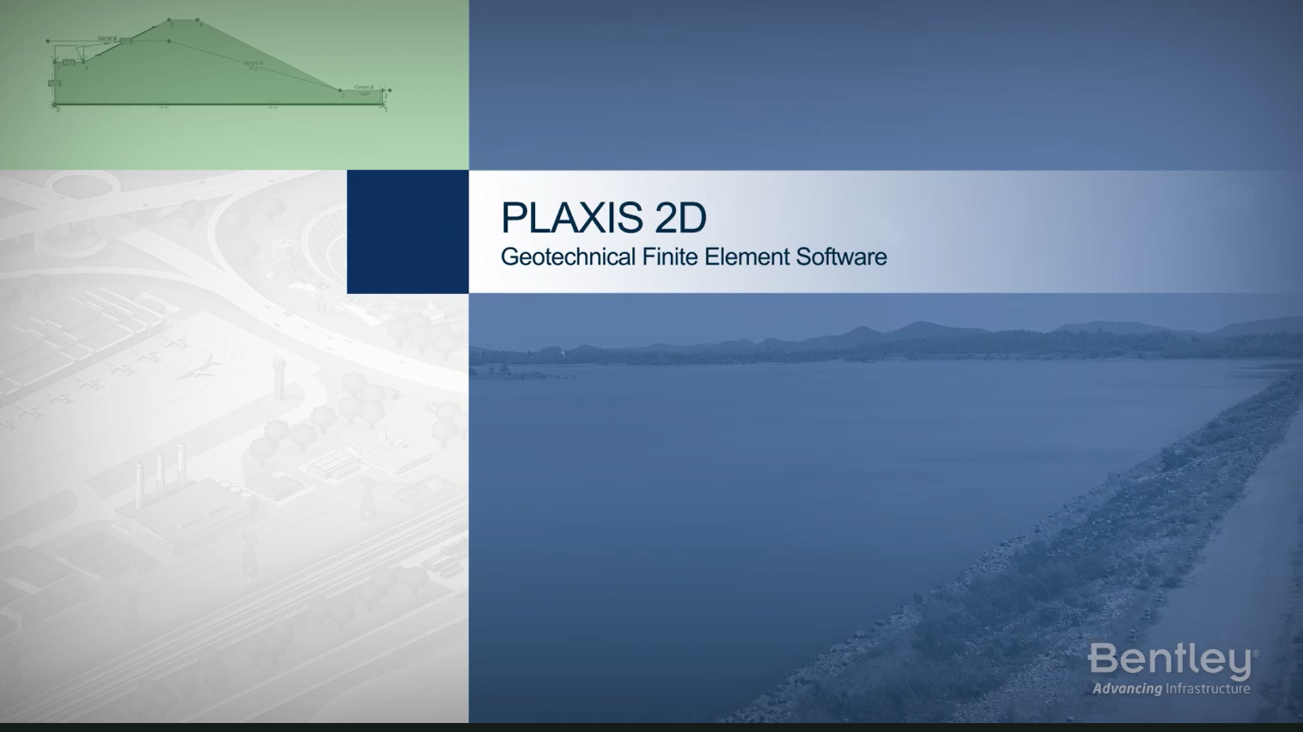
PLAXIS 2D SOFWARE

Slide 9
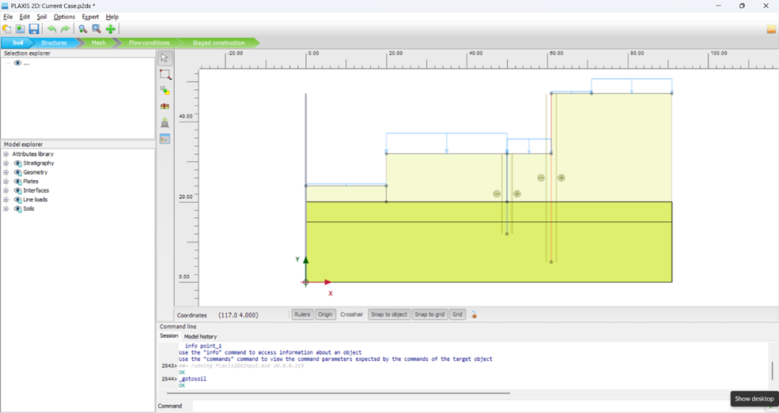
Interface

Slide 10
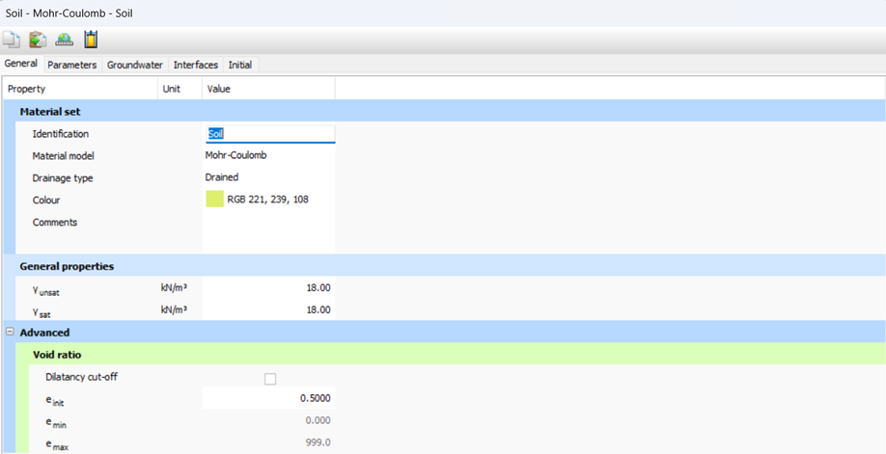
Soil Mode

Slide 11
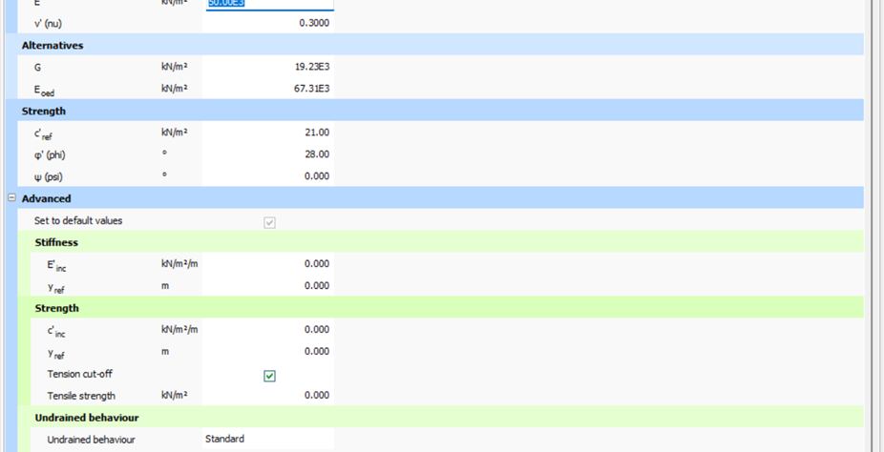

Slide 12
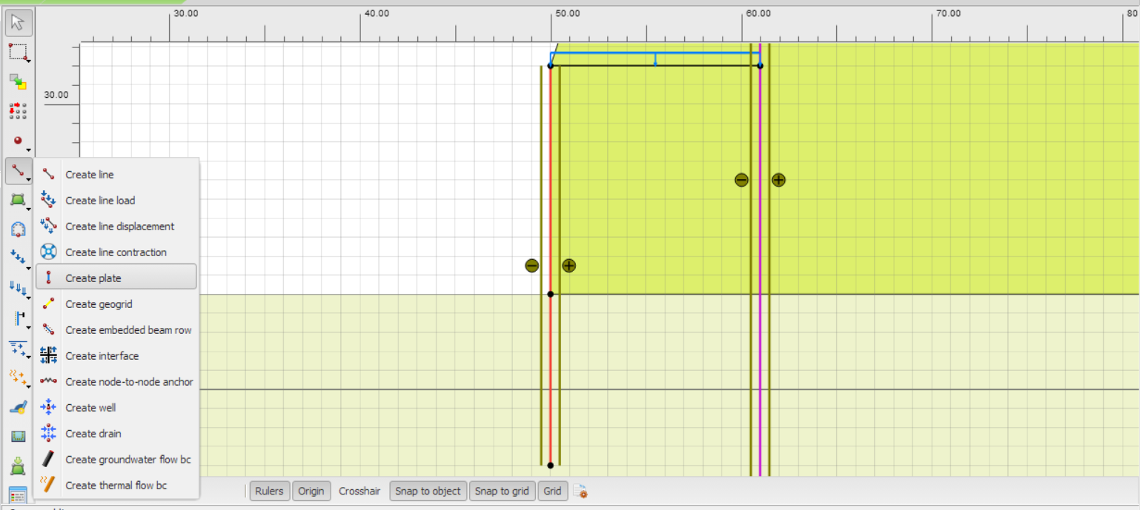
Plates

Slide 13
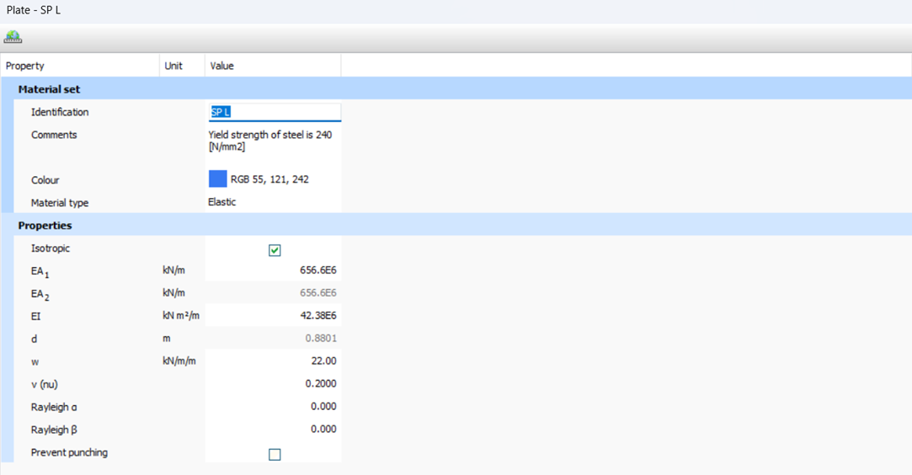
Plate Element

Slide 14
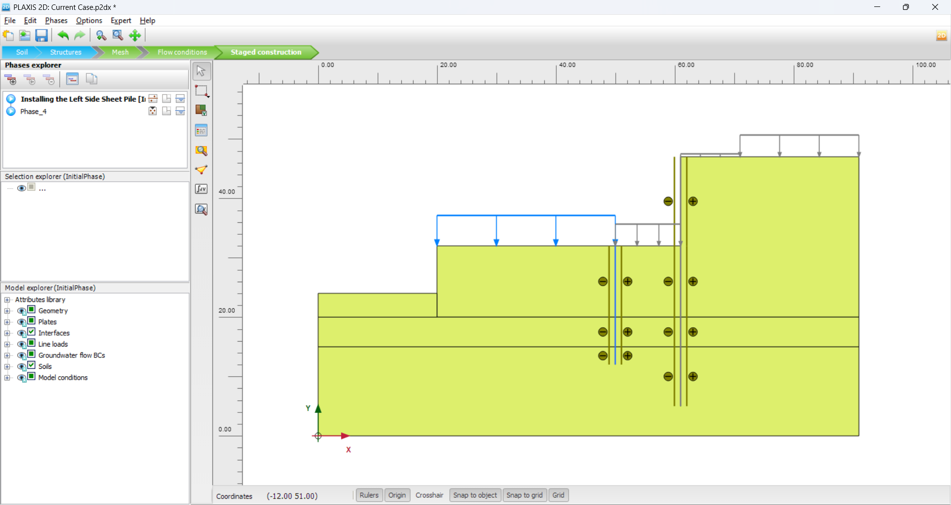
Current Case Model

Slide 16
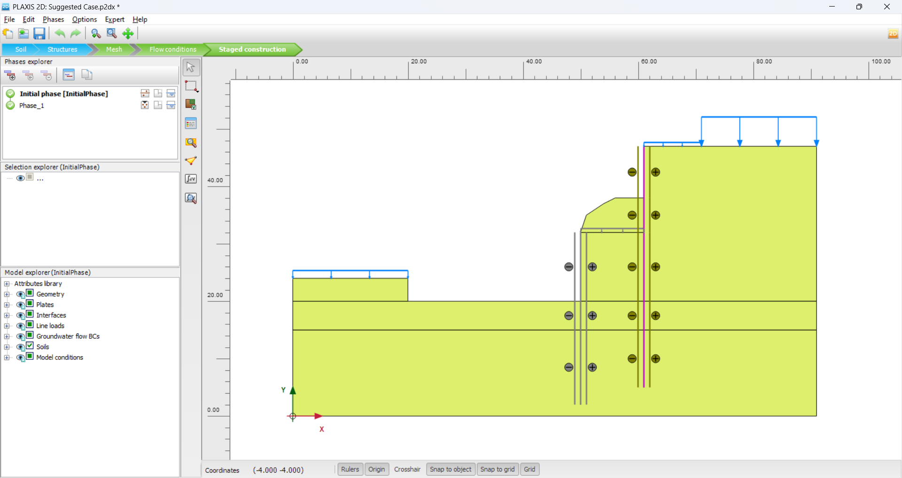
Suggested Case Model

Slide 18
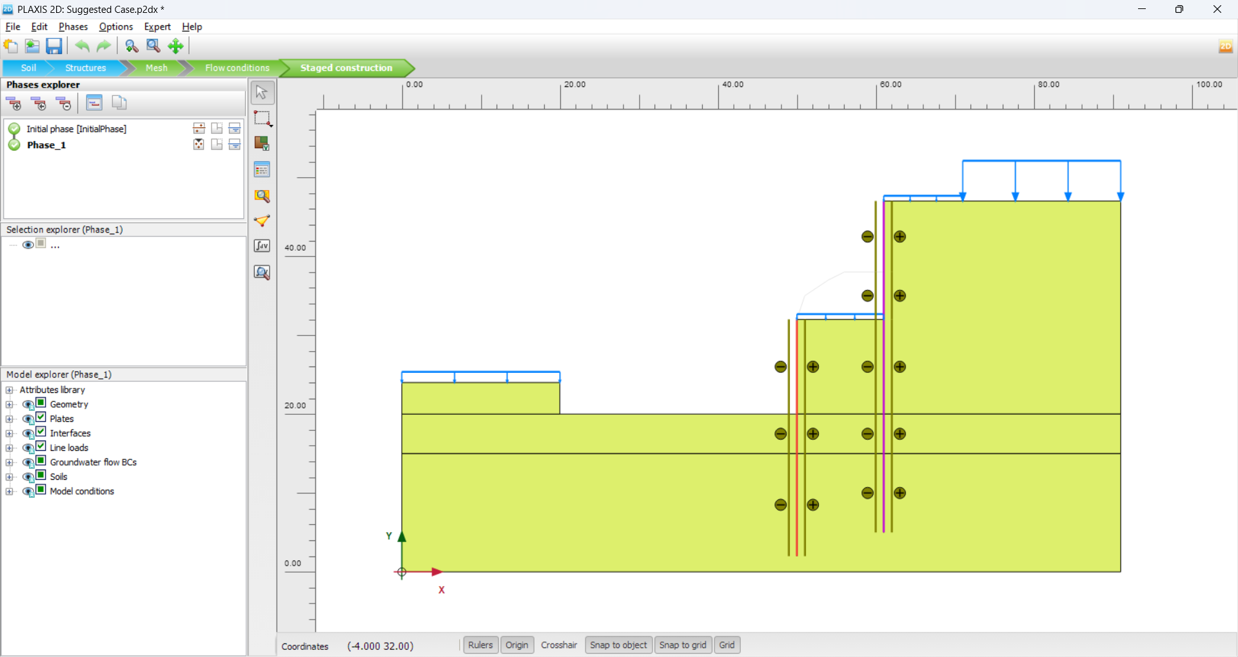

Slide 19
Results
# | Left Sheet Pile |  |  |  |  | Right Sheet Pile
 | Rows | Dia (m) | S (m) | h (m) | Depth (m) | Rows | Dia (m) | S (m) | h (m) | Depth (m)
Current Case | 2 | 0.8 | 1.2 | 0.88 | 20 | 2 | 1.2 | 1.4 | 1.7 | 25
Suggested Case | 1 | 0.8 | 1 | 0.44 | 21 | 2 | 1 | 1.1 | 1.49 | 42

Slide 20
Conclusion
# | Left Sheet Pile |  |  |  | Right Sheet Pile
 | Deflection cm | Axial Force kN/m | Shear Force kN/m | Bending Moment kN.m/m | Deflection cm | Axial Force kN/m | Shear Force kN/m | Bending Moment kN.m/m
Suggested Case | 30 | 586 | 378 | 1963 | 40 | 745 | 116 | 2134
Current Case | 25 | 634 | 542 | 2874 | 37 | 1347 | 390 | 4074

Slide 21
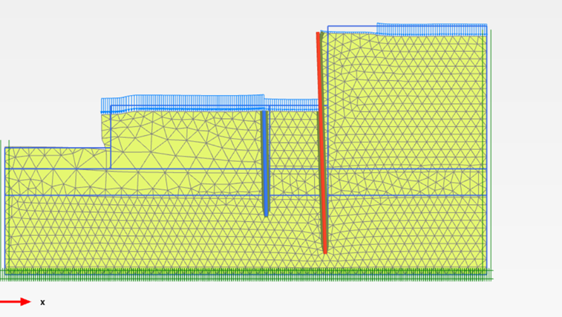
Deflection

Slide 22
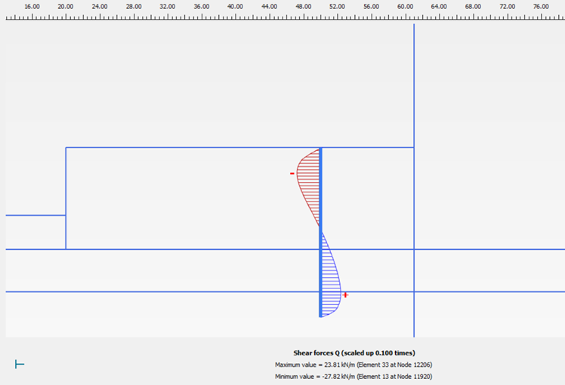
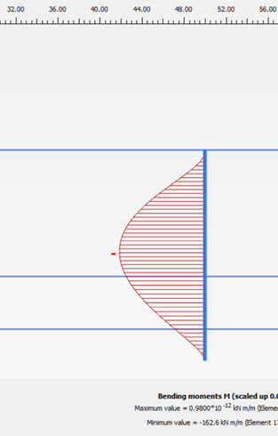
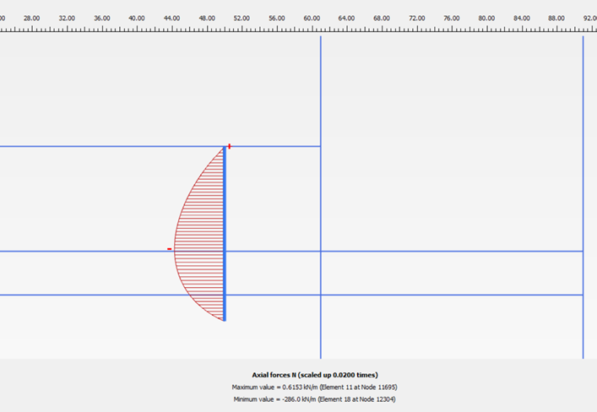
Axial - Shear – Moment Diagrams

Slide 23
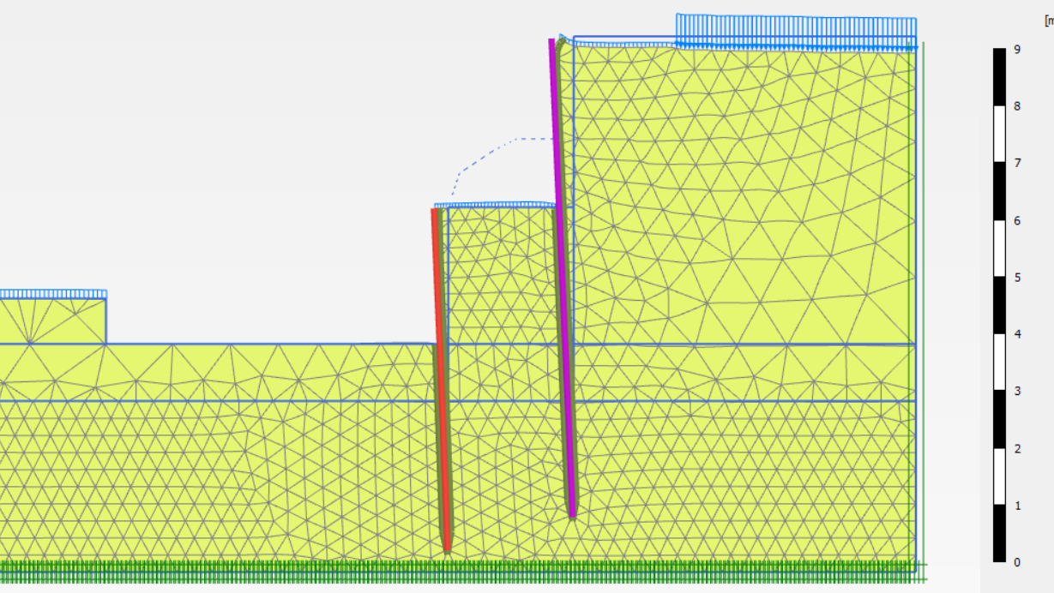
Deflection

Slide 24
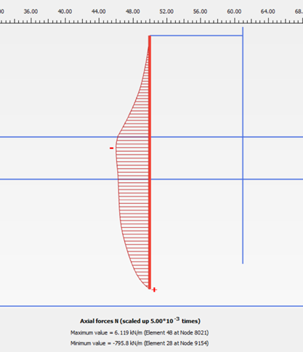
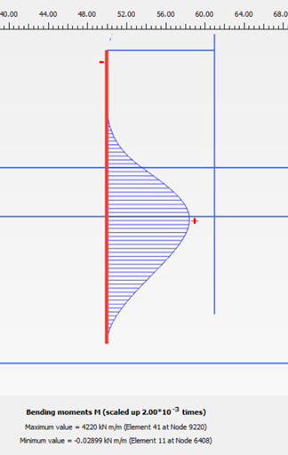
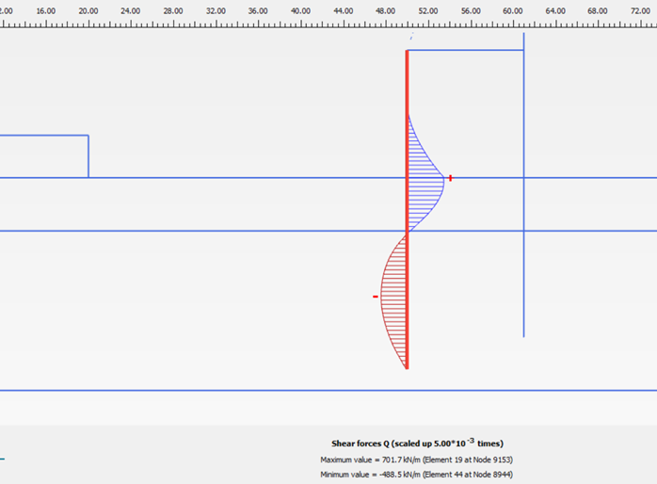
Axial - Shear – Moment Diagrams

Slide 25

Conclusion
It’s noticed that in our suggested case, the left sheet pile could be designed by only 1 row of piles of 0.8m diameter of each pile and 1m center to center spacing, this leads to an equivalent thickness of the sheet pile of 0.44 m with 21m depth. As well as, the right sheet pile also would be designed economically of 2 rows of piles but with 1m diameter and 1.1m center to center spacing which gives a 1.5m equivalent thickness of the sheet pile with 42m depth.

