Slide 1
Multipurpose syringe pump 3d printer
Presented to you by:
Alaa Jawabreh
Ahmed Naser
Tariq Sholi

Slide 2
Outline
Introduction
Mechanical Components
Electrical Components
Material
Software
Printing process
Limitation
Conclusion

Slide 3
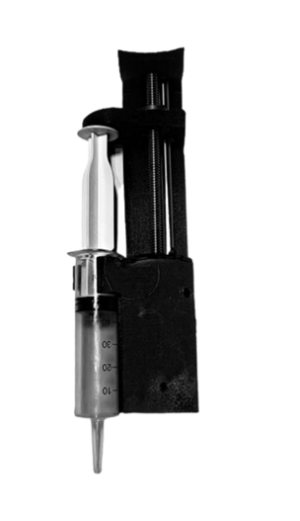
Introduction
What is syringe pump 3D printer?

Slide 4
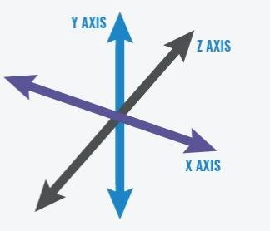
Degrees of freedom
3 axis degrees of freedom

Slide 5
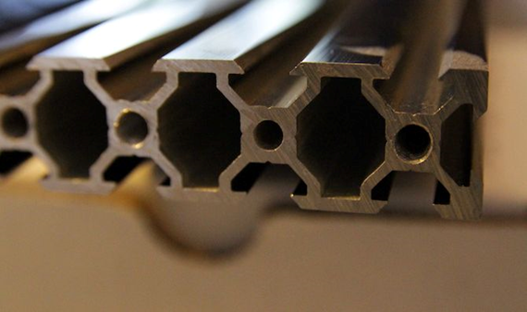
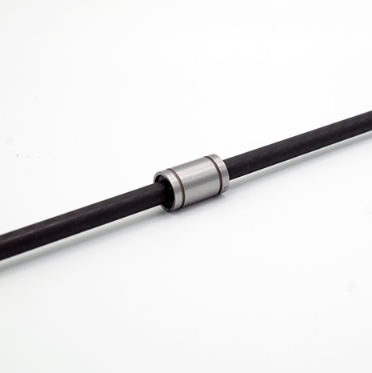
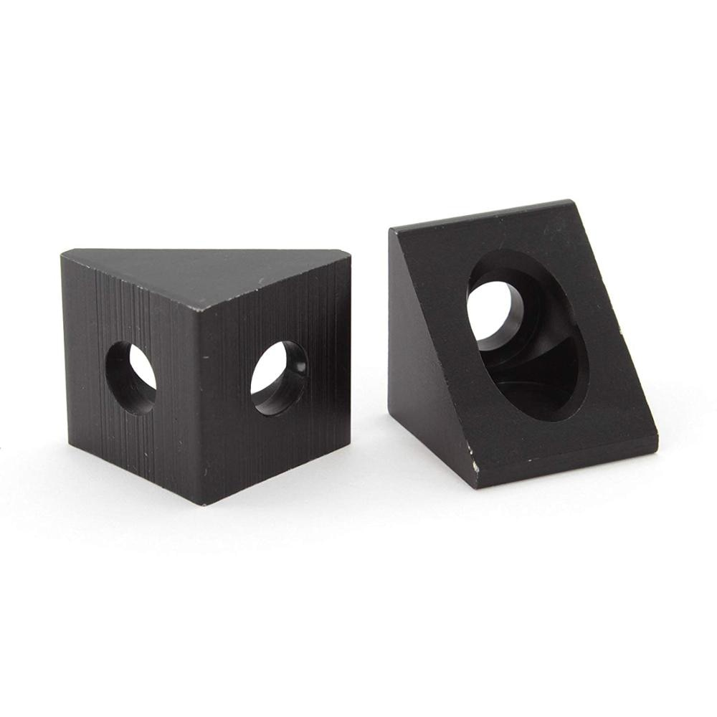
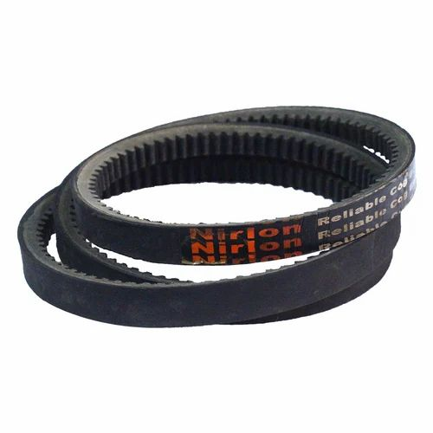
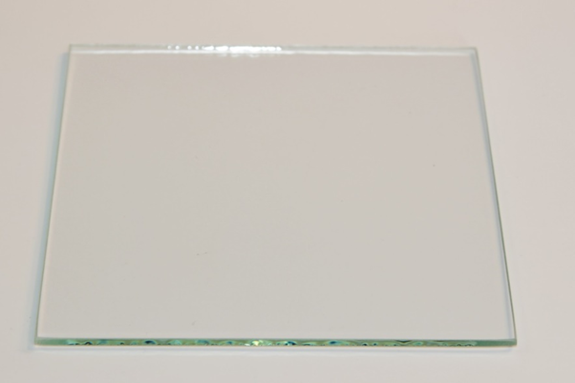
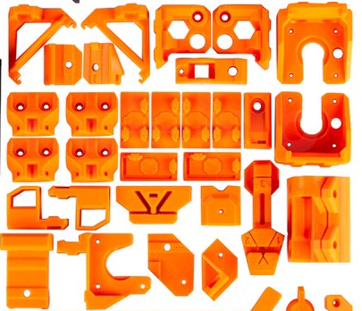
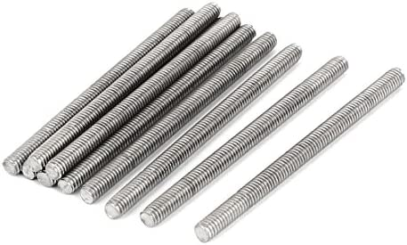
Mechanical components

Slide 6
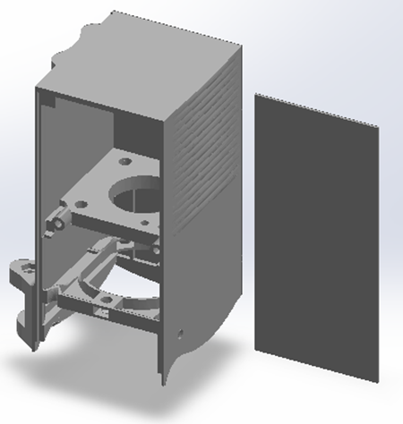
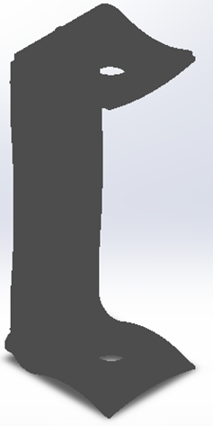
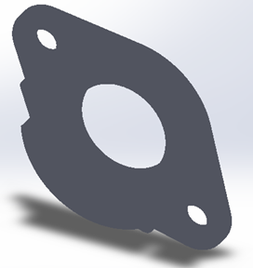
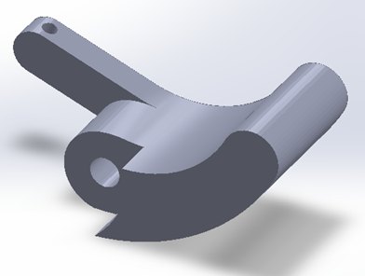

Extruder Mechanical components

Slide 7
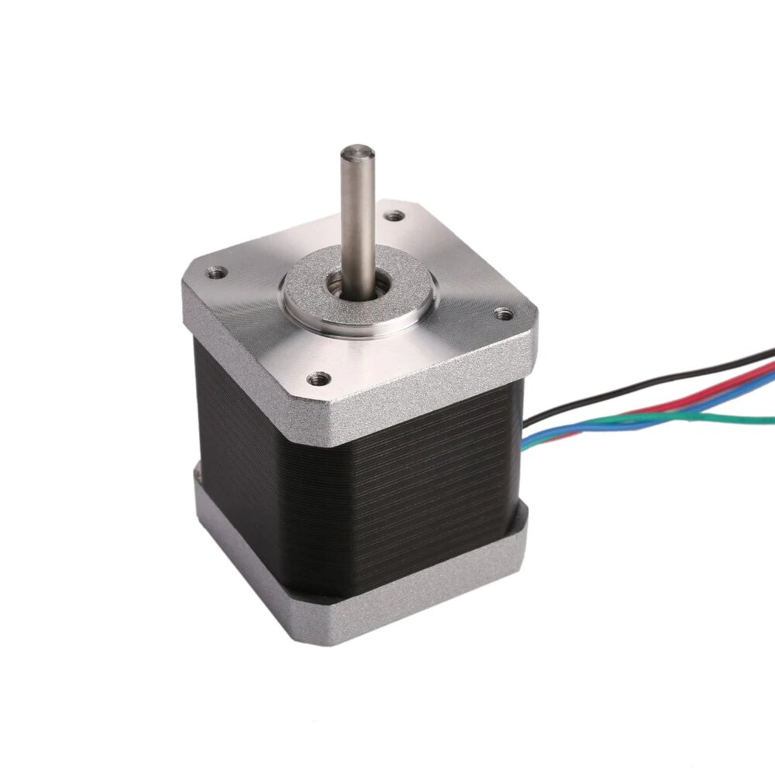
Electrical components
NEMA17 stepper motor 42mm
1.68 A
36 N.cm

Slide 8
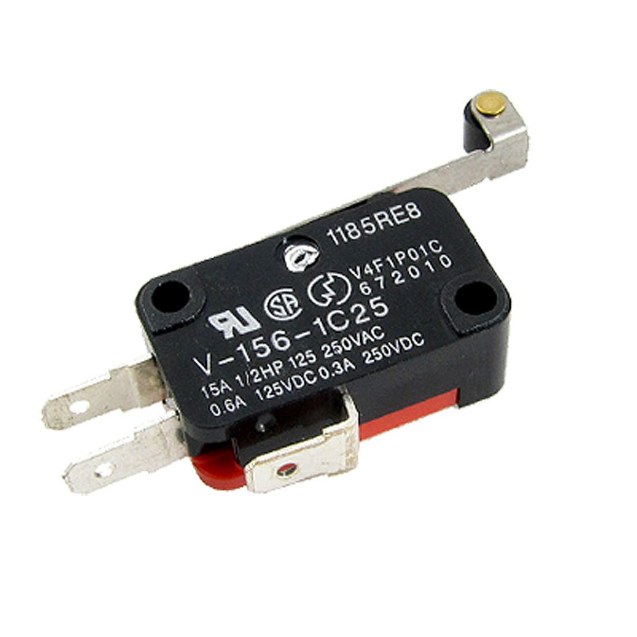
Electrical components
Micro limit switch
Connected to normally closed

Slide 9
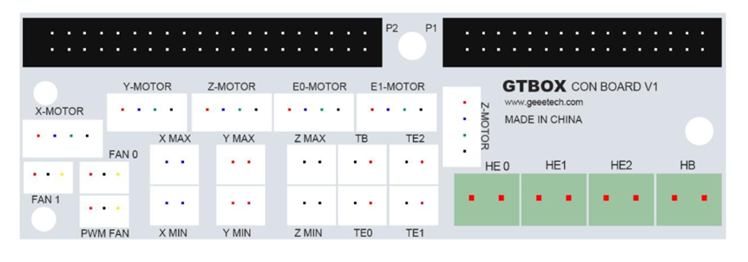
Electrical components
Control board

Slide 10
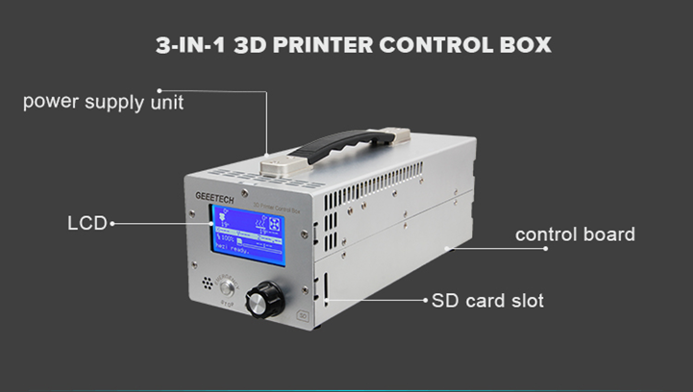
Electrical components
Controller box

Slide 11
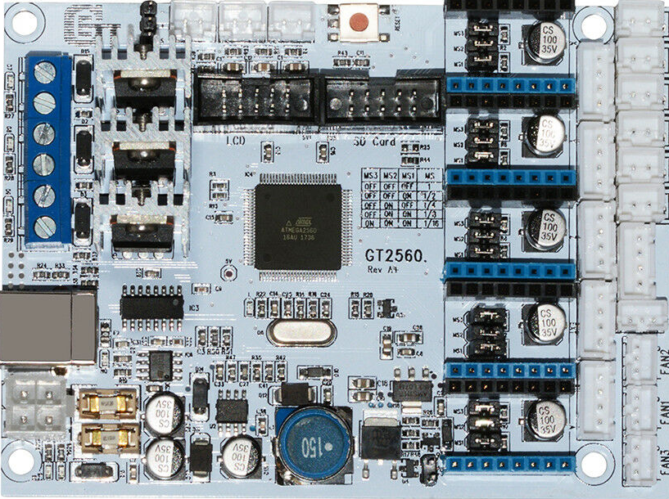
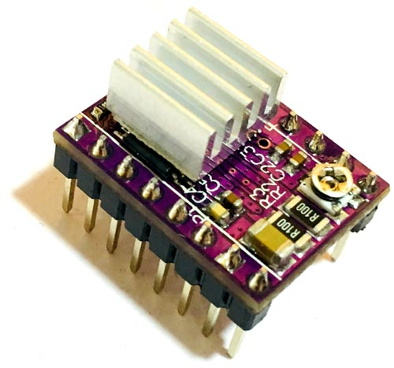
Electrical components
Controller board
NEMA 17 driver

Slide 12
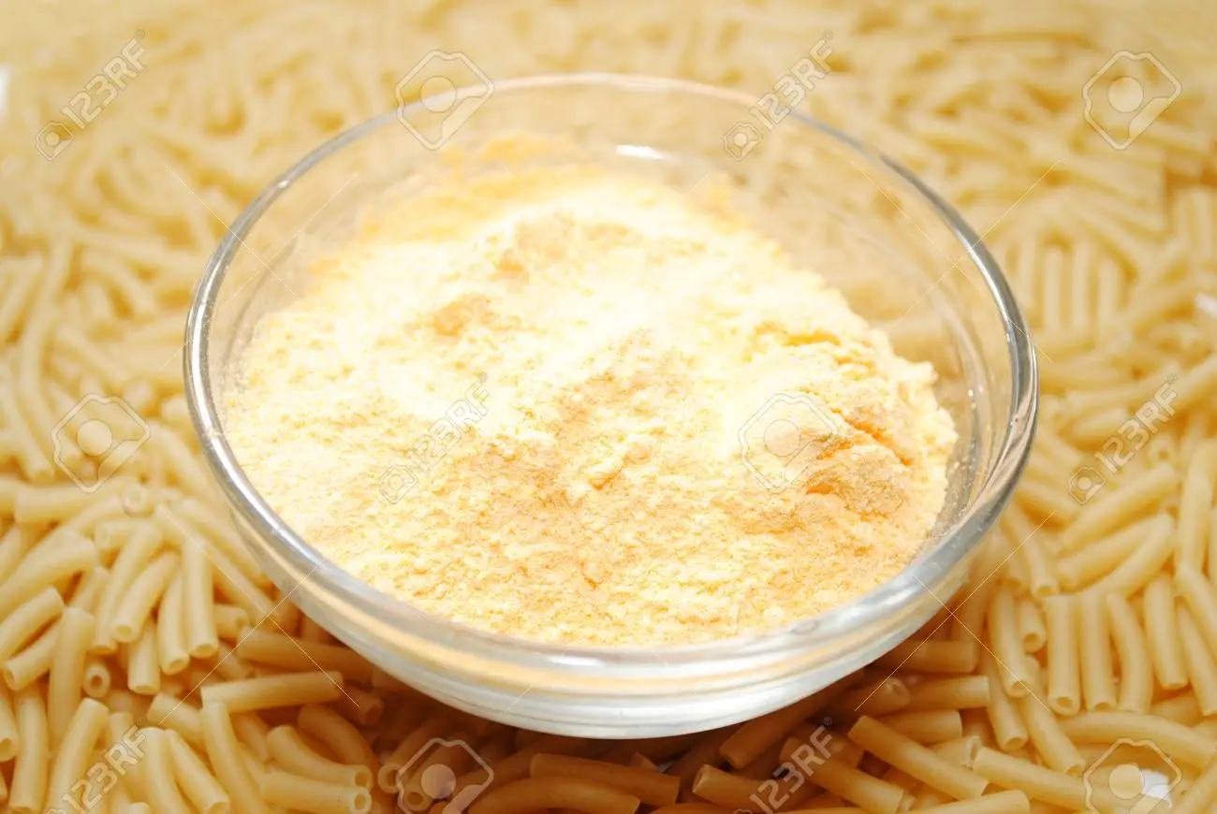
material
Powdered pasta mixed with water
37 grams of pasta mixed with 35 grams
of water.

Slide 13
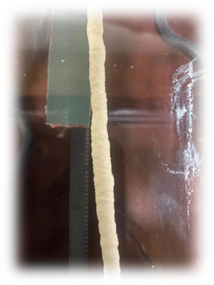
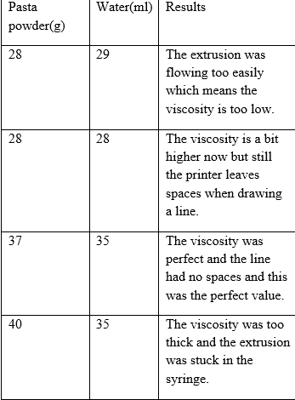
MATERIAL

Slide 14
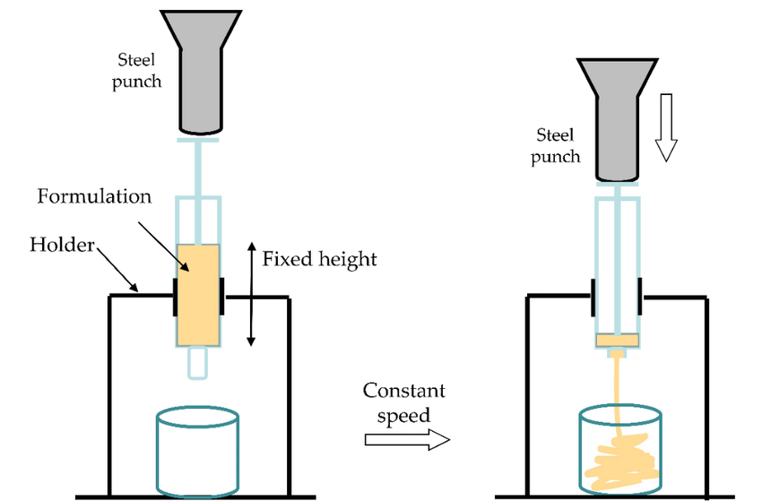
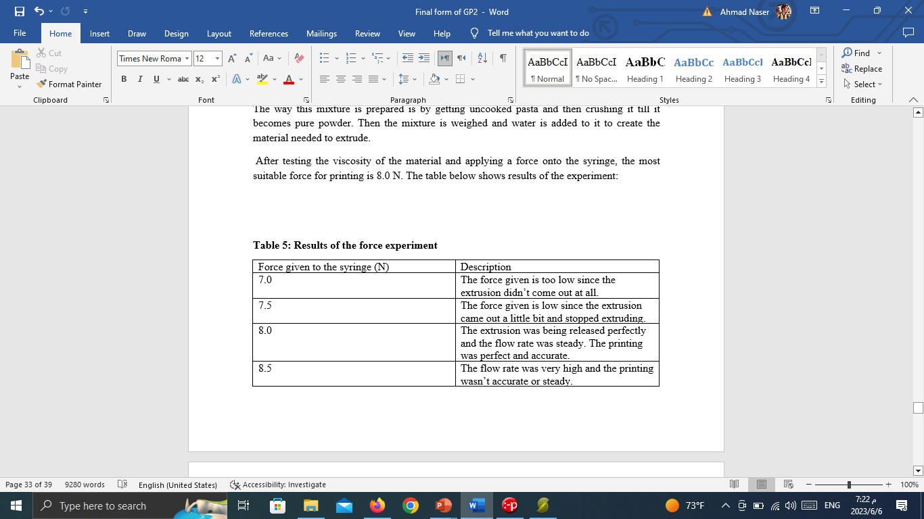
material
Force test
The most suitable force used is 8 Newtons

Slide 15


software
Programs used:
SolidWorks
Slic3r
Pronterface

Slide 16
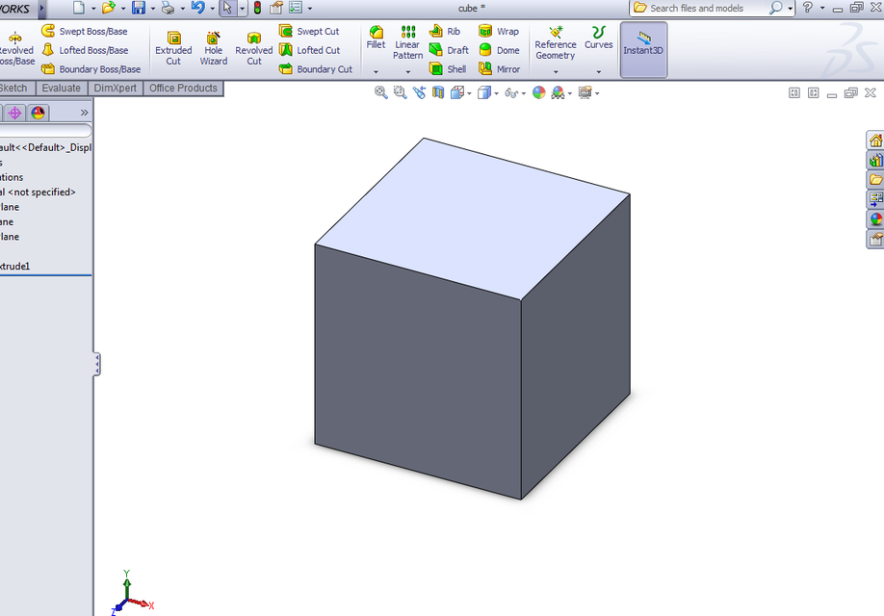
Software
A design of 50x50x50 mm cube designed in SolidWorks

Slide 17
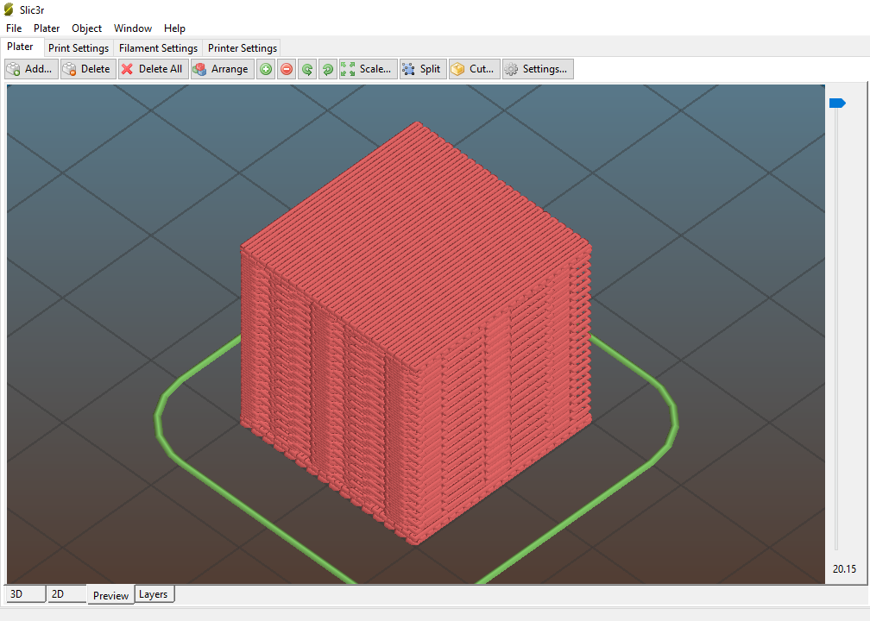
software
The SolidWorks design is saved as an STL file which is opened in Slic3r program

Slide 18
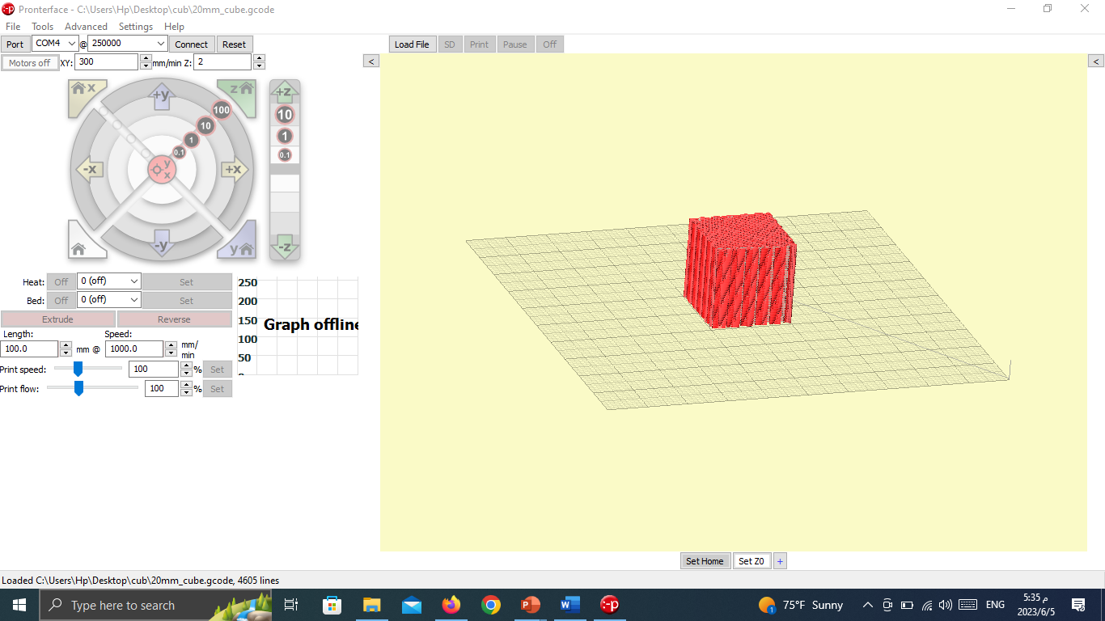
software
The design in Slic3r is saved as a G-code file which is then opened in pronterface

Slide 19
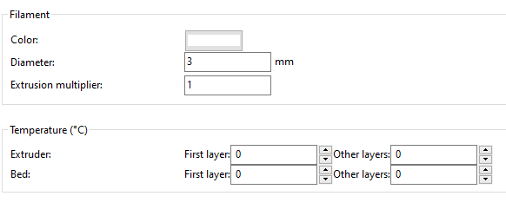
software

Slide 20
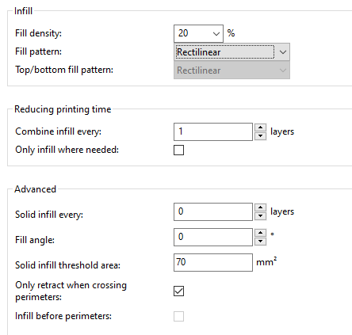
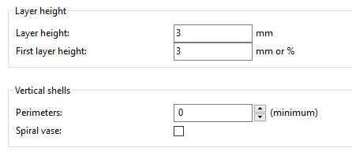
software

Slide 21
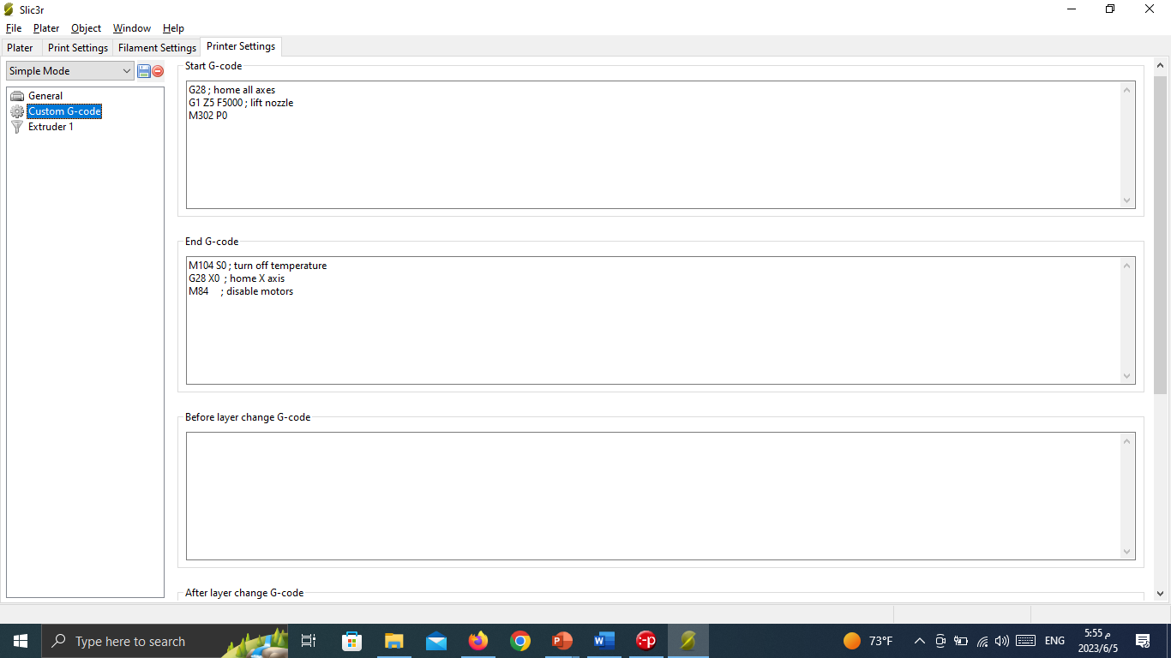
software

Slide 22
Printing process
SolidWorks design
Slicer
PronterFace

Slide 23
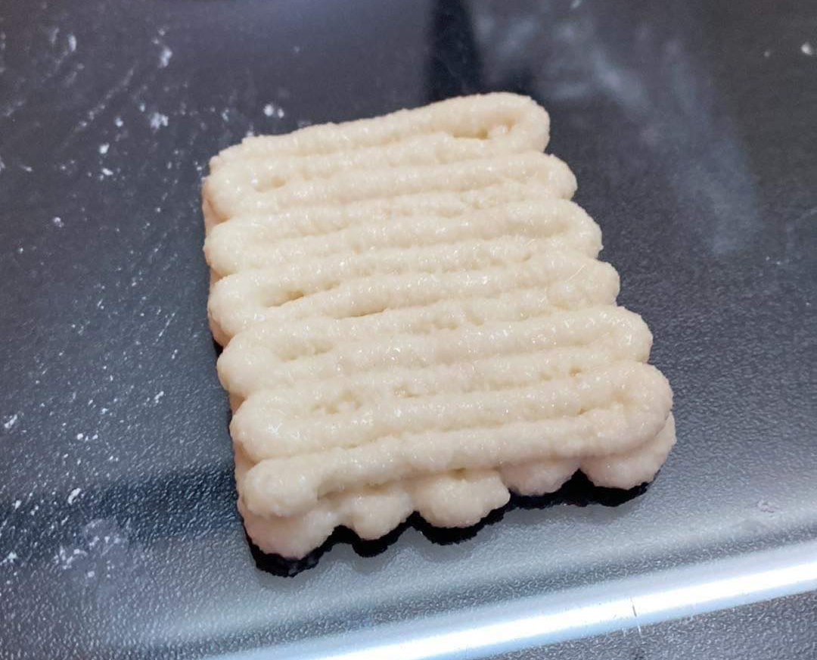
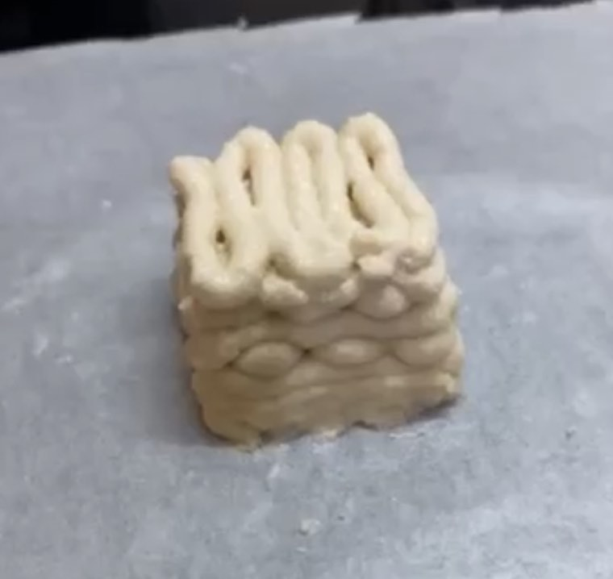
Printing process

Slide 24
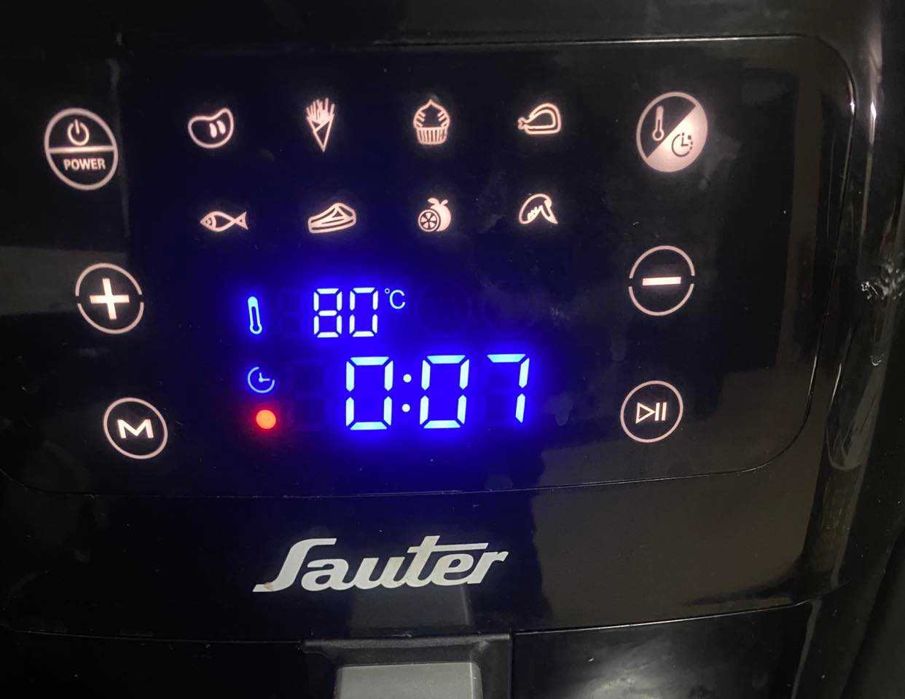
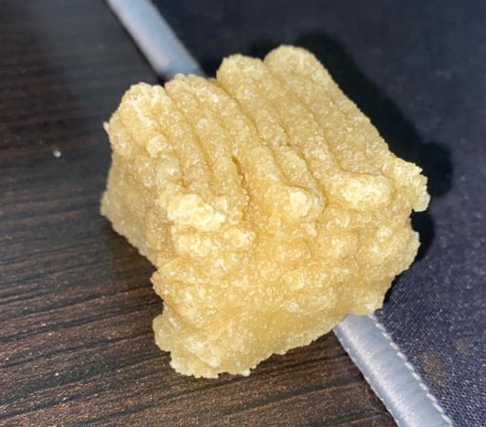
Drying phase

Slide 25
limitations
High cost
Lack of some mechanical parts
Overheated extruder stepper motor
Burnt driver
Small printing size

Slide 26
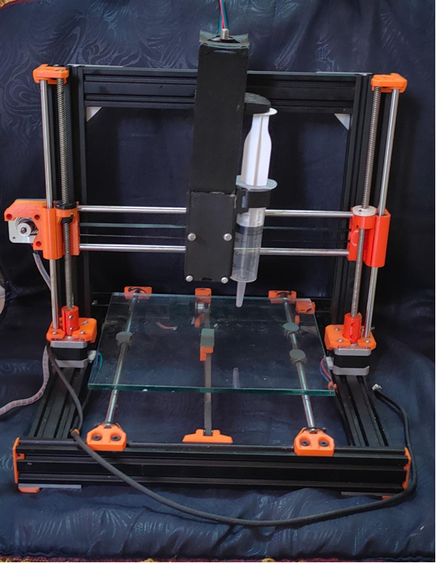
conclusion

Slide 27
Thank you for your attention!

