Slide 1

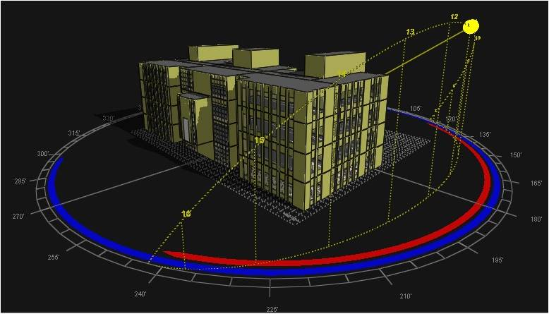



Simulation Analysis for Green Design of Building Envelope
An-Najah National University
Faculty of Building Engineering
May 2011

Slide 2
Prepared By :
Alaa’ Shaheen - Isra ‘ Abu-Saadeh - Isra’ AL-Karmi
Graduation Project
Supervised By :
Dr.Mutasim Ba’ba’
“This Project is a Partial Fulfilment for the Degree Bachelor of Science in Building Engineering”
An-Najah National University
Faculty of Building Engineering

Slide 3
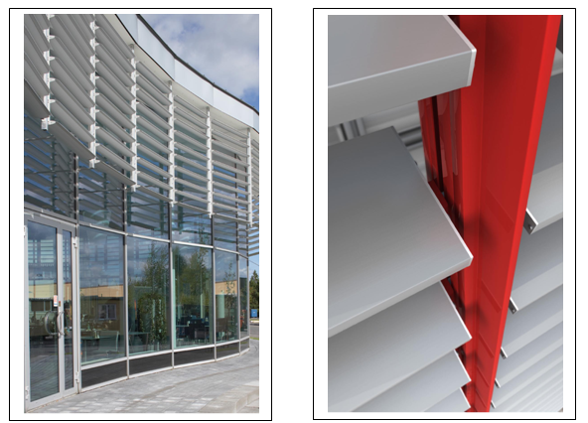
Table of Contents
Building Engineering
Project General Information.
Green Design Steps & Simulation.
Conclusion
Graduation Project

Slide 4
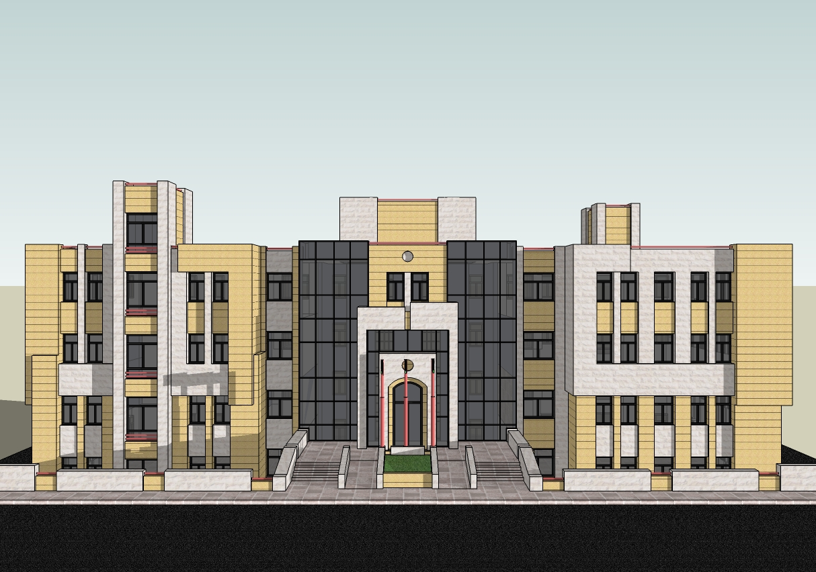
1- Project Information
Building Engineering
A- General Overview
This Graduation Project Interested in transforming a traditional building into an Integrated Modern Green Building which is related to the Ministry of higher Education located in Ramallah City.
The Proposed Building
Graduation Project

Slide 5
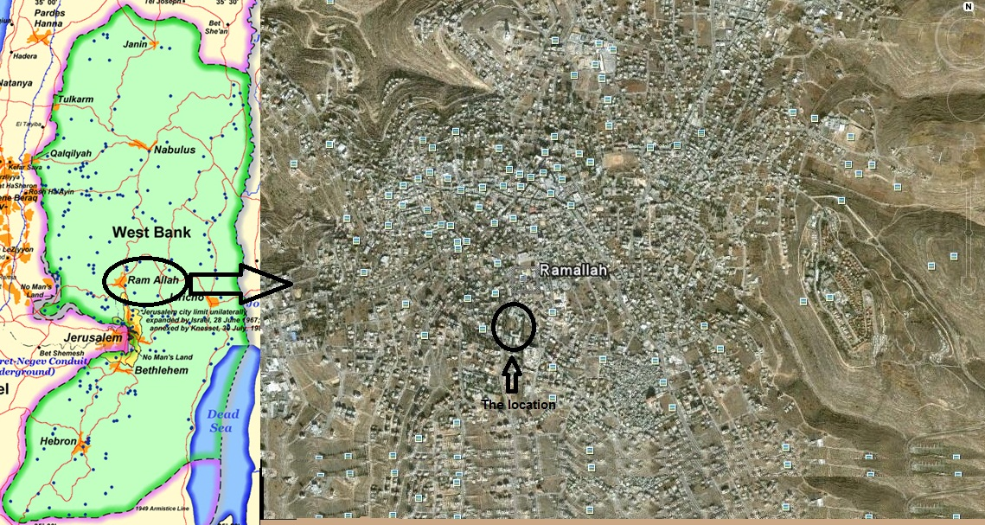
1- Project Information
Building Engineering
B- Location & Site Plan
Graduation Project

Slide 6
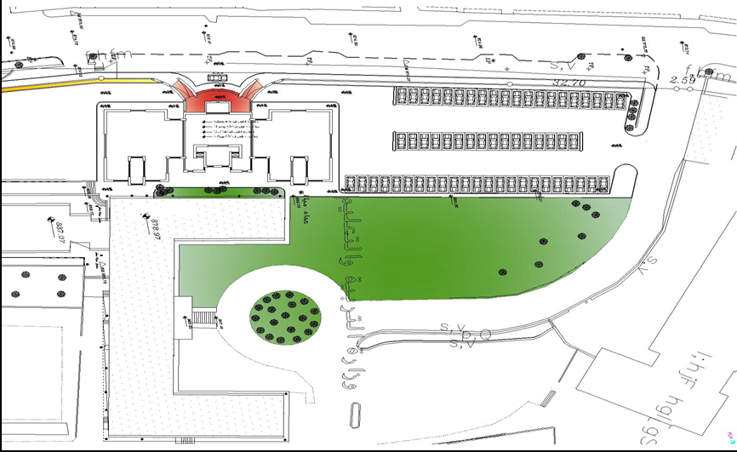
1- Project Information
Building Engineering
B- Location & Site Plan
N
Graduation Project

Slide 7
2- Green Design Steps & Simulation
Building Engineering
Architectural Design Modifications.
Environmental Design.
Structural Design.
Lighting and Mechanical Design.
Graduation Project

Slide 8
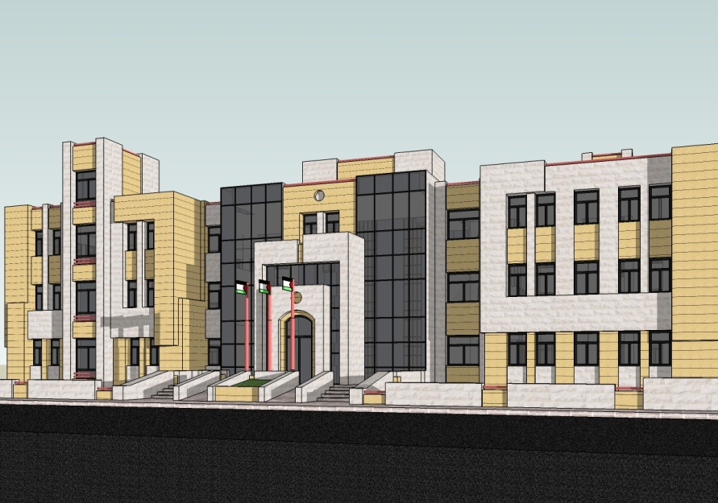
2- Green Design Steps & Simulation
Building Engineering
A- Architectural Design Modifications
Three things were modified for these reasons:
* to achieve aesthetic appeal we desire.
** to achieve smooth movement for better function achievement.
*** to increase the solar gain in winter by treat wall thickness.
Graduation Project

Slide 9
2- Green Design Steps & Simulation
Building Engineering
A- Architectural Design Modifications
*
Front elevation before
Graduation Project

Slide 10
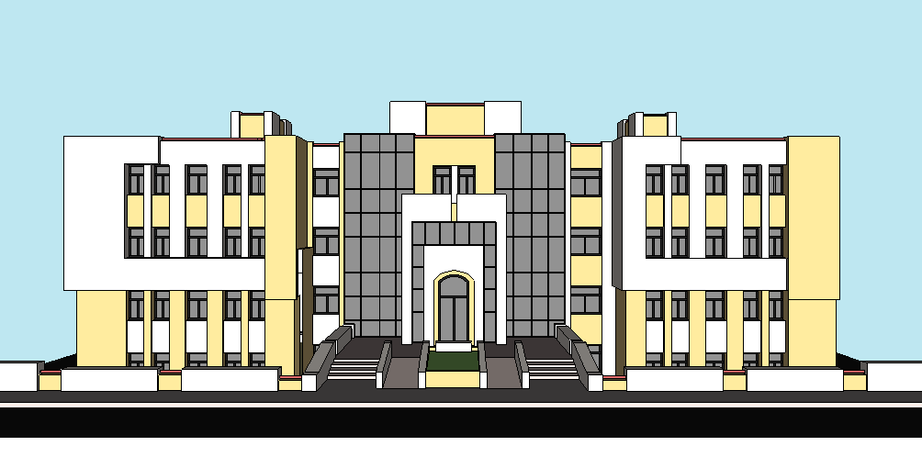
2- Green Design Steps & Simulation
Building Engineering
A- Architectural Design Modifications
Front elevation after
Graduation Project

Slide 11
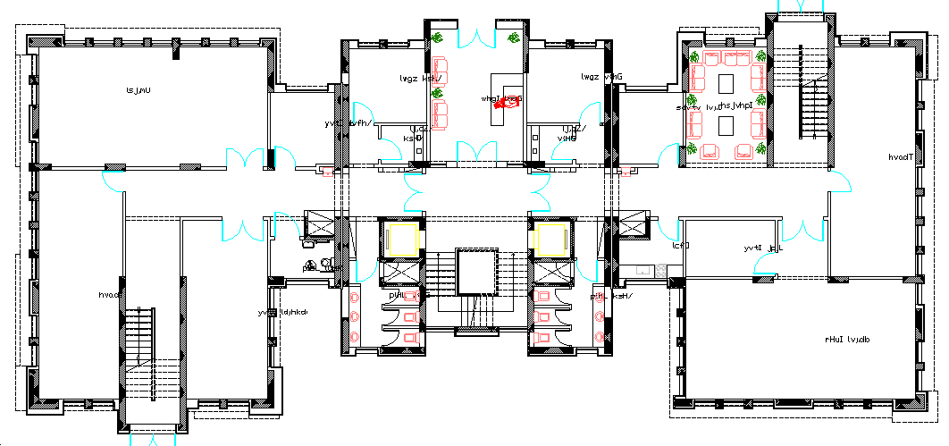
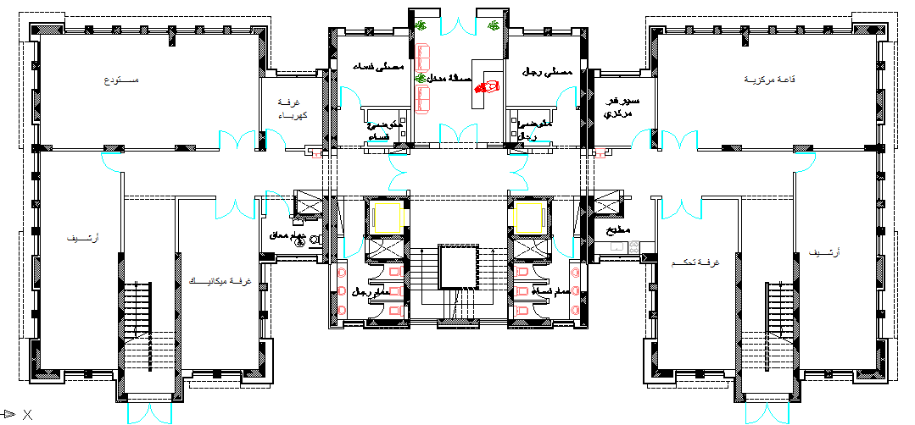
2- Green Design Steps & Simulation
Building Engineering
A- Architectural Design Modifications
First Basement Plan
as Example
of Modification.
Graduation Project

Slide 12
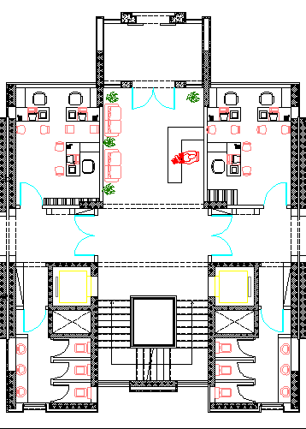
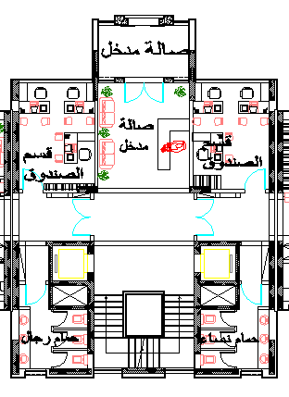
2- Green Design Steps & Simulation
Building Engineering
A- Architectural Design Modifications
**
Modification of the stairs entrance.
Graduation Project

Slide 13
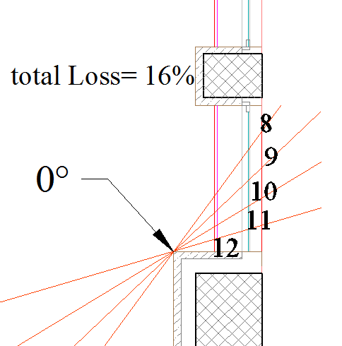
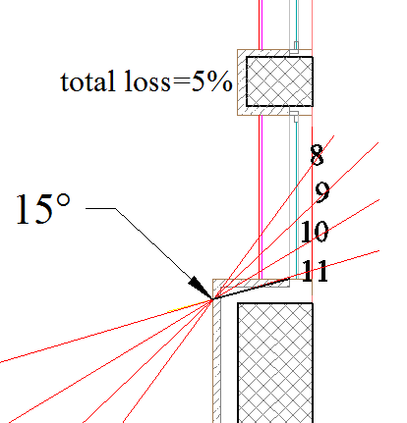
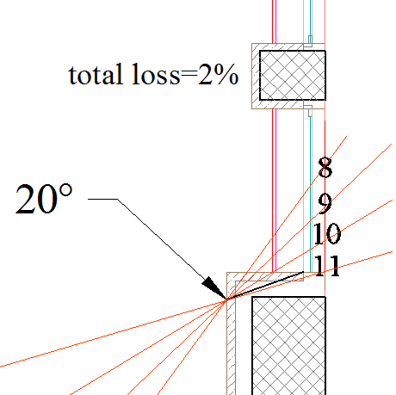
2- Green Design Steps & Simulation
Building Engineering
A- Architectural Design Modifications
Inclination of window edges
In South elevation:
Without inclination → % of solar loss =16%
With 15˚ →% of Solar loss=5%
With 20˚ →% of Solar loss=2%
Graduation Project

Slide 14
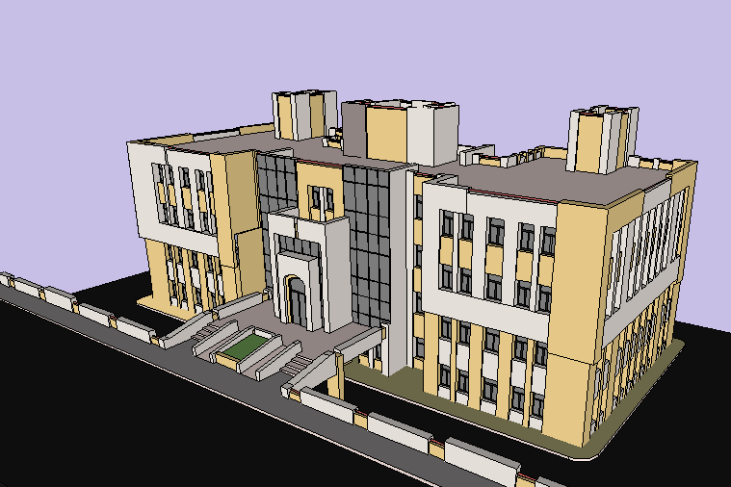
2- Green Design Steps & Simulation
Building Engineering
A- Architectural Design Modifications
Modified Building
Graduation Project

Slide 15
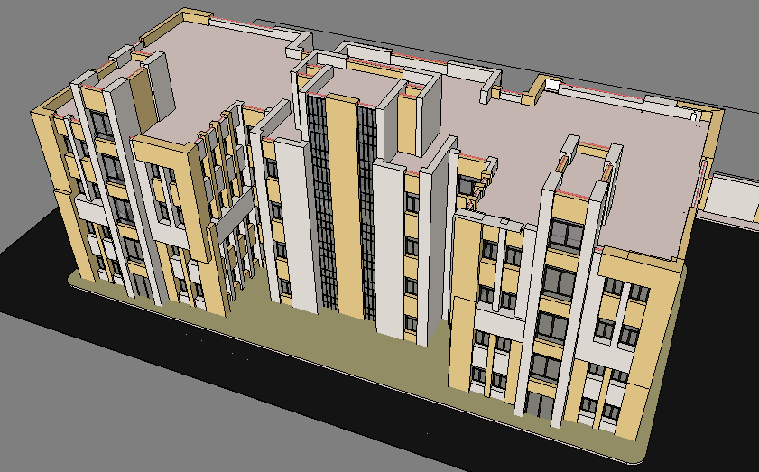
2- Green Design Steps & Simulation
Building Engineering
A- Architectural Design Modifications
Modified Building
Graduation Project

Slide 16
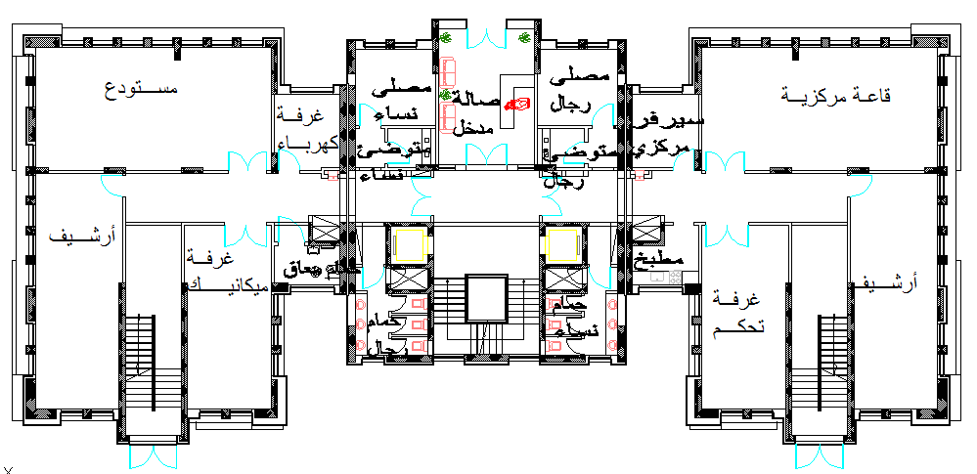
2- Green Design Steps & Simulation
Building Engineering
A- Architectural Design Modifications
First Basement Plan
Graduation Project

Slide 17
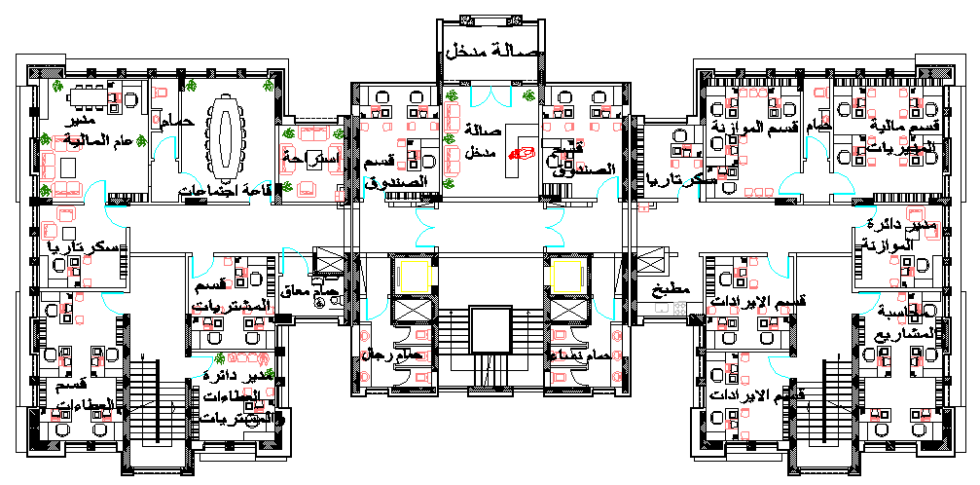
2- Green Design Steps & Simulation
Building Engineering
A- Architectural Design Modifications
.
Ground Floor Plan
Graduation Project

Slide 18
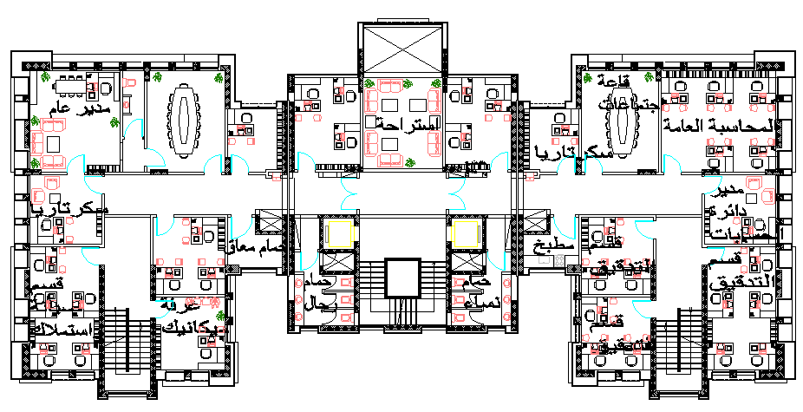
2- Green Design Steps & Simulation
Building Engineering
A- Architectural Design Modifications
First Floor Plan
Graduation Project

Slide 19
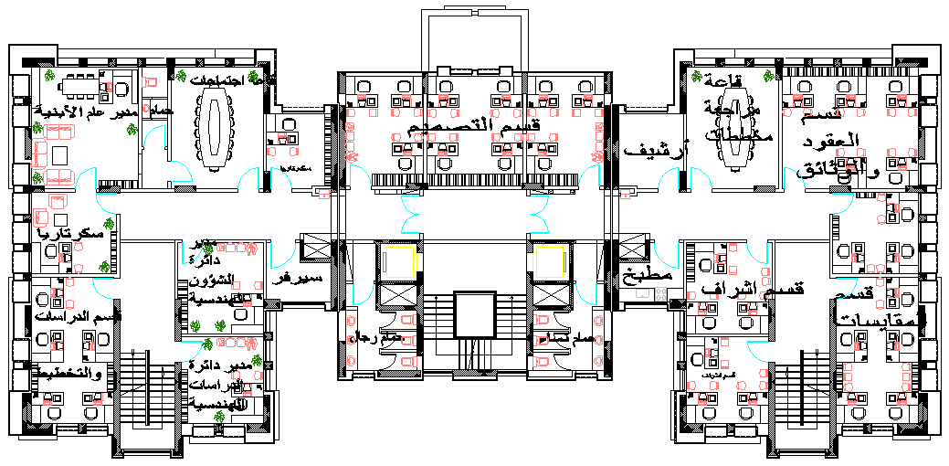
2- Green Design Steps & Simulation
Building Engineering
A- Architectural Design Modifications
Second Floor Plan
Graduation Project

Slide 20
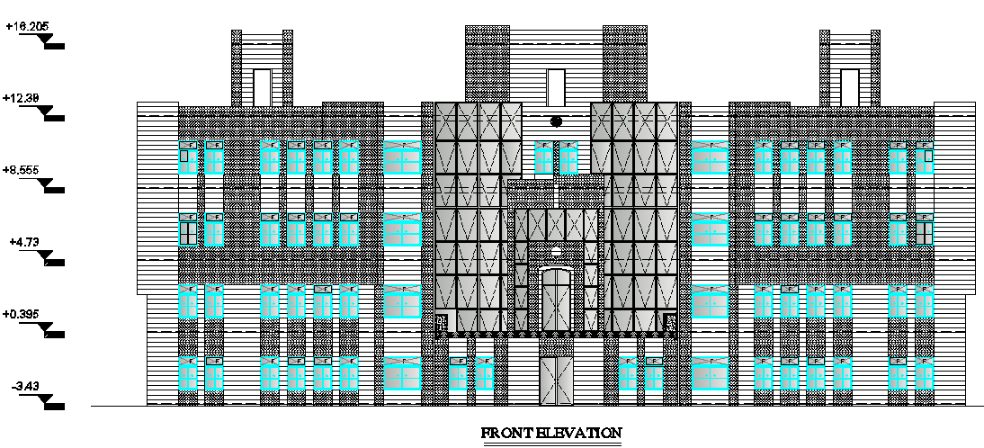
2- Green Design Steps & Simulation
Building Engineering
A- Architectural Design Modifications
Front Elevation (West)
Graduation Project

Slide 21
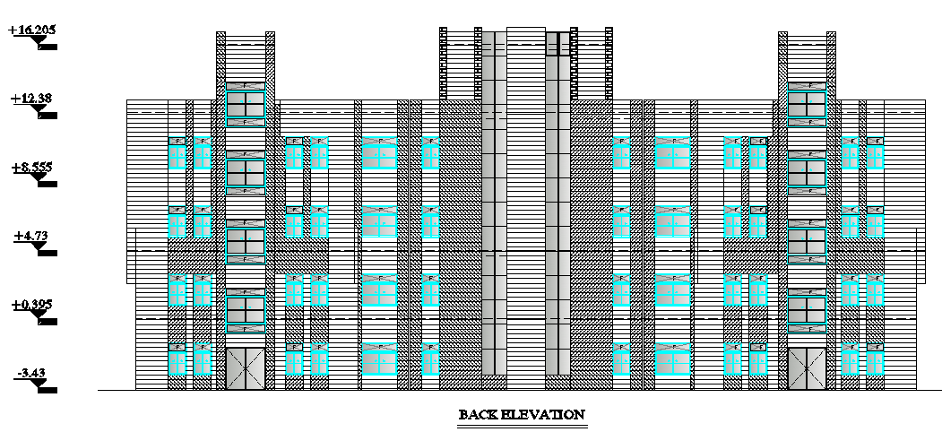
2- Green Design Steps & Simulation
Building Engineering
A- Architectural Design Modifications
Back Elevation (East)
Graduation Project

Slide 22
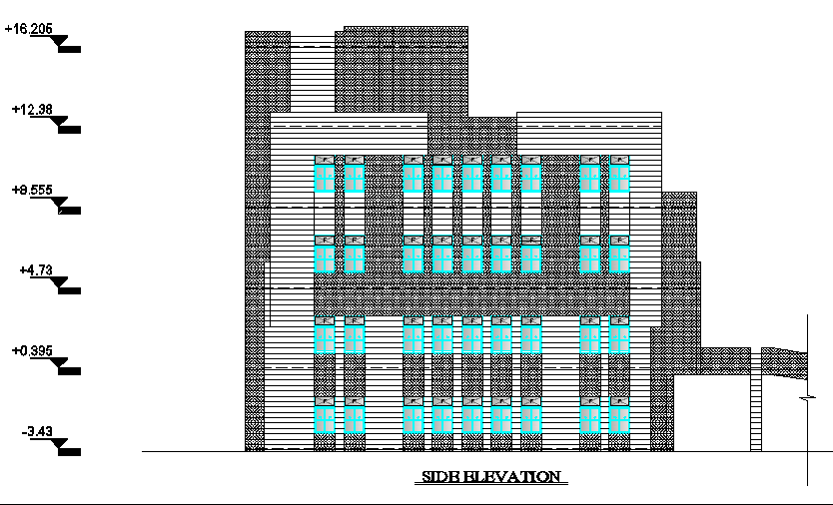
2- Green Design Steps & Simulation
Building Engineering
A- Architectural Design Modifications
Side Elevation (North)
Graduation Project

Slide 23
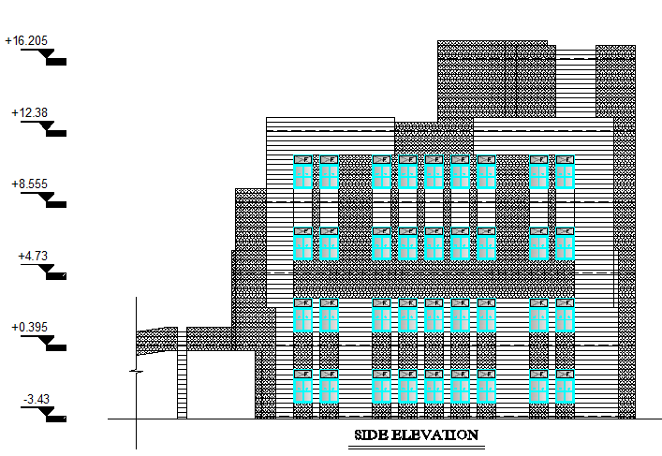
2- Green Design Steps & Simulation
Building Engineering
A- Architectural Design Modifications
Side Elevation (South)
Graduation Project

Slide 24
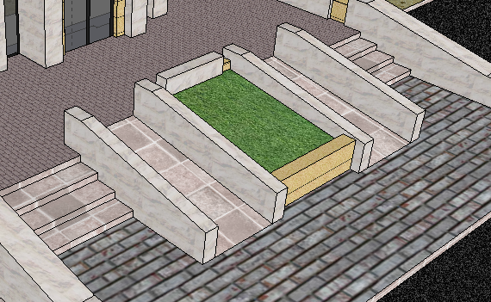
2- Green Design Steps & Simulation
Building Engineering
A- Architectural Design Modifications
Disable Facility:
Horizontal Movement by Ramp
Vertical Movement by Elevator
Graduation Project

Slide 25
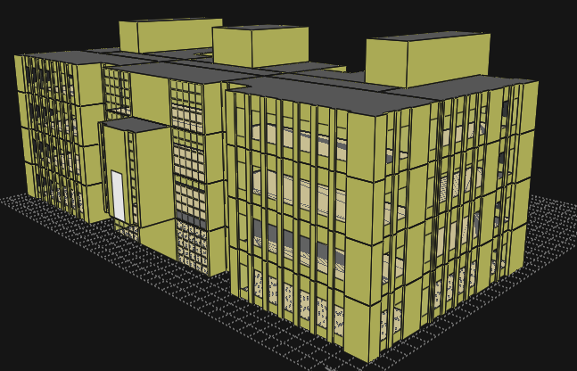
2- Green Design Steps & Simulation
Building Engineering
B-Environmental Design-Simulation by ECOTECT
ECOTECT is an industry leading building analysis program that allows designers to work easily in 3D and apply all the tools necessary for an energy efficient and sustainable future.
Graduation Project

Slide 26
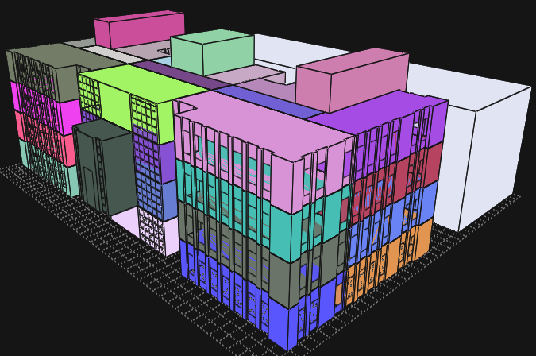
2- Green Design Steps & Simulation
Building Engineering
B-Environmental Design-Simulation by ECOTECT
ECOTECT Zones:
Graduation Project

Slide 27
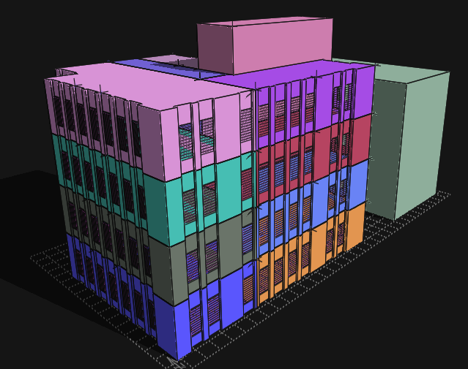
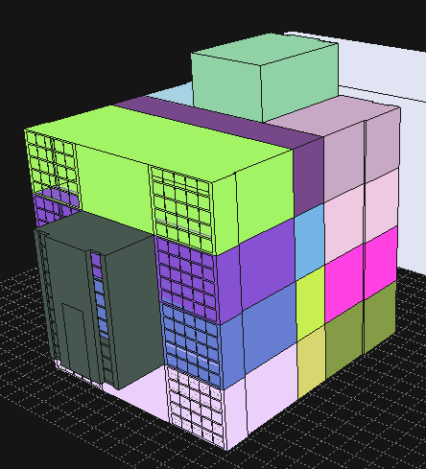
2- Green Design Steps & Simulation
Building Engineering
B-Environmental Design-Simulation by ECOTECT
Part A:
Part B:
Graduation Project

Slide 28
2- Green Design Steps & Simulation
Building Engineering
B-Environmental Design-Simulation by ECOTECT
Analysis of part A :
1) With insulation
2) Without insulation
Evaluation of Building Envelope as Energy Efficient Building:
1) Thermal Insulation
2) Solar Gain
3) Natural Lighting
4) Ventilation
Graduation Project

Slide 29
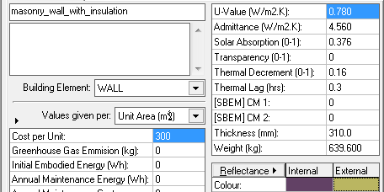
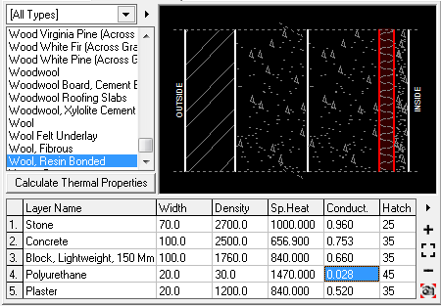
2- Green Design Steps & Simulation
Building Engineering
B-Environmental Design-Simulation by ECOTECT
Section used:
External Wall:
Graduation Project

Slide 30
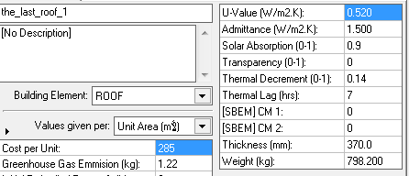
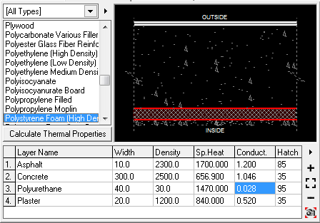
2- Green Design Steps & Simulation
Building Engineering
B-Environmental Design-Simulation by ECOTECT
Roof Section:
Graduation Project

Slide 31
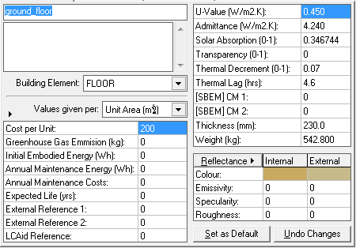
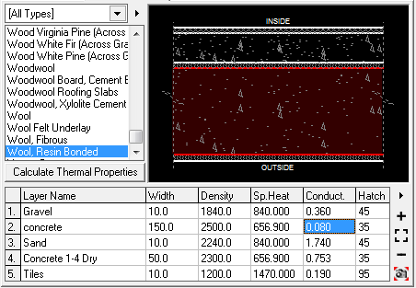
2- Green Design Steps & Simulation
Building Engineering
B-Environmental Design-Simulation by ECOTECT
Ground floor:
Graduation Project

Slide 32
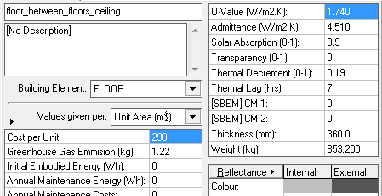
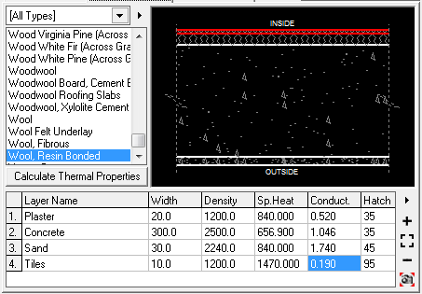
2- Green Design Steps & Simulation
Building Engineering
B-Environmental Design-Simulation by ECOTECT
Floors :
Graduation Project

Slide 33
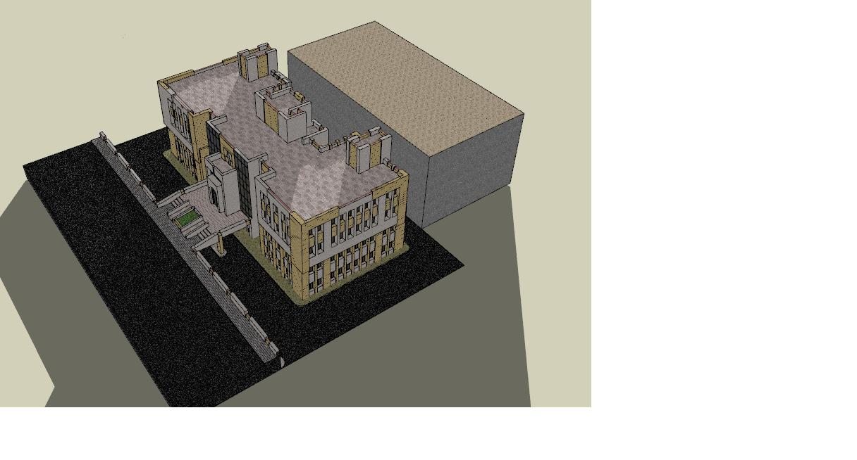
2- Green Design Steps & Simulation
Building Engineering
B-environmental design
2- (building shading)
Building directed & shading
Graduation Project

Slide 34
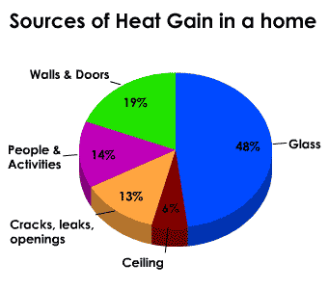
2- Green Design Steps & Simulation
Building Engineering
B-environmental design
2-Shutters (building shading)
windows are the number-one source of heat gain in the summer.
The effective way to deal with this issue is
[Building shading Element ]
Graduation Project

Slide 35
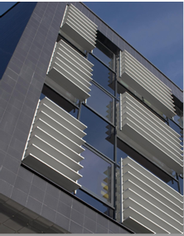
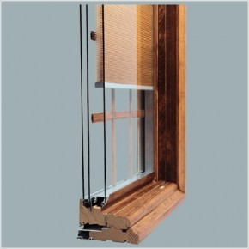
2- Green Design Steps & Simulation
Building Engineering
B-environmental design
2- (building shading element )
shutters
The options
External shutters
Shutters in-between glass
External shutters
Shutters in-between glass
Graduation Project

Slide 36
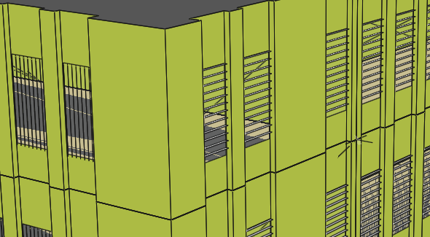
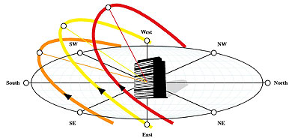
2- Green Design Steps & Simulation
Building Engineering
B-environmental design
2- (building shading element )
External shutters
Shutters design
Solar Geometry
East elevation
South elevation
West elevation
West elevation
South elevation
Graduation Project

Slide 37
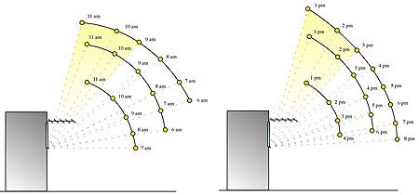
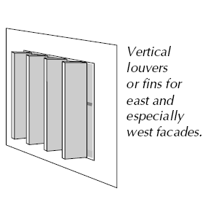
2- Green Design Steps & Simulation
Building Engineering
B-environmental design
2- (building shading element )
External shutters
East &west elevation
Sun movement in summer season in east and west facade
Shutters specification
11 am
1.00pm
34.5
6 am
8.00pm
10.3’
Graduation Project

Slide 38
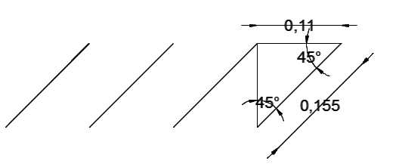
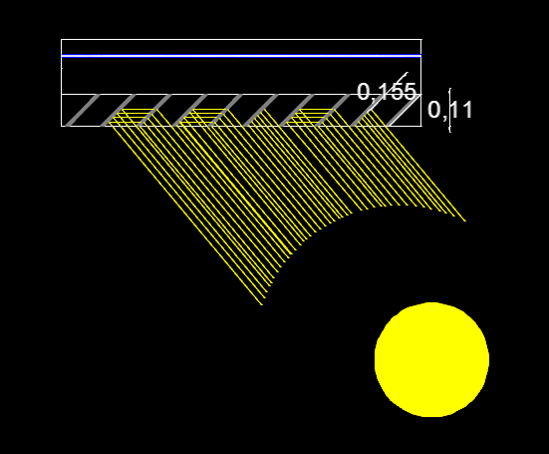
2- Green Design Steps & Simulation
Building Engineering
B-environmental design
2- (building shading element )
External shutters
East & west elevation
Shutters specification
Automatic vertical moveable shutters
it moves in 45 degrees to the north in the winter and 45degrees to the south in the summer
Graduation Project

Slide 39
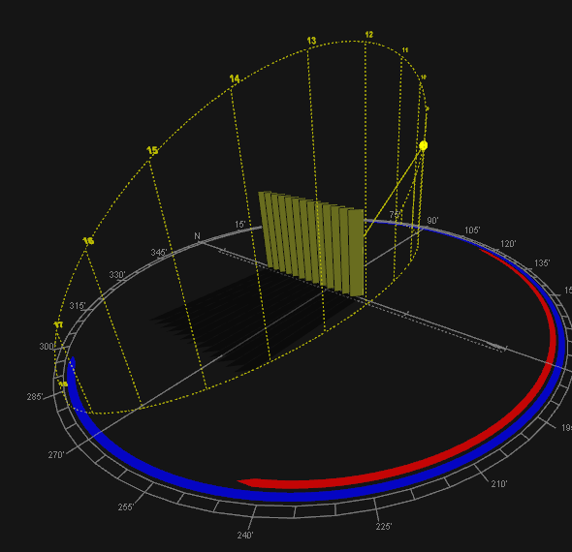
2- Green Design Steps & Simulation
Building Engineering
B-environmental design
2- (building shading element )
External shutters
East & west elevation
Building shading at 8pm in the 21 of April
Vertical shutters in east and west elevation
Shutters in ecotect software
Graduation Project

Slide 40
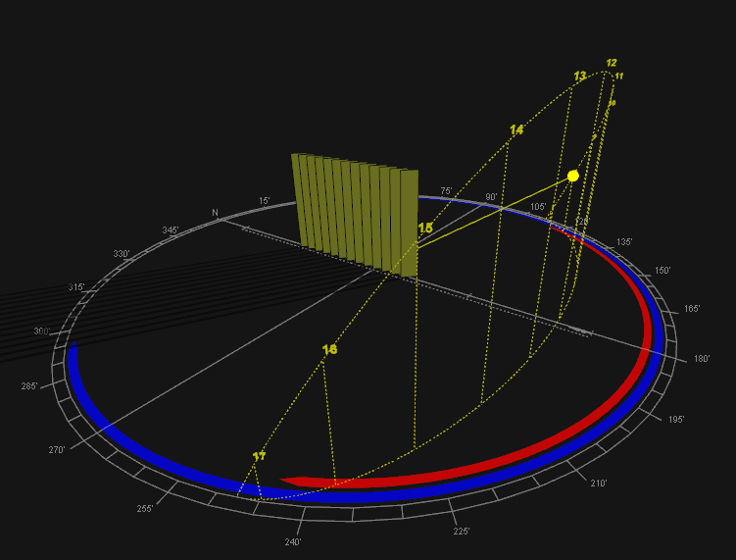
2- Green Design Steps & Simulation
Building shading at 8am
In the 21st January
Building Engineering
B-environmental design
2- (building shading element )
Building shading at 8am
In the 21st January
Graduation Project

Slide 41
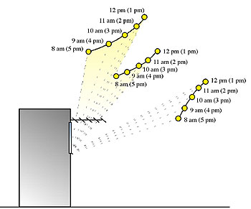

2- Green Design Steps & Simulation
Building Engineering
B-environmental design
2- (building shading element )
External shutters
south elevation
Sun movement in summer season in south facade
Shutters specification
11.00am
65.4
Graduation Project

Slide 42


2- Green Design Steps & Simulation
Building Engineering
B-environmental design
2- (building shading element )
External shutters
south elevation
Graduation Project

Slide 43

2- Green Design Steps & Simulation
Building Engineering
B-environmental design
2- (building shading element )
External shutters
south elevation
Building shading at 11pm in the 21 of April
Horizontal shutters south elevation
Shutters in ecotect
Graduation Project

Slide 44

2- Green Design Steps & Simulation
Building Engineering
B-environmental design
2- (building shading element )
External shutters
south elevation
Building shading at 11 am on 21 January
Graduation Project

Slide 45

2- Green Design Steps & Simulation
Building Engineering
B-environmental design
Sun
Movement at June:
Graduation Project

Slide 46

2- Green Design Steps & Simulation
Building Engineering
B-environmental design
Sun
Movement at January:
Graduation Project

Slide 47

2- Green Design Steps & Simulation
Building Engineering
B-environmental design
Sun
Movement at May for Part A:
Graduation Project

Slide 48

2- Green Design Steps & Simulation
Building Engineering
B-environmental design
Sun
Movement at May for Part B:
Graduation Project

Slide 49

2- Green Design Steps & Simulation
Building Engineering
B-Simulation results by ECOTECT- Part A
Direct Solar Gain Without shutters :
Graduation Project

Slide 50

2- Green Design Steps & Simulation
Building Engineering
B-Simulation results by ECOTECT- Part A
Direct Solar Gain with shutters :
Average % of Heat Loss by shutters in Summer = 15%
Average % of Heat Loss by shutters in Winter = 5%
Graduation Project

Slide 51

2- Green Design Steps & Simulation
Building Engineering
B-Simulation results by ECOTECT- Part A
Heating and Cooling Load without insulation:
3400 KW
6500 KW
Graduation Project

Slide 52

2- Green Design Steps & Simulation
Building Engineering
B-Simulation results by ECOTECT- Part A
Heating and Cooling Load with insulation:
2700 KW
4800 KW
Graduation Project

Slide 53
2- Green Design Steps & Simulation
Total heating load needed without insulation=9800 KW
Total cooling load needed without insulation=16400 KW
Total heating and cooling load without insulation=26200 KW
Building Engineering
B-Simulation results by ECOTECT- Part A
Total heating load needed without insulation=9800 KW
Total cooling load needed without insulation=16400 KW
Total heating and cooling load without insulation=26200 KW
Total heating load needed with insulation= 7800 KW
Total cooling load needed with insulation=13100KW
Total heating and cooling load with insulation=20900 KW
Total % of saving in heating load = (9800-7800)/9800*100%=20 %
Total % of saving in cooling load=(16400-13100)/16400*100%=20%
Total % of saving in heating and cooling load=(26200-20900)/26200*100%=20%
Graduation Project

Slide 54

2- Green Design Steps & Simulation
Building Engineering
B-Simulation results by ECOTECT- Part A
Preliminary Cost without insulation:
Graduation Project

Slide 55

2- Green Design Steps & Simulation
Building Engineering
B-Simulation results by ECOTECT- Part A
Preliminary Cost without insulation:
Graduation Project

Slide 56
2- Green Design Steps & Simulation
Building Engineering
B-Simulation results by ECOTECT- Part A
% of cost increasing for Envelope ~ less than 6%
Graduation Project

Slide 57

2- Green Design Steps & Simulation
Building Engineering
B-Simulation results by ECOTECT- Part B
Analysis of part B
Double Skin Facade.
Two options of Double Skin Façade were discussed and checked for part B:
Multi-story
Box Window
Graduation Project

Slide 58

2- Green Design Steps & Simulation
Building Engineering
B-Simulation results by ECOTECT- Part B
Results without DSF:
Maximum Cooling Load= 9000 KW per June
Graduation Project

Slide 59

2- Green Design Steps & Simulation
Building Engineering
B-Simulation results by ECOTECT- Part B
Results with DSF-Box Window:
Maximum Cooling Load= 5000 KW per June
Graduation Project

Slide 60

2- Green Design Steps & Simulation
Building Engineering
B-Simulation results by ECOTECT- Part B
Results with DSF-Multi story:
Maximum Cooling Load= 7000 KW per June
Graduation Project

Slide 61

2- Green Design Steps & Simulation
Building Engineering
B-Simulation results by ECOTECT- Part B
  The best choice is the “box window”, because: Used as solar Chimney in summer.
  In winter the opening closed to achieve less thermal conductivity.
  Shutters used, so in summer prevent un likely solar gain to enter, and in winter closed at night so prevent losses from the building.
  Better in fire resistance, prevent the fire from spreading.
  Achieve good ventilation around the year.
DSF-Box window
Graduation Project

Slide 62



2- Green Design Steps & Simulation
Building Engineering
C-structural design
The structural design was made by SAP program
3D modeling
Graduation Project

Slide 63

2- Green Design Steps & Simulation
Building Engineering
C-structural design
The building consists of three blocks, two symmetric blocks and a third different block between them , one of the two symmetrical blocks has been analyzed and designed.
The analyzed block (C)
Graduation Project

Slide 64
2- Green Design Steps & Simulation
Building Engineering
C-structural design
Design Codes:
The structural design will be according to :
1) the American Concrete Institute code ACI 318-08 .
2) the seismic design according to UBC-97.
Design will include the following elements :
1) slab ( one way rib slab).
2) beam ( main beam & secondary beam) .
3) column .
4) shear wall.
5) Stairs.
6) footing.
Graduation Project

Slide 65
2- Green Design Steps & Simulation
Building Engineering
C-structural design
Design data
Compressive strength of concrete (f\c)
beams
shear walls
columns
footing
f\c =350 kg/cm²
slabs
f\c =250 kg/cm²
2. Yielding strength of steel (fy)
steel for flexure , fy = 4200 kg/cm2
shear reinforcement , fys = 4200 kg/cm2.
3. Bearing capacity of soil= 4Kg/cm².
Graduation Project

Slide 66
2- Green Design Steps & Simulation
Building Engineering
C-structural design
4. Unit weights of materials:
Density(ton/m³) | Material
2.5 | Reinforced concrete
1.2 | Bricks
1.5 | Filler
2.7 | Masonry
2.5 | Tiles
2.3 | Mortar
2.3 | Plastering
1.9 | Selected filler (compacted base coarse)
0.04 | Polycarbonate
Graduation Project

Slide 67
2- Green Design Steps & Simulation
Building Engineering
C-structural design
Methods of analysis:-
The ultimate design method
The working design method
Preliminary dimensions
Slab thickness= 30 cm
Beam dimension
Mu = 0.2*f’c*b*d²
Main beam→ (30*55) cm
Secondary beam→ (30*30) cm
Main edge→ (30*50) cm
Column dimension
Column dimensions were taken from plans
Column 1→ (100*30) cm
Column2→ (75*40) cm
Column3→ (40*30) cm
Graduation Project

Slide 68
2- Green Design Steps & Simulation
Building Engineering
C-structural design
Loads
Superimposed dead load=350 kg/m²
Live load =300 kg/m²
Weight of external walls=2.5 t/m
SAP MODEL
Graduation Project

Slide 69

2- Green Design Steps & Simulation
Building Engineering
C-structural design
Checks for SAP model
Compatibility check
Graduation Project

Slide 70
2- Green Design Steps & Simulation
Building Engineering
C-structural design
Checks for SAP model
Reaction check
4 stories | Tot. Weight(t) | Length(m) | area(m^2) | w/m` | w/m^2 | Type
800.4 | 200.1 | …… | 230 | …… | 0.87 | Slab
276 | 69 |  | 230 |  | 0.3 | L.L
19.1862 | 4.79655 | 45.9 |  | 0.1045 |  | beams(30*55)
9.234 | 2.3085 | 24.3 |  | 0.095 |  | beams(30*50)
13.9536 | 3.4884 | 61.2 |  | 0.057 |  | beams(30*30)
29.565 | 29.565 | 131.4 |  | 0.225 |  | ground beam(30*30)
0 |  |  |  |  |  | Columns
42 | 10.5 | 3.5 |  | 3 |  | C(1*.3)
10.85 | 2.7125 | 3.5 |  | 0.775 |  | C(.775*.4)
58.8 | 14.7 | 3.5 |  | 4.2 |  | C(.3*.4)
140.0616 | 35.0154 | 21.15 |  | 0.98 |  | shear walls- external
375.165 | 93.79125 | 35.73 |  | 2.625 |  | shear walls
451.3 | 112.825 | 45.13 |  | 2.5 |  | external walls
88.35552 | 22.08888 | 25.101 |  | 0.88 |  | Partitions
ton | 2314.87092 | tot weight
ton | 2420 | reaction(SAP
% | 4.34417686 | %of error
percentage of error shouldn’t exceed 5%.
this difference between manual and SAP weight may be related to ignoring some details in manual calculations or to some assumption in manual calculations.
Graduation Project

Slide 71
2- Green Design Steps & Simulation
Building Engineering
C-structural design
Checks for SAP model
-Internal forces check
the percentage of error between SAP calculation and manual calculation for the beams ultimate moments as shown in table
 |  |  |  | % of error
L4 | L3 | L2 | L1 | name/#
… | … | 35.9513 | 53.0704 | B(30*55)G.C
…. | … | ……. | 55.9026 | B(30*50)G.A(4-8)
4.24486 | 42.7287 | 56.2144 | 40.2996 | B(30*30)G.8
39.5387 | 40.389 | 26.1183 | 32.1918 | B(30*30)G.11
Graduation Project

Slide 72

2- Green Design Steps & Simulation
Building Engineering
C-structural design
Design
Slab design
Slabs are designed as one way ribbed slab with thickness =30cm
Graduation Project

Slide 73


2- Green Design Steps & Simulation
Building Engineering
C-structural design
Flexural design for slab
Section cut in bending moment diagram
Bending moment diagram for slab
Graduation Project

Slide 74
2- Green Design Steps & Simulation
Building Engineering
C-structural design
Flexural design for slab
Moment (t.m) |  | As(cm²) | As min(cm²) | As(taken) (cm²) | #of bars
-2.34 | .0076 | 2.475 | 1.95 | 2.475 | 2Ф14
-5.72 | .022 | 7.128 | 1.95 | 7.128 | 2Ф18
-2.08 | .014 | 4.5778 | 1.95 | 4.5778 | 3Ф14
-1.04 | .00324 | 1.05 | 1.95 | 1.95 | 2Ф14
+1.35 | .0009 | .29 | 1.08 | 1.08 | 2Ф12
+2.81 | .0099 | 0.6156 | 1.08 | 1.08 | 2Ф12
Longitudinal reinforcement for rib
shrinkage steel= 0.0018*B*H= 0.0018*100*7=1.26cm²/m →
Graduation Project

Slide 75

2- Green Design Steps & Simulation
Building Engineering
C-structural design
Flexural design for slab
Slab reinforcement details
Graduation Project

Slide 76

2- Green Design Steps & Simulation
Building Engineering
C-structural design
Beams design
Graduation Project

Slide 77
2- Green Design Steps & Simulation
Building Engineering
C-structural design
Beams design
Main beam(30*55)
span(2) | span(1)
10.655 | 5.606 | (-)steel left(cm^2)
6Φ16 | 3Φ16 | # of bars
6.393 | 5.847 | (+)steel (cm^2)
4Φ16 | 3Φ16 | # of bars
8.767 | 10.655 | (-)right steel(cm^2)
5Φ16 | 6Φ16 | #of bars
 | use 1Φ10mmstirrups(2legs)/10cm | Shear reinforcement
Graduation Project

Slide 78

2- Green Design Steps & Simulation
Building Engineering
C-structural design
Beams design
Details for main beam(30*55)
Graduation Project

Slide 79
2- Green Design Steps & Simulation
Building Engineering
C-structural design
Beams design
Secondary beam(30*30)
span(4) | span(3) | span(2) | span(1)
0.796 | 1.075 | 0.63 | 0.916 | (-)steel left(cm^2)
3Φ14 | 3Φ14 | 3Φ14 | 3Φ14 | # of bars
0.197 | 0.665 | 0.305 | 0.451 | (+)steel (cm^2)
3Φ14 | 3Φ14 | 3Φ14 | 3Φ14 | # of bars
0.095 | 0.796 | 1.075 | 0.63 | (-)right steel(cm^2)
3Φ14 | 3Φ14 | 3Φ14 | 3Φ14 | #of bars
 |  |  | use 1Φ10mmstirrups(2legs)/10cm | Shear reinforcement
Graduation Project

Slide 80

2- Green Design Steps & Simulation
Building Engineering
C-structural design
Beams design
Secondary beam(30*30)
Graduation Project

Slide 81
2- Green Design Steps & Simulation
Building Engineering
C-structural design
Beams design
Edge beam(30*50)
span(3) | span(2) | span(1)
0.64 | 0.845 | 0.103 | (-)steel left(cm^2)
3Φ14 | 3Φ14 | 3Φ14 | # of bars
0.075 | 0.694 | 0.062 | (+)steel (cm^2)
3Φ14 | 3Φ14 | 3Φ14 | # of bars
0.084 | 0.64 | 0.845 | (-)right steel(cm^2)
3Φ14 | 3Φ14 | 3Φ14 | #of bars
 |  | use 1Φ10mmstirrups(2legs)/10cm | Shear reinforcement
Graduation Project

Slide 82


2- Green Design Steps & Simulation
Building Engineering
C-structural design
Beams design
Edge beam(30*50)
Graduation Project

Slide 83
2- Green Design Steps & Simulation
Building Engineering
C-structural design
columns design
Table shows the details of column
#of stirrups | #of longitudinal bars | Area of steel(cm²) | Column name
5Ф10/m | 10Ф20 | 30 | Column 1(100*30)
1Ф10/30cm | 12Ф20 | 31.837 | Column 2(75*40)
5Ф10/m | 8Ф14 | 12 | Column 3(30*40)
Graduation Project

Slide 84

2- Green Design Steps & Simulation
Building Engineering
C-structural design
columns design
Centre plan
Graduation Project

Slide 85
2- Green Design Steps & Simulation
Building Engineering
C-structural design
footing design
All footing are designed manually by working design method, reactions were taken from SAP model, all calculations were made by excel. the following table shows the design details of footings.
This table shows the details of footing
Footing name | Col. dimension | Footing dimension | Longitudinal steel | Transverse steel
F1 | (1x0.3) | (2.5x1.2x0.3) | 12Ф14mm/m | 5Ф14mm/m
F2 | (0.75x0.4) | (1.6x1.6x0.4) | 7Ф14mm/m | 7Ф14mm/m
F3 | (0.3x0.4) | (1.1x1.1x0.4) | 7Ф14mm/m | 7Ф14mm/m
Graduation Project

Slide 86

2- Green Design Steps & Simulation
Building Engineering
C-structural design
footing design
Graduation Project

Slide 87

2- Green Design Steps & Simulation
Building Engineering
C-structural design
Columns and footing design
Details of columns(col.1)
Graduation Project

Slide 88



2- Green Design Steps & Simulation
Building Engineering
C-structural design
columns and footing design
Details of columns(col.2)
Graduation Project

Slide 89



2- Green Design Steps & Simulation
Building Engineering
C-structural design
Columns and footing design
Column3
Graduation Project

Slide 90
2- Green Design Steps & Simulation
Building Engineering
C-structural design
Shear wall design
ACI code 318 chapter 14 is used to design this shear wall ,all moment and forces are taken from SAP.
The cross section of shear wall is designed as three zones ,two on the sides of the shear wall which are designed for tension, the third is in the middle of the cross section which designed for axial loads.
Graduation Project

Slide 91

2- Green Design Steps & Simulation
Building Engineering
C-structural design
Shear wall design details
Graduation Project

Slide 92
2- Green Design Steps & Simulation
Building Engineering
C-structural design
Structural joint design
The project has 2 structural joints which divide the building into three parts: A,B, and C from left to right. It is composed of reinforced concrete parts.
The joint construction was made to achieve the seismic requirement .
(10cm) structural joint is used.
Graduation Project

Slide 93

2- Green Design Steps & Simulation
Building Engineering
C-structural design
Seismic analysis and design
The building frame system is assumed as (shear walls ,concrete, masonry) so the structural system factor equal(5.5) ,this factor was taken from seismic tables .
The soil in the building zone is rocky soil with allowable bearing capacity equals(4)Kg/cm²,according to the previous data about soil ;the soil profile is(SB).
*The seismic coefficient (Ca)=0.2
*The seismic coefficient (Cv)=0.2
Graduation Project

Slide 94

2- Green Design Steps & Simulation
Building Engineering
C-structural design
*Seismic checks:
Base shear
Vs min<Vs<Vs max
(Vs min=46.2ton)<(Vs=142.57ton)<(Vs max=191ton) ………ok.
Graduation Project

Slide 95
2- Green Design Steps & Simulation
Building Engineering
C-structural design
Fundamental period of structure(T)
In this check period calculated manually was compared with period that results from SAP model from mode one, mode two ,mode three.
*Manual period:
* period from mode 1 :
T=0.482 second
* period from mode 2 :
T=0.27826 second
* period from mode 3 :
T=0.19763 second
Graduation Project

Slide 96

2- Green Design Steps & Simulation
Building Engineering
C-environmental design
3-Lighting design
DIALUX software was used to design the e lighting system
Artificial lighting
Emergency lighting
Natural lighting
Graduation Project

Slide 97

2- Green Design Steps & Simulation
Building Engineering
C-environmental design
3-Lighting design
Natural lighting
All of illuminance value are reduced to the half to take into account the natural lighting
For artificial lighting
Technical values for design
illuminance value(Lx)
2. Work plane
Function | Em[lx]
Offices | 500
Open-plan office - with high reflectance | 750
Open-plan offices - with medium reflectance | 1000
Technical drawing | 750
Meeting and conference rooms | 700
Reception areas | 100
Customer areas | 200
Data processing | 500
Function | Height
Offices | Desktop-75cm
Corridors | 150cm
Stairs | The level of pedal stairs
Graduation Project

Slide 98







2- Green Design Steps & Simulation
Building Engineering
C-environmental design
3-Lighting design
Artificial lighting
Florescent lamp
Whitecroft luminaries was used for design.
8 type of whitecroft luminaries
Louvers luminaries
Graduation Project

Slide 99

2- Green Design Steps & Simulation
Building Engineering
C-environmental design
3-Lighting design
Artificial lighting
SAMPLE:.
Department Fund
Laminar distributed
Illumenance =250 lux
Work plane =75cm
Whitecroft CS154HW COMFORT SURFACE T5
#of lamps=4 lamps
Graduation Project

Slide 100

2- Green Design Steps & Simulation
Building Engineering
C-environmental design
3-Lighting design
Artificial lighting
Department Fund
Average illuminances[lx]
Direct = 243
Indirect= 41
Total= 284>250
Graduation Project

Slide 101


2- Green Design Steps & Simulation
Building Engineering
C-environmental design
3-Lighting design
Artificial lighting
Work plane display
False colour display
Graduation Project

Slide 102


2- Green Design Steps & Simulation
Building Engineering
C-environmental design
3-Lighting design
Artificial lighting
Lighting load=16342.9watt
Total number of lamp=200 lamps
Graduation Project

Slide 103
2- Green Design Steps & Simulation
Building Engineering
C-environmental design
3-Lighting design
Emergency & information lighting
Standby Lighting
Emergency Escape Lighting
Emergency Escape Lighting were used in this building to ensure the general safety by ensuring all means of escape which can be safely and effectively used at all times by providing this lighting
Design of emergency lighting
At each intersection of corridors.
At each exit door.
On each staircase so that each flight of stairs receives direct light.
Graduation Project

Slide 104
2- Green Design Steps & Simulation
Building Engineering
C-environmental design
3-Lighting design
Emergency & information lighting
Outside each final exit and close to it.
At fire fighting equipment.
At each first aid post.
Other location:
_ Toilets
_ Lift cars.
_ First-aid rooms.
Graduation Project

Slide 105
2- Green Design Steps & Simulation
Building Engineering
D-Mechanical design
4-Mechanical design
Elevator design
Fire fighting & emergency stairs
Sanitation system
Clean water
Grey water
Black water
Rain water
Graduation Project

Slide 106
2- Green Design Steps & Simulation
Building Engineering
D-Mechanical design
A-Elevator design system
American code
the design consists two things:
The type of the elevator
The number of the elevator
The type of the elevators
(2500Ib/400ft/min)
the door of the elevator is Two Speed Simplex with Auto doors Single Sliding / Telescopic / Centre Opening which is suitable for offices building.
Graduation Project

Slide 107


2- Green Design Steps & Simulation
Building Engineering
D-Mechanical design
A-Elevator design system
Graduation Project

Slide 108


2- Green Design Steps & Simulation
Building Engineering
D-Mechanical design
B. Fire fighting & emergency stairs
Fire alarm system and fire protection system were designed for the building, since Saving lives is a primary consideration in the event of fire within buildings
Fire Alarm
1.Fire alarm systems manual.
2. Fire alarm systems Automatic.
Graduation Project

Slide 109
2- Green Design Steps & Simulation
Building Engineering
D-Mechanical design
B. Fire fighting & emergency stairs
3. Smoke detector
4. Warning microphone
5. Warning lamps
Graduation Project

Slide 110



2- Green Design Steps & Simulation
Building Engineering
D-Mechanical design
B. Fire fighting & emergency stairs
protection system
Tow manual system
fire extinguisher
fire hose system(hose wheel)
Class K Fire Extinguisher
Graduation Project

Slide 111

2- Green Design Steps & Simulation
Building Engineering
D-Mechanical design
B. Fire fighting & emergency stairs
protection system
Graduation Project

Slide 112

2- Green Design Steps & Simulation
Building Engineering
D-Mechanical design
B. Fire fighting & emergency stairs
protection system
The water which well be used for fire is from the domestic roof tank where the opining pipe of the fire water at the bottom of the tank and the pipe of domestic used is at the middle to ensure the
Graduation Project

Slide 113

2- Green Design Steps & Simulation
Building Engineering
D-Mechanical design
B. Fire fighting & emergency stairs
Fire emergency stairs
The basic stairs are also used as emergency stairs so the emergency stairs are tow interior stairs with not more than 30m between them, the stairs providing fire protected door
Graduation Project

Slide 114
2- Green Design Steps & Simulation
Building Engineering
D-Mechanical design
Sanitation system
Clean water
Grey water
Black water
Rain water
Graduation Project

Slide 115
2- Green Design Steps & Simulation
Building Engineering
D-Mechanical design
Sanitation system
Clean water
Feed water to buildings divided into two main sections:
cold water supply (regular),
hot water.
Nutrition attractive fall (Gravity down feed system).
Graduation Project

Slide 116

2- Green Design Steps & Simulation
Building Engineering
D-Mechanical design
Sanitation system
Clean water
Nutrition attractive fall (Gravity down feed system).
2"
Graduation Project

Slide 117

2- Green Design Steps & Simulation
Building Engineering
D-Mechanical design
Sanitation system
Clean water
The collector
Four collector were used
Graduation Project

Slide 118

2- Green Design Steps & Simulation
Building Engineering
D-Mechanical design
Sanitation system
rainwater
Rain water is collected from the roof of the building ,these collected water is treated and used in flush toilet, its collected in tank and passing through filters to clean it, after that its pumped to flush toilet, and also to the fire fighting pipe.
The dimension of the tank 3*3*4m3
Graduation Project

Slide 119

2- Green Design Steps & Simulation
Building Engineering
D-Mechanical design
Sanitation system
Drainage Systems.
Black water :WCS & kitchen sink
Grey water : lavatory
diameters of the pipes =5” (for stack)
Vent :to maintain the air pressure inside the drainage network
Clean out
Floor drain
Graduation Project

Slide 120

2- Green Design Steps & Simulation
Building Engineering
D-Mechanical design
Sanitation system
Drainage Systems.
Black water
line diagram of the sewer network
Graduation Project

Slide 121

2- Green Design Steps & Simulation
Building Engineering
D-Mechanical design
Sanitation system
Drainage Systems.
Black water
with Sewerage and sanitation of Ramallah municipality
Stack
The pipes of the black water will be connected with Sewerage and sanitation of Ramallah municipality
Graduation Project

Slide 122

2- Green Design Steps & Simulation
Building Engineering
D-Mechanical design
Sanitation system
Drainage Systems.
Grey water
The grey water is from the Laundries well be collected by 4inch pipes from it to an underground tank .this tank will have a filter for water treating and pump to pump it to flush toilet.
This tank from reinforcement concrete under the ground level this tank has an Open sealed, pump and filters and also pipes to transform the filtered water to the WC’s flash valve
Graduation Project

Slide 123

Thank You
تم بحمد الله
Alaa Shaheen
Isra ‘ Abu-Saadeh
Isra’ AL-Karmi
Graduation Project

