Slide 1
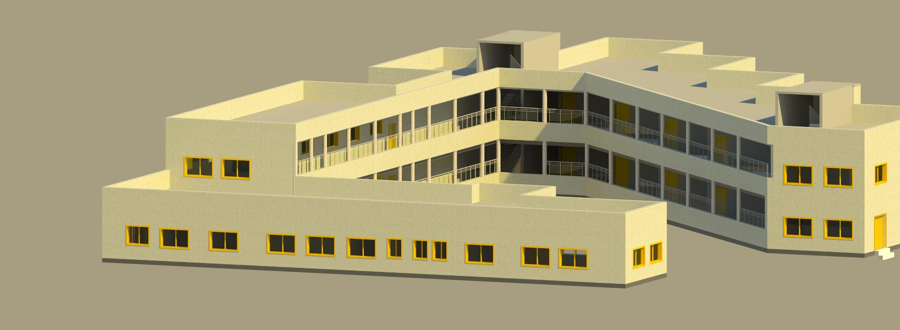

An-Najah National University
Secondary School Design
Aqeed Ghazal
Wardan Abdullah
Amer Horani
Salah Jom’a

Slide 2
outline
Introduction
Architectural Design
Structural Design
Environmental Design
Mechanical Design
Electrical Design
Cost Estimation

Slide 3
Introduction

Slide 4
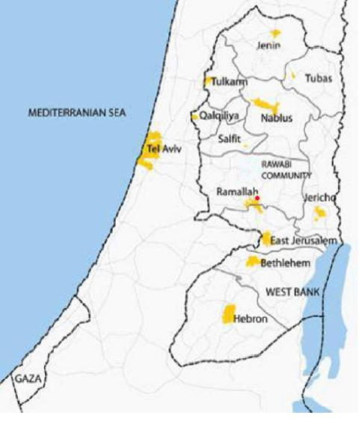
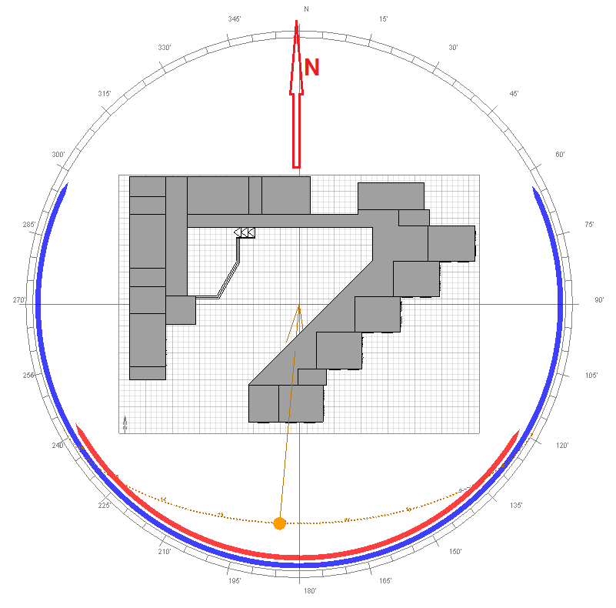
location:
Notes:
Graduation project 2

Slide 5
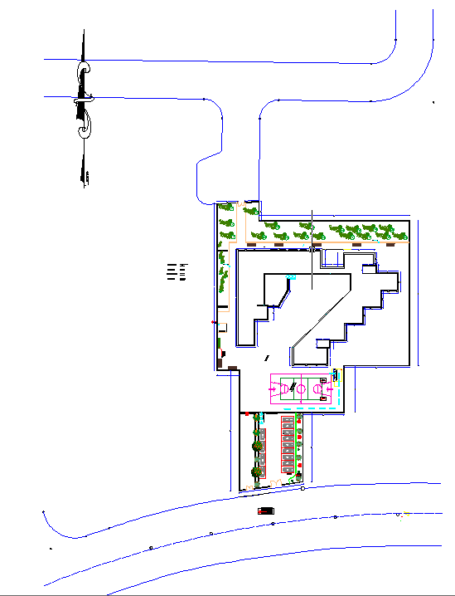
Site plan :
Total area of 4000 m².
No high buildings surrounding the school .
Two main streets.
North westerly winds are prevailing wind directions.

Slide 6
Architectural
Design

Slide 7
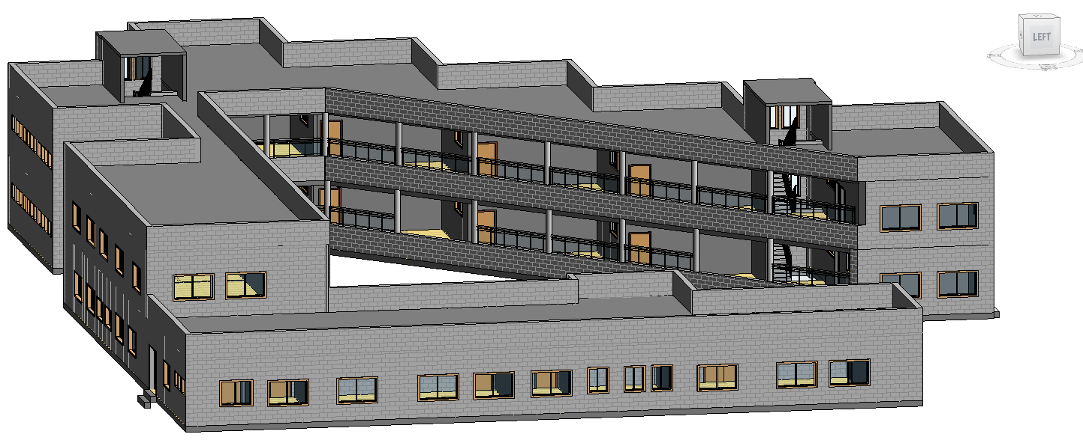
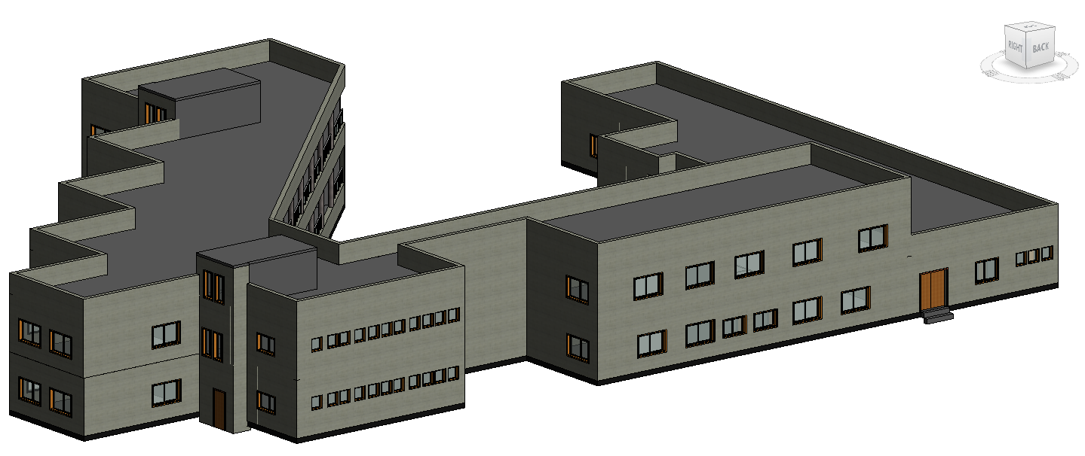
3D Model

Slide 8
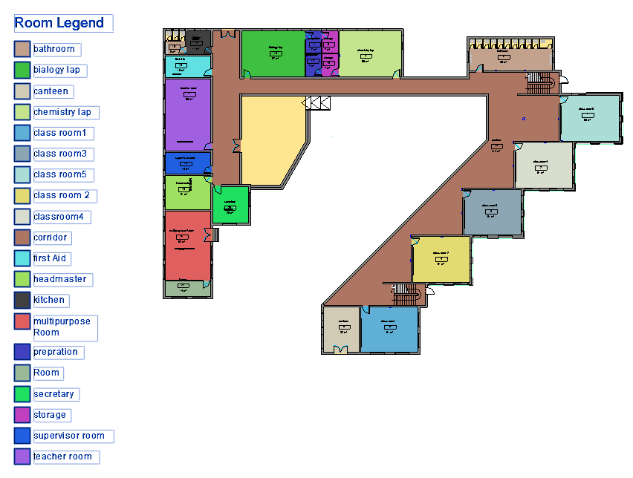
Functional Distributions
Ground Floor
Total area of ground floor =1368 m²

Slide 9
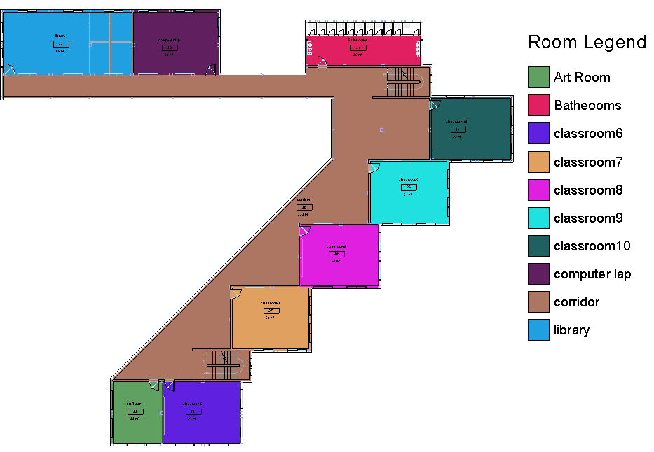
First Floor
Total area of first floor = 871 m²

Slide 10
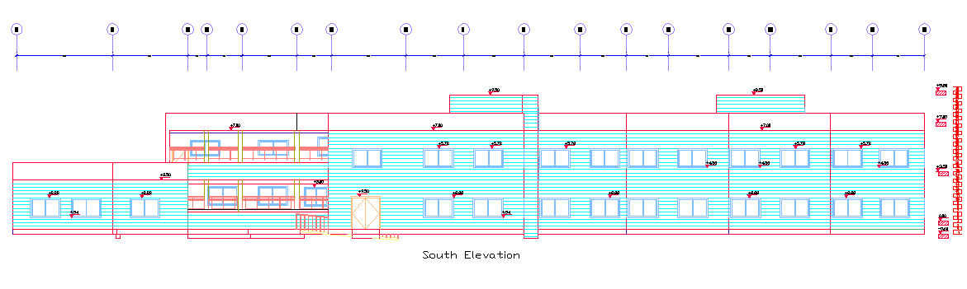
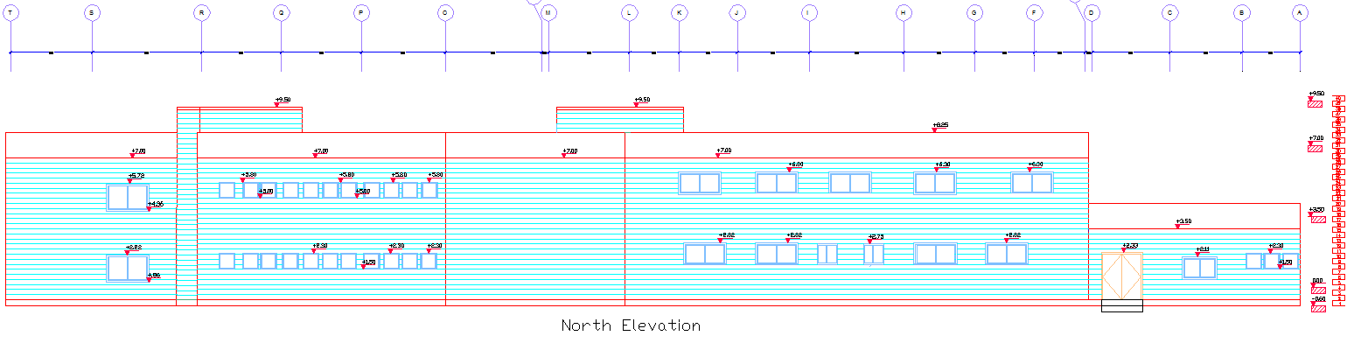
Elevations

Slide 11
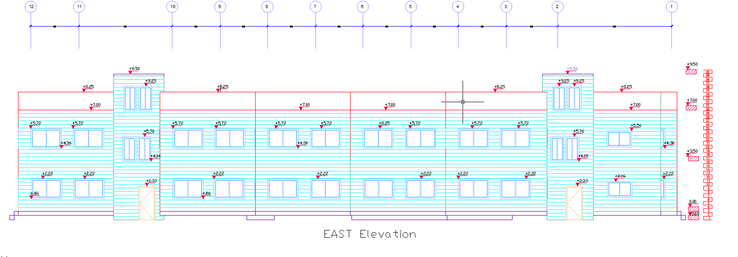
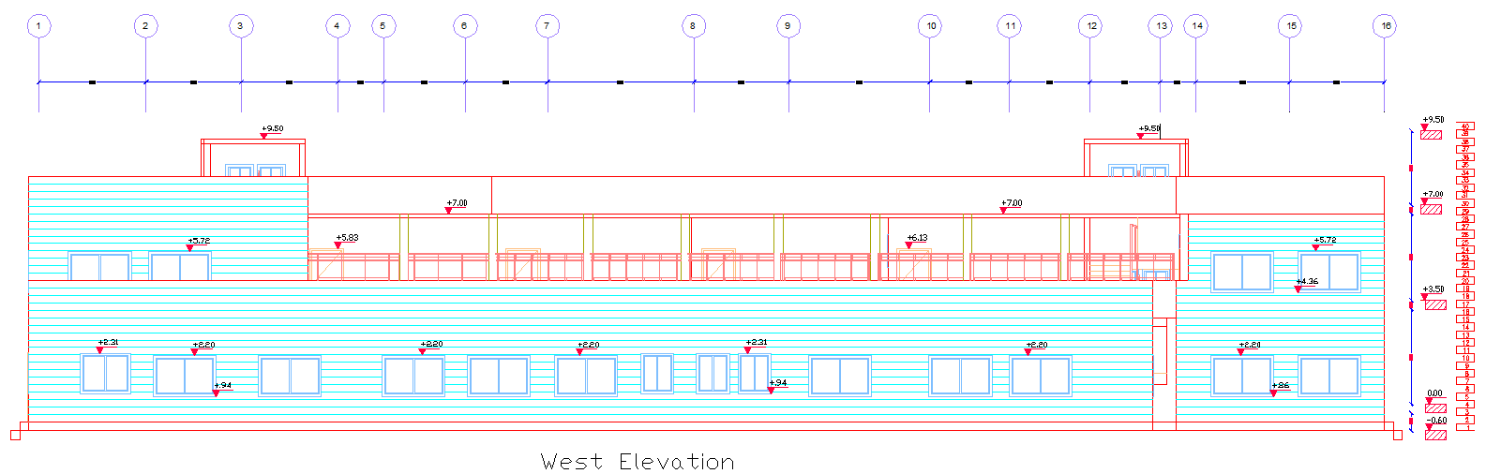

Slide 12
Structural Design

Slide 13
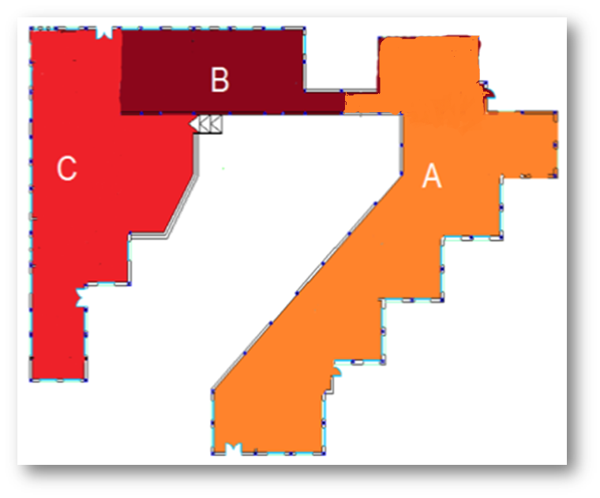

Slide 14
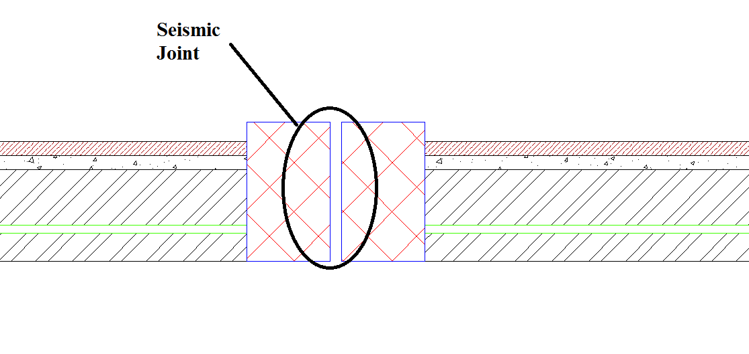
Seismic Joint

Slide 15
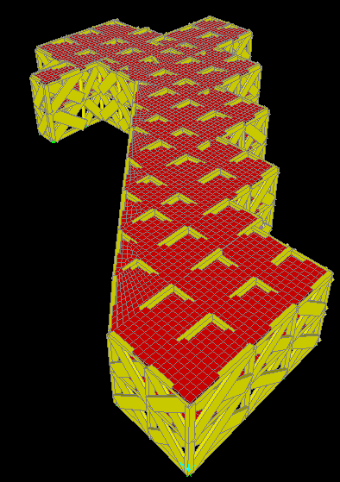
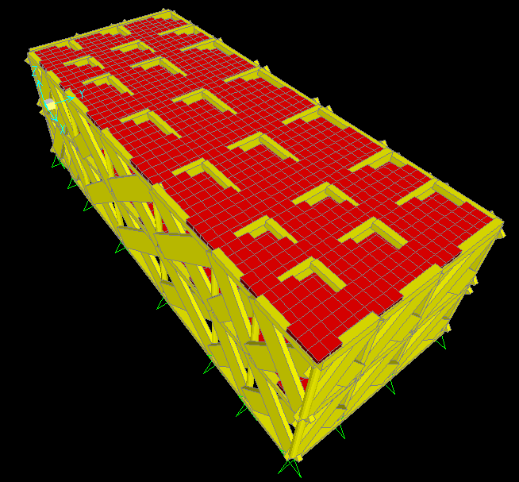
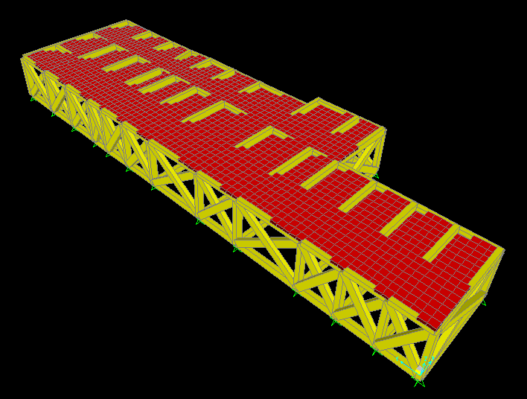

Slide 16
Design Codes
ACI – 318 – 2011 for reinforced concrete structural design.
UBC – 97 for earthquake load combinations.
ASCE for load combinations.

Slide 17
Materials:
Loads:
Material property | Value (MPa)
Compressive strength of concrete (f '_{c} ) | 28
Yielding strength of steel (Fy) | 420
Load Type | Load (Kn/m²)
Super imposed | 4
live | 5

Slide 18
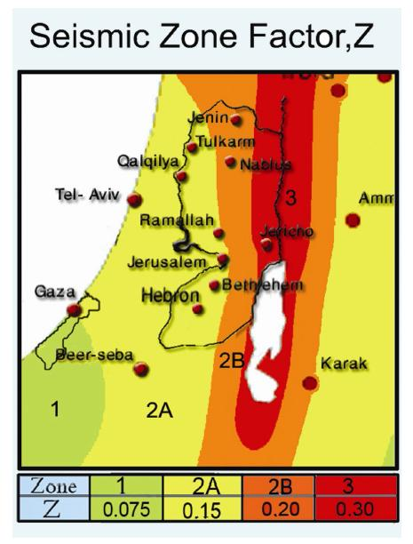
Seismic Design:
Bearing capacity of the soil: 150 Kn/m²
Z= 0.2
Soil profile: S_{D}
Seismic coefficient (C_{v}): 0.4
Importance factor (I): 1.5.
Seismic coefficient (C_{a}): 0.28.
Structural system coefficient (R): 4.5.

Slide 19
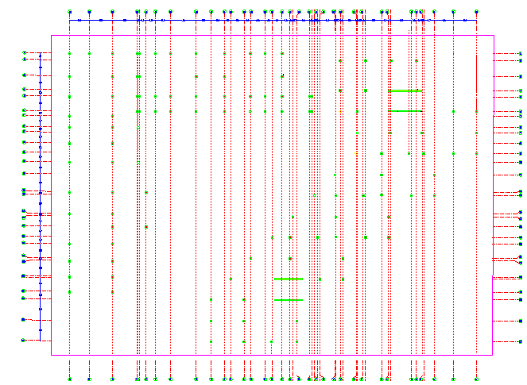
Column centre lines

Slide 20
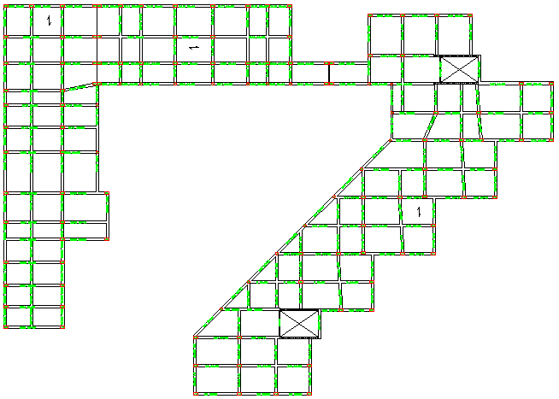
Beams Layout

Slide 21
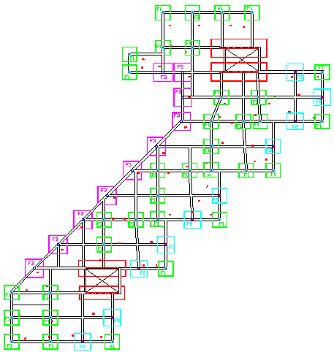
Footings layout

Slide 22
Sections and properties
Columns:
Column type | Dimensions (cm)
Rectangular column | 50*30
Circular column (Dia.) | 40
Beams:
Beam type | Dimensions (cm)
Main beams | 50*30
Secondary beams | 30*30
Tie beams | 50*30

Slide 23
Footings:
Footing name | Dimensions (m)
Isolated
F1 | 1.9*1.9
F2 | 2.2*2.2
F3 | 2.4*2.4
Wall footing
W1 | 2.1*5.2
W2 | 1.8*5.2
W3 | 2.4*5
Slab:
One way solid slab with 20 cm thickness.

Slide 24
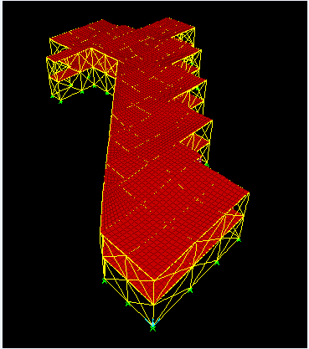
SAP model Checks
1- Compatibility check.

Slide 25
2-Equilibrium check
Load | Manual (Kn) | SAP (Kn) | % error | < 10 %
Dead | 25137.75 | 25498.8 | 1.4 | 0k
Live | 6880 | 7292 | 4.2 | ok
3- Internal forces check
Structural element | Manual calculation(Kn.m) | SAP result (Kn.m) | % error | < 10 %
beam | 185.4 | 190.3 | 2.5 | ok
slab | 67 | 70.4 | 4.8 | ok
Structural element | Manual calculation (Kn) | SAP result (Kn) | % error | < 10 %
column | 325 | 349 | 7 | ok

Slide 26
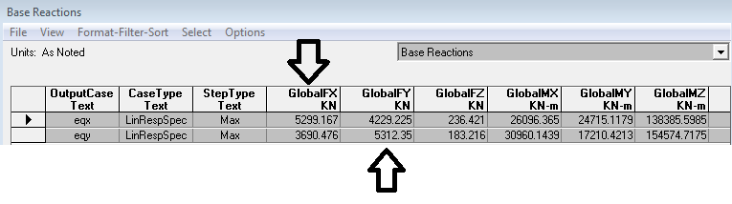
Seismic design checks:
Base shear (V) for seismic design :
Manual calculation for V = 5312 Kn.
From SAP:

Slide 27
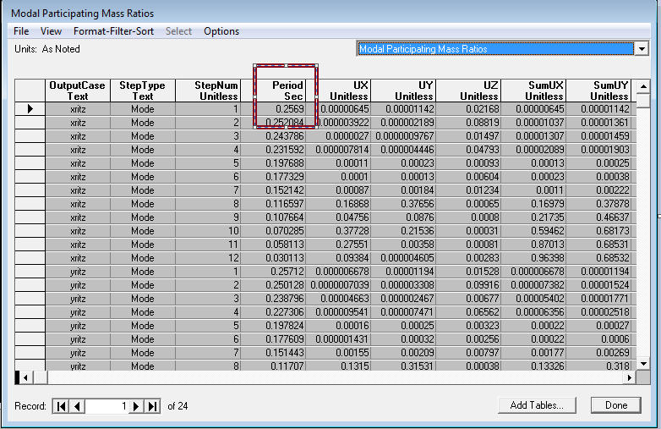
Period
Manual calculation: 0.21 sec.
From SAP:

Slide 28
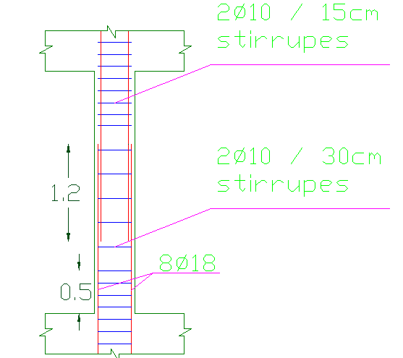
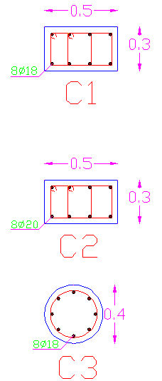
Column Detailing
C1

Slide 29
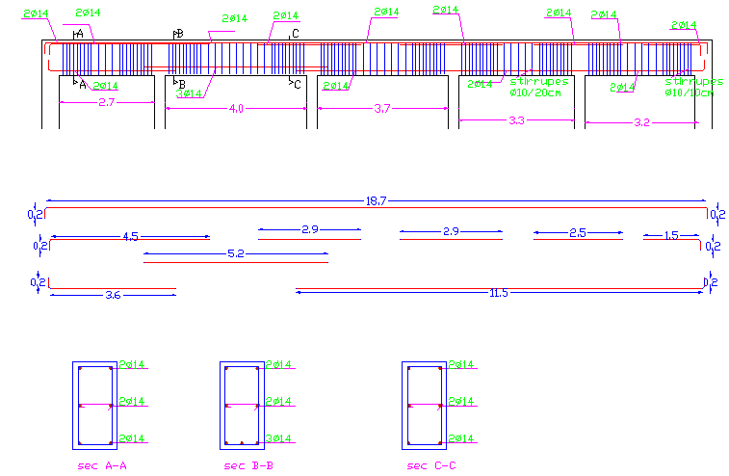
Beam Details

Slide 30
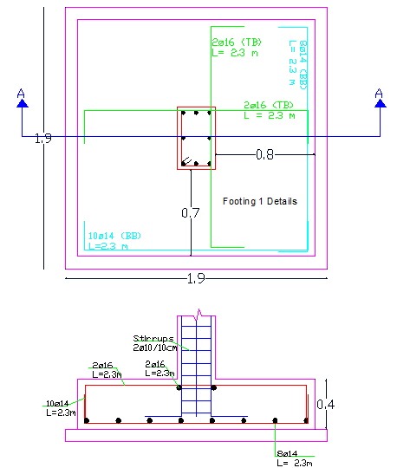
Footing Details

Slide 31
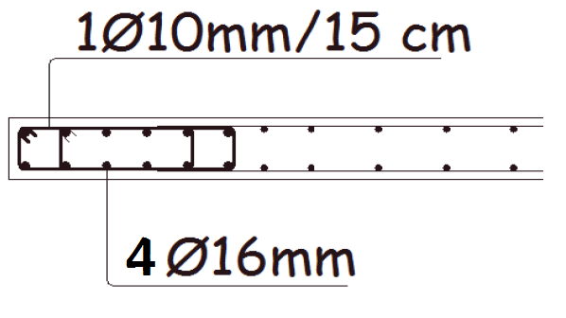
Shear wall Details

Slide 32
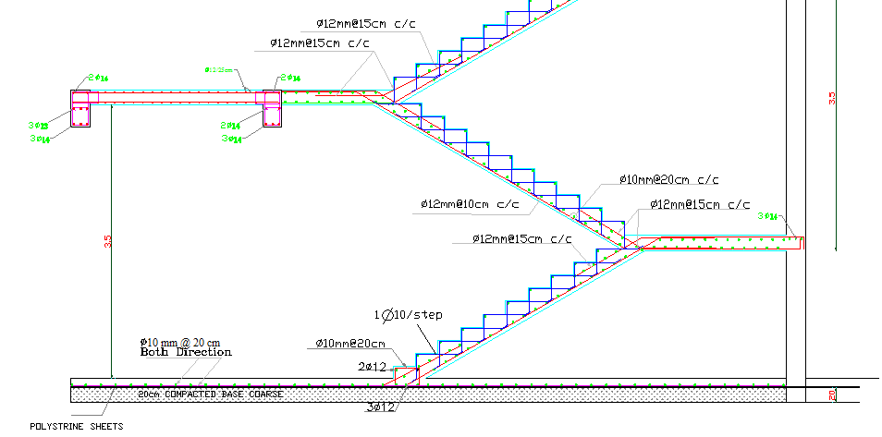
Staircase Detailing

Slide 33
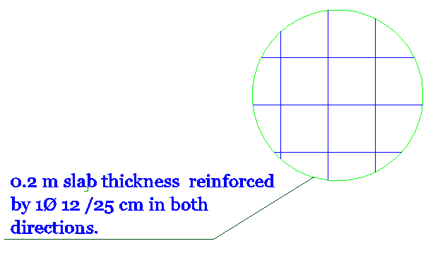
Slab Details

Slide 34
Environmental Design

Slide 35
Nablus
latitude 32.1
longitude 35.16

Slide 36
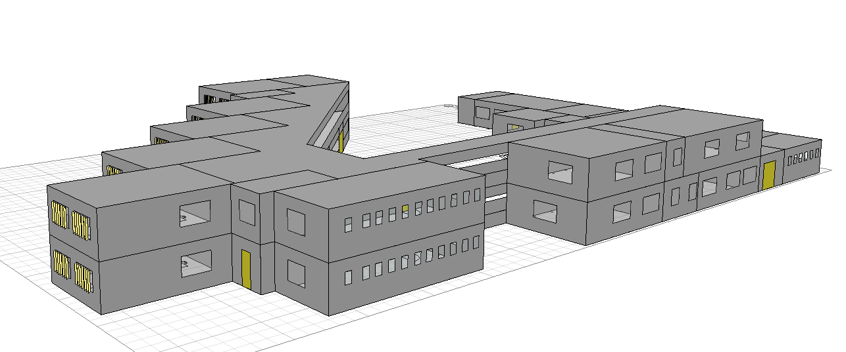
Internal Ceiling
U= 0.31
External Roof
U=0.32
Double Glass
U = 2.41
External Wall
U= 0.34
Single Glass
U = 6
External Floor
U=0.38

Slide 37
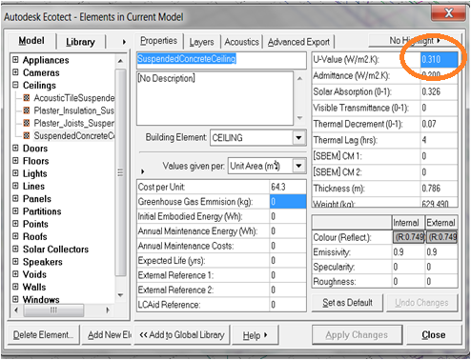
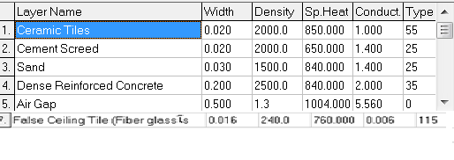
Material used
Ceiling

Slide 38
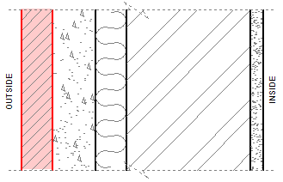
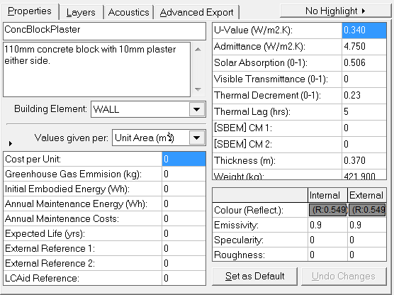
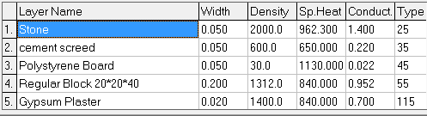
External Wall

Slide 39
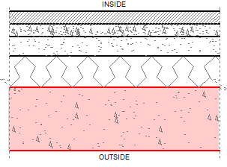
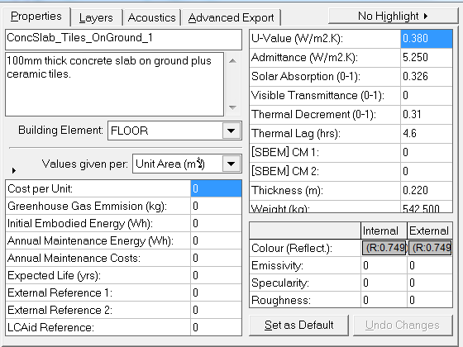
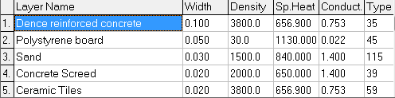
Floor

Slide 40
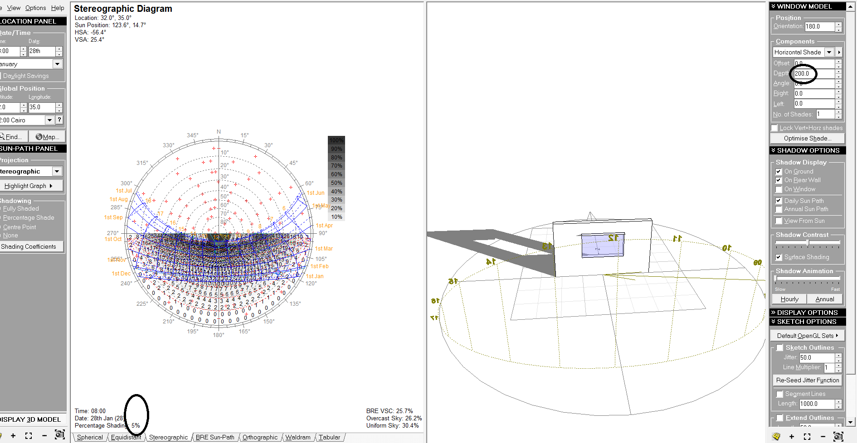
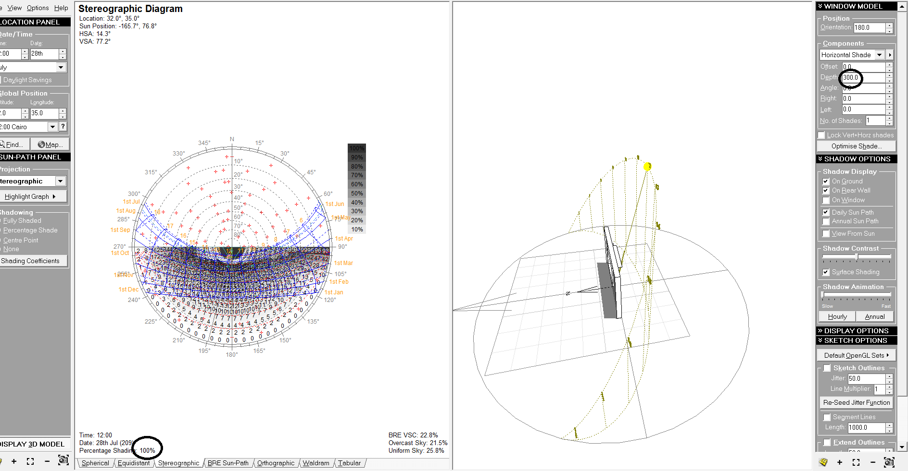
Shading
Percent shading = 100%
Percent shading = 5%
Winter
Summer

Slide 41
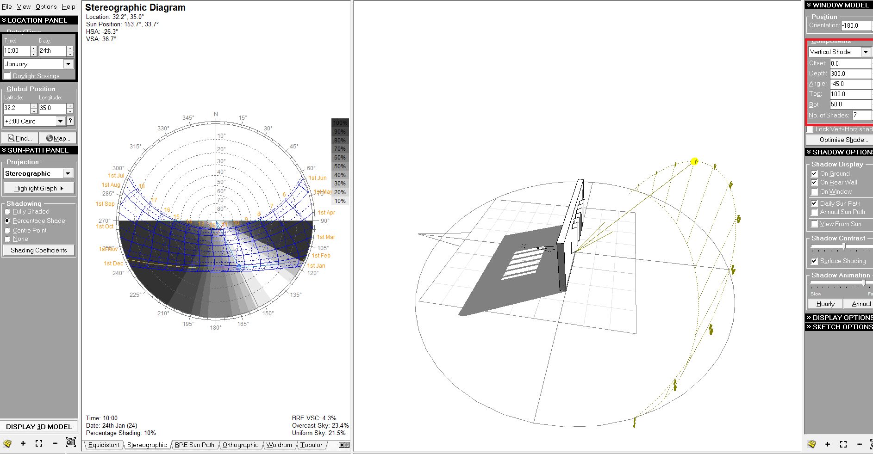
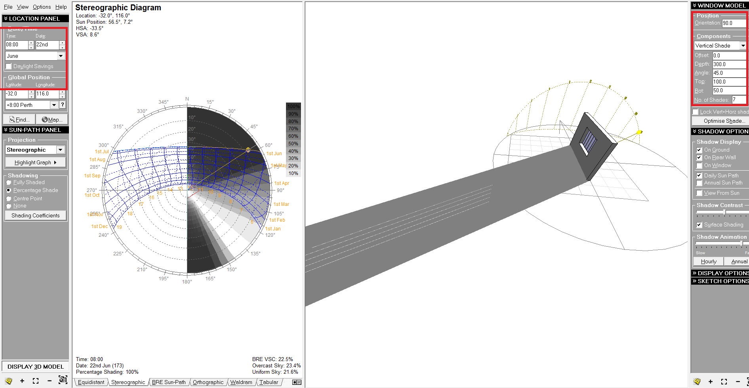
Percent shading = 10%
Percent shading = 100%
Winter
Summer

Slide 42
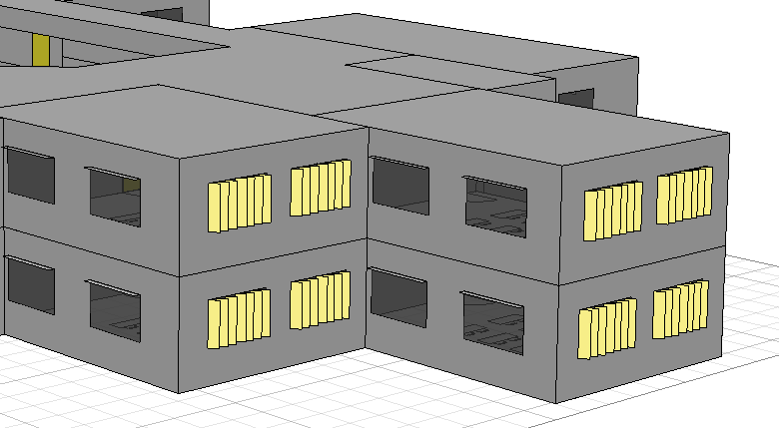
Vertical louvers
Depth = 0.3m
Horizontal shading tools
Depth = 0.25

Slide 43
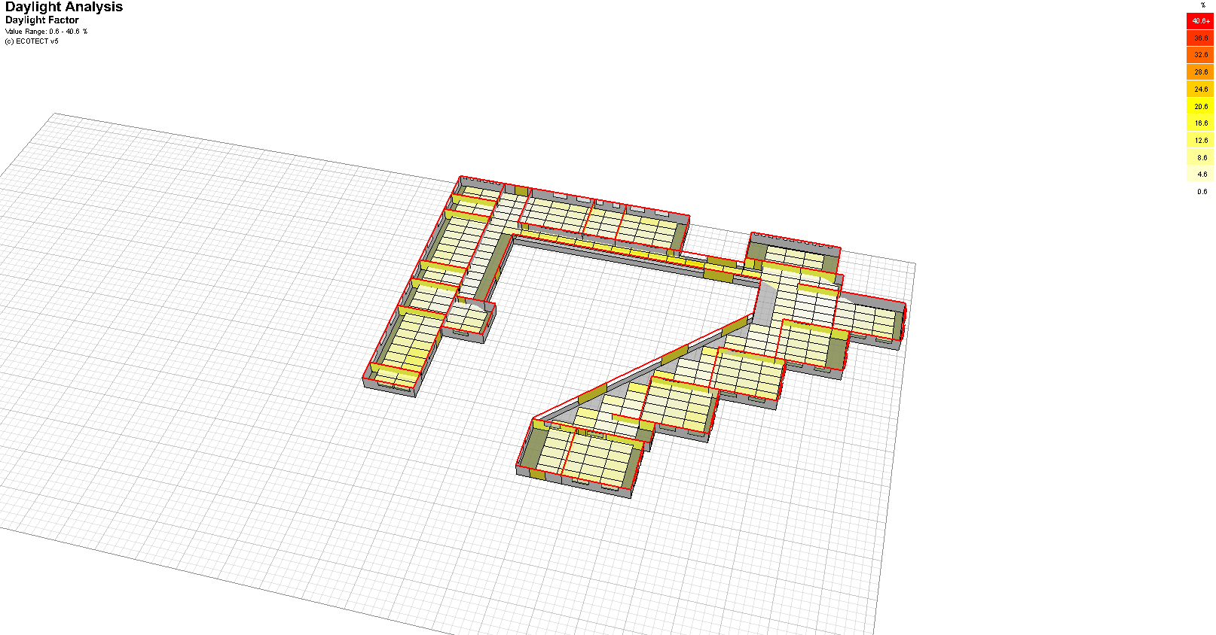
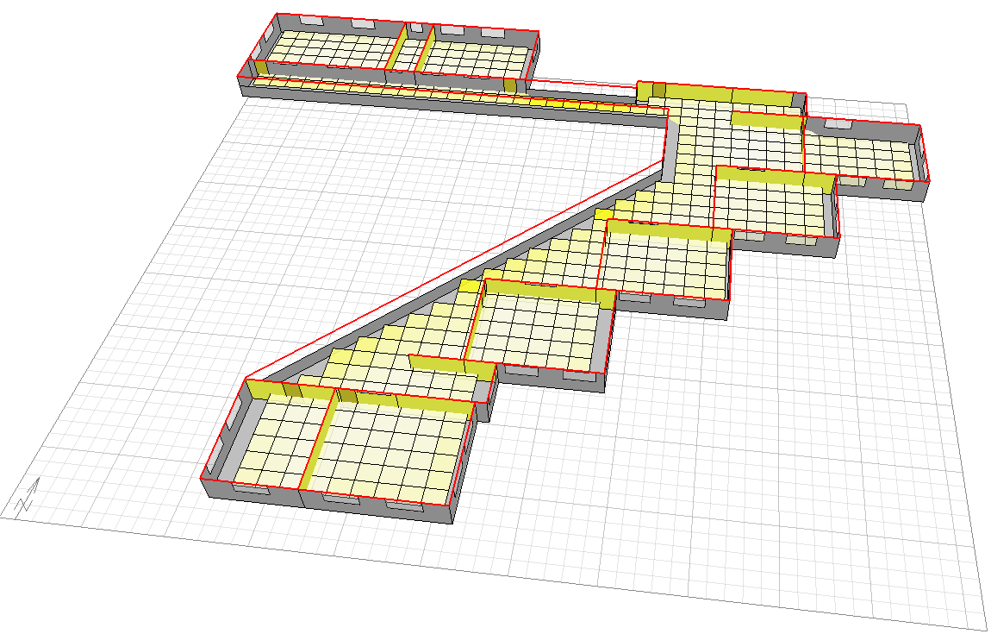
Daylight Analysis
Ground Floor
First Floor

Slide 44
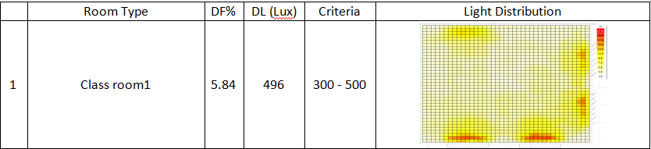
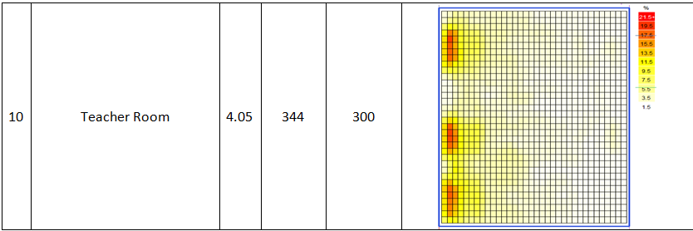
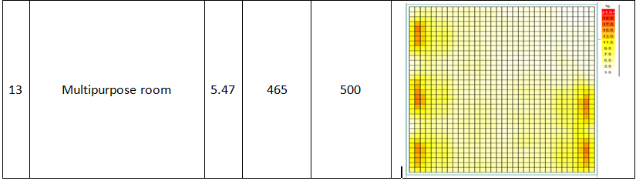
Good light distribution.
Light level conforms with specifications.

Slide 45


Thermal Loads
Working hours schedule
General settings

Slide 46

Total heating load per meter =12.7 KWh
total cooling load per meter =13.5 KWh
Total heating and cooling load per meter = 26.2 KWh
Low heating and cooling loads
Energy conservation

Slide 47


Thermal Comfort
The recommended acceptable PMV range for thermal comfort from ASHRAE 55 is between -0.5 and +0.5 for an interior space.
Comfort For library

Slide 48

Comfort For classroom

Slide 49

Acoustical Design
Hand calculation
Lw = 75 db
Back ground noise = 35 db
Measured
Standards
RT60 :
Empty
Fully occupied
0.6 - 0.8 s
.7175 0.601
S/N :
10 - 30 dB
31.1 31.4

Slide 50




Ecotect calculation
Ceramic Tiles
Pageboard over 25mm(1") fiberglass board
window(glass)
wall ( paint)

Slide 51


The following results are obtained from Ecotect software.
Both hand calculation and software calculation are acceptable.

Slide 52
Mechanical Design

Slide 53
Plumping system
Drainage system.
Water system.
Firefighting system.
Gas system.

Slide 54
Plumbing Fixtures
Used plumbing fixtures in the project are:
Water closets.
Kitchen sinks.
Lavatories (also called bathroom sinks).
Drinking fountains.

Slide 55

Drainage system :
The main pipes are U.P.V.C with 4’’size and P.V.C 2’’ size for internal connection and 6’’ U.P.V.C for outdoor pipes.
All pipes (2’’,4’’ and 6’’ pipes) have slope equal to 1% to let the waste water flow by gravity.
The manholes are connected with the vertical, the last manhole is connected with septic tank in the garden. The pipe’s size between the manholes is 6’’ to ensure good flow rate.

Slide 56

water system :
The system is designed based on flush tank and public used for all fixture unit
The cold and hot water are supplied to the fixture unit from the roof tanks and solar heater by the copper collectors and flow throw galvanized steel pipe and BEX pipe by gravity with different diameters and different lengths.
The hot water is supplied to the building by solar heater in the summer and by electrical heater in the winter

Slide 57

Total cold fixture units: 168 fixture unit
Total cold water flow rate that supply the building: 3.86 L/s
Total hot fixture units: 42 fixture unit
Total hot water flow rate that supply the building: 1.01 l/s
A pump needs to supply hot water to first floor with head equal 38 kpa and Q equal 3.86 L/S and its fixed on the return pipes to protect the pump from heat of water.
A pump will be used to lift water to roof tanks from water tank when there is shortage in water in the tanks and when the city water is cutoff.
The flow rate for the pump is set to be 10 M³ /HOUR with HEAD= 159 KPA

Slide 58

FIREFIGHTING SYSTEM:
The system designed according to the NFPA code and tables, in our project a fire cabinet is used in addition to the landing valves.
A single riser is used to feed the fire cabinets and landing with size equal 4’’ .
Three pumps are used to run the system, the required flow rate for water from the pumps equal to 500 G.P.M according to the NFPA for 1 riser .
Size of pipe which supply the fire cabinet equal 1.5’’ and 2.5’’for landing valve
The system is designed to supply 250 gpm for fire cabinets and 250 gpm for landing valve.

Slide 59

Fire pumps:
The pump calculation is made for the landing valves in the first floor (the highest and the farthest point in the building ) because it has higher flow pressure equal at least 100 psi.
The pump flow rate (Q): 500 G.P.M.
Pump head equal 128 psi or 840 Kpa.
Jockey Pump.
(∆P) HEAD jockey = 133 psi
The pump flow rate (Q): 50 G.P.M.

Slide 60

Gas system:
Gas is needed to supply laboratory’s, kitchens and canteens.
- In general the gas supplier is gas cylinder which is located in suitable place in the school outside the building.
- In this type of building (schools), the gas network has very low pressure and negligible friction losses.
In this project the gas outlets equals 11 points.
The GF has 2 gas cylinders which are used to supply the building.
The size of the pipes equal 0.5’’ for each gas outlet, and the main supply pipe size equal 3/4’'

Slide 61
Electrical Design

Slide 62



Lighting distribution
Classrooms (1, 2, 3, ….,10)
E_{min} / E_{max} | u0 | E_{max} [lx] | E_{min} [lx] | E_{av} [lx] | Grid | Type | Designation | No.
.590 | .689 | 570 | 336 | 587 | 128x128 | perpendicular | Calculation Surface 1 | 1

Slide 63



Computer lab:
E_{min} / E_{max} | u0 | E_{max} [lx] | E_{min} [lx] | E_{av} [lx] | Grid | Type | Designation | No.
0.595 | 0.601 | 403 | 240 | 344 | 128*128 | perpendicular | Calculation Surface 1 | 1

Slide 64

Lighting distribution in GF

Slide 65

Lighting distribution in the 1st floor

Slide 66

Sockets distribution in GF

Slide 67

Sockets distribution in the 1st floor

Slide 68

Main board

Slide 69
Cost
Estimation

Slide 70



