Slide 1
Thermal Efficiency of Buildings
Motaz H. Othman
Mohammad S. Humaidi
Supervised by: Dr. Salameh Abdul Fattah

Slide 2
Outline
Introduction.
Thermal insulation.
Heat losses.
Environmental effects.
New thermal insulation
procedure
Experimental results
Conclusion
Recommendation

Slide 3
Introduction
Reinforced concrete is widely used in construction sector due to its several features, such as:
  workability
  better appearance
  fire resistance
  economical issues
  high durability and ability to be molded to any complex shape using suitable form work.

Slide 4
Introduction
Deficiencies can be found with reinforced concrete usage, such as:
  high thermal conductivity
  high heat losses
  problems with humidity.

Slide 5
Considerations for
Increasing Thermal Efficiency
Thermal insulation.
Vapor barriers.
Heat Losses.
Environmental Effects.
Solar Solutions.

Slide 6
Thermal insulation
What is Thermal Insulation?
Insulation is defined as a material or combination of materials, which retard the flow of heat.

Slide 7
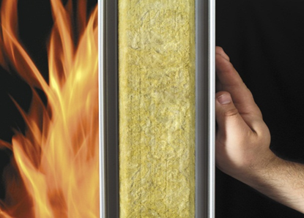
Thermal insulation
Characteristics of Thermal Insulation:
  Thermal Resistance (R)
  Water Vapor Permeability
  Weather Resistance
  Corrosion Resistance
  Fire Resistance Density (lb/ft³) (kg/m³)

Slide 8
Thermal insulation
Insulation Types:
Temperature range | Applications | Properties | R value
Polystyrene
low temperatures (-167 C to 82 C) | cool rooms, refrigeration piping | Rigid, lightweight | R-5.00
Polyurethane
low temperatures (-178C to 4oC) | cool rooms, refrigeration piping and floor and foundation insulation | low density, high mechanical strength | R-7–R-8

Slide 9
Thermal insulation
Insulation Types:
Temperature range | Applications | Properties | R value
Rockwool
temperatures up to 820 C | insulate industrial, heat exchangers, boilers | maintains mechanical strength during handling | R-2.5–R-3.7
Fiber glass
temperatures up to 540oC | heat exchangers , boilers | It should not promote or accelerate the corrosion of steel, provide it is protected from external contamination | R-3.1–R-4.3

Slide 10
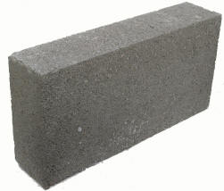
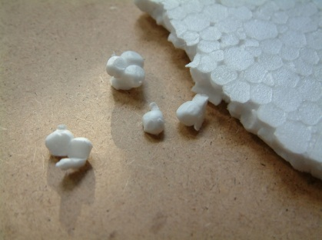
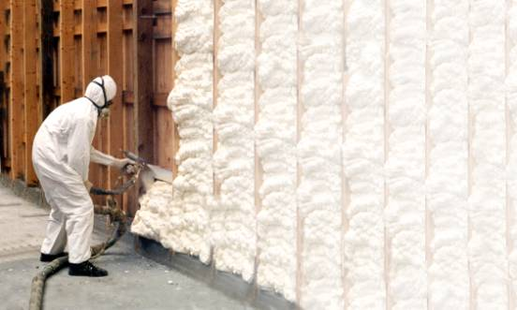
Thermal insulation
Forms of Insulation Board
  Block
  Sheet
  Foam
  Spray
  Cements

Slide 11
Vapor barriers
What is Vapor barriers?
It is defined as the ability of a material to retard the diffusion of water vapor and measured in units known as "perms" or permeability.

Slide 12
Vapor barriers
Vapor barriers Types:
Temperature range | Thermal conductivity | (permeability) | Applications
CELLULAR GLASS
-260 to 430°C | 0.040 | zero | Industrial: tank bases, vessels, piping and equipment . Buildings: roofs, floors, walls
GLASS MINERAL WOOL
-200 to 450°C | 0.040 | zero | in the HAC V sector and insulation in transport, shipping, building and industrial applications.

Slide 13
Vapor barriers
1 kg/(m×s×Pa) = µgm/(Nh) × 2.778 × 10
13
Vapor barriers Types:
Temperature range | Thermal conductivity | (permeability) | Applications
NITRILE RUBBER EXPANDED
-40 to 116°C | 0.037 | 0.25 μgm/Nh | used for and energy conservation on domestic heating, and hot and cold-water pipe work.
PHENOLIC FOAM
-180 to 120°C | 0.018-0.022 | 10 μgm/Nh | Construction – floor, wall, roof insulation in domestic, commercial and industrial buildings.

Slide 14
Heat Losses
What is heat loss?
It is defined as the heat that flows from the building interior, through the building envelope to the outside environment .

Slide 15
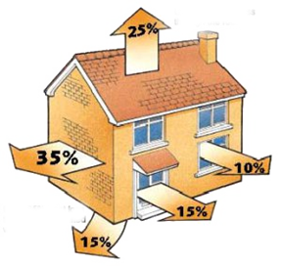
Heat Losses
The heat loss can be calculated as :
H_{t} = A U (t_{i} - t_{o})
H_{t} = transmission heat loss (W)
t_{i} = inside air temperature (ºC)
U = overall heat transmission coefficient (W/m²K)
t_{i} = inside air temperature (ºC)
t_{o}= outside air temperature (ºC)
Roofs
Walls
Windows
Draughts
Floors

Slide 16
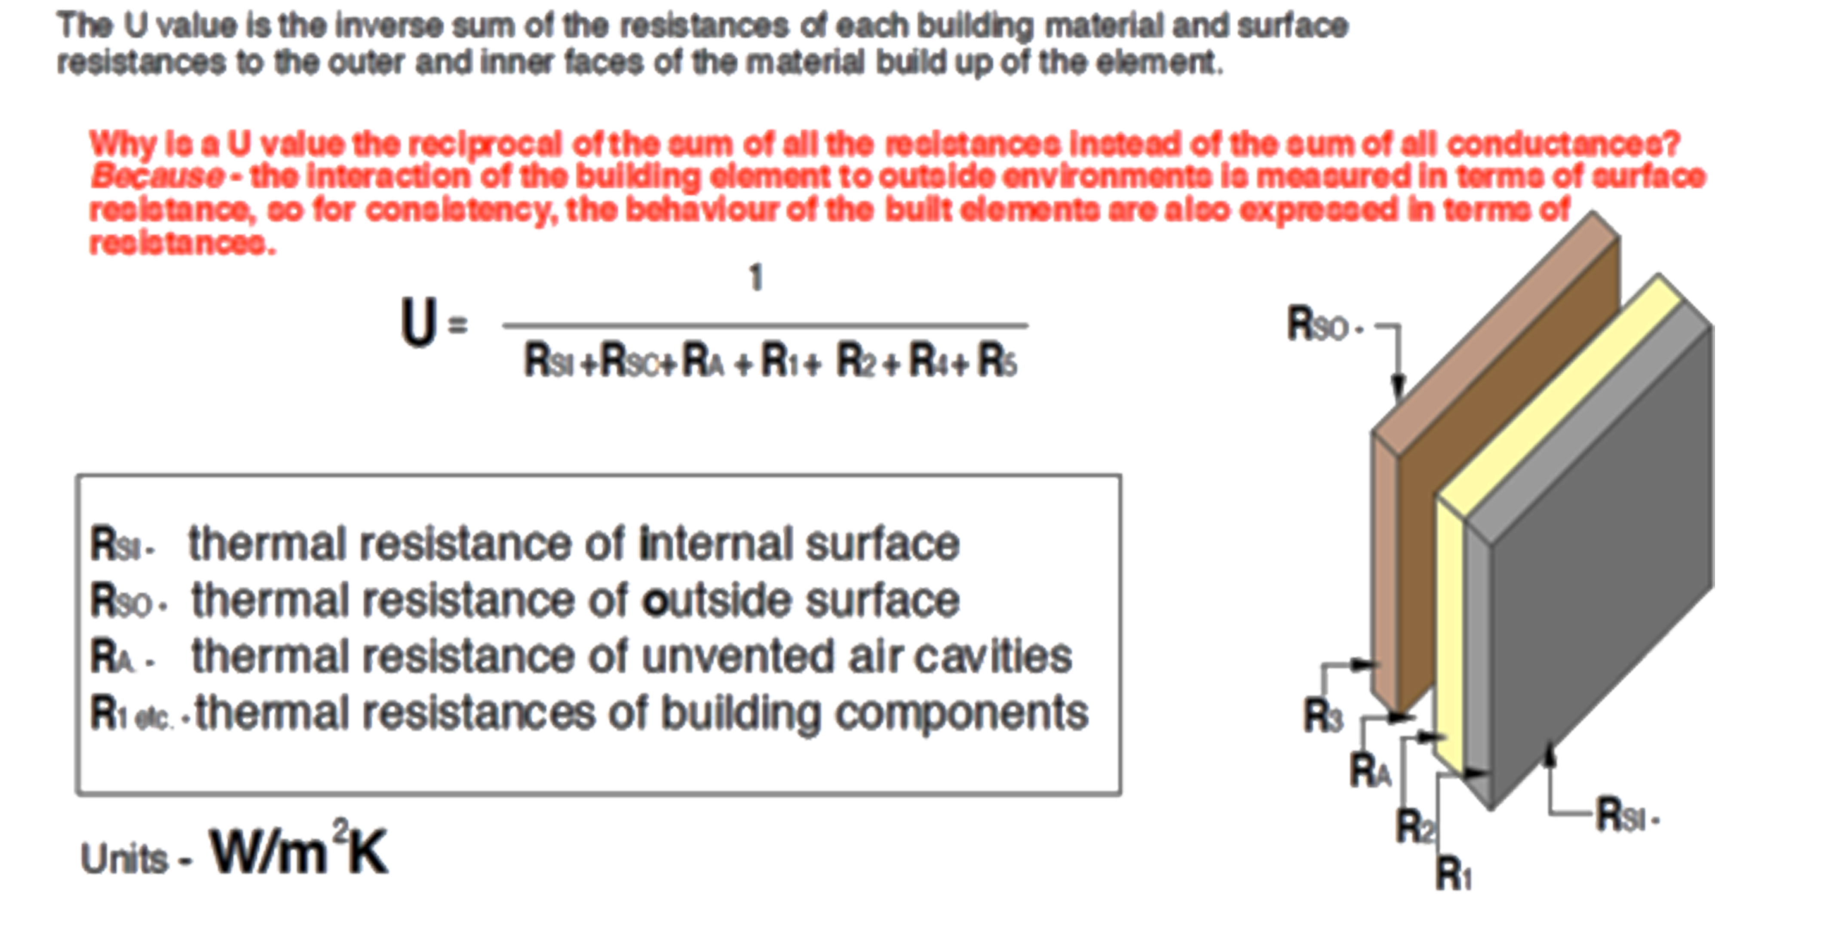
Heat Losses
Overall Heat Transmission Coefficient (U-value)

Slide 17
Heat Losses
Heat loss by Ventilation:
The heat loss by ventilation can be calculated as:
H_{v} = c_{p} ρ q_{v} (t_{i} - t_{o})
H_{v} = ventilation heat loss (W)
c_{p} = specific heat capacity of air (J/kg K)
ρ = density of air (kg/m³)
q_{v} = air volume flow (m³/s)
t_{i} = inside air temperature (ºC)
t_{o} = outside air temperature (ºC)

Slide 18
Environmental Effects

Slide 19
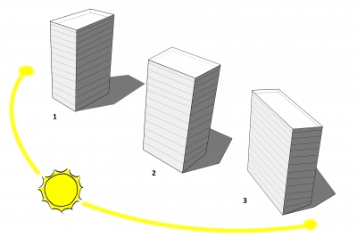
Environmental Effects
Orientation for Visual Comfort:

Slide 20
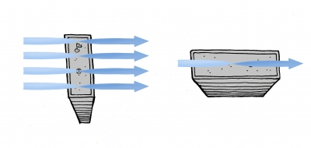
Environmental Effects
Orientation for Thermal Comfort: wind

Slide 21
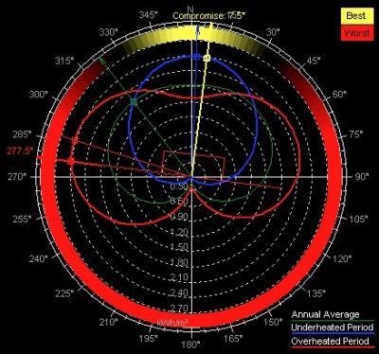
Using Ecotect

Slide 22
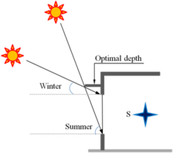
Shading device

Slide 23
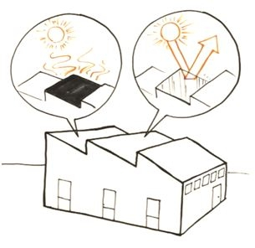
Environmental Effects
Surface Color and Cool Roofs

Slide 24
New Insulation Material

Slide 25
Project description:
The project is about making new insulation material from local simple ones, with high thermal resistance at low price.

Slide 26
New thermal insulation material consists of three components:
  Limestone: :
Limestone Characteristics
k-value: Theoretical: 0.15-1.1 W/(m.K)
  Uses: Limestone is very common in architecture, especially in Europe and North America. Many landmarks across the world, including the Great Pyramid .

Slide 27
  Advantages:
Limestone Characteristics
Available in Palestine.
It is not expensive in the local market.
Relatively easy to cut into blocks or more elaborate carving.
Long lasting.
Stands up well to exposure.
  Disadvantages:
  Heavy weight

Slide 28
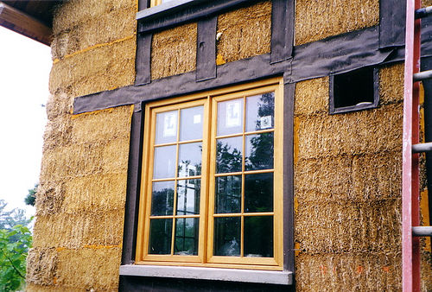
Straw:
Straw Characteristics
K-value: 0.09 W/(m.K)
Uses:
Straw-bale construction is a building method that uses bales of straw (commonly wheat, rice, rye and oats straw)
as structural elements, building, or both.

Slide 29
Advantages:
Straw Characteristics
Lightweight.
Few in the heat conduction.
Disadvantage:
Non-fire-resistant
Unable to withstand stress
Fire ashes:

Slide 30
The Procedure

Slide 31
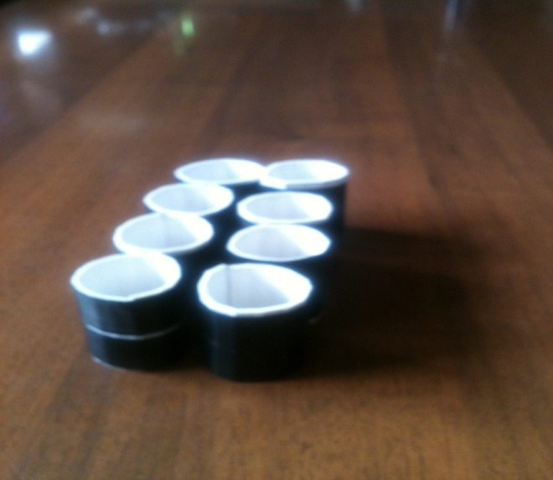
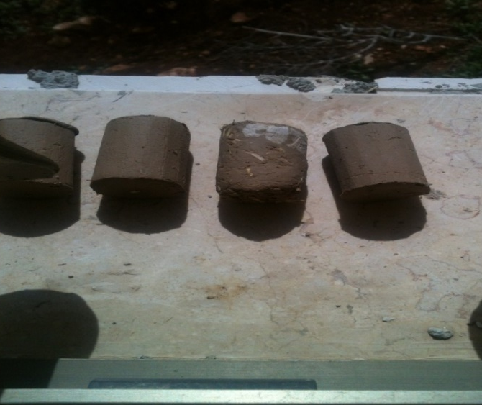
Procedure
1-The sample was put into molds that fit testing apparatus used.
2-Samples were exposed to heat until they have dried.

Slide 32
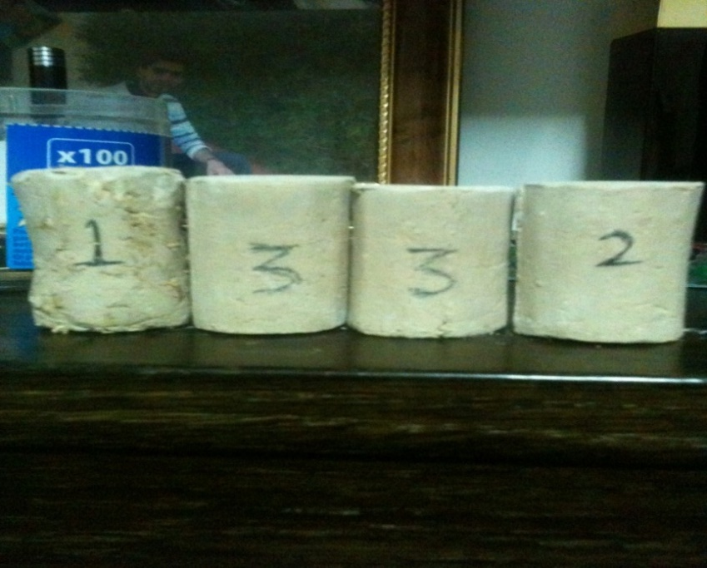
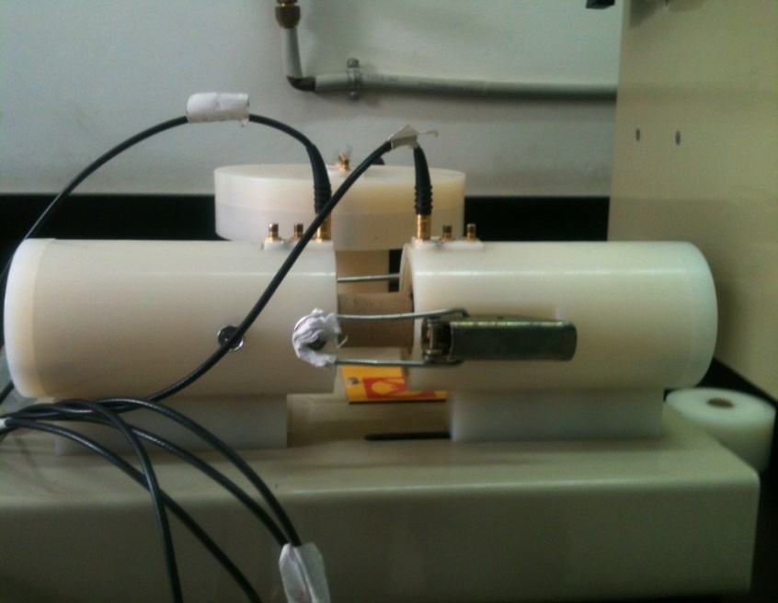
Procedure
3-The samples were ready to test
4-Sample were put one after one between the phases of the apparatus.

Slide 33
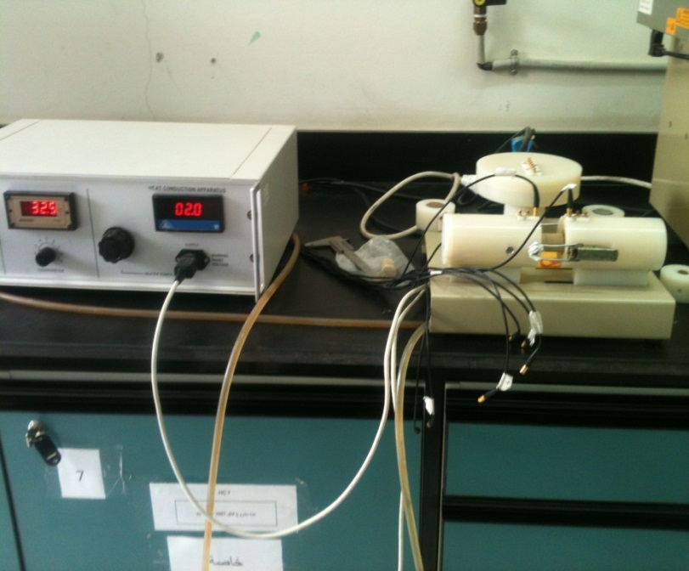
Procedure
6-The apparatus was turned on at 10w heat flux, and then wait for half an hour to reach steady state.
5-Cold water was allowed to flow through the heat unit.

Slide 34
Procedure
7-The temperature was recorded at all six sensors.
8-Step 6 was repeated at 20w.
9-The temperature was recorded at all six sensors.
10-Step 6 was repeated at 30w.
11-The temperature was recorded at all six sensors.
12-The test was repeated to the other samples.

Slide 35
Experiment Results

Slide 36
Sample 1 :
x(mm)
Q (w) | 5 | 15 | 25 | 30 | 40 | 50 | 55 | 65 | 75 | slope | k (w/k.m)
10 | 78.7 | 78.7 | 78.6 |  |  |  | 18.1 | 18.8 | 0.3536 | 0.3536 | 0.3536
20 | 97.2 | 97.2 | 97.1 |  |  |  | 18.7 | 19.5 | 0.568 | 0.568 | 0.568
30 | 139.4 | 139.4 | 139.3 |  |  |  | 19.2 | 20 | 0.4367 | 0.4367 | 0.4367
Area=0.0037 |  | r=.015 |  |  |  |  |  |  |  | kavg | 0.452767

Slide 37
Sample 2 :
x(mm)
Q (w) | 5 | 15 | 25 | 30 | 40 | 50 | 55 | 65 | 75 | slope | k (w/k.m)
10 | 79 | 78.9 | 78.9 |  |  |  | 17 | 17 | 17 | -2.0633 | 0.336
20 | 99.2 | 99.2 | 99.1 |  |  |  | 17.4 | 17.3 | 17 | -2.7233 | 0.552
30 | 143.4 | 143.4 | 143 |  |  |  | 17.9 | 17.8 | 18 | -4.18 | 0.4023
Area=0.0037 |  | R=.015 |  |  |  |  |  |  |  | kavg | 0.336241

Slide 38
Sample 3 :
x(mm)
Q (w) | 5 | 15 | 25 | 30 | 40 | 50 | 55 | 65 | 75 | slope | k (w/k.m)
10 | 79 | 78.9 | 78.9 |  |  |  | 16.2 | 16.2 | 16 | -2.09 | 0.3205
20 | 99.2 | 99.2 | 99.1 |  |  |  | 16.4 | 16.4 | 16.5 | -2.7567 | 0.5782
30 | 143.4 | 143.4 | 143.3 |  |  |  | 16.7 | 16.6 | 17.6 | -4.22 | 0.3762
Area=.0037 |  | R=.015 |  |  |  |  |  |  |  | kavg | 0.324007

Slide 39
Experiment Calculation

Slide 40


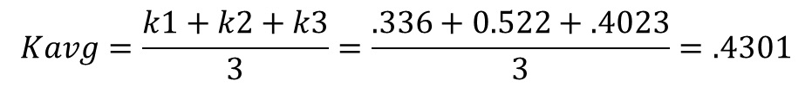
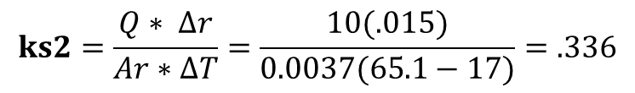
Experiment Calculation
Sample1:
$ks1=\frac{Q∗ ∆r}{Ar∗∆T}=\frac{10(.015)}{(.00378)(62.1−18.7)}=$0.3536
$Kavg=\frac{k1+k2+k3}{3}=\frac{0.3536+.568+0.4376}{3}=$0.452767
Sample 2:
$$ks2=\frac{Q∗ ∆r}{Ar∗∆T}=\frac{10(.015)}{0.0037(65.1−17)}=.336$$
$$Kavg=\frac{k1+k2+k3}{3}=\frac{.336+0.522+.4023}{3}=.4301$$

Slide 41
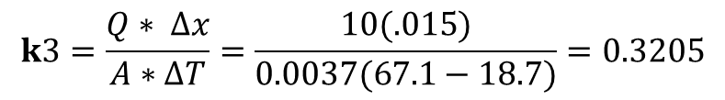
Experiment Calculation
Sample 3:
$$k3=\frac{Q∗ ∆x}{A∗∆T}=\frac{10(.015)}{0.0037(67.1−18.7)}=0.3205$$
$$Kavg=\frac{k1+k2+k3}{3}=\frac{0.3205+0.5782+0.3762}{3}=0.424967$$

Slide 42
Conclusion:
The new material that we have made from local raw material (limestone, straw and fire ashes) proves theoretical is good insulation material.
It give us k-value (sample 1 k-value=0.452767 sample 2 k-value=0.4301, sample 3 k-value=0.424907) with acceptable error.
The theoretical value of the insulation material is good, but the error of the apparatus is too large so the practical value is not accurate.

Slide 43
Recommendation

Slide 44
Recommendation :
The idea of ​​the project is to increase the thermal efficiency of buildings in order to reduce the loss of thermal energy in the cases of heating and cooling, therefore, we proposed several solutions, as stated at the previous chapters. For the fundamental idea, which is making a new thermal insulation material from local materials found in the Palestinian environment.
The new material is characterized by several features, including:
Its thermal insulation is very good,
samples were tested using apparatus and it gives – k- value (0.424967)
Its low cost because it is widely available.
Ease of formation and use
The possibility of development on it to be moisture proof.

Slide 45
Recommendation :
Through that, the new material could be more common, it needs more development to produce products that are easy to use, thus increasing the thermal efficiency of buildings, which in turn reduces energy consumption.

Slide 46
Thank You

