Slide 1


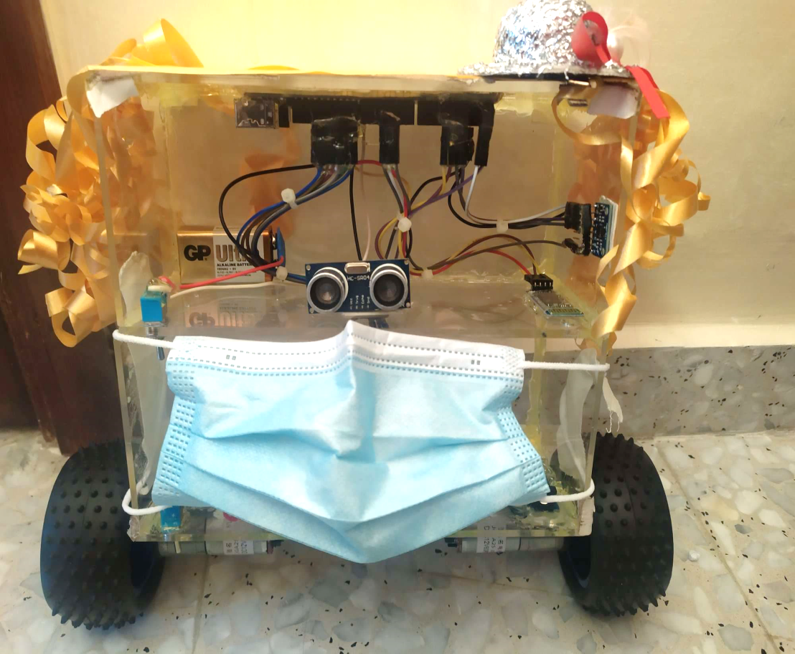



H & M Robot
Supervisor:
Dr. Luai Malhis
Prepared by:
Hadeel Ihbaisheh
Malak Bawwab

Slide 2
Outlines
o Introduction.
o Motivation.
o Hardware Components.
o Software Implementation
o Constraints and Difficulties.
o Future Works.
o Demo.

Slide 3

Introduction
H & M robot is a two-wheeled self-balancing robot consisted of an Arduino Mega microcontroller, gyroscope, accelerometer, motors, Ultrasonic-Bridge and two motors.

Slide 4
Features
o Self-Balancing.
o Avoid obstacles.
o Moving forward and backward by controlling it via Bluetooth.
o Carry loads with different weights.

Slide 5
Motivation
This type of robot is used many applications in medical fields, especially in Areas for people with special needs.
The world now is more interested in this type of robots, because it uses a control system to be able to stabilize an unstable system by using efficient microcontrollers and sensors.

Slide 6
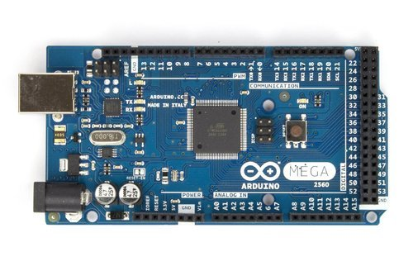
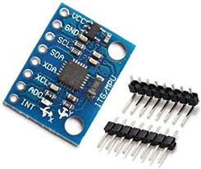
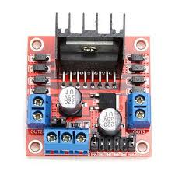
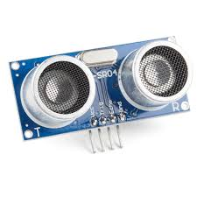
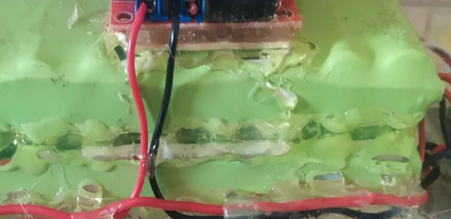
Hardware Components
Arduino Mega.
MPU6050.
Two DC Motors.
Dual H-Bridges [L298N]
Ultrasonic sensor
Two Battery pack.
HC-06 Bluetooth
A pair of wheels
3D Printed Body

Slide 7
Arduino Mega
It is a microcontroller that has 54
digital input/output pins (of which 15
can be used as PWM outputs), •
The Arduino is used to communicate with MPU to read the robot’s tilt angle , proccess it and then it communicate with H-bridge to adjust the speed and direction of the motors.

Slide 8
MPU6050:
MPU6050 has 3 axis Accelerometer and
3-axis Gyroscope on a single chip .Gyroscope
measures rotational velocity ( rate of change
in the angular position over time along X, Y
and Z axis ),Accelerometer measures
gravitational acceleration along X, Y and Z axis ,
MPU6050 has also DMP( Digital Motion Processor) which is used to perform complex calculation
MPU6050 uses the I2C module for communicating with Arduino using SCL and SDA pins.
We use MPU6050 to obtain the tilt angle of the self balancing robot, which is used to know the current orientation of the robot and then try to keep the robot balanced based on it .

Slide 9
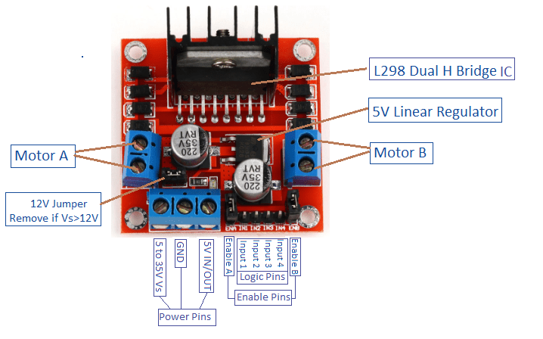
L298N Motor Driver :
It is used for driving a pair of DC motors and to control rotation direction of the 2 DC motors based on the tilt angle of the robot .

Slide 10
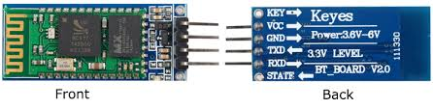
HC-06 Bluetooth :
It is a slave module that receive data from master bluetooth device( smart phones, PC ).It is used to receive commands from smartphone to move the robot forward or backward based on the command sent.

Slide 11
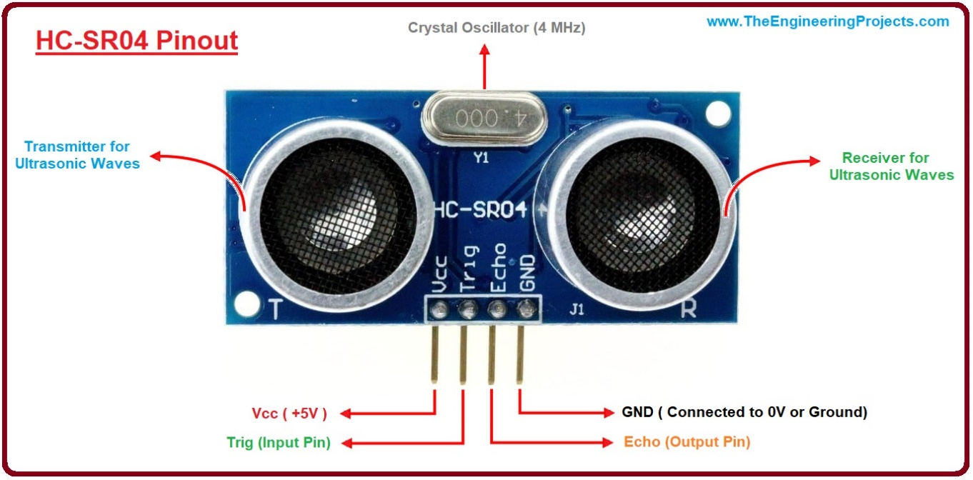
Ultrasonic Sensor
It is used to determine distance to an object . It is used to enable the robot to avoid obstacles

Slide 12
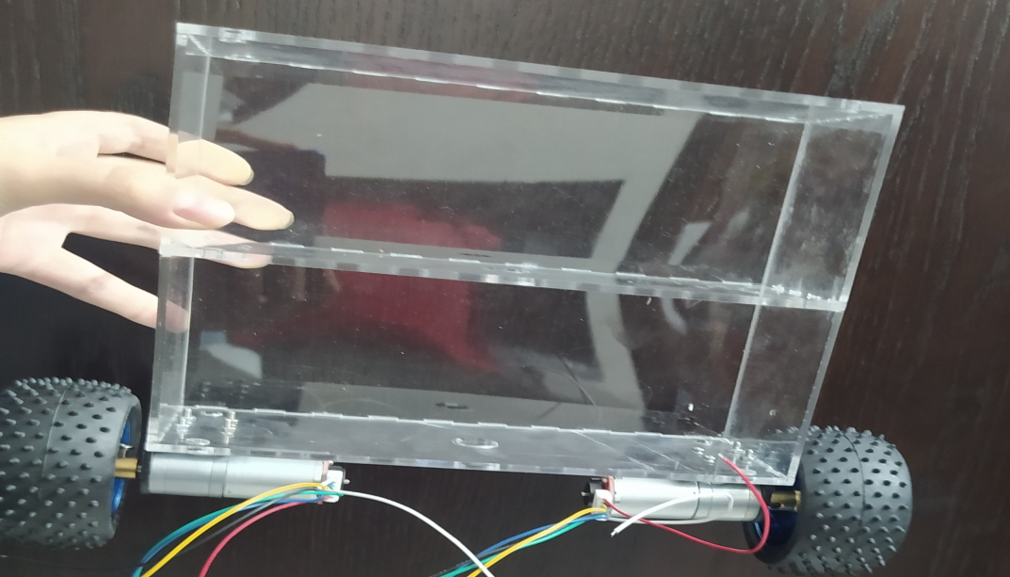
Robot’s Body :
The frame is created from Acrylic ,it a transparent plastic material with outstanding strength, stiffness, and optical clarity.

Slide 13
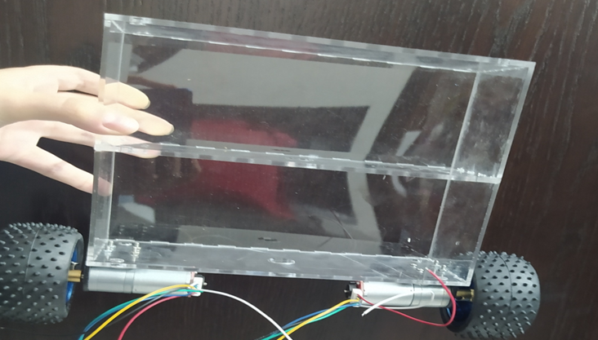
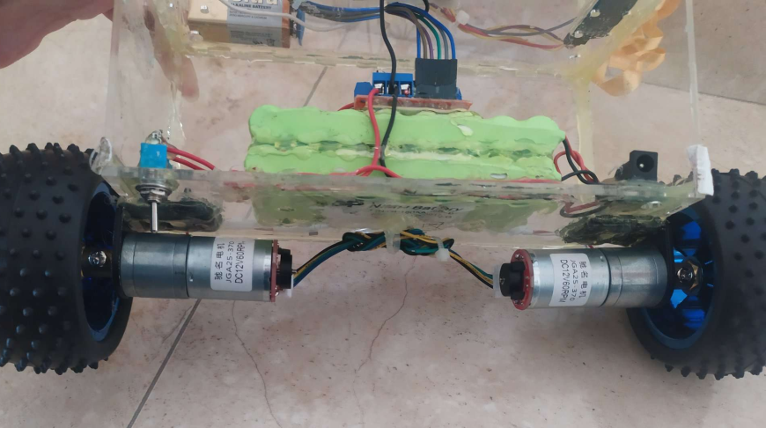
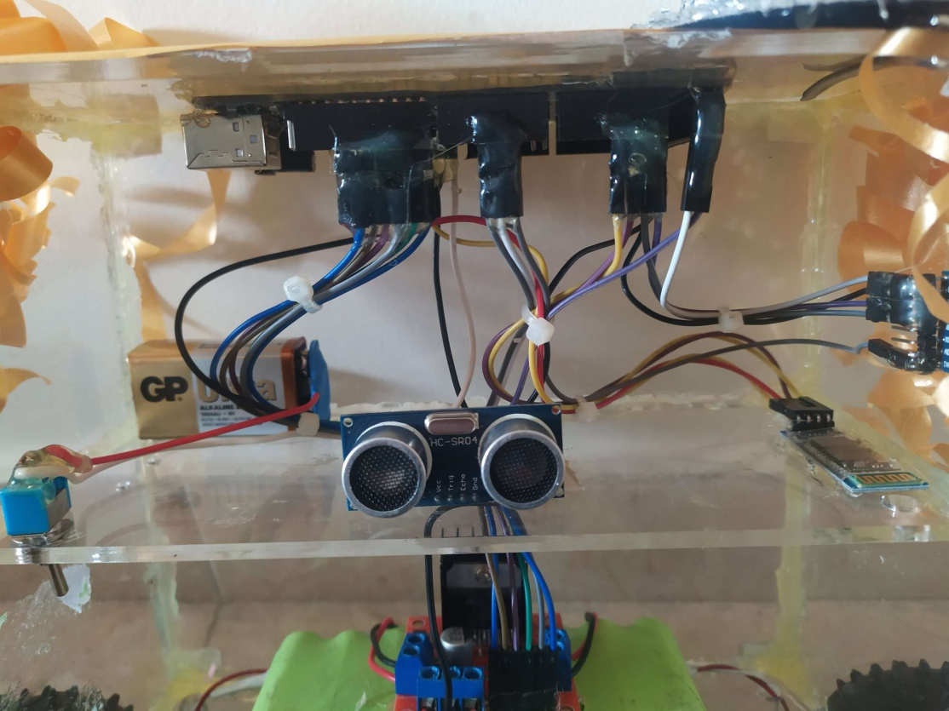

Slide 14
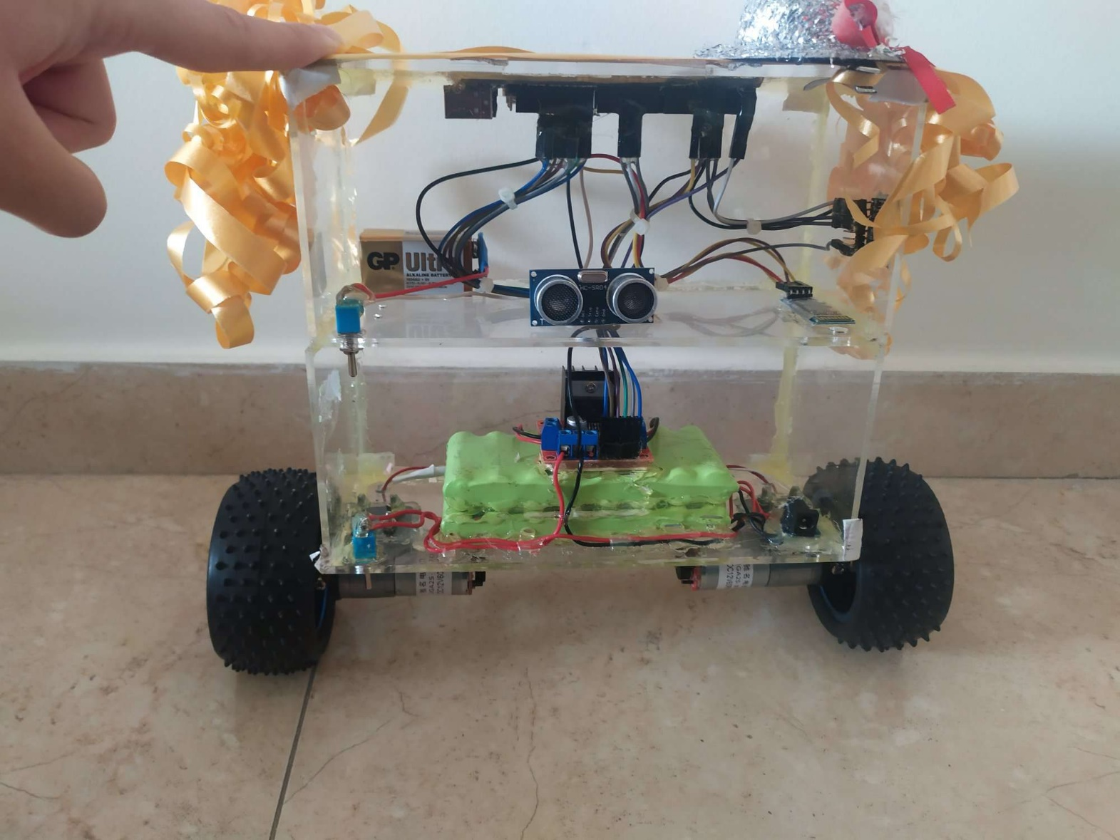
Overall Design

Slide 15
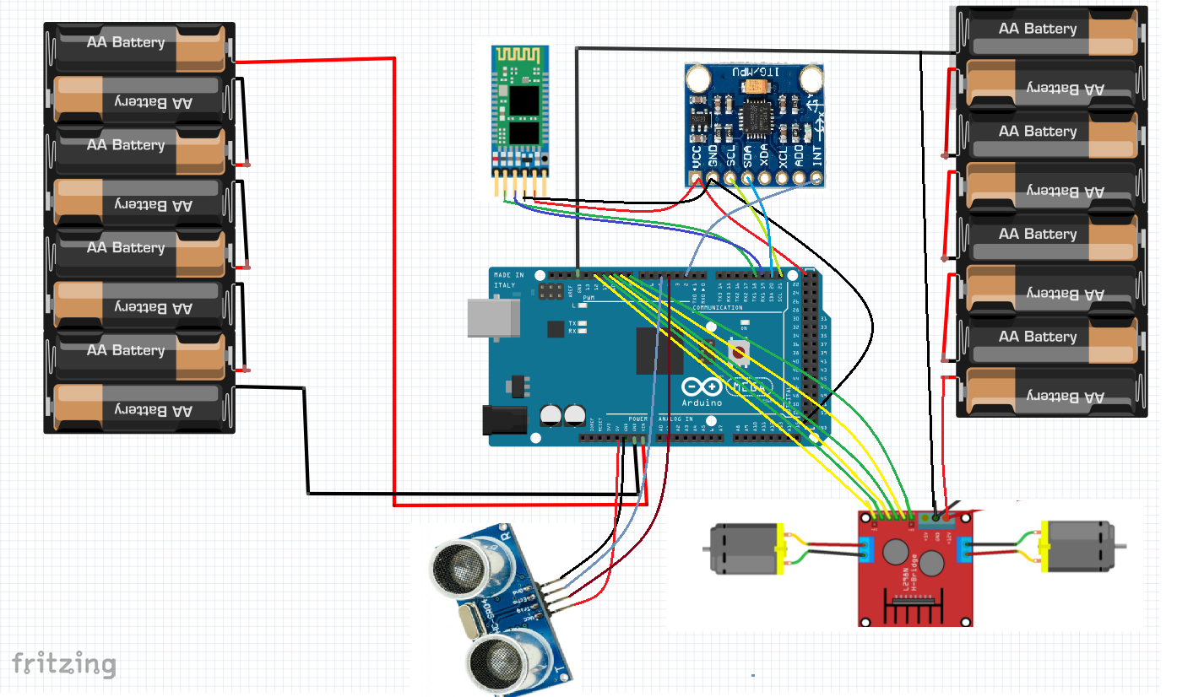
Circuit:-

Slide 16
Software Implementation

Slide 17
Reading from MPU6050:
We used it to find out the current position of the robot , we initialize a DMP (Digital Motion Processor) which will help to integrate the accelerometer information and the gyroscope information and give us a real and accurate value for yaw, pitch, and roll
We will use only the value of yaw .In order to use DMP the INT pin is connected to pin 2 of arduino. to inform the Arduino when to read the data from the module.

Slide 18
PID Controller
The basic idea behind a PID controller is to read a sensor, then compute the desired actuator output by calculating proportional, integral, and derivative responses and summing those three components to compute the output.
PID control uses closed-loop control feedback to keep the actual input from a process as close to the target or setpoint output as possible. It will then provide an output to a control element.

Slide 19
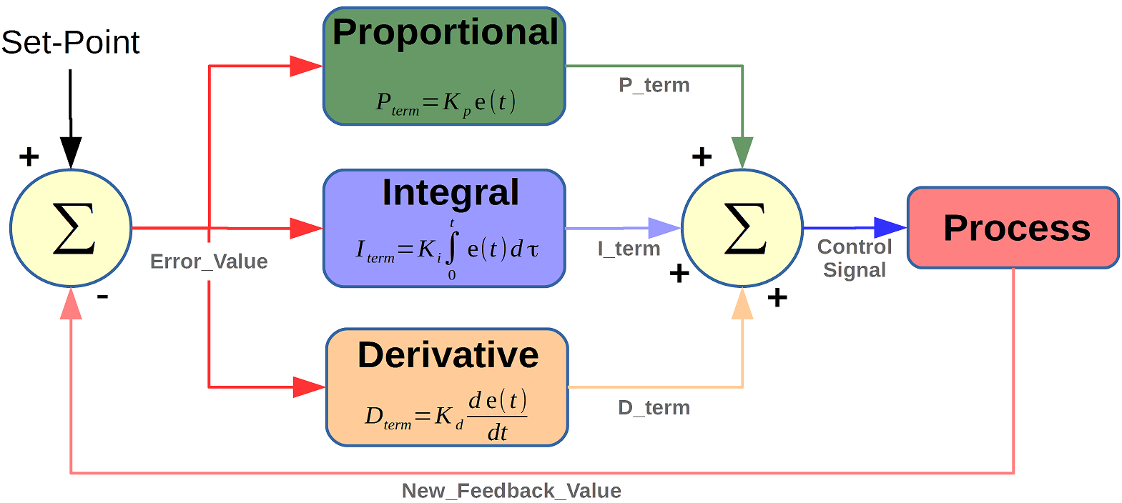
So, you tell the PID what to measure (the "Input",) Where you want that measurement to be (the "Setpoint",) and the variable to adjust that can make that happen (the "Output".) The PID then adjusts the output trying to make the input equal the setpoint.

Slide 20
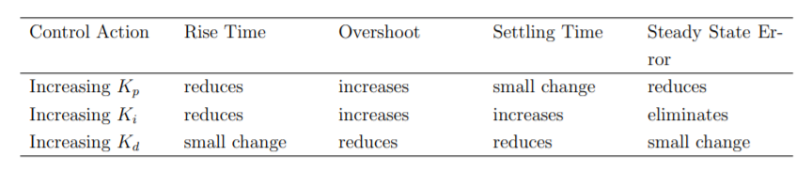
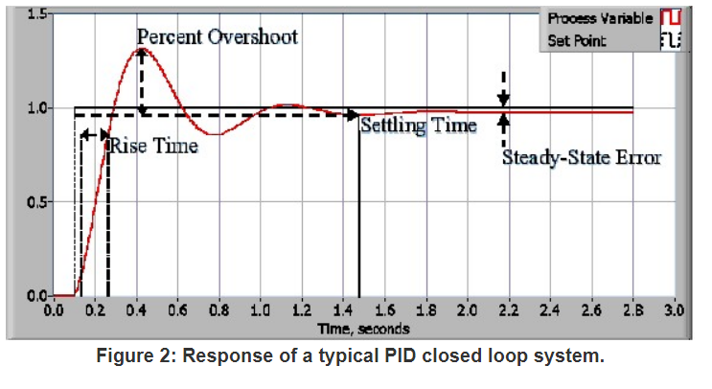

Slide 21
Ki,Kp,Kd -Manual tuning
First, make Kp(Proportional Part), Ki(Integral Part, “Slow Mode”), and Kd (Derivative Part, “Fast Mode”)equal to zero.
Adjust Kp ,too little Kp will cause the robot to fall over and too much Kp will cause the robot to move back and forth violently . So,we start to increase Kp from zero until we reach a point where the system starts to oscillate from its mean position.
Once the Kp is set, we adjust Ki,a good Ki value will reduce the overshoots and oscillations until the robot is almost steady.So,we start trying Ki values until the system reaches steady state.
Finally,we set the Kd.The correct Kd value will reduce the time needed for the robot to stabilize( decrease settling time).

Slide 22
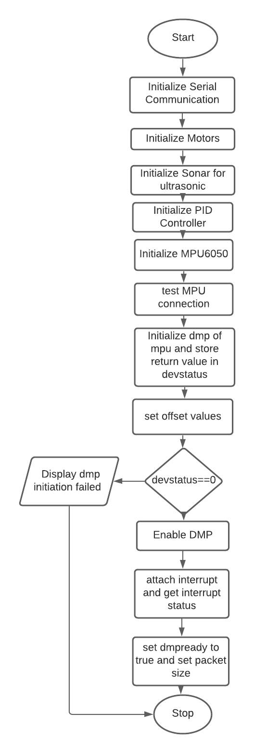
Initialization

Slide 23
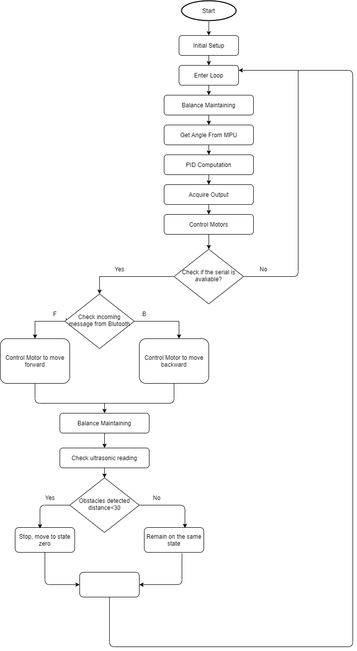
Main Loop

Slide 24
Constraints and Difficulties
Analyze and understand the physical concept of self-balancing and implement it on the robot take a lot of time.
It was difficult to reach to the correct PID coefficients Kp, Ki and Kd.
Difficult to find batteries which are sufficient to operate both DC motors and Arduino
Lack of parts needed to build the system, due to the economic and political situation,We need stronger DC motors to make the robot balanced better.
Coronavirus Crisis.

Slide 25
Future Work
Add a Wi-Fi shield to control it via Internet instead of Bluetooth.
Control robot movement through voice commands.
Make robot’s movement smoother.
Use encoder to make robot back to the same point.

Slide 26

Thank You

