Slide 1
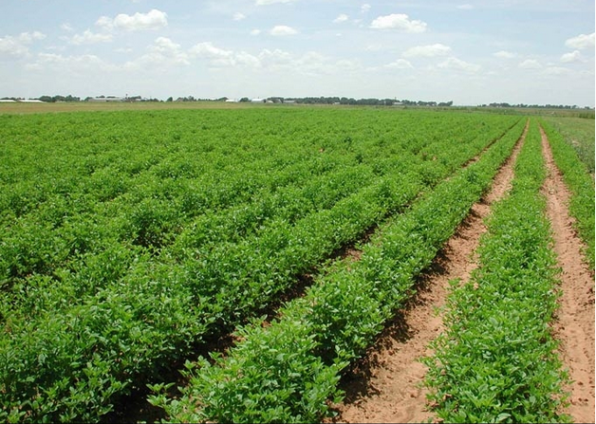

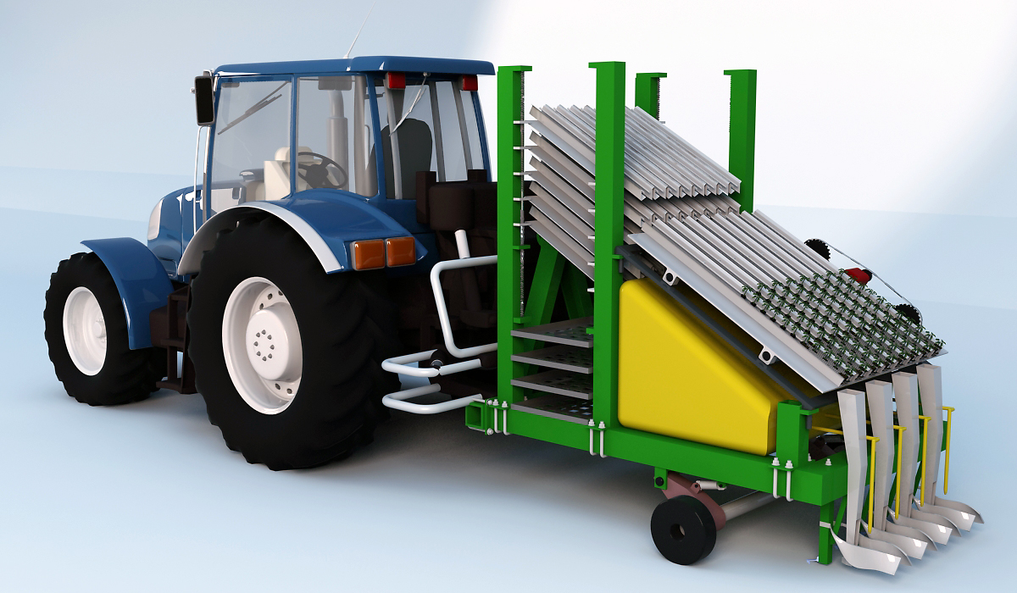
CONTROLLED PLANTING MACHINE
Supervisor:
Dr. Bashir NOURI
The Student:
Mohammed A. AMER (10926858)
Ahmad N. DARAGHMEH (10927096)
Rami A. DWAIKAT (10926675)
Ayman S. YAHYA (10901456)

Slide 2
Outline
Introduction
Machine Components
Machine Operation
Conclusions
Machine Control

Slide 3
Introduction
The agricultural sector represent for 5.6% of gross domestic product and employs 15.2 % of the worker in Palestine .
the area of cultivated land in Palestine reached over 1.854 million dunum .
The total area cultivated with vegetables in the Palestinian during the agricultural year 2011/2010 , about 129,593 dunum .

Slide 4
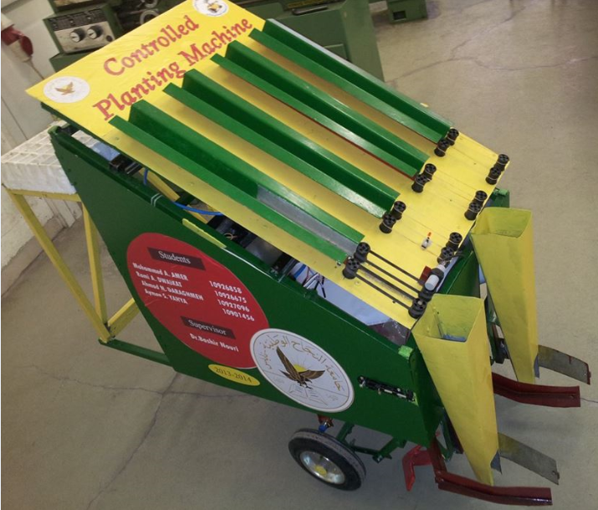
Controlled Planting Machine
Planting machine is a simplified mechanical machine that uses the old basic methods in agriculture from plowing to planting to cover it with soil.

Slide 5
Our Imagine for the project
Video from Graduation Project “1”

Slide 6


Slide 7
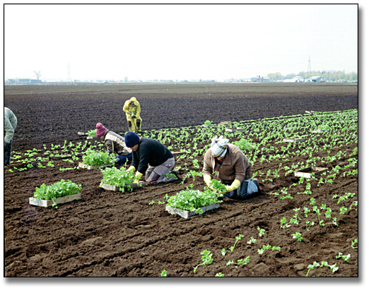

The main objectives of this project
Reducing the economic costs and operational costs
planting wide area rapidly with accurate processing

Slide 8
The importance of the project
The project is important because it supports the agriculture sector through
Reduce the number of workers
Reduce the losses of seedling
Reduce effort
save money

Slide 9
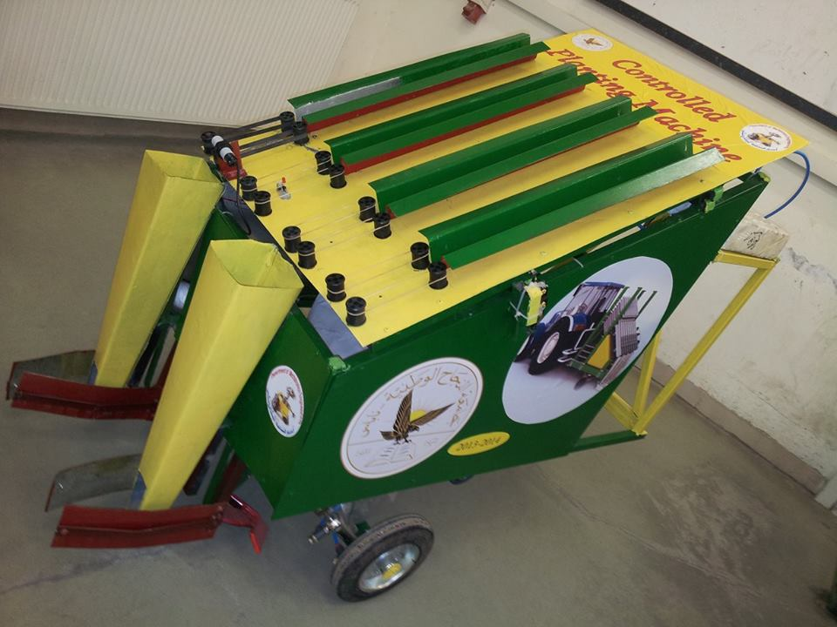
Methodology
The methodology of this project shows how this machine will combine the use of electrical and electronic components like ( stepper motors, servo motors (or pneumatic parts), microcontroller (Arduino) , and sensors , with mechanical parts to get accurate movement of mechanism , to plowing and planting , and finally land fill the seedling by soil.

Slide 10
Machine Components
The whole movement of the system is explained in the flowing slides.
Sensors
Controlling
Pneumatic Jacks
Motors

Slide 11
Sensors
The sensors sense physical quantities and convert it to signals.
The proximity sensors
The proximity sensors are position transducers in which there is no mechanical contact between sensor and the object.

Slide 12
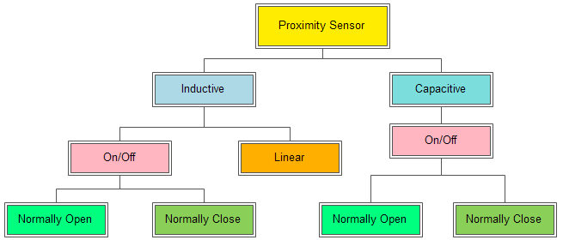
Classification of proximity sensors

Slide 13
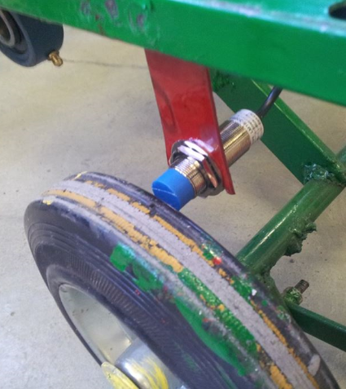
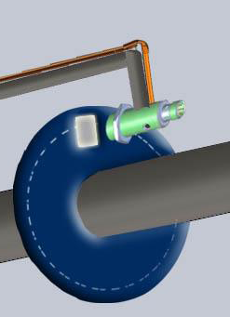
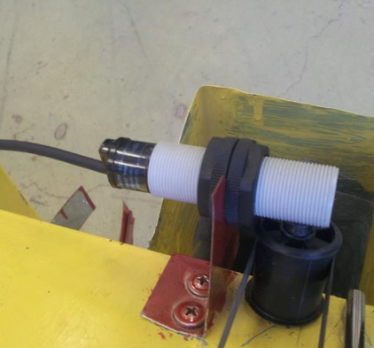
Sensors
The sensors that are used :
- Inductive Proximity used as Position transducer with encoder.
- Capacitive Proximity sensor.
Capacitive Proximity sensor
Position transducer
with encoder

Slide 14
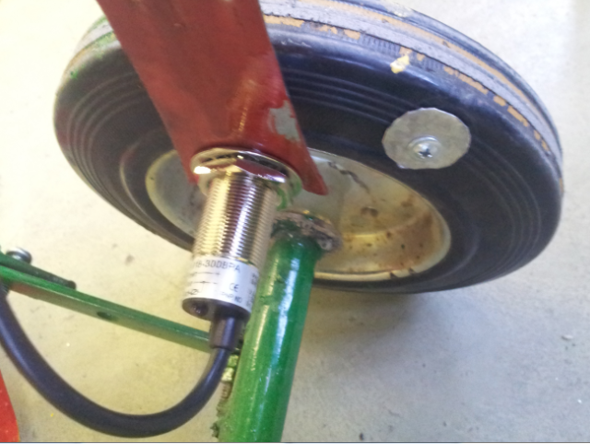
Inductive Proximity Sensor
Used to indicate the distance that needed to implement the transplant.
Position transducer
with encoder

Slide 15
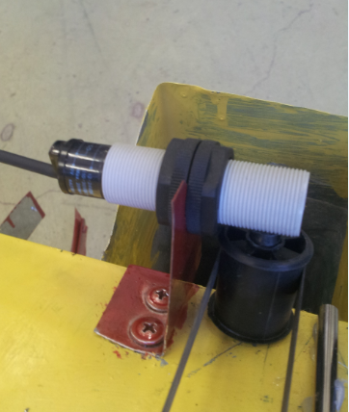
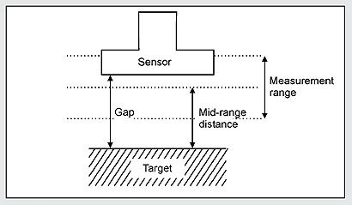
Capacitive Proximity Sensor
Capacitive Proximity Sensor detect any material pass within the sensor rang.
Normally open.

Slide 16
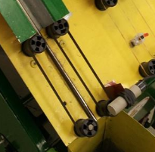
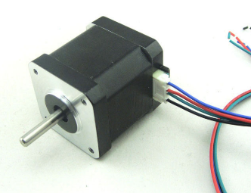
MOTORS
The Motor is an electric device that converts electrical energy into mechanical energy.
The motors needed is that provides high torque and saves the rotation position in order to prevent any locational error that maybe happened after power is OFF.

Slide 17
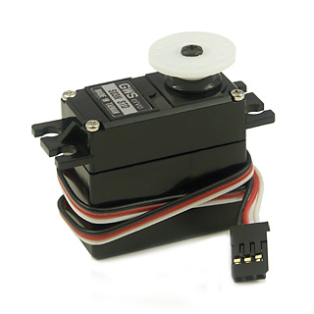
Motors
The motors that choice are:
(a) Stepper motor.
(b) Servomotor.
Motors
Stepper
Servo
Stepper motor
Servomotor

Slide 18
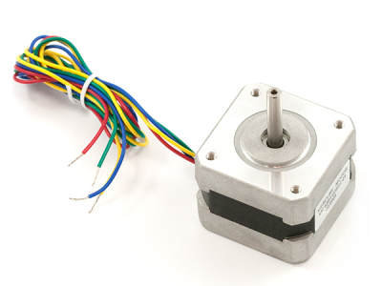
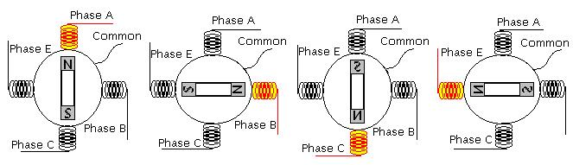
Bipolar Stepper motor concept
*High Torque and High Precision
*Used as agate

Slide 19
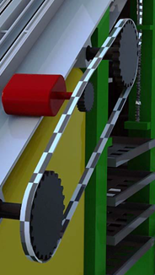
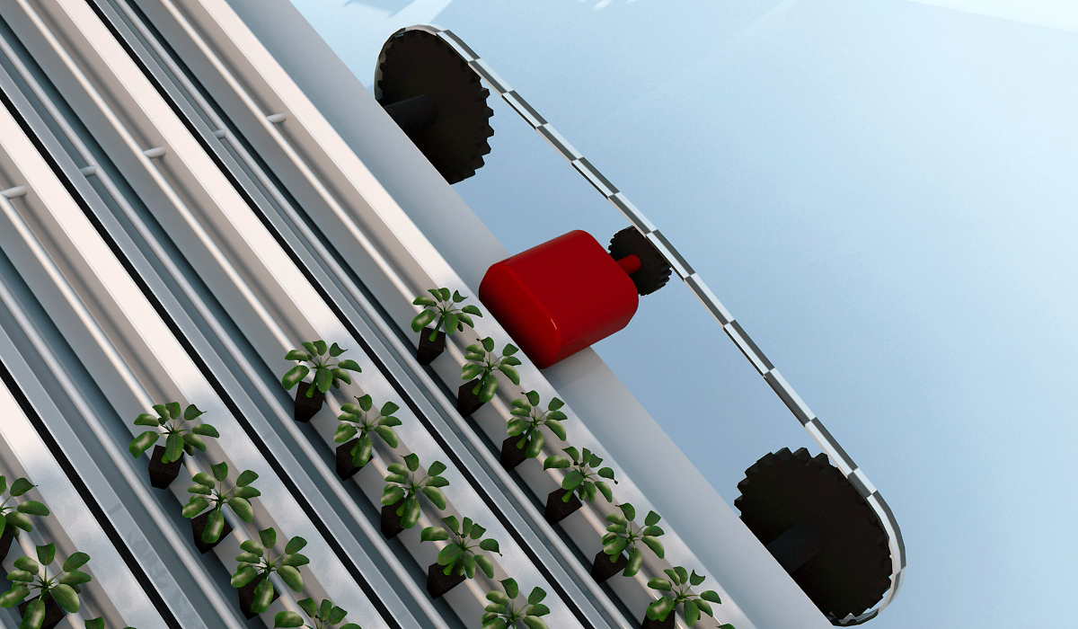
Servomotor
Used for transport the plate.

Slide 20
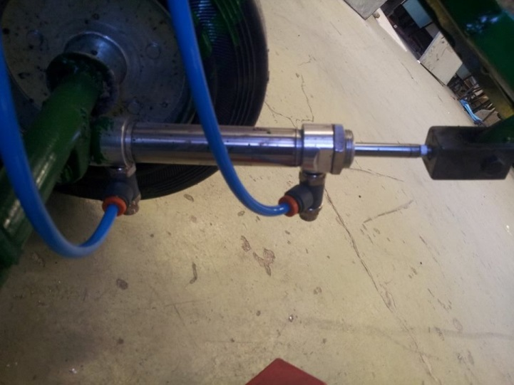
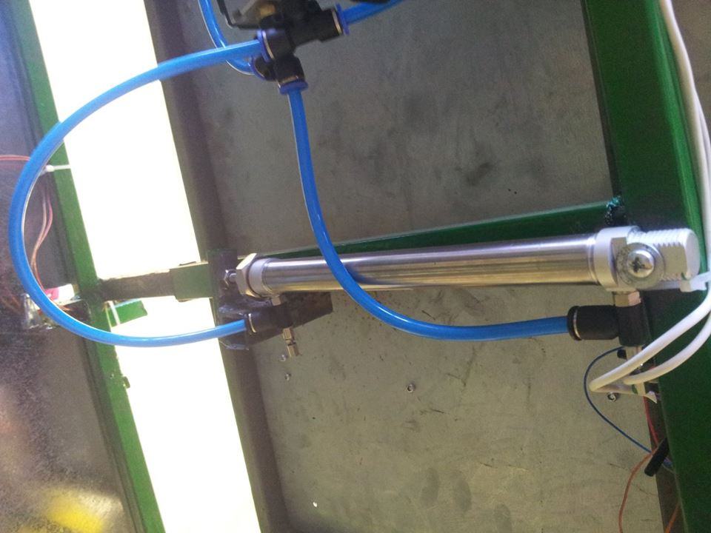
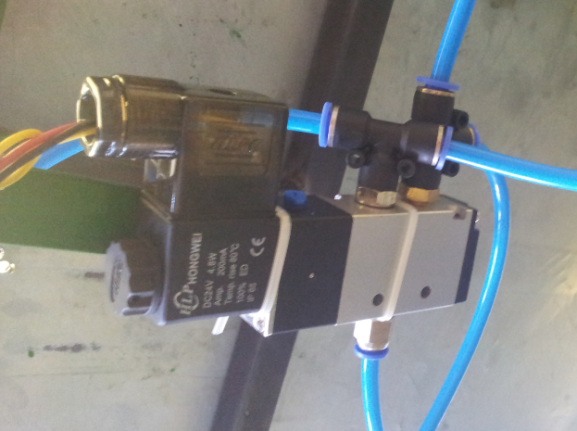
Pneumatic Jacks
The Pneumatic jack are used in place of servomotor to move the horizontal plate and follow the same concept, it is simply works using air pressure; and connected with solenoid valve to make it easy to be controlled by “Arduino”

Slide 21

Flexible belts
The transmitting belts are consists of two separating belts that fasten parallel to each other.
It hold the seedling.

Slide 22
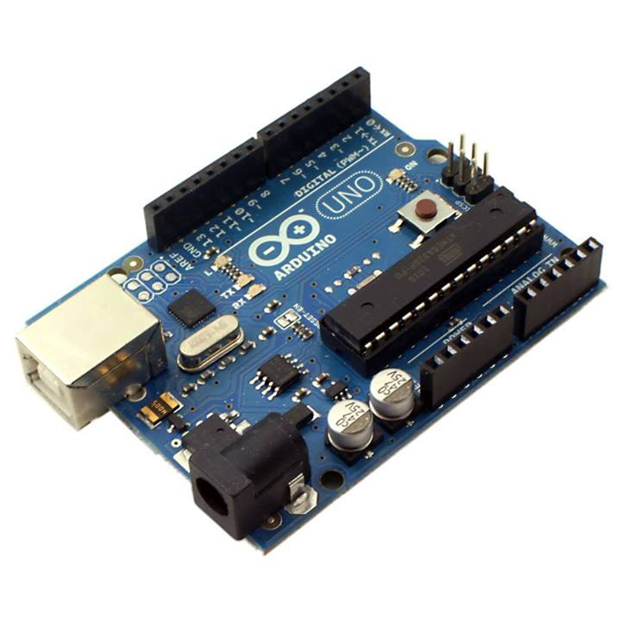
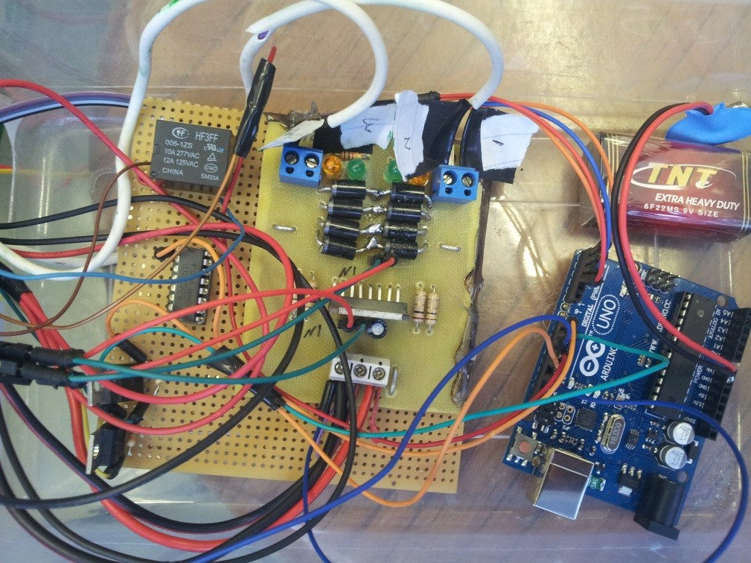
Arduino (controller)
Instead of PIC

Slide 23
Machine Control
Sensors
Connection
Pneumatic Jacks
Motors

Slide 24
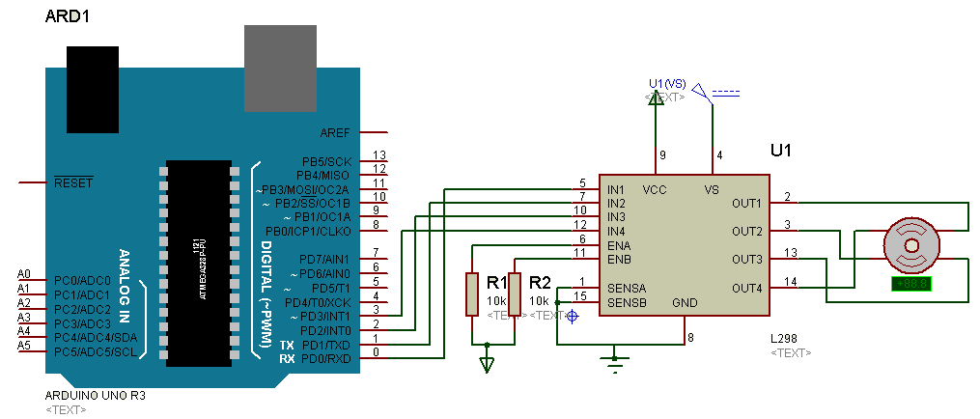
Stepper motor connection

Slide 25
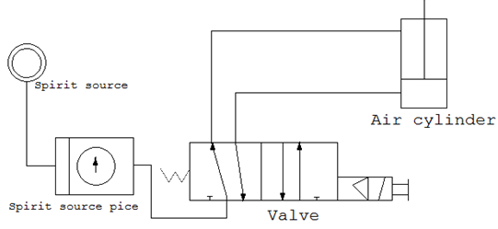
Solenoid connection
Double acting cylinder
5/2 (gate/position) directional valve

Slide 26
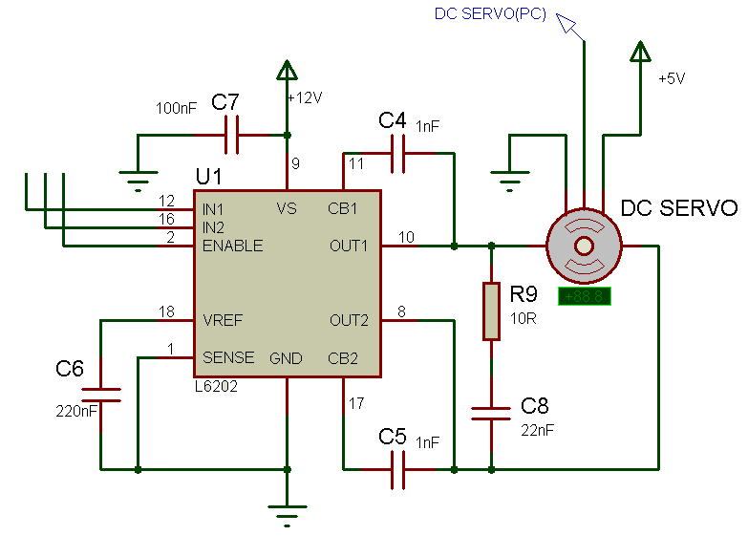
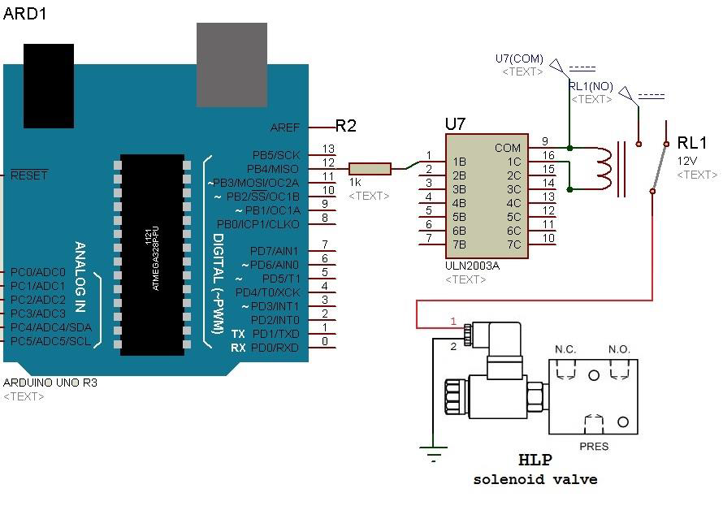
Solenoid connection
Servomotor connection
Pneumatic connection

Slide 27
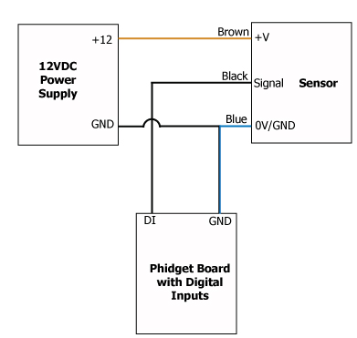
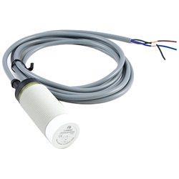
Sensors connection
Capacitive Proximity Sensor
The capacitive proximity sensor
has tree wire connection :
(Brow, black, and blue)

Slide 28
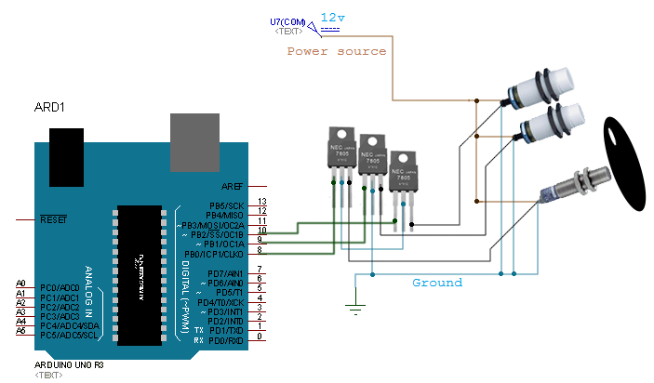
Sensors connection

Slide 29
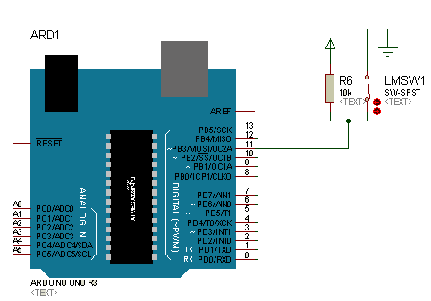
Limit switch connection
The limit switch was used to
detect the initial position of the plates, which for the horizontal plate movement.

Slide 30
Complete circuit connection
Next Slide >>

Slide 31
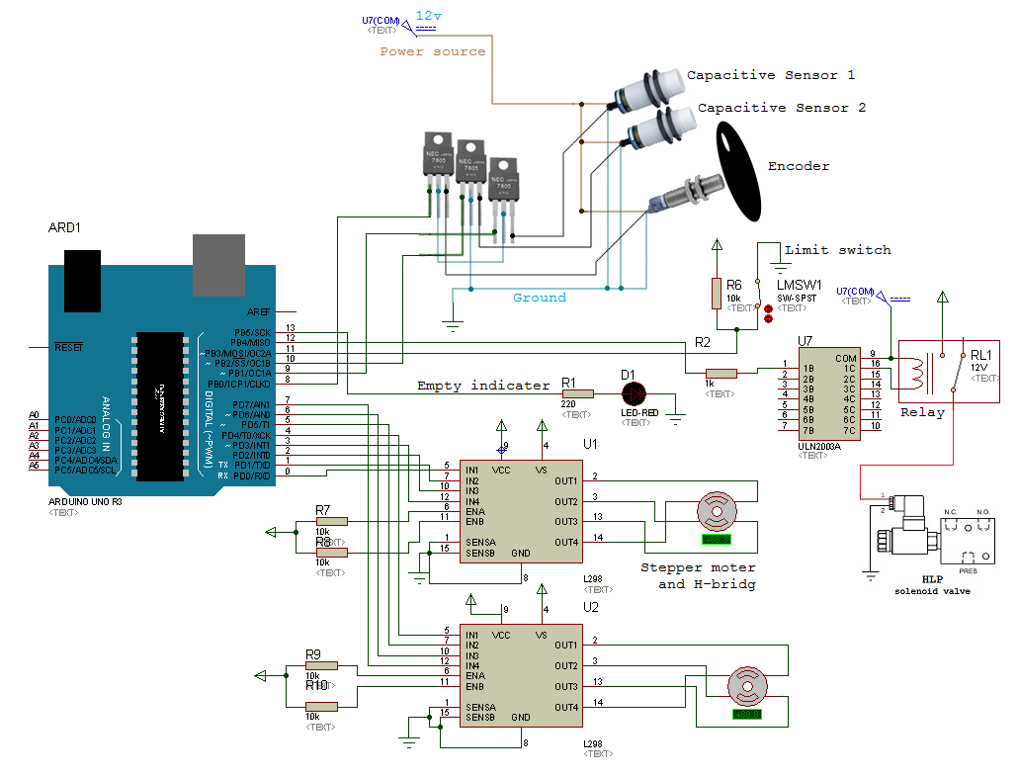
Complete circuit connection

Slide 32
Machine Operation
Plowing process
Falling of the Seedlings
Land fill the seedling
Falling of the Seedlings
Plowing process
Land fill the seedling

Slide 33
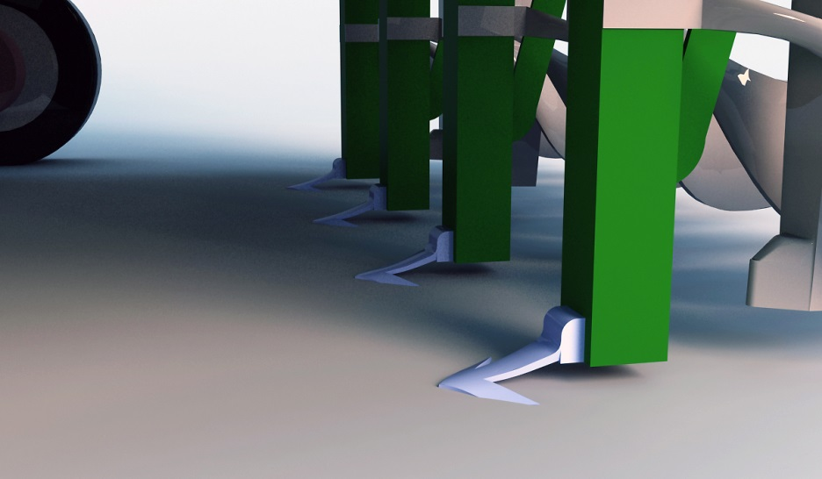
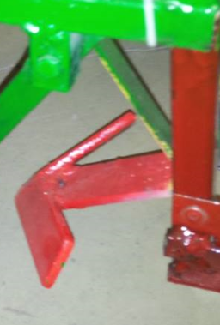
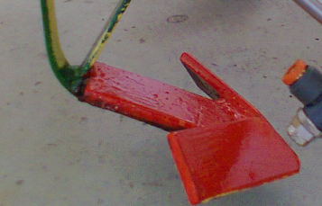
Plowing process

Slide 34
Falling of the Seedlings
Transmit a signal from wheel Sensor
Receive a signal to slot Motor
Seedlings falling
Transmit
Receive
Falling

Slide 35
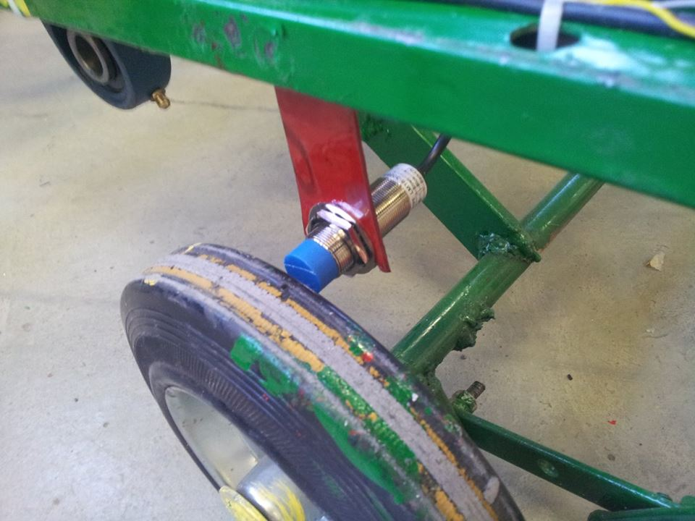
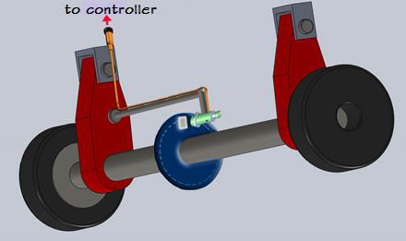
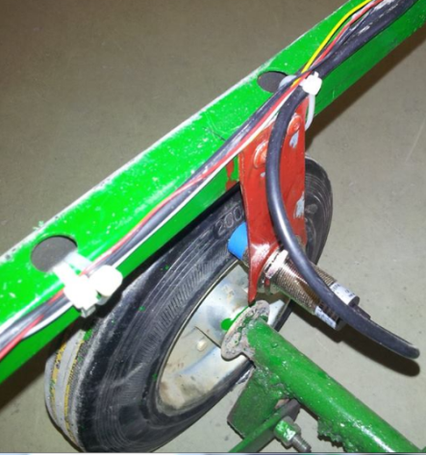
Transmit a signal from wheel Sensor

Slide 36
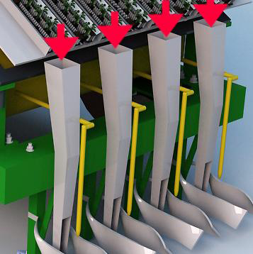

Receive a signal to Motors & Seedlings falling

Slide 37
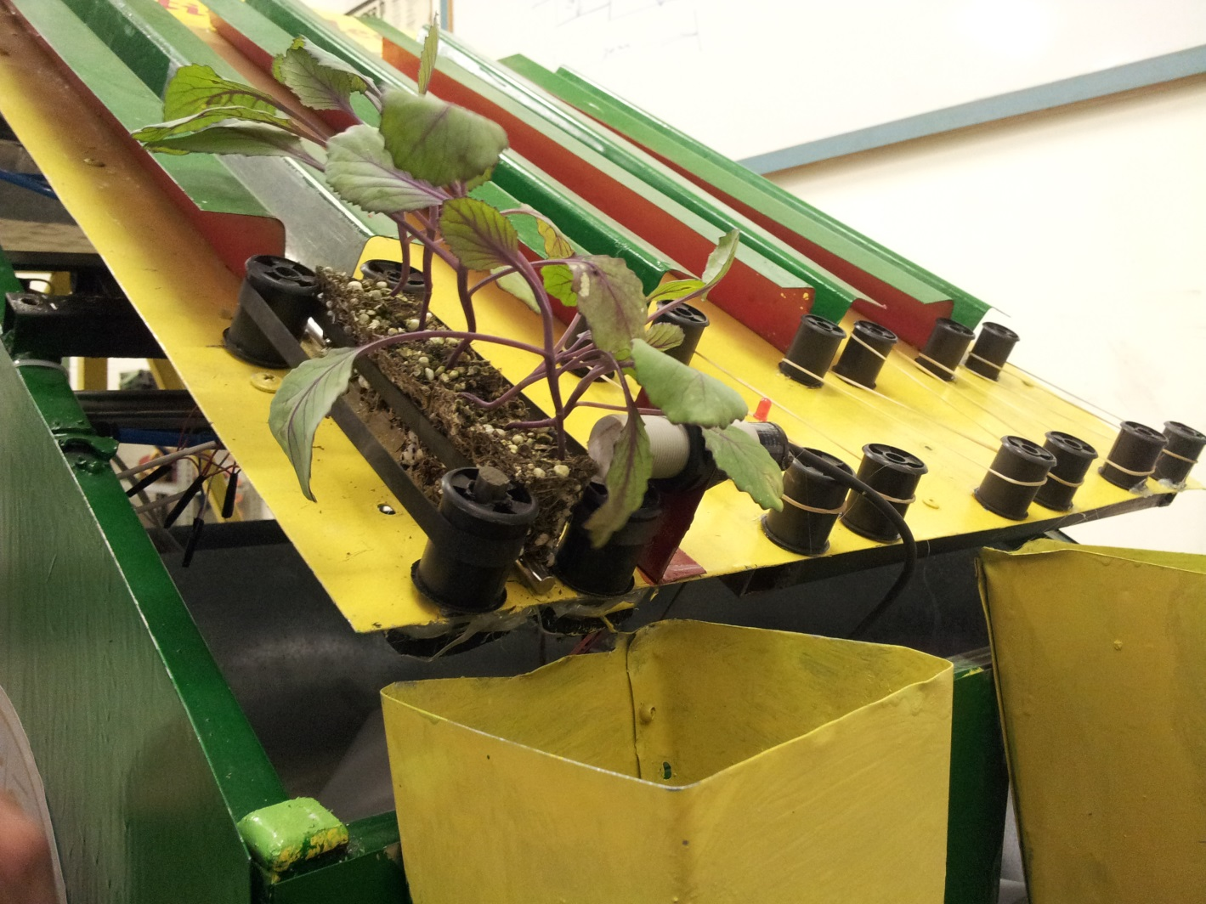
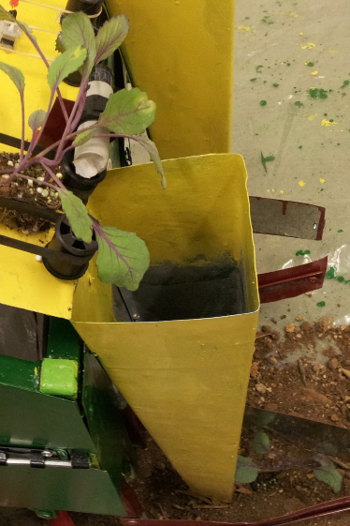
Receive a signal to Motors & Seedlings falling

Slide 38
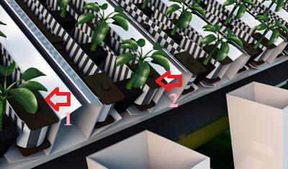
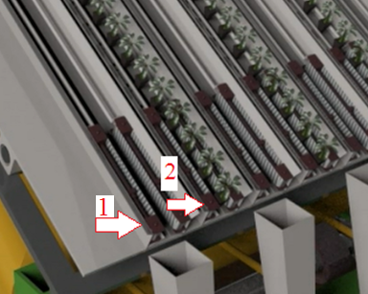
Switching between slots

Slide 39
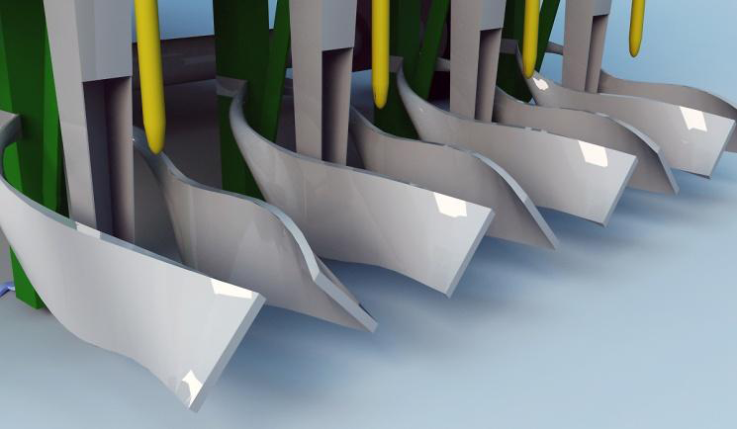
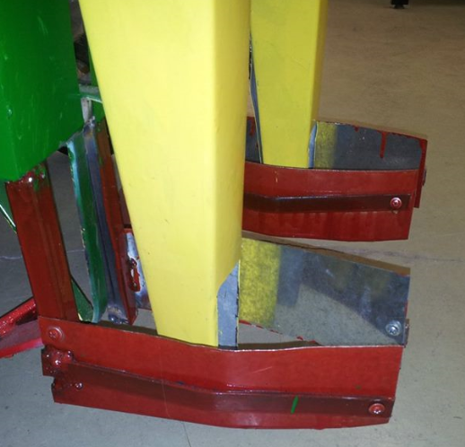
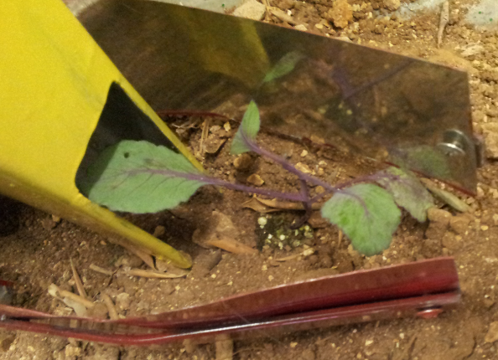
Land filler

Slide 40
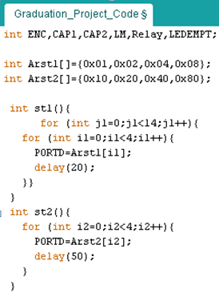
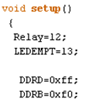
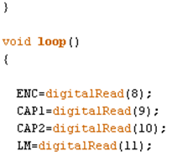
Code

Slide 41




Code - continue

Slide 42
Conclusions
Environmentally Friendly!
Fast performance!
Save
Time
Effort
Cost
And Capable to develop!

Slide 43
Application work
Next Slide >>

Slide 44
THANK YOU ;)

