Slide 1
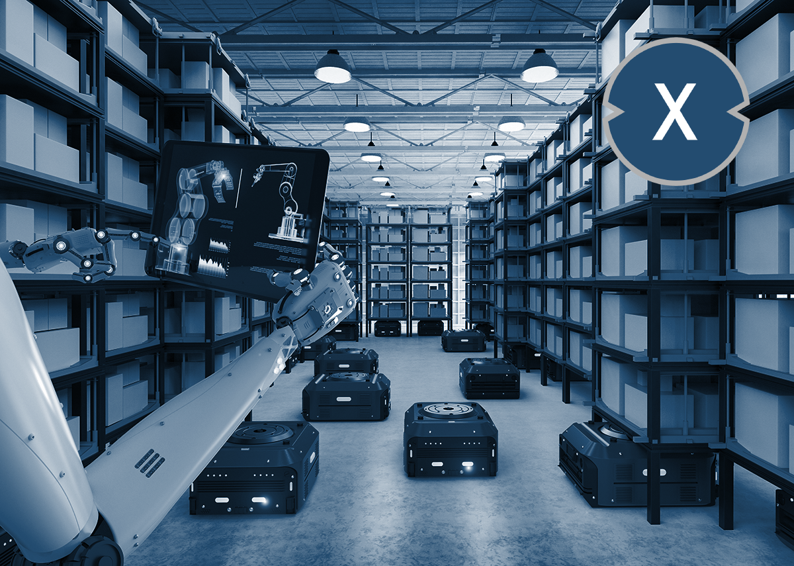
Smart Storage

Slide 2
TABLE OF CONTENT
Introduction
Objectives
Components & Specifications
Control Page
Features
Constraints
Future Work
Acknowledgement
2

Slide 3

INTRODUCTION
The SmartStorage project addresses inefficiencies in storage and retrieval processes within warehouses. The need for efficient storage solutions arises from:
By automating these processes, SmartStorage improves space utilization, reduces human labor, and enhances operational accuracy through robotics.
Underutilization of space.
Risks to worker safety during manual operations.
Increased demand for real-time inventory management.
3

Slide 4

Objectives
Maximize Storage Utilization
Reduce Human Labor
Enhance Precision
Real-Time Monitoring
Optimize Efficiency
4
4

Slide 5
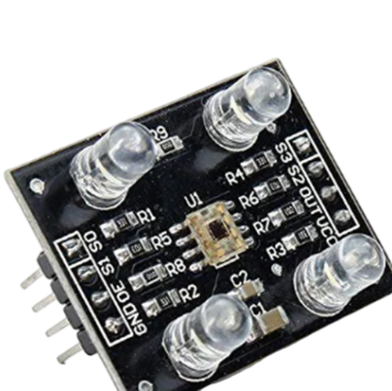
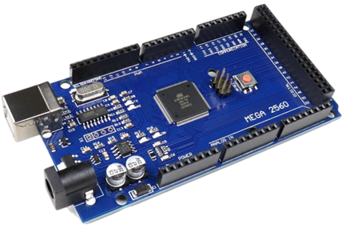
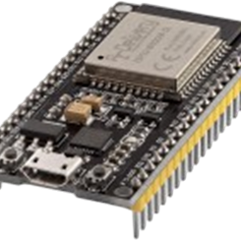
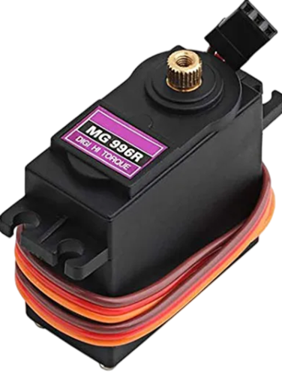
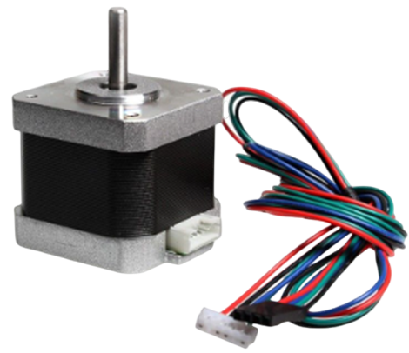
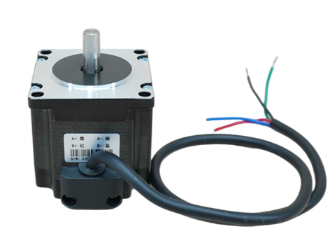
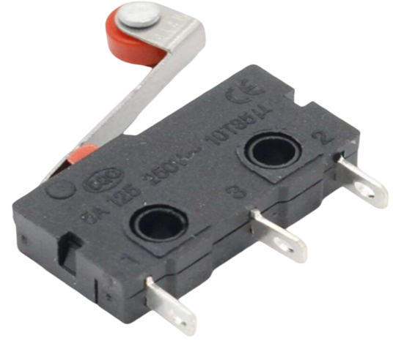
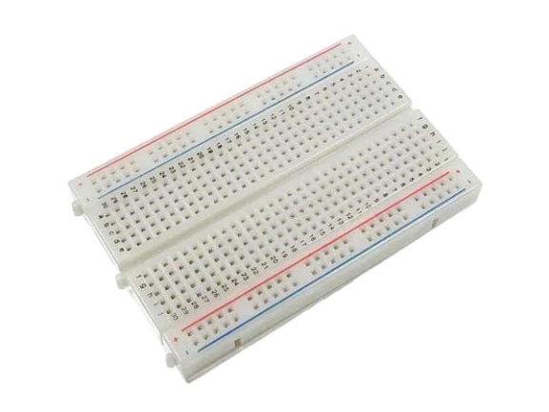
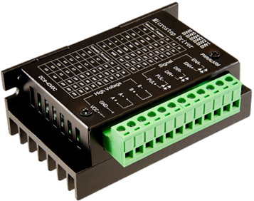
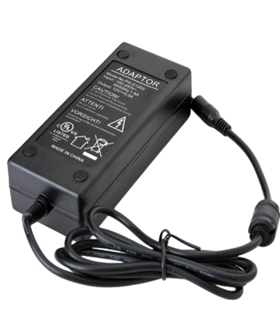
COMPONENTS AND SPECIFICATION
ESP 32 Module
Arduino Mega 2560
Color Sensor
Limit Switch
MG 996R Servo Motor
Stepper Motor Nima 17 &23
Bread Board
TB6600 Stepper Motor Driver
AC/DC Power Supply
5
5
5

Slide 6
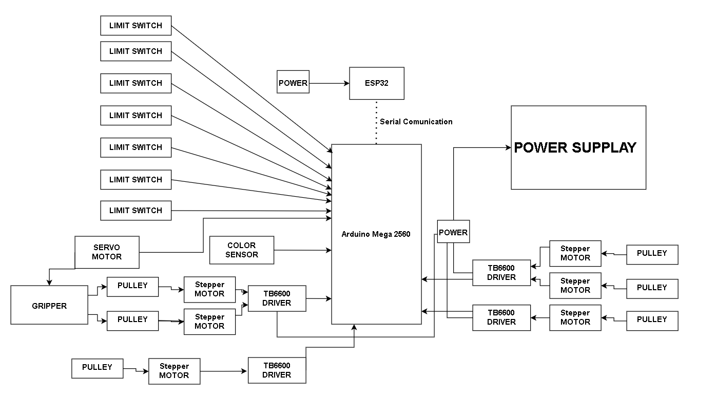
BLOCK DIAGRAM
6

Slide 7
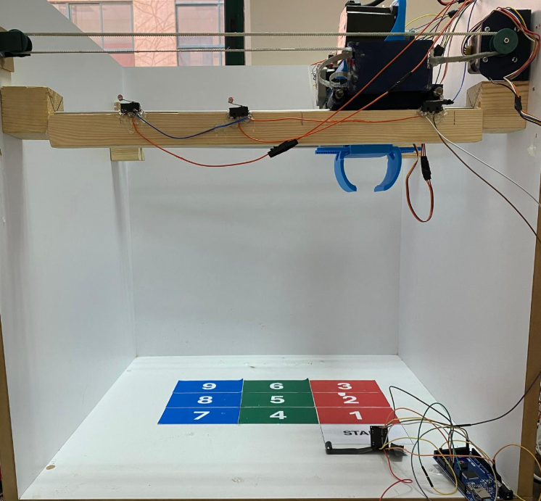
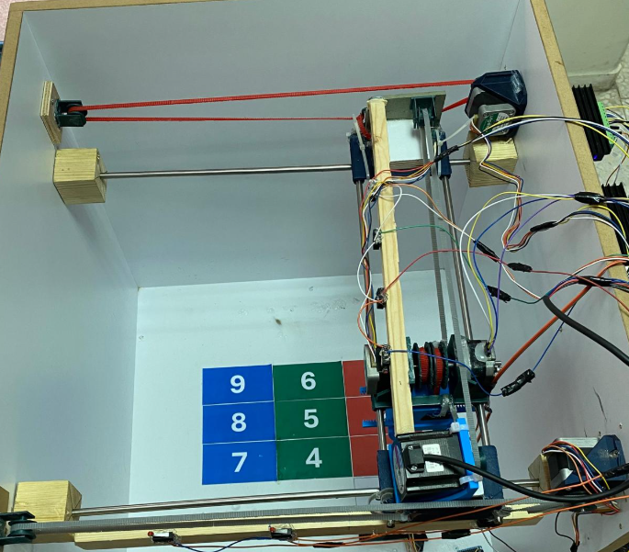
THE RESULT
7

Slide 8
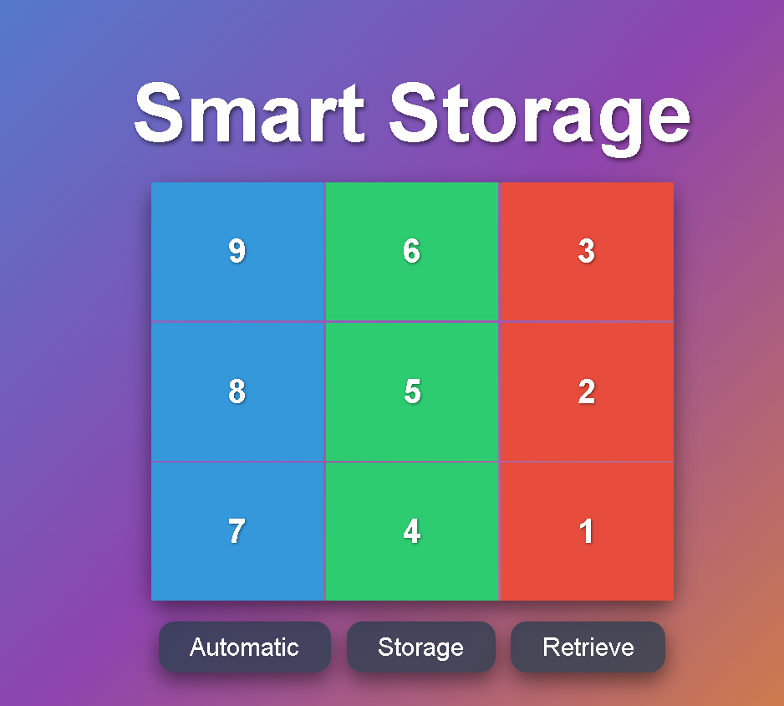
CONTROL PAGE
Responsive Web Page
Choosing Place and Process
Automatic Storage
8

Slide 9


FEATURES
Automated Storage and Retrieval
Efficient Space Utilization
Color-Based Product Identification
9

Slide 10
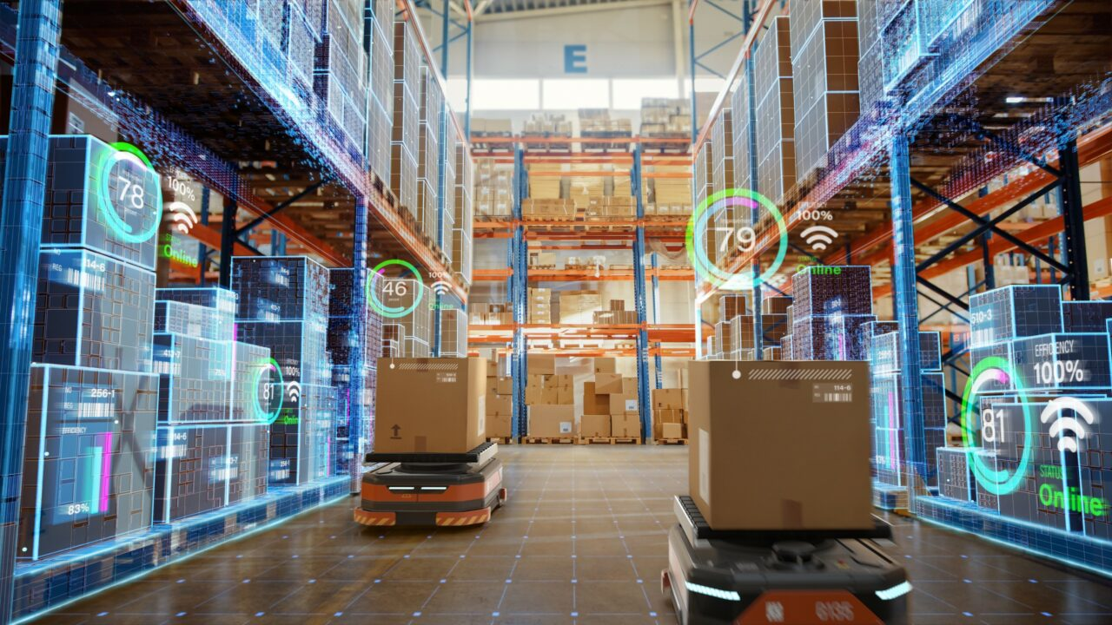

KEY
TIMELINE GOAL
CONSTRAINTS
Limited Resources and Experience
Color Sensor Limitations
Storage Accuracy
Some plastic resources are broken
10

Slide 11
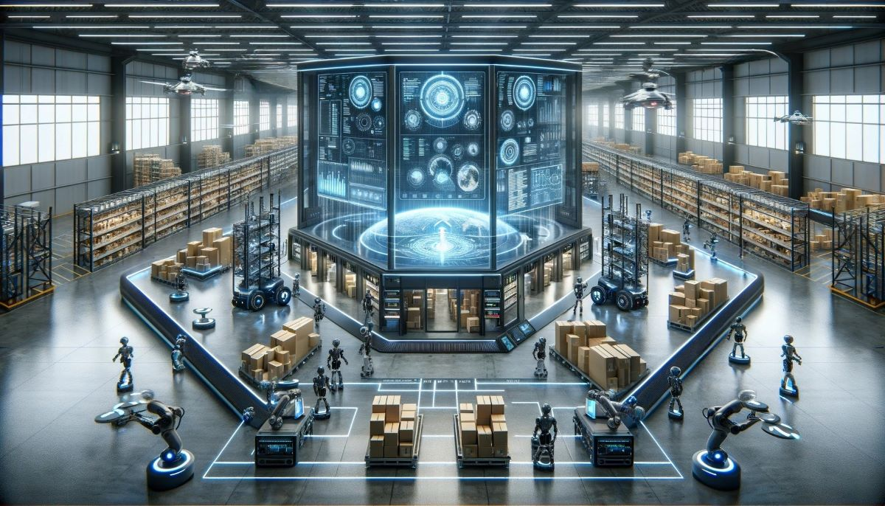
FUTURE WORKE
Use QR Reader Instead Color Sensor
Upgrade Gripper
Use sensors on places
Multitasking Capabilities
Add new process to the robot
11

Slide 12
THANK YOU FOR LISTENING!
CONCLUSION
QUSTIONS AND ANSWERS
12

