Slide 1
SuperbPresenter
Abdalmajeed Saleh, Ruba Sawafta and Asmaa Jumaa
Supervised by Dr.Abdel-Razzak Natsheh

Slide 2
Outlines
Introduction and main goal.
Design.
Environments
- Class room.
- Workshop.
- Computers room.
- Conference.
conclusion.

Slide 3
Introduction
What are VR and AR ?
Main idea.
Main goal.

Slide 4
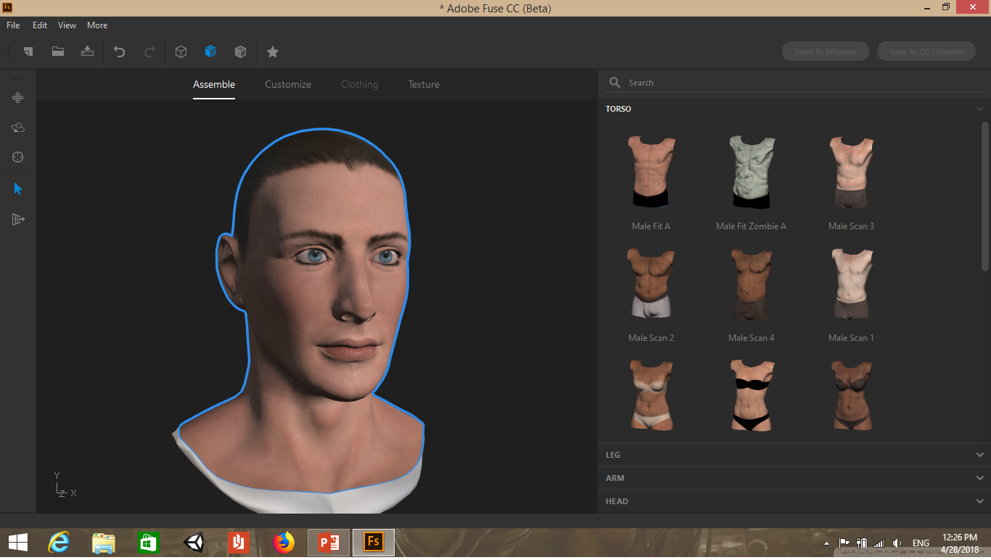
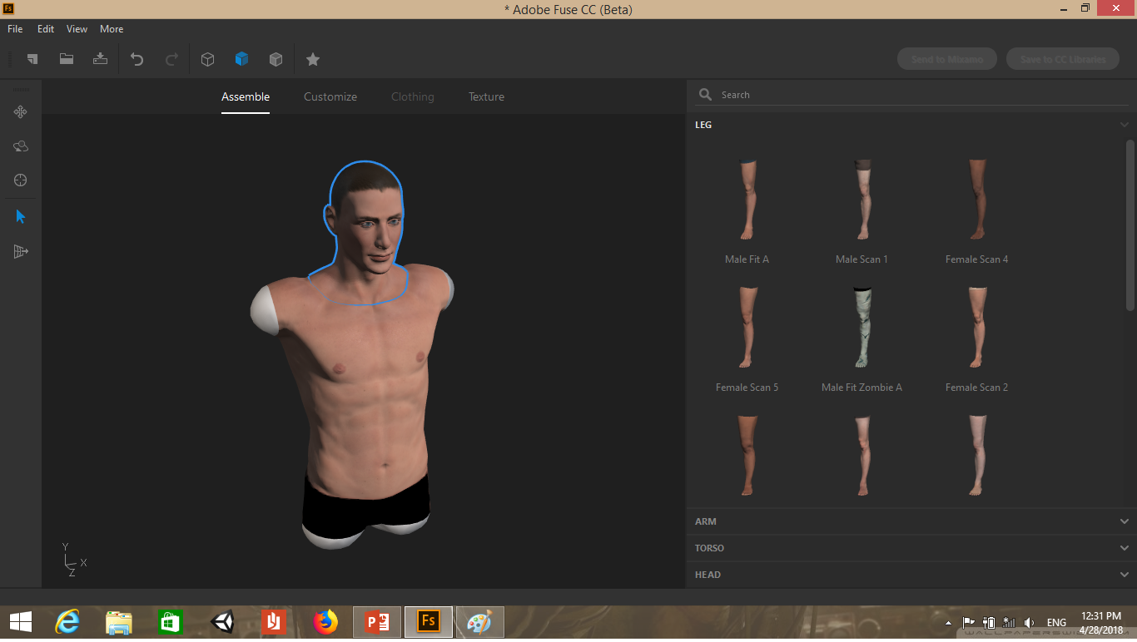
Design
Characters design.

Slide 5
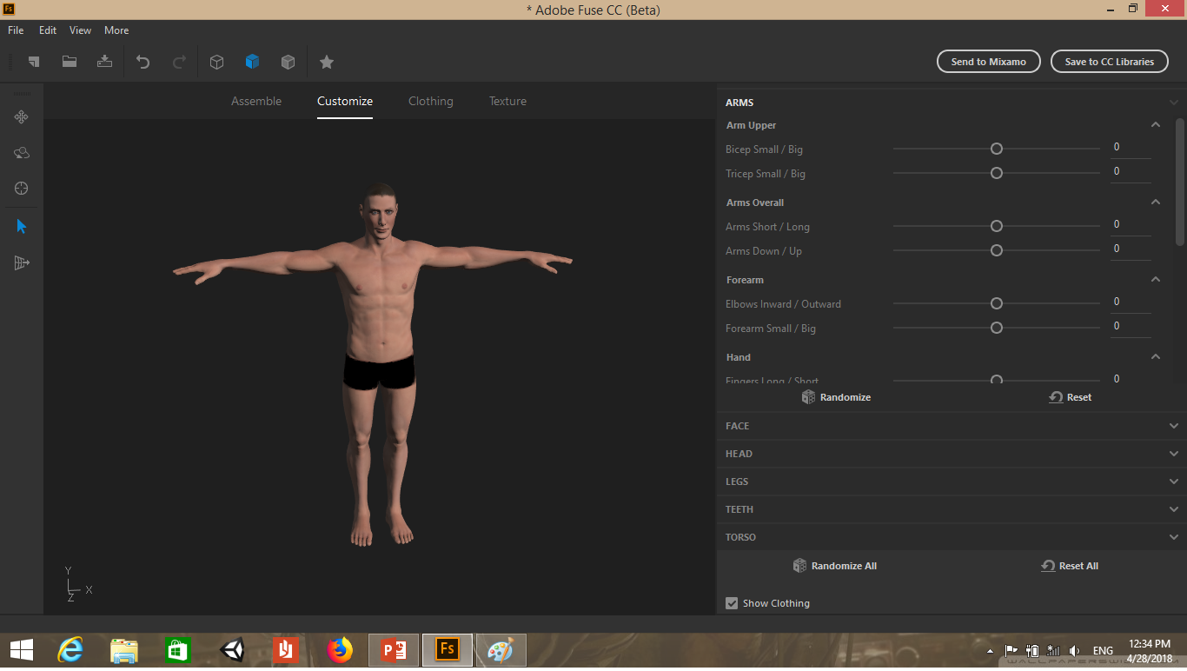
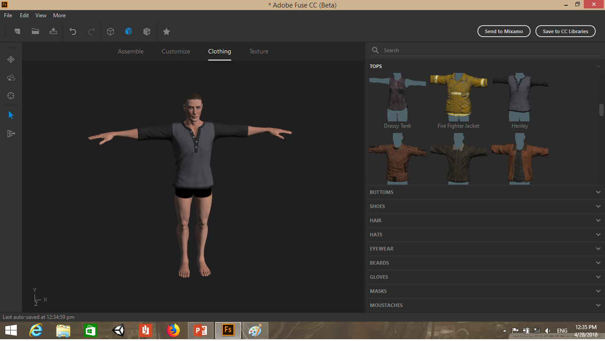
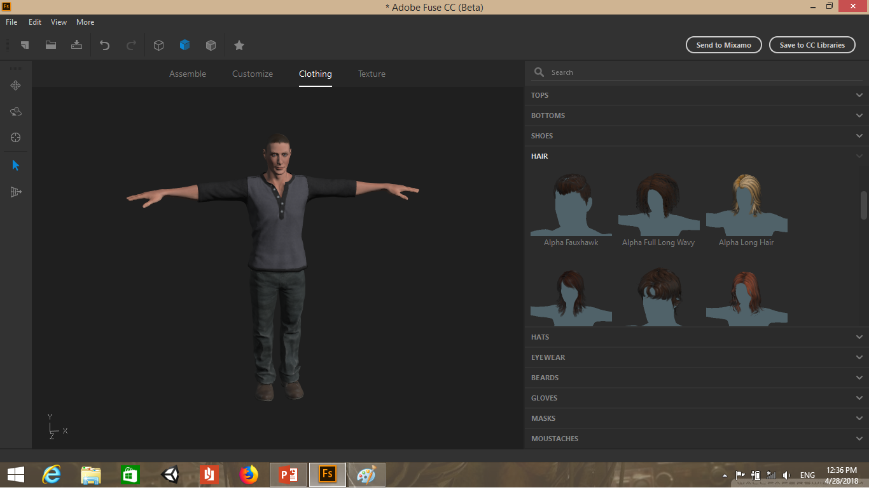

Slide 6
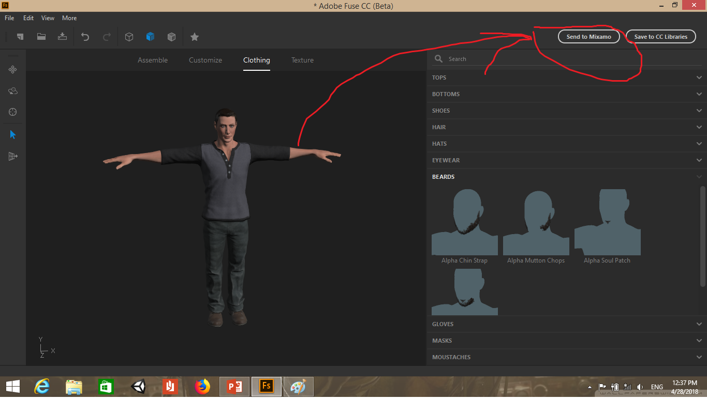
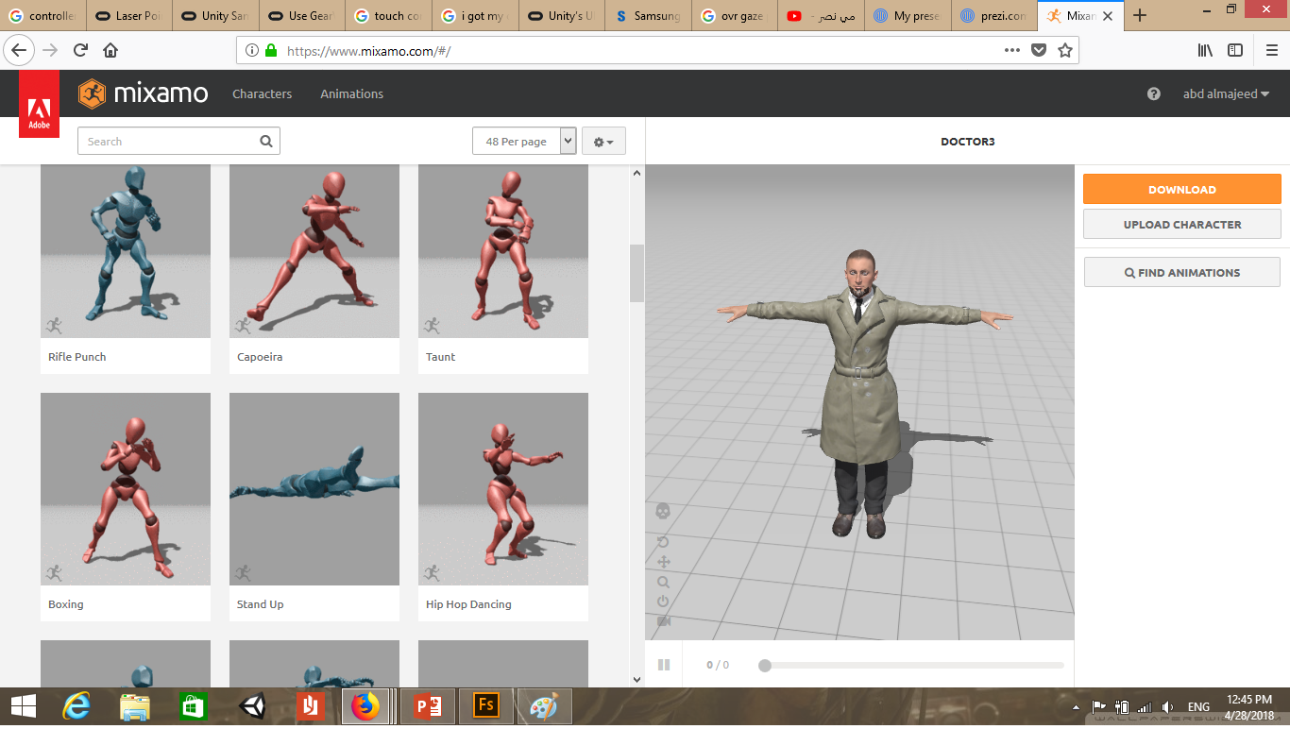
Animation

Slide 7
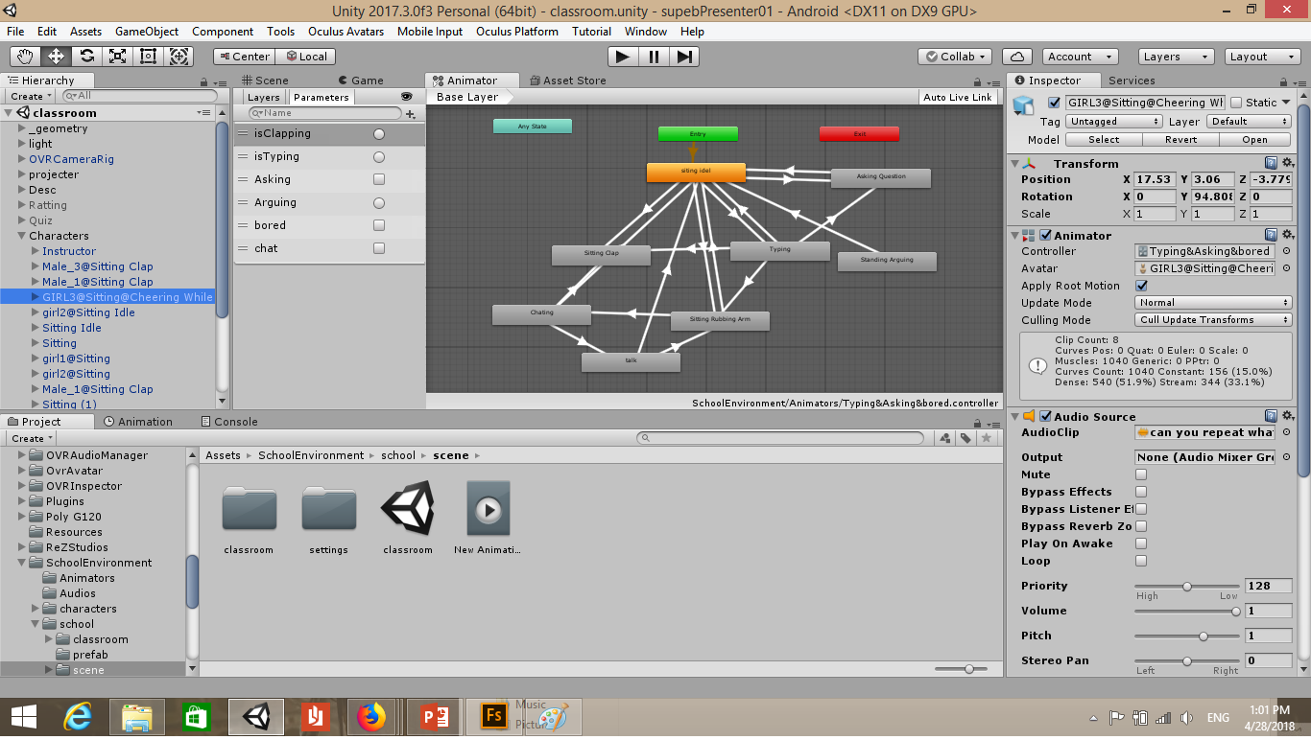

Slide 8
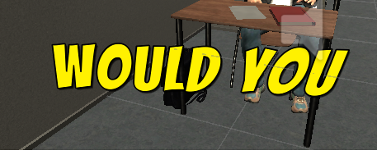
UI and Event System
Event System is a way of sending events to objects in the application based on input, be it keyboard, mouse, touch, or custom input. The Event System consists of a few components that work together to send events.
UI :
- Curved UI Canvas
- Text Mesh Pro (Bangers SDF Font)

Slide 9
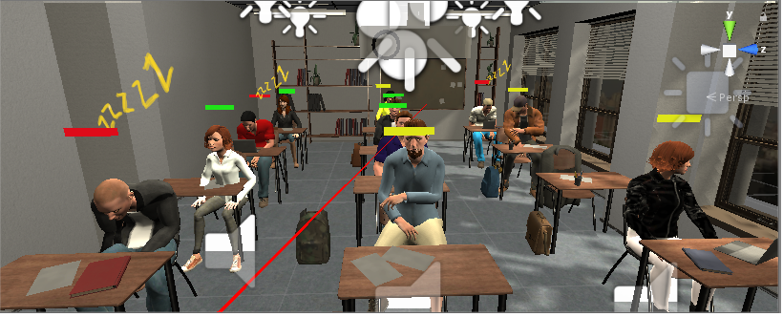
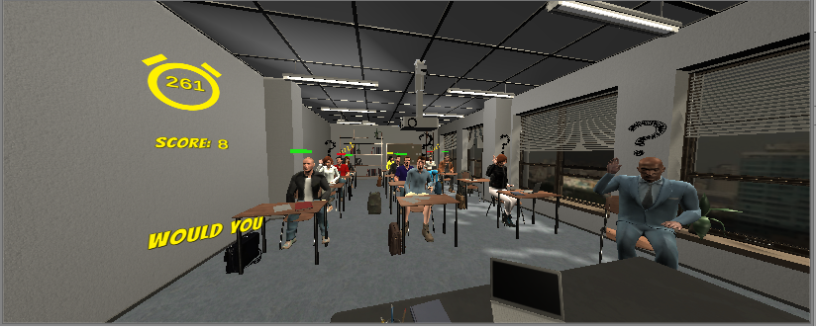
Environments – Class Room
Main goal and objectives.

Slide 10
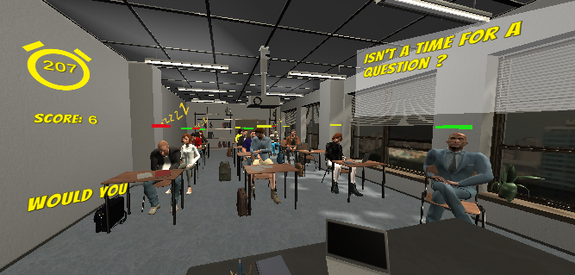
Hints system.
- Pre-Hints

Slide 11
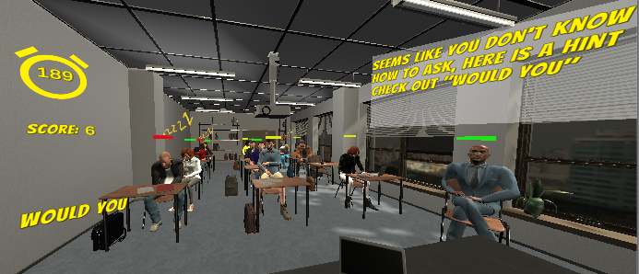
Post-Hint

Slide 12
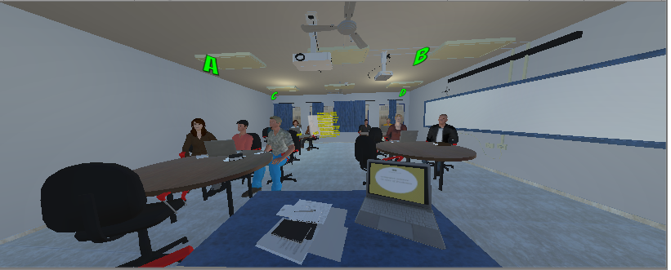
Workshop
Objectives and main goal.

Slide 13
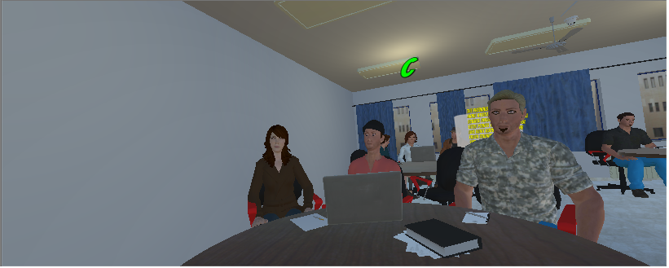
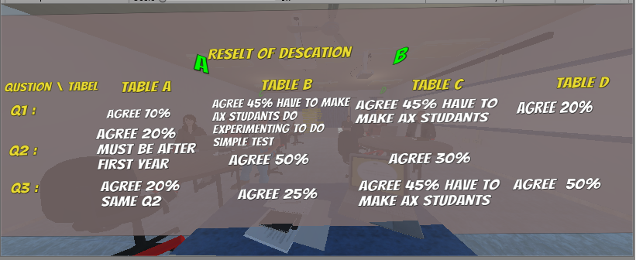
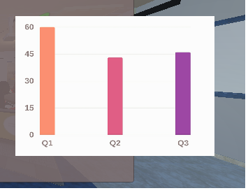
Camera view and reports.

Slide 14
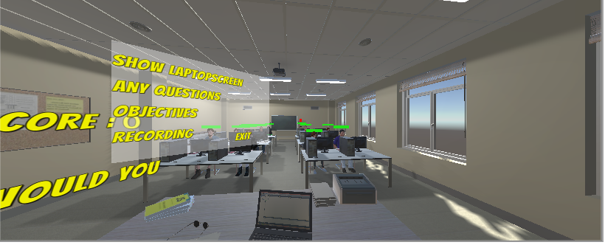
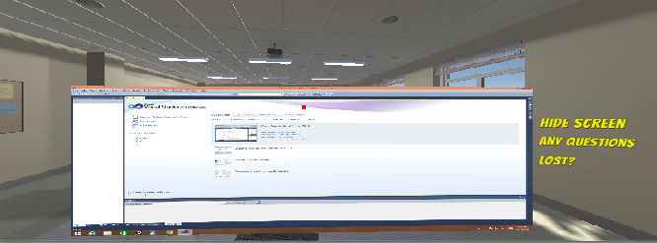
Computers Room
Objectives and main goal.

Slide 15
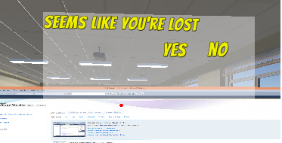
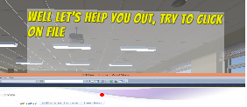
Lost ?

Slide 16
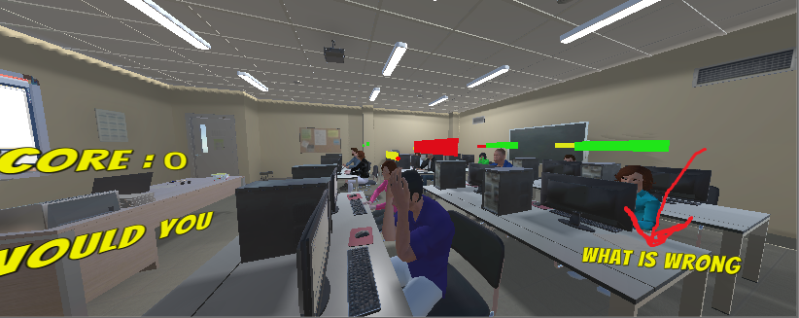
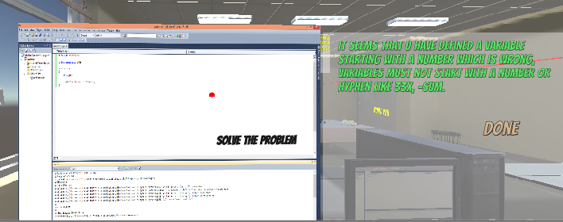
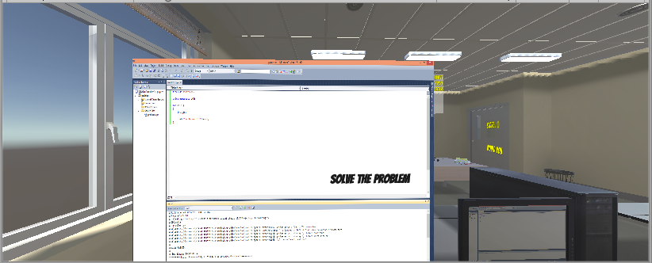
Code Problem

Slide 17
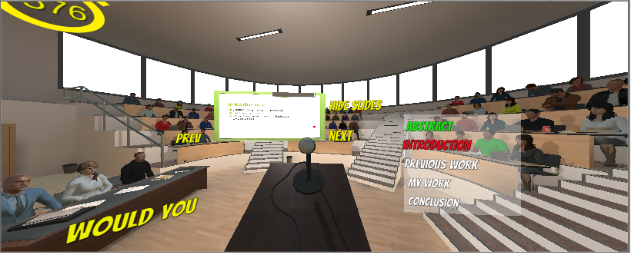
Conference
Objectives and main goal.

Slide 18
Future work
Network VR application.

