Slide 1
Bus Rapid Transit (BRT) System:
Nablus Case study
Ihab Aref Abdelhadi Hashem
Jehad Najeh Fares Kalbouneh
Saeed Ameen Saeed Amoudi
Supervisor
Prof. Sameer Abu-Eisheh

Slide 2
Outline
Introduction
BRT System
Methodology
Data Collection
Data Analysis
Developing Solutions
Design of Selected Route
Future Analysis
Cost Estimation
Conclusion and Recommendations

Slide 3
Introduction

Slide 4
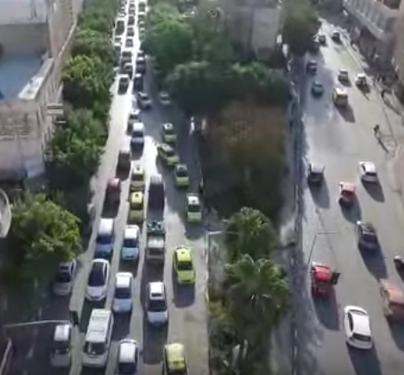
Introduction
Large numbers of vehicles enter the city daily.
No efficient public transportation system.
New terminals were proposed for the public transportation vehicles that enters the city.

Slide 5
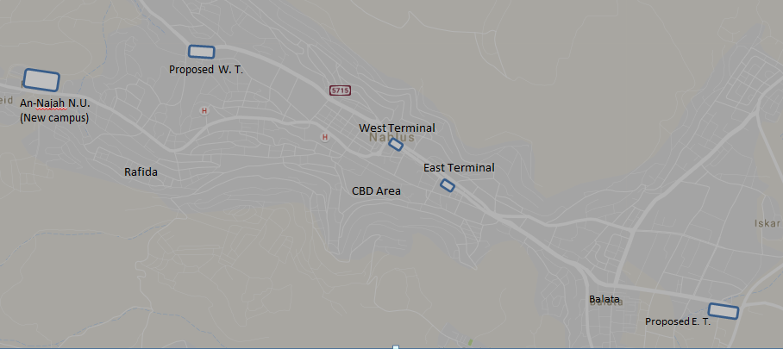
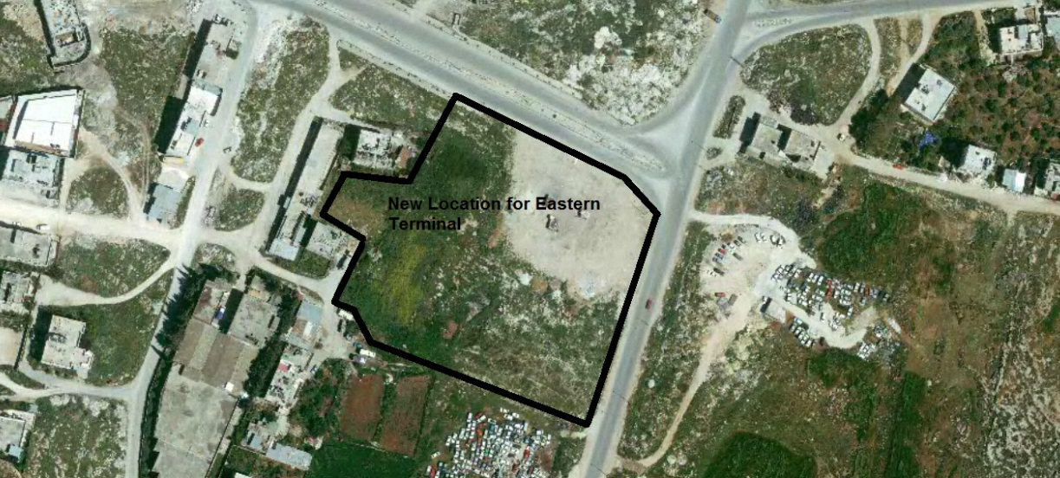
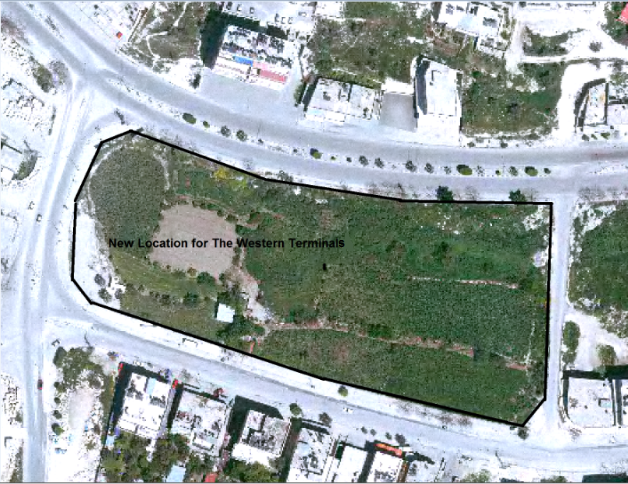
Overview Map
Notes:
An effective system is needed to connect between the new terminals and the Central Business District (CBD).

Slide 6
BRT System

Slide 7
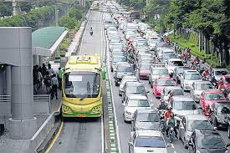
BRT Definition
One of the public transportation system.
Combine between the capacity of light rail and speed of Metro.
Lower cost.
Simple system.
Lower travel time.
Scheduled and more reliable.

Slide 8
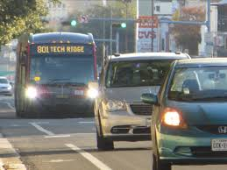
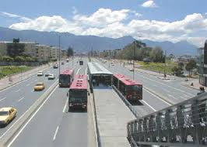
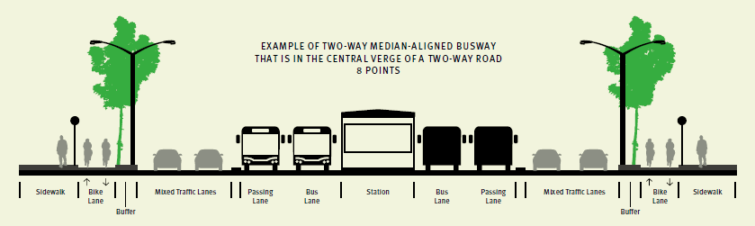
BRT elements
Dedicated (ROW).
2. Busway alignment.

Slide 9
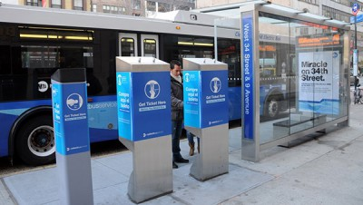
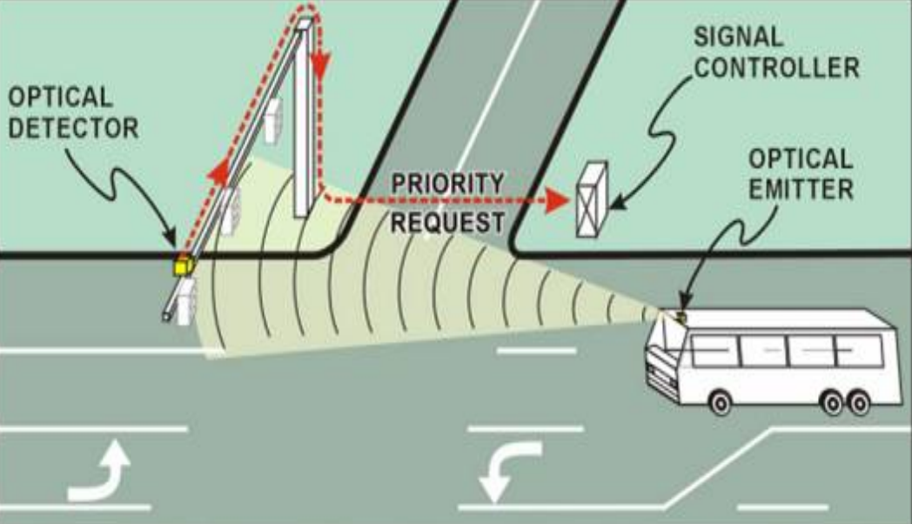
BRT elements
3. Off-board fare collection
4. Intersection treatments

Slide 10
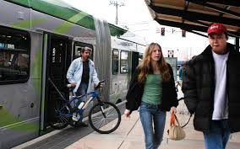
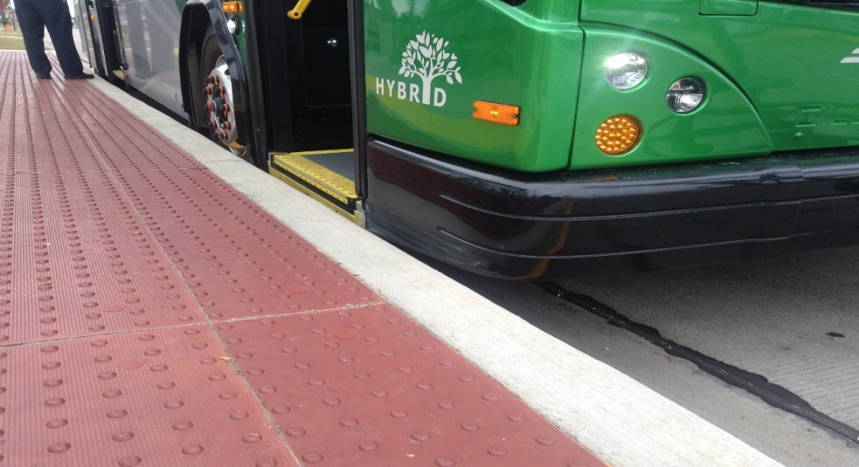
BRT elements
5. Platform-level boarding

Slide 11
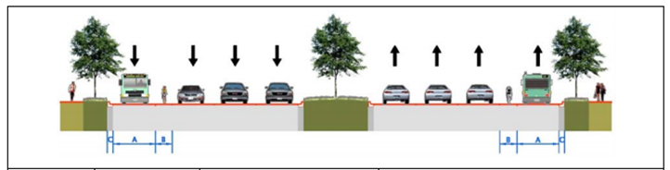
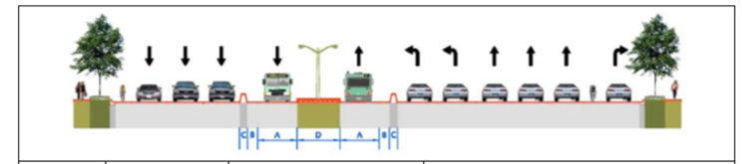
Alternative Cross-sections for the BRT routes
Concurrent flow curb side Bus lanes on a Two-way Street, Typical Midblock section.
Two-Way Median Busway, Typical Cross-section
(separated)

Slide 12
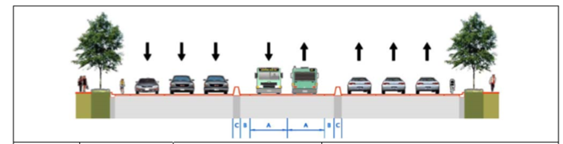
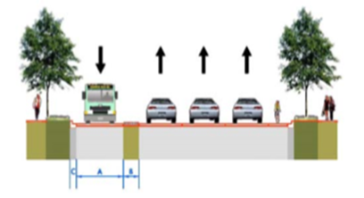
Alternative Cross-sections for the BRT routes
Two-Way Median Busway Typical Cross-section
Contraflow Curb side Bus lanes on a One Way Street, Typical section

Slide 13
Methodology

Slide 14
Methodology
Literature Review
Design Development
Data Collection
Data Analysis

Slide 15
Aerial Photographs and Structural Plan
The Traffic Volumes Count
Destination Study
Operational Studies
Inventory Studies

Slide 16
Headway and Frequency Analysis for Public Transportation
The traffic Volume Analysis
`
Passengers Destination Analysis
Future Analysis
&
Cost Estimation
Developing Solution
Design of Selected Solution

Slide 17
DATA Collection
&
Traffic Studies

Slide 18
  Existing Corridor Conditions
Haifa St. 1 | Lies between Tunis – Haifa intersection and Roundabout-Haifa St. intersection.
Haifa St. 2 | Lies between Tunis – Haifa intersection and Al-Ein Camp.
Haifa St. 3 | Lies between Al-Ein Camp and Al-Salam intersection.
Al-Malek Faisal St.1 | Lies between Al-Salam intersection and Al-Kindi intersection.
Al-Malek Faisal St.2 | Lies between Al-Kindi intersection and Al-Watani hospital.
Al-Malek Faisal St.3 | Lies between Al-Watani hospital and (Hittin-Faisal) intersection.
AL-Malek Faisal St.4 | Lies between (Hittin-Faisal) intersection and Al-Haj Maz’ouz intersection.
AL-Salaheyah St.1 | Lies between Al-Haj Maz’ouz intersection and Al-Moqata building.
AL-Salaheyah St.2 | Lies between Al-Haj Maz’ouz intersection and Al-Moqata building.
Balatah St. 1 | Lies between Al-Moqata building and Al-Quds intersection.
Balatah St. 2 | Lies between Al-Quds intersection and Butchery building.
Balatah St. 3 | Lies between Butchery building and proposed new Eastern terminal.
Rafidy St. | Lies between The Mall and (Rafidy- Tuins) intersection.
Al-Acadmia St. | Lies between (Rafidy- Tunis) intersection and An-Najah N.U (New campus).
Ring Road | Lies between Roundabout-Haifa St. intersections and An-Najah N.U (New campus).

Slide 19
  Existing Corridor Conditions
An inventory was made for 14 links and 11 intersections along this corridor.
Right Of Way
Notes:
ROW From Master Plan

Slide 20
Traffic Volume Counts
Traffic volume studies were conducted for two periods of the day, the morning (7-9) am and the afternoon (2-4) pm.
The volume studies were conducted on two links and some of the main intersections.
Intersections:
Al-Quds – Balata Intersection.
Ma’zouz Intersection.
Ma’zouz Intersection.
Hittin – Faisal Intersection.
Al – Kindi Intesection.
Al – Salam Intersection.
Al – Badawi Intesection.
Rafidia – Tunis Intersection.
Links:
Faisal and Haifa streets

Slide 21
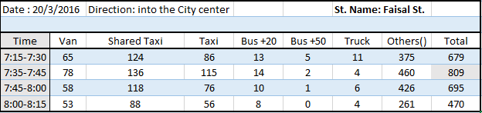

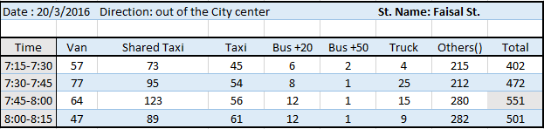

Traffic Volume Counts
Faisal St. at the peak morning period
Notes:
Classifications

Slide 22
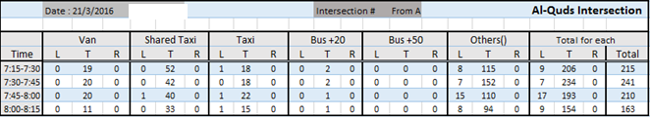
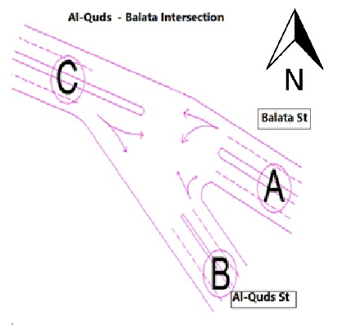
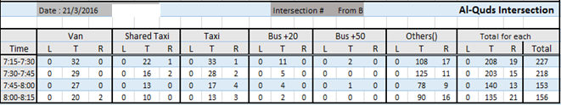
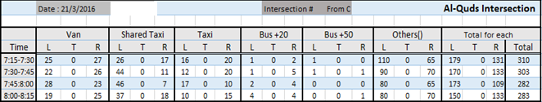

Traffic Volume Counts
Al-Quds – Balata intersection peak morning period

Slide 23
Headway and frequency studies for public transportation
Representative days were chosen for this study, and the study was conducted for three terminals at three periods of the days, those were, the morning peak period (7-9) am, the off-peak period (10-12) am and the afternoon peak period (2-4) pm.
Aims to know the total number passenger that arrive and leave the city.

Slide 24
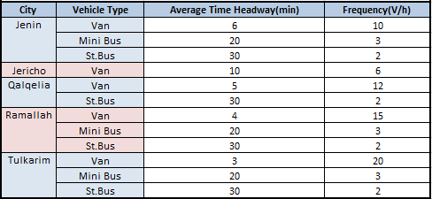
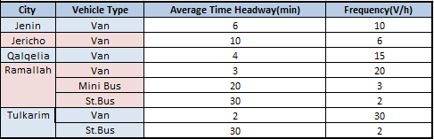
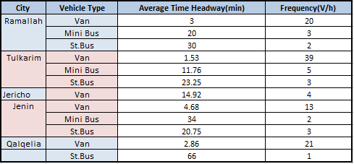
Headway and frequency
Morning headway studies for West terminal (city)
Off peak headway studies for West terminal (city)
Afternoon headway studies for West terminal (city)

Slide 25
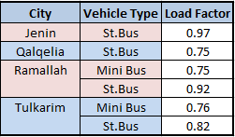
Passenger load factor (LF)
Aims to know the capacity of public transportation vehicles.
This study was conducted during three periods of the day. In the morning and off peak periods, it was noticed that almost all of the vehicles that enters the terminals were at full capacity (LF=1).However, in the afternoon period, it was noticed that the vehicles that depart the terminals have (LF<1).
LF for busses during the afternoon period, For the west terminal (cities).

Slide 26
Passenger Destinations
The study was conducted by conducting interviews with a sample of passengers arriving the terminals at the morning period (7-9) am, and with the passengers departing from the terminals at the afternoon period (2-4 ) pm.
This study aimed to determine the percent of passengers coming from or leaving to the city center or the new campus of An-Najah National University.

Slide 27
Data Analysis

Slide 28
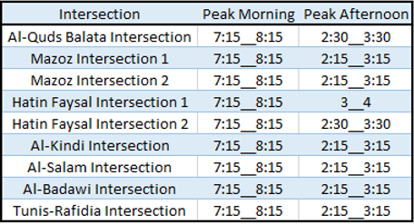

Traffic Volume analysis (before)
After analyzing the results of the traffic volumes, a unified peak was selected depending on the peak hour that has the most frequency at links and intersections.
The unified morning peak (7:15-8:15) am and the unified afternoon peak (2:15-3:15) pm.
The analysis were made using
the Synchro9 software for the
intersections and the HCS2000
software for the links.
Notes:
Unified Peak

Slide 29
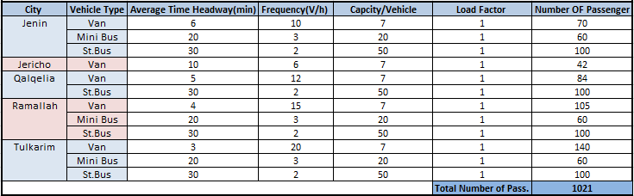
Headway and frequency analysis for public transportation
Headway analysis at the morning period for the west terminal (cities).
Total passenger per hour =1021

Slide 30
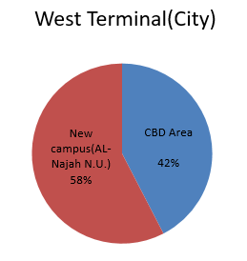
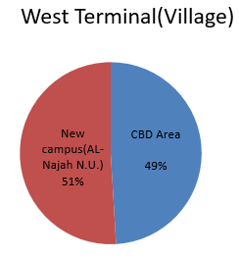
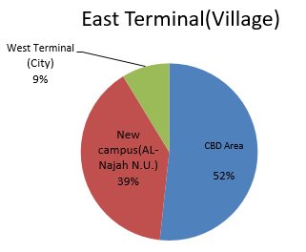
Passenger destination analysis
The results of the percentage and the number of passengers for each terminal.
For the morning period

Slide 31
Reallocation of the external public transportation lines
West terminal (afternoon period).
The western terminals (city and villages) were combined together.
Ramallah and Jericho were moved to the eastern terminal.
Notes:
. The external public transportation lines of Ramallah and Jericho were reallocated and proposed to be moved to the new eastern terminal. In addition, the west villages’ terminal moved with the western terminal

Slide 32
Number of passengers at 2016 and 2021
After 5 years with growth rate = 3 %
Origin | Destination | Period | Passengers at 2016 | Passengers at 2021
Eastern Terminal | CBD | Morning | 1803 | 2090
 |  | Off-peak | 1416 | 1641
 |  | Afternoon | 1565 | 1814
 | New campus | Morning | 1245 | 1443
 |  | afternoon | 843 | 977
Western Terminal | CBD | Morning | 969 | 1123
 |  | Off-peak | 1098 | 1273
 |  | Afternoon | 1654 | 1917
 | New campus | Morning | 1111 | 1288
 |  | afternoon | 753 | 873
Notes:
P = P₀ (1 + r %)^{n}

Slide 33
DEVELOPING
SOLUTIONS

Slide 34
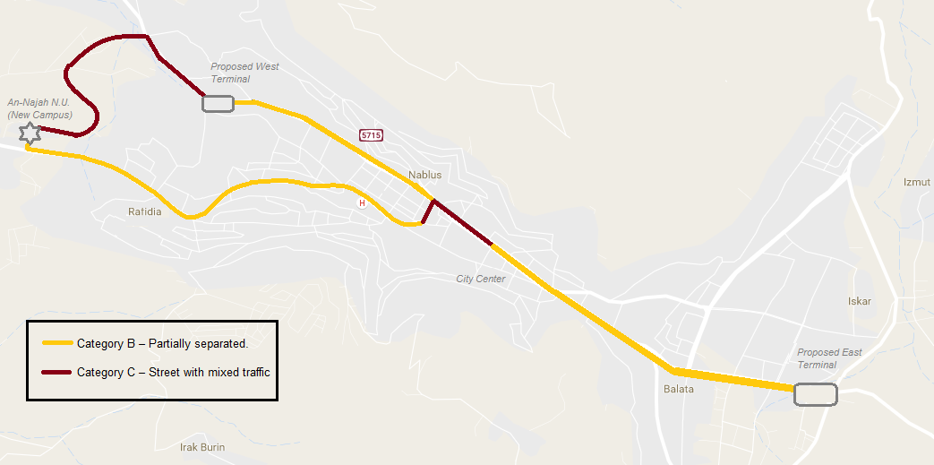
Selecting categories for BRT system

Slide 35
Alternatives for BRT corridors:
Alternatives of connection between the terminals and CBD area
Alternative of connection between the terminals and the new campus of An-Najah University:
    The Eastern Terminal.
    The western Terminal.

Slide 36
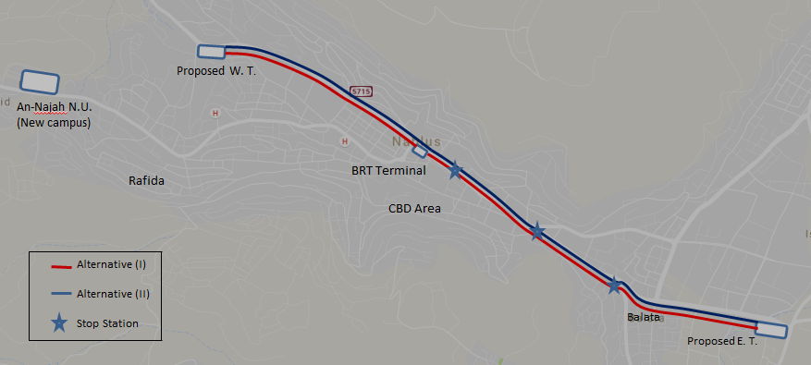
Alternatives of connection between the terminals and CBD area

Slide 37
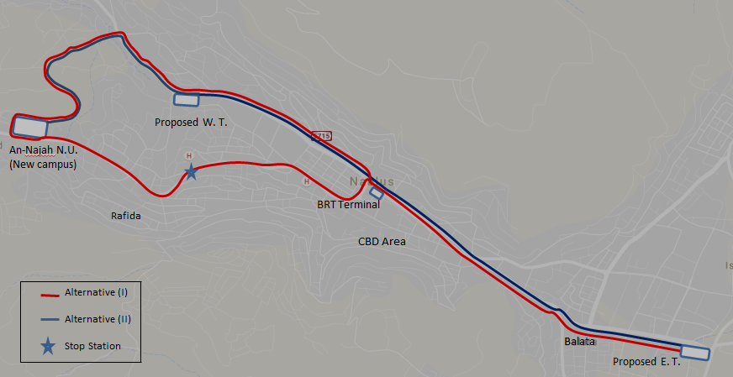
Alternative of connection between the eastern terminal and the new campus of An-Najah University

Slide 38
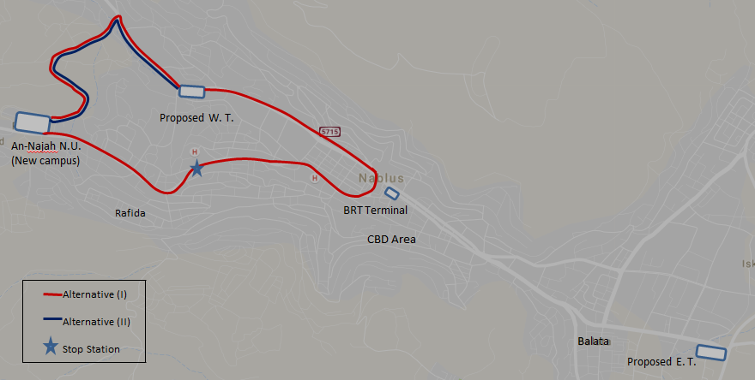
Alternative of connection between the western terminal and the new campus of An-Najah University

Slide 39
Schedule for the alternatives
Operating Speed was chosen to be 25 Km/h
The load factor was assumed to be 1
The vehicle capacity equals 60 (40 seats and 20 standees) passengers.
The bus stays at the terminal for 4 min.
Average delay on intersection from synchro equal 40 sec.
Passenger boarding time equals 2.5 second, and the time of passenger alighting from front door equal 3.3 second.

Slide 40
Schedule for the alternatives of Connection between the terminals and the CBD for Alternative I
Schedule for the alternatives

Slide 41
Connection between East terminal and the new campus (Alternative I)
Connection between West terminal and the new campus (Alternative I)

Slide 42
DESIGN OF SELECTED SOLUTION

Slide 43
Design of Selected Solution
Design Criteria:
  Travel time.
  Transit units.
  Population density.
  Percent of length of dedicated lane.
  Slope.

Slide 44
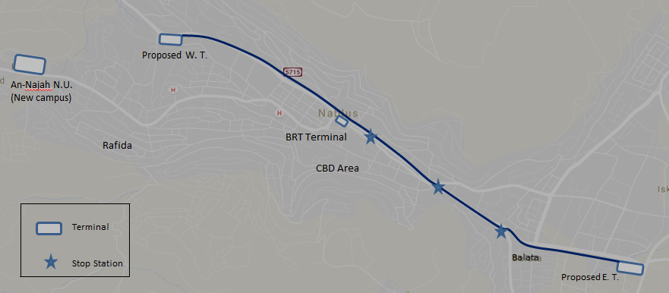
Selection of the best solution
Connection between terminals
Alternative II

Slide 45
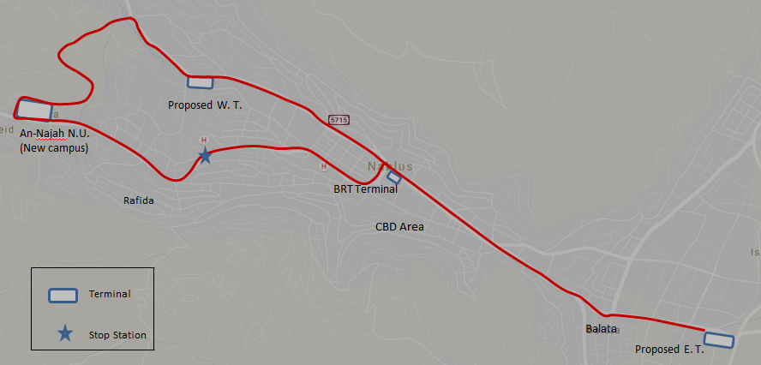
Selection of the best solution
Connection between the east terminal and new campus
Alternative I

Slide 46
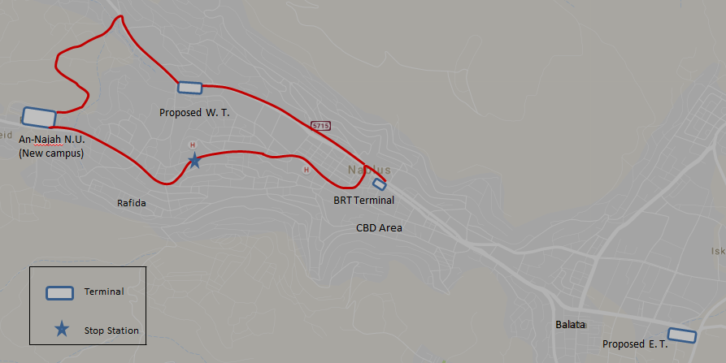
Selection of the best solution
Connection between the west terminal and new campus
Alternative I

Slide 47
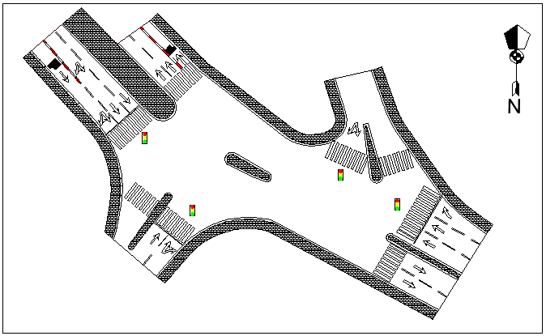
Cross-section and Plan for BRT
Intersection plan (Al-Salam intersection).

Slide 48
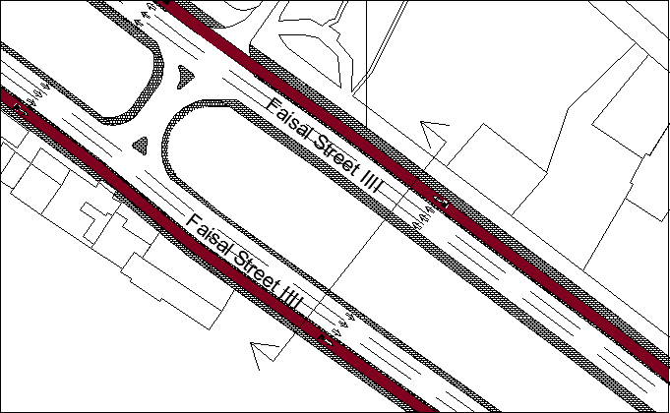
Cross-section and Plan for BRT
Plan for midblock.

Slide 49
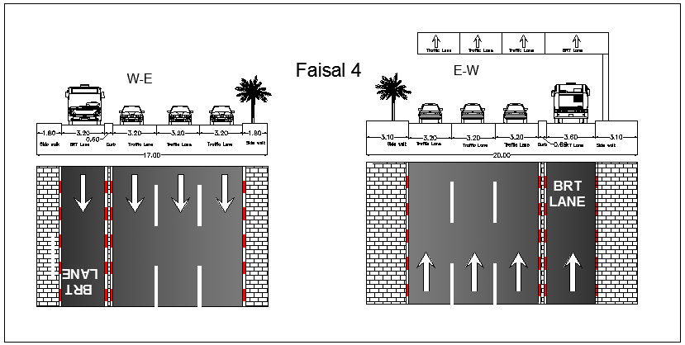
Cross-section and Plan for BRT
Cross- section for midblock and plan.

Slide 50
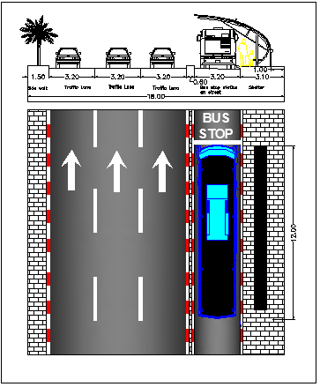
Cross-section and Plan for BRT
Bus stop station cross section and plan.

Slide 51
FUTURE ANALYSIS

Slide 52
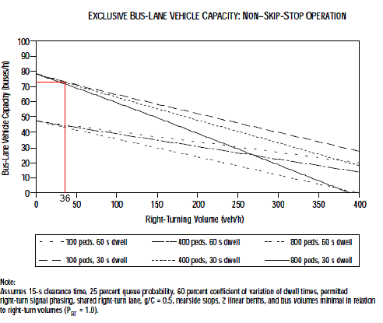
Capacity of BRT lane
Max. right turn at critical intersection
Assuming the conflicting of pedestrian with bus lane equal 100 ped/h
Assuming dwell time equal 30 sec
Assuming non-Skip-Stop operation

Slide 53
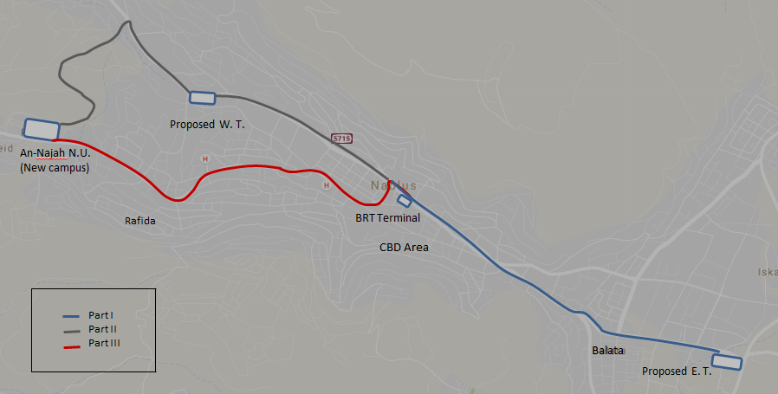
Capacity of BRT lane
Morning period
Part | Critical Intersection | Volume of R.T. (Veh/hr) | Max. No. of bus/hr
Part (I) | Hittin Intersection II | 36 | 73
Part (II) | Al-Salam intersection | 230 | 49
Part (III) | Tunis Intersection (top) | 101 | 65

Slide 54
Analysis Before & After Implementing BRT
Analysis for Links for with growth rate of 3%
@ 2016
@ 2021

Slide 55
Analysis Before & After Implementing BRT
Analysis for intersection for morning period with growth rate of 3%
@ 2016
@ 2021

Slide 56
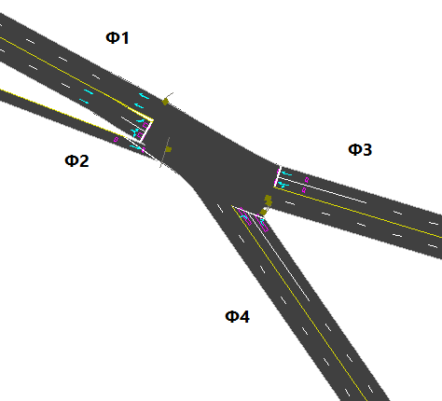
Design signals for intersections
Al-Quds - Balata Intersection
  The signals design were made after reducing the volumes of external public transportation vehicles.
  For the volume of 2021 based on a growth rate of 3%

Slide 57
COST ESTIMATION

Slide 58
BOQ for implementing the system

Slide 59
CONCLUSION
&
RECOMMENDATION

Slide 60
Conclusion
The congestion is getting worse and
the traffic problems are in increasing.
The external public transportation vehicles is one of the main reasons of traffic congestion.

Slide 61
Conclusion
An effective way to transport passengers must be provided.
Implementing the BRT system would enhance the LOS on the links and intersections.
For the long term, if there were no better improvement for the infrastructure in addition to public transportation, the traffic congestion will get worse than it has been.

Slide 62
Recommendations
To use the existing western terminal as a BRT terminal for the proposed system.
Consider bridges and tunnels to meet the future demand.
To move shared taxies to the existing terminals, and use their original spaces for extra parking for private vehicles.

Slide 63
Recommendations
Bus priority treatment.
Land-use, ROW and population densities should be taken into consideration for the bus stops.
Make the CBD a Pedestrians’ area.

Slide 64
Thanks for Your Attention

