Slide 1

An-Najah National University
Mechanical Engineering Department
Graduation Project 2
Drugs Addicts Rehabilitation Center
Supervisor:
Dr. Iyad Assaf.
The Students:
Ramez Rafeeq Ishtayyeh (10840852) Othman Jaser Irshead (10825361)
Amr Mohammad Masri (10718810)
Hikmat Reda Hjab (10544696)

Slide 2
The aim of this project is to design installation of heating, ventilation and air condition system (HVAC) for Drugs Addicts Rehabilitation Center.
Air Conditioning will be used in the building for heating and cooling.
Water service and plumping design is required for service system inside the building.
Fire protection system serves to detect the fire and evacuate the building.

Slide 3
Presentation outline
- Building Description.
- Heating load calculation.
- Cooling load calculation.
- Duct Design.
- Plumbing System.
- Fire protection System
- Equipment Selection.
3

Slide 4
Building Description
Building Location :
Drugs Addicts Rehabilitation Center location in Bait Wazan /Nablus city-Palestine that consist of four floor, two basement floors, ground floor, and first floor.
Elevation: 700 m above sea level
Latitude: 32˚
Building face sits at the North direction.
The wind speed in Nablus above 5 m/s.

Slide 5
Building details
The building consists of seven sections:
1.: Entrance
Consists of waiting rooms, information center, registration, W.C.
2.: Administration Department
Consists of director rooms and secretarial, archive, hall meetings, W.C.
3.: Diagnosis and evaluation
Consists of waiting rooms, rooms for specialists, rooms for doctors, store, W.C.
4.: Therapy Department
Consists of Music therapy unit, computer therapy unit, physical exercises unit, stores, W.C.

Slide 6
5.: Community Service Unit
Consists of consulting room, lectures room, hall practical training, conference hall, W.C.
6.: Medical treatment
Consists of rooms for doctors, rooms for nurses, lab, store medicines, rooms for examination, W.C.
7.: Public Services
Consists of maintenance room, kitchen, swimming pool, hall to eat, hall activities

Slide 7
Heating load
    The heat loss is calculated by this equation :
Outside design condition | Inside design condition | Parameters
8.3 °C | 22 °C | T: temperature
72 % | 50 % | Φ : relative humidity
9.4 g of water/kg of dry air | 8.4 g of water/kg of dry air | W : moisture content
15.15 °C |  | Tun: unconditioned temperature
5 °C |  | Tg : ground temperature

Slide 8
Summary for heating load
Heating load (kw) | Block
97.1 | Block A
281.6 | Block B
109.2 | Block C
487.9 (kw) | Total

Slide 9
Cooling Load
Outside design condition | Inside design condition | Parameters
33.7 °C | 24 °C | T: temperature
44 % | 50 % | Φ : relative humidity
12.5 g of water/kg of dry air | 9.4 g of water/kg of dry air | W : moisture content
30.5°C |  | Tun: unconditioned temperature
5 °C |  | Tg : ground temperature
    The general conduction equation in cooling calculation is:
For transmitted through glass:
For convection through glass:

Slide 10
Summary of cooling load
Cooling load (ton ref) | Block
61 | Block A
256.1 | Block B
53.7 | Block C
352.8 (ton ref) | Total

Slide 11
Duct Design
Design procedures
* The total sensible heat was calculated.
* The Vcirculation was calculated.
* The flow rate (CFM) was calculated.
* Number of diffusers are calculated and distributed uniformly.
* The initial velocity for the main duct is 5 m/s.
* The pressure drop is depend on the initial velocity for the main
duct and flow rate (CFM).
* The main diameter is calculated.
* The height and width of the rectangular ducts are determined from the tables.

Slide 12
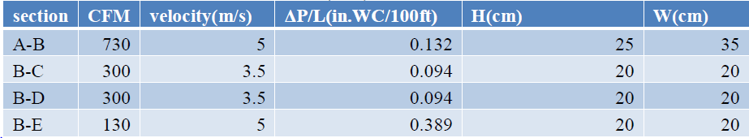
Sample calculation For duct Design:

Slide 13
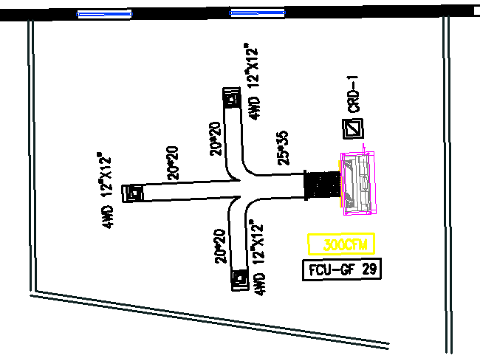
13

Slide 14
Plumbing System
Total demand water :
Demand Water (L/S) | Totally Fixture Unit | Type Of Supply Water
13.67 | 1070.75 | Cold
6.81 | 300.75 | Hot

Slide 15
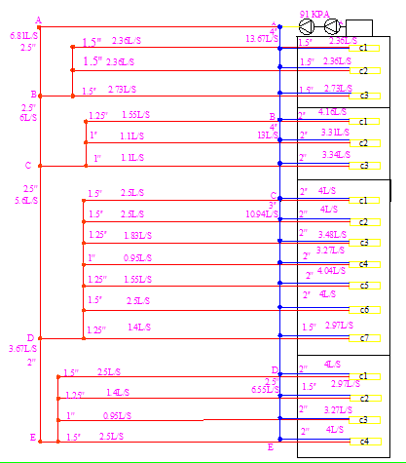
15

Slide 16
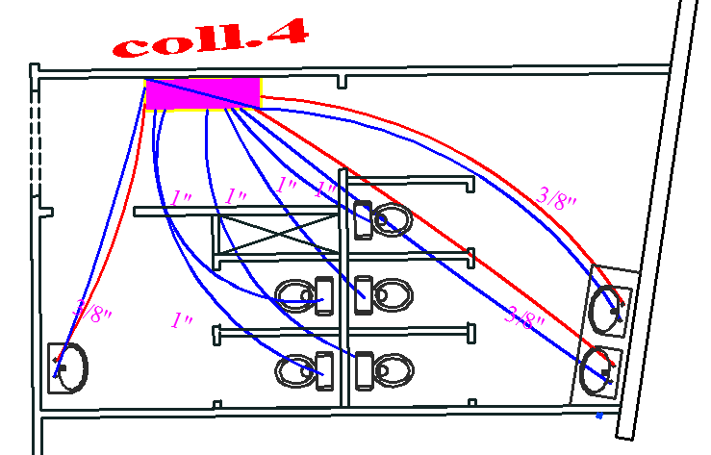

Slide 17
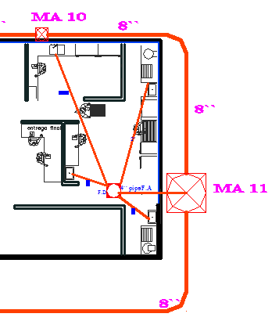

Slide 18
Fire Protection System
The Class III is used for design the fire system
Pipe size
Size (in) | Demand(GPM) | Name of pipe
4’’ | 1000 | Main pipe
4’’ | 250 | Riser for block A
4’’ | 500 | Riser for block B
4’’ | 250 | Riser for block C
2 1/2’’ | 250 | Pipe for landing valve
1 1/2’’ | 100 | Pipe for Cabinet

Slide 19
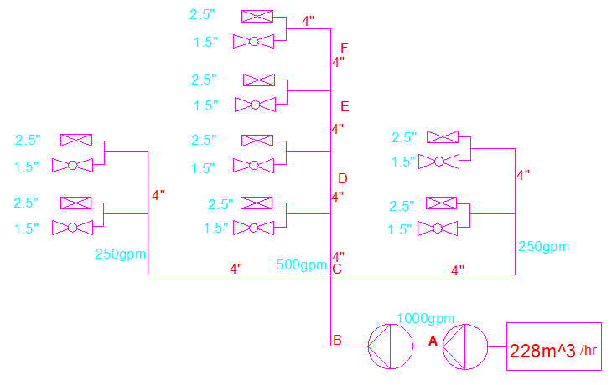

Slide 20
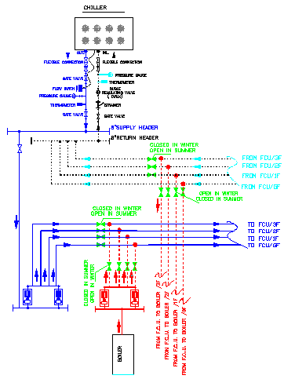

Slide 21
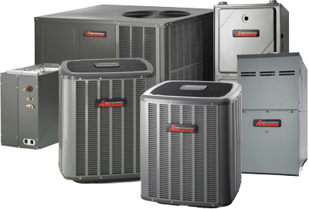
Equipment Selection
Selection of component in mechanical system is the final stage in this building design because it depends on the all previous system design

Slide 22
Equipment Selection
Boilers :
From NORTHVALE COMPANY catalog of steam boiler is
Boiler #1: ICI ASX 100 which has capacity of 98 KW
Boiler #2: ICI ASX 300 which has capacity of 282 KW
Boiler #3: ICI ASX 100 which has capacity of 110 KW
Chiller :
From PETRA catalog we select a model
Chiller #1: APSa 90 – 2S which has capacity of 62 ton
Chiller #2: APSa 330 – 4D which has capacity of 256 ton
Ciller #3: APSa 80 – 2S which has capacity of 54 ton
Fan coil :
From PETRA catalog (DC series)
DC P 4 H/C 3 400 cfm

Slide 23
Equipment selection cont.
Fresh air and Exhaust fans:
From EASY VENT – SNP company
The selection of fresh air fans for the building were done as the following:
Fan#1 CFM = 6500
Static pressure=22 mm.H2O
Model : CVTT-12/12
Fan#2 CFM = 7100
Static pressure=29 mm.H2O
Model : CVTT-12/12
Fan#3 CFM = 7500
Static pressure=33 mm.H2O
Model : CVTT-12/12

Slide 24
Equipment selection cont.
Pumps
Chiller pump for Block(B):
Flow rate = 32 m3/hr ΔP = 14m
Model: CM25-1 60 Hz
Chiller pump for Block(A&C):
Flow rate = 20 m3/hr ΔP = 9m
Model: 96411834 TP 80-160/2 B 60 Hz`
Boiler pump for Block(B):
Flow rate = 35 m3/hr ΔP =14 m
Model: CME25-1 60 Hz

Slide 25
Boiler pump for Block(A&C) :
Flow rate =26 m3/hr ΔP =9m
Model: 96411834 TP 80-160/2 B 60 Hz
Electrical and diesel Fire-Fighting Pump
Flow rate = 1000 GPM ΔP =129.0948 psi
Model: 5-491-18 A
Standby Pump ( Jockey Pump )
Flow rate = 20 GPM ΔP =142 psi
Model: 2-383-9C

Slide 26
SUMMARY
*All steps of design and plans of HVAC system are done.
*All steps of design and plans of plumping system are done.
*we select a suitable equipment for the system which satisfied the required conditions.

Slide 27
Thank you

