Slide 2


Table of Contents
01
Our Team
02
Software Details
03 04
Project Details Project Development Hardware Stages
05
06
07
Demo
Conclusion and
Constraints and
Future Work
Challenges

Slide 3

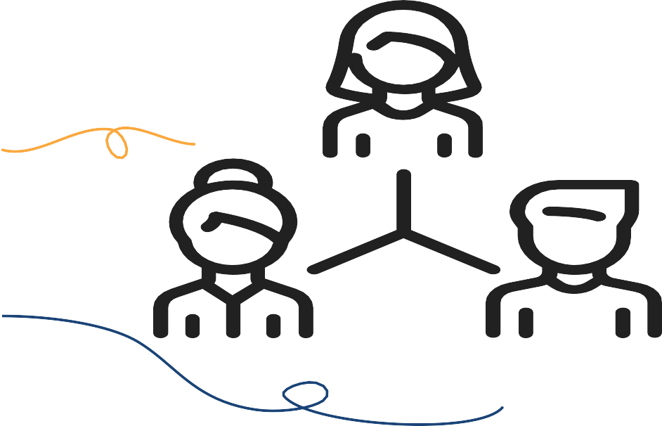


Our Team
Mohammed Taha
Nasser Khaled

Slide 4

Software
1- Django.
2-Flutter.
3-Python anywhere.
4-AWS Lambda Service

Slide 5
Project Details
The Bus will have three main modes in which it can operate in:
Modern payment services
The robot will search
for balls, no matter
what color it is, pick it up
let the user decide the
destination.
IOT
The user will control the path of the robot and pick any object he wants.
Safety first
The user will say what color he wants and the robot will ﬁnd balls with this color.

Slide 6
Project Details Cont.

Slide 7
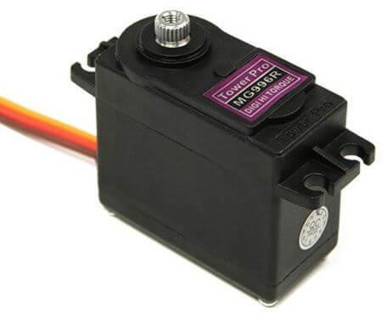
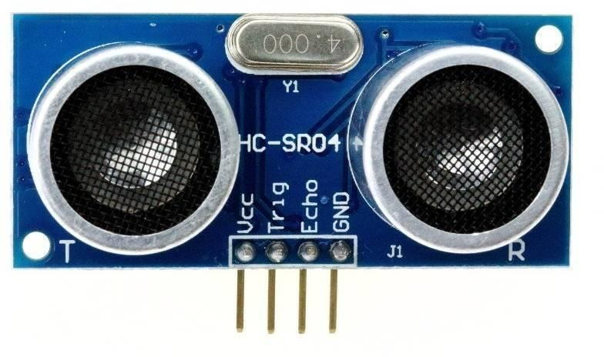
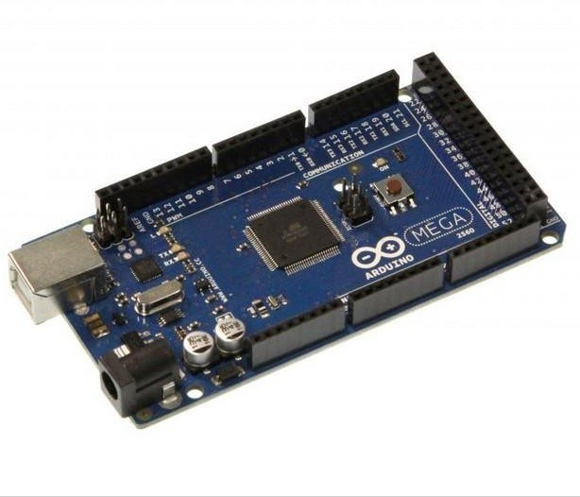
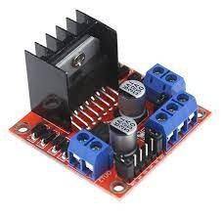
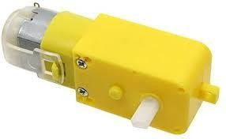
Hardware Structure
Car Structure
include <Servo.h>
Ultrasonic Sensor
Servo Motor
Arduino Mega
DC Motors
H-Bridge

Slide 8
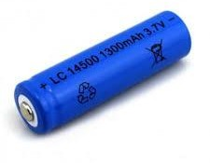
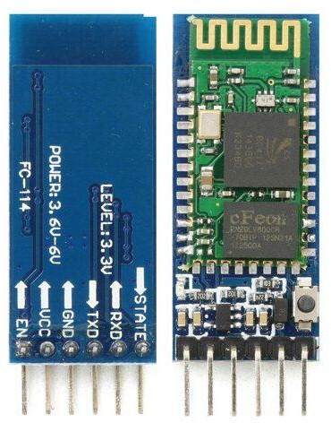
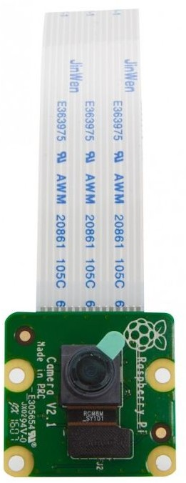
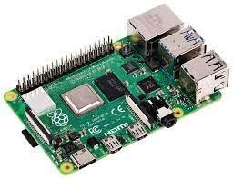
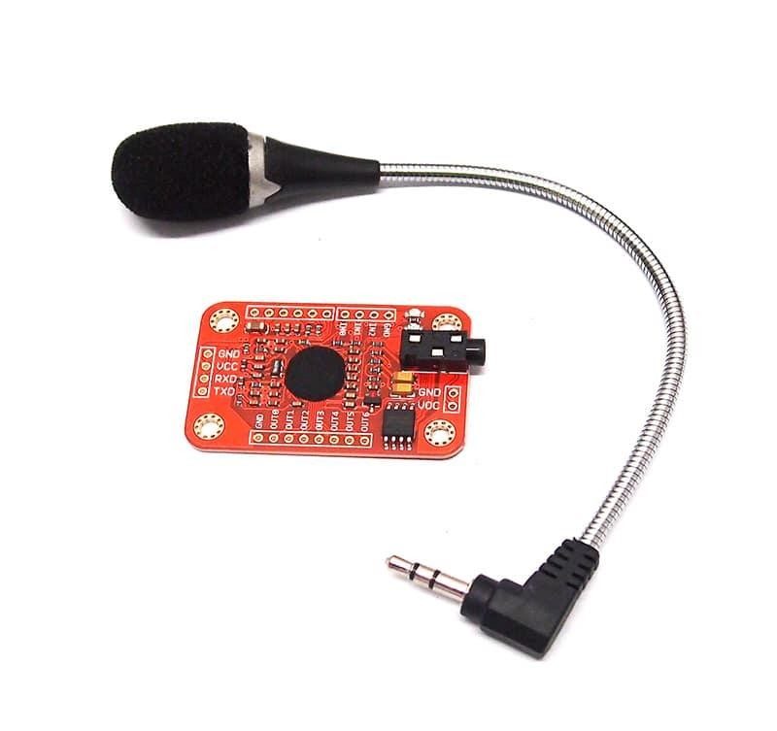
Hardware Structure Cont.
Car Structure
include <VoiceRecognitionV3.h>
include <SoftwareSerial.h>
-
Lithium Batteries
Bluetooth Module
Voice Recognition Module
Pi Camera V2
Raspberry Pi 3

Slide 9
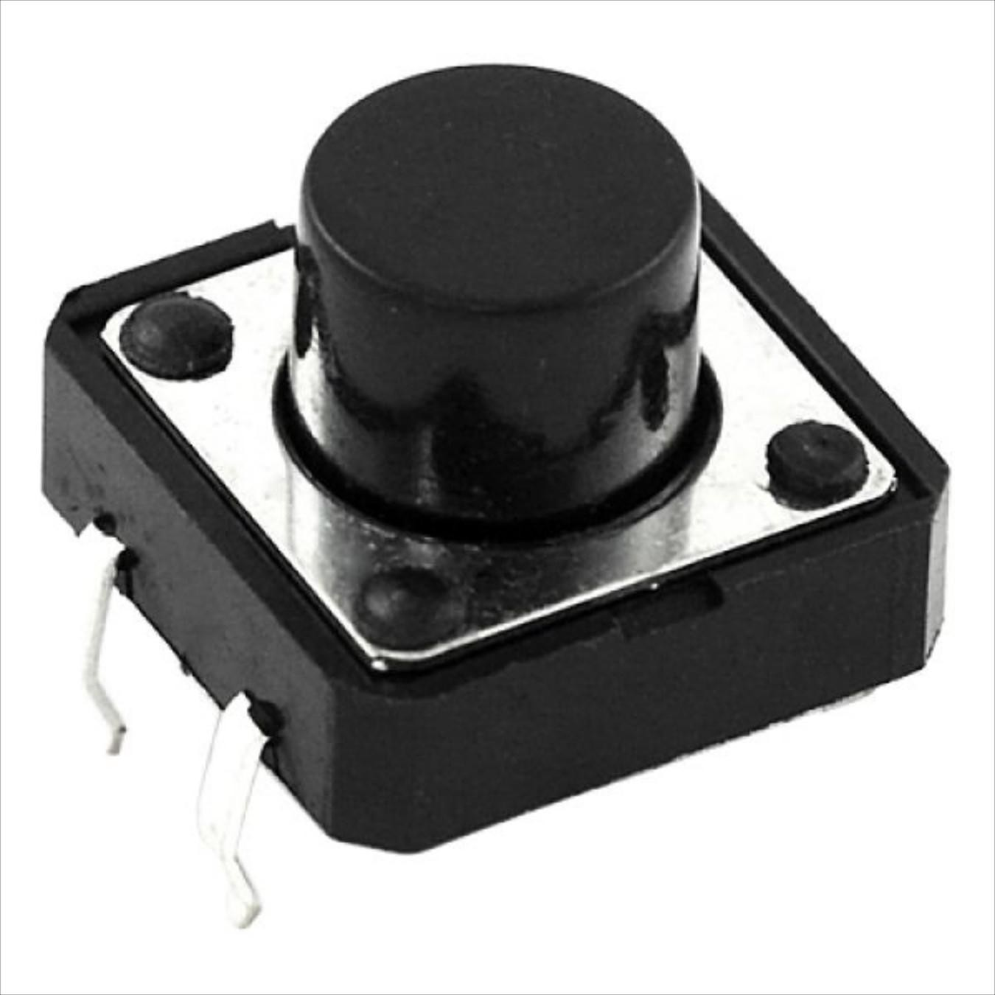
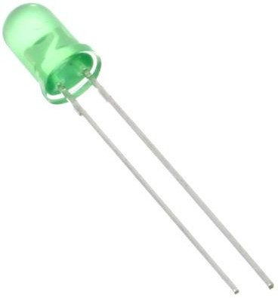
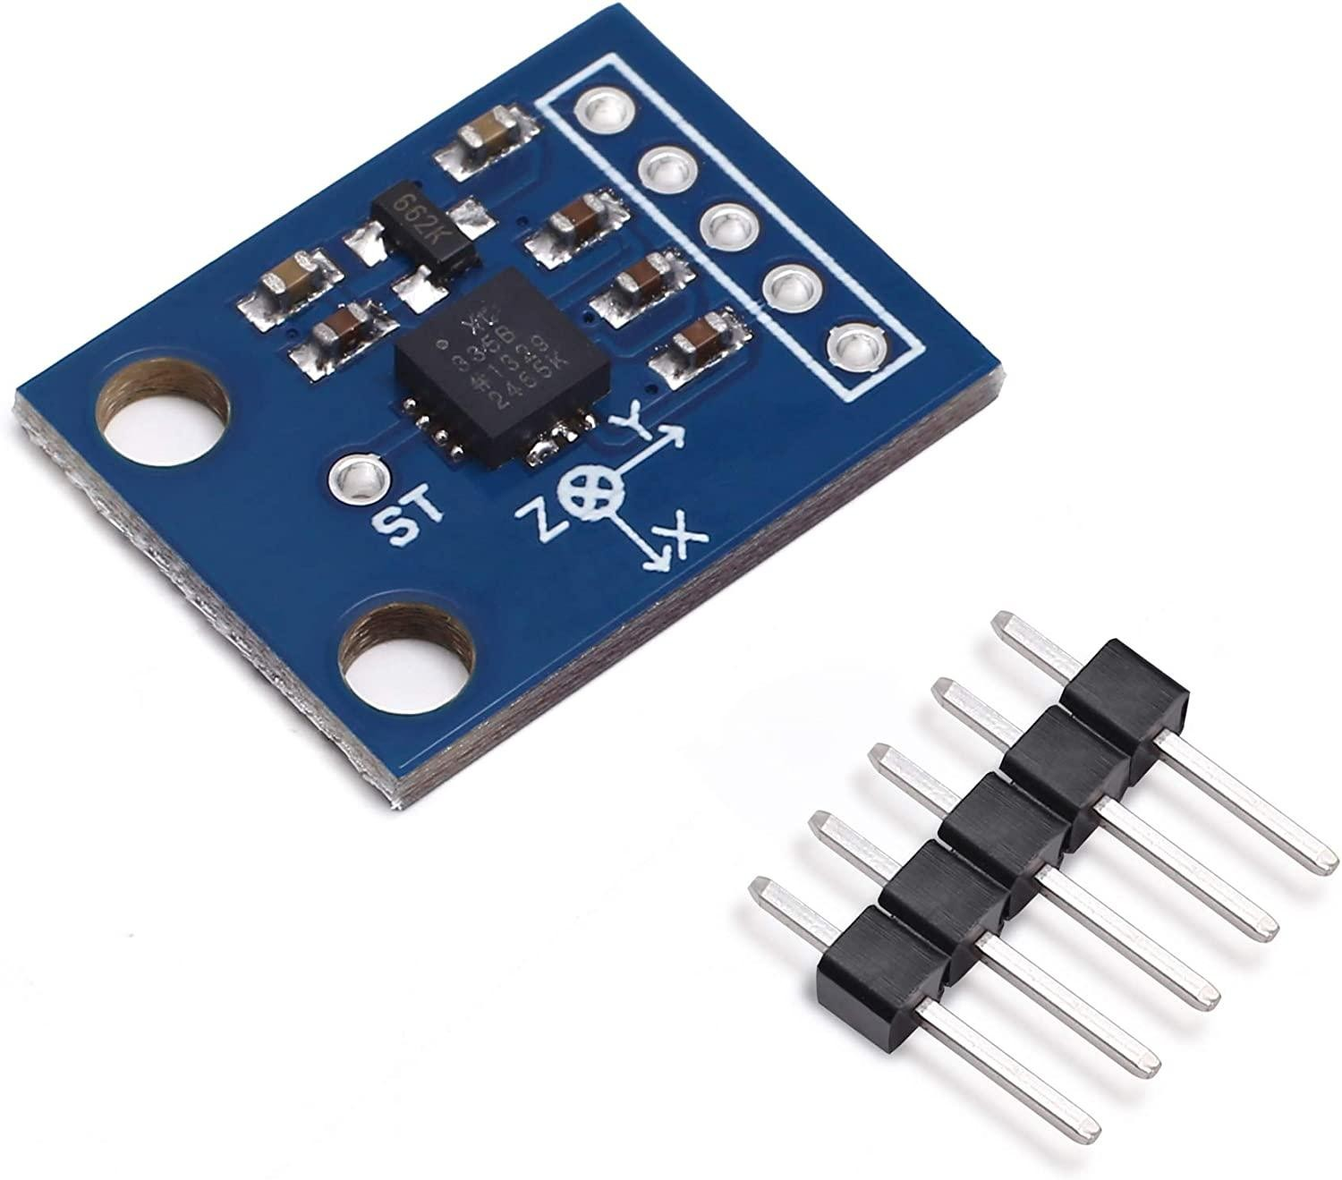
Hardware Structure Cont.
Hand Gesture
Include <SoftwareSerial.h>
Light Emitting Diode
Push button
GY- 61 Acceleromete
Arduino UNO
Bluetooth Module

Slide 10

Project Development Stages
Building & Developing Car Movement
Developing Voice Recognition
01
Developing OpenCV
02
03
Developing Hand Gesture
04

Slide 11
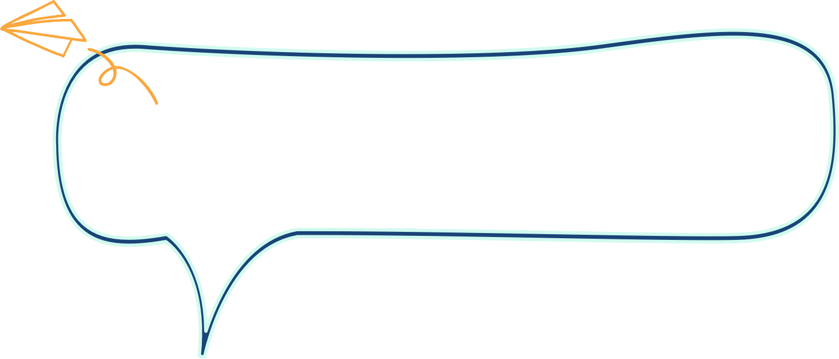
Conclusion and Future Work
The robot will be developed, taken into a bigger scale and include more features in order to be used in bigger scale
.

Slide 12
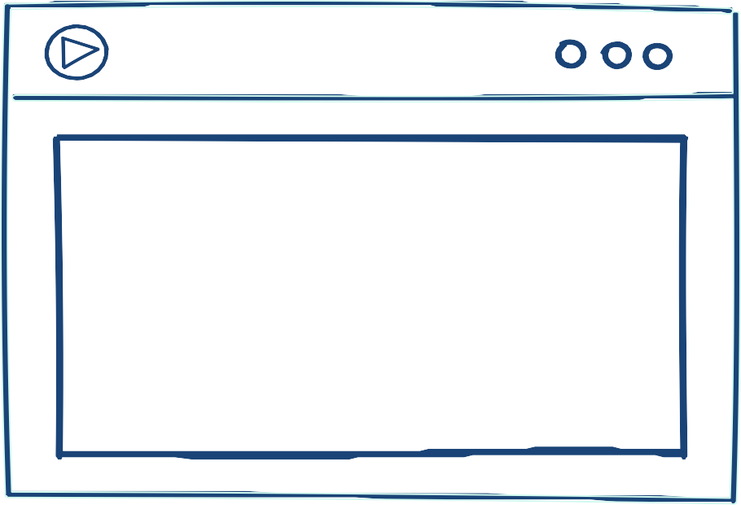
Demo

Slide 13
Thanks for listening
Any questions?

